Slide 1
UNIT 4 7Hrs
Embedded System Design Concepts: Characteristics and Quality Attributes of Embedded Systems, Operational and non-operational quality attributes, Embedded Systems-Application and Domain specific, Fundamental issues in Hardware Software Co-Design, Computational models in embedded design- DFG model, CDFG model State machine model, Concurrent Process model, Object Oriented model , Source file to object file translation.

Slide 2
Source file to object file translation

Slide 3
Embedded software in a system
Application specific software
In the final stage, it is placed in the memory (ROM) for all the tasks that have to be executed.
The final stage software is also called ROM image. Why?

Slide 4
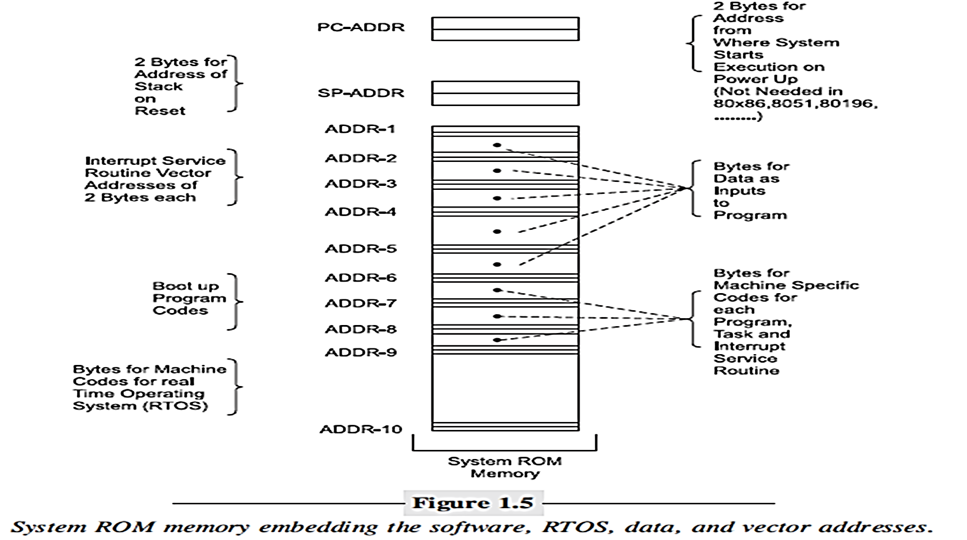
ROM IMAGE
Embedded software is a unique placement and arrangement of bytes for instructions and data.

Slide 5
Coding of software in machine code
time consuming
the programmer must first understand the processor instructions set and then memorize the instructions and their machine codes.

Slide 6
Software in processor specific assembly language
Coding in assembly language is easy to learn for a designer who has knowledge about machine specific instruction set
Assembly Coding is extremely useful for configuring physical devices like ports, a line-display interface, ADC and DAC and reading into or transmitting from a buffer
They are useful to run the device specific features and provide an optimal coding solution.
To do all the coding in assembly language may be very time consuming.
Full coding in assembly may be done only for a few simple, small-scale systems

Slide 7
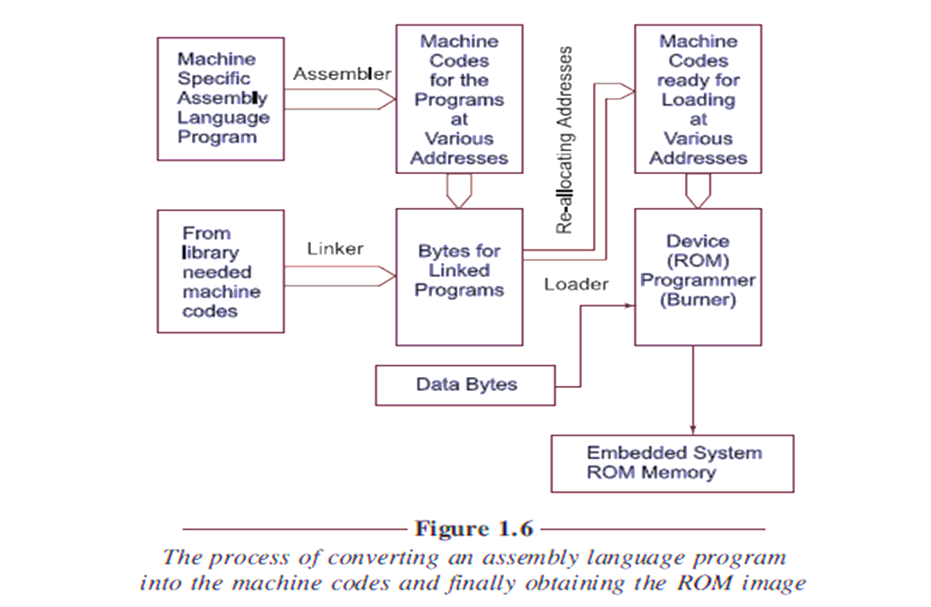
Process of Converting Assembly Program to create ROM Image
library - a collection of precompiled routines that a program can used

Slide 8
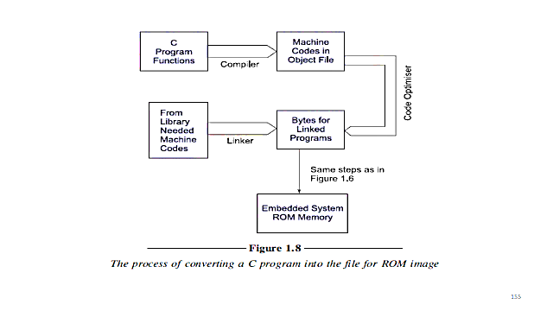
Process of Converting Assembly Program/ C program to create ROM Image
library - a collection of precompiled routines that a program can used

Slide 9
Step1- assembling assembler translates assembly software into machine codes.
step2- linking phase linker links no of codes with other assembled codes.
Linking produces the final binary file by linking all these. The linked file in a computer is commonly known as .exe file.
step3- reallocation of codes is done by placing it in physical memory by a program called loader.
Loader finds out appropriate position in RAM that is ready to run.
Step4- locating phase ROM image is permanently placed in actually available address of ROM.

Slide 10
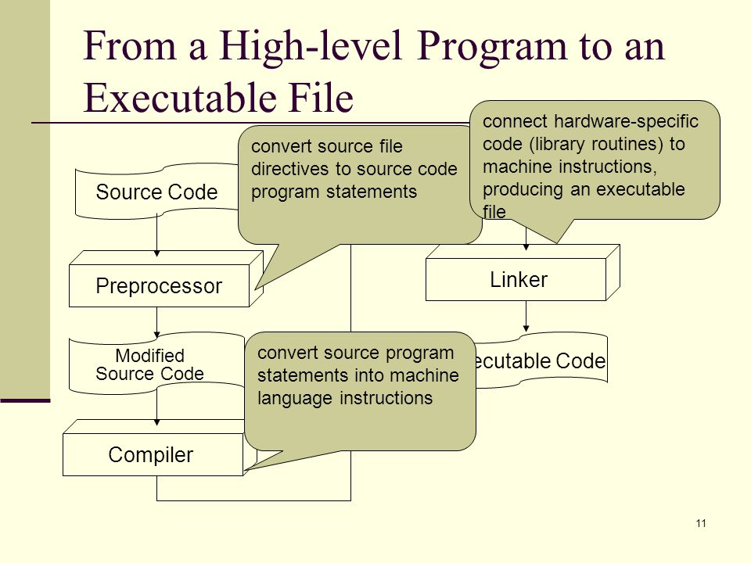

Slide 11
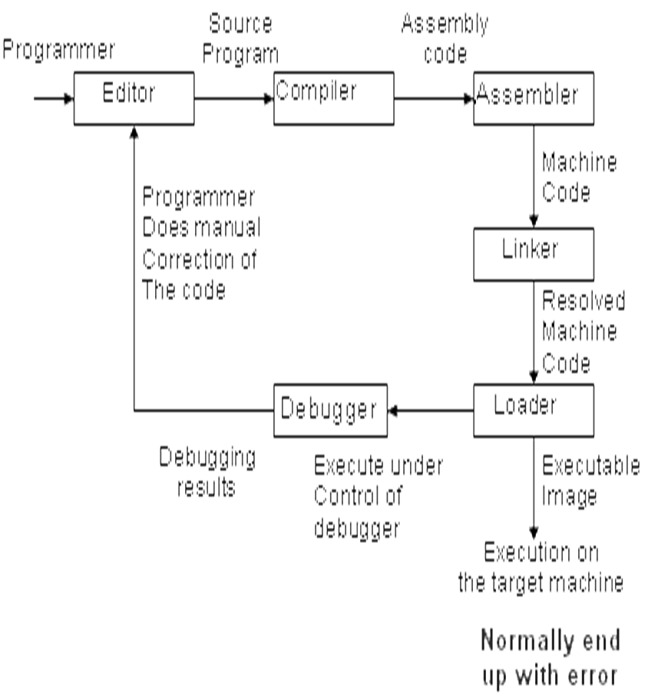

Slide 12
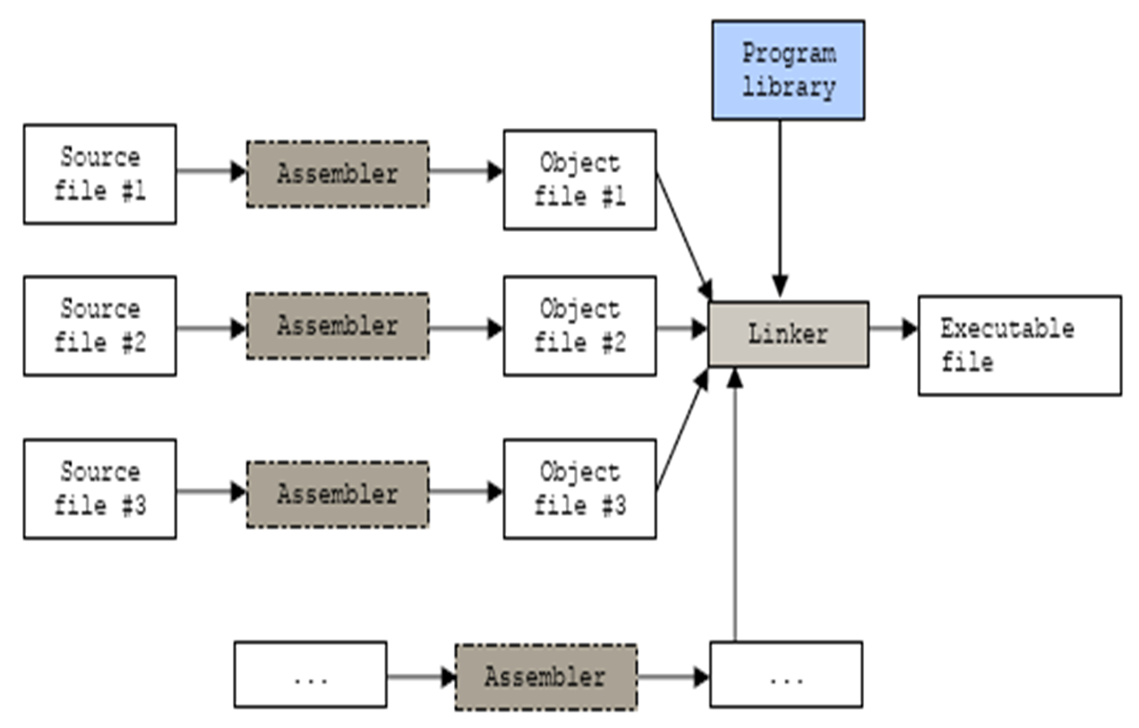
Linking
All of the object must be linked together to produce a single object file, called the relocatable program.
The job of the linker is to combine these object files and to resolve all of the unresolved symbols

Slide 13

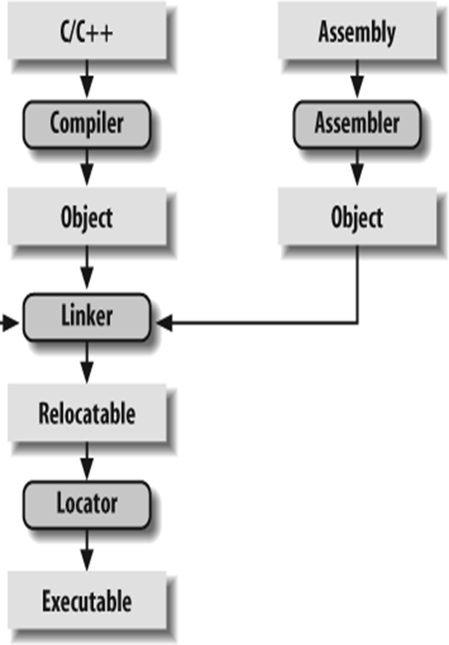

Slide 14
Locator- The tool that performs the conversion from relocatable program to executable binary image
It then produces an output file that contains a binary memory image that can be loaded into the target.

Slide 15
Loader: A program which loads the executable file to the primary memory of the machine.
It is a part of OS
After reading .exe file loader places the code in memory. This is necessary as memory addresses may not start from 0000H
Loader finds appropriate start address and reallocates the codes
In computer after loader loads, section of program is ready to run

Slide 16
The loader does the following things:
Allocates primary memory for the program's execution.
Copies address space from secondary to primary memory.
Copies the .text and .data sections from the executable into primary memory.
Copies program arguments (e.g., command line arguments) onto the stack.
Initializes registers

Slide 17
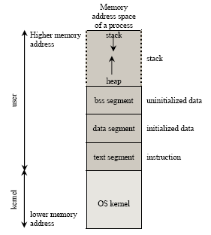
Memory layout for a process
Local variables are allocated
Block Started by Symbol
Statically allocated and global data

Slide 18
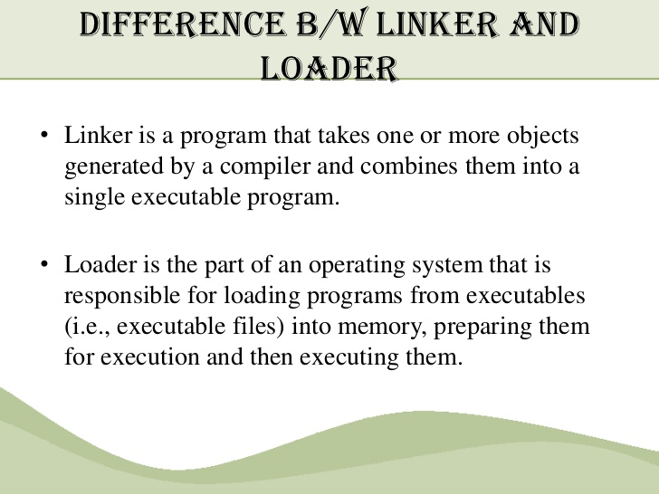
Difference in Linker and Loader

Slide 19
Embedded System Software

Slide 20
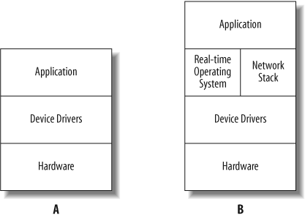
The software for the embedded system varies depending on the functionality needed.
.
The RTOS can help the programmer separate the application’s functionality into distinct tasks for better organization of the application software and a more responsive system.

Slide 21
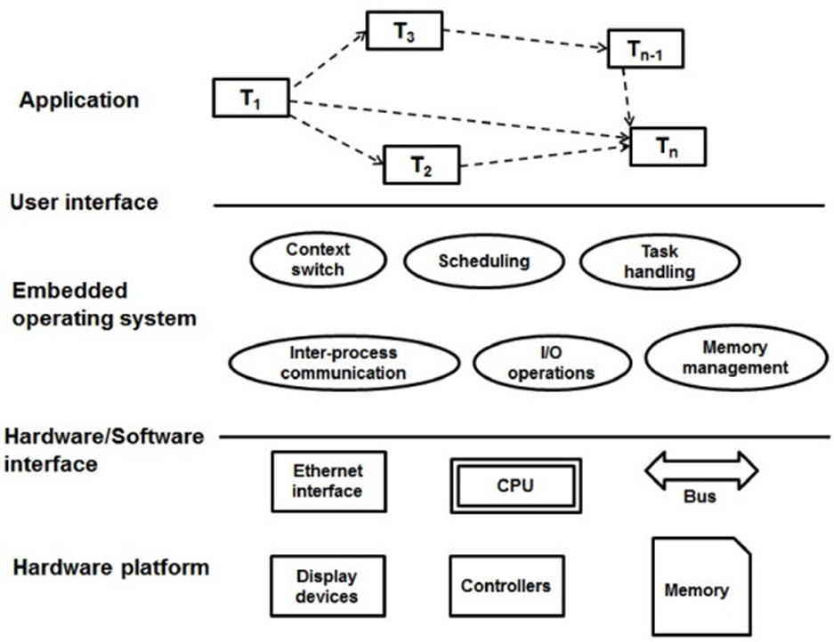
Different program layers in the embedded software in C

Slide 22
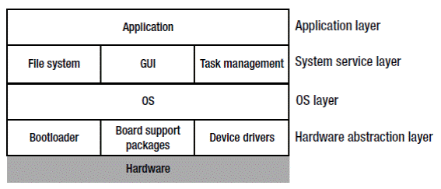
Hardware Abstraction Layer- a software abstraction layer between the embedded system hardware and OS

Slide 23
Application Layer
located at the top level of the software hierarchy
provides services directly to user application

Slide 24
Bootloader -similar to BIOS
a program that runs before the OS kernel executes.
It completes the initialization of the hardware
enables the hardware and software environment to reach an appropriate state for the final scheduling of the system kernel.
From the perspective of end users, the bootloader is used to load the OS.

Slide 25
BSP- Board support packages
provides a standardized interface between hardware and the operating system
is used to start up and run the embedded target processor
does not directly access hardware.
A BSP Contains hardware-specific drivers and other routines that allow a particular operating system to function in a particular hardware environment

Slide 26
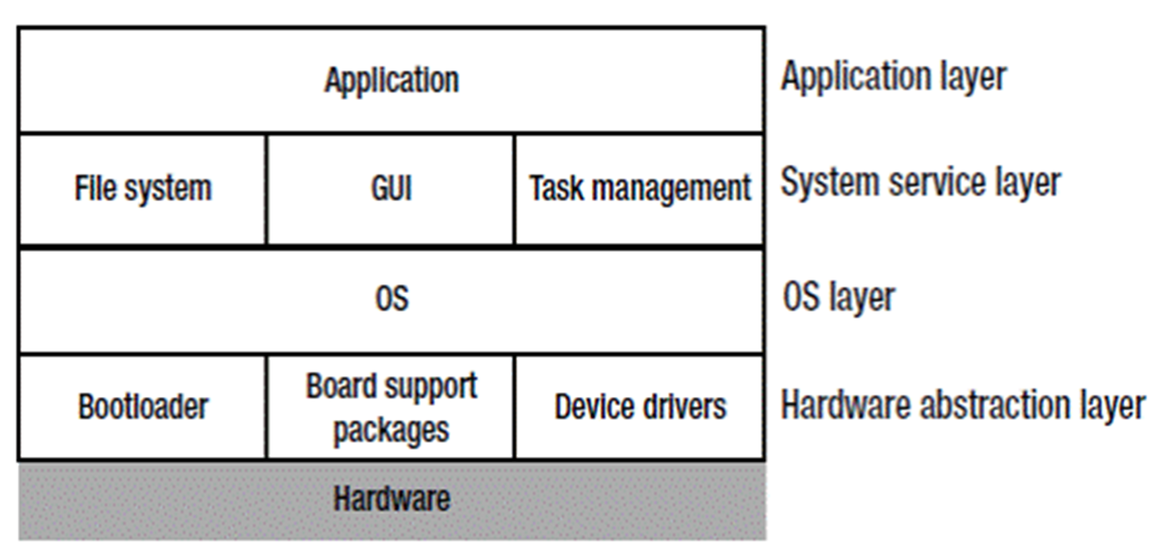
OS layer
Scheduling, files synchronization, and networking
Example- Windows Embedded Compact, embedded Linux, VxWorks, MeeGo, Tizen, Android, Ubuntu,
outstanding real-time and reliable features widely used in communications, military, aerospace, aviation

Slide 27
Kernel- software collection in OS
core component of an operating system.
responsible for translating the command which computer understands
It handles the hardware, timing, peripherals, memory, disks, user access
Using interprocess communication and system calls, it acts as a bridge between applications and the data processing performed at the hardware level.
When an operating system is loaded into memory, the kernel loads first and remains in memory until the operating system is shut down again.

Slide 28
Functions of Kernel
Memory allocation
task scheduling
inter-process communication
effective management of shared memory

Slide 29
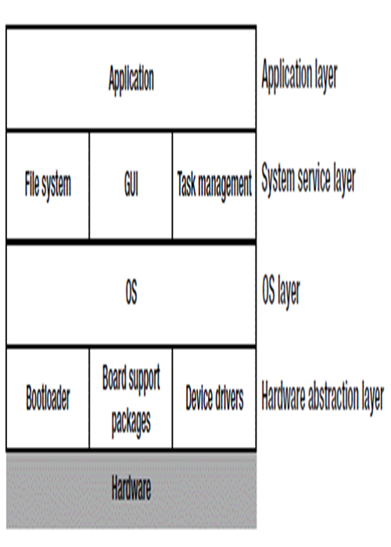
System service layer
a link between the OS and applications
applications can access various services provided by the OS.
A GUI library for various GUI programming interfaces, to interact with users through application windows, menus, dialog boxes, and other graphic forms instead of a command line.

Slide 30
Important characteristics of an embedded system
Application and domain specific
Reactive and Real Time
Operates in harsh environments
Distributed
Small size and weight
Power concern

Slide 31
Application and Domain Specific
Fixed functions- each embedded system is designed to perform a set of defined functions
They cannot be used for any other purpose. It is the major criterion which distinguishes an embedded system from a general purpose computing system.
Specific design and Purpose- cannot replace the embedded unit of one system from another, designed to perform certain specific tasks.

Slide 32
Embedded Systems are Reactive
produce changes in output in response to the changes in the input.
constant interaction with the Real world through sensors and user-defined input devices
Controlling output variables to the desired level.

Slide 33
Real Time
All embedded systems are not Real Time.
Real Time System operation- the timing behaviour of the system should be deterministic; the system should respond to requests or tasks in a known amount of time.
A Real Time system should not miss any deadlines for tasks or operations.
Embedded applications or systems which are mission critical, like flight control systems, Antilock Brake Systems (ABS), etc. are examples of Real Time systems.

Slide 34
Operates in Harsh Environment
Adverse operating conditions- It is not necessary that all embedded systems should be deployed in controlled environments.
Embedded system should withstand in all operating conditions.
The design should take care of the operating conditions of the area where the system is going to implement.
Power supply fluctuations, corrosion and component aging are the other factors that need to be taken into consideration for embedded systems to work in harsh environments.

Slide 35
Distributed System- may be a part of larger systems
Example- Automatic Teller Machine (ATM)
card reader- for reading and validating the user’s ATM card
transaction unit -for performing transactions
currency counter- for dispatching/vending currency to the authorised person
printer unit- for printing the transaction details.

Slide 36
Small Size and Weight
Product aesthetics is an important factor in choosing a product
the product aesthetics- (size, weight, shape, style, will be one of the deciding factors to choose a product.

Slide 37
Power Concerns
Power management is important factor to be considered
to minimise the heat dissipation by the system.
The production of high amount of heat demands cooling requirements like cooling fans which in turn occupies additional space and make the system bulky.
design according to the low power components, controllers
processors with power saving modes.
Also power management is a critical constraint in battery operated
application.

Slide 38
Operational Quality Attributes
Response
Throughput
Reliability
Maintainability
Security
Safety

Slide 39
Response
how fast your system is tracking the changes in input variables.
Most of the embedded systems demand fast response which should be almost Real Time.
It is not necessary that all embedded systems should be Real Time in response.
For example, the response time requirement for an electronic toy is not at all time-critical .There is no specific deadline that this system should respond within this particular timeline.

Slide 40
Throughput
Throughput deals with the efficiency of a system.
rate of production or operation of a defined process over a stated period of time.
Example- For Card Reader, throughput means how many transactions the Reader can perform in a minute or in an hour or in a day.
Throughput is generally measured in terms of ‘Benchmark’. ‘Benchmark’ is a reference point by which something can be measured.

Slide 41
Reliability
% proper functioning of the system
Mean Time Between Failures ( MTBF) and Mean Time To Repair ( MTTR) are the terms used in defining system reliability.
the system is allowed to be out of order following a failure.
For an embedded system with critical application need, it should not be out of the order

Slide 42
Maintainability
deals with support and maintenance to the end user in case of technical issues and product failures or on the basis of a routine system check-up.
A more reliable system means a system with less corrective maintainability requirements and vice versa.
As the reliability of the system increases,the chances of failure and non-functioning also reduces, thereby the need for maintainability is also reduced.
Maintainability can be broadly classified as
Scheduled or Periodic Maintenance (preventive maintenance)
Maintenance to unexpected failures (corrective maintenance)

Slide 43
Security
protection of data and application from unauthorised disclosure
Confidentiality
Availability –
Integrity- Some data may be visible to all users but there may be no permissions to alter the data by the users.
Read Only access is allocated to all users

Slide 44
Non-Operational Quality Attributes
Testability & Debug-ability
Evolvability
Portability
Time to prototype and market
Per unit and total cost.

Slide 45
Testability & Debug-ability
Testability- how easily one can test the design either hardware or firmware
Debug-ability - debugging the product, to figure out the probable sources that create unexpected behaviour in the total system.
Hardware debugging - the issues created by hardware
firmware debugging- figure out the probable errors in the firmware.

Slide 46
Evolvability
Reconfigurable to take advantage of new firmware or hardware technologies

Slide 47
Portability - measure of ‘system independence’
if the product is capable of functioning ‘as such’ in various environments, target processors/
controllers and embedded operating systems.
The ease with which an embedded product can be ported on to a new platform is a direct measure of the re-work required.

Slide 48
Time-to-Prototype and Market
Time-to-market- conceptualisation of a product and the time at which the product is ready for selling
critical factor in the success of a commercial embedded product.
multiple players in the embedded industry who develop products of the same category
If you come up with a new design and if it takes long time to develop and market it, the competitor product may take advantage of it with their product

Slide 49
Time-to-Prototype and Market
Product prototyping helps a lot in reducing time-to-market.
Prototyping is an informal kind of rapid product development in which the important features of the product under consideration are developed.
The time to prototype is also another critical factor. If the prototype is developed faster, the actual estimated development time can be brought down significantly.

Slide 50
Per Unit Cost and Revenue Cost
Cost- highly sensitive factor for commercial products
Proper market study and cost benefit analysis
the budget and total system cost should be properly balanced to provide a marginal profit

Slide 51
The Product Life Cycle (PLC)
product idea generation
prototyping
Roadmap definition
actual product design and development
revenue increases from the product introduction stage to the product maturity stage
The unit cost is very high during the introductory stage

Slide 52
Fundamental issues in Hardware Software Co-Design
traditional embedded system development approach
Hardware –software codesign
Hardware development development
functional requirement- product requirements captured from the customer
system level processing requirements transferred into functions for simulation
Product Testing
-----
----
Use of programming models for software development

Slide 53
Program Models
use of suitable a model to find solutions to a problem
It is hard to make a decision on which model should be followed
Most often designers switch between a variety of models from the requirements

Slide 54
COMPUTATIONAL MODELS IN EMBEDDED DESIGN
commonly used computational models in embedded systemdesign.
Data Flow Graph (DFG) model
Sequential Program model
Concurrent Process model
Object Oriented model
State Machine model

Slide 55
Data Flow Graph/Diagram (DFG) Model
translates the data processing requirements into a data flow graph
a data driven model in which the program execution is determined by data

Slide 56
Data Flow Graph/Diagram (DFG) Model
a visual model in which the operation on the data (process) is represented using a circle and data flow is represented using arrows
Programmer predetermines the data inputs and designs the programming steps to generate the data output

Slide 57
Data Flow Graph/Diagram (DFG) Model
Embedded applications which are computational intensive and data driven are modeled using the DFG model.
Example- DSP applications

Slide 58
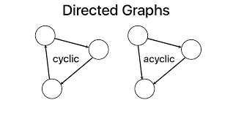
DFG
Acyclic DFG (ADFG)
doesn’t contain multiple values for the input variable and multiple output values for a given set of inputs
there is no cycle, or closed path
Acyclic DFG
Cyclic DFG
non-acyclic DFG
Output is fed back to Input

Slide 59
DFG
Helps in a simple code design.
no control conditions and thus a single path for the program flow.
DFG model program translates and executes as a single process sequential model program

Slide 60
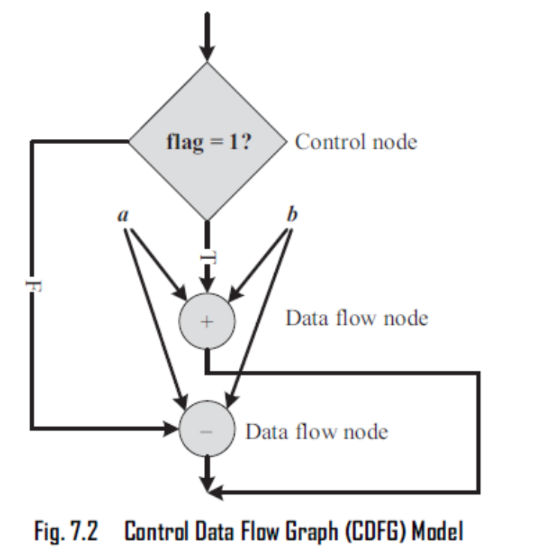
Control DFG
DFG model that may have statements to controls input and outputs
It may have loops or conditional statements for various designs in the process
CDFG is a graphically represents the conditions and the program flow along condition dependent path

Slide 61
Control Data Flow Graph/ Diagram (CDFG)
CDFG contains both data flow nodes and decision nodes whereas
DFG contains only data flow nodes.
Example- If flag = 1, x = a + b; else y = a – b;

Slide 62
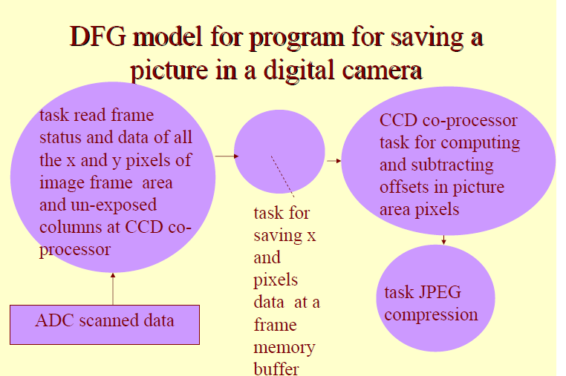

Slide 63
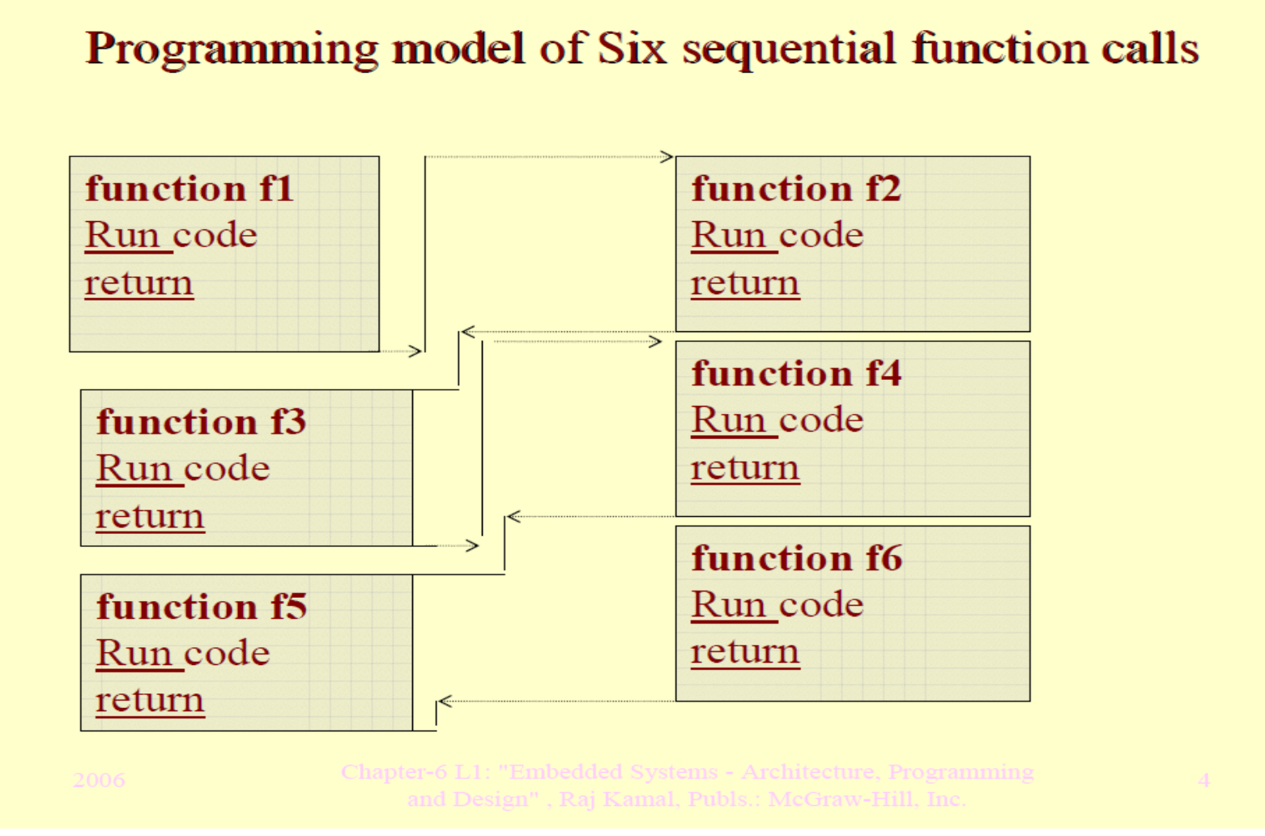
Sequential Program model
Use of multiple function calls sequentially

Slide 64
Seat Belt Warning System
The warning system alerts the driver if the seatbelts are not fastened when the car is started.
It waits for few secs to fasten seat belts
Car will move only if seat belt is fastened

Slide 65
Seat Belt Warning’ system in concurrent processing model
Timer task for waiting 10 seconds (wait timer task)
Task for checking the ignition key status (ignition key status monitoring task)
Task for checking the seat belt status (seat belt status monitoring task)
Task for starting and stopping the alarm (alarm control task)
Alarm timer task for waiting 5 seconds (alarm timer task)

Slide 66
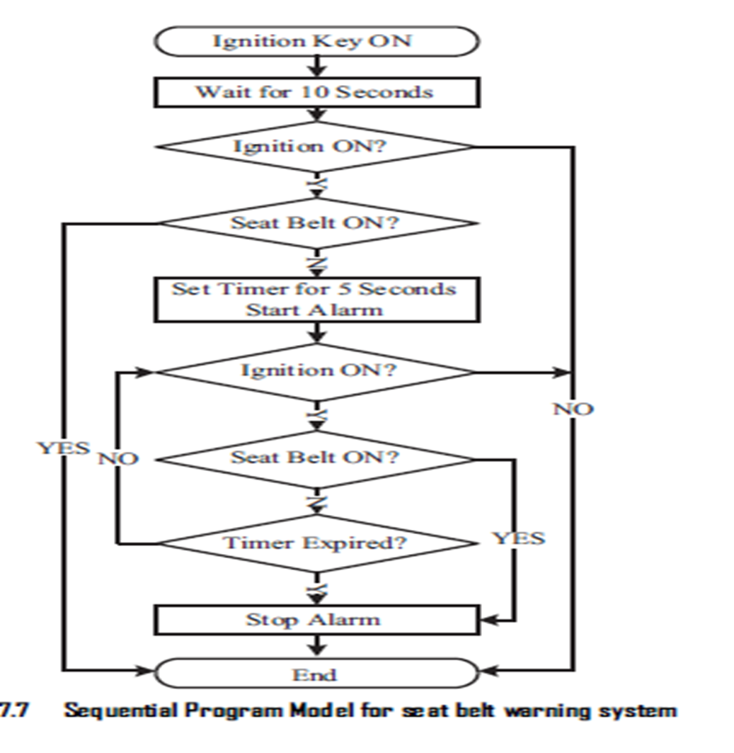
Seat Belt Warning System

Slide 67
Sequential execution leads to a single sequential execution of task
leads to poor processor utilization, when the task involves I/O waiting, sleeping for specified duration etc.

Slide 68
concurrent or communicating process mode
commonly used for the modelling of ‘Real Time’ systemsconcurrently executing tasks/processes.
Sequential execution leads to a single sequential execution of task
Hence, leads to poor processor utilization, when the task involves I/O waiting, sleeping for specified duration etc.

Slide 69
concurrent process mode
split the task into multiple subtasks
tackle the CPU usage effectively, when the subtask under execution goes to a wait or sleep mode, by switching the task execution.
requires additional overheads in task scheduling, task synchronisation and communication.

Slide 70
concurrent processing model
commonly used for the modelling of ‘Real Time’ systems.
Various techniques like ‘Shared memory’, ‘Message Passing’, ‘Events’, etc. are used for communication and synchronising between concurrently executing processes.

Slide 71
Seat Belt Warning’ system in concurrent processing model
Timer task for waiting 10 seconds (wait timer task)
Task for checking the ignition key status (ignition key status monitoring task)
Task for checking the seat belt status (seat belt status monitoring task)
Task for starting and stopping the alarm (alarm control task)
Alarm timer task for waiting 5 seconds (alarm timer task)

Slide 72
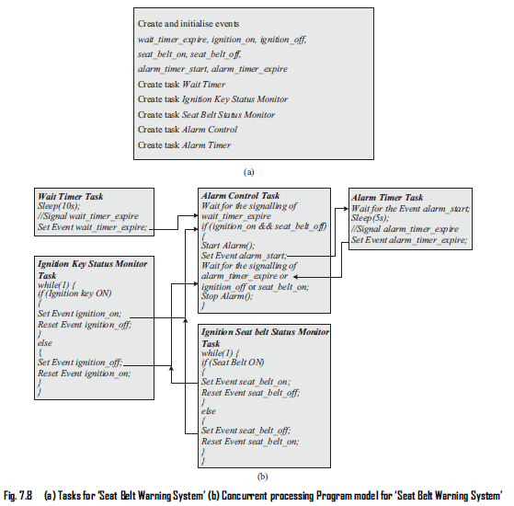
Seat Belt Warning’ system in concurrent processing model
Tasks for ‘Seat Belt Warning System

Slide 73
Concurrent processing Program model for ‘Seat Belt Warning System’

Slide 74
State Machine model
used for modelling reactive or event-driven embedded systems whose processing behavior are dependent on state transitions.
Embedded systems used in the control and industrial applications
This model describes the system behaviour with ‘States’, ‘Events’, ‘Actions’ and ‘Transitions’.

Slide 75
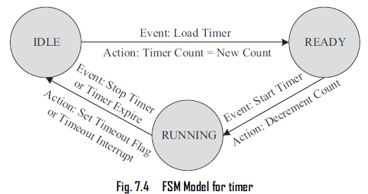

Slide 76
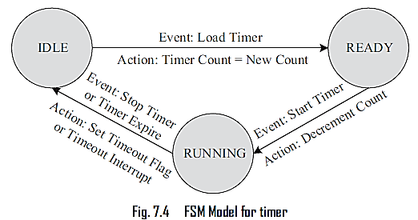
‘IDLE’ state- During the normal condition when the timer is not running it is said to be in the.
‘READY’ state - when the timer is loaded with the count corresponding to the required time delay. The timer remains in the ‘READY’ state until a ‘Start Timer’ event occurs.
‘RUNNING’ state - on receiving a ‘Start Timer’ event and remains in the ‘RUNNING’ state until the timer count expires or a ‘Stop Timer’ even occurs.

Slide 77
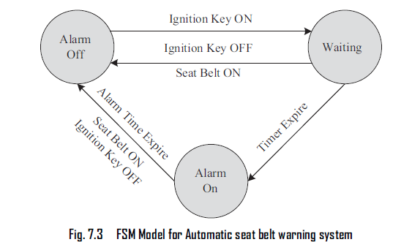
State Machine model - Automatic seat Belt warning system
states - ‘Alarm Off’, ‘Waiting’ and ‘Alarm On’
events - ‘Ignition Key ON’, ‘Ignition Key OFF’, ‘Timer Expire’, ‘Alarm Time Expire’ and ‘Seat
Belt ON’

Slide 78
Design an automatic tea/coffee vending machine based on FSM model for the following requirement
The tea/coffee vending is initiated by user inserting a 5 rupee coin. After inserting the coin, the user can either select ‘Coffee’ or ‘Tea’ or press ‘Cancel’ to cancel the order and take back the coin

Slide 79
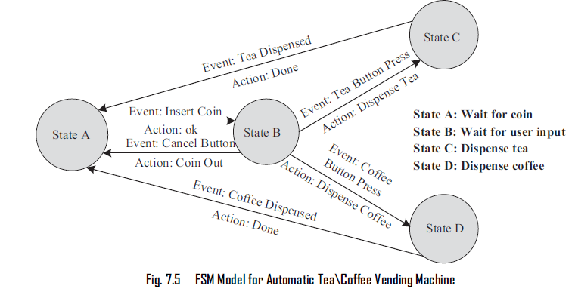

Slide 80
Design a coin operated public telephone unit based on FSM model for the following requirements.
The calling process is initiated by lifting the receiver (off-hook) of the telephone unit
After lifting the phone the user needs to insert a 1 rupee coin to make the call.
If the line is busy, the coin is returned on placing the receiver back on the hook (on-hook)
If the line is through, the user is allowed to talk till 60 seconds and at the end of 45th second, prompt for inserting another 1 rupee coin for continuing the call is initiated
If the user doesn’t insert another 1 rupee coin, the call is terminated on completing the 60 seconds time slot.
The system is ready to accept new call request when the receiver is placed back on the hook (on-hook)
The system goes to the ‘Out of Order’ state when there is a line fault

Slide 81
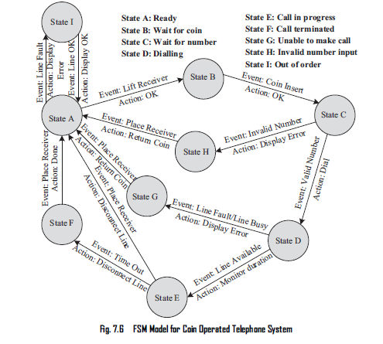

Slide 82
Object oriented programming model
organized around objects rather than "actions" and “data” rather than logic
identify all the objects the programmer wants to manipulate and how they relate to each other
Java, Python, C++, Visual Basic .NET and Ruby are the most popular OOP languages today.

Slide 83
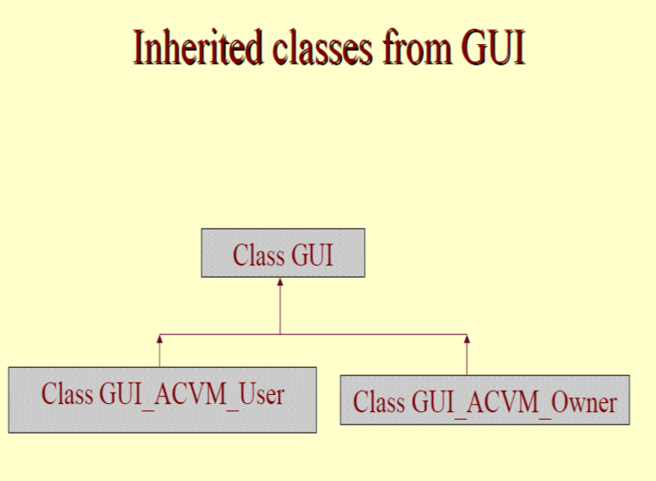

Slide 84
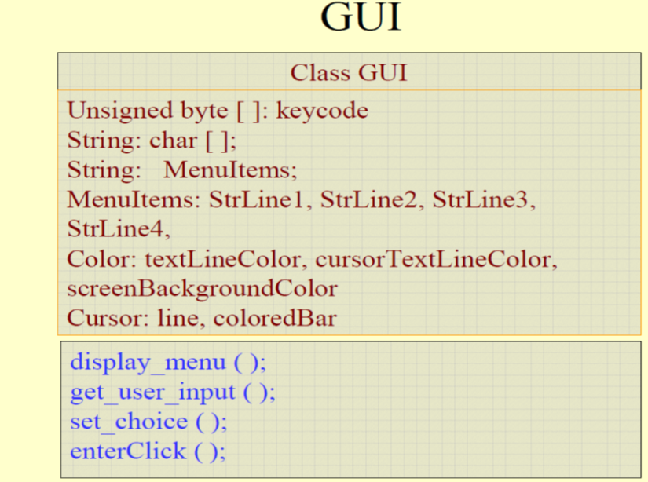

Slide 86
Unit4 Complete

