Slide 1

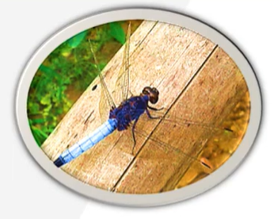
B.M.S College of Engineering
Department of Machine Learning
Nature Inspired Computing
UNIT 05
Dragon Fly Optimization Algorithm
Prof. VARSHA R
Asst. Prof, Dept. of MEL, BMSCE

Slide 2


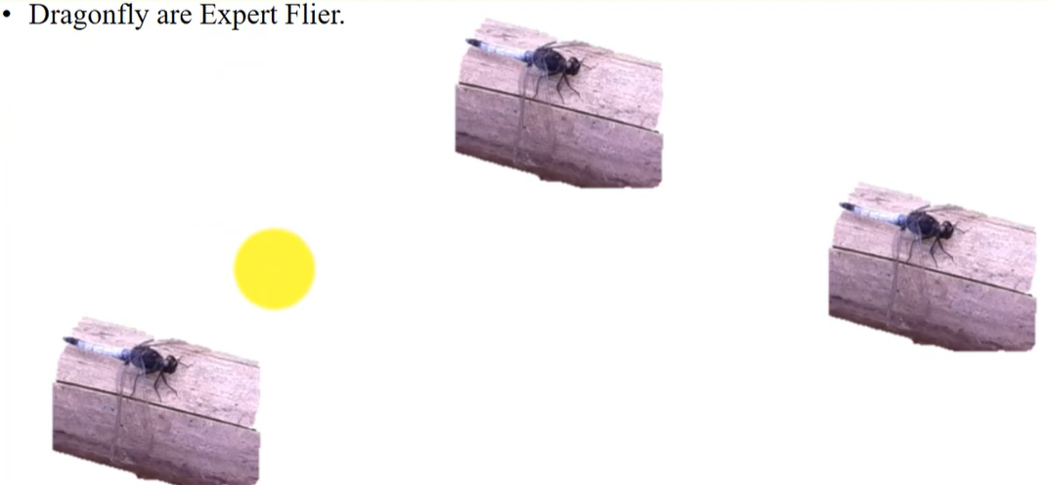

Introduction
The dragon flies can fly straight up and down and they can move like a helicopter.

Slide 3
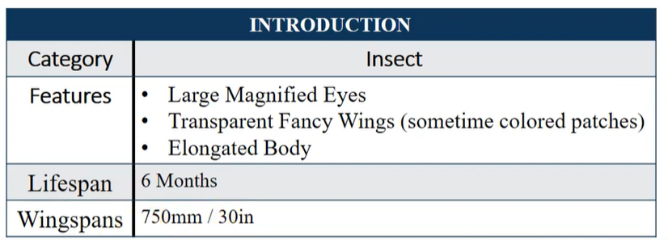
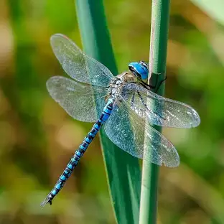
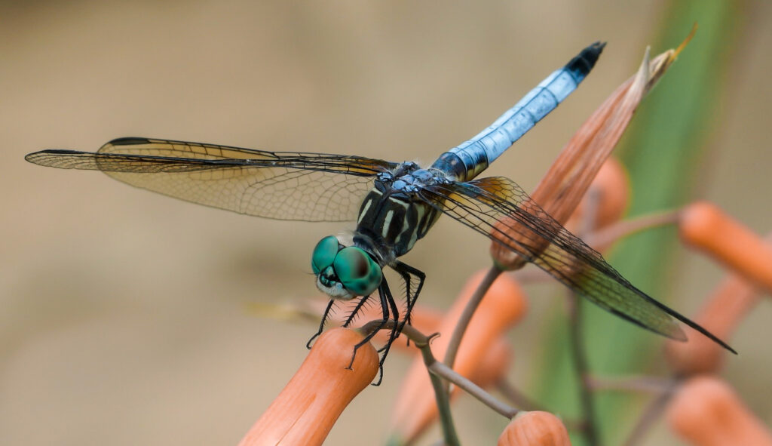
Characteristics/ Properties of Dragon Fly Algorithm

Slide 4

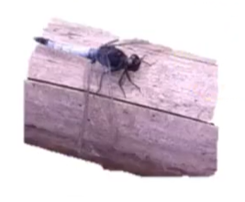
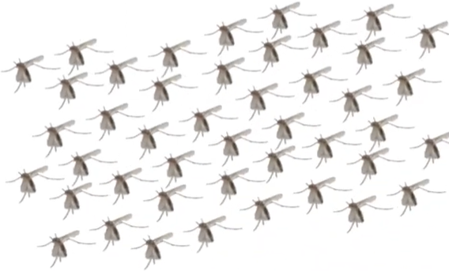
Characteristics/ Properties of Dragon Fly Algorithm

Slide 5

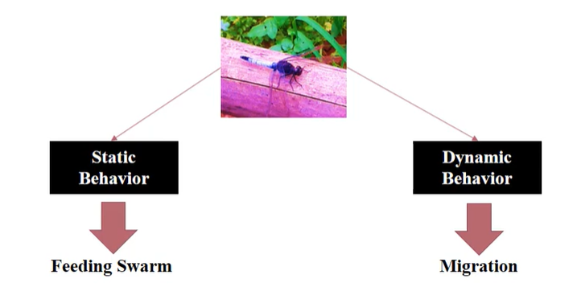
Characteristics/ Properties of Dragon Fly Algorithm

Slide 6
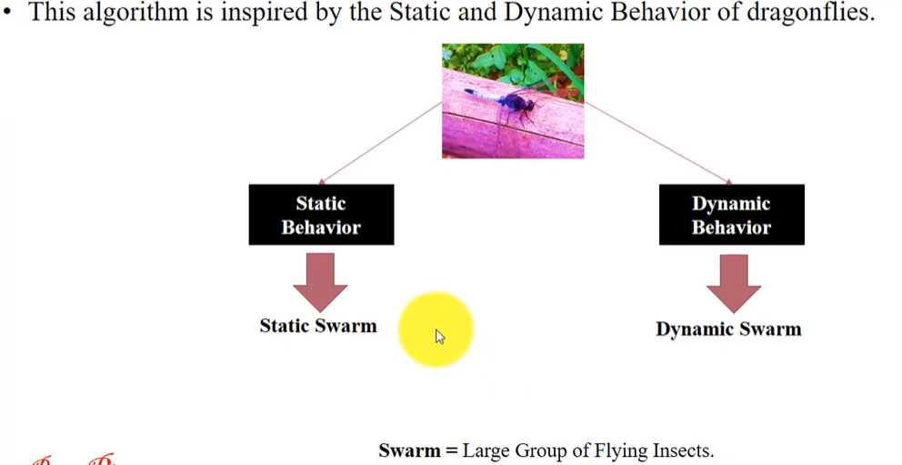
Characteristics/ Properties of Dragon Fly Algorithm

Slide 7
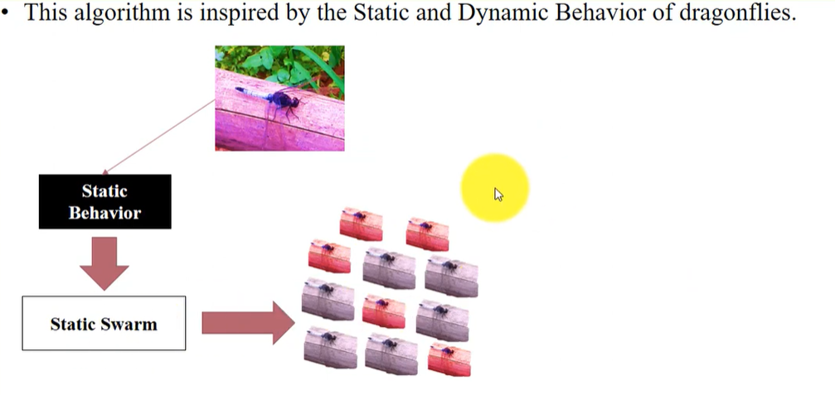
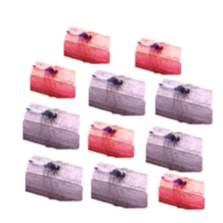
Characteristics/ Properties of Dragon Fly Algorithm

Slide 8
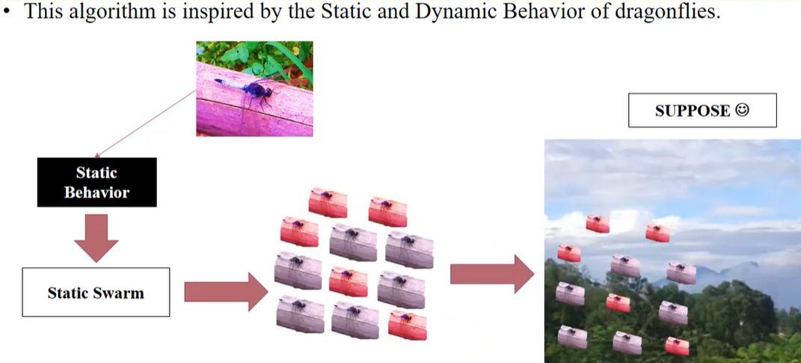
Characteristics/ Properties of Dragon Fly Algorithm

Slide 9
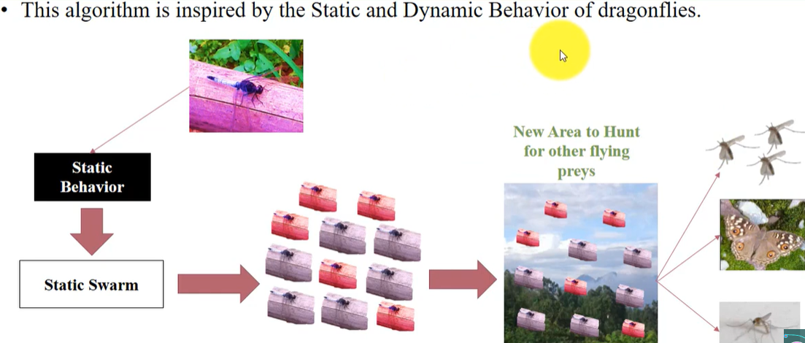
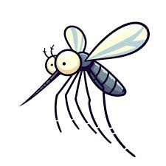
Characteristics/ Properties of Dragon Fly Algorithm

Slide 10
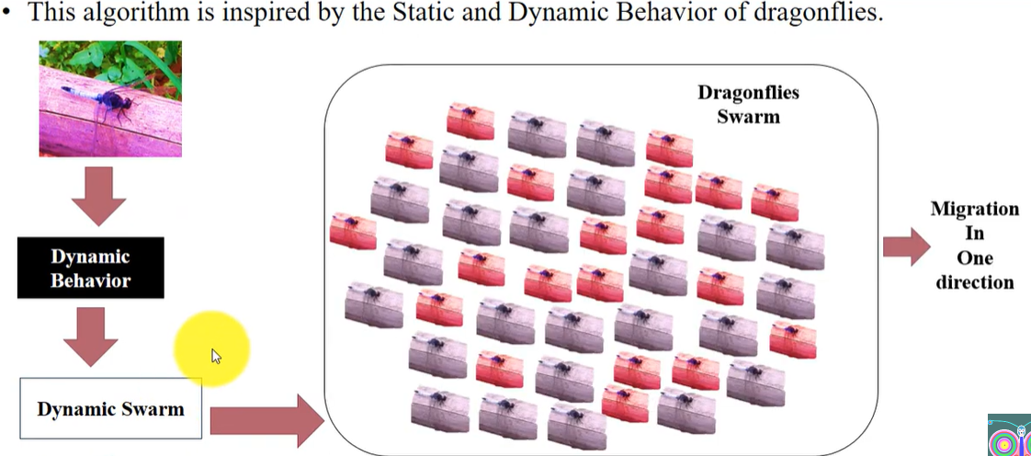

Characteristics/ Properties of Dragon Fly Algorithm

Slide 11
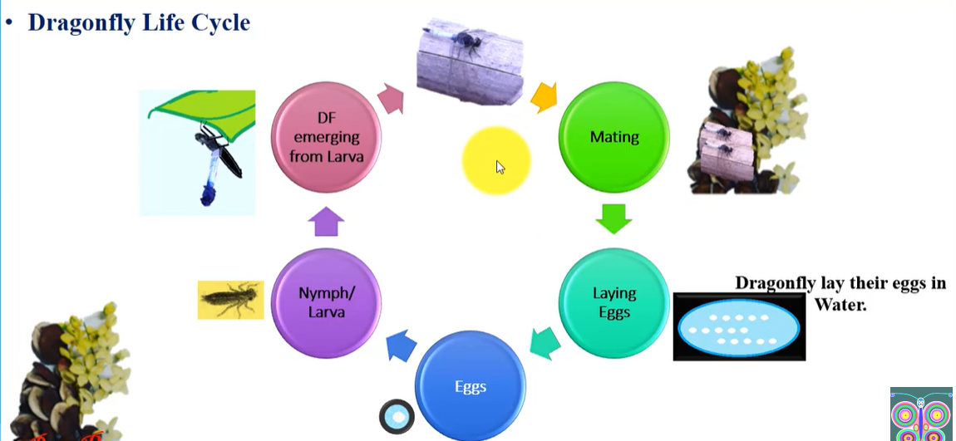
Dragon Fly Life Cycle

Slide 12
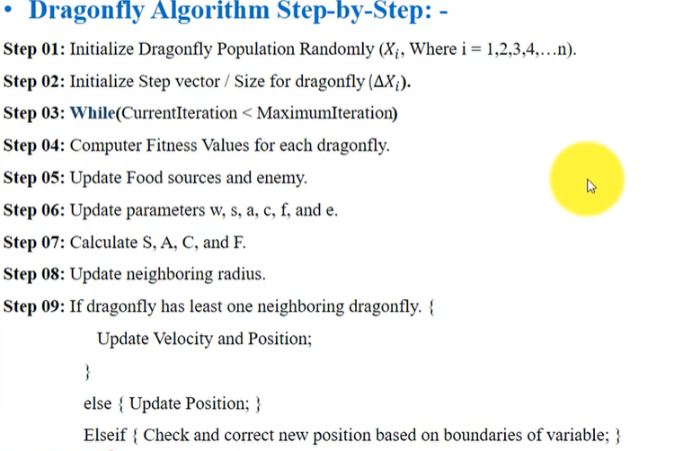
Dragon Fly Algorithm

Slide 13

Steps 01

Slide 14
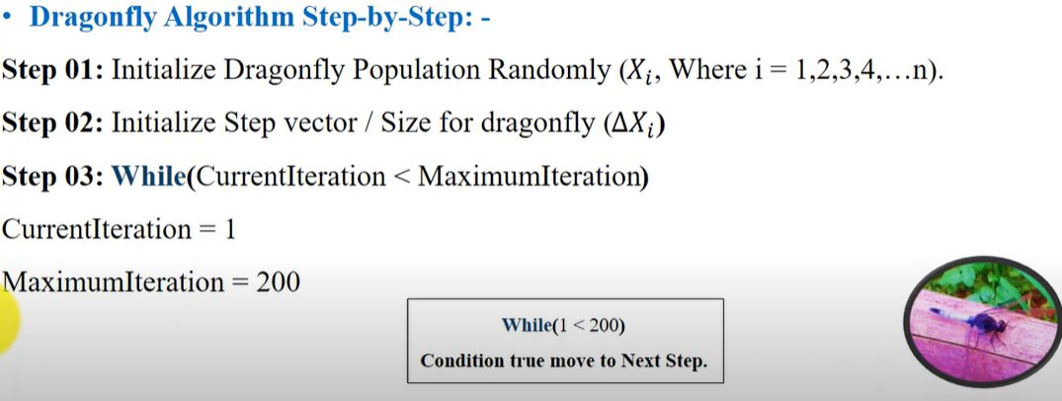

Steps 02

Slide 15
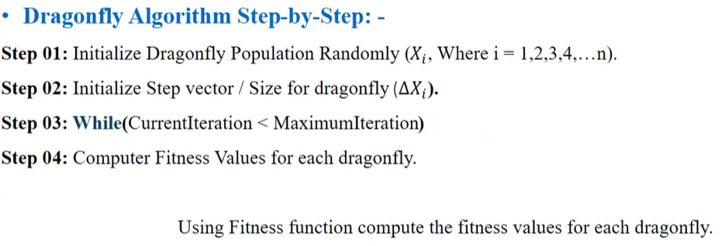
Steps 03

Slide 16
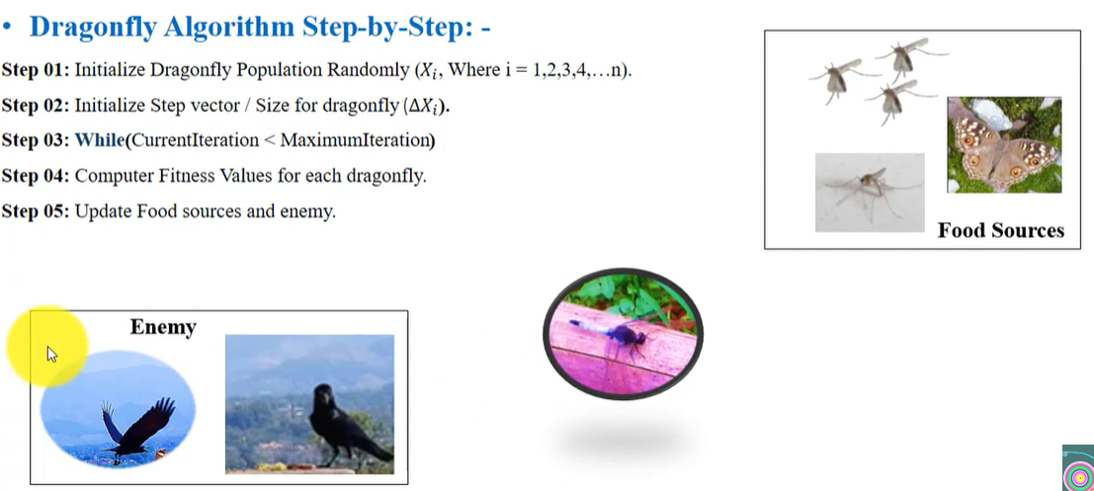
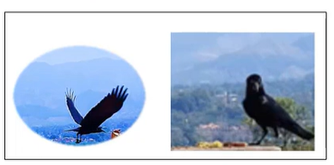

Steps 04

Slide 17
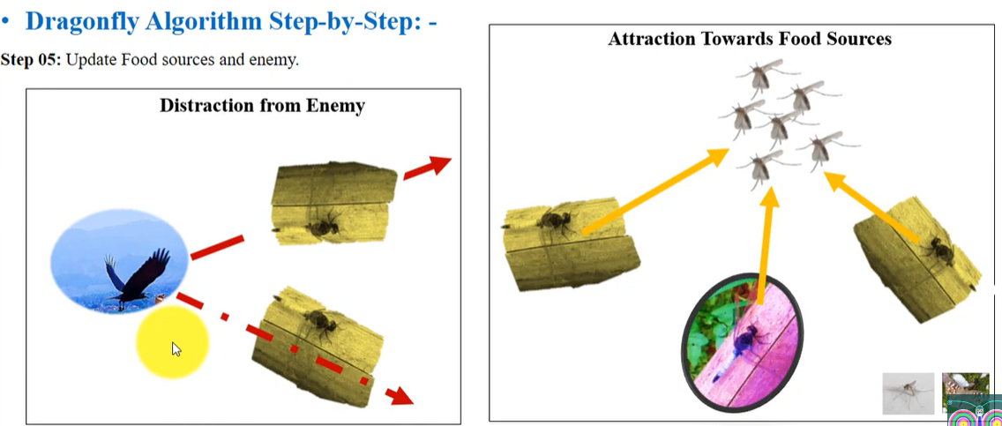
Steps 05

Slide 18
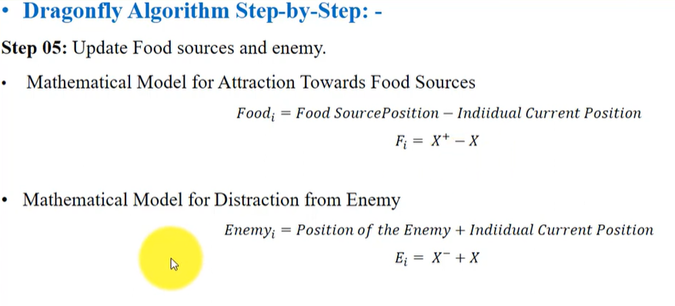
Steps 05

Slide 19
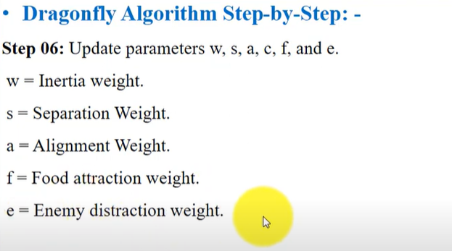


Steps 06

Slide 20
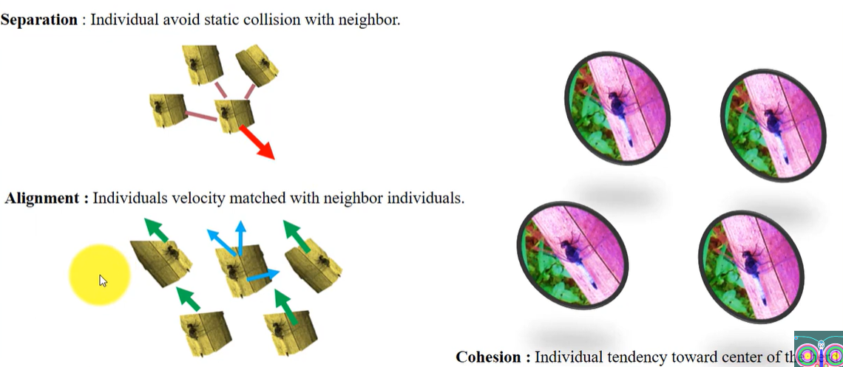

Steps 06

Slide 21
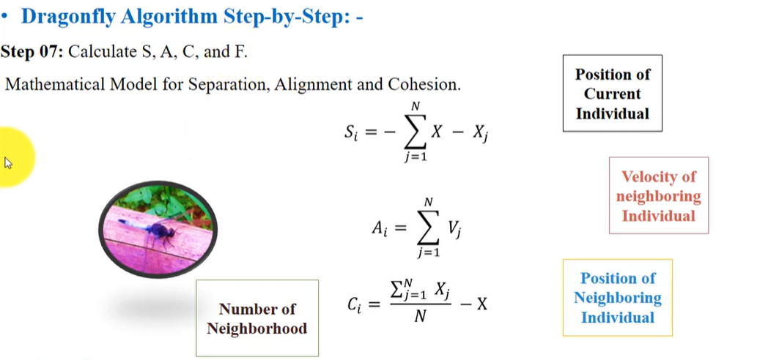
Step 07

Slide 22
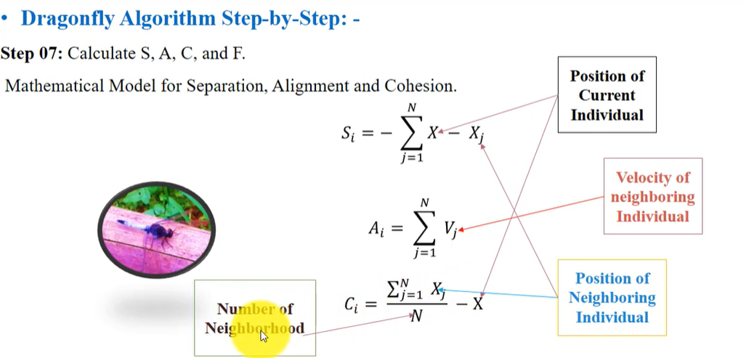
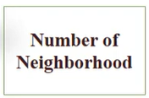
Step 07

Slide 23
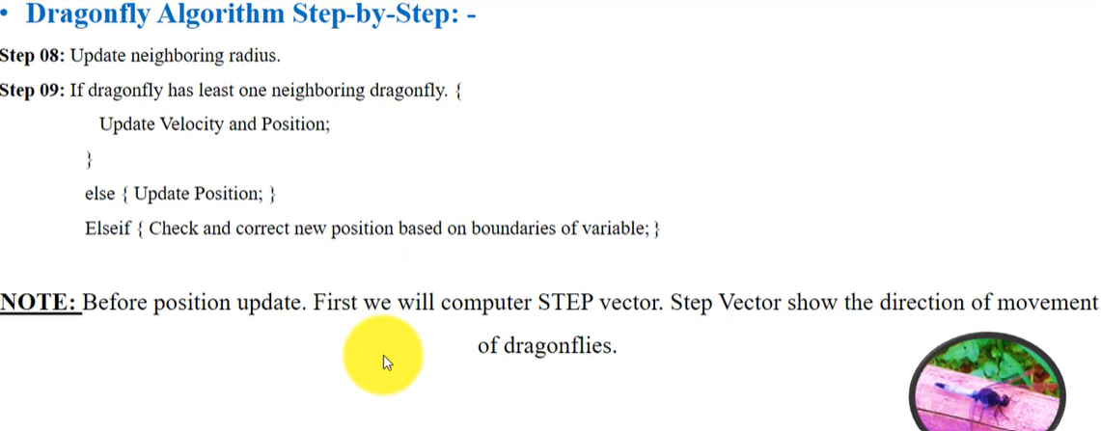

Step 08

Slide 24
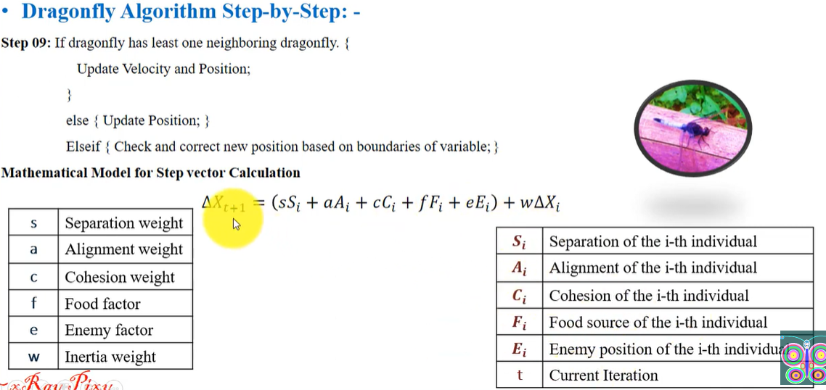

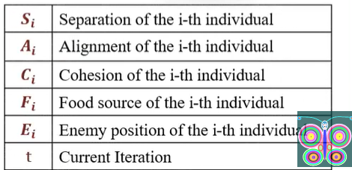
Step 09

Slide 25
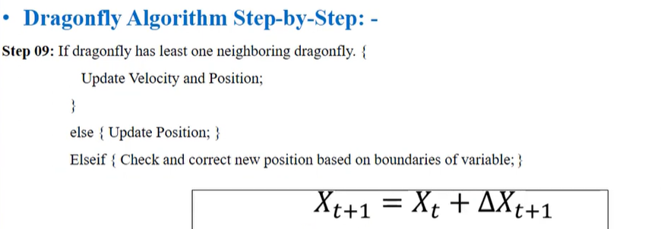
Step 09

Slide 26

Step 09

