Slide 1

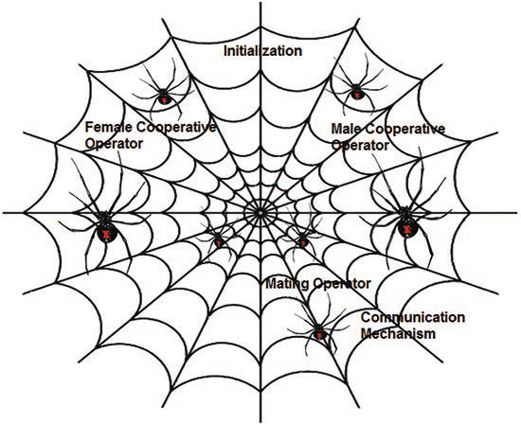
B.M.S College of Engineering
Department of Machine Learning
Nature Inspired Computing
UNIT 04
Social Spider Algorithm
Prof. VARSHA R
Asst. Prof, Dept. of MEL, BMSCE

Slide 2
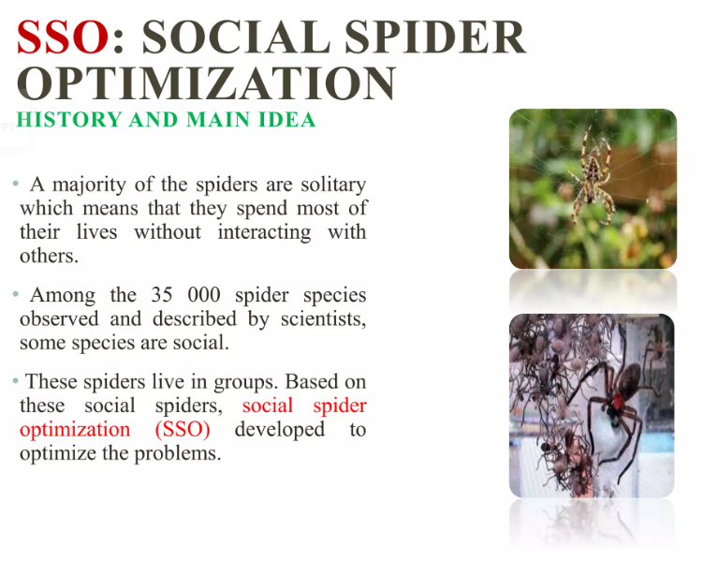
Social Spider Optimization

Slide 3
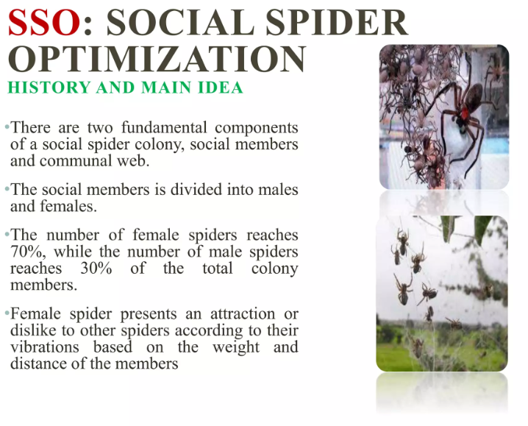
Social Spider Optimization

Slide 4
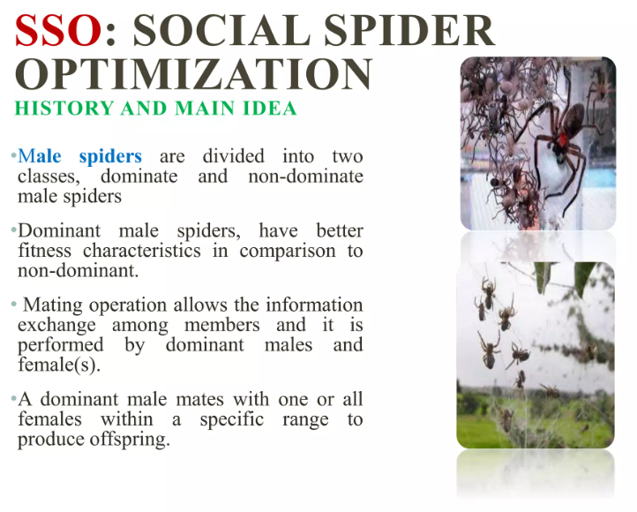
Social Spider Optimization

Slide 5
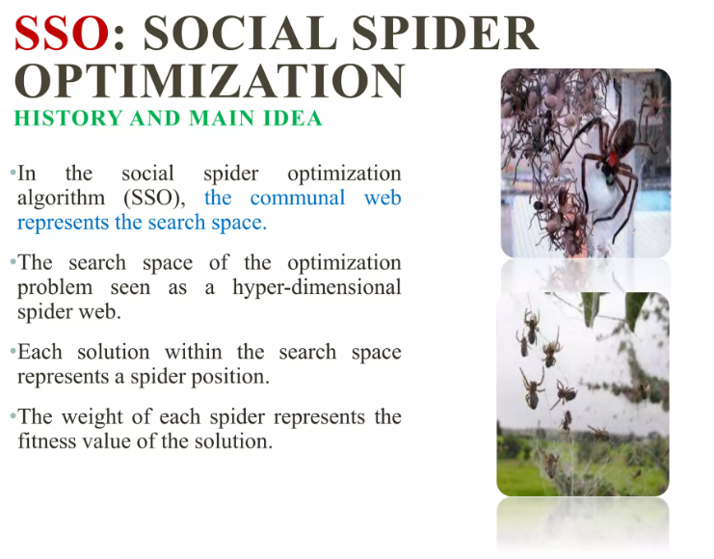
Social Spider Optimization

Slide 6
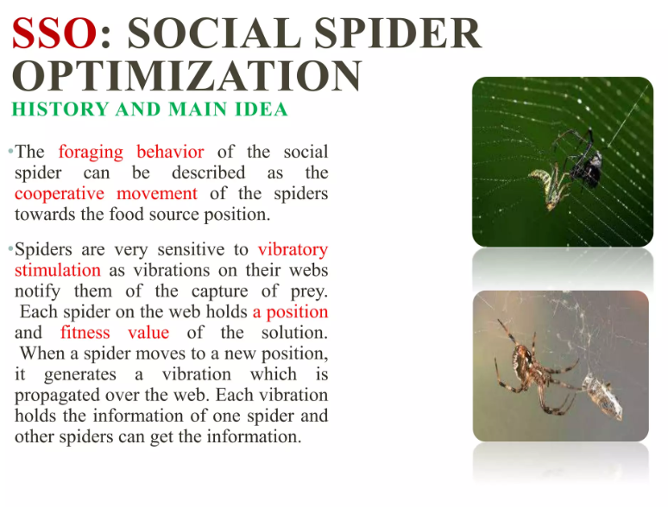
Social Spider Optimization

Slide 7
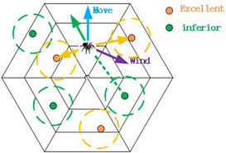
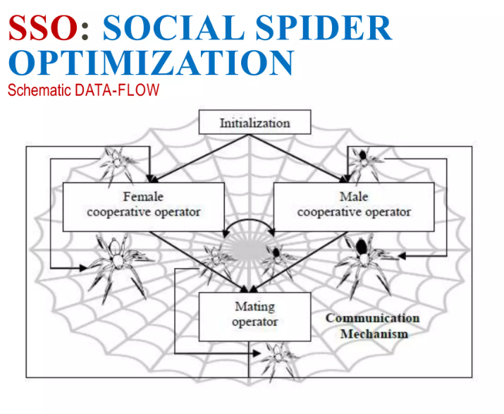
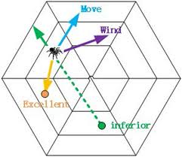
Social Spider Optimization

Slide 8
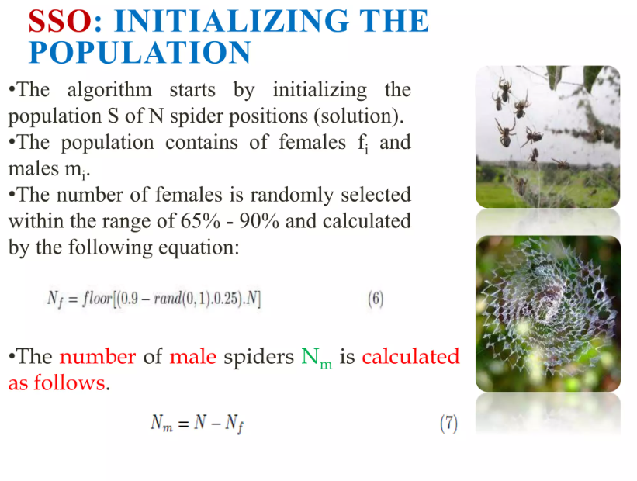
Social Spider Optimization

Slide 9
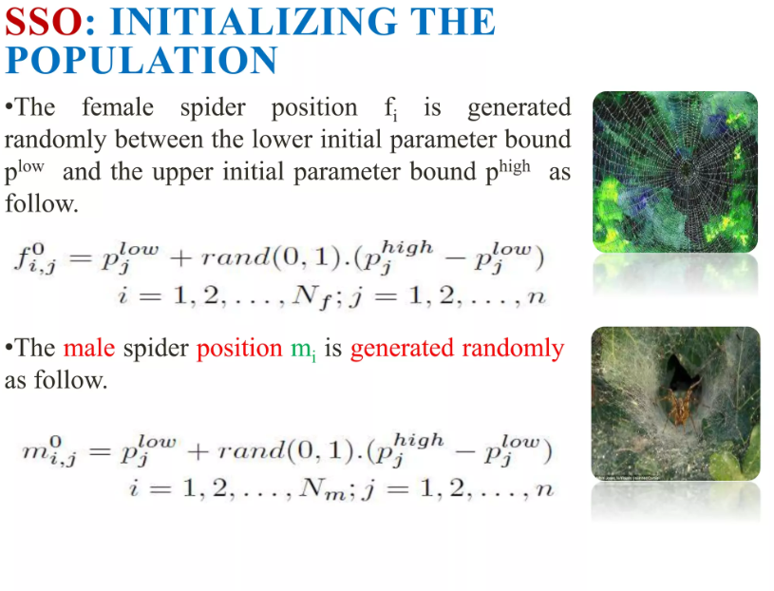
Social Spider Optimization

Slide 10
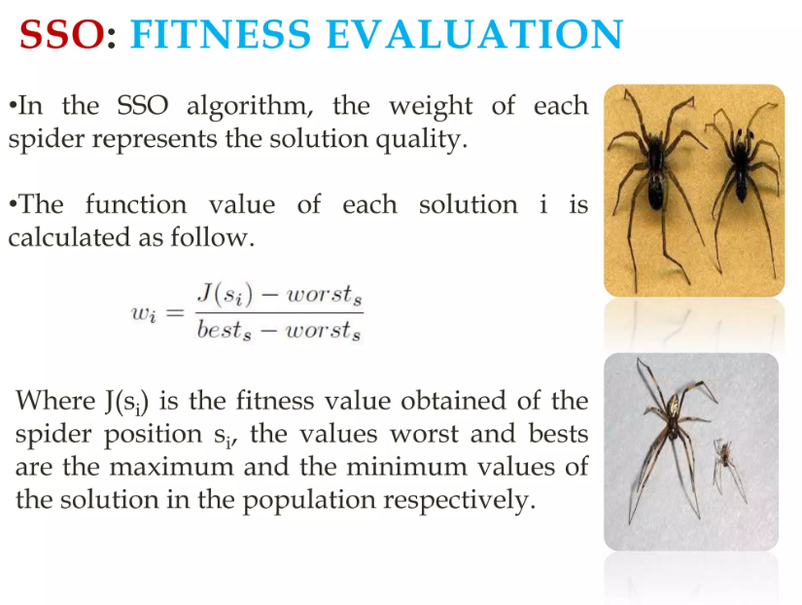
Social Spider Optimization

Slide 11
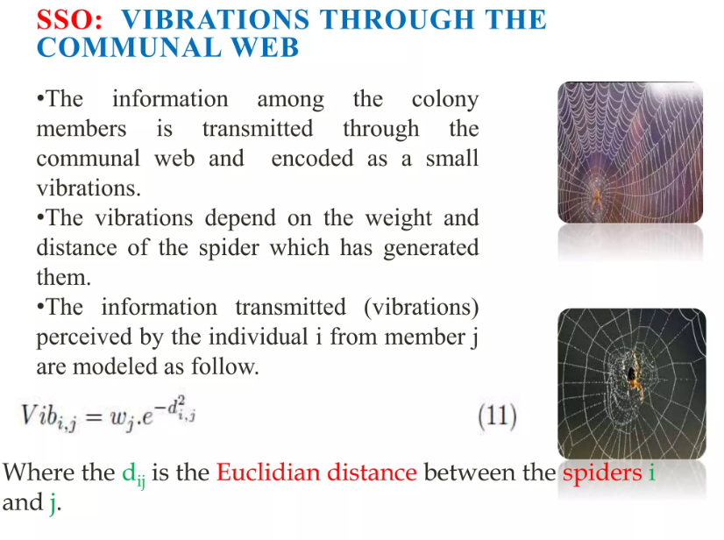
Social Spider Optimization

Slide 12
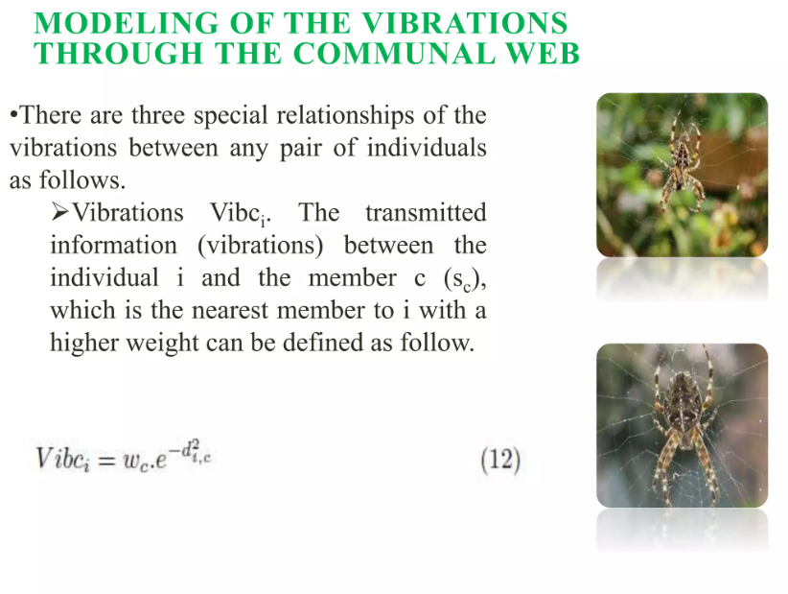
Social Spider Optimization

Slide 13
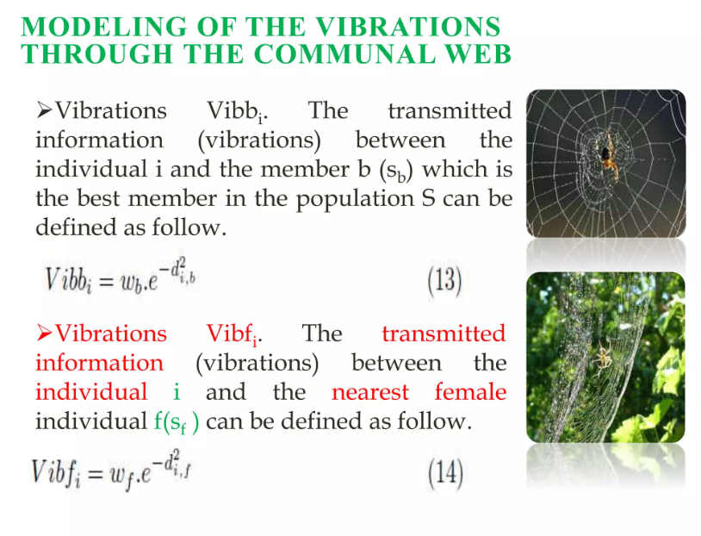
Social Spider Optimization

Slide 14
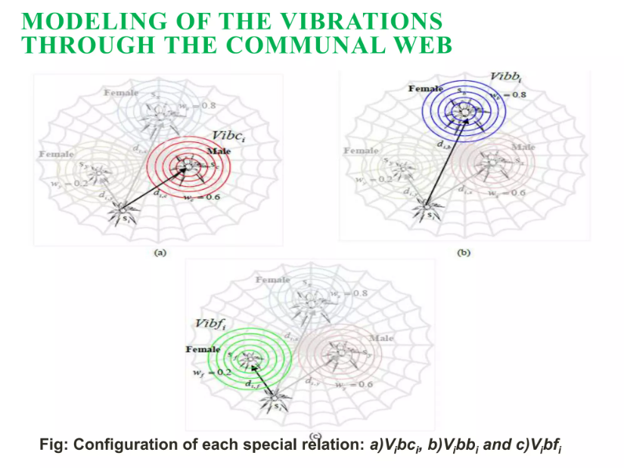
Social Spider Optimization

Slide 15
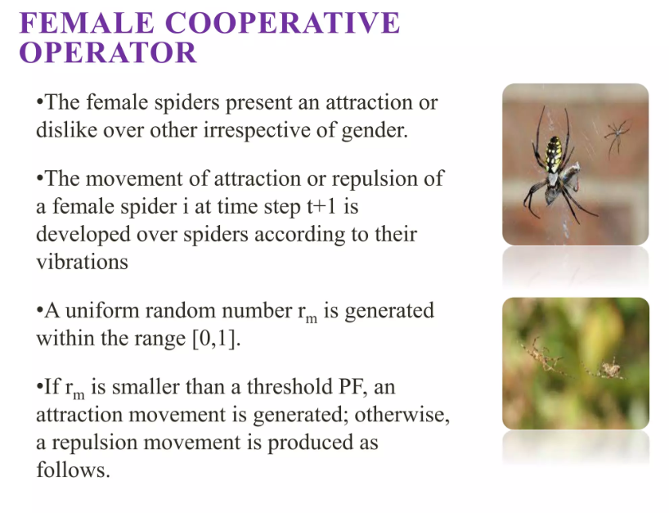
Social Spider Optimization

Slide 16
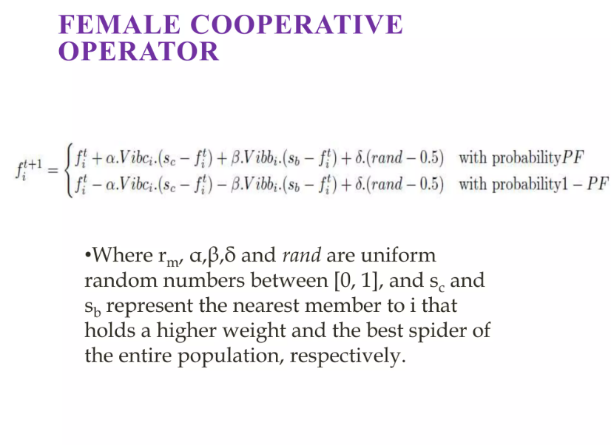
Social Spider Optimization

Slide 17
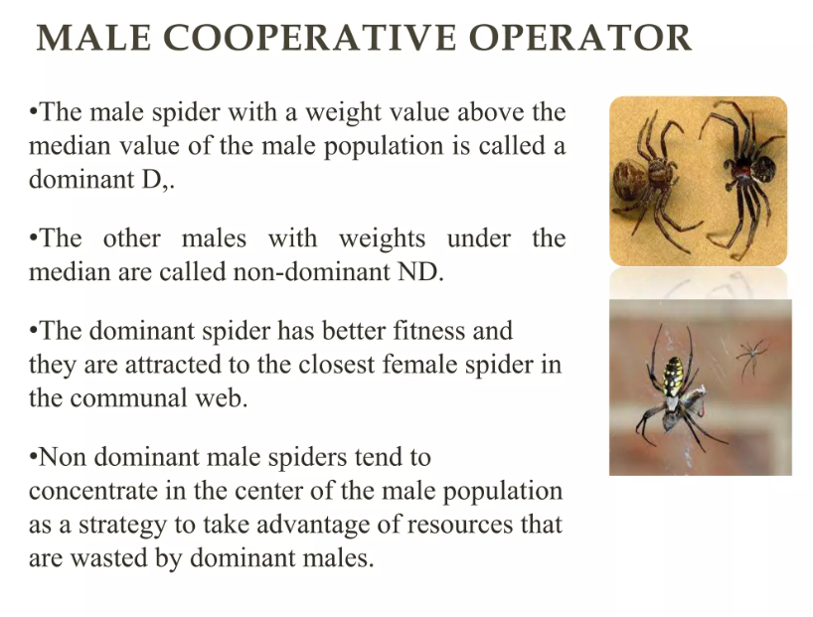
Social Spider Optimization

Slide 18
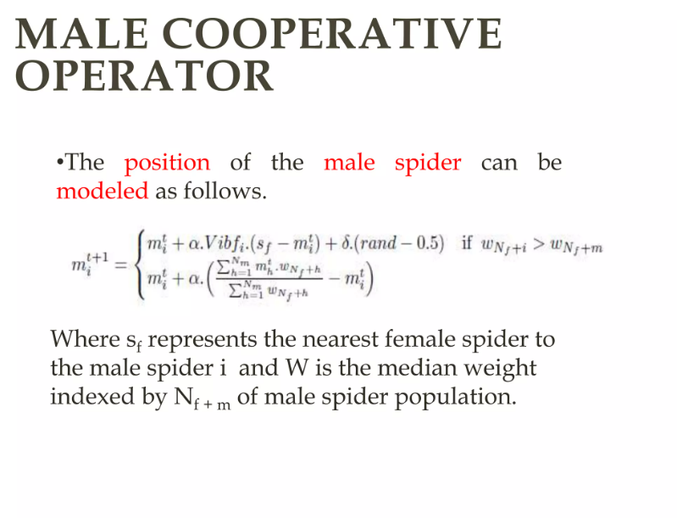
Social Spider Optimization

Slide 19
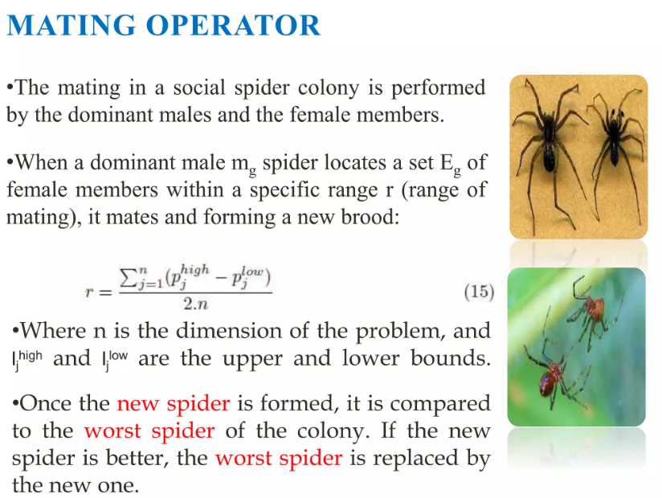
Social Spider Optimization

Slide 20
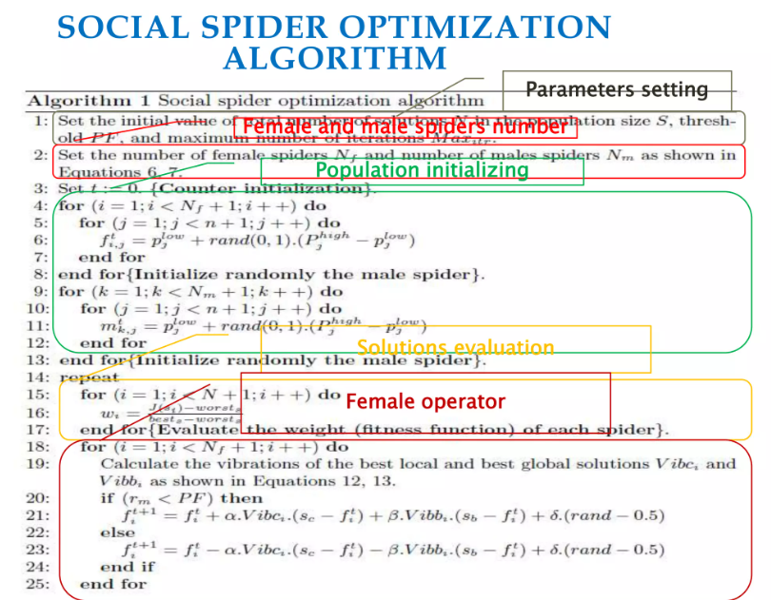
Social Spider Optimization Algorithm

Slide 21
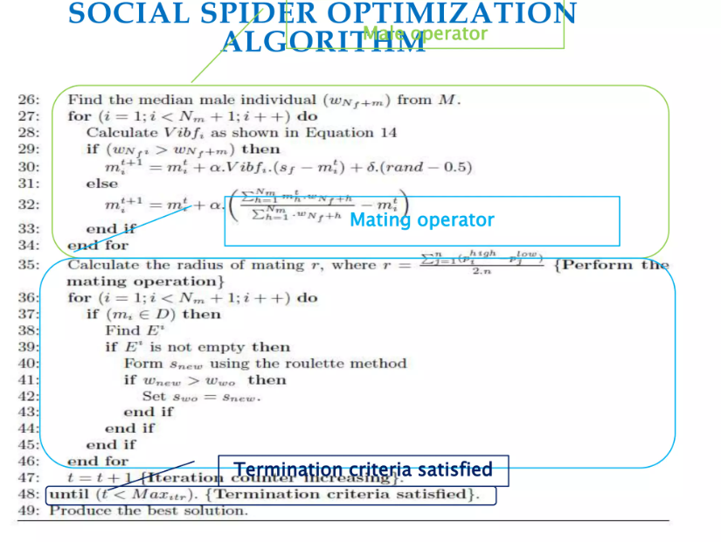
Social Spider Optimization Algorithm

Slide 22
Applications of SSO
SSA has been successfully applied in various domains:
Engineering Design: Optimizing structural and mechanical designs.
Network Optimization: Solving problems in wireless sensor networks and communication networks.
Machine Learning: Feature selection and parameter optimization.
Bioinformatics: Sequence alignment and other computational biology tasks.
Scheduling: Resource allocation and task scheduling.

Slide 23
Advantages of SSO
Simple to implement and computationally efficient.
Balances exploration and exploitation effectively.
Robust in handling complex, nonlinear, and multimodal optimization problems.

Slide 24
Challenges of SSO
May require parameter tuning for optimal performance.
Can suffer from premature convergence in some cases.

