Slide 1


B.M.S College of Engineering
Department of Machine Learning
Nature Inspired Computing
UNIT 04
Intelligent Water Droplets Algorithm
Prof. VARSHA R
Asst. Prof, Dept. of MEL, BMSCE

Slide 2
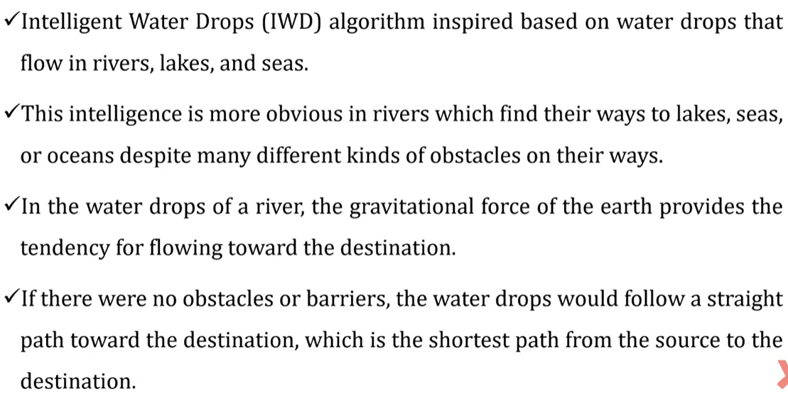
Intelligent Water Drops Algorithm (IWD)

Slide 3
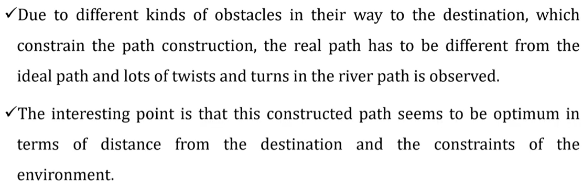
Intelligent Water Drops Algorithm

Slide 4
Intelligent Water Drop Algorithm
The Intelligent Water Droplet (IWD) Algorithm is a nature-inspired optimization algorithm modelled on the natural processes of water flow in rivers.
It mimics the way water droplets interact with the environment to find optimal paths, typically minimizing or maximizing a given objective function.

Slide 5
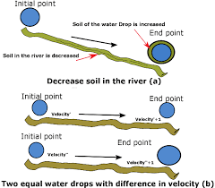
Key Concepts of the IWD Algorithm
1. Water Droplets as Agents:
Each droplet represents an intelligent agent that moves across the search space.
The droplets interact with the environment and adapt their paths based on their observations.
2. Soil and Velocity:
Soil represents a property of the environment (e.g., resistance or cost).
As droplets traverse a path, they remove soil, effectively "improving" the path for subsequent droplets.
Droplet velocity increases in low-resistance (low-soil) paths, promoting exploration of better routes.
3. Path Selection:
Each droplet selects the next step based on a probabilistic decision mechanism that considers soil and velocity.
Paths with less soil are more likely to be chosen.

Slide 6
Key Concepts of the IWD Algorithm
4. Global and Local Updates:
Local Update: When a droplet moves through a path, it removes soil from it.
Global Update: After all droplets complete their journey, global soil updates occur to consolidate the learning and guide future iterations.

Slide 7
Algorithm Steps
1. Initialization:
Define the problem and map it to a graph-like structure.
Initialize soil levels for all paths and velocities for all droplets.
2. Droplet Movement:
Droplets probabilistically choose paths based on the soil content and their velocity.
Update soil and velocity dynamically as droplets traverse paths.
3. Solution Construction:
Each droplet builds a solution as it moves across the graph.
A complete solution is obtained when the droplet satisfies the stopping criteria (e.g., visits all nodes in a graph for a Traveling Salesman Problem).
4. Update Rules:
Local soil update: Reduce soil on the traversed path.
Global soil update: Reinforce the best solutions after a certain number of iterations.
5. Termination:
Stop when a predefined criterion is met (e.g., maximum number of iterations or a satisfactory solution quality).

Slide 8
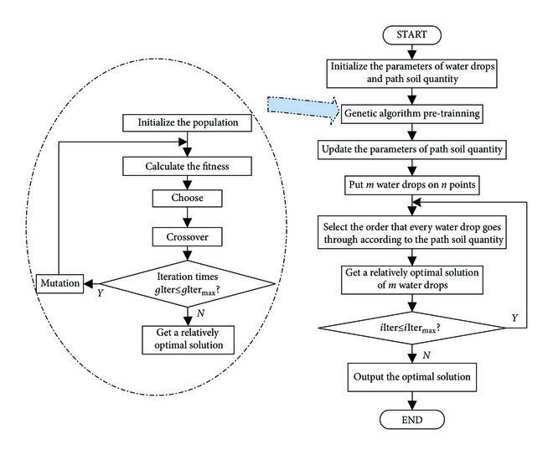
Workflow Diagram for IWD

Slide 9
Applications
The IWD algorithm has been applied to a variety of optimization problems, such as:
Traveling Salesman Problem (TSP)
Job Scheduling
Vehicle Routing
Resource Allocation

