Slide 1

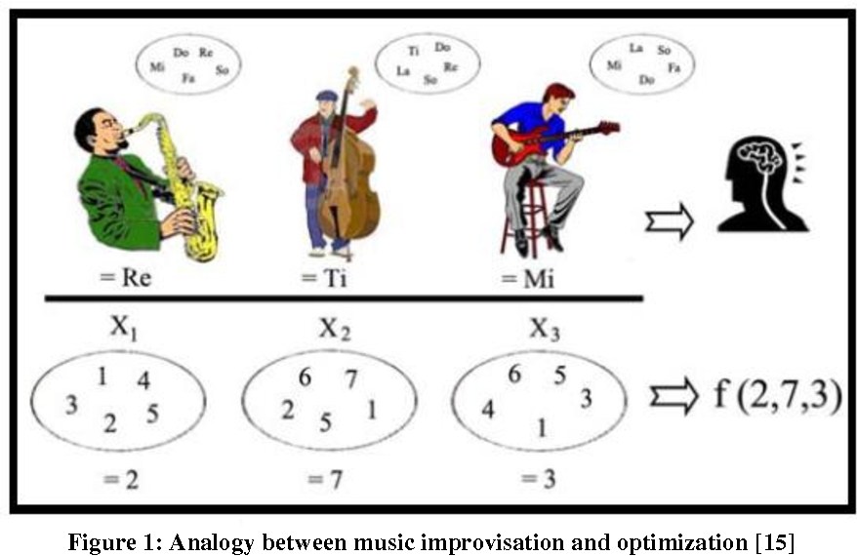
B.M.S College of Engineering
Department of Machine Learning
Nature Inspired Computing
UNIT 04
Harmony Search Algorithm
Prof. VARSHA R
Asst. Prof, Dept. of MEL, BMSCE

Slide 2
Introduction
Harmony search (HS) is a music-inspired algorithm developed by Zong Woo Geem et al. in 2001.
It is not swarm-intelligence-based, but it is a metaheuristic algorithm.
In the standard HS, solutions are represented in terms of a population of harmonies, using the following three choices or rules (of a musician playing a piece of music):
play any famous piece of music from memory,
play something similar to a known piece (pitch adjustment), and
compose new or random notes.
HS uses mainly mutation and selection, whereas crossover is not explicitly used. The first rule corresponds to selection or elitism, and the second and third rules are mutation.

Slide 3
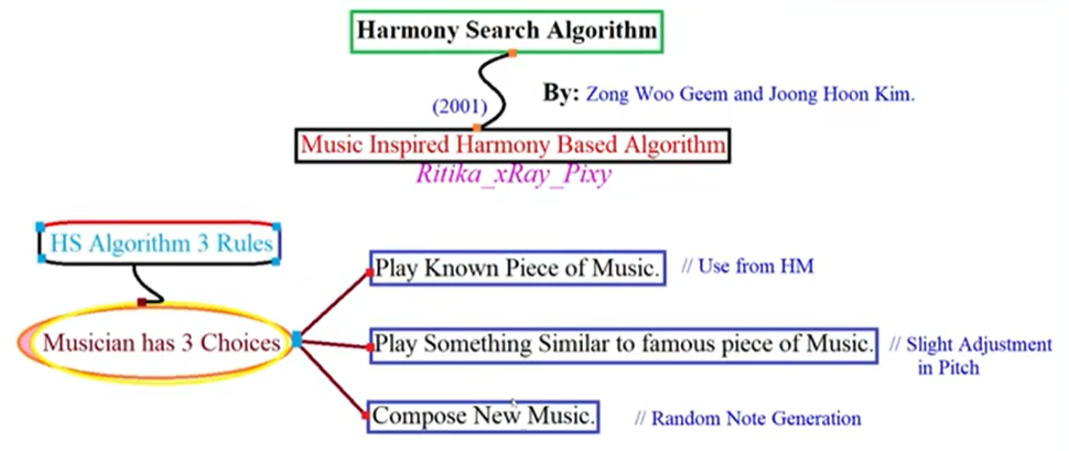
Harmony Search Algorithm

Slide 4
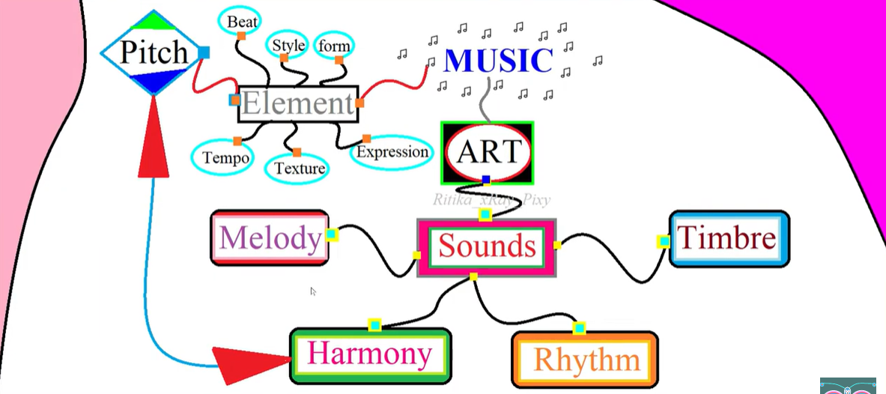

Harmony Search Algorithm

Slide 5
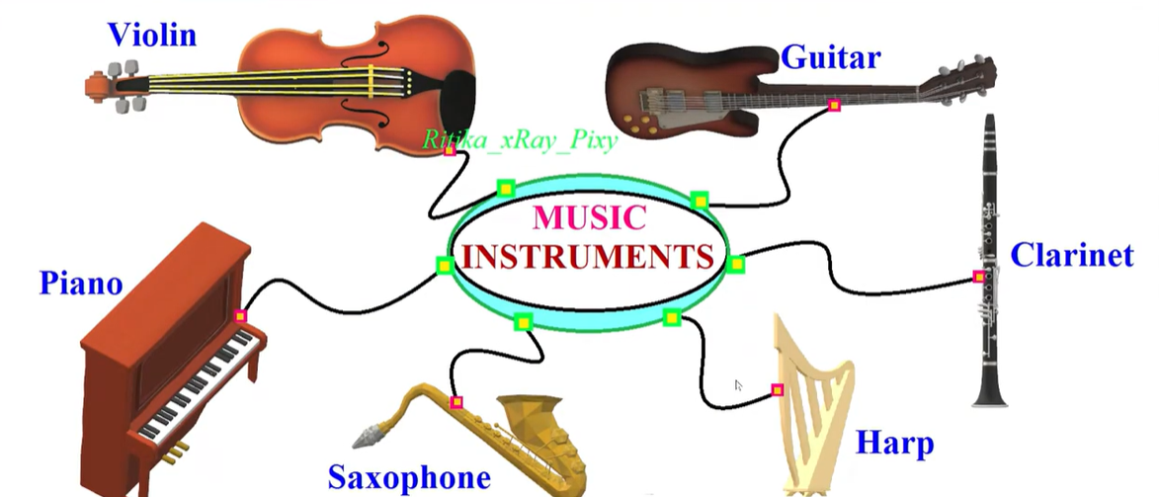
Harmony Search Algorithm

Slide 6
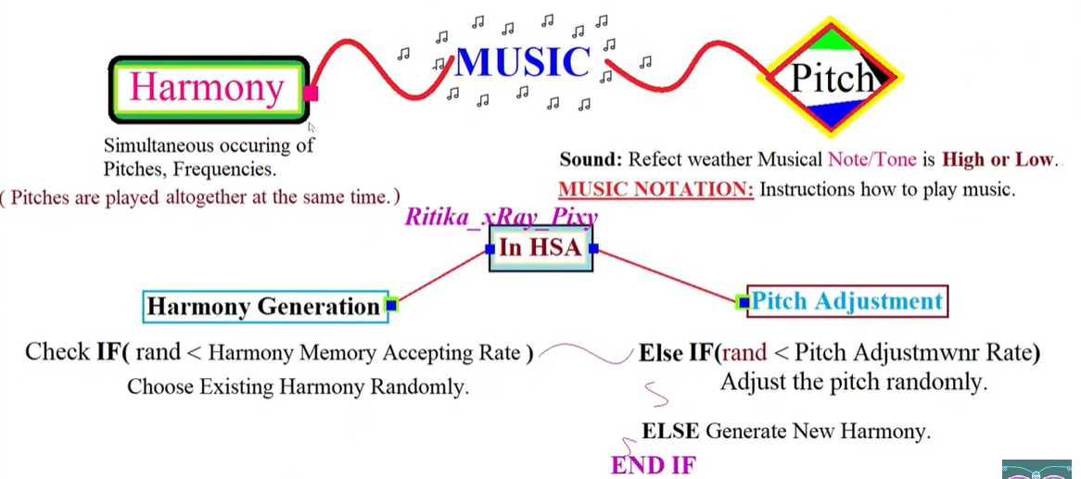

Harmony Search Algorithm

Slide 7
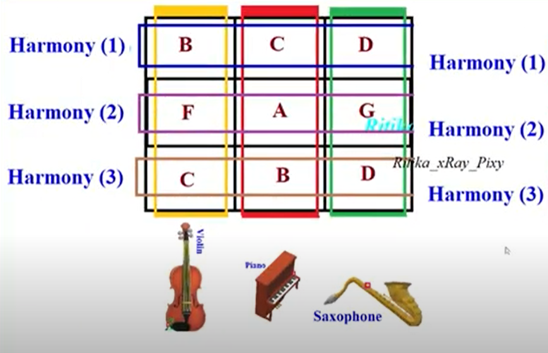
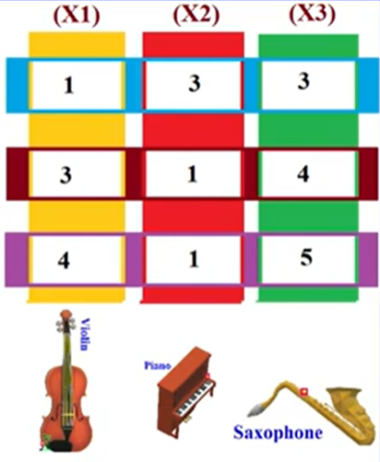
Harmony Search Algorithm

Slide 8
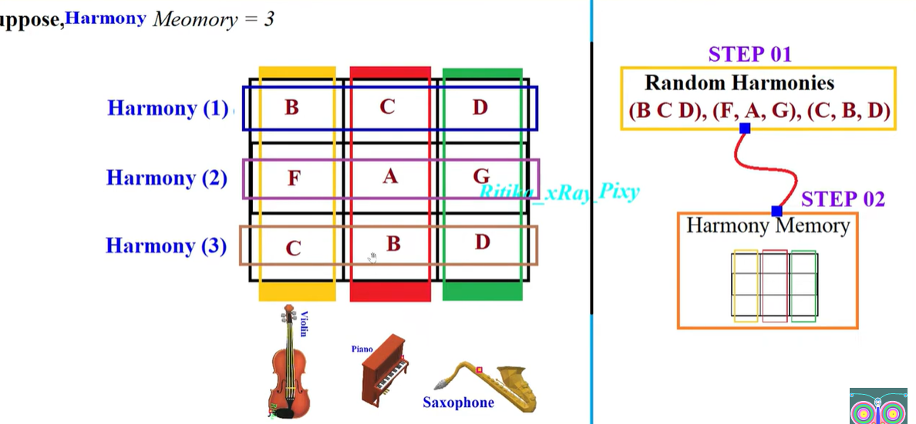


Harmony Search Algorithm Example 1

Slide 9
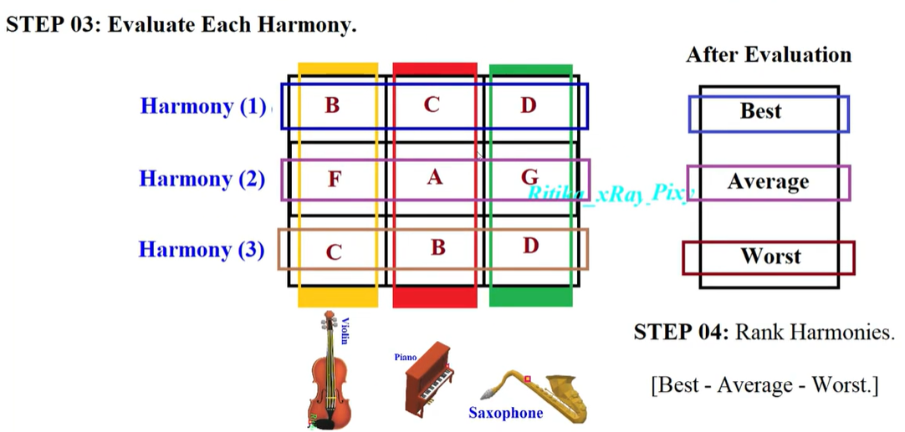
Harmony Search Algorithm Example 1

Slide 10
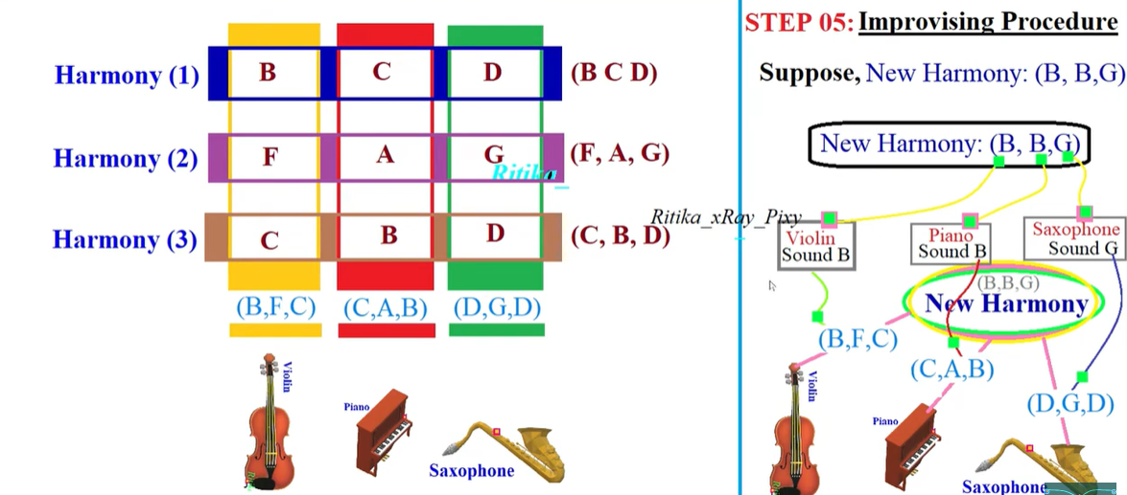
Harmony Search Algorithm Example 1

Slide 11
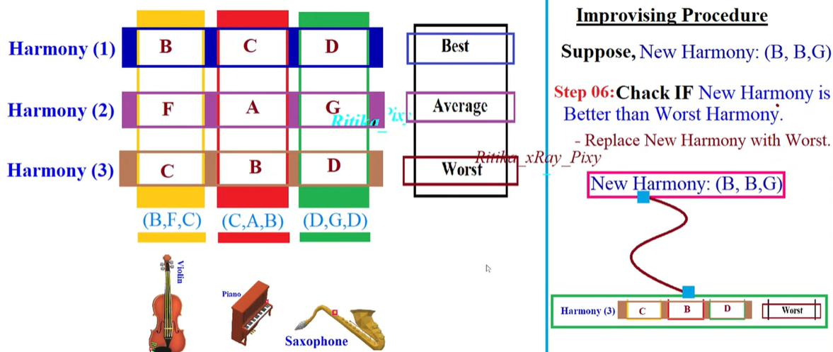
Harmony Search Algorithm Example 1

Slide 12
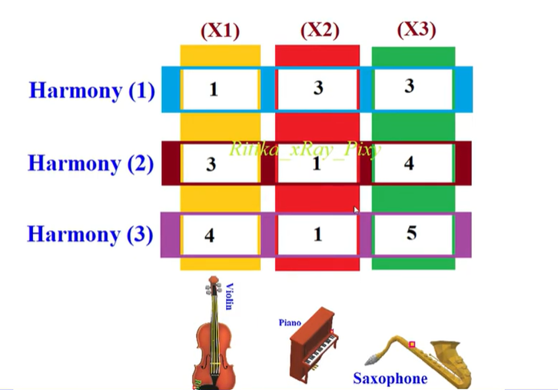
Harmony Search Algorithm Example 2

Slide 13
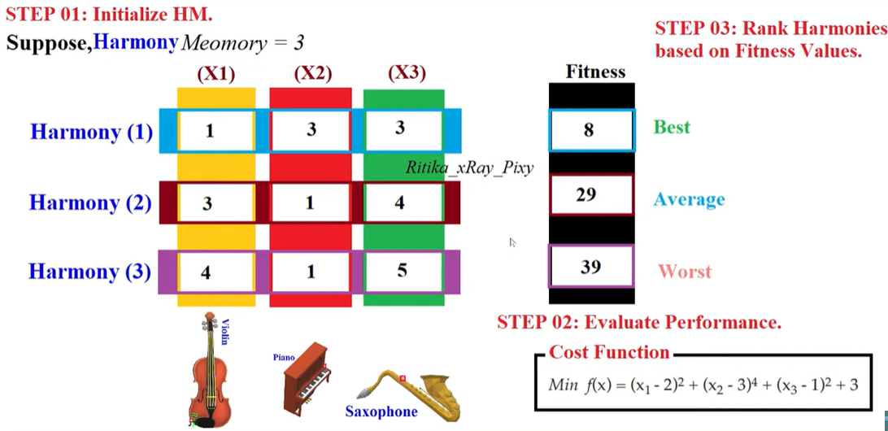
Harmony Search Algorithm Example 2

Slide 14
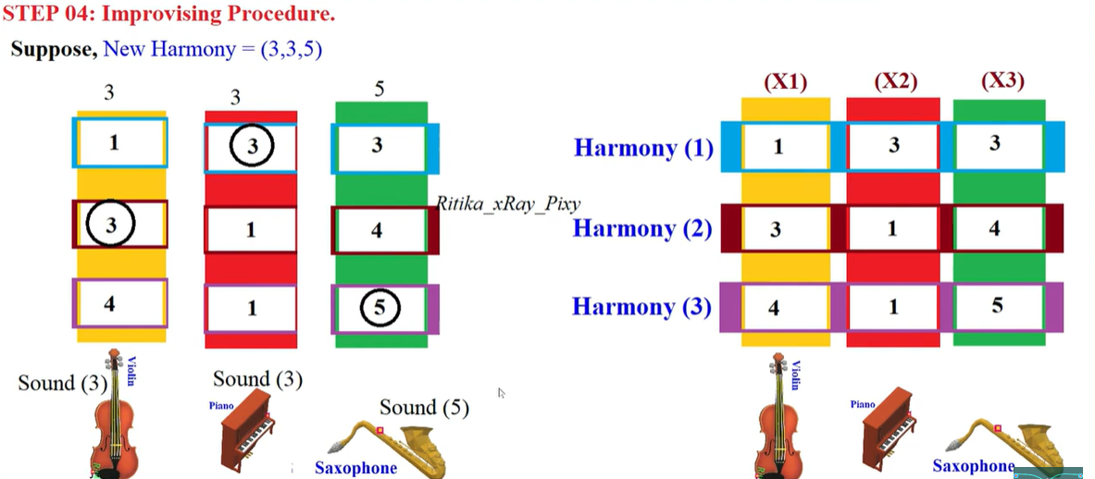
Harmony Search Algorithm Example 2

Slide 15
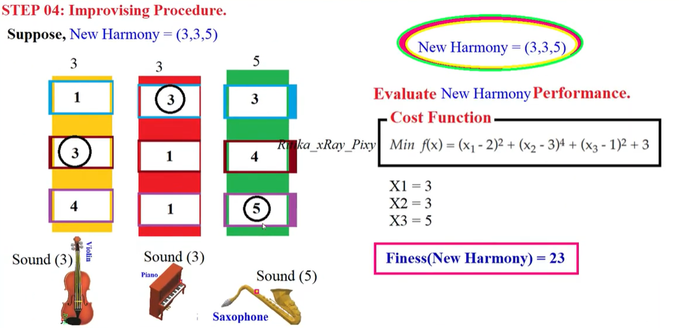
Harmony Search Algorithm Example 2

Slide 16
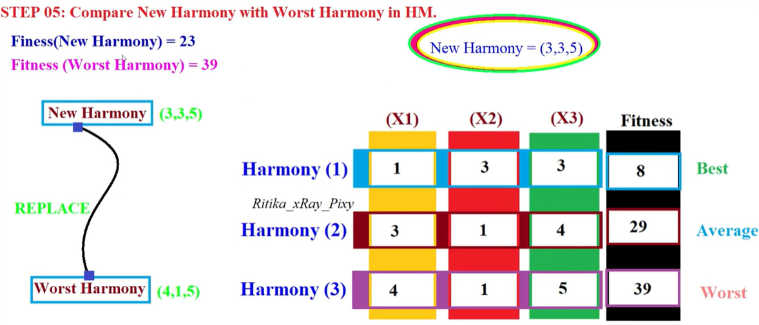
Harmony Search Algorithm Example 2

Slide 17
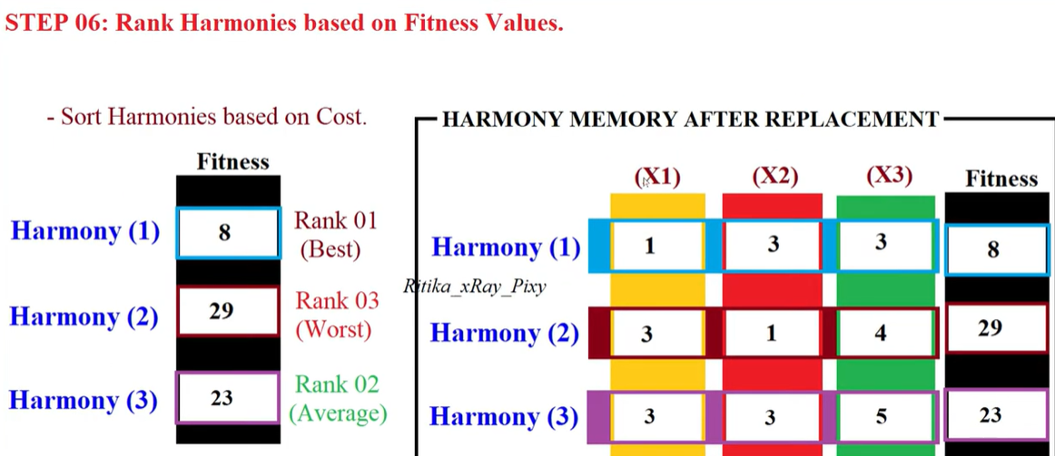
Harmony Search Algorithm Example 2

Slide 18
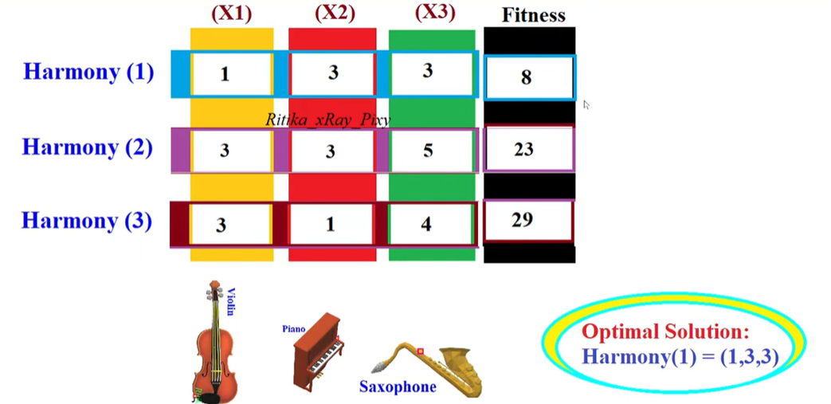
Harmony Search Algorithm Example 2

Slide 19
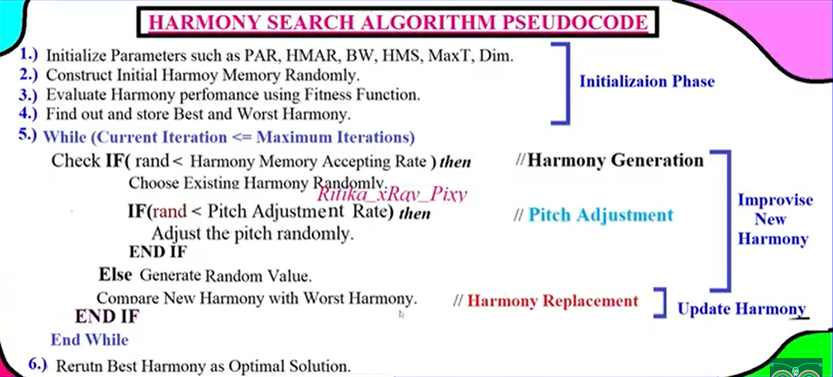
Harmony Search Algorithm

Slide 20
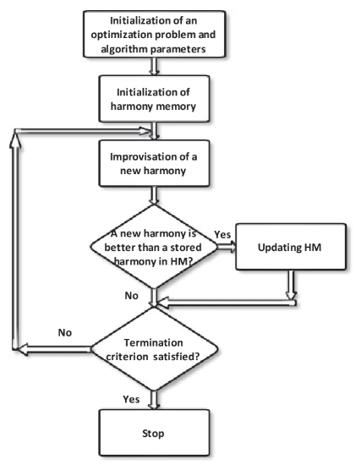
Flow Chart of Harmony Search Algorithm

