Slide 1


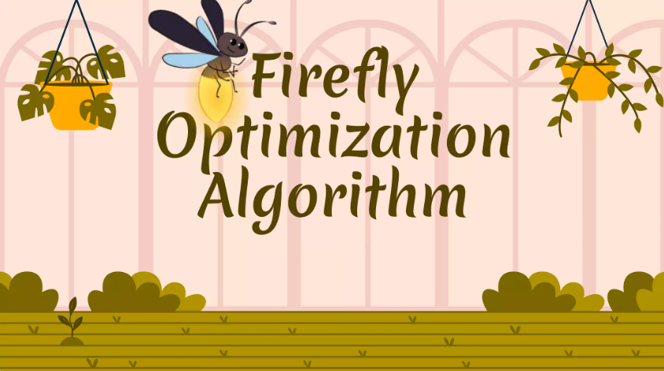
BMS COLLEGE OF ENGINEERING
Department of Machine Learning
Nature Inspired Computing
UNIT 04
Fire Fly Algorithm
Prof. Varsha R
Assistant Professor, Dept. of Machine Learning

Slide 2
Introduction
The Firefly Algorithm (FA) is a nature-inspired optimization algorithm based on the flashing behavior of fireflies.
Fireflies use bioluminescence to communicate and attract mates.
The algorithm simulates this behavior to optimize solutions to various optimization problems.
The following rules are used to describe the standard FA(Firefly Algorithm):
All fireflies are unisex, so one firefly will be attracted to other fireflies regardless of their sex.
Attractiveness is proportional to a firefly’s brightness. Thus for any two flashing fireflies, the less brighter one will move toward the brighter one. The attractiveness is proportional to the brightness, both of which decrease as their distance increases. If there is no brighter one than a particular firefly, it will move randomly.
The brightness of a firefly is affected or determined by the landscape of the objective function.

Slide 3
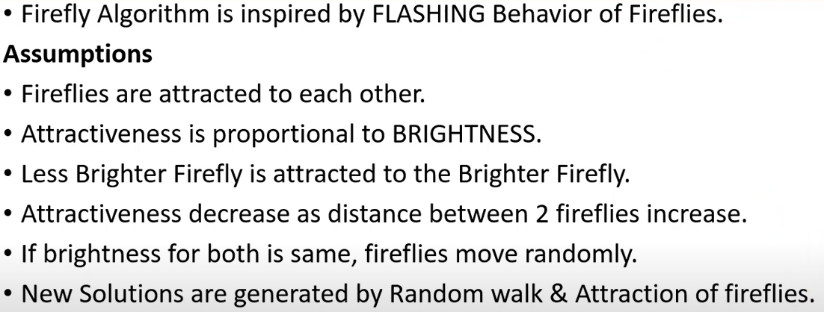
Assumptions

Slide 4
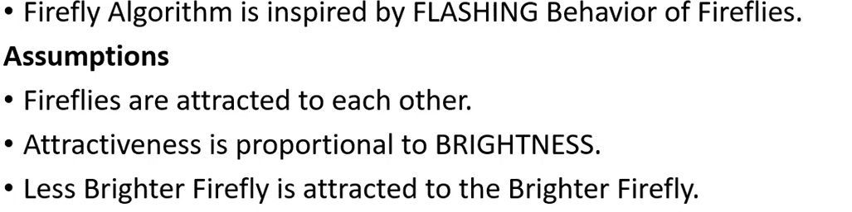
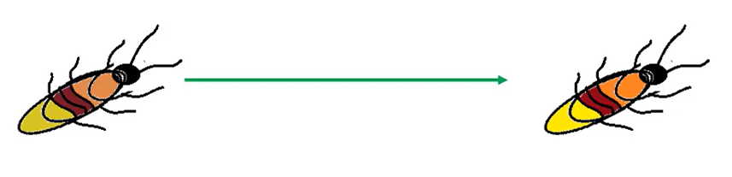

Assumption 1

Slide 5
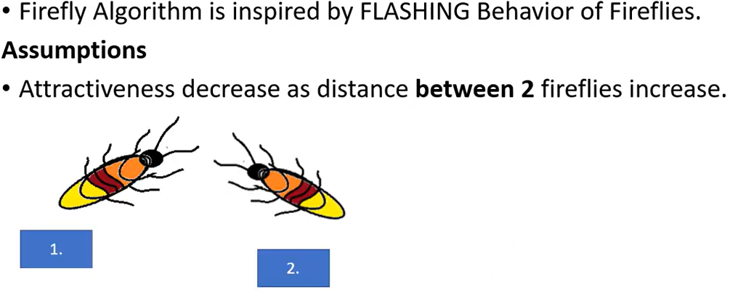
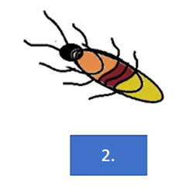
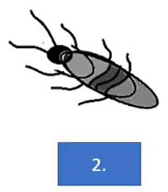
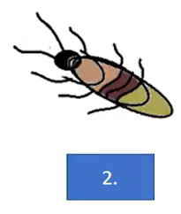
Assumption 2

Slide 6
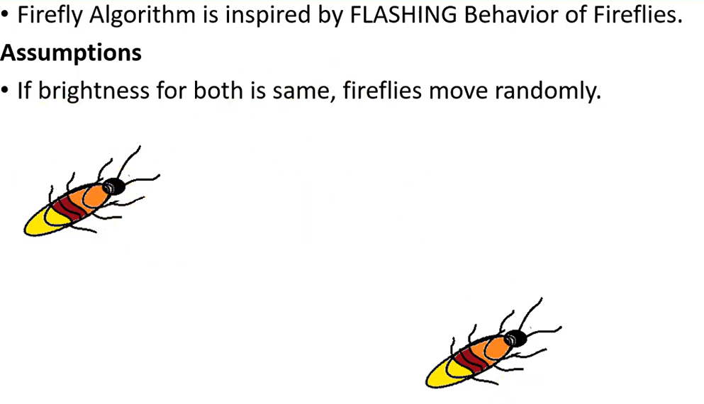
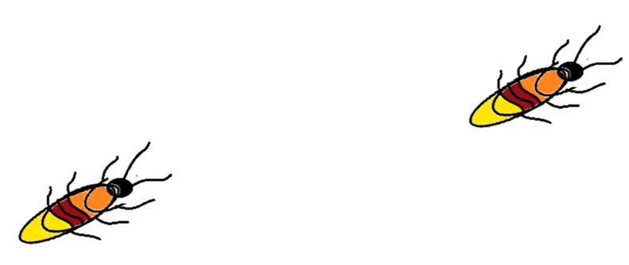
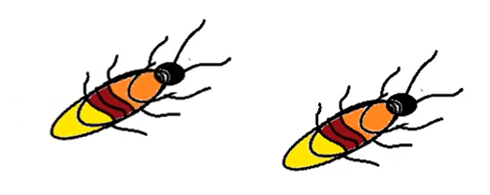
Assumption 3

Slide 7
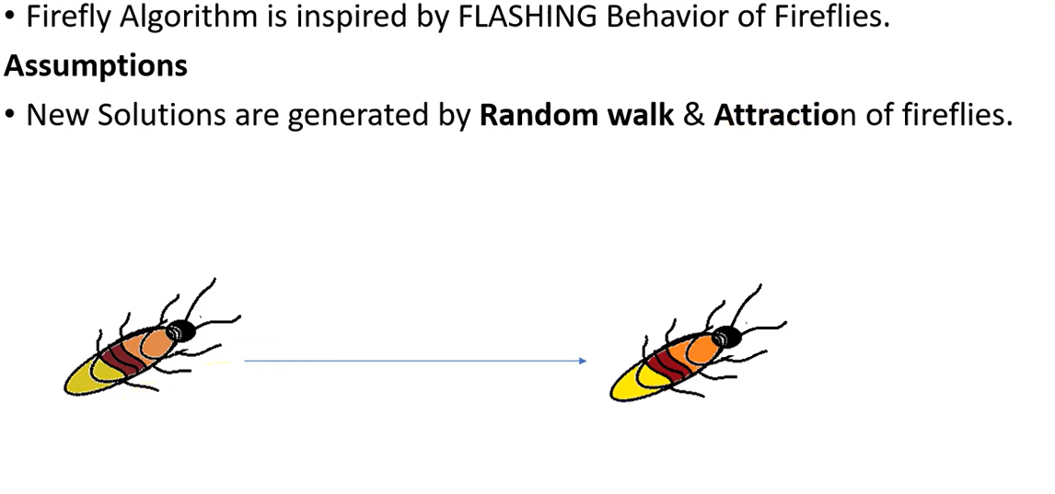

Assumption 4

Slide 8
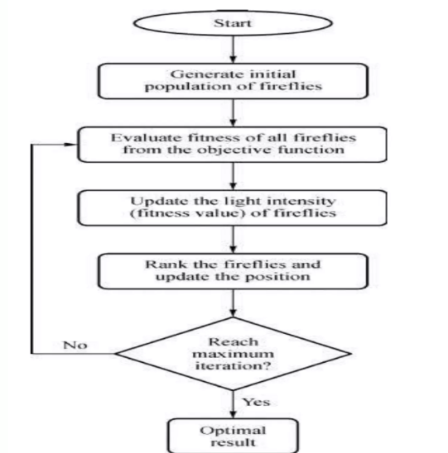
Flow chart of FA

Slide 9
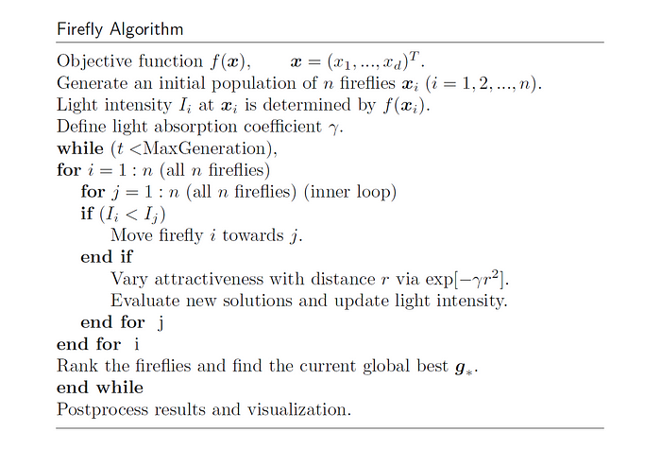
Fire Fly Algorithm

Slide 10
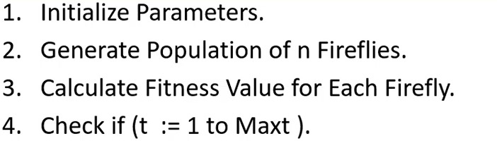
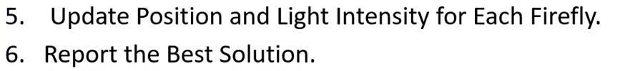
Fire Fly Optimization Algorithm Explanation

Slide 11
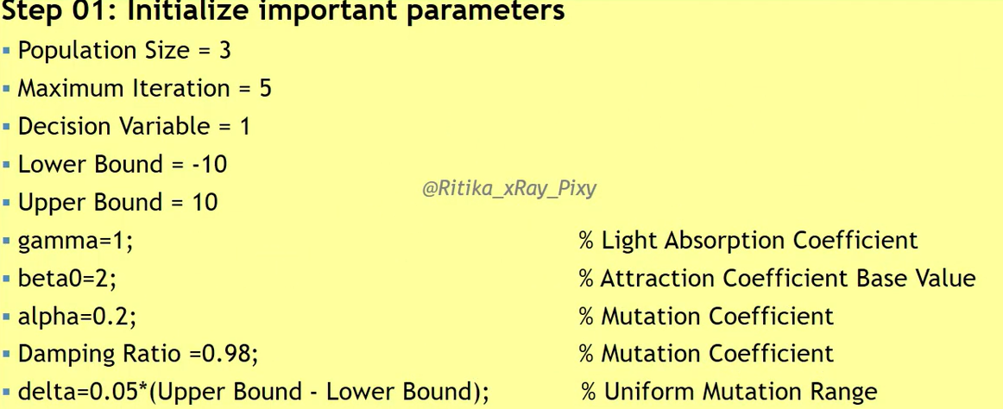
Example 1

Slide 12
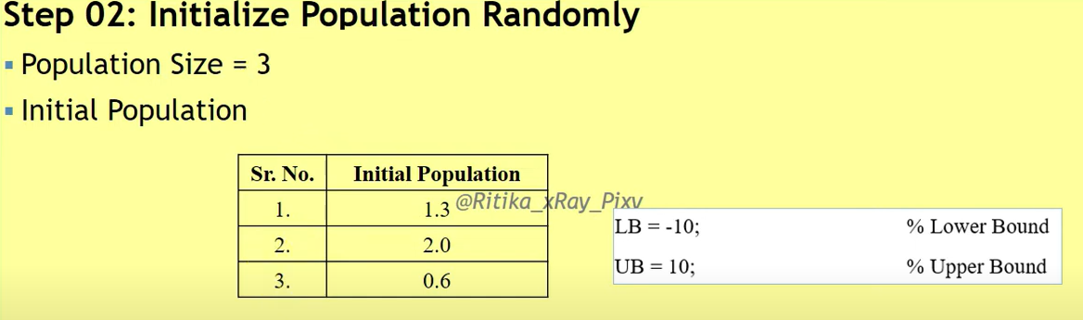
Example 1

Slide 13
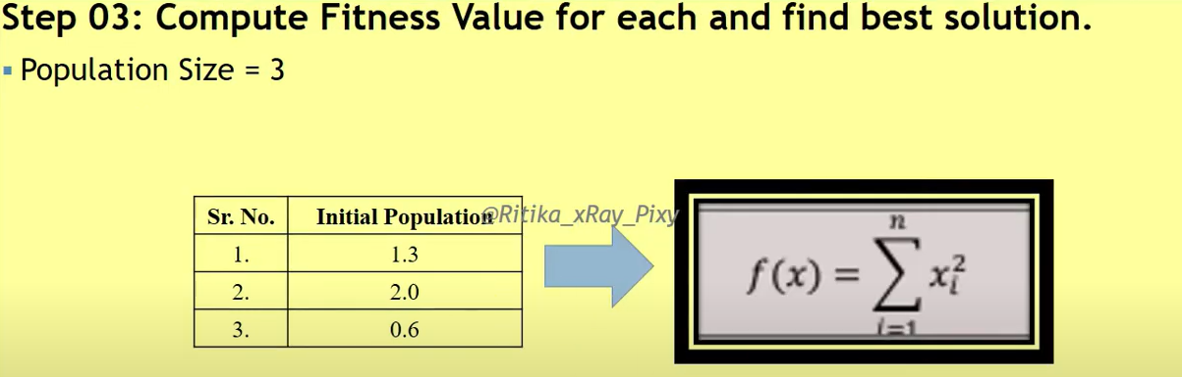
Example 1

Slide 14
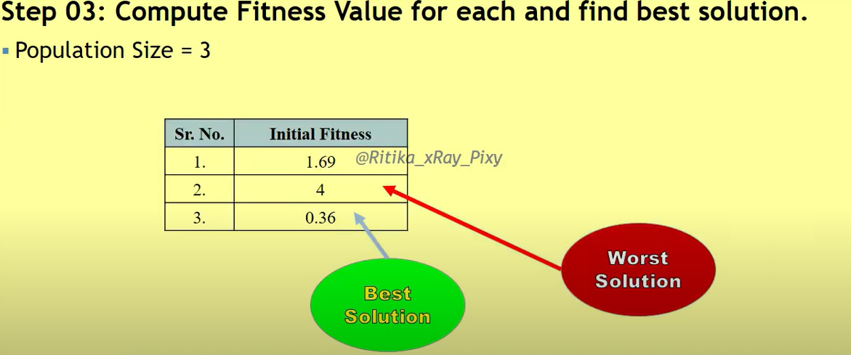
Example 1

Slide 15
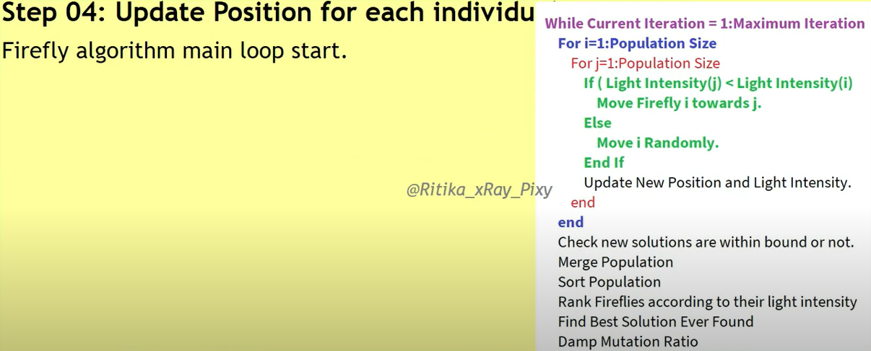
Example 1

Slide 16
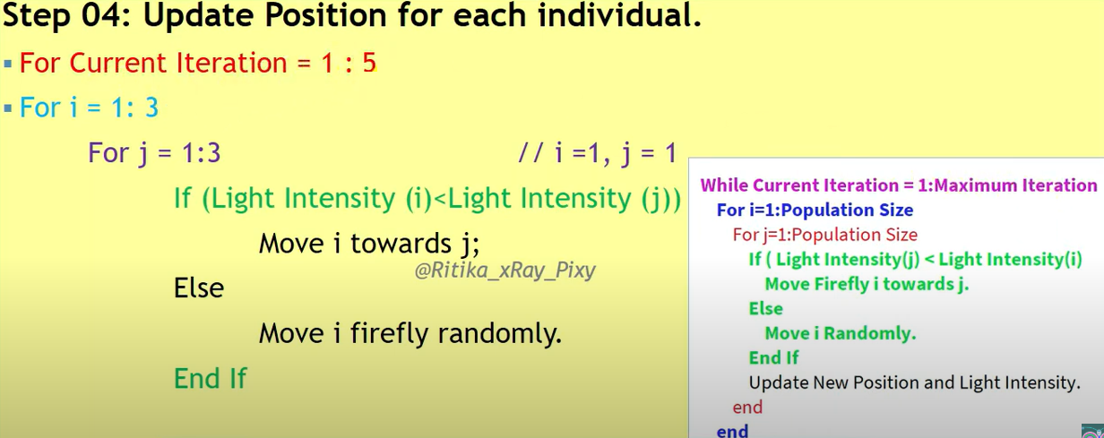
Example 1

Slide 17
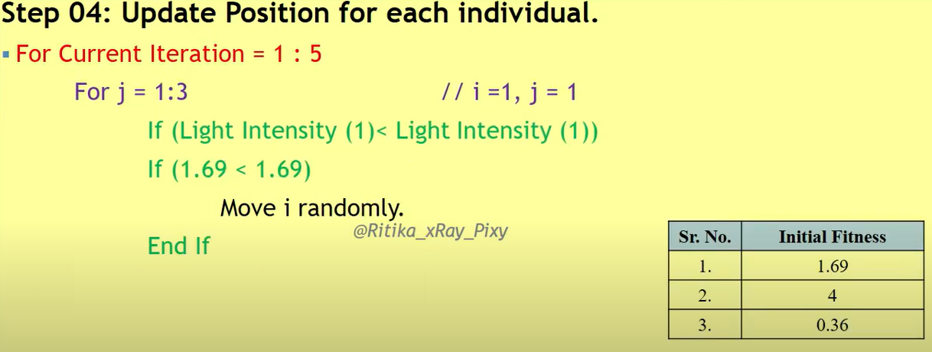
Example 1

Slide 18
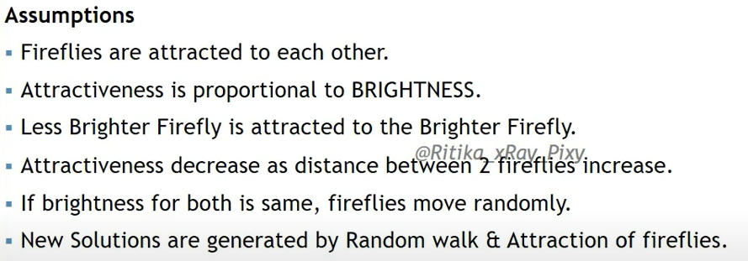
Example 1

Slide 19
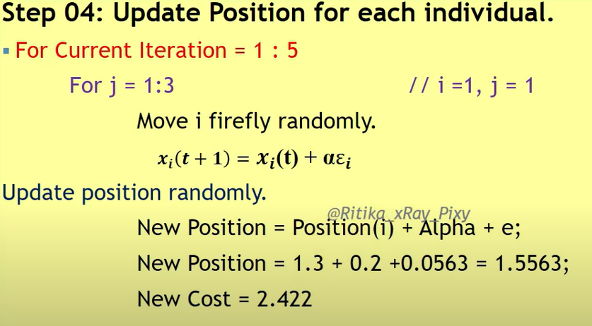
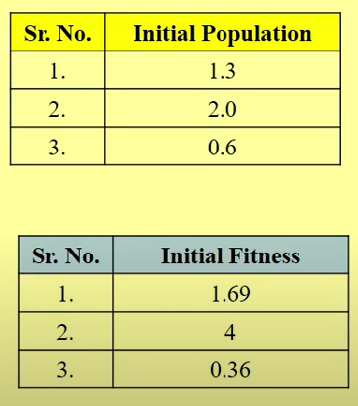

Example 1
(
*
)

Slide 20
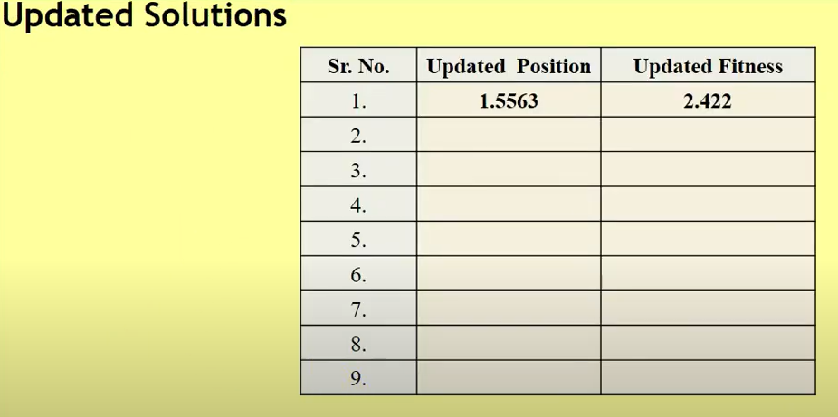
Example 1

Slide 21
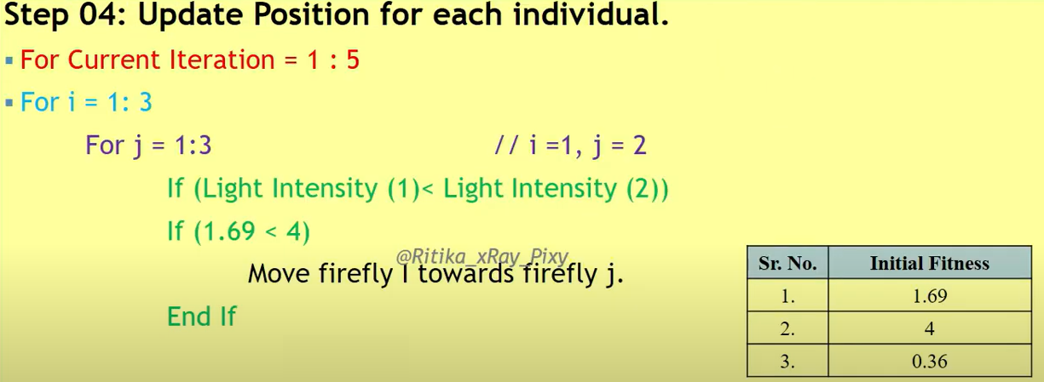
Example 1

Slide 22
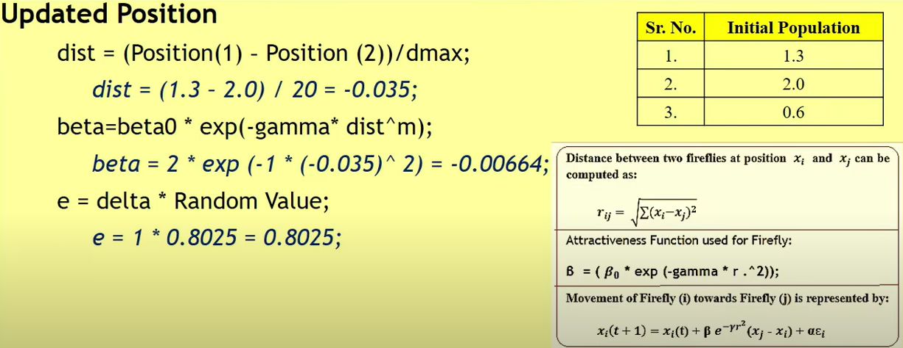
Example 1

Slide 23
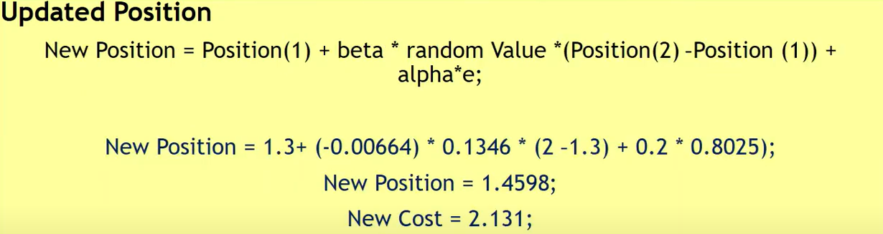
Example 1

Slide 24

Example 1

Slide 25
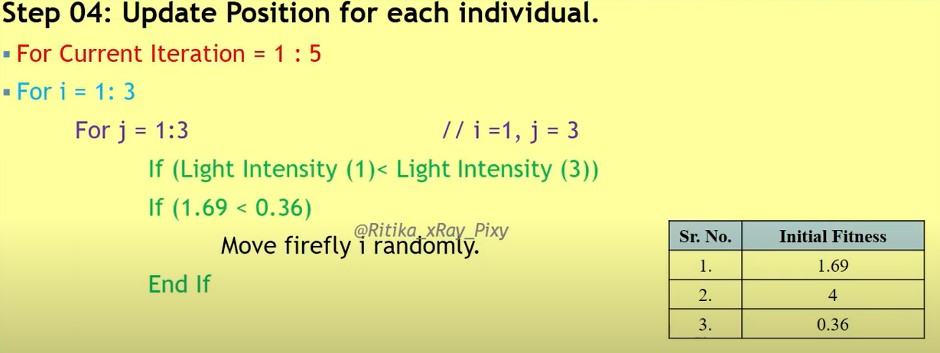
Example 1

Slide 26
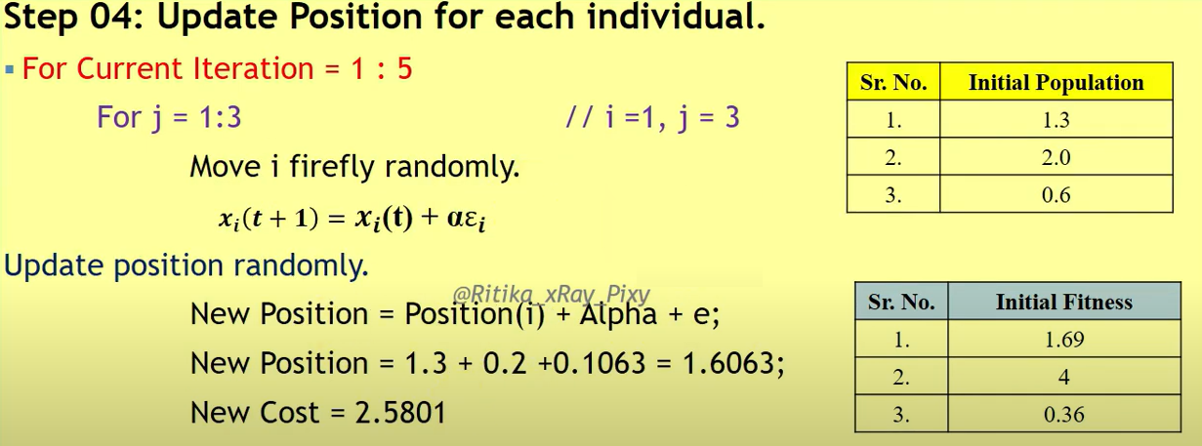
Example 1

Slide 27
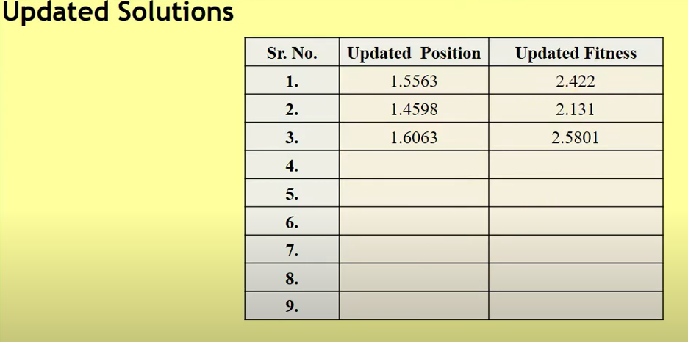
Example 1

Slide 28
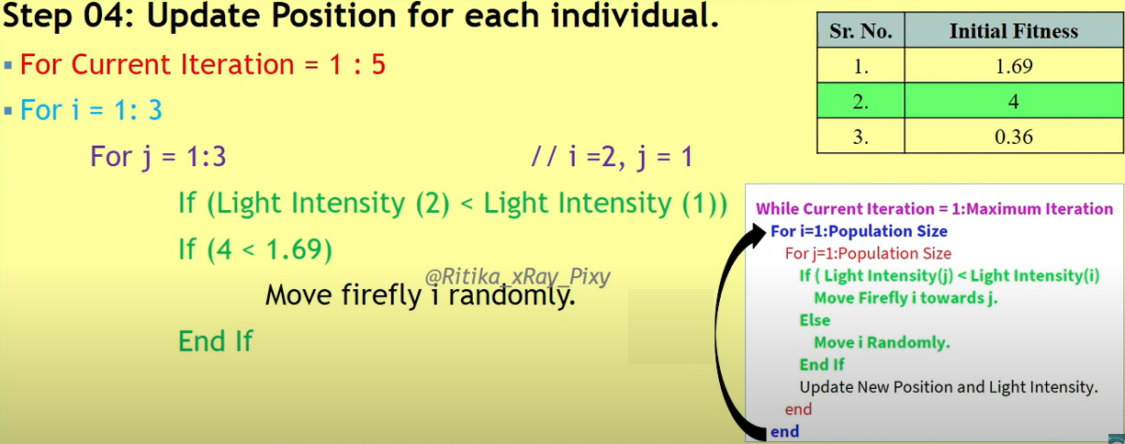
Example 1

Slide 29
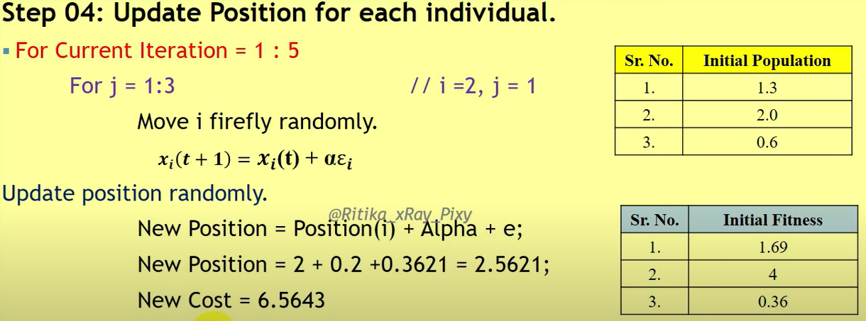
Example 1

Slide 30
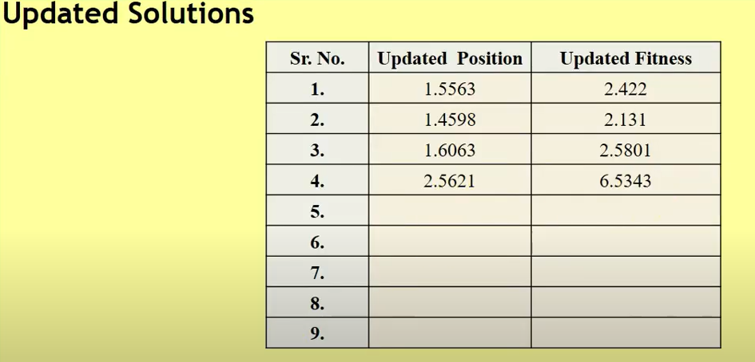
Example 1

Slide 31
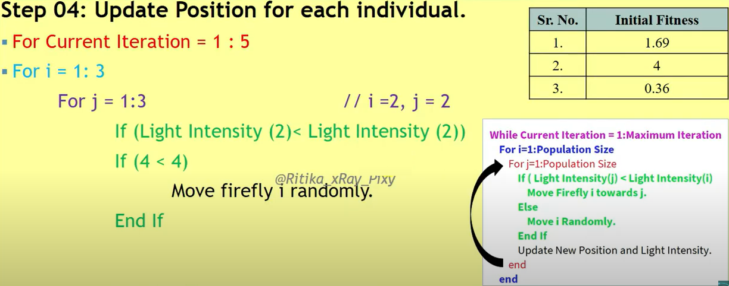
Example 1

Slide 32
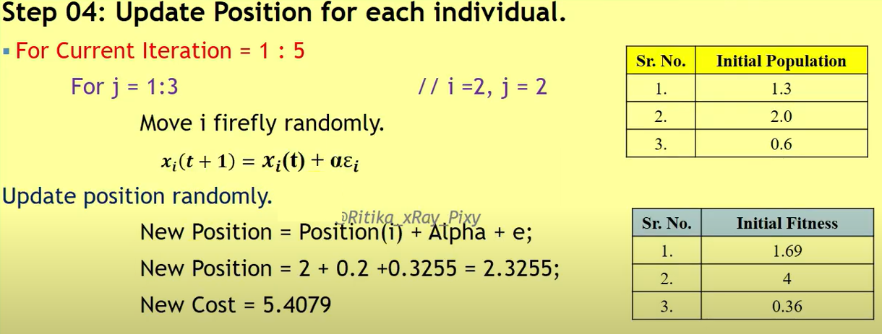
Example 1

Slide 33
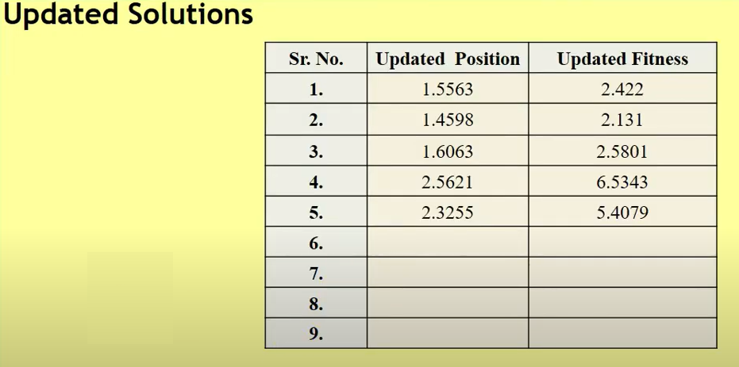
Example 1

Slide 34
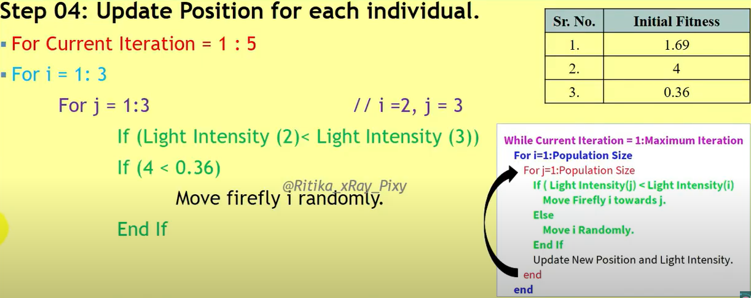
Example 1

Slide 35
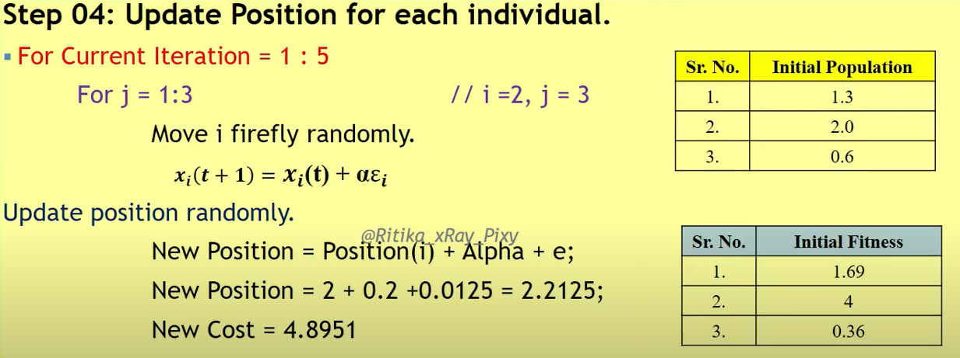

Example 1

Slide 36
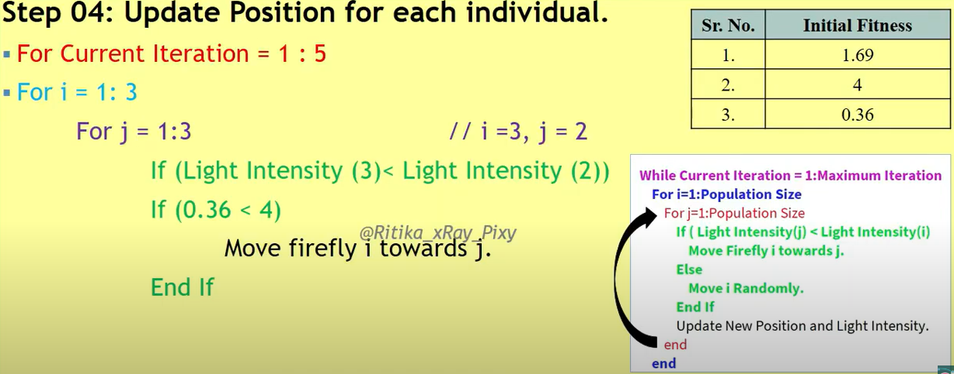
Example 1

Slide 37
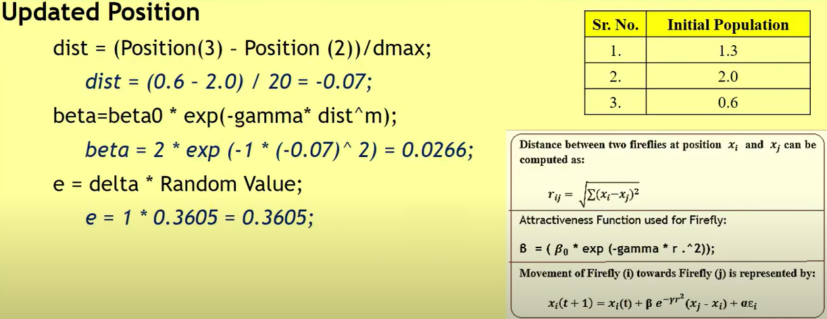
Example 1

Slide 38
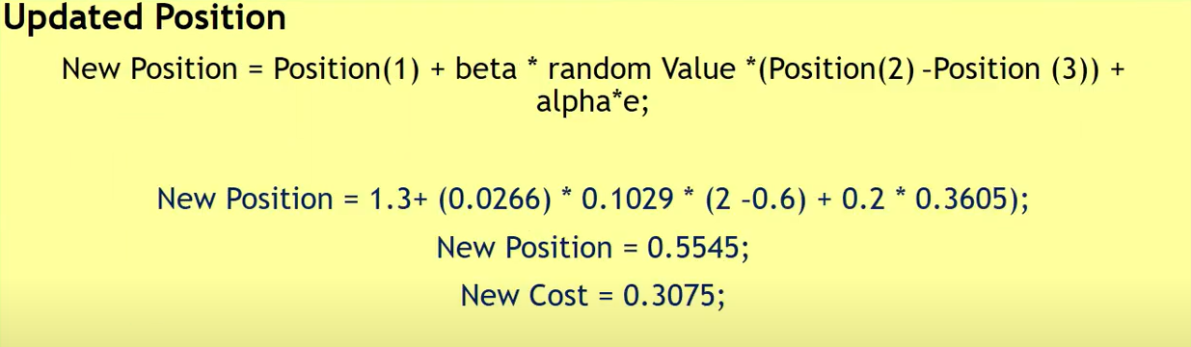
Example 1

Slide 39
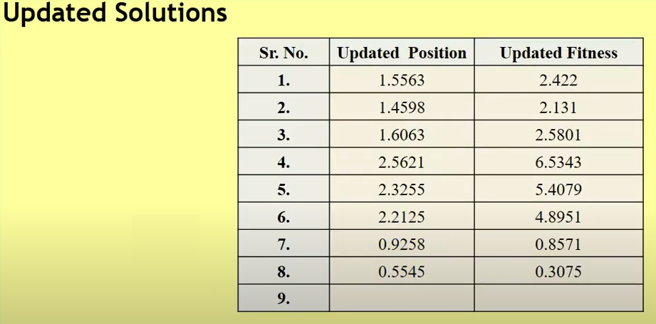
Example 1

Slide 40
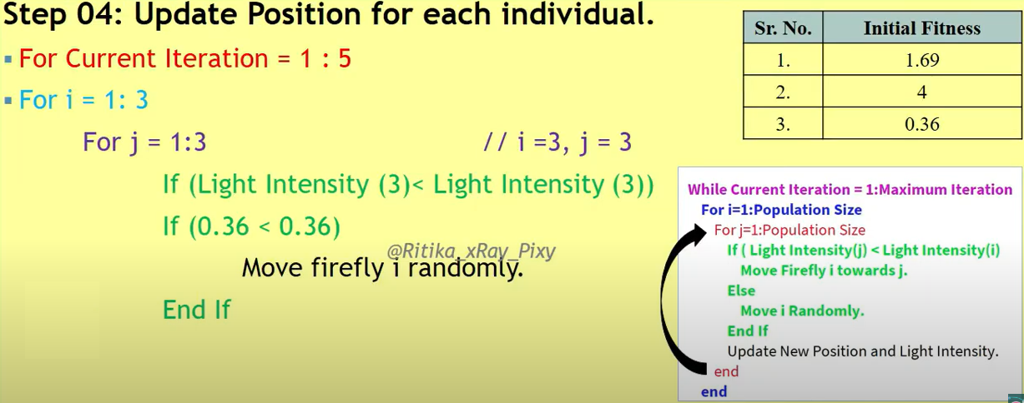
Example 1

Slide 41
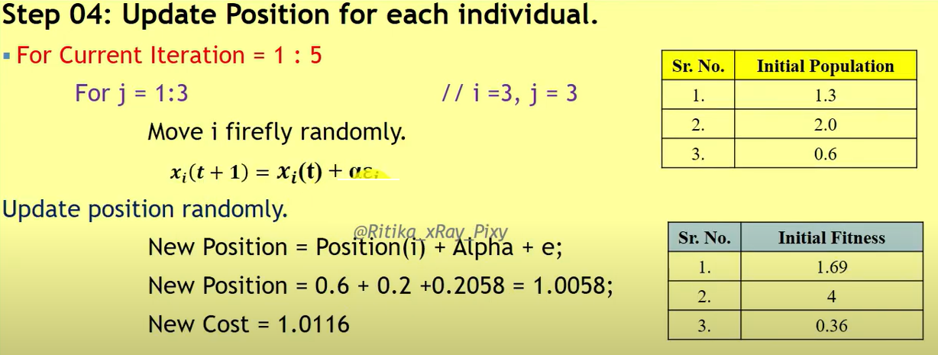
Example 1

Slide 42
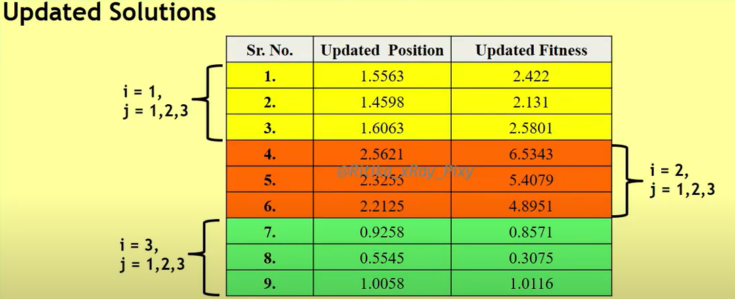
Example 1

Slide 43

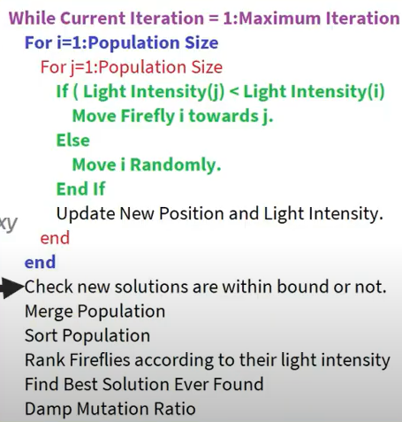
Example 1

Slide 44

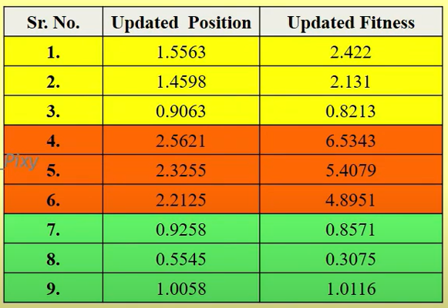
Example 1

Slide 45

Example 1

Slide 46


Example 1

Slide 47


Example 1

Slide 48



Example 1

Slide 49


Example 1

Slide 50


Example 1

Slide 51

Example 1

Slide 52

Example 1

Slide 53
Applications of Fire Fly Algorithm
Digital image compression and image processing: Digital image compression and image processing requires solution of optimization problems. In this context, trapped local optima is optimized by using firefly algorithm.
Feature selection and fault detection: Firefly algorithm has been used for discriminative feature selection in classification and regression models to support decision making process using data-based learning methods.
Biomedical and healthcare: Firefly algorithm has been utilized in important medical fields such as breast cancer classification, human retinal images, breast tumor classification, detection of brain tumor, health monitoring, etc.
Clustering: Firefly algorithm has been used to determine optimum number of clusters and to improve the performance of clustering.
Semantic web composition: Firefly algorithm has been used to determine optimal solution in semantic web services.

Slide 54

Example 2

Slide 55

Example 2

Slide 56

Computation in Matlab

Slide 57

Example 2

Slide 58

Example 2

Slide 59

Example 2

Slide 60

Example 2

Slide 61

Example 2

Slide 62

Example 2

Slide 63

Example 2

Slide 64

Example 2

Slide 65


Example 2

Slide 66

Example 2

Slide 67


Example 2

Slide 68

Example 2

Slide 69

Example 2

Slide 70

Example 2

Slide 71

Example 2

Slide 72

Example 2

Slide 73


Example 2

Slide 74

Example 2

Slide 75

Example 2

Slide 76

Example 2

Slide 77

Example 2

Slide 78

Example 2

Slide 79

Example 2

Slide 80

Example 2

Slide 81

Example 2

Slide 82


Example 2

Slide 83

Example 2

Slide 84

Example 2

Slide 85

Example 2

Slide 86

Example 2

Slide 87

Example 2

Slide 88

Example 2

Slide 89

Example 2

Slide 90

Example 2

