Slide 1


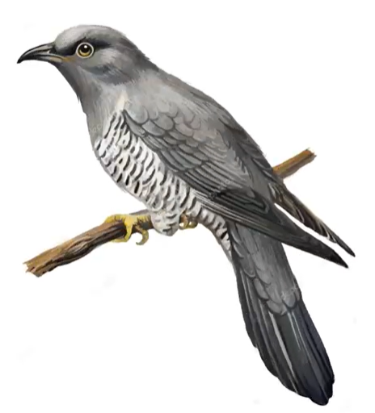
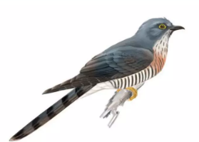
BMS COLLEGE OF ENGINEERING
Department of Machine Learning
Nature Inspired Computing
UNIT 04
Cuckoo Search Algorithm
Prof. Varsha R
Assistant Professor, Dept. of Machine Learning

Slide 2
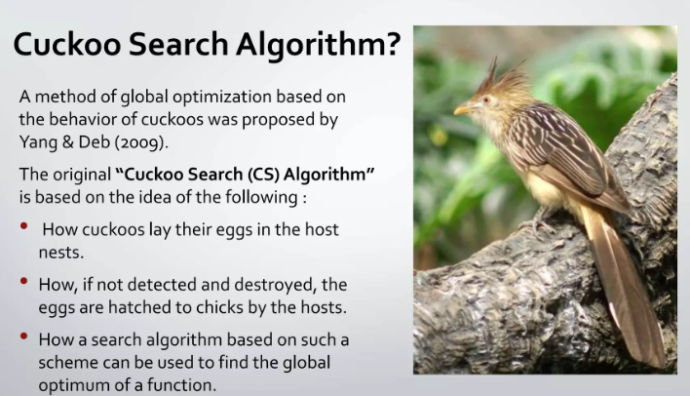
Introduction

Slide 3
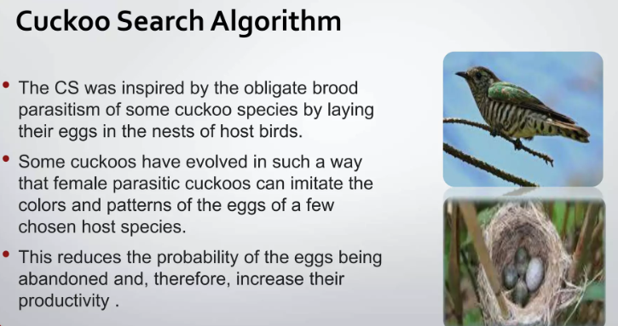
Cuckoo Search Algorithm

Slide 4
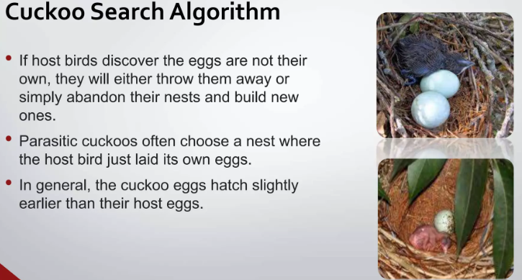
Cuckoo Search Algorithm

Slide 5
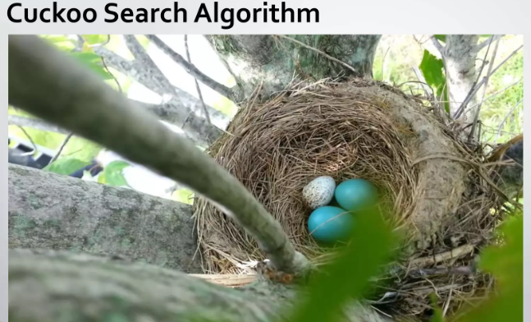
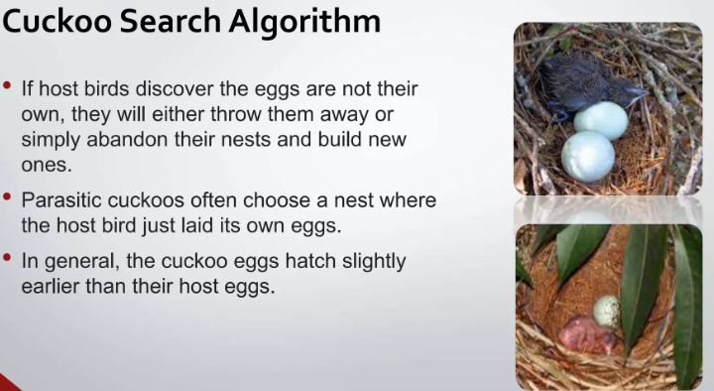
Cuckoo Search Algorithm

Slide 6
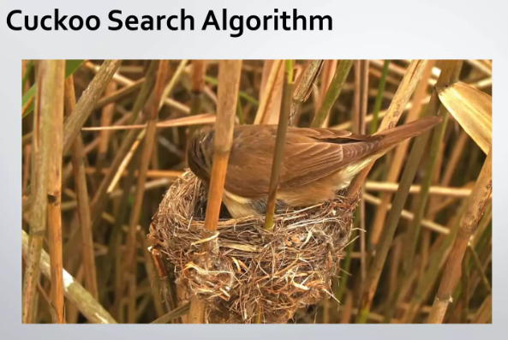
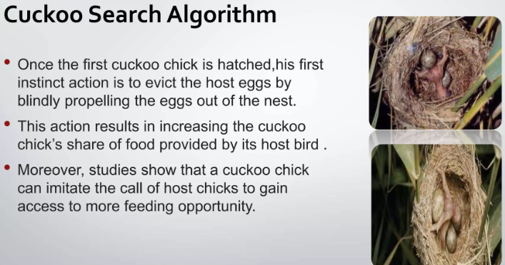
Cuckoo Search Algorithm

Slide 7
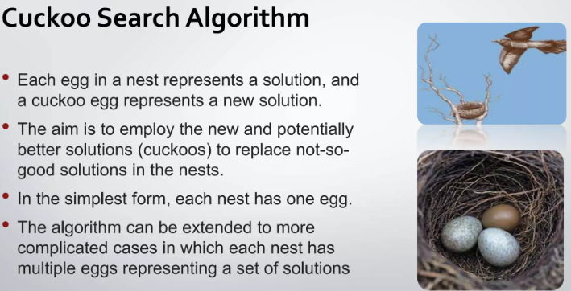
Cuckoo Search Algorithm

Slide 8
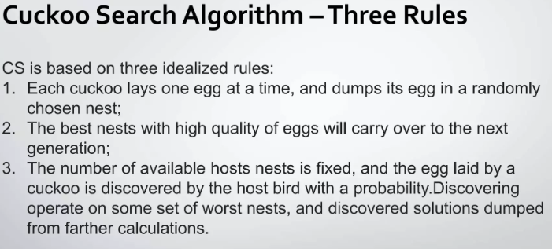
Three Important Rules in Cuckoo Search

Slide 9
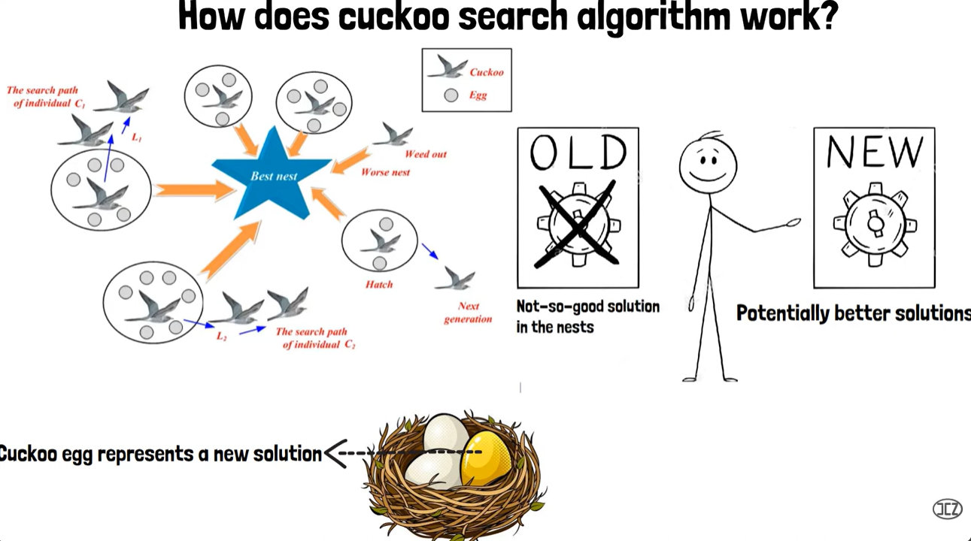
How does Cuckoo Search Algorithm Works?

Slide 10
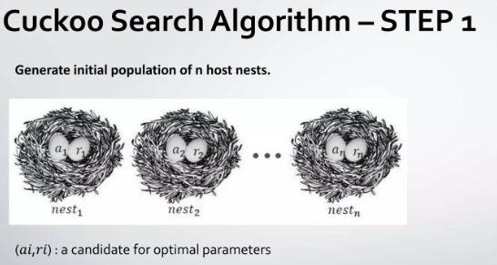
Steps in Cuckoo Search Algorithm

Slide 11
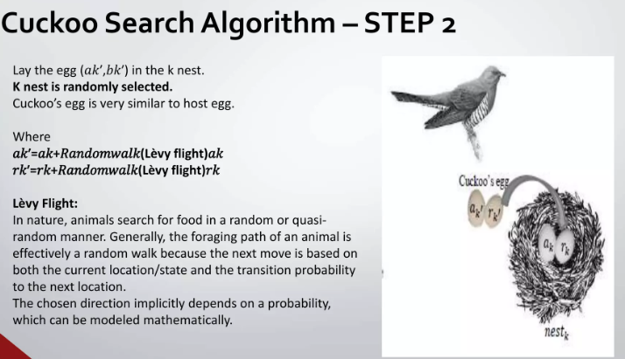
Steps in Cuckoo Search Algorithm

Slide 12
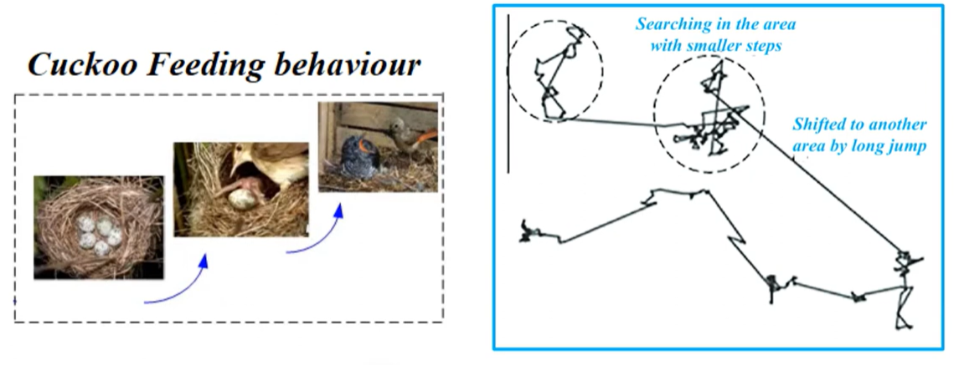
Steps in Cuckoo Search Algorithm

Slide 13
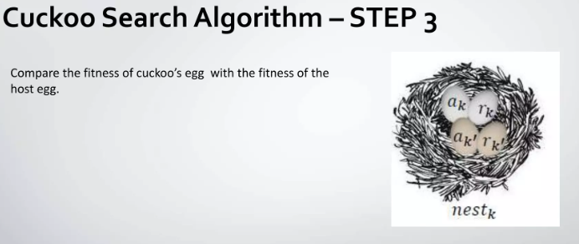
Steps in Cuckoo Search Algorithm

Slide 14
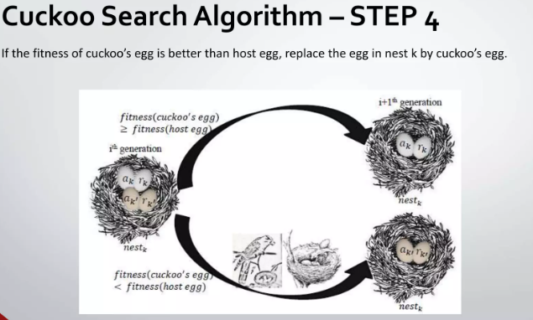
Steps in Cuckoo Search Algorithm

Slide 15
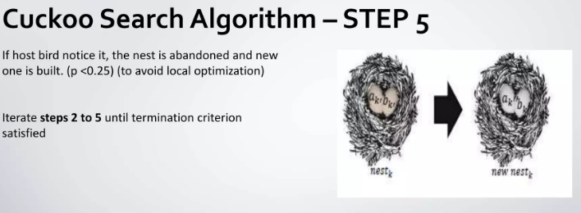
Steps in Cuckoo Search Algorithm

Slide 16
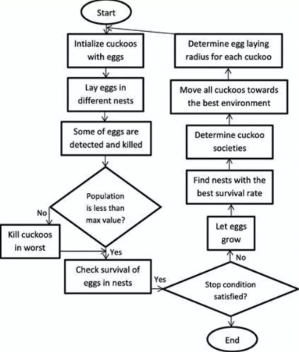
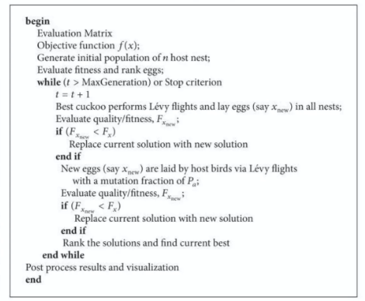
Flow Chart and Pseudo code of CS

Slide 17
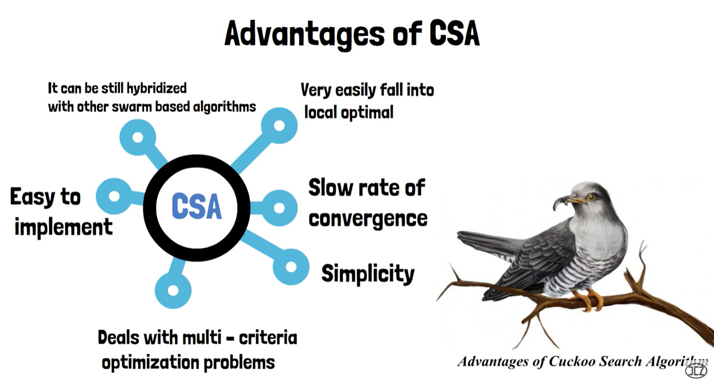
Advantages of CSA

Slide 18
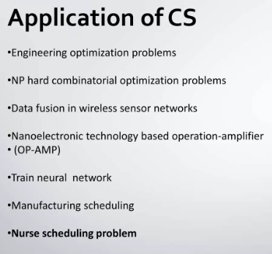
Applications of CS

