Slide 1

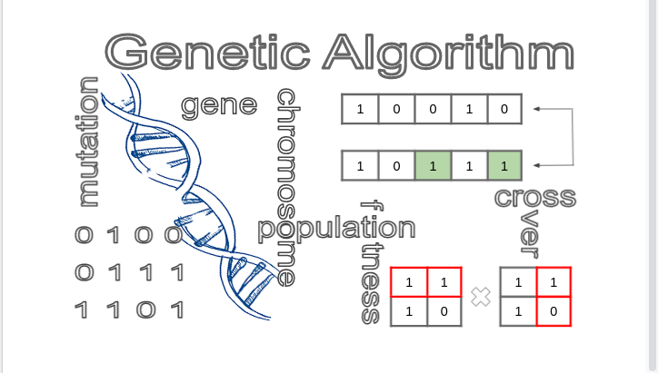
B.M.S College of Engineering
Department of Machine Learning
Nature Inspired Computing
UNIT 03
Genetic Algorithm
Prof. VARSHA R
Asst. Prof, Dept. of MEL, BMSCE

Slide 2
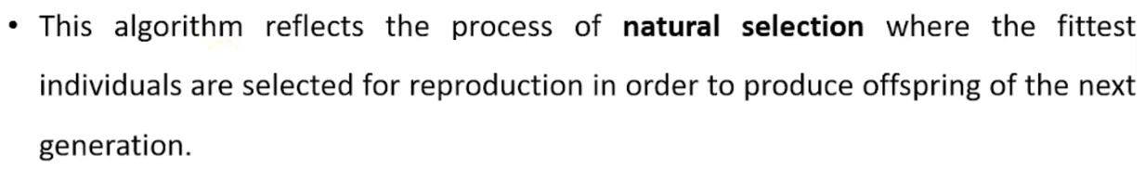
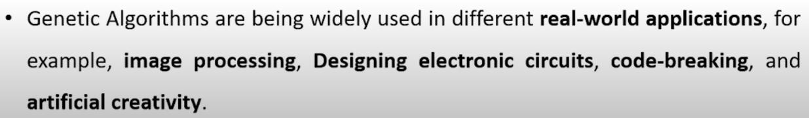
Introduction

Slide 3
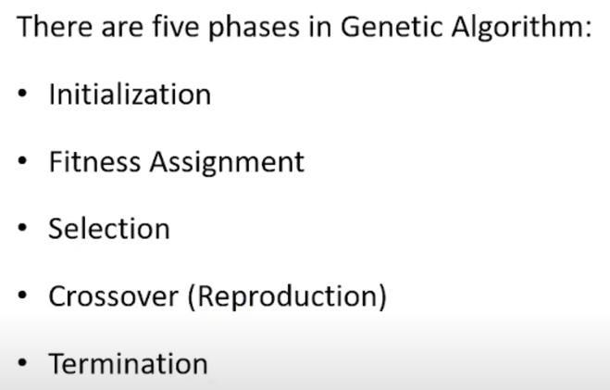
How Genetic Algorithm works?

Slide 4

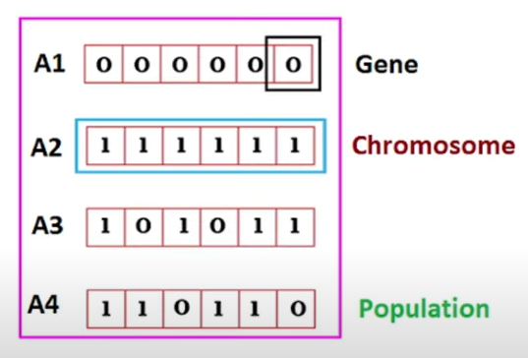
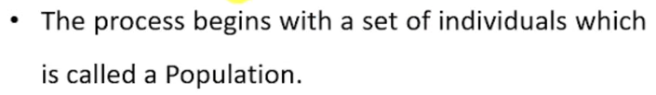

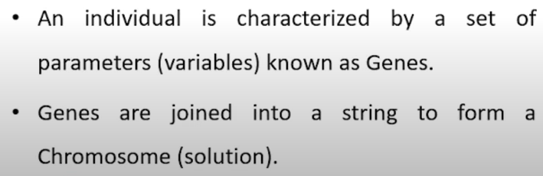
Step 1 Initial Population

Slide 5

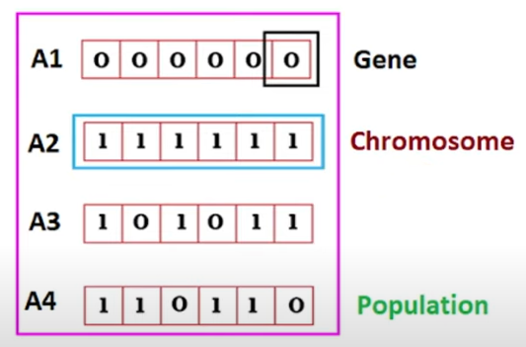
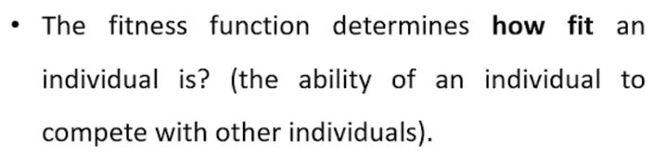


Step 2 Fitness Function

Slide 6

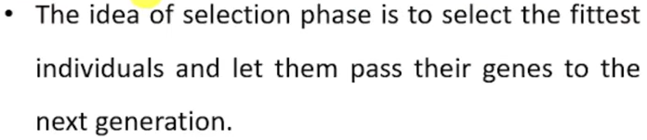
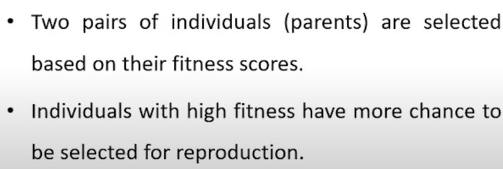
Step 3 Selection

Slide 7
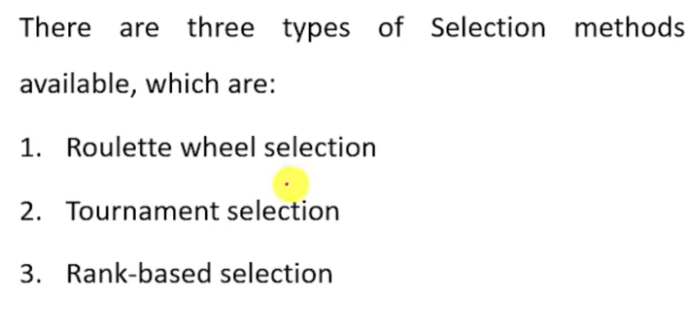

Step 3 Selection

Slide 8

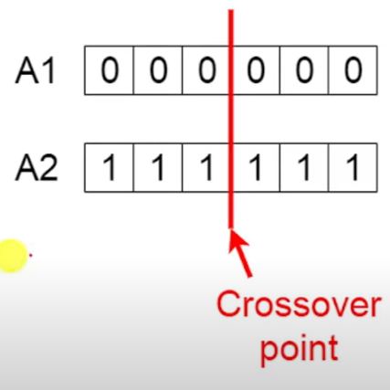
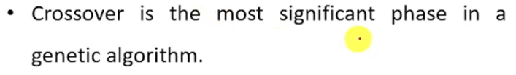

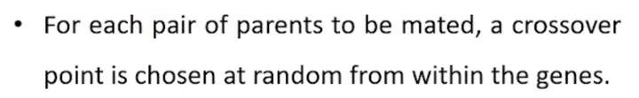
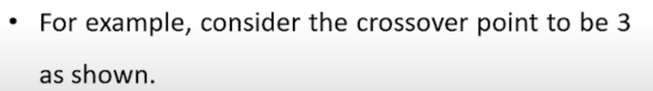

Step 4 Crossover

Slide 9

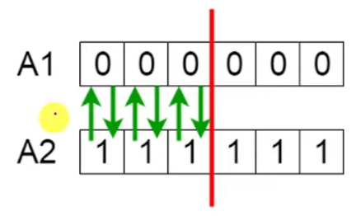
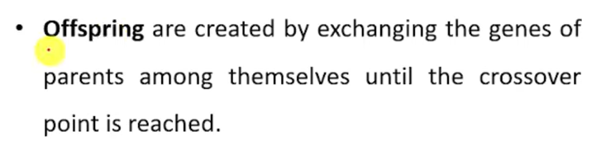


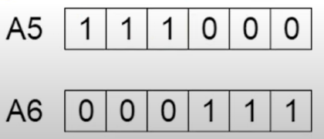
Step 5 Offspring

Slide 10

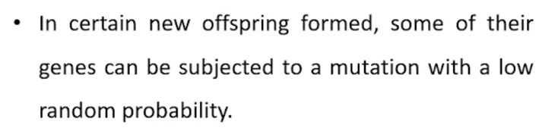
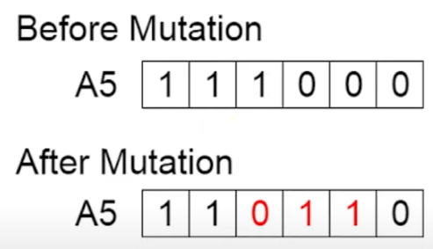

Step 6 Mutation

Slide 11
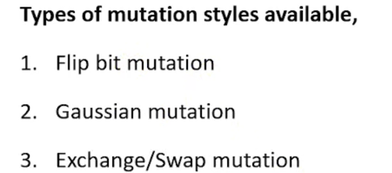
Step 6 Mutation

Slide 12

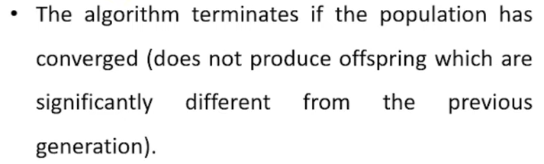
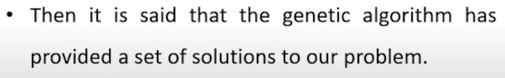
Step 7 Termination

Slide 13
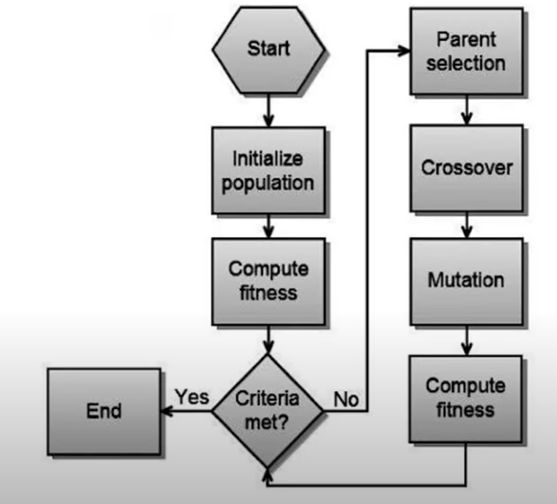
Working of Genetic Algorithm

Slide 14
Pseudo Code for Genetic Algorithm
1) Randomly initialize populations p
2) Determine fitness of population
3) Until convergence repeat:
a) Select parents from population
b) Crossover and generate new population
c) Perform mutation on new population
d) Calculate fitness for new population

Slide 15
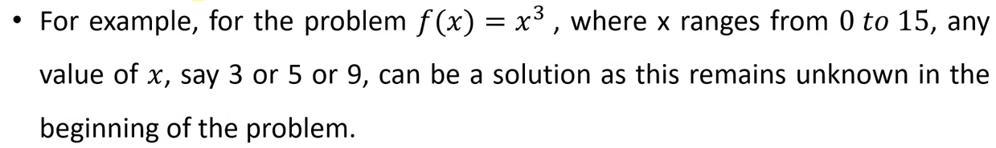
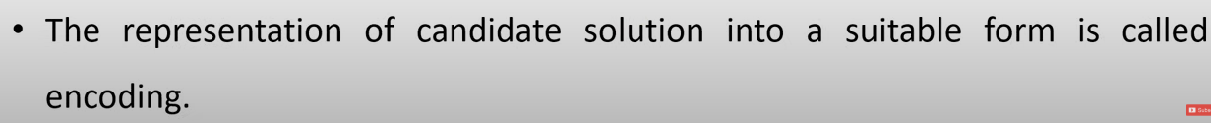
Encoding Techniques in Genetic Algorithm

Slide 16

Binary Encoding

Slide 17
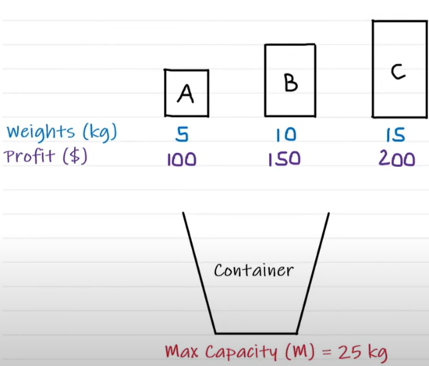
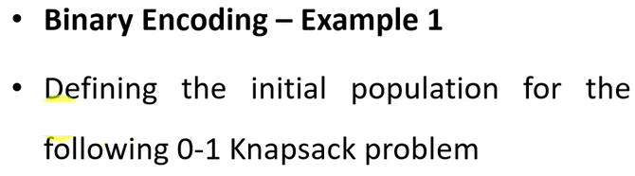
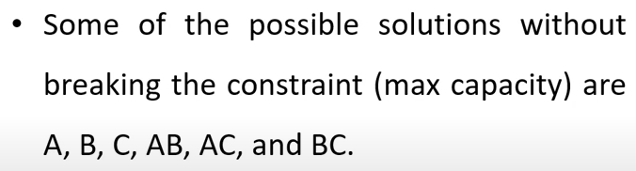
Binary Encoding

Slide 18
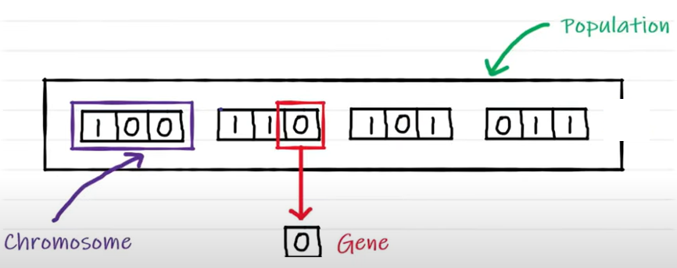
Binary Encoding Example 1

Slide 19

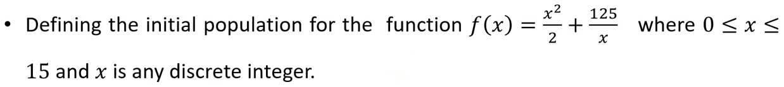

Binary Encoding Example 2

Slide 20


Value Encoding

Slide 21


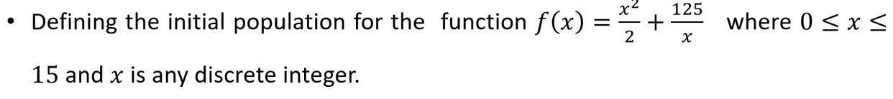

Value Encoding Example 1

Slide 22
Permutation (or order) Encoding

Slide 23
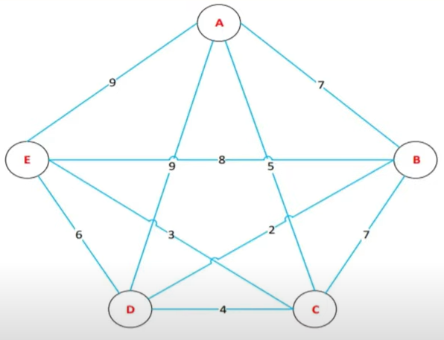
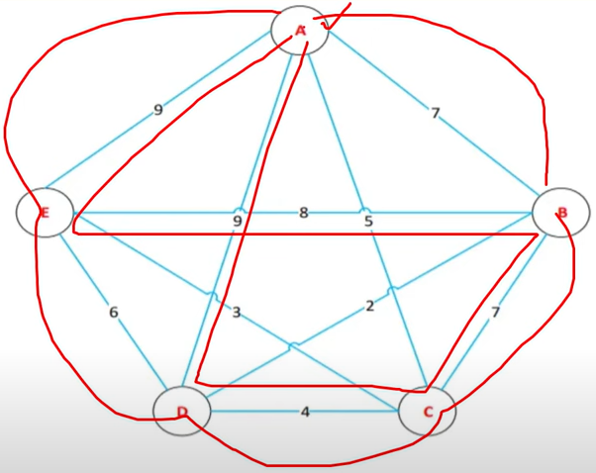
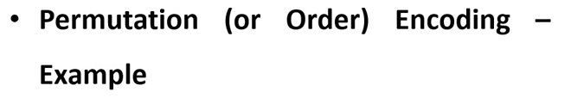
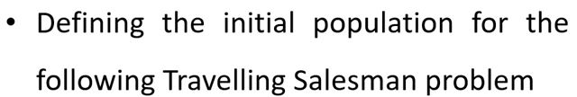

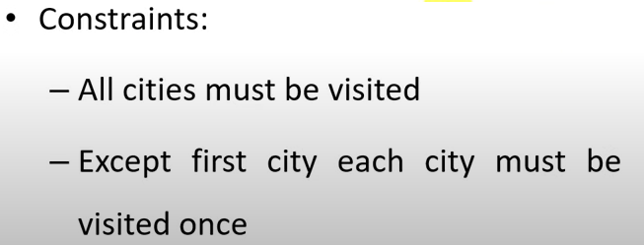
Permutation (or order) Encoding Example 1

Slide 24

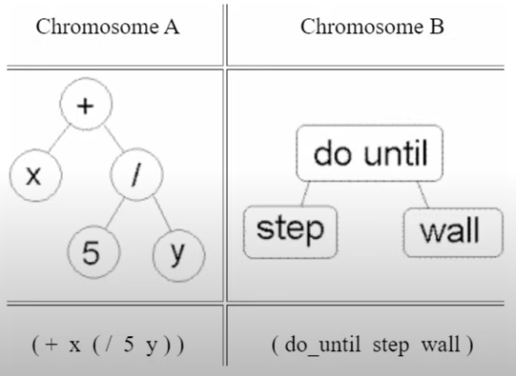
Tree Encoding

Slide 25
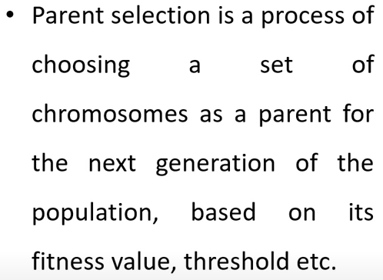
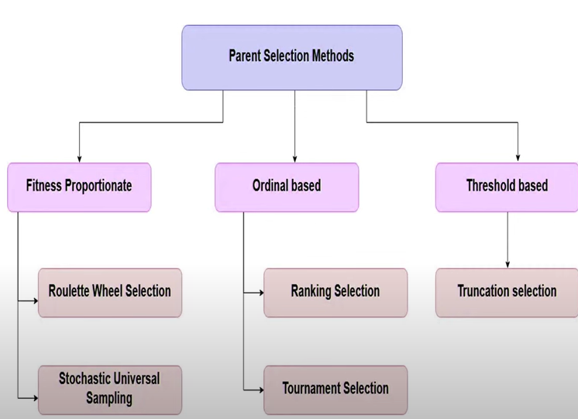
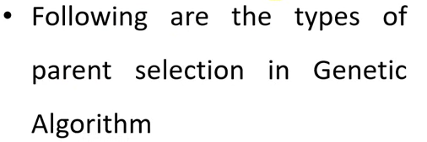
Parent Selection Operators

Slide 26
Fitness Proportionate Selection

Slide 27

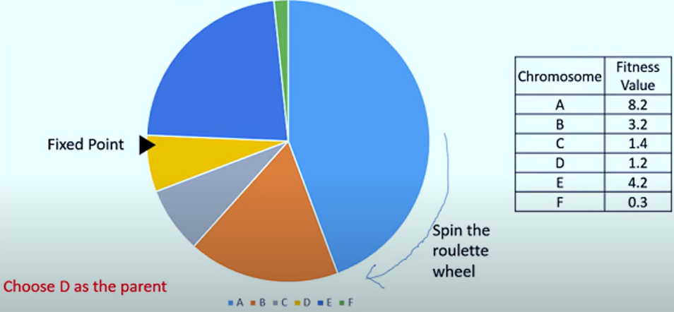
Roulette Wheel Selection

Slide 28
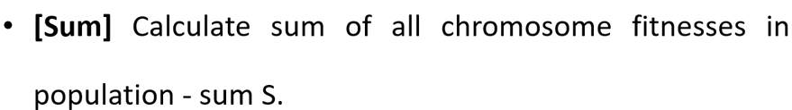
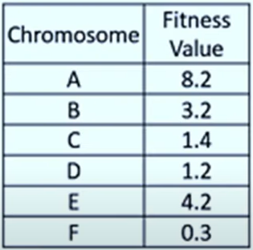
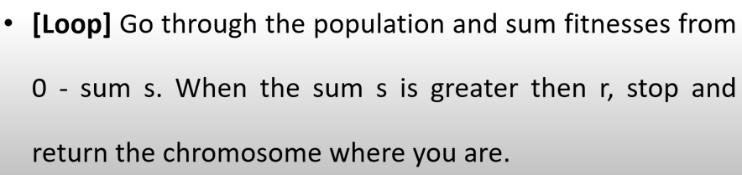
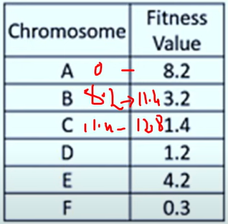
Roulette Wheel Selection

Slide 29
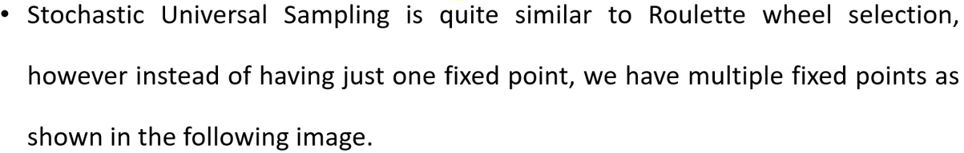
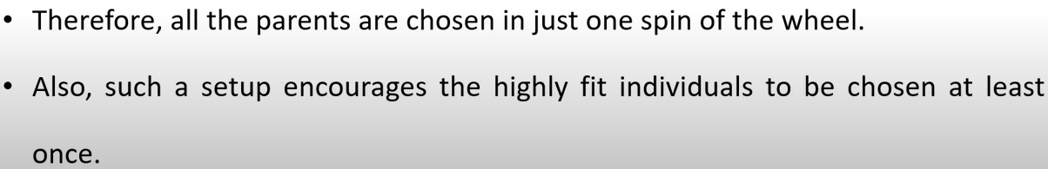
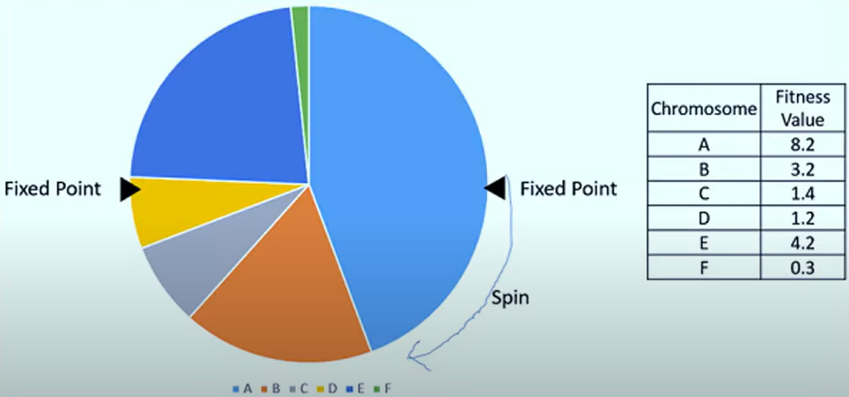
Stochastic Universal Sampling (SUS)

Slide 30



Ranking Selection

Slide 31


Ranking Selection

Slide 32





Tournament Selection

Slide 33

Truncation Selection

Slide 34

Crossover Operators

Slide 35

Binary Coded Crossover Operators

Slide 36

Single Point Crossover

Slide 37



Single Point Crossover

Slide 38

Two Point Crossover

Slide 39



Two Point Crossover

Slide 40

Two Point Crossover

Slide 41

Multi Point Crossover

Slide 42



Multi Point Crossover

Slide 43

Multi Point Crossover

Slide 44

Uniform Crossover

Slide 45

Uniform Crossover

Slide 46

Uniform Crossover

Slide 47

Half- Uniform Crossover

Slide 48


Half- Uniform Crossover

Slide 49

Uniform Crossover with Crossover Mask (CM)

Slide 50

Uniform Crossover with Crossover Mask (CM)

Slide 51



Uniform Crossover with Crossover Mask (CM)

Slide 52

Shuffle Crossover

Slide 53


Shuffle Crossover

Slide 54

Shuffle Crossover

Slide 55

Three Parent Crossover

Slide 56


Three Parent Crossover

Slide 57
Three Parent Crossover

Slide 58

Real Coded Crossover Operators

Slide 59

Single Arithmetic Crossover

Slide 60

Single Arithmetic Crossover

Slide 61

Single Arithmetic Crossover

Slide 62




Single Arithmetic Crossover

Slide 63

Linear Crossover

Slide 64

Linear Crossover

Slide 65

Linear Crossover

Slide 66



Linear Crossover

Slide 67

Linear Crossover

Slide 68

Order Coded Crossover Operator

Slide 69

Partially Mapped Crossover

Slide 70

Partially Mapped Crossover

Slide 71

Partially Mapped Crossover

Slide 72

Partially Mapped Crossover

Slide 73


Partially Mapped Crossover

Slide 74




Cycle Crossover

Slide 75

Cycle Crossover

Slide 76


Mutation Operators

Slide 77


Mutation Operators

Slide 78


Bit Flip Mutation

Slide 79


Random Resetting

Slide 80

Swap Mutation

Slide 81

Scramble Mutation

Slide 82

Inversion Mutation

Slide 83

Stopping Condition for Genetic Algorithm Flow

Slide 84


Stopping Condition for Genetic Algorithm Flow

Slide 85



Problem Solving Using GA- Example 1

Slide 86


Problem Solving Using GA- Example 1

Slide 87




Problem Solving Using GA- Example 1

Slide 88



Problem Solving Using GA- Example 1

Slide 89

Problem Solving Using GA- Example 1

Slide 90



Problem Solving Using GA- Example 1

Slide 91


Problem Solving Using GA- Example 1

Slide 92


Problem Solving Using GA- Example 1

Slide 93

Problem Solving Using GA- Example 1

Slide 94


Problem Solving Using GA- Example 1

Slide 95


Problem Solving Using GA- Example 2

Slide 96


Problem Solving Using GA- Example 2

Slide 97


Problem Solving Using GA- Example 2

Slide 98
Problem Solving Using GA- Example 2
Repeat the steps until we get the maximum value for f(x) function.

Slide 99
Classification of GA
Messy Genetic Algorithm
Adaptive Genetic Algorithm
Hybrid Genetic Algorithm
Parallel Genetic Algorithm

Slide 100
Messy Genetic Algorithms (mGA)
Concept: Messy Genetic Algorithms are designed to work efficiently with highly complex optimization problems by allowing individuals to represent partial solutions. They address issues related to premature convergence and inefficiency in representing solutions in standard GAs.
Key Characteristics:
Variable-length chromosomes: Unlike standard GAs where chromosome lengths are fixed, mGAs allow variable lengths to represent solutions.
Explicit gene representation: Genes in mGAs include both their position (locus) and value, enabling a more flexible representation.
Building blocks emphasis: mGAs focus on evolving and combining "building blocks" or smaller problem subcomponents to form complete solutions.

Slide 101
Messy Genetic Algorithms (mGA)
Phases:
Initialization Phase: Starts with a diverse population of chromosomes, including short (partial) solutions.
Juxta positional Phase: Combines short solutions into longer, more comprehensive ones.
Clean-up Phase: Refines the solutions by removing redundant or unfit components.
Applications:
Problems with highly interdependent variables.
Complex combinatorial optimization tasks, such as scheduling and network design.

Slide 102
Adaptive Genetic Algorithms (AGA)
Concept: Adaptive Genetic Algorithms dynamically adjust their parameters (e.g., mutation and crossover rates) during the evolution process to enhance convergence speed and maintain diversity.
Key Characteristics:
Dynamic parameter tuning: Adapt mutation and crossover rates based on the performance of the current population.
Focus on diversity: Prevents premature convergence by adapting to the search space’s characteristics.
Feedback-based adaptation: Uses feedback from fitness values to guide the adjustments.

Slide 103
Adaptive Genetic Algorithms (AGA)
Advantages:
Reduces the need for manual parameter tuning.
Balances exploration (diversity) and exploitation (convergence) effectively.
Applications:
Problems where the search space characteristics change during optimization.
Dynamic optimization problems, such as real-time system control.

Slide 104
Hybrid Genetic Algorithms (hGA)
Concept: Hybrid Genetic Algorithms combine GAs with other optimization techniques (e.g., local search, simulated annealing) to leverage the strengths of each method.
Key Characteristics:
Enhanced exploration and exploitation: GAs handle global exploration, while other methods refine local solutions.
Domain-specific customization: Integrates problem-specific heuristics or algorithms for better performance.
Modular design: Combines multiple optimization paradigms flexibly.

Slide 105
Hybrid Genetic Algorithms (hGA)
Types of Hybrids:
1. GA + Local Search (Memetic Algorithms): Incorporates a local search phase after the GA operators to fine-tune solutions.
2. GA + Simulated Annealing: Combines the probabilistic nature of simulated annealing with the population-based approach of GAs.
3. GA + Gradient Descent: Uses gradient-based methods for refining solutions generated by GAs.
Applications:
Large-scale optimization problems, such as vehicle routing and resource allocation.
Scenarios requiring both high-quality solutions and computational efficiency.

Slide 106
Parallel Genetic Algorithms (pGA)
Concept: Parallel Genetic Algorithms distribute the computational workload across multiple processors to accelerate the optimization process and explore the search space more effectively.
Key Characteristics:
Distributed population: Divides the population into smaller subpopulations (islands) that evolve independently.
Migration mechanism: Periodically exchanges individuals between subpopulations to maintain diversity.

Slide 107
Parallel Genetic Algorithms (pGA)
Parallelism levels:
  Coarse-grained parallelism: Subpopulations evolve in parallel on different processors.
  Fine-grained parallelism: Each individual or group of genes is processed in parallel.
  Master-slave parallelism: A central processor (master) manages fitness evaluation distributed to worker nodes (slaves).
Advantages:
Significantly faster convergence, especially for computationally intensive problems.
Increased diversity due to isolated evolution in subpopulations.
Scalability with the number of processors.
Applications:
High-dimensional optimization problems, such as protein folding and aerodynamic design.
Scenarios requiring rapid solution times, like real-time simulations.

