Slide 1
BMS COLLEGE OF ENGINEERING
Department OF MACHINE LEARNING
Nature Inspired Computing
UNIT 02
PARTICLE SWARM OPTIMIZATION
PROF. VARSHA R,
Assistant Professor, Dept. of Machine Learning

Slide 2
INTRODUCTION
Particle Swarm Optimization (PSO) is inspired by the social behavior of birds flocking.
Just like birds in a flock search for food —
Each bird doesn’t know where the food is.
But they adjust their movement by observing their own experience and that of their neighbors.
Eventually, the entire flock moves toward the best food source.
Similarly, in PSO, a swarm of particles (potential solutions) explores the search space by sharing information.

Slide 3
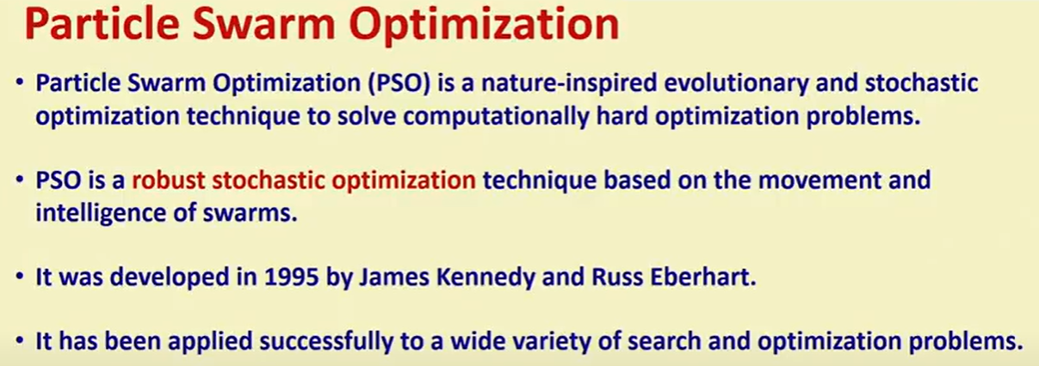
Particle Swarm Optimization

Slide 4
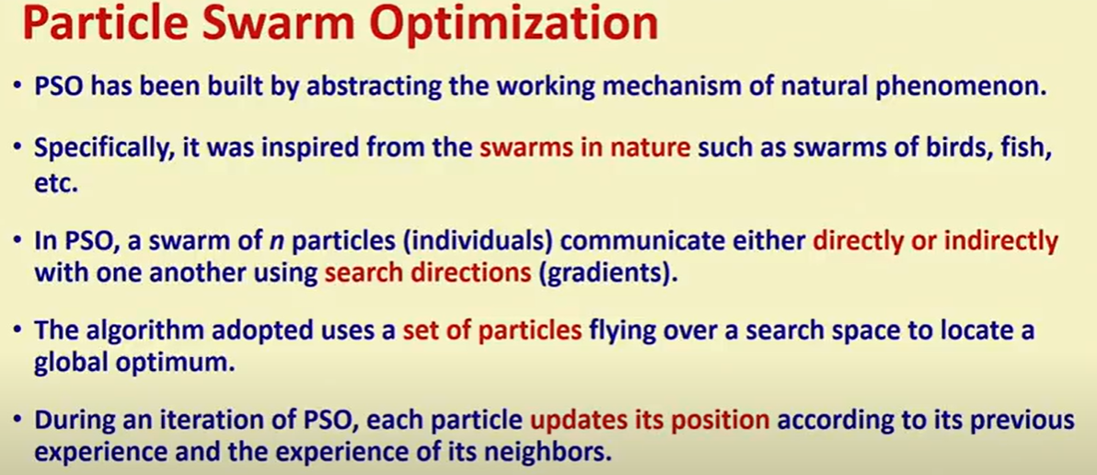
Particle Swarm Optimization

Slide 5
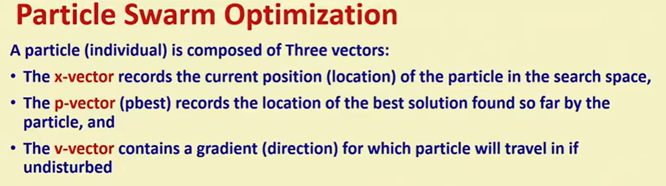
Particle Swarm Optimization

Slide 6
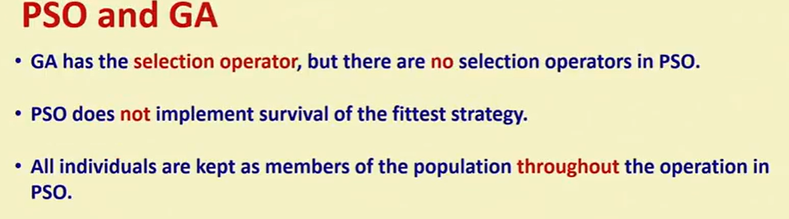
Particle Swarm Optimization and Genetic Algorithm

Slide 7
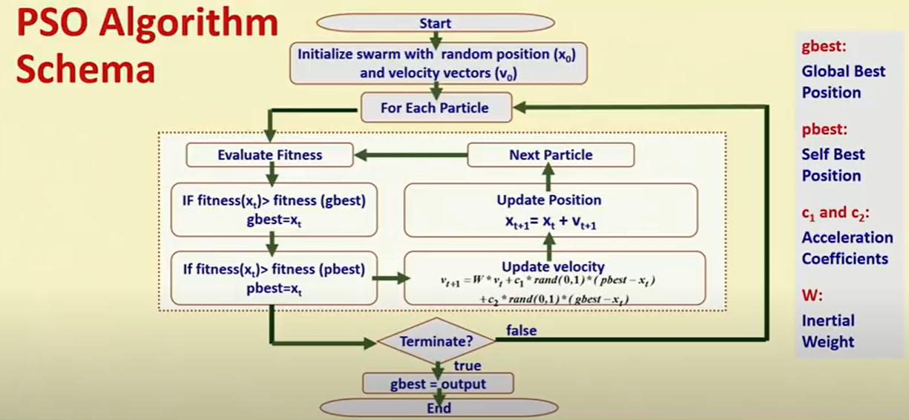
PSO ALGORITHM

Slide 8
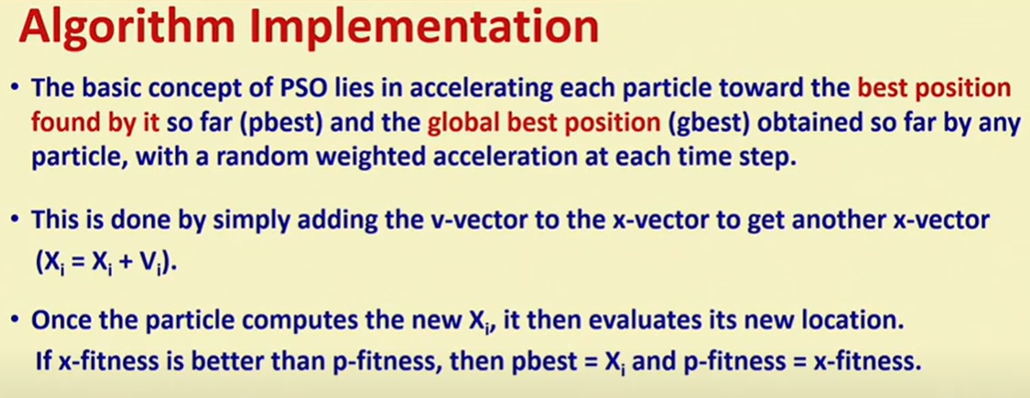
Algorithm Implementation

Slide 9
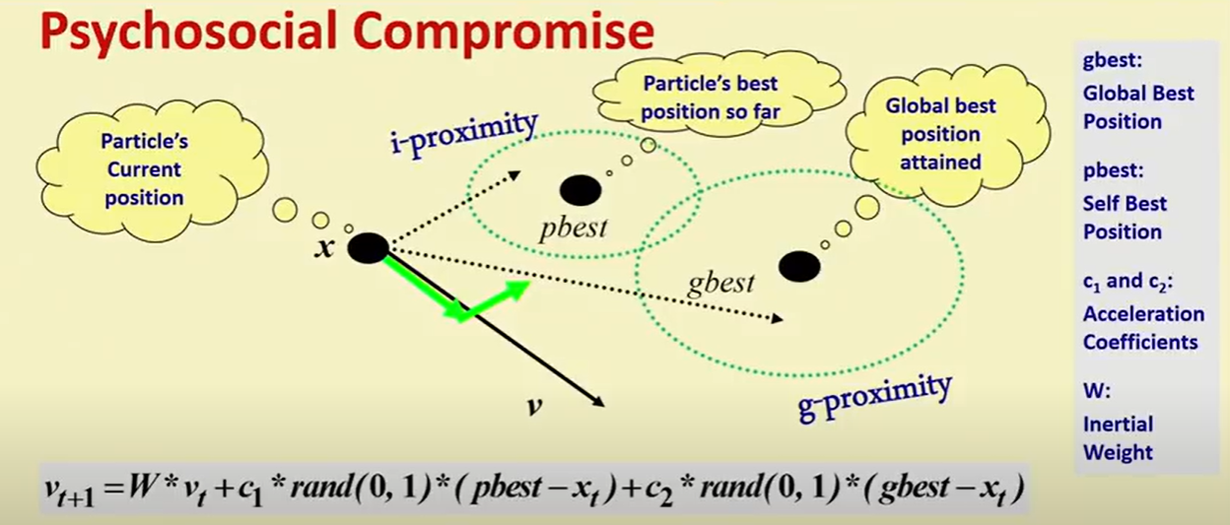
Psychosocial Compromise

Slide 10
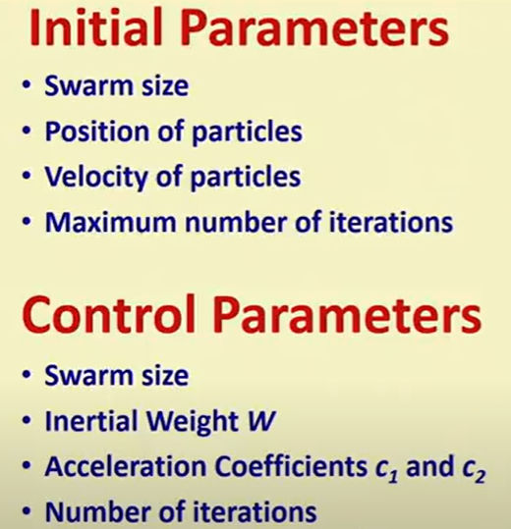
Initial and Control Parameters

Slide 11
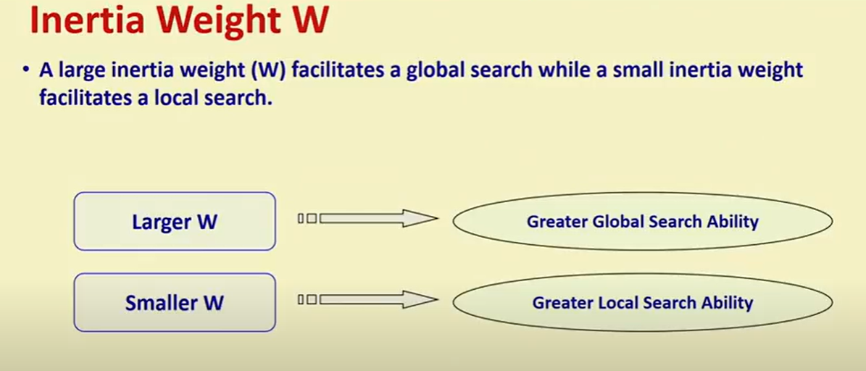
Inertia Weight W

Slide 12
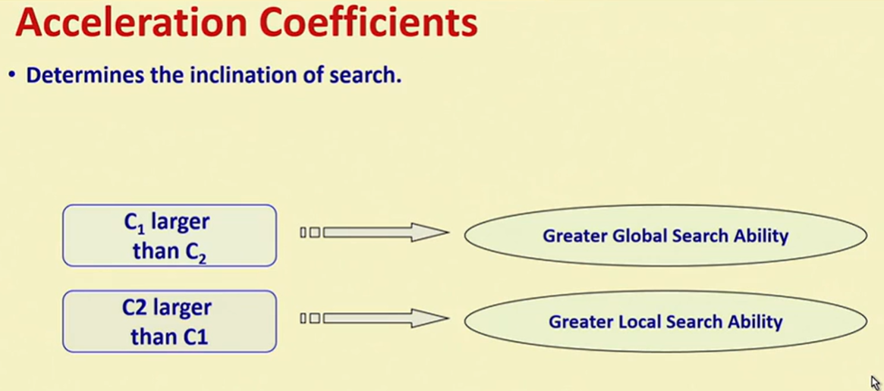
Acceleration Coefficients

Slide 13
STEPS TO COMPUTE PSO
Initialization:
We have a population of particles (each particle represents a possible solution).
Initialize each particle’s position and velocity randomly within the search space.
Assign each particle a random velocity.
Calculate the fitness of each particle (based on the objective function).
Identify the personal best position (pBest) for each particle and the global best position (gBest) among all particles.

Slide 14
STEPS TO COMPUTE PSO
Iteration 1:
Update Velocity: The velocity of each particle is updated based on:
  Its current velocity.
  The distance between its current position and its personal best position (pBest).
  The distance between its current position and the global best position (gBest)

Slide 15
STEPS TO COMPUTE PSO
Formula:
Update velocity: vnew​=w⋅v+c1​⋅r1​⋅(pbest​−x)+c2​⋅r2​⋅(gbest​−x)
where r1​ and r2​ are random numbers in [0,1].
Update position: xnew​=x+vnew​
Ensure that both xnew and vnew​ are within their respective bounds.

Slide 16
STEPS TO COMPUTE PSO
where:
vi(t) is the current velocity.
xi(t) is the current position.
w is the inertia weight.
c1​ and c2 are acceleration coefficients.
r1 and r2 are random numbers in the range [0, 1]
Evaluate Fitness: Calculate the fitness of the new position for each particle.
Update pBest and gBest: Check if the new position is better than the personal best for each particle, and update pBest if it is. If any particle has found a better global position, update gBest.

Slide 17
STEPS TO COMPUTE PSO
3. Iteration 2:
Repeat the same steps: update the velocity, update the position, evaluate fitness, and update pBest and gBest based on the new positions.
4. Iteration 3:
The process continues for a third iteration. After this, you have a new set of positions and velocities, along with updated personal and global bests.
After these 3 iterations, the algorithm will have a better approximation of the optimal solution based on how the particles moved through the search space.

Slide 18
EXAMPLE 01
Example of Particle Swarm Optimization for 3 Iterations:
Minimize the following objective function:
f(x)=x Pow 2+2x+1
This is a simple quadratic function with a minimum at x=−1

Slide 19
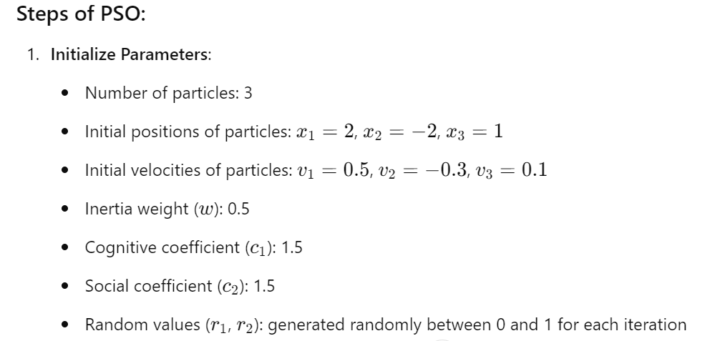
EXAMPLE 01

Slide 20
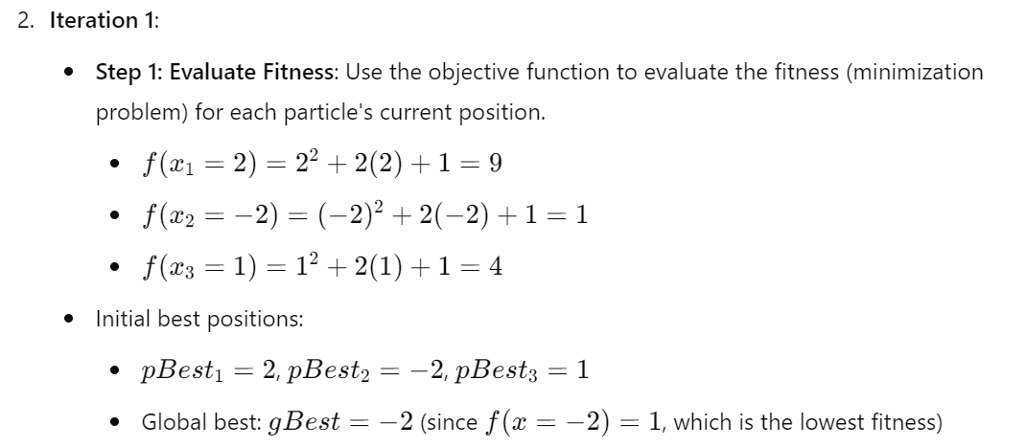
EXAMPLE 01

Slide 21
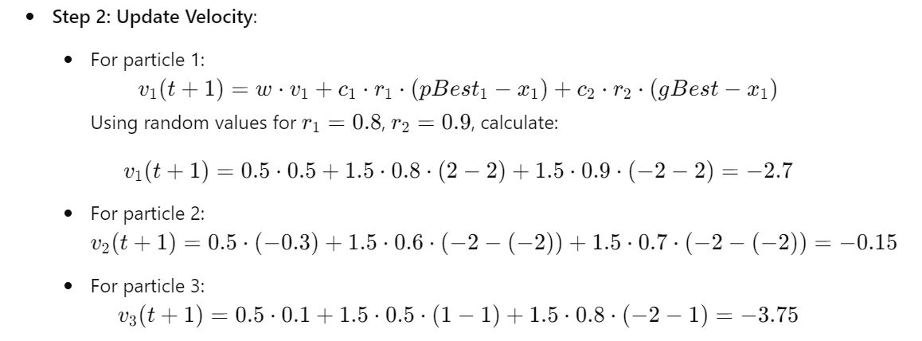
EXAMPLE 01

Slide 22
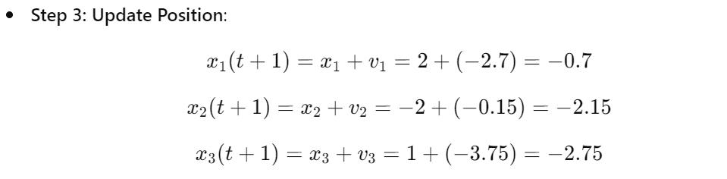
EXAMPLE 01

Slide 23
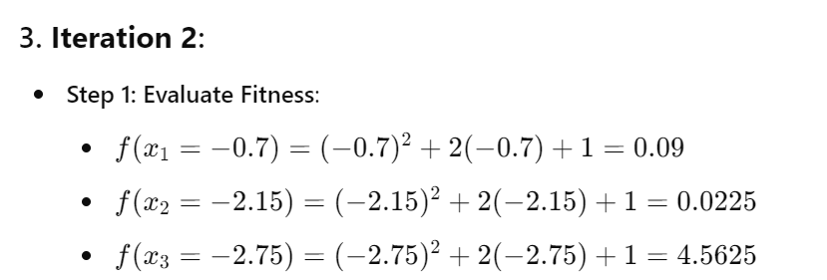
EXAMPLE 01

Slide 24
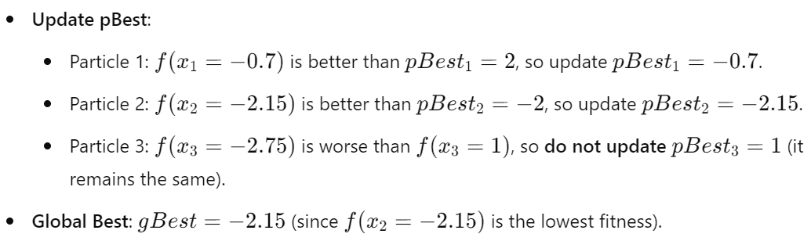
EXAMPLE 01

Slide 25
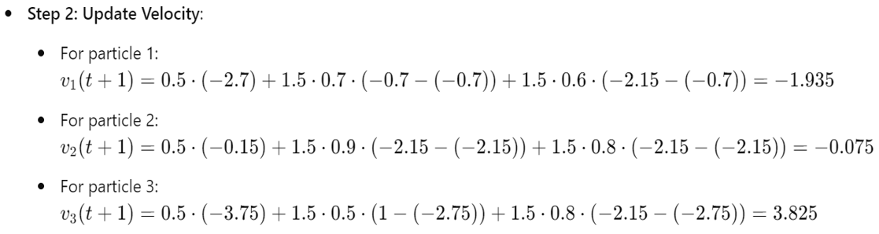
EXAMPLE 01

Slide 26
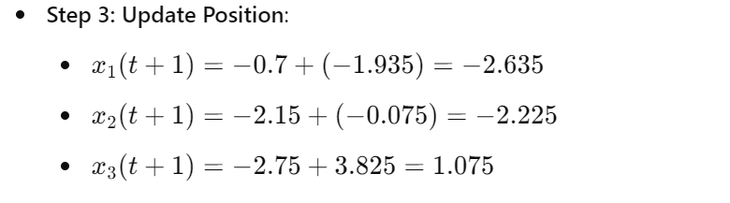
EXAMPLE 01

Slide 27
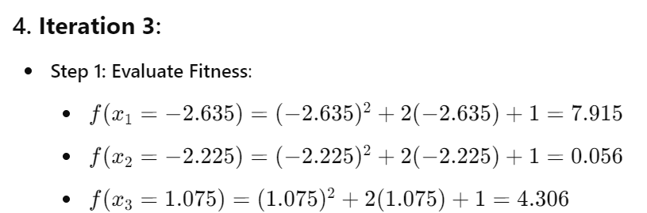
EXAMPLE 01

Slide 28
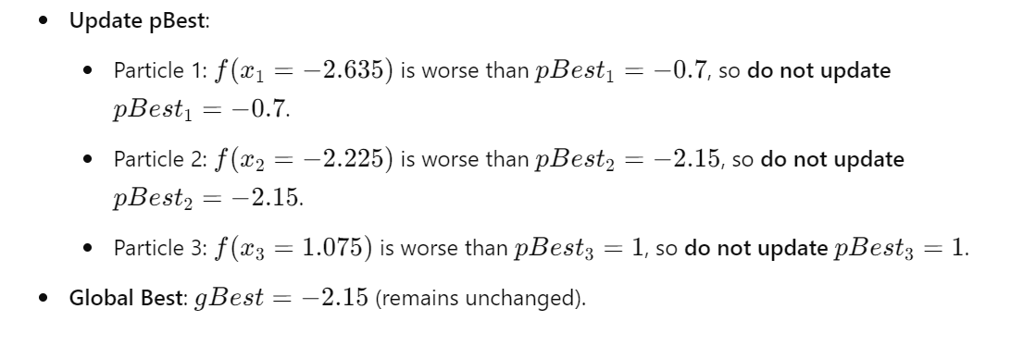
EXAMPLE 01

Slide 29
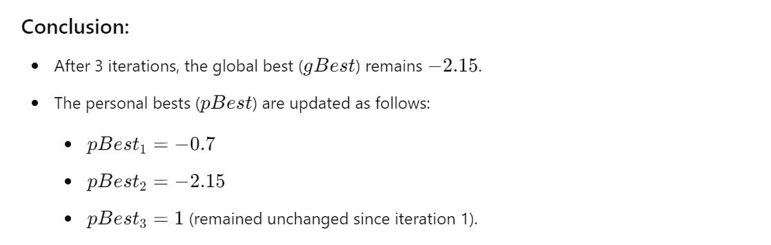
EXAMPLE 01

Slide 30
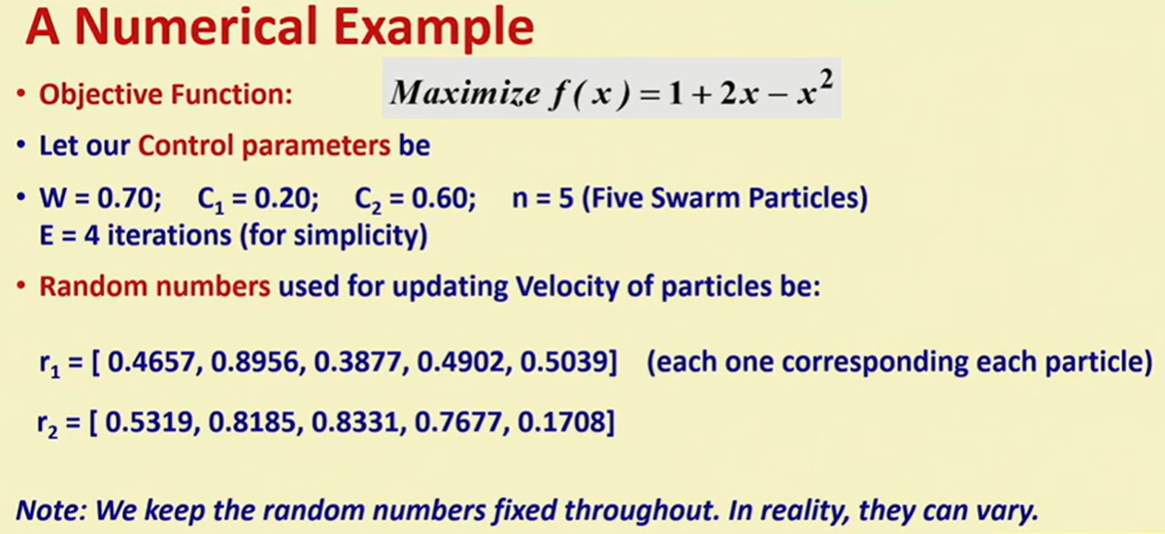
Home Work

