Slide 1


BMS COLLEGE OF ENGINEERING
DEPARTMENT OF MACHINE LEARNING
Nature inspired computing
Unit 02
Artificial Bee Colony Optimization
Prof. Varsha R,
Assistant Professor, Dept. of Machine Learning,
BMSCE

Slide 2
Introduction
Swarm intelligence is the study of collective behaviors of decentralized, self-organized systems, such as ant colonies, bird flocks, or bee hives.
The BCO algorithm mimics the social behavior of bees as they explore and exploit the environment to find optimal solutions to problems, especially in the field of combinatorial optimization and continuous optimization.

Slide 3
Artificial Bee Colony
Bee Colony Optimization (BCO) is a class of swarm intelligence algorithms inspired by the natural foraging behavior of honey bee colonies. These algorithms simulate the way honey bees collectively find, share, and exploit food sources to solve complex optimization problems.

Slide 4
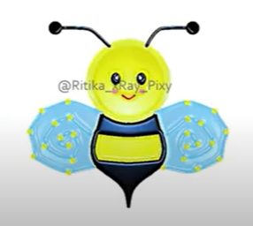
About Bee
Bee=Flying insects with wings

Slide 5
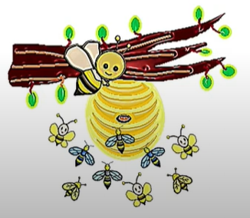
BEE hive contains around 60,000 to
70,000 living elements
Bee colony contains:
1 reproductive female=Queen
Few males(approx..1000)=Drones
Many sterile females=Workers

Slide 6
Bees collect and process nectar {highly organized practice}
Bees feed on nectar as Energy Source in their life
Nectar is collected in the pollen baskets situated in their legs
How each bee reach the nectar sources?
By nest mates (who already discovered a patch of flowers)

Slide 7
Certain Features
1. Nectar Exploration: The process where bees search for flowers to collect nectar, which is used for making honey.
2. Waggle Dance: A specific movement pattern used by bees to communicate the direction and distance of a food source to other bees.
3. Food Foraging: The act of bees collecting food, particularly nectar and pollen, from plants to bring back to their hive.
4. Division of Bees: The social organization of a bee colony into different roles such as workers, drones, and the queen, each with distinct responsibilities.
5. Mating During Flight: A process where a queen bee mates with drones in mid-air during her nuptial flight to collect sperm for future fertilization.

Slide 8
Types of Bee-Inspired Algorithms
Artificial Bee Colony (ABC) Algorithm: Proposed by Derviş Karaboğa in 2005, this is the most popular bee-inspired algorithm, and it focuses on solving both continuous and combinatorial optimization problems.
Bees Algorithm: Proposed by Pham et al. in 2006, this focuses on local search methods.
Bee Colony Algorithm: Another variant based on bee communication and decision-making during the foraging process.

Slide 9
Bee Behavior Modeled in Optimization
The optimization processes in bee colony algorithms are based on two fundamental behaviors in natural bee colonies:
Exploitation: This is the process by which bees focus on high-quality food sources. In an optimization context, this refers to intensively searching the neighborhood of a current solution that has proven promising.
Exploration: Bees also explore new areas when current food sources are no longer productive or if a new potential source is discovered. This corresponds to the algorithm's ability to search different areas of the solution space, preventing it from getting stuck in local optima.

Slide 10
Bee Algorithms are used to solve different problems
Bee System: Genetics Problems
Bee Hive: Routing Protocols
Honey Bee Marriage: Cluster Analysis
Bee Colony Optimisation: TSP, Vehicle Routing Problem, Ride Matching problems, Job Scheduling Problems
Artificial Bee Colony Optimisation: Engineering problems, Numerical Optimisation

Slide 11
Bee’s in ABC are divided into 3 groups
Honey Bee/Employee Bees
Followers/ Onlooker Bees
Scout Bees
Search for Nectar/Food Sources information from surrounding and share with the followers

Slide 12
Bee’s in ABC are divided into 3 groups
Honey Bee/Employee Bees
Followers/ Onlooker Bees
Scout Bees
Search the bee with better nectar information

Slide 13
Bee’s in ABC are divided into 3 groups
Honey Bee/Employee Bees
Followers/ Onlooker Bees
Scout Bees
Honey bees that abandon nectar and search for new sources for nectar

Slide 14
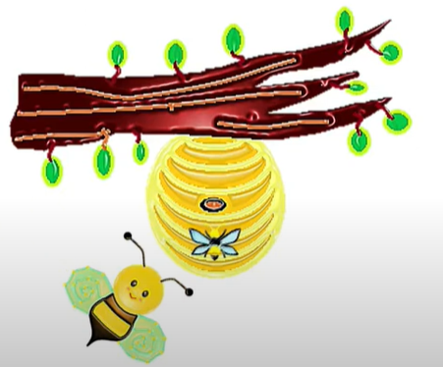
ABC Pseudocode
Initialization Phase
REPEAT
Employee Bee Phase
Onlooker Bee Phase
Scout Bees Phase
Memories the best solution achieved
UNTIL Stopping criteria

Slide 15
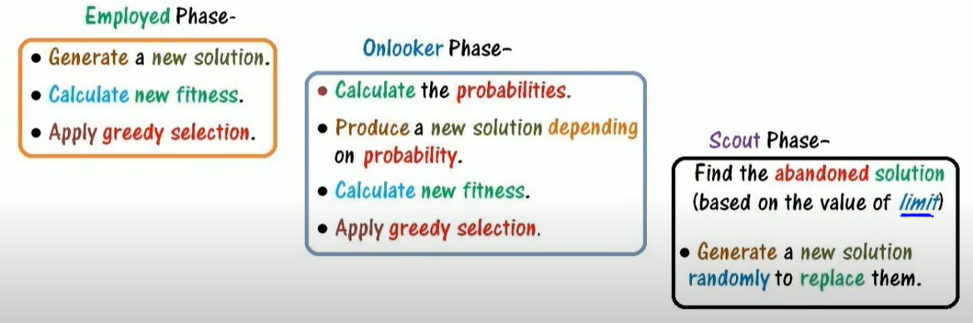
The movement of bees is recorded in three phases

Slide 16
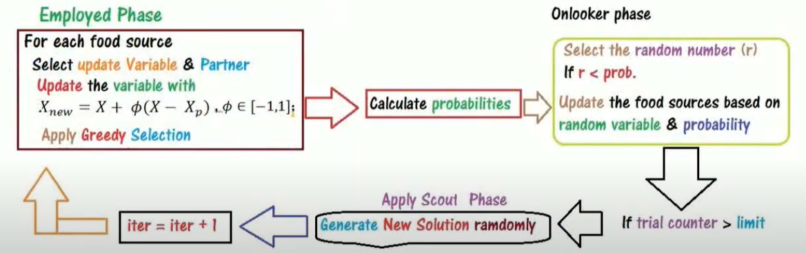
Working Rule

Slide 17
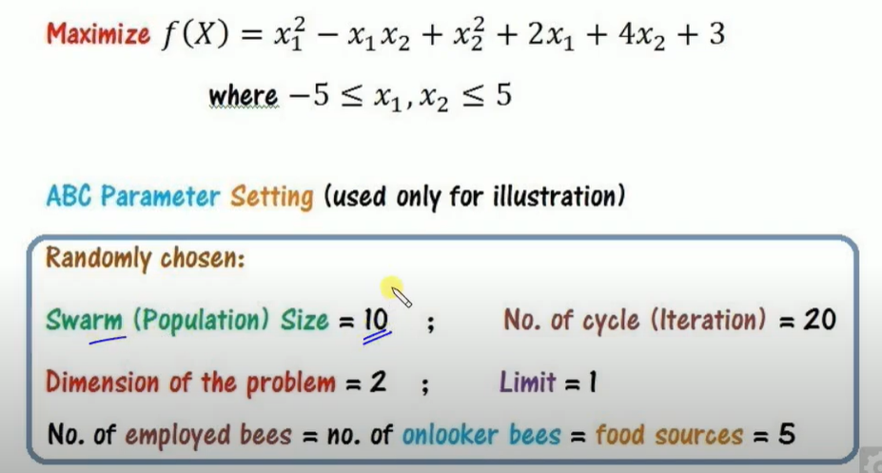
Illustrative Example

Slide 18
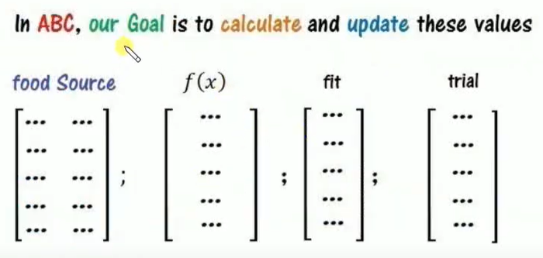

Slide 19
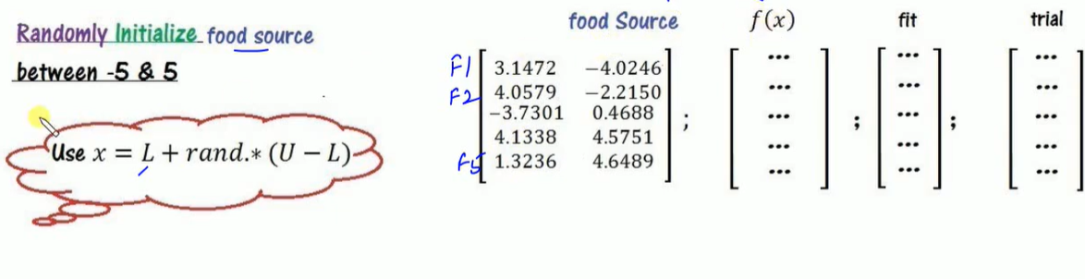

Slide 20
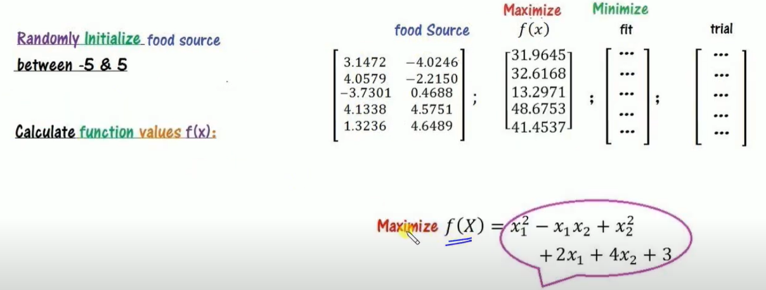

Slide 21
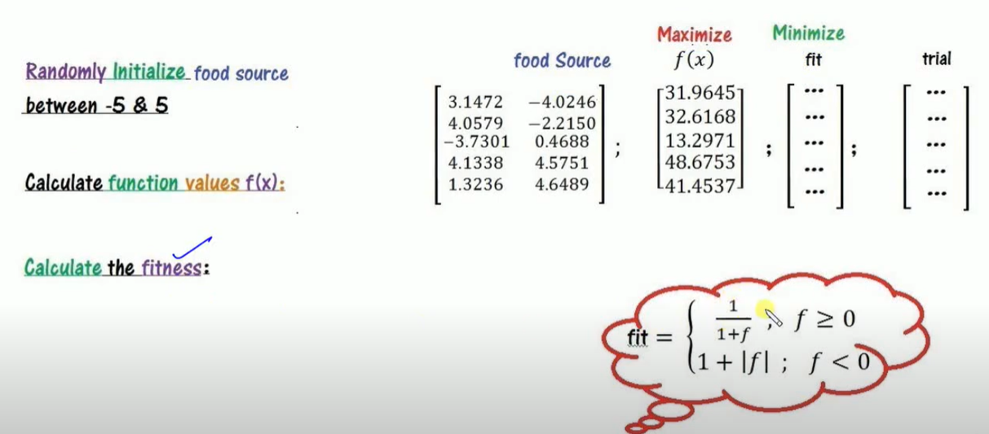

Slide 22
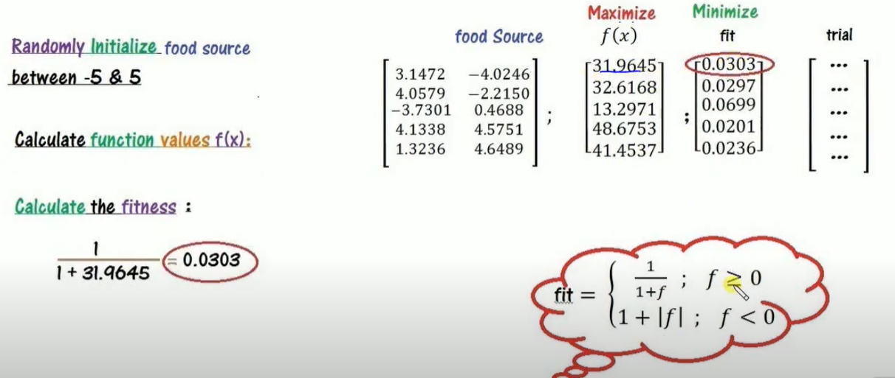

Slide 23
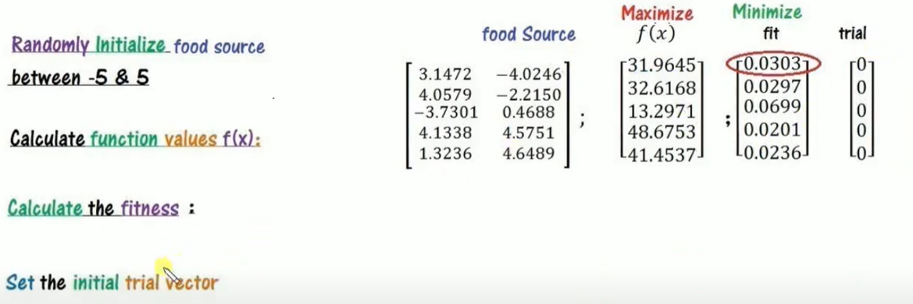

Slide 24


Slide 25
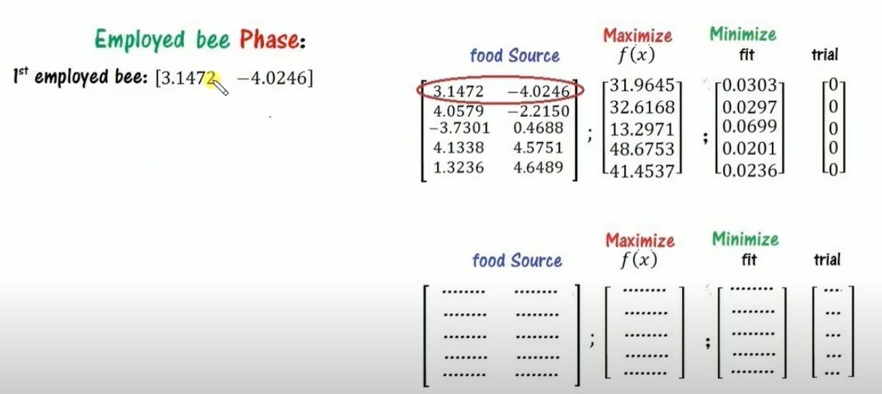

Slide 26
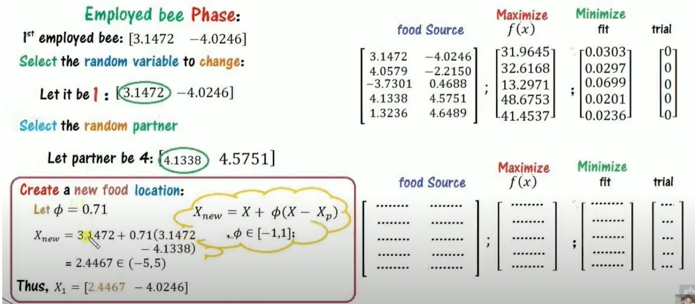

Slide 27
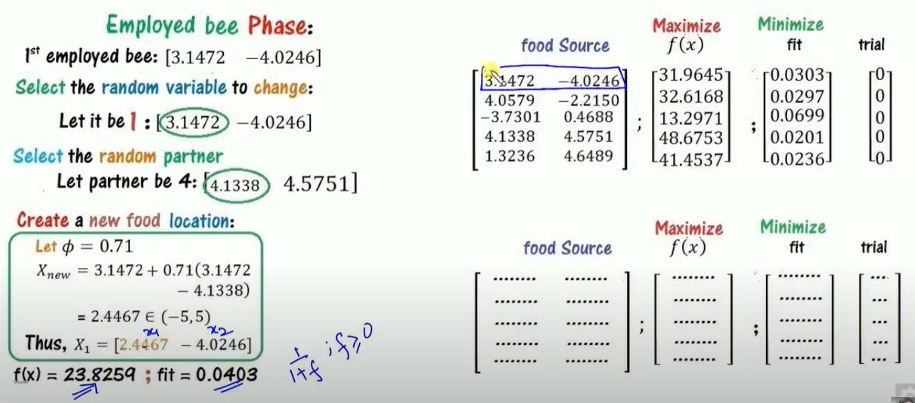

Slide 28
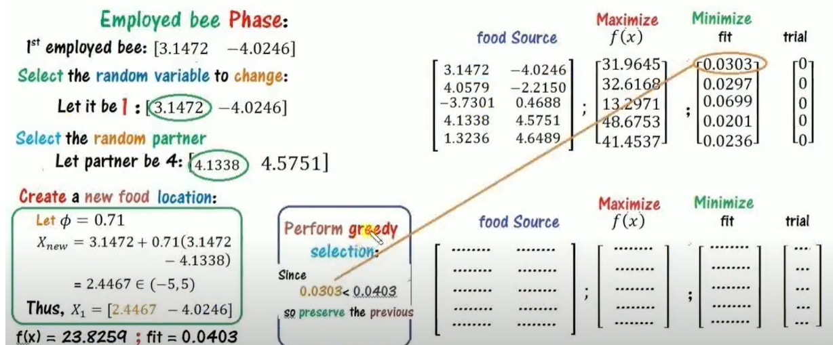

Slide 29
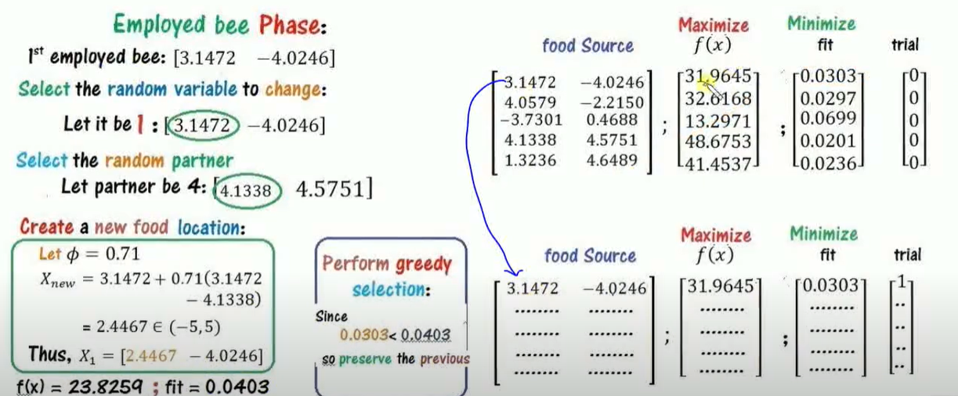

Slide 30


Slide 31
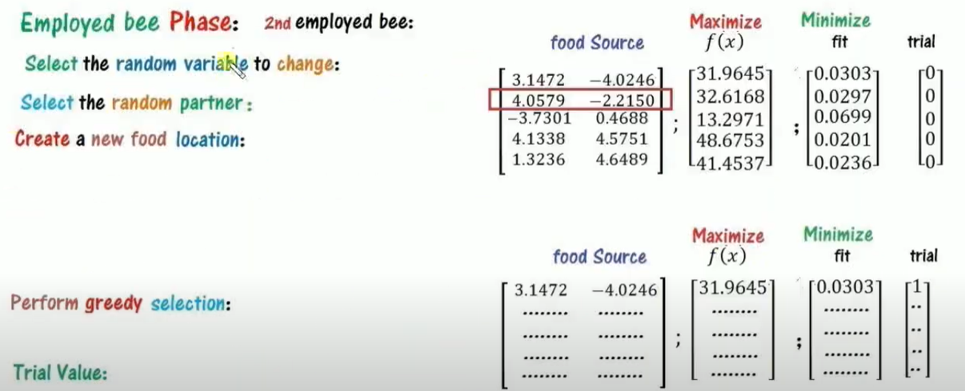

Slide 32
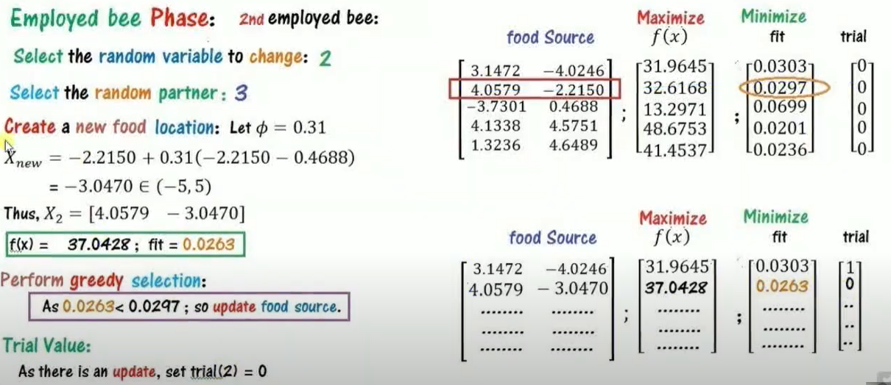

Slide 33


Slide 34
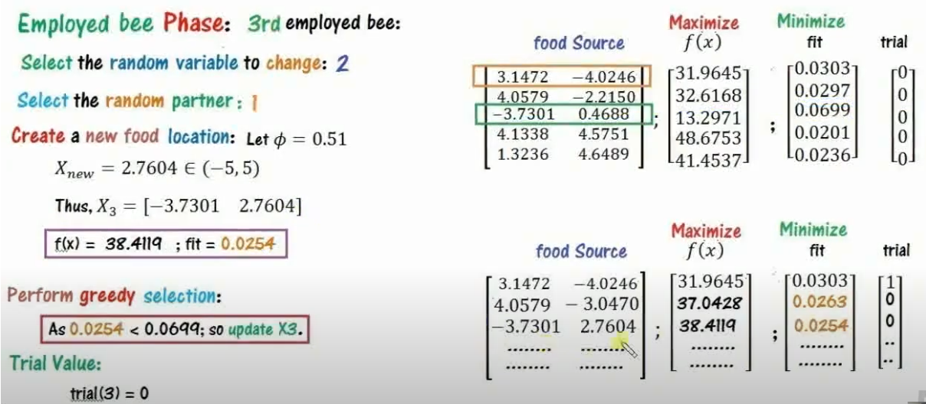

Slide 36
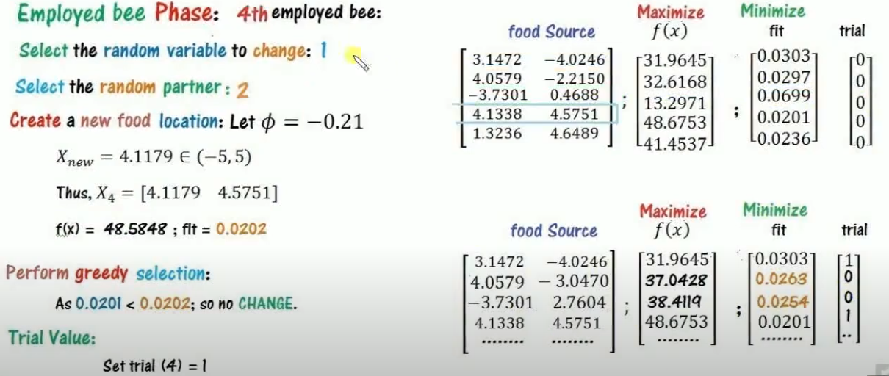

Slide 37
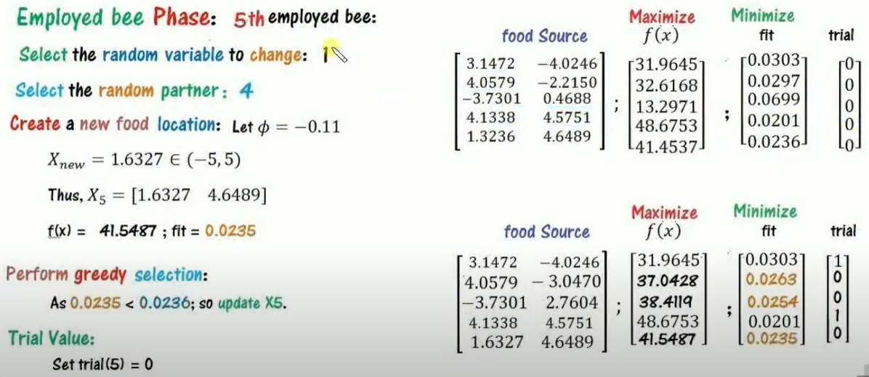

Slide 38
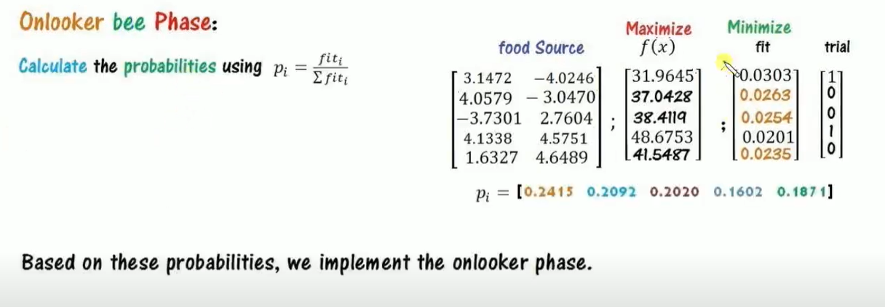

Slide 39
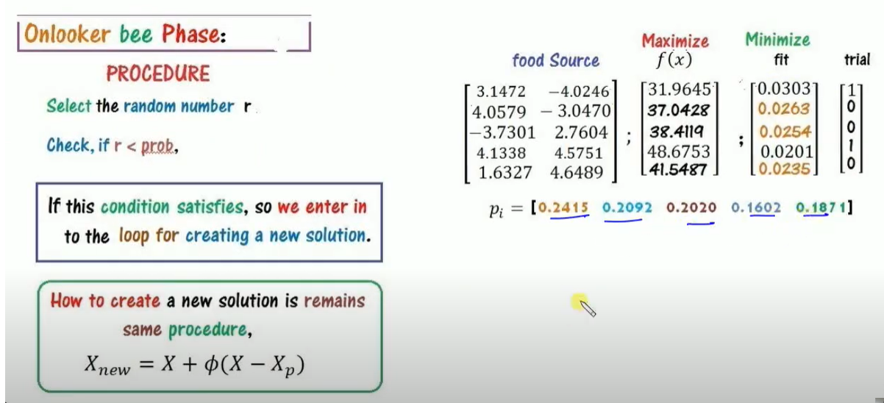

Slide 41
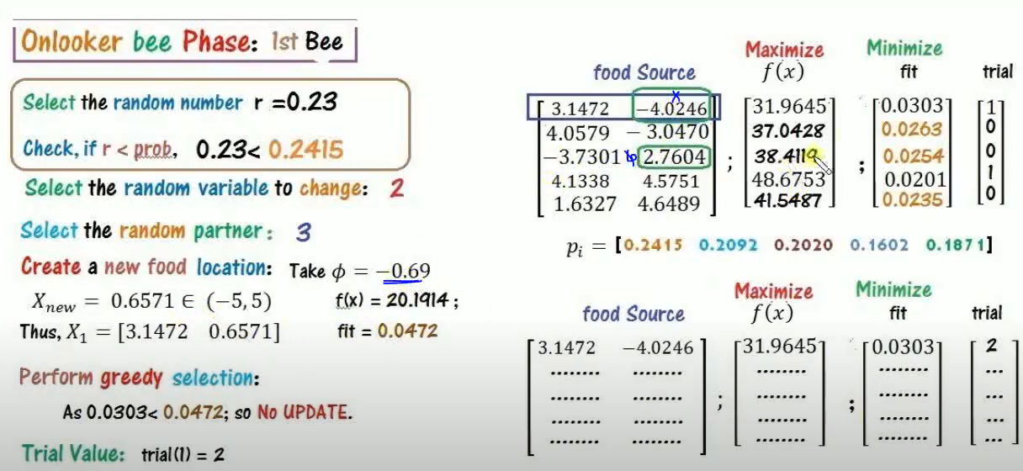

Slide 42
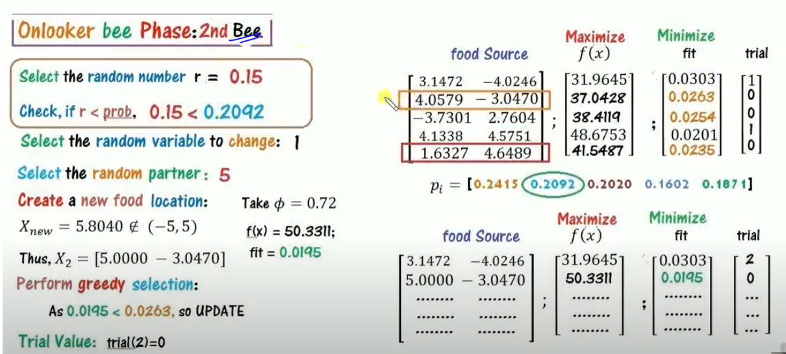

Slide 43
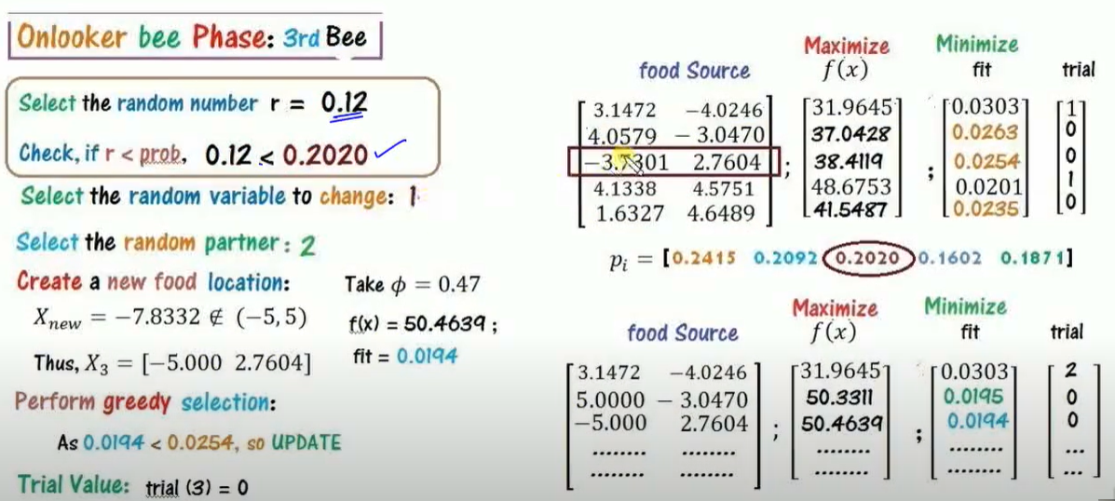

Slide 44
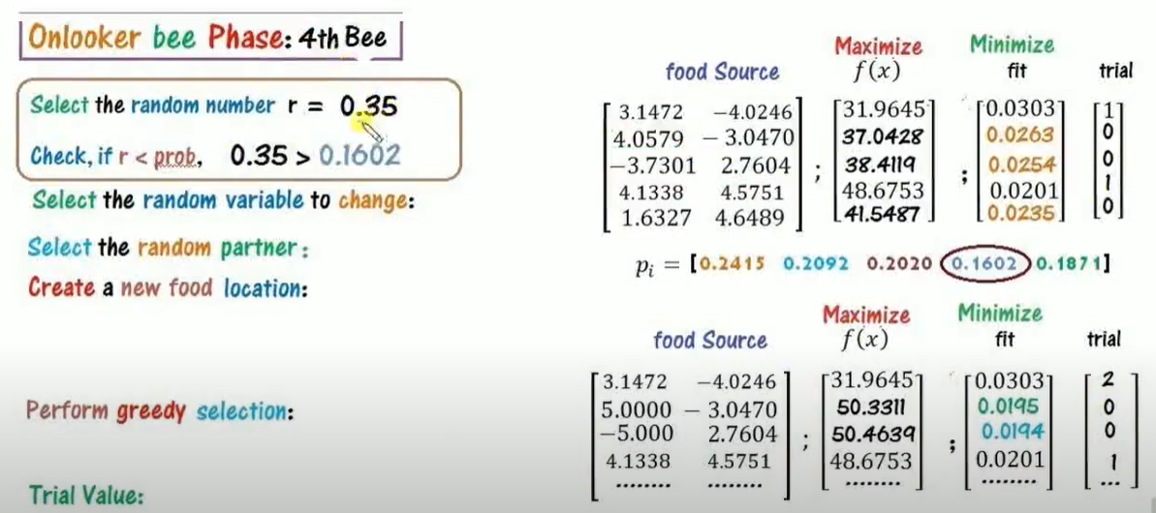

Slide 45
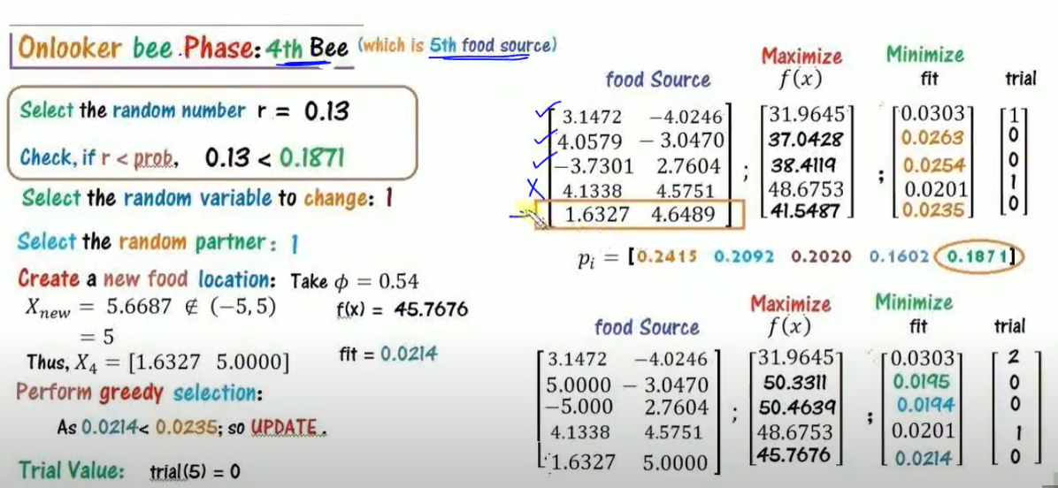

Slide 46
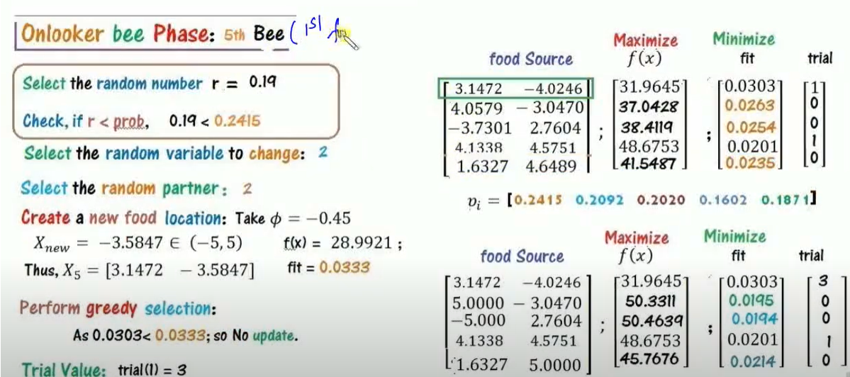

Slide 47
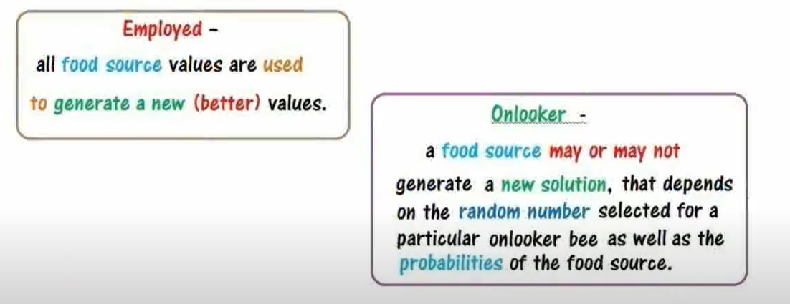

Slide 48
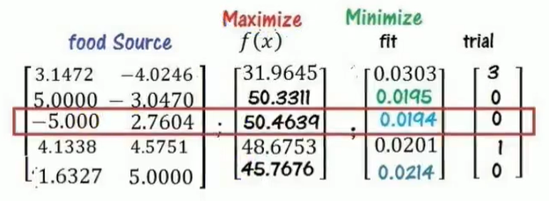

Slide 49
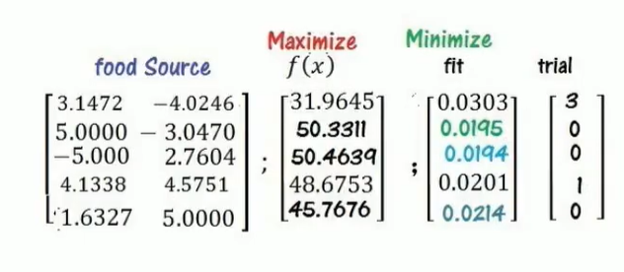
Scout Phase

Slide 50
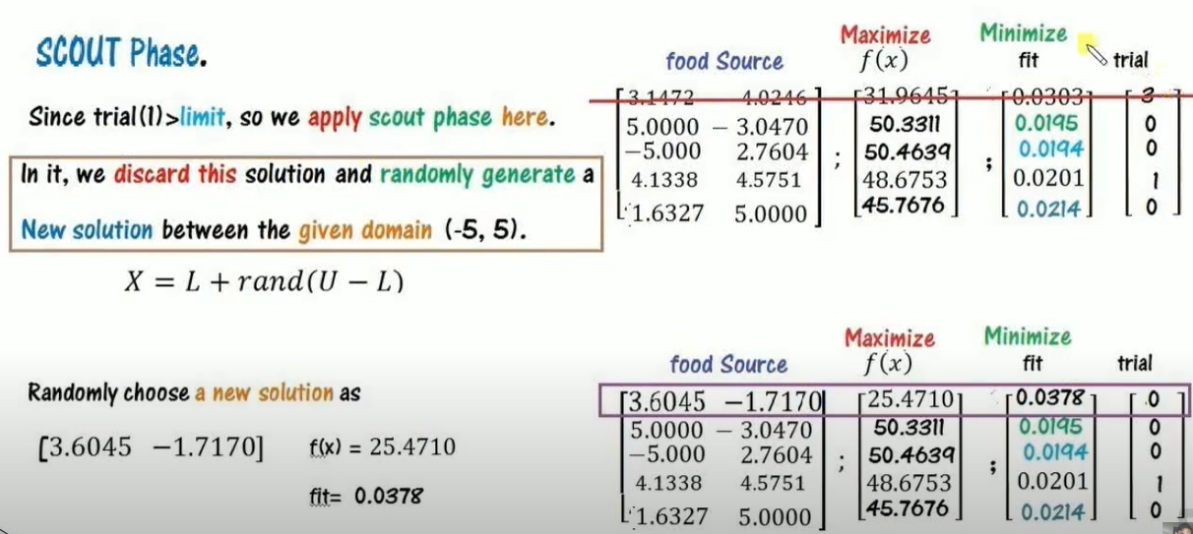

Slide 51
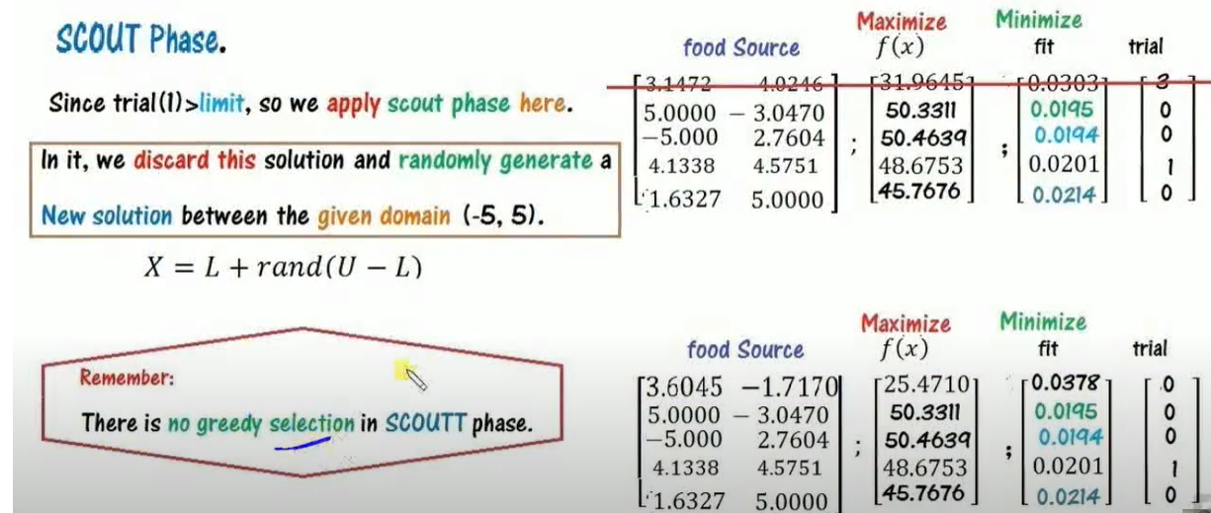

Slide 52
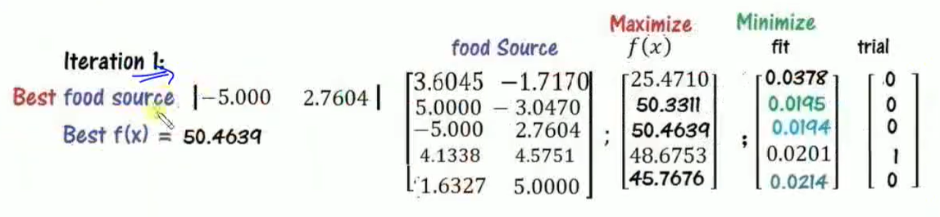

Slide 53
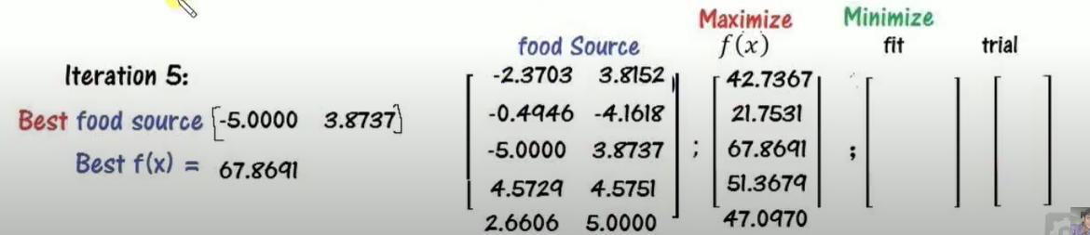

Slide 54
