Slide 1

BMS COLLEGE OF ENGINEERING
Department OF MACHINE LEARNING
Nature inspired computing unit 02
ANT COLONY OPTIMIZATION
Prof. VARSHA R
Assistant Professor, Dept. of MEL

Slide 2
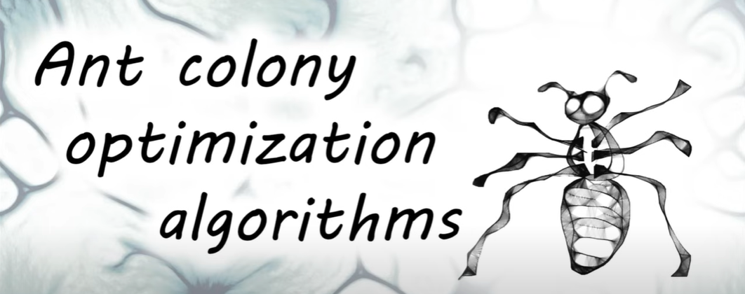
Ant Colony Optimization
The idea of the algorithm is inspired by the behaviour of an ant colony finding a path to food that is close to optimal.
The researchers have long been interested in how ants, with their tiny brain, manage to build good routes and the essence of the algorithm is very simple.
Ants begin to move along all the routes, delivering food to the ant hill.
Along the way, they leave an odorous trail of pheromones. On a shorter path, ants will go back and forth more times over the same period, and as a result, they will leave more pheromones on every centimetre of the path.
This path will smell stronger and attract ants. Over time, all the ants will switch to a stronger smelling shortcut, and the long path will be abandoned, as pheromones evaporate

Slide 3
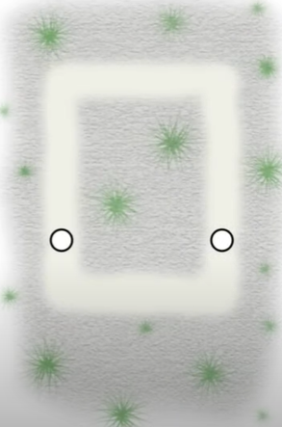
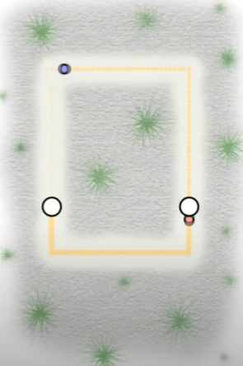
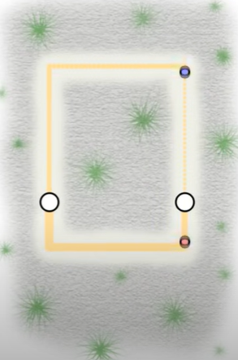
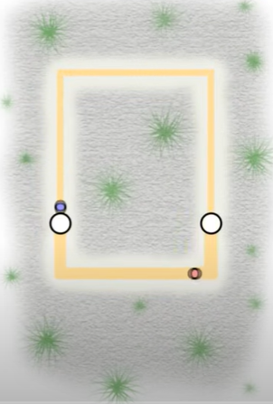
Ant Colony Optimization

Slide 4
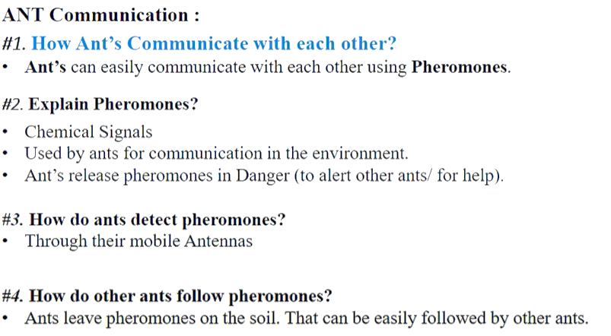


Slide 5
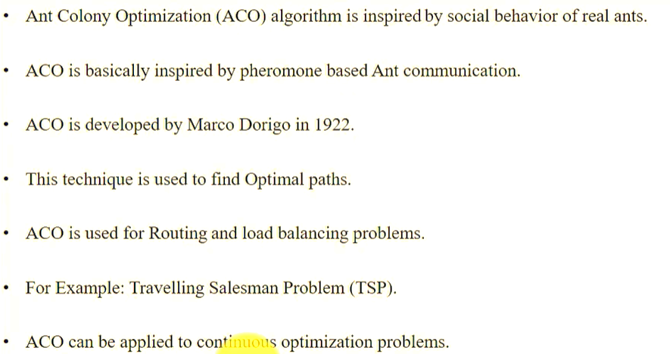
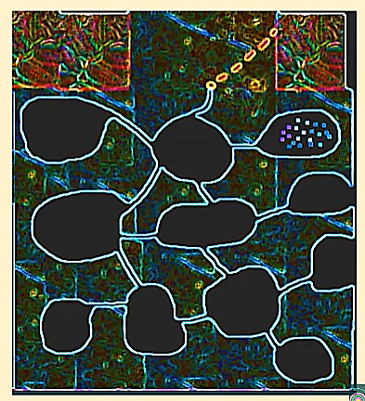

Slide 6
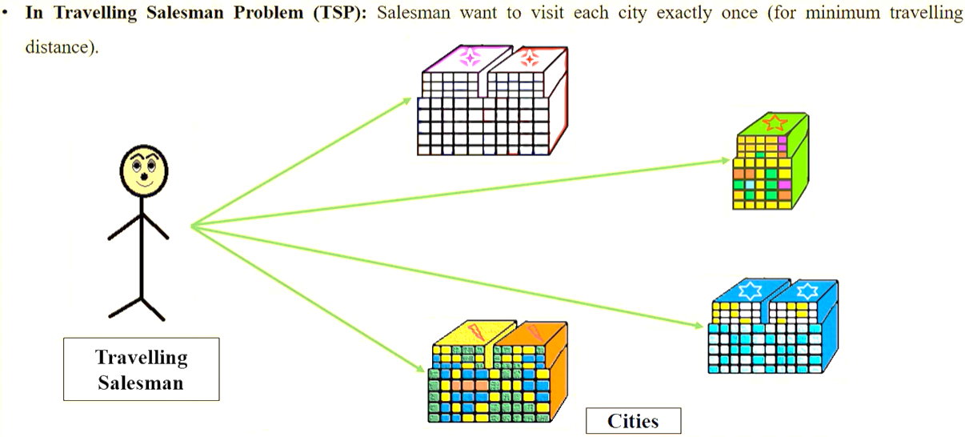

Slide 7
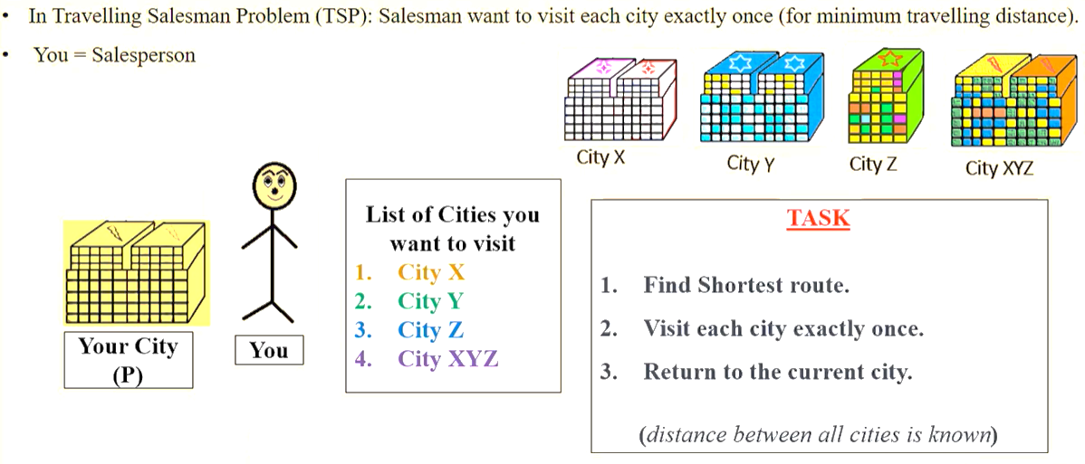

Slide 8
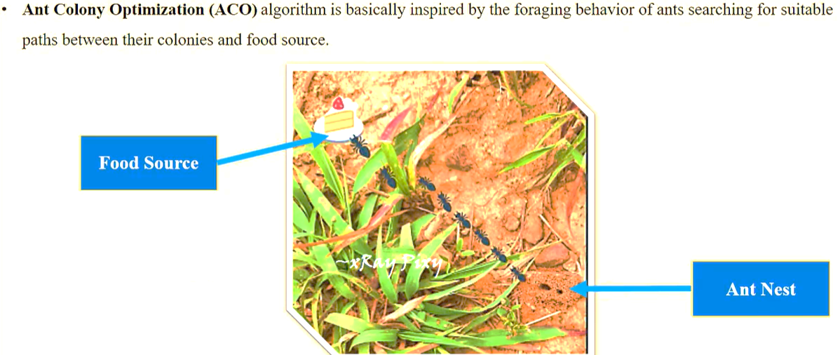

Slide 9
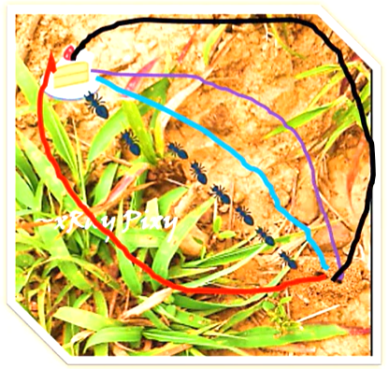
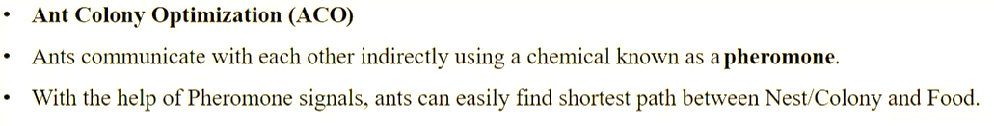
How do ants find out the shortest path between nest and food

Slide 10
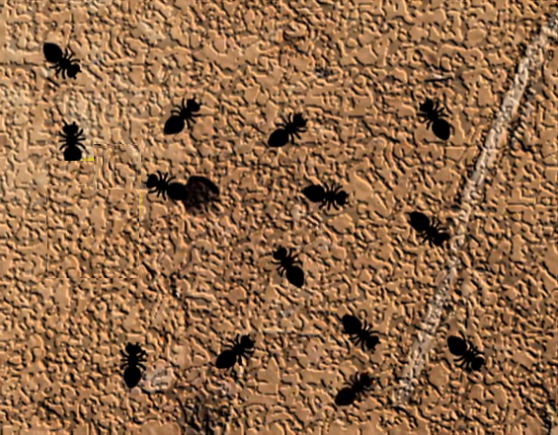
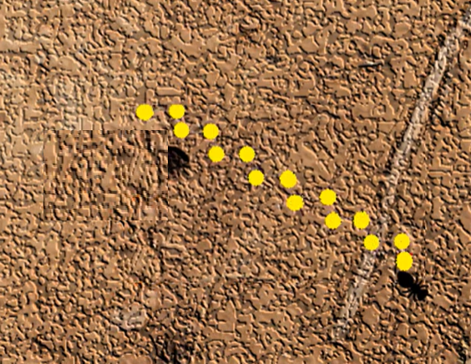
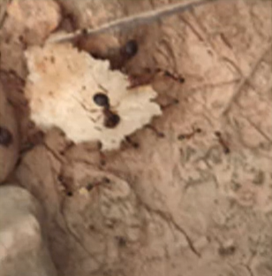
Ants foraging behaviour
Explores the area randomly.
The ants releases the chemical.
When the ants find the food source they choose the way have a strong pheromones.

Slide 11
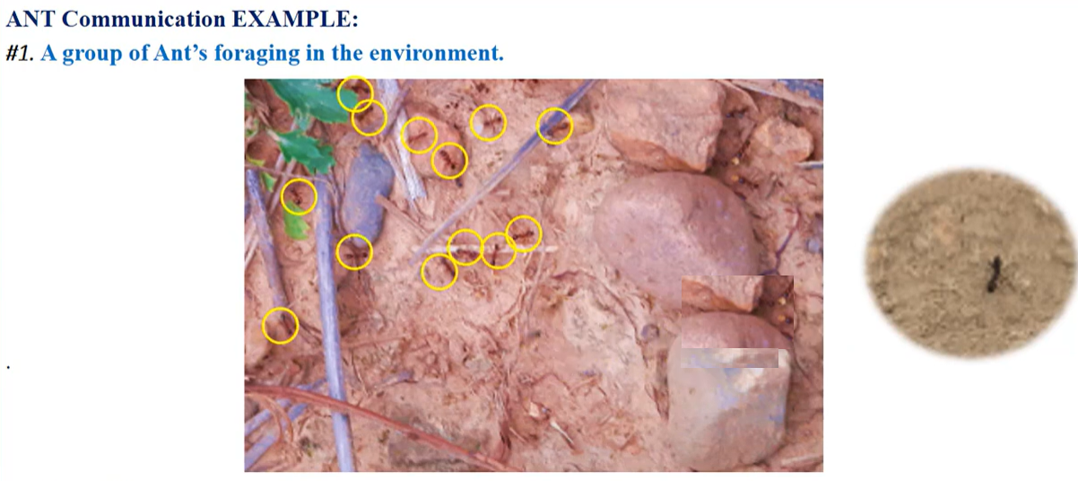
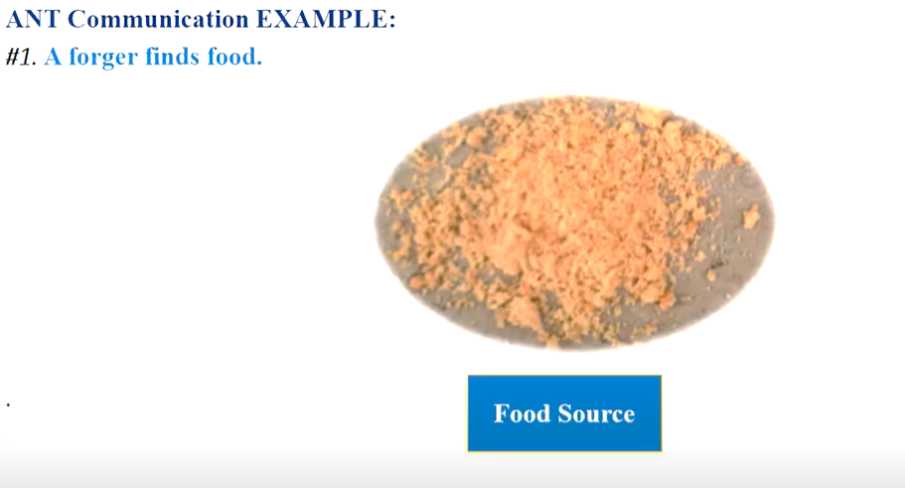
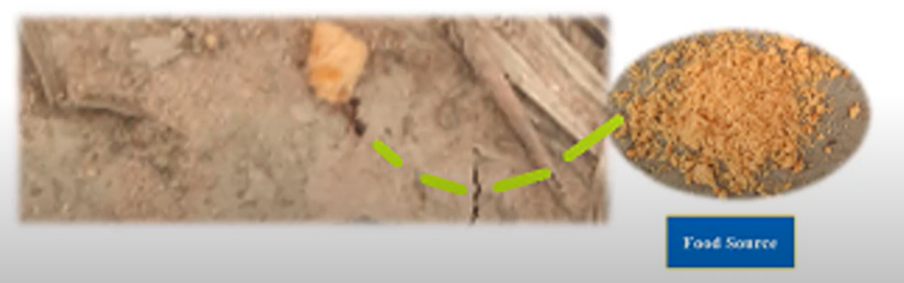

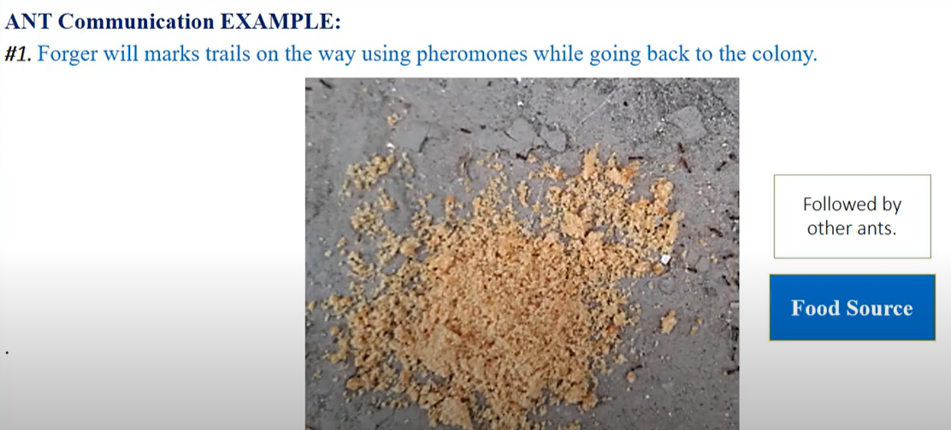
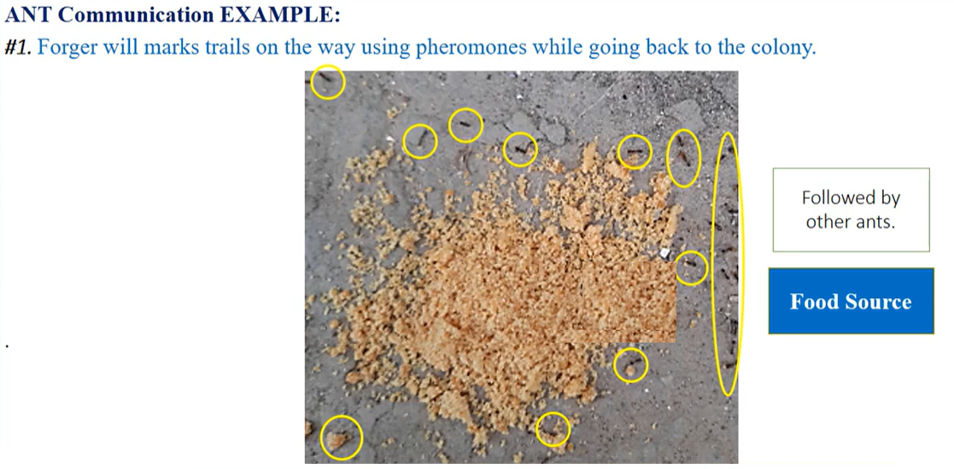
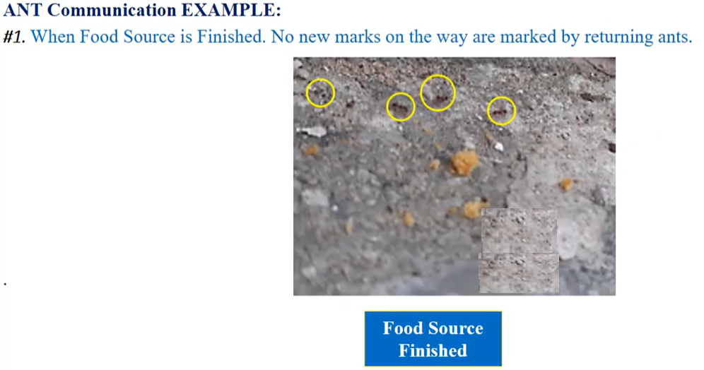
Ants foraging behaviour

Slide 12
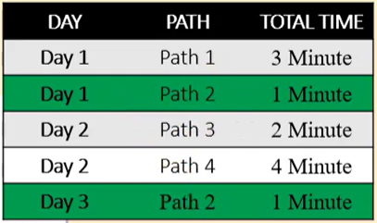
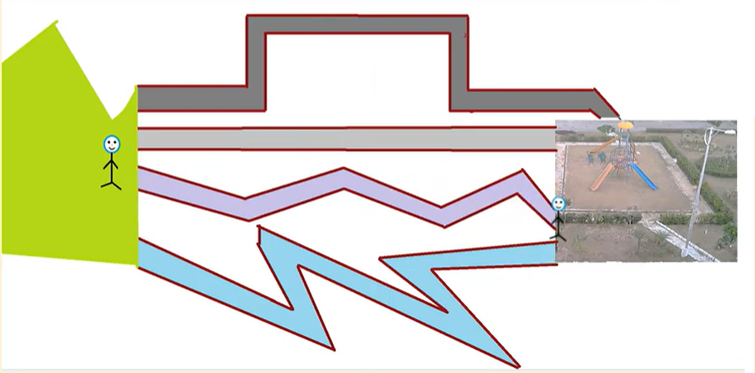
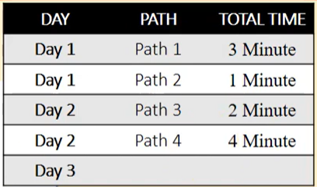


Ants Communication

Slide 13
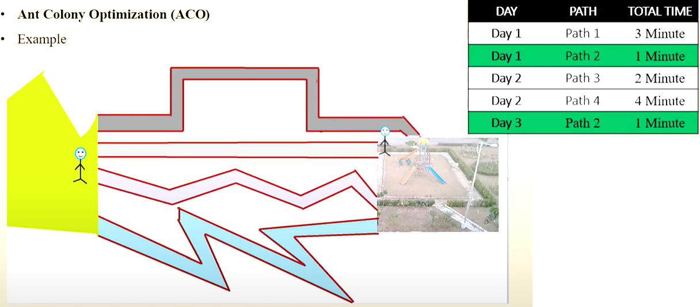
Ants Communication

Slide 14
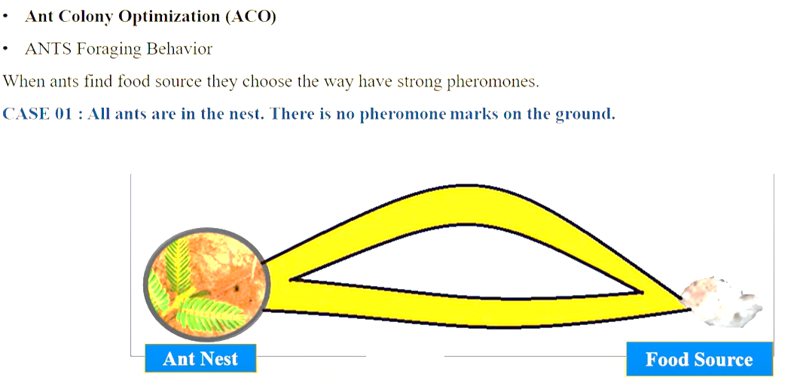

Slide 15
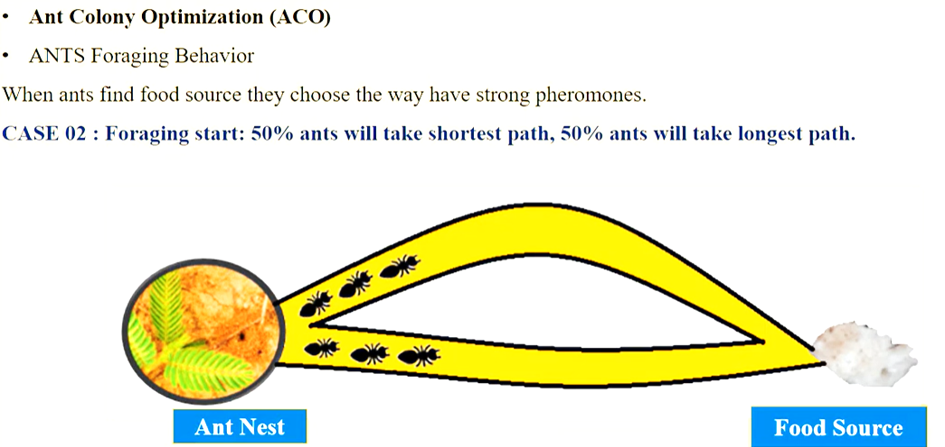

Slide 16
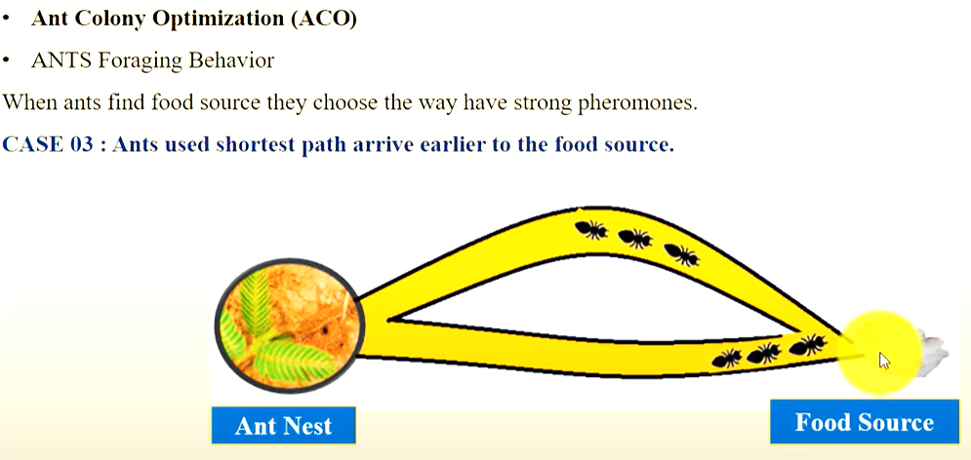


Slide 17
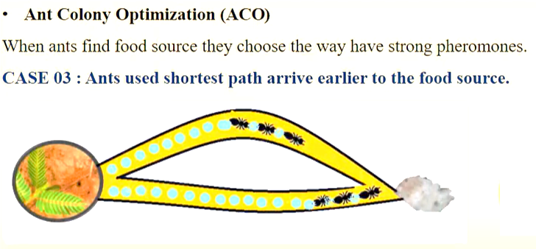
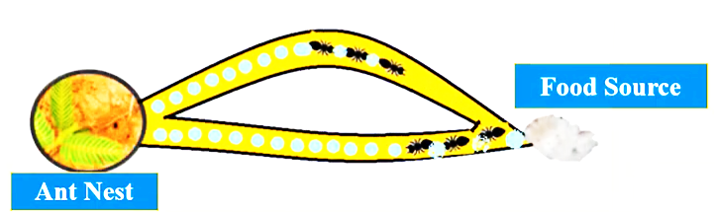

Slide 18
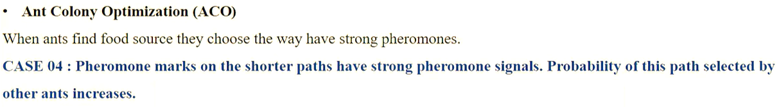
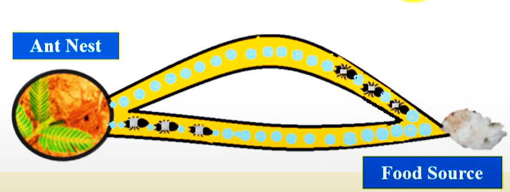

Slide 19
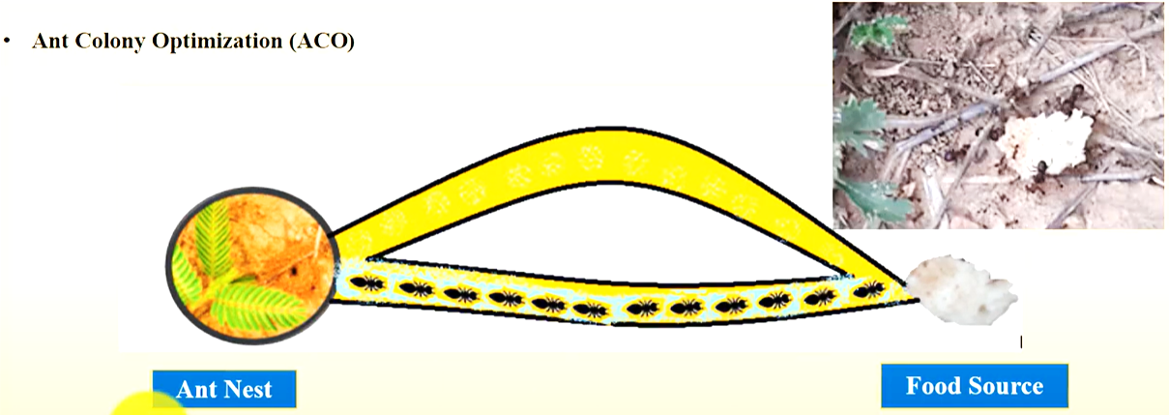

Slide 20
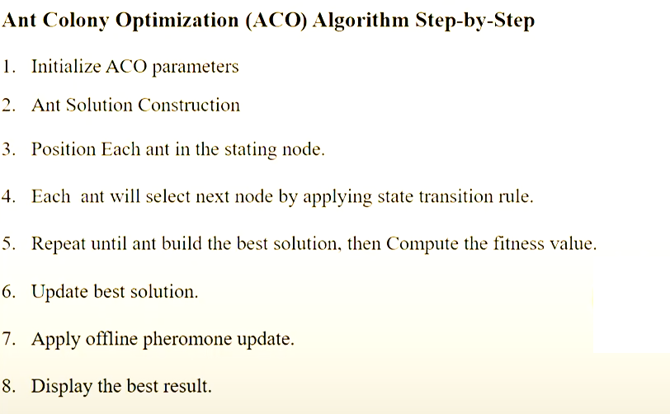
Ant colony Optimization Algorithm

Slide 21
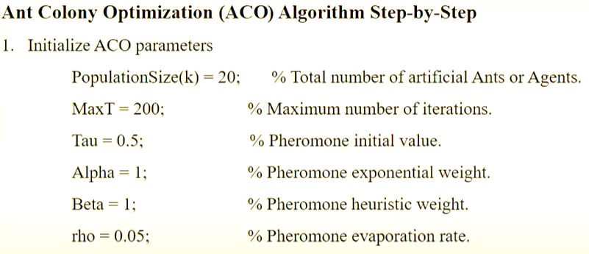
Example 1

Slide 22
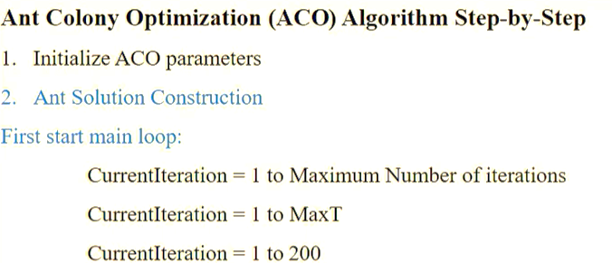

Slide 23
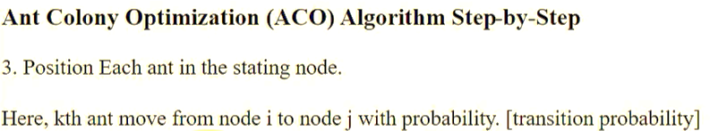
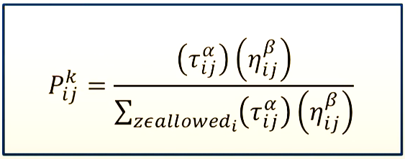

Slide 24
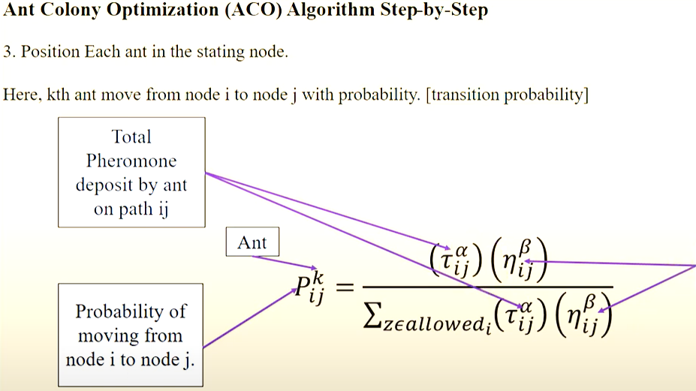


Slide 25
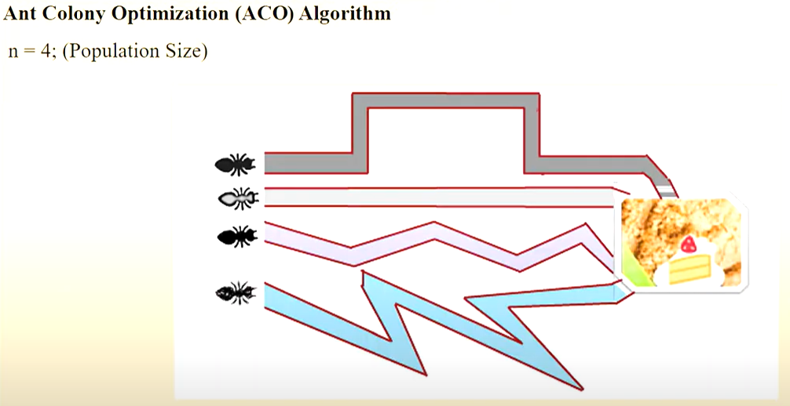

Slide 26
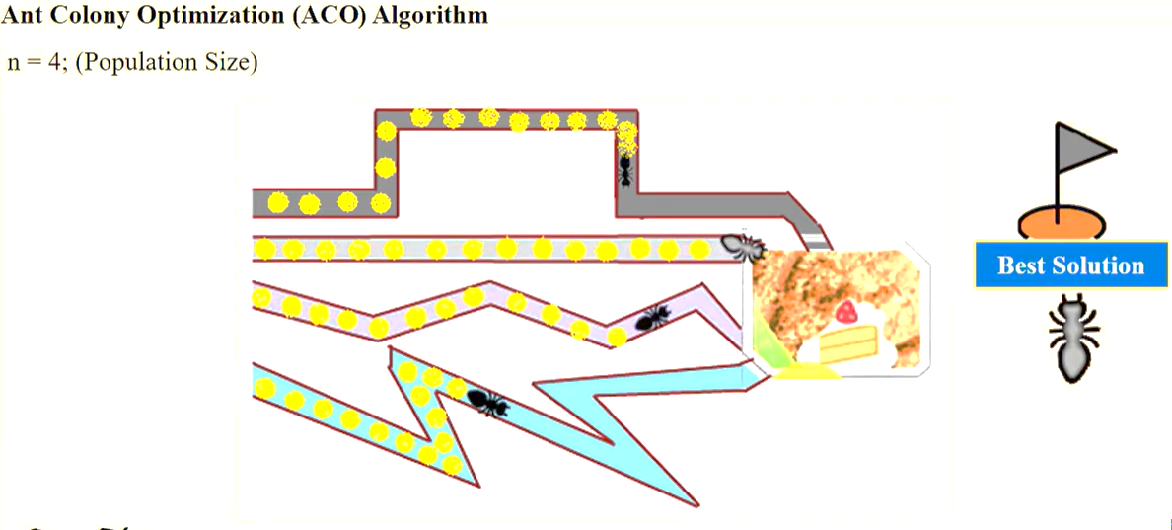

Slide 27
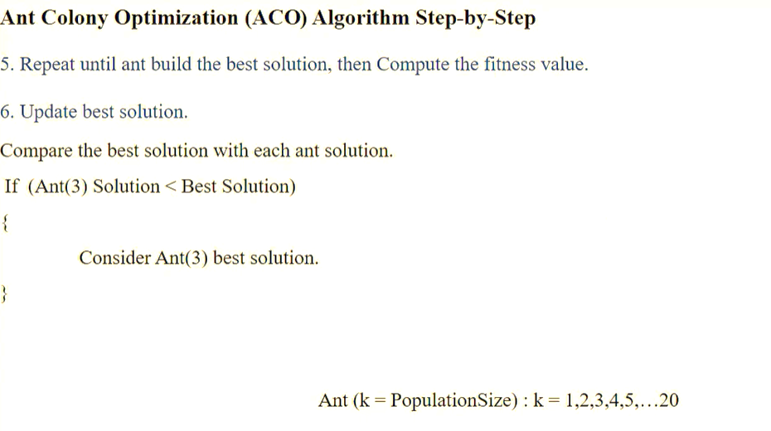

Slide 28
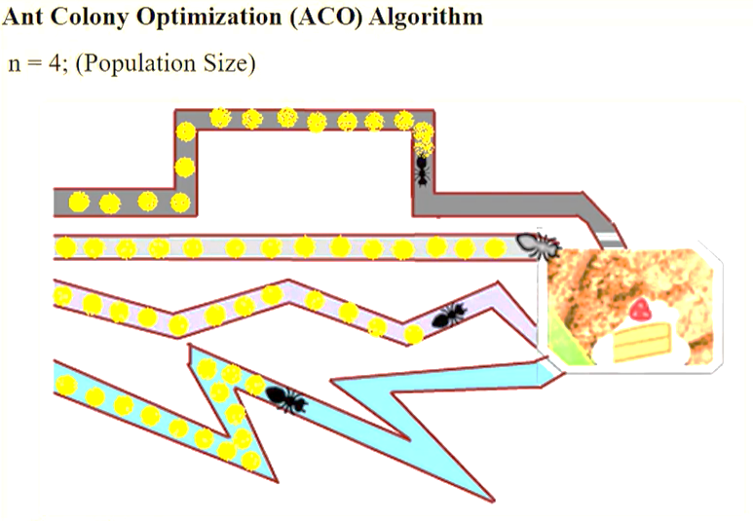
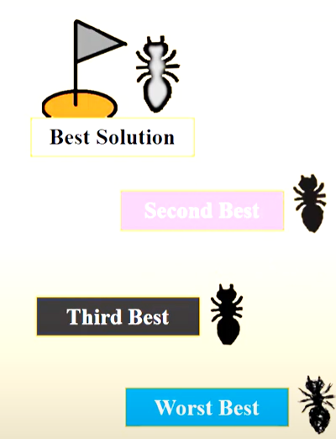

Slide 29
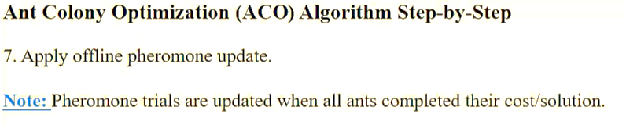
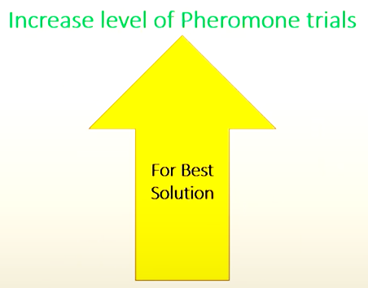
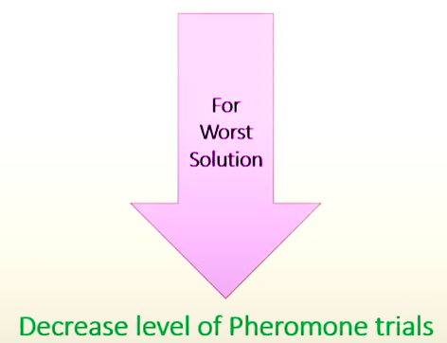

Slide 30
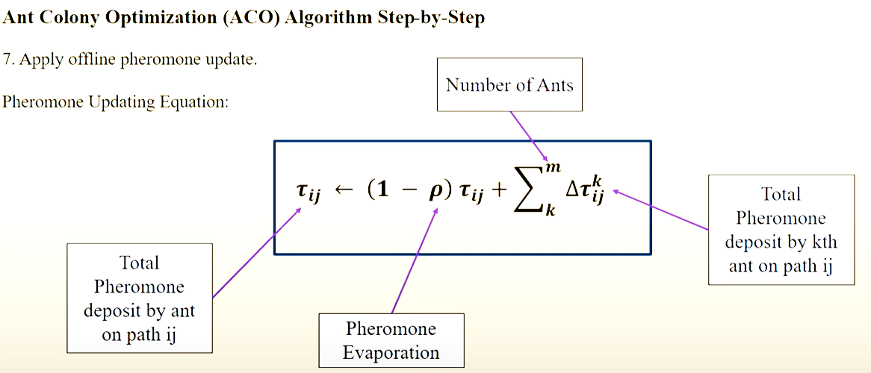

Slide 31
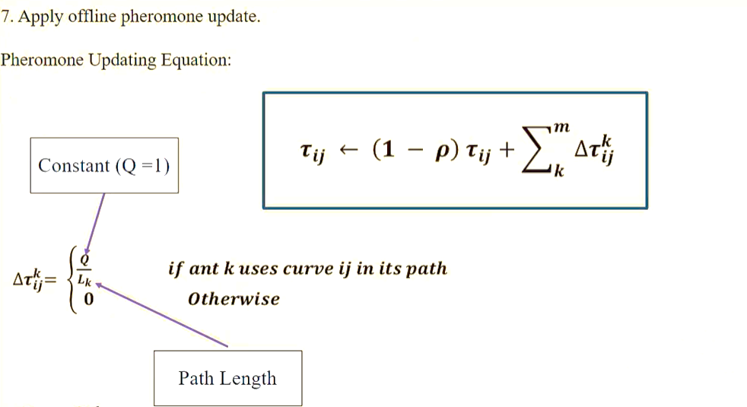

Slide 32


Slide 33


Slide 34


Slide 35


Slide 36


Slide 37


Slide 38


Limitations and Advantages

Slide 39

Ant Colony Optimization
The first version of the algorithm was suggested by Marco Dorigo in 1992.
It was aimed at finding the optimal path on the graph. Actually with the help of this algorithm the problems represented as a graph aimed at finding the optimal path in it are solved.
It is usually about transport logistics or network technologies.

Slide 40



Ant Colony Optimization using TSP
Lets analyze the “Travelling Salesman Problem”
There are different tasks setting approaches, we will consider the following option.
Lets say that there are 5b cities and we are in the city “A”. We need to find the shortest route by going through all the cities once and return to the initial city.

Slide 41




Ant Colony Optimization using TSP
In the beginning, we have a choice of 4 cities.
We have chosen one of the options, now we need to choose from 3 remaining cities.
We make a choice, at the moment, the route options are: 4 times 3 equals 12.

Slide 42


Ant Colony Optimization using TSP
We need to choose from 2 cities.
Development options are: 4 times 3 times 2 equals 24

Slide 43


Ant Colony Optimization using TSP
And then, there is only 1 option.

Slide 44


Ant Colony Optimization using TSP
The number of options is the factorial of the number of cities minus one.
Here the small “n” means the number of cities. Since our problem is symmetrical and the route is closed the result must be divided by 2, since the routes are equivalent

Slide 45

Ant Colony Optimization using TSP
The number of options increases rapidly with the increase in the number of cities, and for 66 cities and more, the problem, in practice, cannot be solved using brute force search.
But in many cases, a person can instantly solve this problem, and here is an example.

Slide 46


Ant Colony Optimization using TSP
The algorithm, by the way, tries other options.
This is the cardinal difference.
This is how the cities are approximately located in one of the articles on travelling salesman problem.

Slide 47

Ant Colony Optimization using TSP
The example is clearly not the best, since it does not show the complexity of the task.
Things get a little more complicated when the points connecting the route are located more or less evenly.
But even in this case, a person, by simply following common sense, finds a solution within 5%, maximum 10% of the best solutions.

Slide 48


Ant Colony Optimization using TSP
In fact, from a huge number of options, these are immediately excluded.
Lets connect 30 cities by ourselves.
Firstly, you shouldn’t arrange everything so that you will then have to make a long jump to the starting city.

Slide 49



Ant Colony Optimization using TSP
The route should be like this.
We are trying to move to the nearest cities, if we go here, we will have to take a long jump to return to these cities, so we add them at once.

Slide 50


Ant Colony Optimization using TSP
Also, don’t forget to include these cities.

Slide 51


Ant Colony Optimization using TSP
Next, you can go either this way or this way.

Slide 52


Ant Colony Optimization using TSP
Lets go with the option 2.
The path turned out to be 6842 pixel.
And now lets see the results of the ant algorithm.

Slide 53



Ant Colony Optimization using TSP
The green substance represents pheromone paths, These were poured lot

Slide 54

Ant Colony Optimization using TSP
At iteration 16, the algorithm outperformed
At 283 iterations, it found an even shorter path, and one more improvement for 372 iterations.
Our path turned out to be longer by a little more than 3%. Not a bad result given that the there was only one iteration.

Slide 55


Ant Colony Optimization using TSP
However , a person needs to visually see the cost of moving from one node to another and the roads may not be straight and of different quality.
The work around may be shorter than the direct way.
Roads can have different costs in different directions, meaning that the problem becomes asymmetric and the person here is taken down.

Slide 56

Ant Colony Optimization using TSP
But the algorithm doesn’t pay attention to this, since it works with a table instead of a picture and we begin to crack the classic ant colony optimization algorithm.

Slide 57


Slide 58
Ant Colony Optimization using TSP
The first formula is the probability of an ant moving from one city to another.
These formulas are taken from different sources, yet they describe the same thing.

Slide 59



Ant Colony Optimization using TSP

Slide 60

Ant Colony Optimization using TSP

Slide 61



Example 1
The ant is at vertice 0

Slide 62




Example 1
It can go to vertice 1 , the desire to go there equals “a”.
It can also go to vertice 2, the desire to go there equals “b”.

Slide 63


Example 1
And for vertice 3, the desire equals “c”.

Slide 64



Example 1
To calculate the probability of going to vertice 1.
We take the desire to go there and divide it by the sum of all desires.
This is the probability that the ant will move from vertice 0 to vertice 1.

Slide 65


Example 1
This probability is the desire to go there divided by the sum.
In exactly the same way, we calculate the probability of moving to vertice 2 and vertice 3.
If we add up all these probabilities, we end up with one.
Actually, this formula serves to ensure that the sum of all probabilities is equal to one.

Slide 66


Example 1
We launch a random number generator, which generates a real number from zero to one.
The result will show which city we will move to.
Lets say, we have generated 0.47, so we will go to city 2.

Slide 67

Formula

Slide 68
The second formula describes the distribution of pheromones across the paths.
The pheromones are distributed post factum , when all the ants have made their route.
These are formulas from different sources

Slide 69

Lets analyze the formula
The symbol “k” represents the index of the ant
The symbol “t” represents the iteration number
The pheromone addition that the ant “k” makes on the route between the i city and j city at iteration “t” is equal to some constant “Q” divided by the length of the route travelled by the ant “k”, provided that this path between the I city and j city is in line with the route of the ant.
If its not then there is no addition.

Slide 70
The amount of pheromones of the route between the I city and j city in the new iteration is equal to the amount of pheromones in the previous iteration, multiplied by the evaporation coefficient (pheromones are constantly evaporating), and to the result obtained , we need to add the sum of all the new positions of the pheromones that all the ants have left in this area.
We could include the amount of pheromones remaining after evaporation in the constant and multiplied by the amount of pheromones.

Slide 71

Example 1

Slide 72


Slide 73


Slide 74


Slide 75


Slide 76


Slide 77


Slide 78



Slide 79


Slide 80


Slide 81


Slide 82


