Slide 1

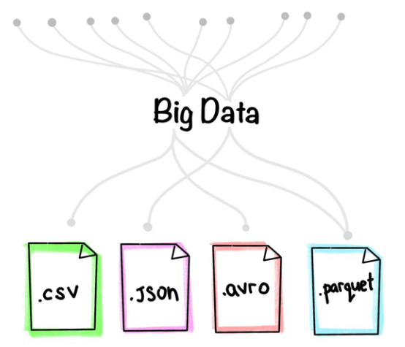
B.M.S COLLEGE OF ENGINEERING, BANGALORE-19
DEPARTMENT OF MACHINE LEARNING
BIG DATA ANALYTICS
(24AM6PEBDA)
UNIT -02
Chapter 2
BIG DATA FILE FORMTS AND COMPRESSION TECHNIQUES
Prof. Varsha R,
Assistant Professor, Dept. of Machine Learning, BMSCE

Slide 2
Introduction
We live in a digital era where thousands of zettabytes of data are generated at an ever-increasing pace. This brings the challenge of storing and processing all this data. So, what does that have to do with big data file formats for data engineers?
When we say “data” we don’t only refer to the data of businesses and organizations. To clarify, this data is generated from numerous sources including web applications, cell phones, social media networks, bank transactions, messages, sensors, etc.,
The data structure always differs in nature, some may be structured while some remain semi-structured or unstructured. Therefore, in order to store this data, a significantly large storage area is required that has the capability of handling various data types.

Slide 3
What is File Format?
A file format is a standard way in which information is encoded for storage in a file. First, the file format specifies whether the file is a binary or ASCII file. Second, it shows how the information is organized. For example, comma-separated values (CSV) file format stores tabular data in plain text.
To identify a file format, you can usually look at the file extension to get an idea. For example, a file saved with name “Data” in “CSV” format will appear as “Data.csv”. By noticing “.csv” extension we can clearly identify that it is a “CSV” file and data is stored in a tabular format

Slide 4
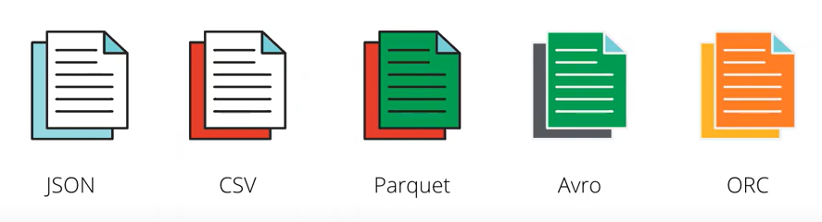
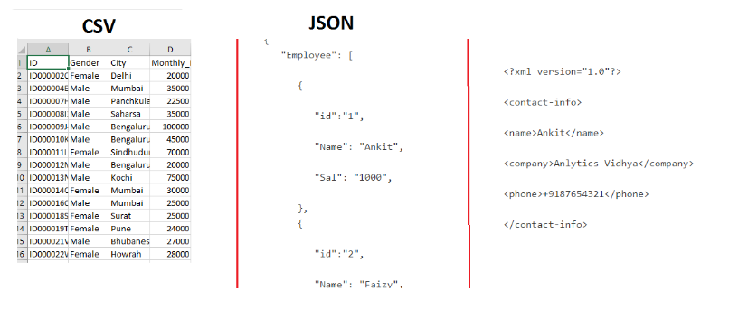
File formats

Slide 5
What is Data Format?
Data format is a process of formatting the data in a proper way either by storing, by ordering or by compressing the data.
For example, lets assume that we want to withdraw money from the bank. We provide the following information:
Account number first
Amount to be withdraw and
Name
For successful transactions or completion of tasks, it's crucial to accurately format and present the data.

Slide 6
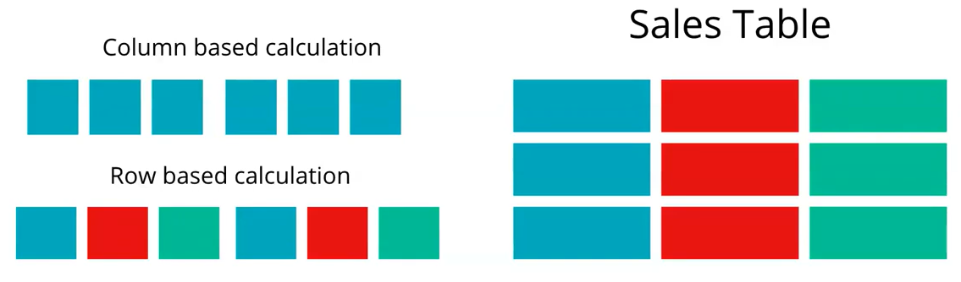
Types of Data Format
The data formats are primarily segregated into :
Columnar / Column based
Row based
Consider a sales data which comprises of 3 columns having the attribute id, item and amount
id
item
amount
Row
Column

Slide 7
Types of Data Format
Example 1:Total sales done ?
The column that we will be focusing on is the amount column.
This query or transaction requires only interaction with only one column at the most.
This will result in a column scan.
Example 2: What did id = 002 bought/ purchased?
For this particular information we have to retrieve a row.
This will result in a row scan.

Slide 8
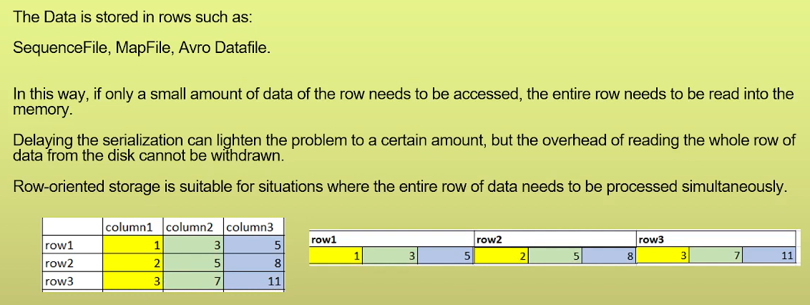
Row Based Format

Slide 9
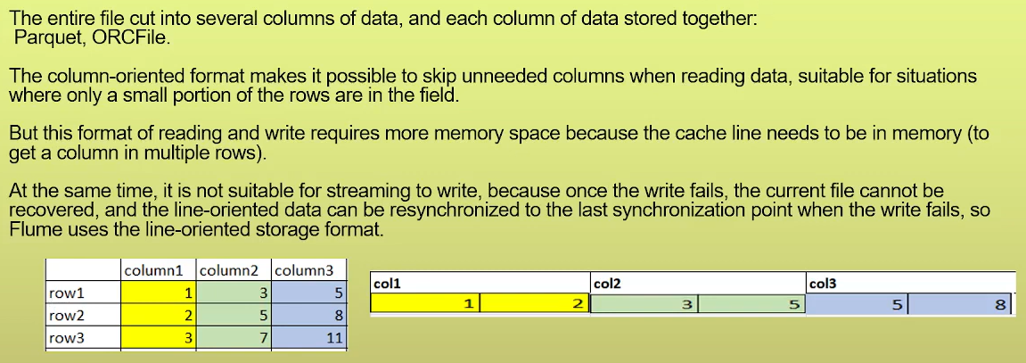
Column Based Format

Slide 10
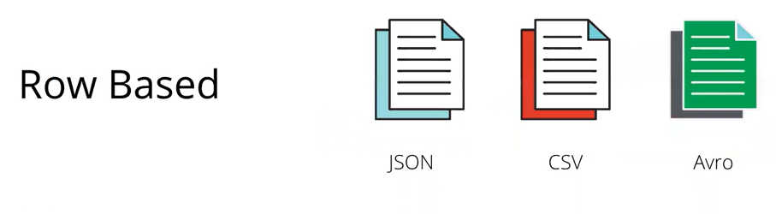
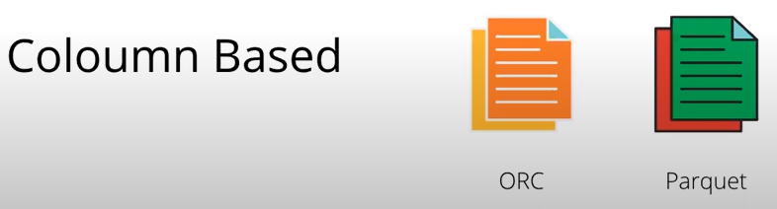
Difference between Row oriented and Column oriented scan
Row Oriented | Column Oriented
Storing the data in the row based format includes, understanding the behaviour of the customer, the purchase information and what is the status of a particular order. Such kind of data requires a row scan. | Storing the data in the column based format, results in faster retrieval/accessing of the data.
Most of the data are segregated on a higher section which includes JSON, CSV and AVRO. | The data are segregated into ORC and Parquet.
If we are intending to use some machine learning or data analysis regarding how a particular product was sold, the user behaviour when he/she is buying things, we use row scan. | If we want to access sales related data i.e total sales done per days, per week, per month or to understand the total items sold, we use column scan. If we have some aggregation or sum which focuses on certain columns only, then we use column orientation.

Slide 11
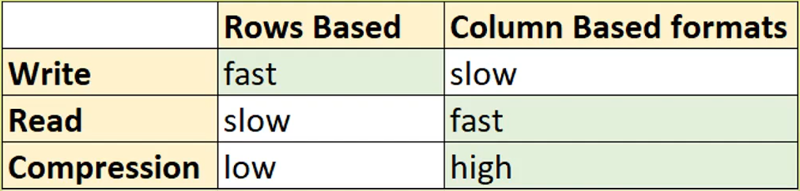
Comparing Row based and Column based

Slide 12
Benefits of Using Appropriate Big Data File Formats
The data Reading from storage becomes faster.
The data writing becomes faster.
Splitable in nature to support parallelism.
The compression support helps in file size reduction.
Support of schema evolution.
Cost reduction

Slide 13
Types of File Format
Different types of file formats used in Big data analytics are :
ORC
Parquet Popularly used in big data processing system
Avro
CSV Commonly used data formatting tools
JSON

Slide 14
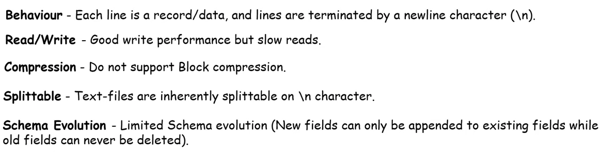
Text files (CSV, TSV)

Slide 15
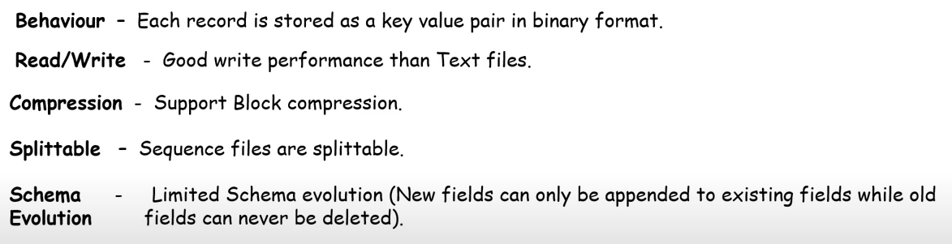
Sequence files

Slide 16
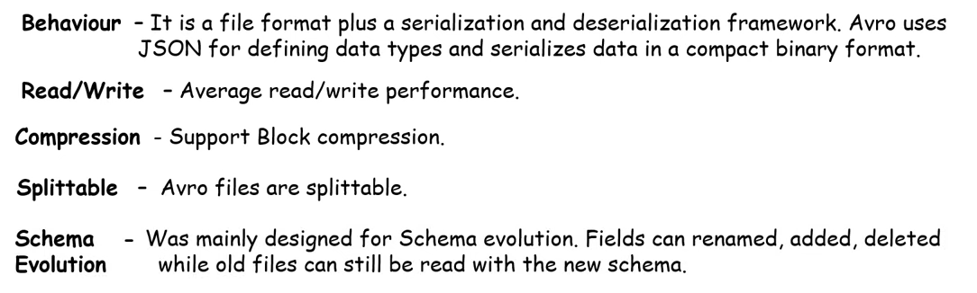
Avro file format

Slide 17

Avro file format
Apache Avro is a row-based data serialization format commonly used for data exchange and streaming in Big Data systems.
AVRO is an open-source project and it provides the data serialization and exchange services for Apache Hadoop.
It is a row-based storage format for Hadoop systems and is used as a data serialization platform.
It stores schema in JSON format, making it easy to read and interpret.
In AVRO the data is stored in binary format so, it is compact and efficient.
AVRO files have markers that help in splitting the larger datasets into smaller subsets that help to achieve parallelism.
The key feature of AVRO is it can efficiently handle any change in data schema over time. i.e. Schema Evolution. It handles schema changes like missing fields, added fields, and changed fields.
It also provides API support for the different programming languages like C, C++, Java, Python, Ruby, etc.

Slide 18
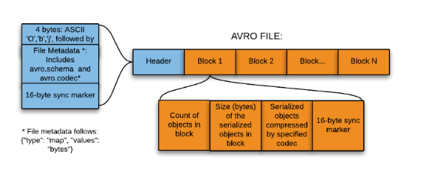
Avro file format
Structure
An Avro file consists of:
1. File header and
2. One or more file data blocks
Header contains information about the schema and codec, while blocks are divided into:
1. Counts of objects in a block
2. Size of the serialized objects
3. Objects themselves

Slide 19
Advantages and Limitations
Advantages
Efficient for write-heavy workloads
Supports schema evolution (adding/removing fields)
Language independent (Java, Python, C++, etc.)
Limitations
Not optimized for analytical queries
Slower for column-based operations

Slide 20
Use Cases
Data ingestion pipelines
Kafka messaging
Log data storage

Slide 21
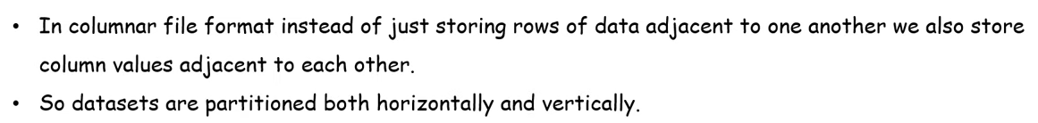
Columnar file format

Slide 22
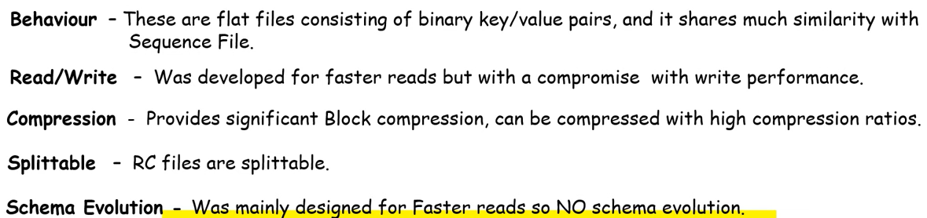
RC (Row Columnar) file format

Slide 23
Advantages and Limitation
Advantages
Better performance than plain text files
Reduced storage size
Limitations
High CPU overhead
Slower compared to ORC and Parquet
Largely deprecated

Slide 24
Use Cases
Legacy Hadoop systems
Older Hive implementations

Slide 25
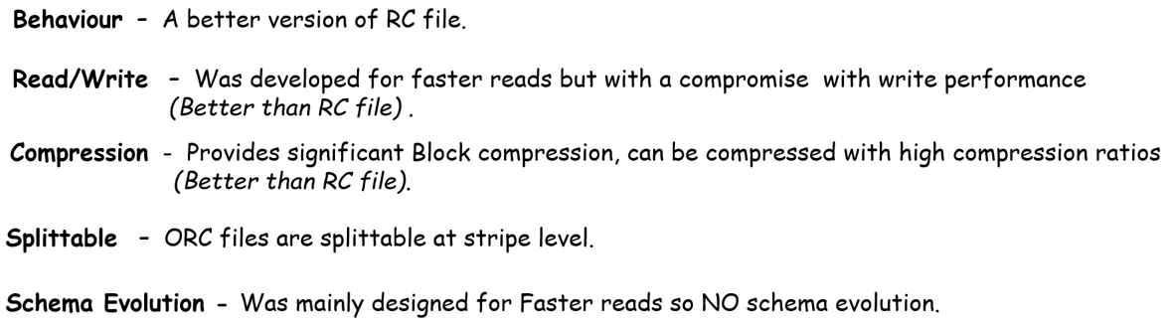
ORC (Optimize Row Columnar) file format

Slide 26

ORC (Optimize Row Columnar) file format
The Optimized Row Columnar (ORC) file format provides an effective way to store the data. Facebook was an early adopter of this format.
It was designed in such a way that it can handle the limitations of other file formats. This file format stores the data in a compact manner and skips the irrelevant parts without the need for large, complex, or manually maintained indices. It addresses all of these issues.
It is a column-oriented data storage format same as Parquet.
The advantages of ORC file formats are:-
The compression ratio is very high, it reduces the size of the original data by up to 75%.
It generates a single file as output for each of the tasks, by doing this it reduces the load from the NameNodes.
A concurrent read of the same file is possible with the help of RecordReaders.
It has the ability to split the files without scanning the markers.

Slide 27
ORC (Optimize Row Columnar) file format
ORC files are self-describing and it has no dependency on Hive Metastore or any other external metadata. The file contains all the types and encoding information for objects that are stored in the file. Also, there is no dependency on the user’s environment for correctly interpreting the file contents.
It contains groups of row data called stripes and auxiliary information in a file footer. The default stripe size is 250 MB. A larger stripe size helps in the effective reading of data from HDFS.
ORC file format stores collections of rows in one file and within the collection the row data is stored in a columnar format.
The file footer contains:
A list of stripes in the file.
The number of rows per stripe.
Each column’s data type.

Slide 28
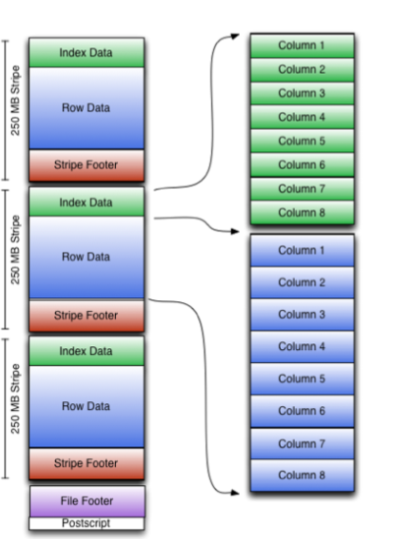
ORC file format
Stripe footer contains a directory of stream locations. It also contains column-level aggregates count, min, max, and sum.
Row data is used in table scans.
Index data include min and max values for each column and the row’s positions within each column.
ORC indexes are used only for the selection of stripes and row groups and not for answering queries.

Slide 29
Advantages and Limitation
Advantages
Very high compression ratio
Faster query performance
Reduced disk I/O
Limitations
Slower write speed compared to Avro
Less flexible schema evolution

Slide 30
Use Cases
Data warehousing
Hive-based analytics
Large-scale batch processing

Slide 31
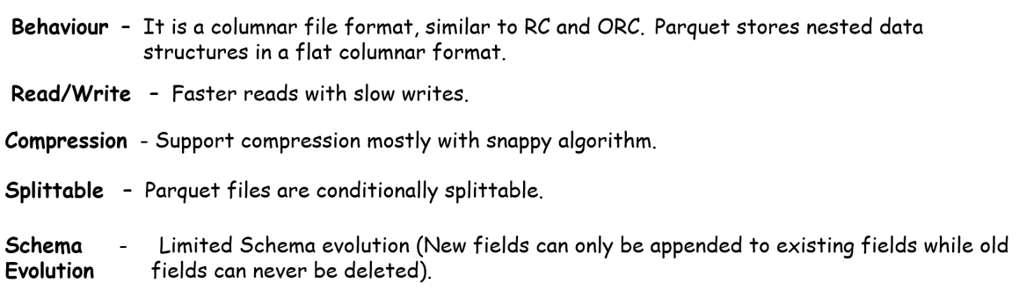
Parquet file

Slide 32

Parquet file format
Parquet is an open-source file format.
It stores data in a columnar format.
It provides great data compression and encoding schemes with enhanced performance to handle complex data in bulk.
Parquet is a binary file and contains metadata about its content. The metadata of the column is stored at the end of the file. It is optimized for the paradigm of Write Once Read Many (WORM).
It supports the splitting of files which helps in the parallel data processing.
Organizing by column, allows better compression, as data is more homogeneous.
It also supports schema evolution.
It’s only restricted to batch processing.
It provides high efficiency for OLAP workload. For example, the Analysis of data in BI (Business Intelligence) works.
With the help of Spark processing engines, it can read the data in less time.
It is mostly used along with Spark, Impala, Arrow, and Drill.

Slide 33
Advantages and Limitations
Advantages
Excellent query performance
Interoperable across tools (Spark, Hive, Presto)
Efficient for analytical workloads
Limitations
Not ideal for frequent updates
Slower write speed than Avro

Slide 34
Use Cases
Data lakes
Analytical queries
Machine learning pipelines

Slide 35

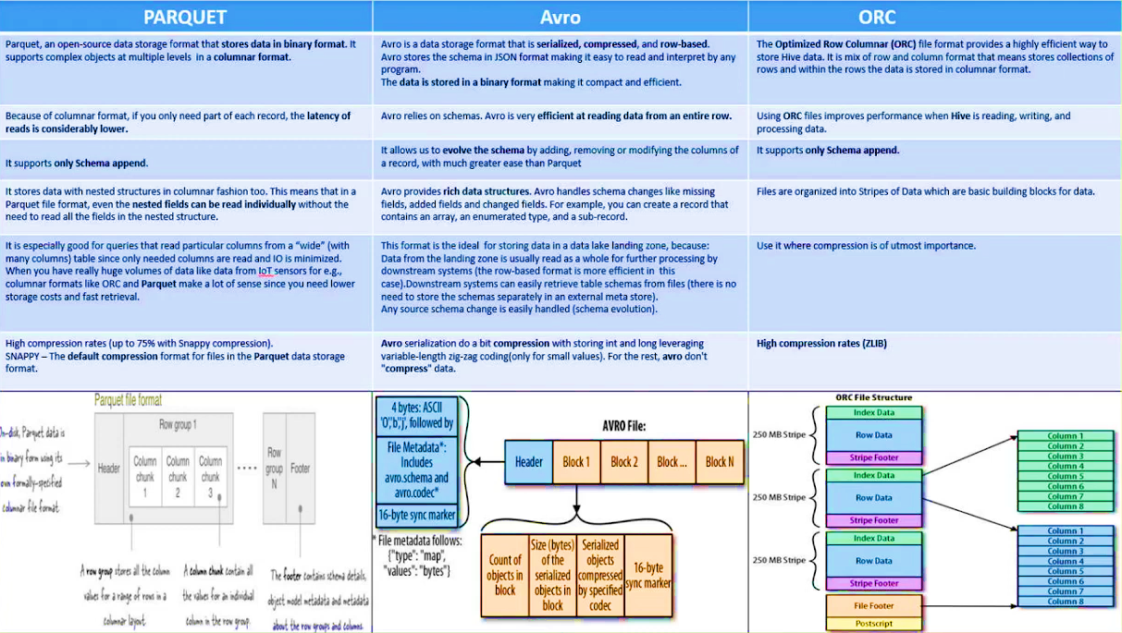
Comparing Parquet, Avro and ORC

Slide 36
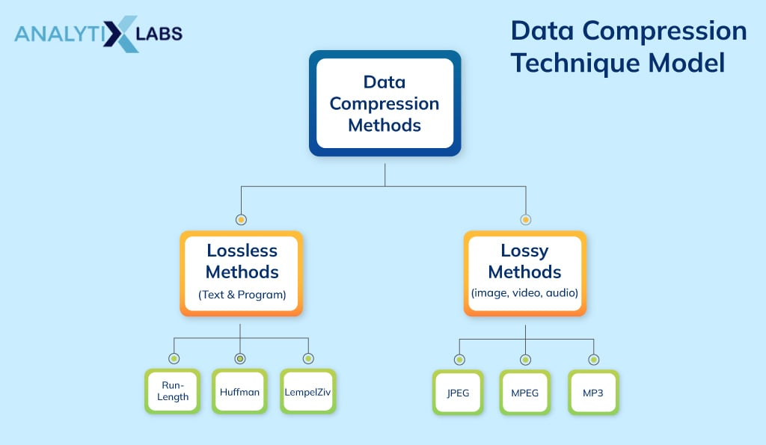
Data Compression
Data Compression is also referred to as bit-rate reduction or source coding. This technique is used to reduce the size of large files.
The advantage of data compression is that it helps us save our disk space and time in the data transmission.
Data compression seeks to reduce the number of bits used to store or transmit information.

Slide 37
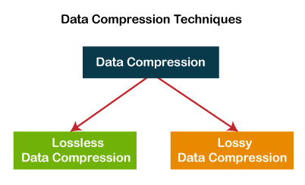
Types of data compression
Lossless Data Compression
Lossy Data Compression

Slide 38
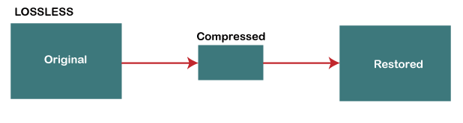
Lossless Data Compression
Lossless data compression is used to compress the files without losing an original file's quality and data. Simply, we can say that in lossless data compression, file size is reduced, but the quality of data remains the same.
The main advantage of lossless data compression is that we can restore the original data in its original form after the decompression.
Lossless data compression mainly used in the sensitive documents, confidential information, and PNG, RAW, GIF, BMP file formats.

Slide 39
Lossless Data Compression
Some most important Lossless data compression techniques are -
Run Length Encoding (RLE)
Lempel Ziv - Welch (LZW)
Huffman Coding
Arithmetic Coding

Slide 40
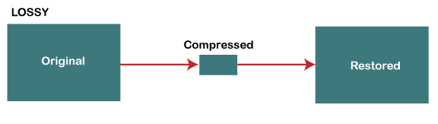
Lossy Data Compression
Lossy data compression is used to compress larger files into smaller files. In this compression technique, some specific amount of data and quality are removed (loss) from the original file.
It takes less memory space from the original file due to the loss of original data and quality.
This technique is generally useful for us when the quality of data is not our first priority.
Lossy data compression is most widely used in JPEG images, MPEG video, and MP3 audio formats.

Slide 41
Lossy Data Compression
Some important Lossy data compression techniques are -
Transform coding
Discrete Cosine Transform (DCT)
Discrete Wavelet Transform (DWT)

Slide 42
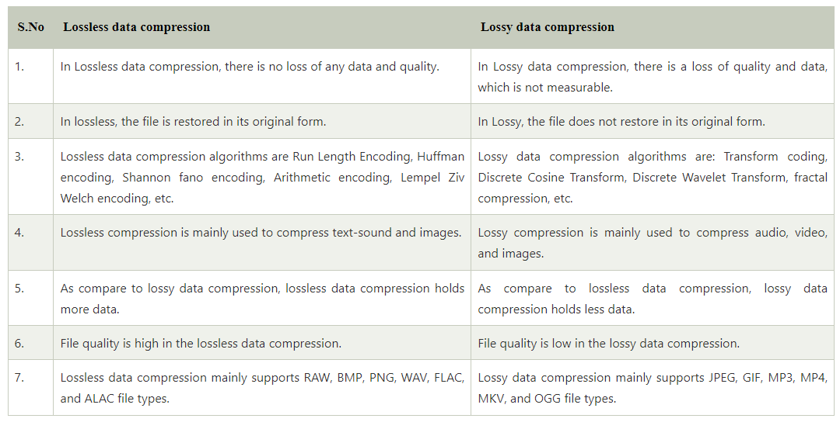
Difference between Lossless and Lossy data compression

Slide 43
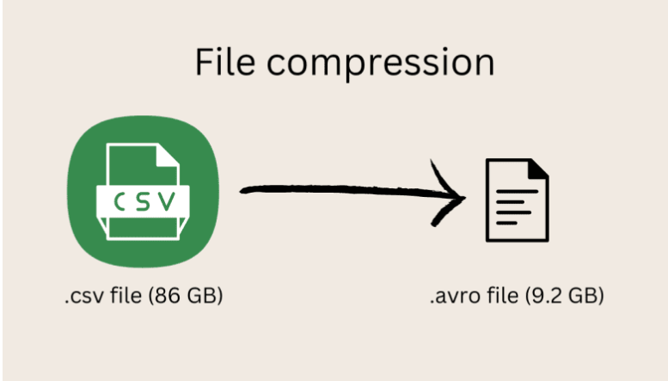
File compression
One of the main benefits of using big data file formats is a significant reduction in storage requirements and, consequently, costs. This benefit is achieved via multiple compression methods that both Avro and Parquet support. However, the difference lies in how the compression is performed and how efficient it is.

Slide 44
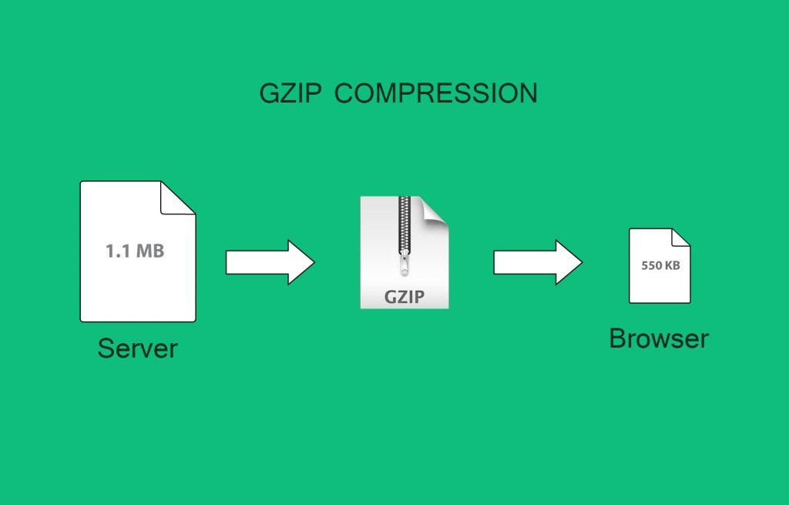
GZIP (GNU Zip)
It is a compression utility adopted by the GNU or Gnu’s Not Unix project which generates compressed files.
It is naturally supported by Hadoop. Not only that, it is based on the DEFLATE algorithm, which is a combination of LZ77 and Huffman Coding.
GZIP provides very good compression performance.
In comparison to Snappy, it provides about 2.5 times more compression. But its write speed is not as good as Snappy’s.
GZIP usually performs almost as well as Snappy in terms of reading performance.
It is also not splitable, so it should be used with a container format.
It is sometimes slower than Snappy for processing is that GZIP compressed files take up fewer blocks, so fewer tasks are required for processing the same data. For this reason, using smaller blocks with GZIP can lead to better performance.

Slide 45

BZIP2
BZIP2 is a freely available, high-quality data compressor. It typically compresses files to within 10% to 15% of the best available techniques, while being around twice as fast at compression and six times faster at decompression.
Using this compression technique, data is splitable in Hadoop. It generates a better compression ratio than GZIP, but is very slow.
Bzip2 provides excellent compression performance. But it can be significantly slower than other compression codecs such as Snappy in terms of processing performance.
Unlike Snappy and GZIP, Bzip2 is inherently splitable.
In many examples, we have seen, bzip2 will normally compress around 9% better than GZIP, in terms of storage space. However, this extra compression comes with a significant read/write performance cost.
This performance difference will vary with different machines, but in general, bzip2 is about 10 times slower than GZIP. For this reason, it’s not an ideal codec for Hadoop storage, unless your primary need is reducing the storage footprint. One example of such a use case would be using Hadoop mainly for active archival purposes.

Slide 46
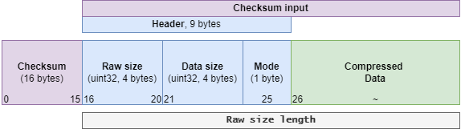
LZ4
It is a compression technique that creates a splitable compressed file in Hadoop. There is no need for external indexing when using this compression.
It can be used at any level of speed/compression ratio in Hadoop: from fast mode reaching 500 MB/s compression speed up to high/ultra modes providing increased compression ratio, almost comparable with GZIP one.

Slide 47
Snappy
Snappy is a compression/decompression library. It does not aim for maximum compression or compatibility with any other compression library; instead, it aims for very high speeds and reasonable compression. It is widely used inside Google, in everything from Big Table and MapReduce.
Although Snappy doesn’t offer the best compression sizes, it does provide a good trade-off between speed and size. Processing performance with Snappy can be significantly better than other compression formats. It’s important to note that Snappy is intended to be used with a container format like Sequence Files or Avro since it’s not inherently splitable.

