Slide 1

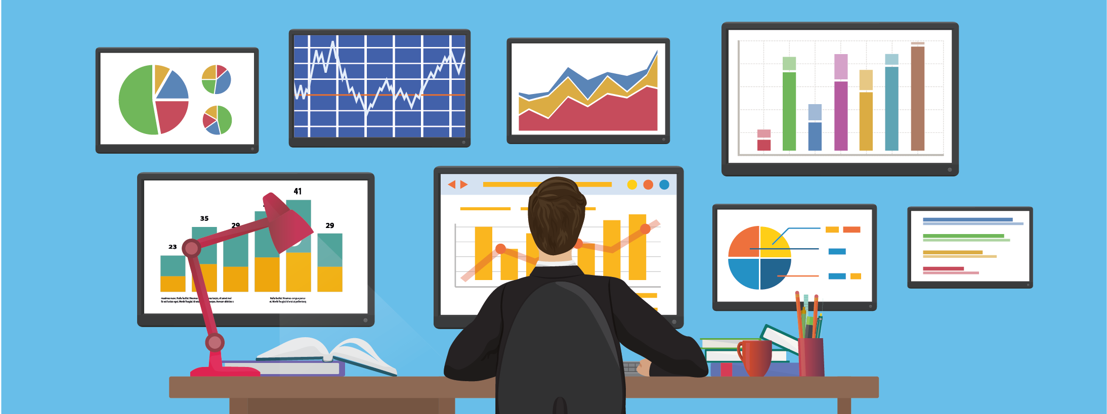
B.M.S COLLEGE OF ENGINEERING, BANGALORE-19
DEPARTMENT OF MACHINE LEARNING
BIG DATA ANALYTICS
(24AM6PEBDA)
UNIT -01
Chapter 1
INTRODUCTION TO BIG DATA ANALYTIVS
Prof. VARSHA R
Assistant Professor, Dept. of Machine Learning, BMSCE

Slide 2
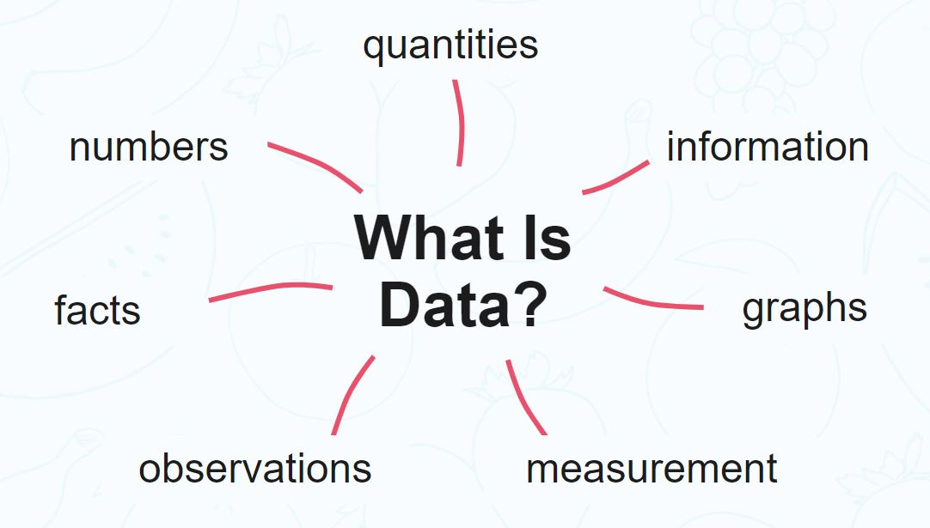
What is Data?
Definition : Data is information such as facts and numbers used to analyze something or make decisions.
Data is different types of information usually formatted in a particular manner.
Data can also be defined as a set of recorded facts, numbers or events that have no meaning, Data is meaningless until it is given relevance.
Data must be interpreted by human or machine, to derive meaning.

Slide 3
What is Big Data?
Definition: Big data is high-volume, high-velocity and/or high-variety information assets that demand cost-effective, innovative forms of information processing that enable enhanced insight, decision making, and process automation.
Data which are very large in size is called Big Data.
Normally we work on data of size MB(WordDoc ,Excel) or maximum GB(Movies, Codes) but data in Peta bytes i.e. 10^15 byte size is called Big Data.

Slide 4
What is Big Data Analytics?
Definition: Big data analytics is the process of collecting, examining, and analyzing large amounts of data to discover market trends, insights, and patterns that can help companies make better business decisions.
This information is available quickly and efficiently so that companies can be agile in crafting plans to maintain their competitive advantage.
Technologies such as business intelligence (BI) tools and systems help organizations take unstructured and structured data from multiple sources. Users (typically employees) input queries into these tools to understand business operations and performance. Big data analytics uses the four data analysis methods to uncover meaningful insights and derive solutions.
For example, big data analytics is integral to the modern health care industry. As you can imagine, systems that must manage thousands of patient records, insurance plans, prescriptions, and vaccine information.

Slide 5
Importance of Big Data Analytics
Big data analytics is important because it helps companies leverage their data to identify opportunities for improvement and optimization.
Big data analytics helps companies reduce costs and develop better, customer-centric products and services.
Data analytics helps provide insights that improve the way our society functions.
In health care, big data analytics not only keeps track of and analyses individual records but it plays a critical role in measuring outcomes on a global scale.
During the COVID-19 pandemic, big data-informed health ministries within each nation’s government on how to proceed with vaccinations and devised solutions for mitigating pandemic outbreaks in the future.

Slide 6
Sources of Big Data
The primary sources of Big data
1. Machine data : Machine data is automatically generated, either as a response to a specific event or a fixed schedule.
It means all the information is developed from multiple sources such as smart sensors, SIEM logs, medical devices and wearables, road cameras, IoT devices, satellites, desktops, mobile phones, industrial machinery, etc. These sources enable companies to track consumer behavior.
2. Social data : It is derived from social media platforms through tweets, retweets, likes, video uploads, and comments shared on Facebook, Instagram, Twitter, YouTube, Linked In etc.
The extensive data generated through social media platforms and online channels offer qualitative and quantitative insights on each crucial facet of brand-customer interaction.

Slide 7
Sources of Big Data
3. Transactional data : As the name suggests, transactional data is information gathered via online and offline transactions during different points of sale.
The data includes vital details like transaction time, location, products purchased, product prices, payment methods, discounts/coupons used, and other relevant quantifiable information related to transactions.
The sources of transactional data include:
Payment orders
Invoices
Storage records and
E-receipts

Slide 8
Sources of Big Data
Social networking sites: Facebook, Google, LinkedIn all these sites generates huge amount of data on a day to day basis as they have billions of users worldwide.
E-commerce site: Sites like Amazon, Flipkart, Alibaba generates huge amount of logs from which users buying trends can be traced.
Weather Station: All the weather station and satellite gives very huge data which are stored and manipulated to forecast weather.
Telecom company: Telecom giants like Airtel, Vodafone study the user trends and accordingly publish their plans and for this they store the data of its million users.
Share Market: Stock exchange across the world generates huge amount of data through its daily transaction.

Slide 9
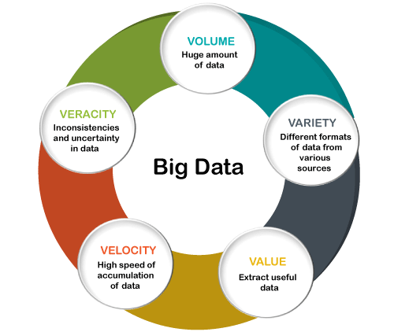
Characteristics of Big Data
There are five v's of Big Data that explains the characteristics.
Volume
Veracity
Variety
Value
Velocity

Slide 10
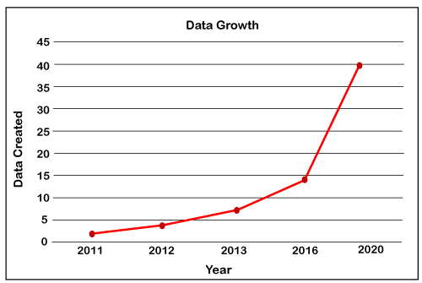
Characteristics of Big Data
1. Volume : The name Big Data itself is related to an enormous size.
Big Data is a vast 'volumes' of data generated from many sources daily, such as business processes, machines, social media platforms, networks, human interactions, and many more.
Facebook can generate approximately a billion messages, 4.5 billion times that the "Like" button is recorded, and more than 350 million new posts are uploaded each day. Big data technologies can handle large amounts of data.

Slide 11
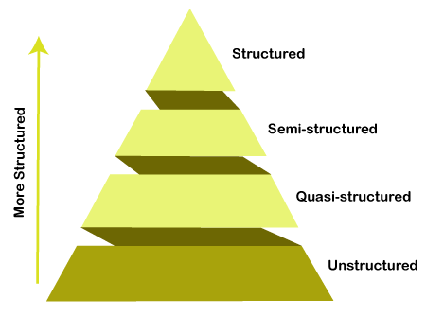
Characteristics of Big Data
2. Variety : Big Data can be structured, unstructured, and semi-structured that are being collected from different sources.
Data will only be collected from databases and sheets in the past, But these days the data will comes in array forms, that are PDFs, Emails, audios, SM posts, photos, videos, etc.

Slide 12
Categorization of Data
The data is categorized as below:
Structured data: In Structured schema, along with all the required columns. It is in a tabular form. Structured Data is stored in the relational database management system.
Semi-structured: In Semi-structured, the schema is not appropriately defined, e.g., JSON, XML, CSV, TSV, and email. OLTP (Online Transaction Processing) systems are built to work with semi-structured data. It is stored in relations, i.e., tables.
Unstructured Data: All the unstructured files, log files, audio files, and image files are included in the unstructured data. Some organizations have much data available, but they did not know how to derive the value of data since the data is raw.
Quasi-structured Data: The data format contains textual data with inconsistent data formats that are formatted with effort and time with some tools.
Example: Web server logs, i.e., the log file is created and maintained by some server that contains a list of activities.

Slide 13
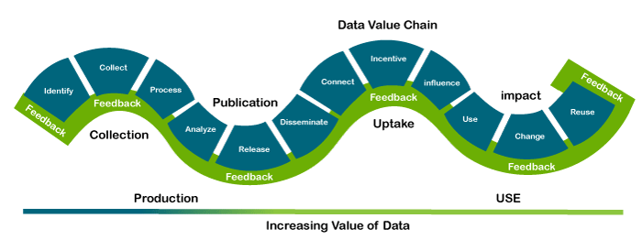
Characteristics of Big Data
3. Veracity : Veracity means how much the data is reliable. It has many ways to filter or translate the data. Veracity is the process of being able to handle and manage data efficiently. Big Data is also essential in business development.
For example, Facebook posts with hashtags.
4. Value : Value is an essential characteristic of big data. It is not the data that we process or store. It is valuable and reliable data that we store, process, and also analyze.

Slide 14
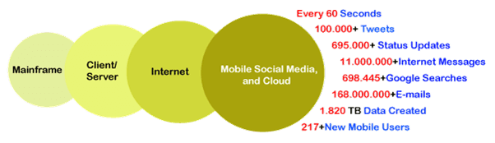
Characteristics of Big Data
5. Velocity : Velocity plays an important role compared to others. Velocity creates the speed by which the data is created in real-time. It contains the linking of incoming data sets speeds, rate of change, and activity bursts. The primary aspect of Big Data is to provide demanding data rapidly.
Big data velocity deals with the speed at the data flows from sources like application logs, business processes, networks, and social media sites, sensors, mobile devices, etc.

Slide 15
Types of Big Data Analytics
Four main types of big data analytics support and inform different business decisions.
1. Descriptive analytics : Descriptive analytics refers to data that can be easily read and interpreted. This data helps create reports and visualize information that can detail company profits and sales.
Example: During the pandemic, a leading pharmaceutical company conducted data analysis on its offices and research labs. Descriptive analytics helped them identify consolidated unutilized spaces and departments, saving the company millions of pounds.
2. Diagnostics analytics : Diagnostics analytics helps companies understand why a problem occurred. Big data technologies and tools allow users to mine and recover data that helps dissect an issue and prevent it from happening in the future.
Example: An online retailer’s sales have decreased even though customers continue to add items to their shopping carts. Diagnostics analytics helped to understand that the payment page was not working correctly for a few weeks.

Slide 16
Types of Big Data Analytics
3. Predictive analytics : Predictive analytics looks at past and present data to make predictions. With artificial intelligence (AI), machine learning, and data mining, users can analyze the data to predict market trends.
Example: In the manufacturing sector, companies can use algorithms based on historical data to predict if or when a piece of equipment will malfunction or break down.
4. Prescriptive analytics : Prescriptive analytics solves a problem, relying on AI and machine learning to gather and use data for risk management.
Example: Within the energy sector, utility companies, gas producers, and pipeline owners identify factors that affect the price of oil and gas to hedge risks.

Slide 17
Big Data Analytics Tools and Techniques
1. Hadoop: An open-source framework that stores and processes big data sets. Hadoop can handle and analyze structured and unstructured data.
2. Spark: An open-source cluster computing framework for real-time processing and data analysis.
3. Data integration software: Programs that allow big data to be streamlined across different platforms, such as MongoDB, Apache, Hadoop, and Amazon EMR.
4. Stream analytics tools: Systems that filter, aggregate, and analyze data that might be stored in different platforms and formats, such as Kafka.

Slide 18
Big Data Analytics Tools and Techniques
5. Distributed storage: Databases that can split data across multiple servers and can identify lost or corrupt data, such as Cassandra.
6. Predictive analytics hardware and software: Systems that process large amounts of complex data, using machine learning and algorithms to predict future outcomes, such as fraud detection, marketing, and risk assessments.
7. Data mining tools: Programs that allow users to search within structured and unstructured big data.
8. NoSQL databases: Non-relational data management systems ideal for dealing with raw and unstructured data.
9. Data warehouses: Storage for large amounts of data collected from many different sources, typically using predefined schemas.

Slide 19
Benefits of Big Data Analytics
Incorporating big data analytics into a business or organization has several advantages. These include:
Cost reduction: Big data can reduce costs in storing all business data in one place. Tracking analytics also helps companies find ways to work more efficiently to cut costs wherever possible.
Product development: Developing and marketing new products, services, or brands is much easier when based on data collected from customers’ needs and wants. Big data analytics also helps businesses understand product viability and to keep up with trends.
Strategic business decisions: The ability to constantly analyze data helps businesses make better and faster decisions, such as cost and supply chain optimization.
Customer experience: Data-driven algorithms help marketing efforts (targeted ads, for example) and increase customer satisfaction by delivering an enhanced customer experience.
Risk management: Businesses can identify risks by analyzing data patterns and developing solutions for managing those risks.

Slide 20
Usage of Big Data
Healthcare: It aids in precise diagnoses and disease prediction, elevating patient care.
Retail: Amazon’s use of Big Data Analytics offers personalized product recommendations based on your shopping history, creating a more tailored and enjoyable shopping experience.
Finance: Credit card companies such as Visa rely on Big Data Analytics to swiftly identify and prevent fraudulent transactions, ensuring the safety of your financial assets.
Transportation: Companies like Uber use Big Data Analytics to optimize drivers’ routes and predict demand, reducing wait times and improving overall transportation experiences.
Agriculture: Farmers make informed decisions, boosting crop yields while conserving resources.
Manufacturing: Companies like General Electric (GE) use Big Data Analytics to predict machinery maintenance needs, reducing downtime and enhancing operational efficiency.

Slide 21
Big Data in Real World
Big data analytics helps companies and governments make sense of data and make better, informed decisions.
Entertainment: Providing a personalized recommendation of movies and music according to a customer’s preferences has been transformative for the entertainment industry (think Spotify and Netflix).
Education: Big data helps schools and educational technology companies develop new curriculums while improving existing plans based on needs and demands.
Government: Big data can be used to collect data from CCTV and traffic cameras, satellites, body cameras and sensors, emails, calls, and more, to help manage the public sector.
Marketing: Customer information and preferences can be used to create targeted advertising campaigns with a high return on investment (ROI).
Banking: Data analytics can help track and monitor illegal money laundering.

Slide 22
Challenges of Big Data
Data Overload: Consider Twitter, where approximately 6,000 tweets are posted every second. The challenge is sifting through this avalanche of data to find valuable insights.
Data Quality: If the input data is inaccurate or incomplete, the insights generated by Big Data Analytics can be flawed. For example, incorrect sensor readings could lead to wrong conclusions in weather forecasting.
Privacy Concerns: With the vast amount of personal data used, like in Facebook’s ad targeting, there’s a fine line between providing personalized experiences and infringing on privacy.
Security Risks: With cyber threats increasing, safeguarding sensitive data becomes crucial. For instance, banks use Big Data Analytics to detect fraudulent activities, but they must also protect this information from breaches.
Costs: Implementing and maintaining Big Data Analytics systems can be expensive. Airlines like Delta use analytics to optimize flight schedules, but they need to ensure that the benefits outweigh the costs.

