Slide 1

B.M.S COLLEGE OF ENGINEERING, BANGALORE-19
DEPARTMENT OF MACHINE LEARNING
BIG DATA ANALYTICS
(24AM6PEBDA)
UNIT-05
Data Analytics with Apache Spark
Prof. Varsha R
Assistant Professor, Dept. of Machine Learning

Slide 2
Introduction
Apache Spark is an open-source distributed computing framework designed for fast processing of large-scale data.
•It performs computations in-memory, which makes it much faster than traditional systems like Hadoop MapReduce.
•Spark supports multiple workloads such as:
•Batch processing
•Real-time streaming
•Machine learning
•Graph processing
•SQL queries
•It provides high-level APIs in languages like Scala, Python, Java, and R.

Slide 3
Spark: A Unified Engine
•Spark is called a unified analytics engine because it supports multiple types of data processing within a single platform.
•Apache Spark is an open-source unified analytics engine for large-scale data processing. Spark provides an interface for programming clusters with implicit data parallelism and fault tolerance.

Slide 4
Brief History of Apache Spark
•2009 – Spark was developed at the UC Berkeley AMPLab.
•2010 – Spark was released as an open-source project.
•2013 – Spark became a top-level project in the Apache Software Foundation.
•2014 onwards – Spark became widely adopted for big data processing due to its speed and flexibility.
•Spark was developed mainly to overcome the limitations of Hadoop MapReduce, especially the slow disk-based processing.

Slide 5
Uses of Spark
•Spark is widely used in big data analytics for:
1. Big Data Processing
•Processing large datasets distributed across clusters.
2. Real-Time Analytics
•Handling streaming data from sources such as sensors, logs, and social media.
3. Machine Learning
•Using MLlib for classification, clustering, and recommendation systems.
4. Data Engineering
•ETL pipelines and large-scale data transformations.
5. Graph Processing
•Analyzing social networks or relationship-based datasets.

Slide 6
Apache Spark Architecture
•The Spark follows the master-slave architecture. Its cluster consists of a single master and multiple slaves.
•The Spark architecture depends upon two abstractions:
1. Resilient Distributed Dataset (RDD) :The Resilient Distributed Datasets are the group of data items that can be stored in-memory on worker nodes. Here,
•Resilient: Restore the data on failure.
•Distributed: Data is distributed among different nodes.
•Dataset: Group of data.
2. Directed Acyclic Graph (DAG) : Directed Acyclic Graph is a finite direct graph that performs a sequence of computations on data. Each node is an RDD partition, and the edge is a transformation on top of data. Here, the graph refers the navigation whereas directed and acyclic refers to how it is done.

Slide 7
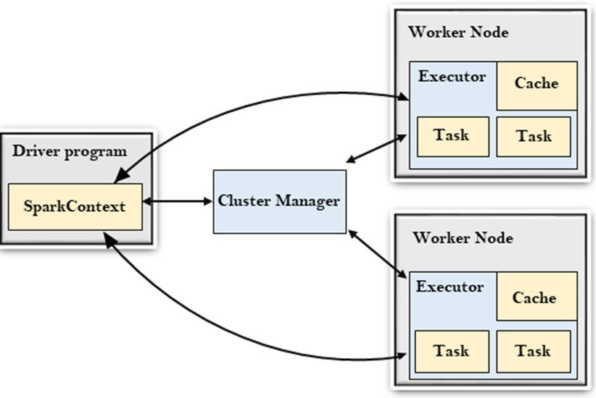
Apache Spark Architecture

Slide 8
Driver Program
•Driver Program :
•The Driver Program is a process that runs the main() function of the application and creates the SparkContext object. The purpose of SparkContext is to coordinate the spark applications, running as independent sets of processes on a cluster.
•To run on a cluster, the SparkContext connects to a different type of cluster managers and then perform the following tasks: -
•It acquires executors on nodes in the cluster.
•Then, it sends your application code to the executors. Here, the application code can be defined by JAR or Python files passed to the SparkContext.
•At last, the SparkContext sends tasks to the executors to run.

Slide 9
Cluster Manager
•Cluster Manager :
•The role of the cluster manager is to allocate resources across applications. The Spark is capable enough of running on a large number of clusters.
•It consists of various types of cluster managers such as Hadoop YARN, Apache Mesos and Standalone Scheduler.
•Here, the Standalone Scheduler is a standalone spark cluster manager that facilitates to install Spark on an empty set of machines.
•Worker Node
•The worker node is a slave node
•Its role is to run the application code in the cluster.

Slide 10
Executor
•Executor : An executor is a process launched for an application on a worker node.
•It runs tasks and keeps data in memory or disk storage across them.
•It read and write data to the external sources.
•Every application contains its executor.
•Task:A unit of work that will be sent to one executor.

Slide 11
Features of Spark
•Fault Tolerance: Apache Spark is designed to handle worker node failures. It achieves this fault tolerance by using DAG and RDD (Resilient Distributed Datasets). DAG contains the lineage of all the transformations and actions needed to complete a task. So in the event of a worker node failure, the same results can be achieved by rerunning the steps from the existing DAG.
•Dynamic nature: Spark offers over 80 high-level operators that make it easy to build parallel apps.
•Lazy Evaluation: Spark does not evaluate any transformation immediately. All the transformations are lazily evaluated. The transformations are added to the DAG and the final computation or results are available only when actions are called. This gives Spark the ability to make optimization decisions, as all the transformations become visible to the Spark engine before performing any action.
•Real Time Stream Processing: Spark Streaming brings Apache Spark's language-integrated API to stream processing, letting you write streaming jobs the same way you write batch jobs.
•Speed: Spark enables applications running on Hadoop to run up to 100x faster in memory and up to 10x faster on disk. Spark achieves this by minimizing disk read/write operations for intermediate results. It stores in memory and performs disk operations only when essential. Spark achieves this using DAG, query optimizer and highly optimized physical execution engine.

Slide 12
Features of Spark
•Reusability: Spark code can be used for batch-processing, joining streaming data against historical data as well as running ad-hoc queries on streaming state.
•Advanced Analytics: Apache Spark has rapidly become the de facto standard for big data processing and data sciences across multiple industries. Spark provides both machine learning and graph processing libraries, which companies across sectors leverage to tackle complex problems.
•Supporting Multiple languages: Spark comes inbuilt with multi-language support. It has most of the APIs available in Java, Scala, Python and R. Also, there are advanced features available with R language for data analytics. Also, Spark comes with Spark SQL which has an SQL like feature. SQL developers find it therefore very easy to use, and the learning curve is reduced to a great level.
•Integrated with Hadoop: Apache Spark integrates very well with Hadoop file system HDFS. It offers support to multiple file formats like parquet, json, csv, ORC, Avro etc. Hadoop can be easily leveraged with Spark as an input data source or destination.
•Cost efficient: Apache Spark is an open source software, so it does not have any licensing fee associated with it. Users have to just worry about the hardware cost. Also, Apache Spark reduces a lot of other costs as it comes inbuilt for stream processing, ML and Graph processing.

Slide 13
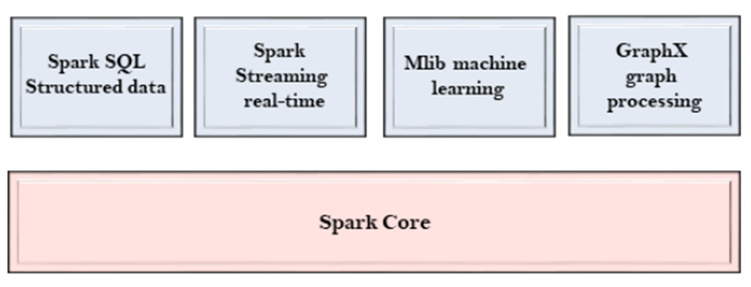
Spark Components
•The Spark project consists of different types of tightly integrated components. At its core, Spark is a computational engine that can schedule, distribute and monitor multiple applications.
Spark Core :
•The Spark Core is the heart of Spark and performs the core functionality.
•It holds the components for task scheduling, fault recovery, interacting with storage systems and memory management.

Slide 14
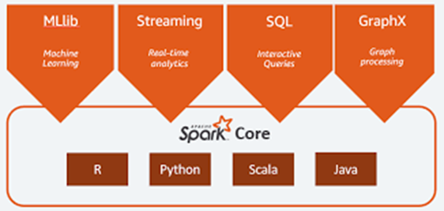
Spark SQL :
•The Spark SQL is built on the top of Spark Core. It provides support for structured data.
•It allows to query the data via SQL (Structured Query Language) as well as the Apache Hive variant of SQL?called the HQL (Hive Query Language).
•It supports JDBC and ODBC connections that establish a relation between Java objects and existing databases, data warehouses and business intelligence tools.
•It also supports various sources of data like Hive tables, Parquet, and JSON.

Slide 15
Spark Streaming :
•Spark Streaming is a Spark component that supports scalable and fault-tolerant processing of streaming data.
•It uses Spark Core's fast scheduling capability to perform streaming analytics.
•It accepts data in mini-batches and performs RDD transformations on that data.
•Its design ensures that the applications written for streaming data can be reused to analyze batches of historical data with little modification.
•The log files generated by web servers can be considered as a real-time example of a data stream.

Slide 16
Mllib :
•The MLlib is a Machine Learning library that contains various machine learning algorithms.
•These include correlations and hypothesis testing, classification and regression, clustering, and principal component analysis.
•It is nine times faster than the disk-based implementation used by Apache Mahout.
GraphX :
•The GraphX is a library that is used to manipulate graphs and perform graph-parallel computations.
•It facilitates to create a directed graph with arbitrary properties attached to each vertex and edge.
•To manipulate graph, it supports various fundamental operators like subgraph, join Vertices, and aggregate Messages.

Slide 17
Storage Layers for Spark
•Spark can read and write data from multiple storage systems.
1. Hadoop Distributed File System (HDFS)
•Most commonly used distributed storage.
•Stores large datasets across multiple nodes.
2. Local File System
•Used for testing and small datasets.
3. Amazon S3
•Cloud-based object storage.

Slide 18
4. Apache Cassandra
•Distributed NoSQL database.
5. Apache HBase
•Column-oriented database built on HDFS.
6. Data Warehouses
•Hive
•JDBC databases
•Spark’s flexibility allows it to integrate with different storage systems without modifying the processing logic.

Slide 19
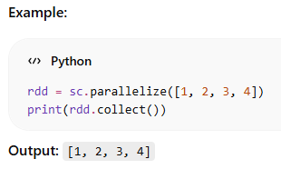
RDD (Resilient Distributed Dataset)
An RDD (Resilient Distributed Dataset) is:
Immutable (cannot be changed once created)
Distributed (data split across nodes)
Fault-tolerant (can recover lost data using lineage)
👉 Think of it as a large dataset split across multiple machines, enabling parallel processing.

Slide 20


Creating RDDs
RDDs can be created in two main ways:
From a collection
(b) From external data (files)

Slide 21
3. RDD Operations
RDD operations are of two types:
🔸 Transformations (lazy)
Return a new RDD
Not executed immediately
🔸 Actions (eager)
Return a result
Trigger execution

Slide 22

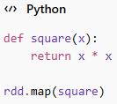
4. Passing Functions to Spark
You can pass functions in multiple ways:
(a) Lambda function
(b) Named function

Slide 23


5. Common Transformations
🔸 map()
Applies a function to each element
🔸 filter()
Filters elements based on condition

Slide 24


🔸 flatMap()
Flattens nested structures
🔸 distinct()
Removes duplicates

Slide 25


6. Common Actions
🔸 collect()
Returns all elements
🔸 count()
Counts elements

Slide 26


🔸 take(n)
Returns first n elements
🔸 reduce()
Aggregates data

Slide 27
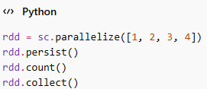
7. Persistence (Caching)
By default, RDDs are recomputed every time an action is called.
👉 To improve performance, use persistence:
Types of persistence:
MEMORY_ONLY
MEMORY_AND_DISK
💡 Use caching when:
The same RDD is used multiple times
Iterative algorithms (e.g., ML tasks)

Slide 28
