Slide 1

B.M.S COLLEGE OF ENGINEERING, BANGALORE-19
DEPARTMENT OF MACHINE LEARNING
BIG DATA ANALYTICS
(24AM6PEBDA)
UNIT-04
Relational Data in Hadoop & Apache Flume
Presentation By
Prof. Varsha R
Assistant Professor, Dept. of Machine Learning

Slide 2
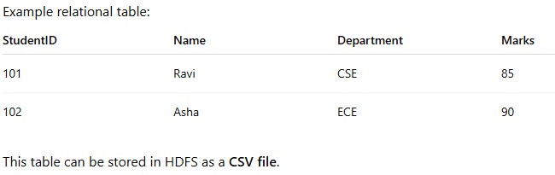
Relational Data in Hadoop
Relational data refers to structured data organized in tables with rows and columns, similar to data stored in relational database systems such as MySQL, Oracle Database, or PostgreSQL.
In the Hadoop ecosystem, relational data can also be stored and processed even though Apache Hadoop was originally designed for large-scale distributed storage and processing of various types of data.
How Relational Data is Stored in Hadoop
Relational data is typically stored in Hadoop Distributed File System (HDFS) in formats such as:
1. Text files (CSV, TSV)
2. Sequence files
3. Columnar formats (ORC, Parquet)

Slide 3
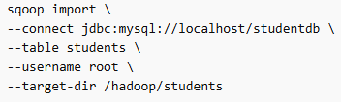
Tools Used to Process Relational Data in Hadoop
Apache Hive: Provides SQL-like query language (HiveQL).
Converts SQL queries into MapReduce, Tez, or Spark jobs.
Apache Hbase: Column-oriented database running on HDFS.
Used for real-time read/write access.
Apache Sqoop: Used to import/export relational data between RDBMS and Hadoop.
Example Sqoop command:

Slide 4
Advantages of Handling Relational Data in Hadoop
Handles large-scale structured data
Supports parallel processing
Integrates with SQL-based tools like Hive

Slide 5
Bi directional data transfer between Hadoop and external database using Apache Sqoop
Generally, applications interact with the relational database using RDBMS, and thus this makes relational databases one of the most important sources that generate Big Data. Such data is stored in RDB Servers in the relational structure.
Here, Apache Sqoop plays an important role in the Hadoop ecosystem, providing feasible interaction between the relational database server and HDFS.
It is designed to transfer data between HDFS (Hadoop storage) and relational database servers like MySQL, Oracle RDB, SQLite, Teradata, Netezza, Postgres etc.
Sqoop is particularly useful in big data scenarios where large volumes of data need to be transferred between Hadoop and relational databases.

Slide 6
Apache Sqoop is a tool in the Apache Hadoop ecosystem used to transfer bulk data between Hadoop and relational databases such as MySQL, Oracle Database, and PostgreSQL.
The term bi-directional data transfer means data can move in two directions:
From RDBMS → Hadoop
From Hadoop → RDBMS

Slide 7
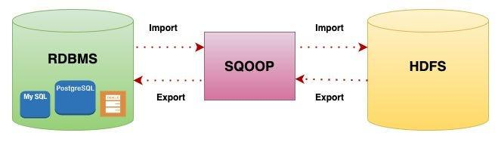
Apache Sqoop
The name “Sqoop” was derived from the combination of “SQL” and “Hadoop”.
Initially, Sqoop was developed and maintained by Cloudera. Later, on 23 July 2011, it was incubated by Apache. In April 2012, the Sqoop project was promoted as Apache’s top-level project.
Additionally, Sqoop is used to import data from external datastores into Hadoop ecosystem’s tools like Hive & HBase.

Slide 8
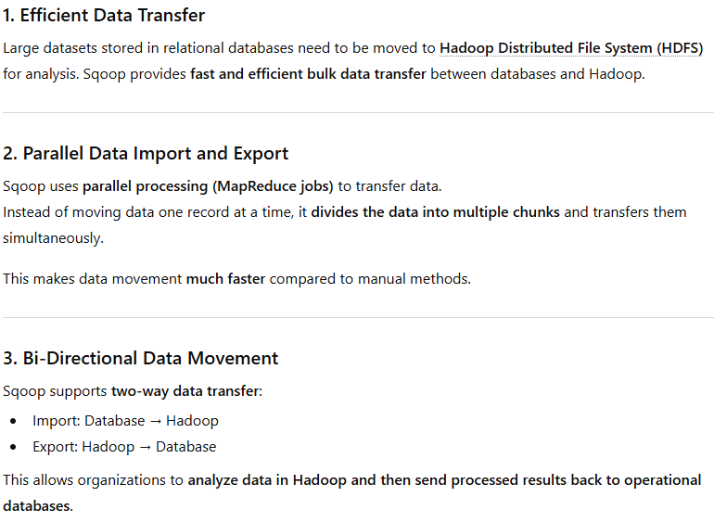
Why Sqoop is needed in big data?

Slide 9
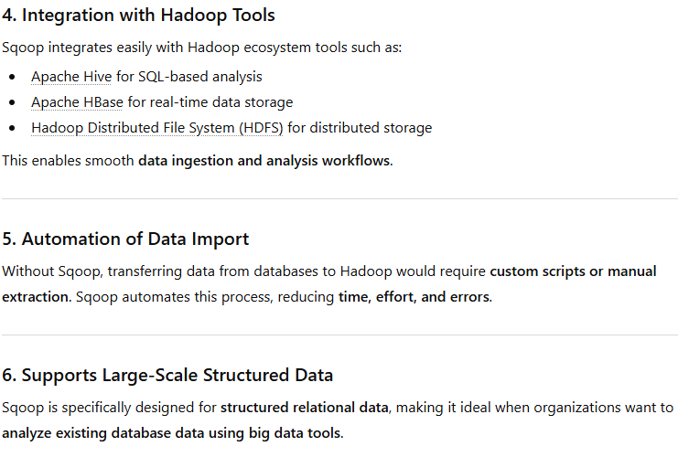
Why Sqoop is needed in big data?

Slide 10
Why Sqoop is needed in big data?
For Hadoop developer gains various insights hidden in the data after it is being loaded in HDFS
for this analysis, the data residing in the relational database management systems need to be transferred to HDFS
The task of writing MapReduce code for importing and exporting data from the relational database to HDFS is uninteresting & tedious.
This is where Apache Sqoop comes to rescue, it automates the process of importing & exporting the data.
Sqoop provides CLI for importing and exporting data. It requires basic information like database authentication, source, destination, operations etc.
Sqoop internally converts the command into MapReduce tasks, which are then executed over HDFS. It uses YARN framework to import and export the data, which provides fault tolerance on top of parallelism.

Slide 11
Key features of Sqoop
Full Load: Apache Sqoop can load the whole table by a single command. You can also load all the tables from a database using a single command.
Incremental Load: Apache Sqoop also provides the facility of incremental load where you can load parts of table whenever it is updated.
Parallel import/export: Sqoop uses YARN framework to import and export the data, which provides fault tolerance on top of parallelism.
Import results of SQL query: You can also import the result returned from an SQL query in HDFS.
Compression: You can compress your data by using deflate(gzip) algorithm with –compress argument, or by specifying –compression-codec argument. You can also load compressed table in Apache Hive.
Connectors for all major RDBMS Databases: Apache Sqoop provides connectors for multiple RDBMS databases, covering almost the entire circumference.
Kerberos Security Integration: Kerberos is a computer network authentication protocol which works on the basis of ‘tickets’ to allow nodes communicating over a non-secure network to prove their identity to one another in a secure manner. Sqoop supports Kerberos authentication.
Load data directly into HIVE/HBase: You can load data directly into Apache Hive for analysis and also dump your data in HBase, which is a NoSQL database.
Support for Accumulo: You can also instruct Sqoop to import the table in Accumulo rather than a directory in HDFS.

Slide 12
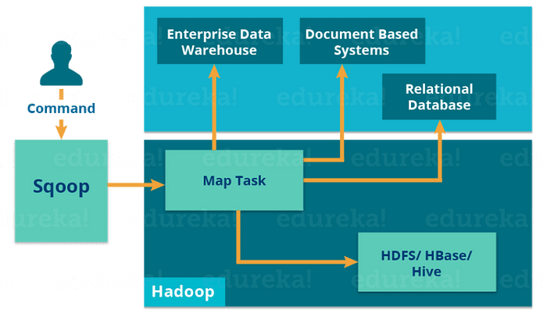
Working of Sqoop - Import
The import tool imports individual tables from RDBMS to HDFS. Each row in a table is treated as a record in HDFS.
When we submit Sqoop command, our main task gets divided into subtasks which is handled by individual Map Task internally. Map Task is the subtask, which imports part of data to the Hadoop Ecosystem. Collectively, all Map tasks imports the whole data.

Slide 13
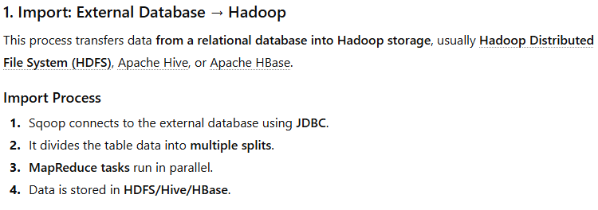
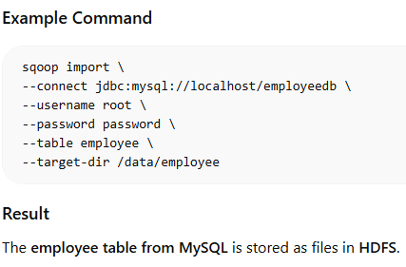

Slide 14
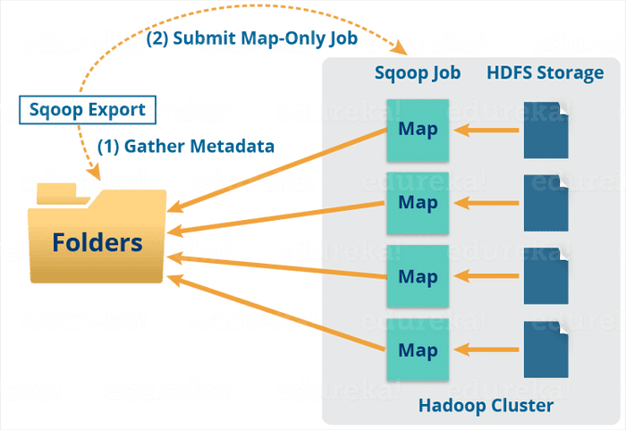
Working of Sqoop - Export
The export tool exports a set of files from HDFS back to an RDBMS. The files given as input to Sqoop contain records, which are called as rows in the table.
When we submit our Job, it is mapped into Map Tasks which brings the chunk of data from HDFS. These chunks are exported to a structured data destination. Combining all these exported chunks of data, we receive the whole data at the destination, which in most of the cases is an RDBMS (MYSQL/Oracle/SQL Server).

Slide 15
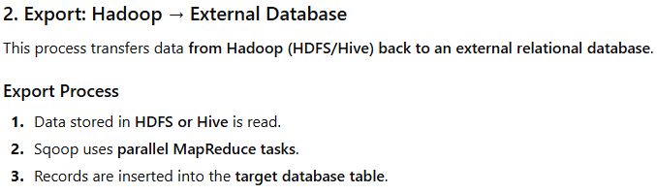
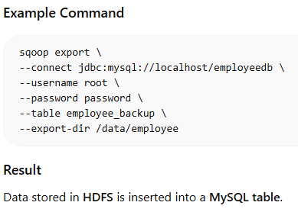

Slide 16
Example Use Case
A company stores transaction data in MySQL but wants to perform big data analytics using Hive on Hadoop.
Import transaction data into Hadoop using Sqoop Import.
Analyze the data using Hive queries.
Export the processed results back to MySQL using Sqoop Export.

Slide 17
Working of Sqoop
Reduce phase is required in case of aggregations. But, Apache Sqoop just imports and exports the data; it does not perform any aggregations.
Map job launch multiple mappers depending on the number defined by the user.
For Sqoop import, each mapper task will be assigned with a part of data to be imported.
Sqoop distributes the input data among the mappers equally to get high performance.
Then each mapper creates a connection with the database using JDBC and fetches the part of data assigned by Sqoop and writes it into HDFS or Hive or HBase based on the arguments provided in the CLI.

Slide 18
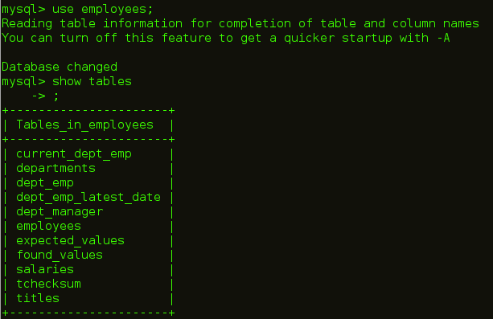
Sqoop – Import a table Command
Sqoop — IMPORT Command
Import command is used to importing a table from relational databases to HDFS. In our case, we are going to import tables from MySQL databases to HDFS.
As you can see in the below image, we have employees table in employees database which we will be importing into HDFS.

Slide 19
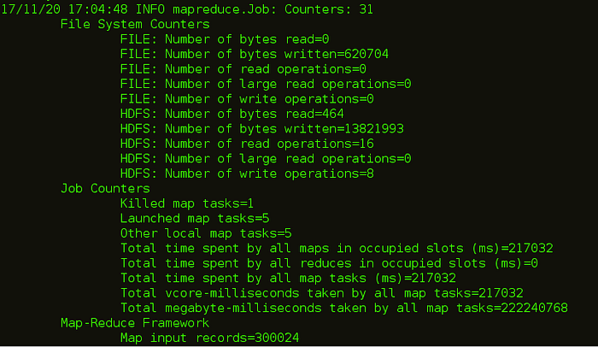
Sqoop – Import a table Command
The command for importing table is:
sqoop import --connect jdbc:mysql://localhost/employees --username edureka --table employees
As you can see in the below image, after executing this command Map tasks will be executed at the back end.

Slide 20
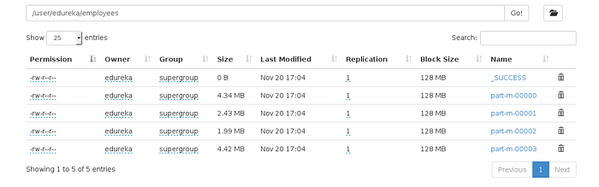
Sqoop – Import a table Command
After the code is executed, you can check the Web UI of HDFS i.e. localhost:50070 where the data is imported.

Slide 21
Sqoop – IMPORT Command
Sqoop — IMPORT Command with target directory
You can also import the table in a specific directory in HDFS using the below command:
sqoop import --connect jdbc:mysql://localhost/employees --username edureka --table employees --m 1 --target-dir /employees
Sqoop imports data in parallel from most database sources. -m property is used to specify the number of mappers to be executed.
Sqoop imports data in parallel from most database sources. You can specify the number of map tasks (parallel processes) to use to perform the import by using the -m or –num-mappers argument. Each of these arguments takes an integer value which corresponds to the degree of parallelism to employ.

Slide 22
Sqoop – IMPORT Command
You can control the number of mappers independently from the number of files present in the directory
Export performance depends on the degree of parallelism.
By default, Sqoop will use four tasks in parallel for the export process. This may not be optimal, you will need to experiment with your own particular setup.
Additional tasks may offer better concurrency, but if the database is already bottlenecked on updating indices, invoking triggers, and so on, then additional load may decrease performance.

Slide 23
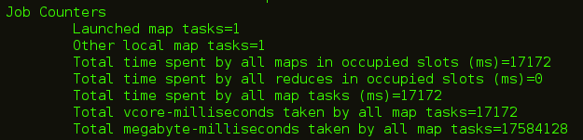
Sqoop – IMPORT Command
You can see in the below image, that the number of mapper task is 1.
The number of files that are created while importing MySQL tables is equal to the number of mapper created.

Slide 24
Sqoop — IMPORT subset of a table
Sqoop — IMPORT Command with Where Clause
You can import a subset of a table using the ‘where’ clause in Sqoop import tool.
It executes the corresponding SQL query in the respective database server and stores the result in a target directory in HDFS.
You can use the following command to import data with ‘where‘ clause:
sqoop import --connect jdbc:mysql://localhost/employees --username edureka --table employees --m 3 --where "emp_no &gt; 49000" --target-dir /Latest_Employees

Slide 25
Sqoop — Incremental Import
Sqoop provides an incremental import mode which can be used to retrieve only rows newer than some previously-imported set of rows. Sqoop supports two types of incremental imports: append and lastmodified. You can use the –incremental argument to specify the type of incremental import to perform.
You should specify append mode when importing a table where new rows are continually being added with increasing row id values. You specify the column containing the row’s id with –check-column. Sqoop imports rows where the check column has a value greater than the one specified with –last-value.
An alternate table update strategy supported by Sqoop is called lastmodified mode. You should use this when rows of the source table may be updated, and each such update will set the value of a last-modified column to the current timestamp.
When running a subsequent import, you should specify –last-value in this way to ensure you import only the new or updated data. This is handled automatically by creating an incremental import as a saved job, which is the preferred mechanism for performing a recurring incremental import.

Slide 26
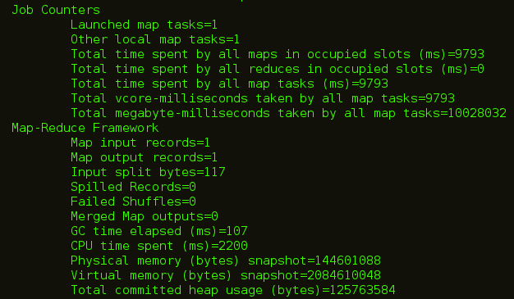
Sqoop — Incremental Import
First we are inserting a new row which will be updated in our HDFS.
The command for incremental import is:
sqoop import --connect jdbc:mysql://localhost/employees --username edureka --table employees --target-dir /Latest_Employees --incremental append --check-column emp_no --last-value 499999
You can see in the below image, a new file is created with the updated data.

Slide 27
Sqoop — Import All Tables
You can import all the tables from the RDBMS database server to the HDFS. Each table data is stored in a separate directory and the directory name is same as the table name.
It is mandatory that every table in that database must have a primary key field. The command for importing all the table from a database is:
sqoop import-all-tables --connect jdbc:mysql://localhost/employees --username edureka

Slide 28
Sqoop — List Databases
You can list out the databases present in relation database using Sqoop. Sqoop list-databases tool parses and executes the ‘SHOW DATABASES’ query against the database server. The command for listing databases is:
sqoop list-databases --connect jdbc:mysql://localhost/ --username edureka

Slide 29
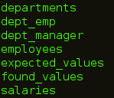
Sqoop — List Tables
You can also list out the tables of a particular database in MySQL database server using Sqoop. Sqoop list-tables tool parses and executes the ‘SHOW TABLES’ query. The command for listing tables is a database is:
sqoop list-tables --connect jdbc:mysql://localhost/employees --username edureka

Slide 30
Flume Introduction
Apache Flume is a distributed, reliable, and available service for efficiently collecting, aggregating, and moving large amounts of log-like data from various sources to a centralized data store.
It's often used for ingesting data from log files, web servers, and other sources into HDFS, HBase, or similar systems. Flume is a core component of the Apache Hadoop ecosystem.
While Flume specializes in reliable and scalable data ingestion, usually to Hadoop, Apache Kafka is primarily designed as a distributed streaming platform that provides high-throughput, fault-tolerant publish-subscribe messaging.

Slide 31
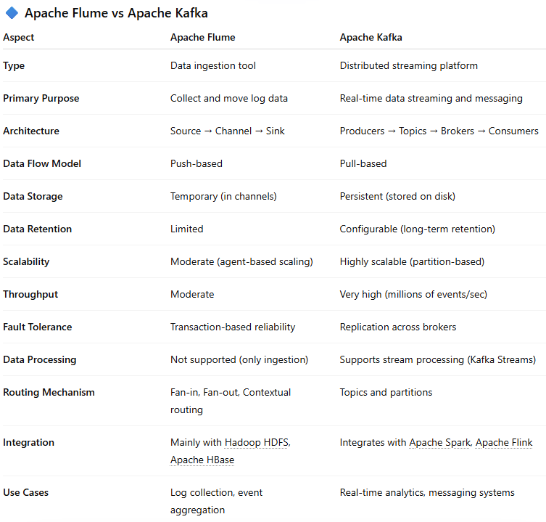

Slide 32
Features of Flume
Apache Flume has many features and lets us have a look at some of the notable and essential elements of Flume:
Flume efficiently ingests log data from many online sources and web servers into a centralised storage system (HDFS, HBase).
Flume is also used to ingest massive amounts of event data produced by social networking sites like Facebook and Twitter and e-commerce sites like Amazon and Flipkart and log files.
Flume can handle many data sources and destinations.
Flume can handle multi-hop flows, fan-in-fan-out flows, contextual routing, etc.
The flume may be horizontally scaled.
We can quickly pull data from many servers into Hadoop using Flume.

Slide 33
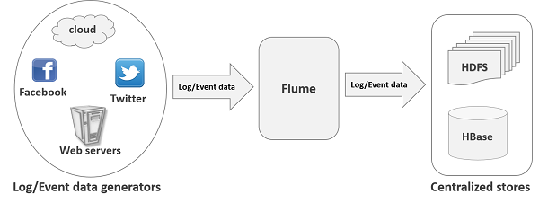
Flume Architecture Overview
Apache Flume’s architecture revolves around a simple yet powerful concept of data flow pipelines.
It consists of three main components: sources, channels, and sinks.
Sources represent the data origin,
channels act as intermediate storage for the data, and
sinks are the final destinations where the data is delivered.
This modular architecture allows flexibility in configuring the data flow and ensures fault tolerance and scalability.

Slide 34
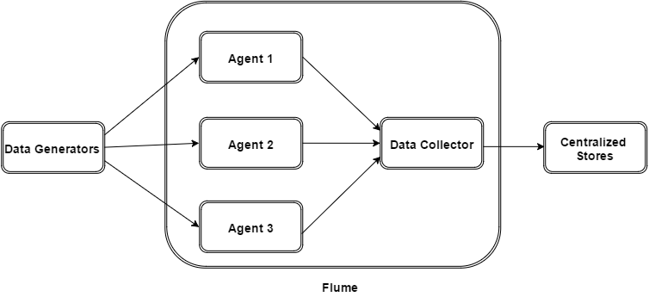
Flume Architecture
The following illustration depicts the basic architecture of Flume.
As shown in the illustration, data generators (such as Facebook, Twitter) generate data which gets collected by individual Flume agents running on them.
Thereafter, a data collector (which is also an agent) collects the data from the agents which is aggregated and pushed into a centralized store such as HDFS or HBase.

Slide 35

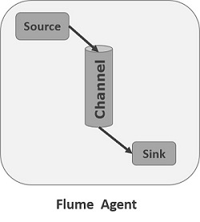
Flume Architecture
Flume Event
An event is the basic unit of the data transported inside Flume. It contains a payload of byte array that is to be transported from the source to the destination, accompanied by optional headers. A typical Flume event would have the following structure −
Flume Agent
An agent is an independent daemon process (JVM) in Flume. It receives the data (events) from clients or other agents and forwards it to its next destination (sink or agent). Flume may have more than one agent. Following diagram represents a Flume Agent
As shown in the diagram a Flume Agent contains three main components namely, source, channel, and sink.

Slide 36
Flume Architecture
Source - A source is the component of an Agent which receives data from the data generators and transfers it to one or more channels in the form of Flume events.
  Apache Flume supports several types of sources and each source receives events from a specified data generator.
  Example − Avro source, Thrift source, twitter 1% source etc.
Channel - A channel is a transient store which receives the events from the source and buffers them till they are consumed by sinks. It acts as a bridge between the sources and the sinks.
  These channels are fully transactional and they can work with any number of sources and sinks.
  Example − JDBC channel, File system channel, Memory channel, etc.
Sink - A sink stores the data into centralized stores like HBase and HDFS. It consumes the data (events) from the channels and delivers it to the destination. The destination of the sink might be another agent or the central stores.
  Example − HDFS sink

Slide 37
Flume Architecture
Additional Components of Flume Agent
What we have discussed above are the primitive components of the agent. In addition to this, we have a few more components that play a vital role in transferring the events from the data generator to the centralized stores.
Interceptors - Interceptors are used to alter/inspect flume events which are transferred between source and channel.
Channel Selectors - These are used to determine which channel is to be opted to transfer the data in case of multiple channels. There are two types of channel selectors −
  Default channel selectors − These are also known as replicating channel selectors they replicates all the events in each channel.
  Multiplexing channel selectors − These decides the channel to send an event based on the address in the header of that event.
Sink Processors - These are used to invoke a particular sink from the selected group of sinks. These are used to create failover paths for your sinks or load balance events across multiple sinks from a channel.

Slide 38
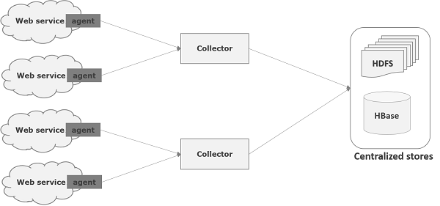
Apache Flume - Data Flow
Flume is a framework which is used to move log data into HDFS. Generally events and log data are generated by the log servers and these servers have Flume agents running on them. These agents receive the data from the data generators.
The data in these agents will be collected by an intermediate node known as Collector. Just like agents, there can be multiple collectors in Flume.
Finally, the data from all these collectors will be aggregated and pushed to a centralized store such as HBase or HDFS. The following diagram explains the data flow in Flume.

Slide 39
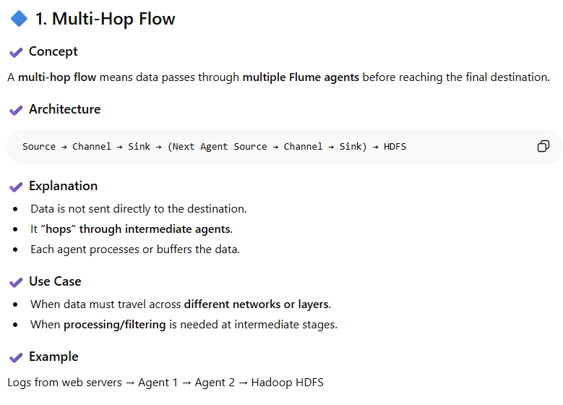
Multi Hop Flow
Multi-hop Flow
Within Flume, there can be multiple agents and before reaching the final destination, an event may travel through more than one agent. This is known as multi-hop flow.

Slide 40
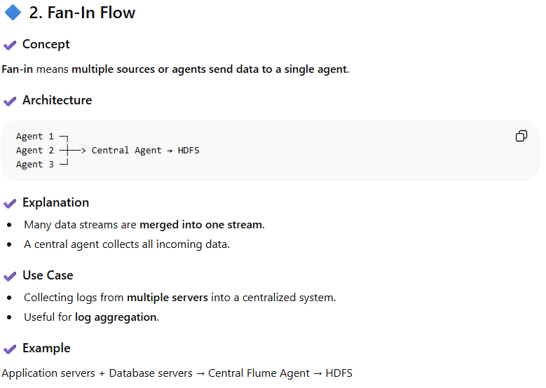
Fan-In and Fan-Out Flow
Fan-in Flow
The data flow in which the data will be transferred from many sources to one channel is known as fan-in flow.

Slide 41
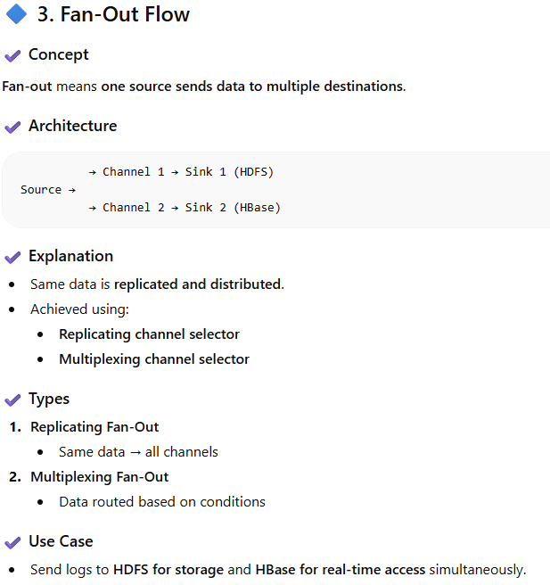
Fan-out Flow
The dataflow from one source to multiple channels is known as fan-out flow. It is of two types −
Replicating − The data flow where the data will be replicated in all the configured channels.
Multiplexing − The data flow where the data will be sent to a selected channel which is mentioned in the header of the event.

Slide 42
Failure Handling
In Flume, for each event, two transactions take place: one at the sender and one at the receiver. The sender sends events to the receiver. Soon after receiving the data, the receiver commits its own transaction and sends a received signal to the sender. After receiving the signal, the sender commits its transaction. (Sender will not commit its transaction till it receives a signal from the receiver.)

Slide 43
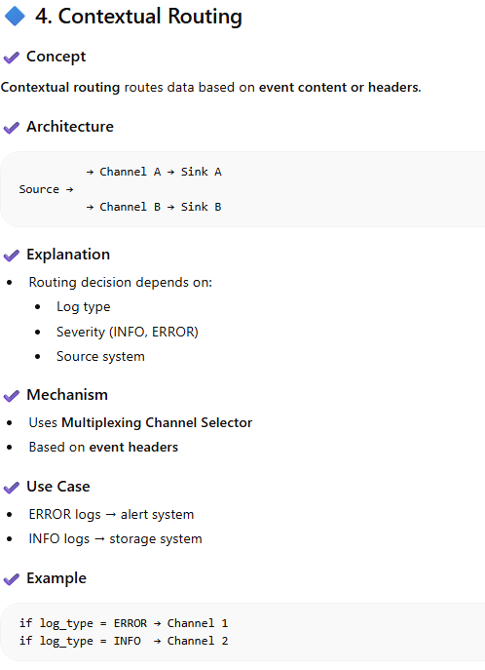
Contextual Routing

Slide 44
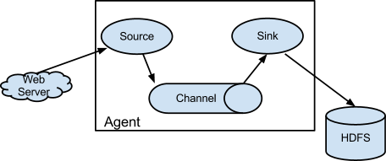

How Flume works
A Flume agent hosts the components through which events flow from an external source to the next destination (hop):
Flume allows users to build different data flow architectures, including multi-hop flows, fan-in, fan-out, and contextual routing. In a multi-hop flow, Flume agents are strung together:

Slide 45
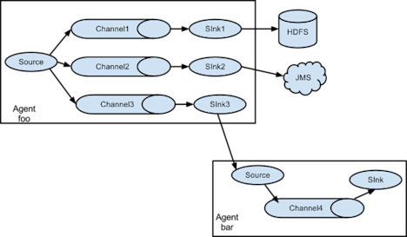
How Flume works
In a consolidation flow, multiple Flume agents are linked to a single sink agent that writes to the target sink:

Slide 46
How Flume works
Flume can support writing to multiple sinks from the same source, employing contextual routing and fan-out architecture patterns:
Flume agents are lightweight Java processes that can be installed alongside a data source either on the same host or the same local network. This enables efficient collection of log data that would otherwise roll away. Keeping this data and moving it to a single place allows it to be aggregated, processed and queried for insights such as user behavior, cross-channel data correlation, service level quality, and so on.

Slide 47
Advantages of Flume
Using Apache Flume we can store the data in to any of the centralized stores (HBase, HDFS).
When the rate of incoming data exceeds the rate at which data can be written to the destination, Flume acts as a mediator between data producers and the centralized stores and provides a steady flow of data between them.
Flume provides the feature of contextual routing.
The transactions in Flume are channel-based where two transactions (one sender and one receiver) are maintained for each message. It guarantees reliable message delivery.
Flume is reliable, fault tolerant, scalable, manageable, and customizable.

Slide 48
