Slide 1

B.M.S COLLEGE OF ENGINEERING, BANGALORE-19
DEPARTMENT OF MACHINE LEARNING
BIG DATA ANALYTICS
(24AM6PEBDA)
UNIT -03
HBASE
Presentation By
Prof. Varsha R,
Assistant Professor, Dept. of Machine Learning

Slide 2
HBase Overview
Since 1970, RDBMS is the solution for data storage and maintenance related problems.
After the advent of big data, companies realized the benefit of processing big data and started opting for solutions like Hadoop.
Hadoop uses distributed file system for storing big data, and MapReduce to process it. Hadoop excels in storing and processing of huge data of various formats such as arbitrary, semi-, or even unstructured.

Slide 3
HBase Overview
Limitations of Hadoop
Hadoop can perform only batch processing, and data will be accessed only in a sequential manner. That means one has to search the entire dataset even for the simplest of jobs.
A huge dataset when processed results in another huge data set, which should also be processed sequentially. At this point, a new solution is needed to access any point of data in a single unit of time (random access).
Hadoop Random Access Databases
Applications such as HBase, Cassandra, couchDB, Dynamo, and MongoDB are some of the databases that store huge amounts of data and access the data in a random manner.

Slide 4
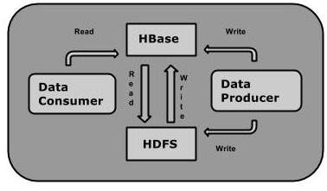
HBase
HBase is a distributed column-oriented database built on top of the Hadoop file system.
It is an open-source project and is horizontally scalable.
HBase is a data model that is similar to Google’s big table designed to provide quick random access to huge amounts of structured data. It leverages the fault tolerance provided by the Hadoop File System (HDFS).
It is a part of the Hadoop ecosystem that provides random real-time read/write access to data in the Hadoop File System.
One can store the data in HDFS either directly or through HBase. Data consumer reads/accesses the data in HDFS randomly using HBase. HBase sits on top of the Hadoop File System and provides read and write access.

Slide 5
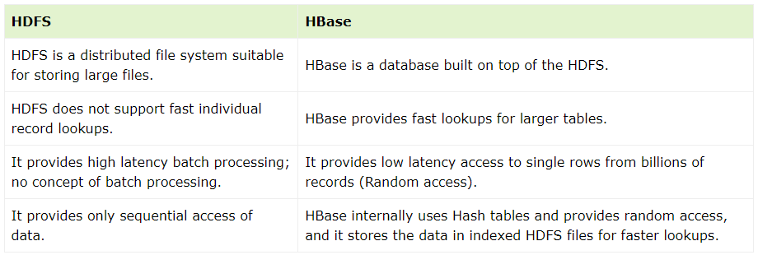
Difference Between HDFS and HBase

Slide 6
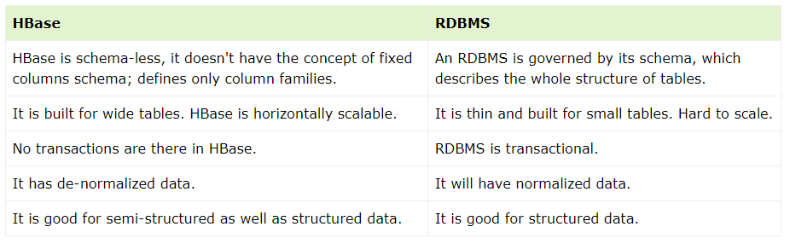
Difference Between HBase and RDBMS

Slide 7
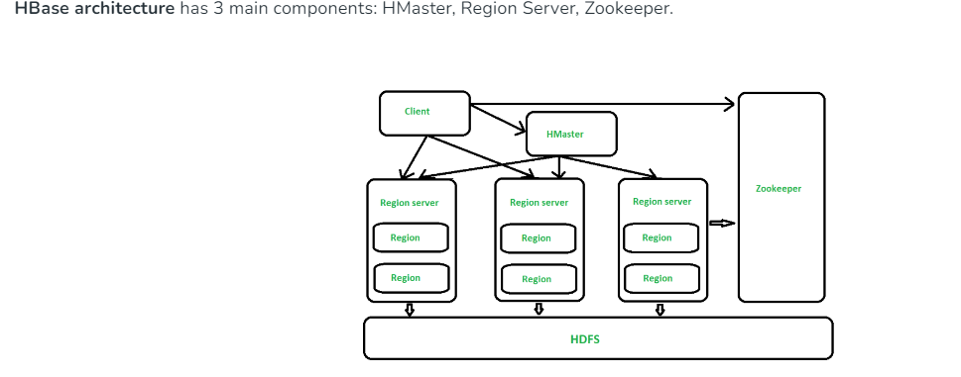
HBase Architecture

Slide 8
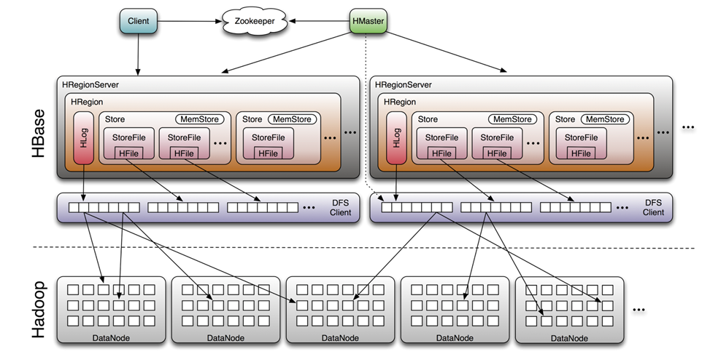
Hbase Detailed Architecture

Slide 9
HBase Architecture
HMaster – The implementation of Master Server in HBase is HMaster. It is a process in which regions are assigned to region server as well as DDL (create, delete table) operations. It monitor all Region Server instances present in the cluster. In a distributed environment, Master runs several background threads. HMaster has many features like controlling load balancing, failover etc.
Region Server – HBase Tables are divided horizontally by row key range into Regions. Regions are the basic building elements of HBase cluster that consists of the distribution of tables and are comprised of Column families. Region Server runs on HDFS DataNode which is present in Hadoop cluster.
Regions of Region Server are responsible for several things, like handling, managing, executing as well as reads and writes HBase operations on that set of regions. The default size of a region is 256 MB.
Zookeeper – It is like a coordinator in HBase. It provides services like maintaining configuration information, naming, providing distributed synchronization, server failure notification etc. Clients communicate with region servers via zookeeper.

Slide 10
General Flow of Data Search
The general flow is that a new client contacts the Zookeeper quorum first to find a particular row key. It does so by retrieving the server name (i.e. host name) that hosts the -ROOT- region from Zookeeper. With that information it can query that server to get the server that hosts the .META. table. Both of these two details are cached and only looked up once. Lastly it can query the .META. server and retrieve the server that has the row the client is looking for.
Once it has been told where the row resides, i.e. in what region, it caches this information as well and contacts the HRegionServer hosting that region directly. So over time the client has a pretty complete picture of where to get rows from without needing to query the .META. server again.
Next the HRegionServer opens the region it creates a corresponding HRegion object. When the HRegion is "opened" it sets up a Store instance for each HColumnFamily for every table as defined by the user beforehand. Each of the Store instances can in turn have one or more StoreFile instances, which are lightweight wrappers around the actual storage file called HFile. A HRegion also has a MemStore and a HLog instance. We will now have a look at how they work together but also where there are exceptions to the rule.

Slide 11
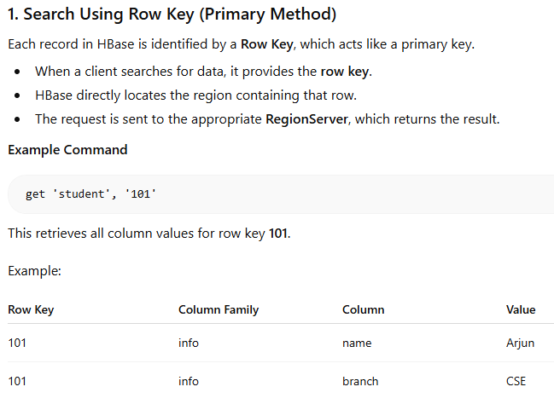
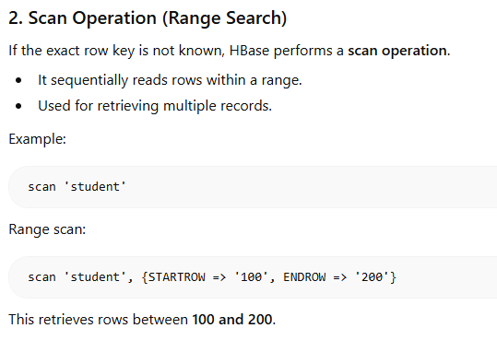

Slide 12
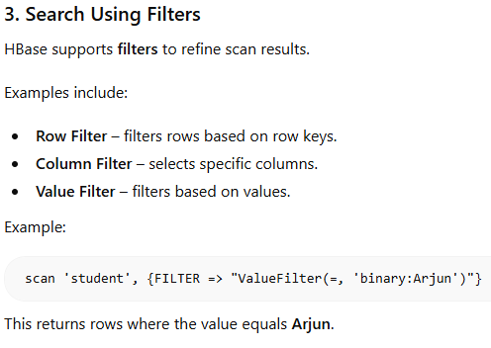
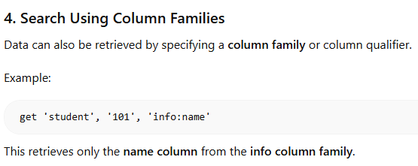

Slide 13
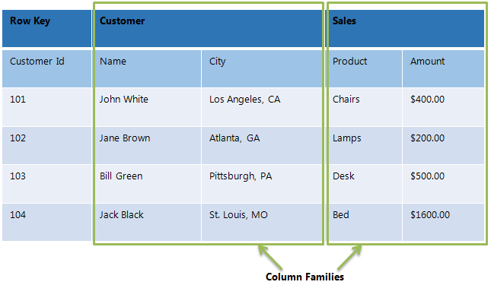
Hbase Data Model
The Data Model in HBase is designed to accommodate semi-structured data that could vary in field size, data type and columns. Additionally, the layout of the data model makes it easier to partition the data and distribute it across the cluster. The Data Model in HBase is made of different logical components such as Tables, Rows, Column Families, Columns, Cells and Versions.

Slide 14
Hbase Data Model
Tables – The HBase Tables are more like logical collection of rows stored in separate partitions called Regions. As shown above, every Region is then served by exactly one Region Server. The figure above shows a representation of a Table.
Rows – A row is one instance of data in a table and is identified by a rowkey. Rowkeys are unique in a Table and are always treated as a byte[].
Column Families – Data in a row are grouped together as Column Families. Each Column Family has one more Columns and these Columns in a family are stored together in a low level storage file known as HFile. Column Families form the basic unit of physical storage to which certain HBase features like compression are applied. Hence it’s important that proper care be taken when designing Column Families in table. The table above shows Customer and Sales Column Families. The Customer Column Family is made up 2 columns – Name and City, whereas the Sales Column Families is made up to 2 columns – Product and Amount.

Slide 15
Hbase Data Model
Columns – A Column Family is made of one or more columns. A Column is identified by a Column Qualifier that consists of the Column Family name concatenated with the Column name using a colon – example: columnfamily:columnname. There can be multiple Columns within a Column Family and Rows within a table can have varied number of Columns.
Cell – A Cell stores data and is essentially a unique combination of rowkey, Column Family and the Column (Column Qualifier). The data stored in a Cell is called its value and the data type is always treated as byte[].
Version – The data stored in a cell is versioned and versions of data are identified by the timestamp. The number of versions of data retained in a column family is configurable and this value by default is 3.

Slide 16
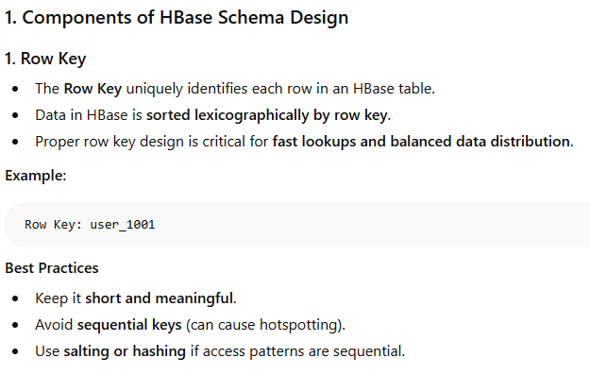
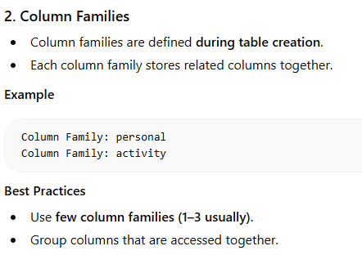

Slide 17
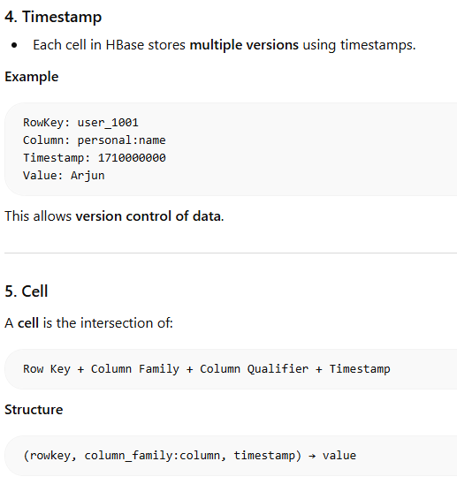
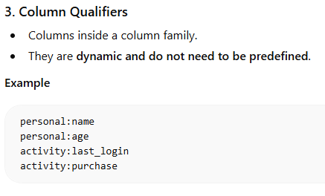

Slide 18
Features of HBase
Distributed and Scalable: HBase is designed to be distributed and scalable, which means it can handle large datasets and can scale out horizontally by adding more nodes to the cluster.
Column-oriented Storage: HBase stores data in a column-oriented manner, which means data is organized by columns rather than rows. This allows for efficient data retrieval and aggregation.
Hadoop Integration: HBase is built on top of Hadoop, which means it can leverage Hadoop’s distributed file system (HDFS) for storage and MapReduce for data processing.
Consistency and Replication: HBase provides strong consistency guarantees for read and write operations, and supports replication of data across multiple nodes for fault tolerance.
Built-in Caching: HBase has a built-in caching mechanism that can cache frequently accessed data in memory, which can improve query performance.
Compression: HBase supports compression of data, which can reduce storage requirements and improve query performance.
Flexible Schema: HBase supports flexible schemas, which means the schema can be updated on the fly without requiring a database schema migration.
Note – HBase is extensively used for online analytical operations, like in banking applications such as real-time data updates in ATM machines, HBase can be used.

Slide 19
Advanced Usage of HBase
It is used whenever there is a need to write heavy applications.
HBase is used whenever we need to provide fast random access to available data.
Companies such as Facebook, Twitter, Yahoo, and Adobe use HBase internally.

Slide 20
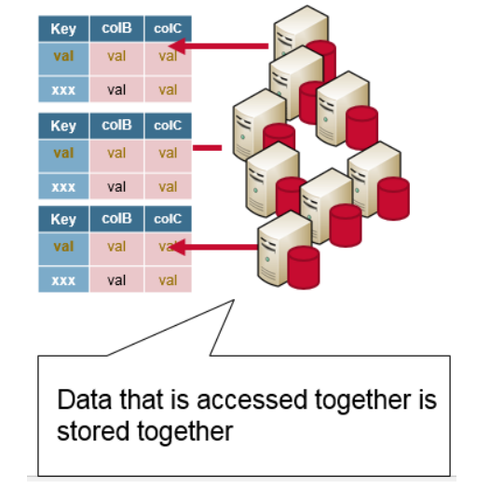
HBase Design Schema
With HBase, you have a ―query-first schema design; all possible queries should be identified first, and the schema model designed accordingly. You should design your HBase schema to take advantage of the strengths of HBase. Depending on access patterns, schema can be designed so that the data that is read together is stored together.
Remember that HBase is designed for clustering

Slide 21
Advance Indexing In HBase
In HBase, the row key provides the same data retrieval benefits as a primary index. So, when you create a secondary index, use elements that are different from the row key.
Secondary indexes allow you to have a secondary way to read an HBase table. They provide a way to efficiently access records by means of some piece of information other than the primary key.
Secondary indexes require additional cluster space and processing because the act of creating a secondary index requires both space and processing cycles to update.
A method of index maintenance, called Diff-Index, can help IBM® Big SQL to create secondary indexes for HBase, maintain those indexes, and use indexes to speed up queries

Slide 22
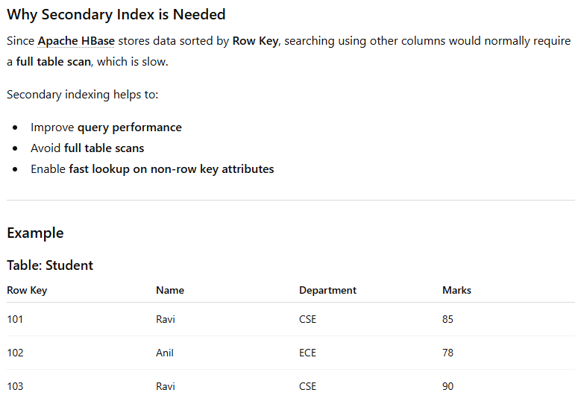
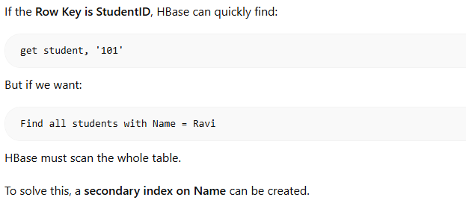

Slide 23
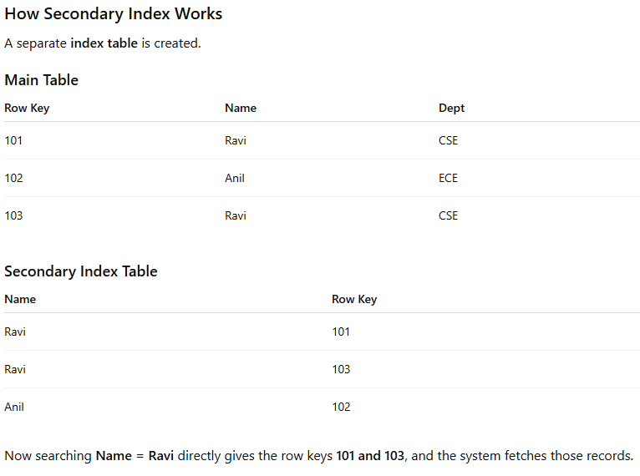

Slide 24
Table Management Commands
Create a Table
create 'table_name', 'column_family'
Example: create 'students', 'details'
List Tables
list
Disable a Table
disable 'table_name'
Check if Table is Disabled
is_disabled 'table_name'

Slide 25
Enable a Table
enable 'table_name'
Check if Table is Enabled
is_enabled 'table_name'
Describe a Table
describe 'table_name'
Drop a Table (must be disabled first)
disable 'table_name'
drop 'table_name'

Slide 26
Data Manipulation Commands
Insert Data (Put)
put 'table_name', 'row_key', 'column_family:column', 'value'
Example: put 'students', '101', 'details:name', 'Alice'
Retrieve Data (Get)
get 'table_name', 'row_key'
Delete Specific Column
delete 'table_name', 'row_key', 'column_family:column'
Delete All Columns in Row
deleteall 'table_name', 'row_key'

Slide 27
Other Commands
Scan a Table
scan 'table_name'
Count Rows
count 'table_name'
Truncate a Table (deletes all rows but keeps schema)
truncate 'table_name'

