Slide 1

B.M.S COLLEGE OF ENGINEERING, BANGALORE-19
DEPARTMENT OF MACHINE LEARNING
BIG DATA ANALYTICS
(24AM6PEBDA)
UNIT -03
HIVE
Presentation By
Prof. Varsha R,
Assistant Professor, Dept. of Machine Learning

Slide 2
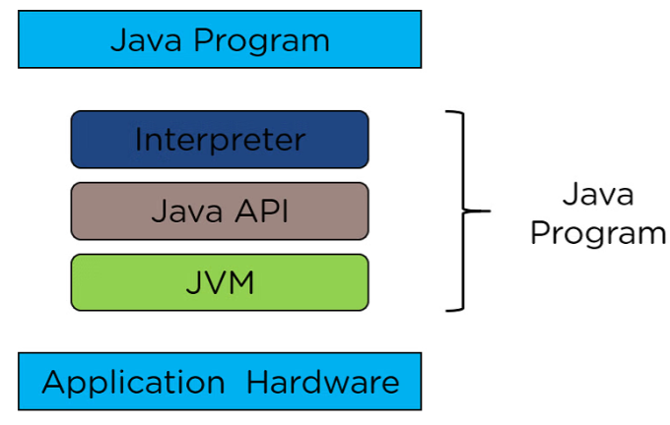
Java API
Java APIs are integrated pieces of software that come with JDKs. APIs in Java provides the interface between two different applications and establish communication.
APIs are important software components bundled with the JDK. APIs in Java include classes, interfaces, and user Interfaces. They enable developers to integrate various applications and websites and offer real-time information.
Java APIs serve several important purposes in software development. They promote code reuse, as developers can incorporate existing API functionality into their applications instead of writing everything from scratch.
The following image depicts the fundamental components of the Java API.

Slide 3
What is HIVE
Hive is a data warehouse system which is used to analyze structured data.
It is built on the top of Hadoop. It was developed by Facebook.
Hive provides the functionality of reading, writing, and managing large datasets residing in distributed storage.
It runs SQL like queries called HQL (Hive query language) which gets internally converted to MapReduce jobs.
Using Hive, we can skip the requirement of the traditional approach of writing complex MapReduce programs. Hive supports Data Definition Language (DDL), Data Manipulation Language (DML), and User Defined Functions (UDF).

Slide 4
Features
Hive is fast and scalable.
It provides SQL-like queries (i.e., HQL) that are implicitly transformed to MapReduce or Spark jobs.
It is capable of analyzing large datasets stored in HDFS.
It allows different storage types such as plain text, RCFile (Record Columnar File), and HBase.
It uses indexing to accelerate queries.
It can operate on compressed data stored in the Hadoop ecosystem.
It supports user-defined functions (UDFs) where user can provide its functionality.

Slide 5
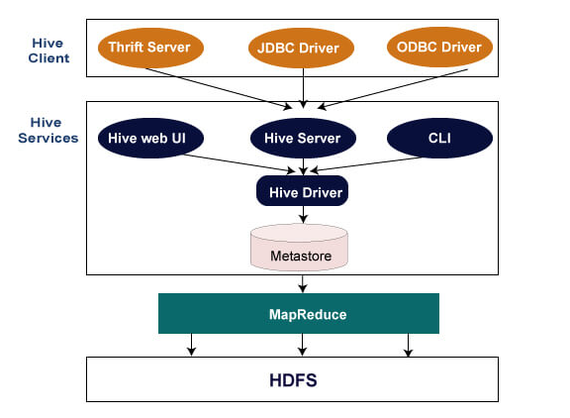
HIVE ARCHITECTURE

Slide 6
Hive Client
Hive allows writing applications in various languages, including Java, Python, and C++. It supports different types of clients such as:-
Thrift Server - It is a cross-language service provider platform that serves the request from all those programming languages that supports Thrift.
JDBC (Java Database Connectivity) Driver - It is used to establish a connection between hive and Java applications. The JDBC Driver is present in the class org.apache.hadoop.hive.jdbc.HiveDriver.
ODBC (Open Database Connectivity) Driver - It allows the applications that support the ODBC protocol to connect to Hive.

Slide 7
Hive Services
Hive CLI - The Hive CLI (Command Line Interface) is a shell where we can execute Hive queries and commands.
Hive Web User Interface - The Hive Web UI is just an alternative of Hive CLI. It provides a web-based GUI for executing Hive queries and commands.
Hive MetaStore - It is a central repository that stores all the structure information of various tables and partitions in the warehouse. It also includes metadata of column and its type information, the serializers and deserializers which is used to read and write data and the corresponding HDFS files where the data is stored.
Hive Server - It is referred to as Apache Thrift Server. It accepts the request from different clients and provides it to Hive Driver.
Hive Driver - It receives queries from different sources like web UI, CLI, Thrift, and JDBC/ODBC driver. It transfers the queries to the compiler.
Hive Compiler - The purpose of the compiler is to parse the query and perform semantic analysis on the different query blocks and expressions. It converts HiveQL statements into MapReduce jobs.
Hive Execution Engine - Optimizer generates the logical plan in the form of DAG of map-reduce tasks and HDFS tasks. In the end, the execution engine executes the incoming tasks in the order of their dependencies.

Slide 8


In Hive, a table is a collection of data that is sorted according to a specific set of identifiers using a schema.
Step 1: Create a Database
If a database with the name "mydatabase" doesn't already exist, this statement creates one. The database is only created if it doesn't already exist, thanks to the IF NOT EXISTS condition.
Step 2: Switching to a Database:
By switching to the "mydatabase" database using this line, further activities can be carried out in that database.

Slide 9
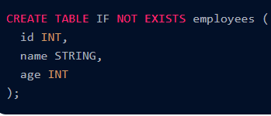
Step 3: Creating a Table
The "employees" table is created with this statement. It has three columns: "id" (integer), "name" (string), and "age" (integer). The table is only generated if it doesn't already exist thanks to the IF NOT EXISTS condition.

Slide 10


Loading Data into Tables
Load data from HDFS
Insert data into the table
The LOAD DATA statement inserts data into the designated table from an HDFS path. The "employees" table receives a specific row of data when the INSERT INTO TABLE query is executed.

Slide 11




Querying Data with HiveQL
1. Select All Records:
This hadoop hiveql command retrieves all records from the "employees" table.
2. Filtering: Example: Select employees older than 25
Only those records from the "employees" table that have a "age" greater than 25 are chosen by this.
3. Aggregation: Example: Count the number of employees
Example: Calculate the average age
These hadoop hiveql queries count the number of employees and determine the average age using aggregation operations on the "employees" table.

Slide 12
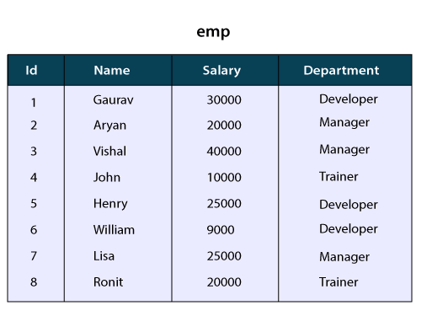
HiveQL - ORDER BY and SORT BY Clause
By using HiveQL ORDER BY and SORT BY clause, we can apply sort on the column. It returns the result set either in ascending or descending order. Here, we are going to execute these clauses on the records of the below table:
HiveQL - ORDER BY Clause
In HiveQL, ORDER BY clause performs a complete ordering of the query result set. Hence, the complete data is passed through a single reducer. This may take much time in the execution of large datasets. However, we can use LIMIT to minimize the sorting time.
Example of ORDER BY Clause in Hive
Let's see an example to arrange the data in the sorted order by using ORDER BY clause.
Select the database in which we want to create a table.
hive> use hiveql;

Slide 13
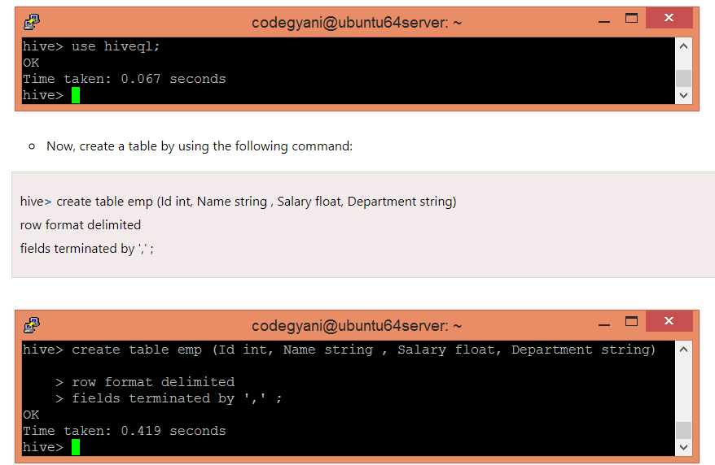

Slide 14
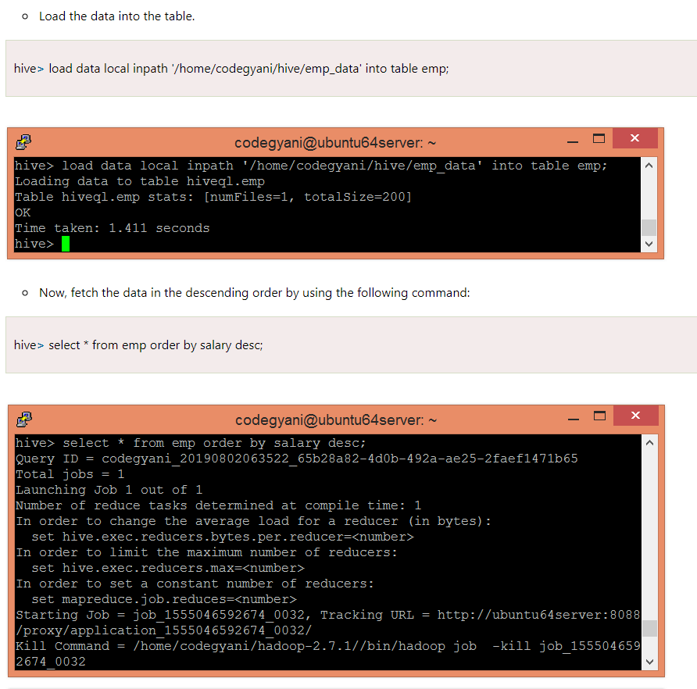
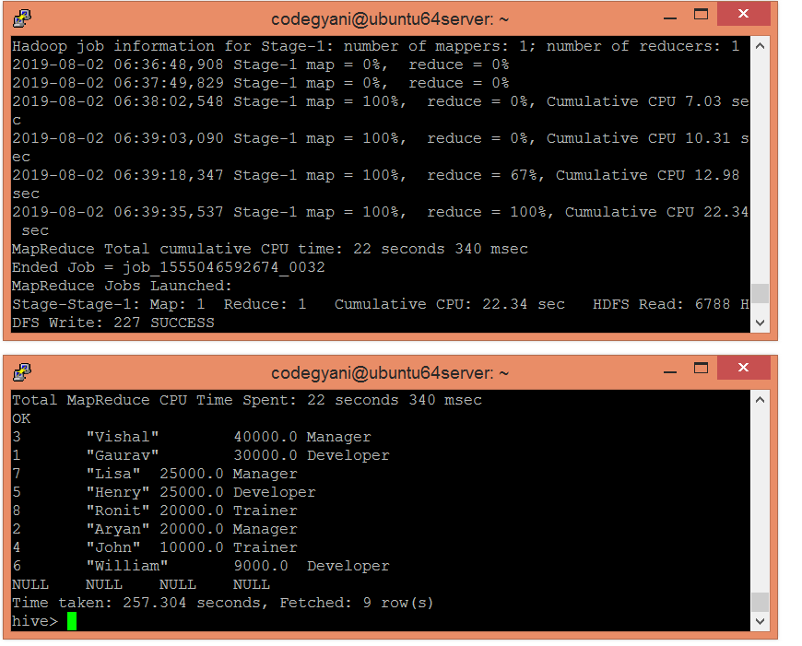

Slide 15
HiveQL - SORT BY Clause
The HiveQL SORT BY clause is an alternative of ORDER BY clause. It orders the data within each reducer. Hence, it performs the local ordering, where each reducer's output is sorted separately. It may also give a partially ordered result.
Example of SORT BY Clause in Hive
In this example, we arrange the data in the sorted order by using SORT BY clause.
Let's fetch the data in the descending order by using the following command:
hive> select * from emp sort by salary desc;

Slide 16

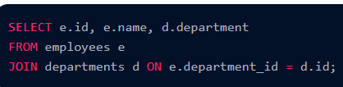
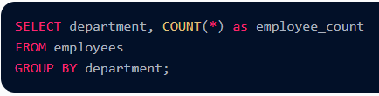
4.Sorting: Example: Sort by age in descending order
In order to extract employee names and their related departments, this query connects the "employees" and "departments" databases based on the "department_id" field.
5. Joining Tables: Example: Join employees and departments based on department_id
The "department_id" column is used to link the "employees" and "departments" databases in order to access employee names and their related departments.
6. Grouping and Aggregation: Example: Count employees in each department
This query counts the number of employees in each department and organises employees by department.

Slide 17

Data Filtering and Sorting
HiveQL offers the means to carry out these actions on your data contained in Hive tables. Data filtering and sorting are crucial data analysis activities. To filter and sort data using HiveQL, follow these steps:
1. Data Filtering: You can use the WHERE clause to filter rows based on specific conditions.
Example: Select marks which are more than 60.
The "marks" table's field must be greater than 60 in order for this query to return all items with that value.
2. Sorting Data: You can use the ORDER BY clause to order the result set according to one or more columns.
Example: Consider ranking the by marks in increasing order.
3.Combining Filtering and Sorting: To obtain particular subsets of data in a specified order, you can combine filtering and sorting.
Example: Select and sort marks more than 60.

Slide 18
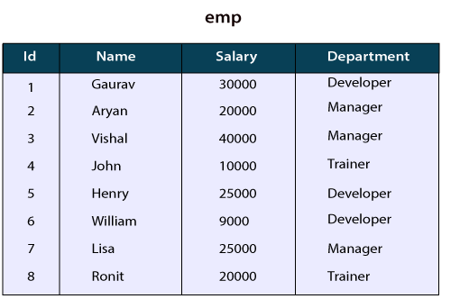
HiveQL - GROUP BY and HAVING Clause
The Hive Query Language provides GROUP BY and HAVING clauses that facilitate similar functionalities as in SQL. Here, we are going to execute these clauses on the records of the below table:
GROUP BY Clause
The HQL Group By clause is used to group the data from the multiple records based on one or more column. It is generally used in conjunction with the aggregate functions (like SUM, COUNT, MIN, MAX and AVG) to perform an aggregation over each group.
Example of GROUP BY Clause in Hive
Let's see an example to sum the salary of employees based on department.
Select the database in which we want to create a table.

Slide 19
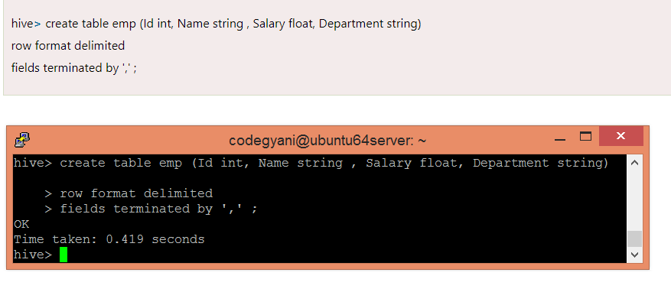
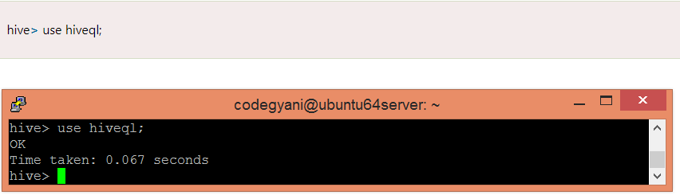
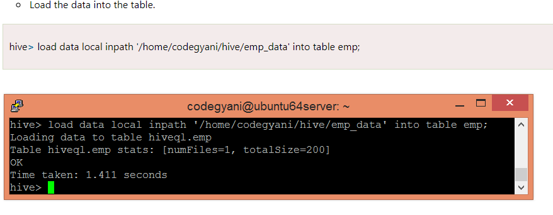

Slide 20
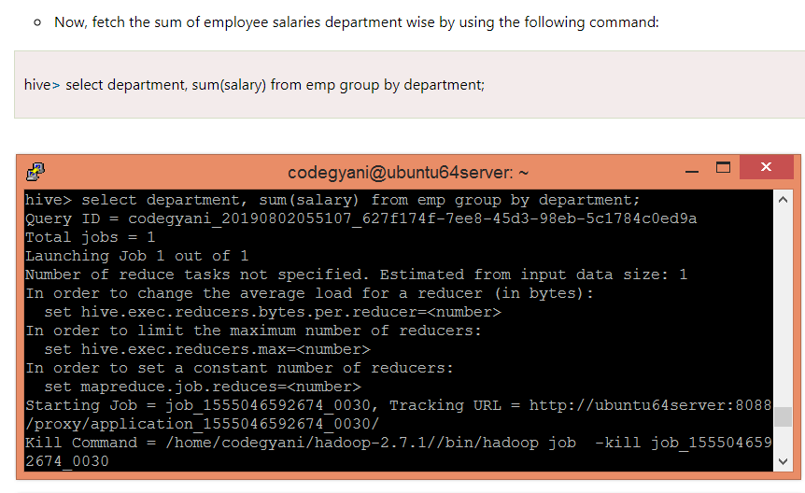
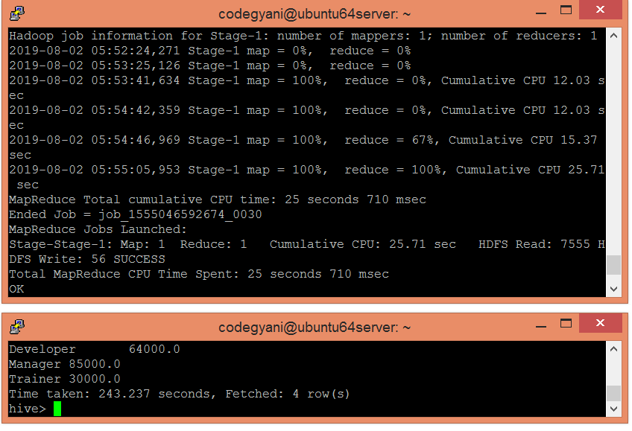

Slide 21


Data Transformations and aggregations :
1.Data transformations: HiveQL provides a number of built-in functions for changing the data in your query.
Example: Change the case of names
This hadoop hiveql query pulls the "name" column from the "employees" table and uses the UPPER function to change the names to uppercase.
2.Aggregations: Using functions like COUNT, SUM, AVG, and others, aggregates let you condense data.
Example: Calculate the average age of the workforce, for instance.

Slide 22
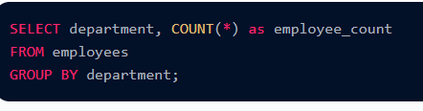
3. Grouping and Aggregating: To group data into categories, the GROUP BY clause is used with aggregate functions.
Example: For instance, total the personnel in each department.
The COUNT function is used in this query to count the number of employees in each department and group the employees by the "department" column.

Slide 23
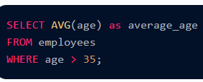
4.Filtering Before Aggregating: Before doing aggregations, data transformations and filtering might be used.
Example: Calculate the typical age of your staff members that are over 35. This hadoop hiveql query determines the average age of the filtered subset of employees by first excluding those over the age of 35.

Slide 24
HAVING CLAUSE
The HQL HAVING clause is used with GROUP BY clause. Its purpose is to apply constraints on the group of data produced by GROUP BY clause. Thus, it always returns the data where the condition is TRUE.
Example of Having Clause in Hive
In this example, we fetch the sum of employee's salary based on department and apply the required constraints on that sum by using HAVING clause.
Let's fetch the sum of employee's salary based on department having sum >= 35000 by using the following command:
select department, sum(salary) from emp group by department having sum(salary)>=35000;

Slide 25

Joins and Subqueries
HiveQL's advanced features, including as joins and subqueries, let you aggregate data from various tables and run sophisticated searches.
Using HiveQL, let's examine how to use joins and subqueries:
1. Joins: With the use of joins, you can merge rows from various tables based on a shared column. The INNER JOIN, LEFT JOIN, RIGHT JOIN, and FULL OUTER JOIN are examples of common join types.
Example: As an illustration, retrieve the employees and the corresponding departments from an inner join

Slide 26
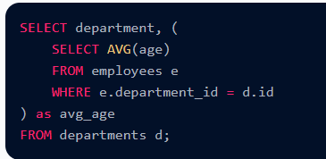
2. Subqueries: A subquery is a query that is nested inside another query. The SELECT, WHERE, and FROM clauses can all use them.
Example: Determine the typical age of employees in each department using a subquery in the SELECT statement.

Slide 27
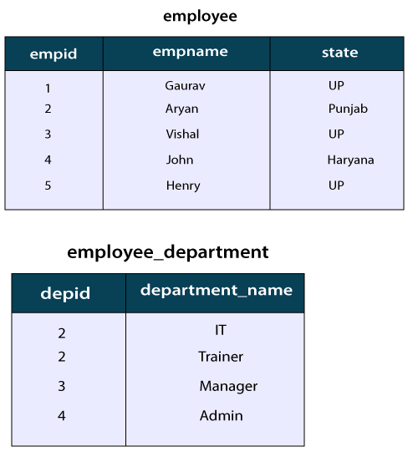
select e1.empname, e2.department_name from employee e1 join employee_department e2 on e1.empid= e2.depid;
select e1.empname, e2.department_name from employee e1 left outer join employee_department e2 on e1.empid= e2.depid;
select e1.empname, e2.department_name from employee e1 right outer join employee_department e2 on e1.empid= e2.depid;
select e1.empname, e2.department_name from employee e1 full outer join employee_department e2 on e1.empid= e2.depid;

