Slide 1

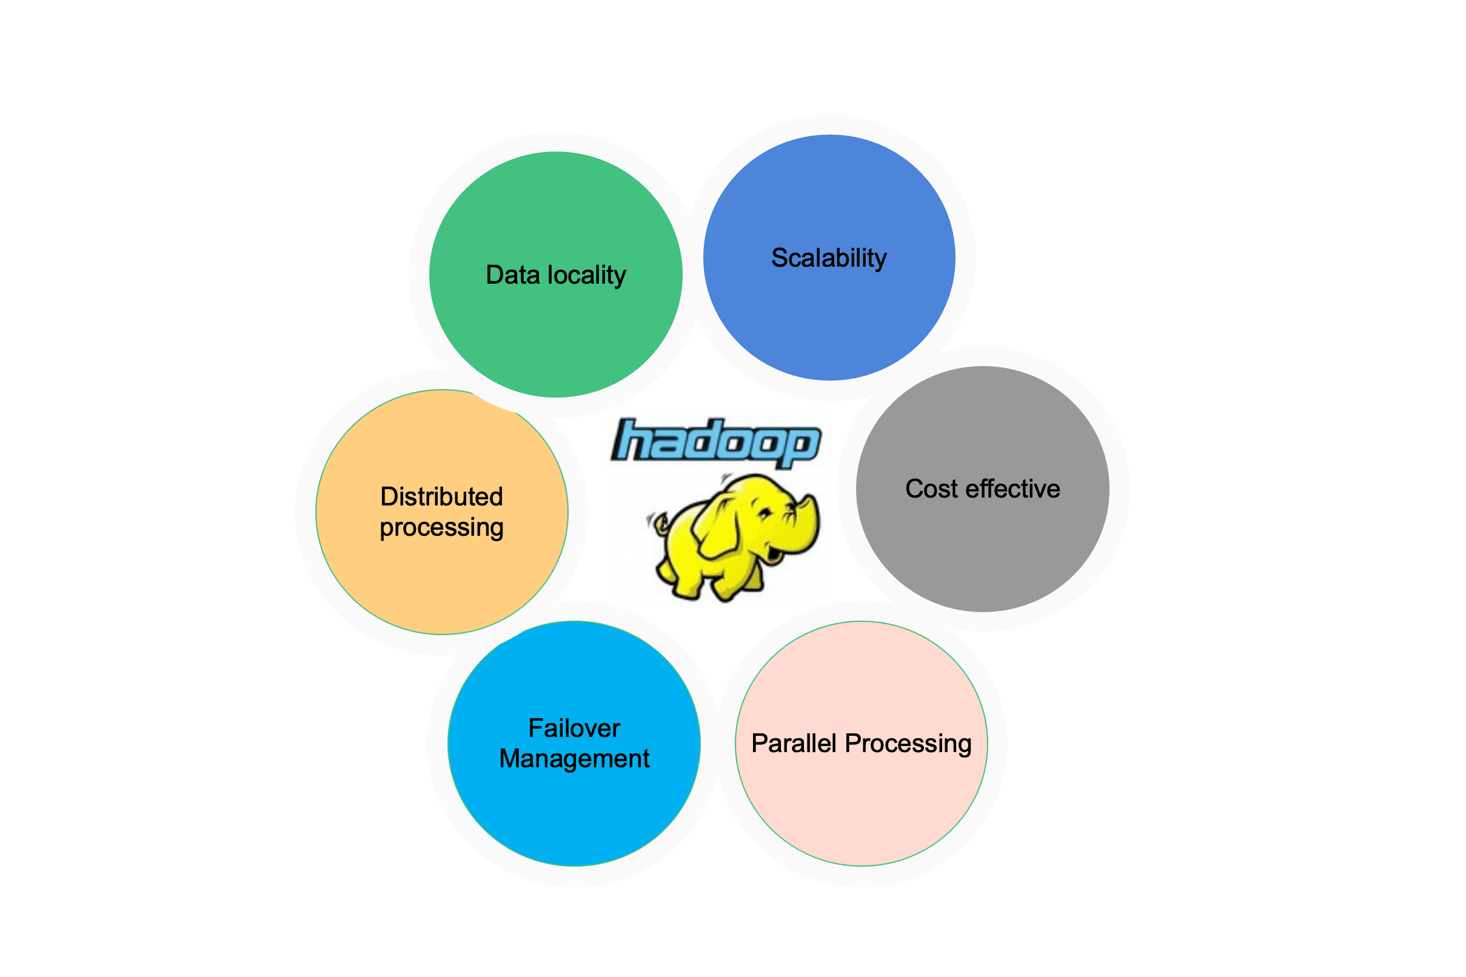
B.M.S COLLEGE OF ENGINEERING, BANGALORE-19
DEPARTMENT OF MACHINE LEARNING
BIG DATA ANALYTICS
(24AM6PEBDA)
UNIT -02
INTRODUCTION TO HADOOP AND HADOOP ARCHITECTURE
Prof. Varsha R,
Assistant Professor, Dept. of Machine Learning, BMSCE

Slide 2
Introduction
In essence, the ability to design, develop, and implement a big data application is directly dependent on an awareness of the architecture of the underlying computing platform, both from hardware and more importantly from a software perspective.
One commonality among the different appliances and frameworks is the adaptation of tools to leverage the combination of collections of four key computing resources:
1. Processing capability:
– Often referred to as a CPU, processor, or node.
– Generally speaking, modern processing nodes often incorporate multiple cores that are individual
CPUs that share the node’s memory and are managed and scheduled together, allowing multiple tasks to be run simultaneously; this is known as multithreading.
2. Memory:
– This holds the data that the processing node is currently working on.
– Most single node machines have a limit to the amount of memory.

Slide 3
Introduction
3. Storage:
– Provides persistence of data—the place where datasets are loaded, and from which the data is loaded into memory to be processed.
4. Network:
– This provides the “pipes” through which datasets are exchanged between different processing and storage nodes.

Slide 4
A General Overview of High-Performance
Architecture
Most high-performance platforms are created by connecting multiple nodes together via a variety of network topologies.
Specialty appliances may differ in the specifics of the configurations, as do software appliances.
However, the general architecture distinguishes the management of computing resources and the management of the data across the network of storage nodes, as is seen in Figure below.
In this configuration, a master job manager oversees the pool of processing nodes, assigns tasks, and monitors the activity.
At the same time, a storage manager oversees the data storage pool and distributes datasets across the collection of storage resources.
While there is no a priori requirement that there be any collocation of data and processing tasks, it is beneficial from a performance perspective to ensure that the threads process data that is local, or close to minimize the costs of data access latency.
To get a better understanding of the layering and interactions within a big data platform, we will examine the Apache Hadoop stack.

Slide 5
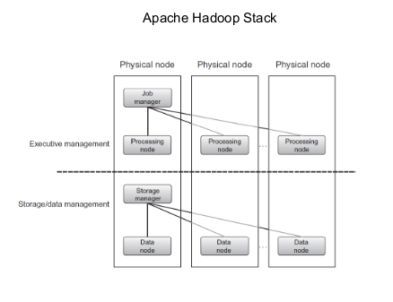
Apache Hadoop Stack

Slide 6
History
Apache Software Foundation is the developers of Hadoop, and it’s co-founders are Doug Cutting and Mike Cafarella. It’s co-founder Doug Cutting named it on his son’s toy elephant.
In October 2003, the first paper release was Google File System. In January 2006, MapReduce development started on the Apache Nutch which consisted of around 6000 lines coding for it and around 5000 lines coding for HDFS. In April 2006 Hadoop 0.1.0 was released.
It was created by Apache Software Foundation in 2006, based on a white paper written by Google in 2003 that described the Google File System (GFS) and the MapReduce programming model.
It is designed to scale up from single servers to thousands of machines, each offering local computation and storage.
It is used by many organizations, including Yahoo, Facebook, and IBM, for a variety of purposes such as data warehousing, log processing, and research. Hadoop has been widely adopted in the industry and has become a key technology for big data processing.

Slide 7
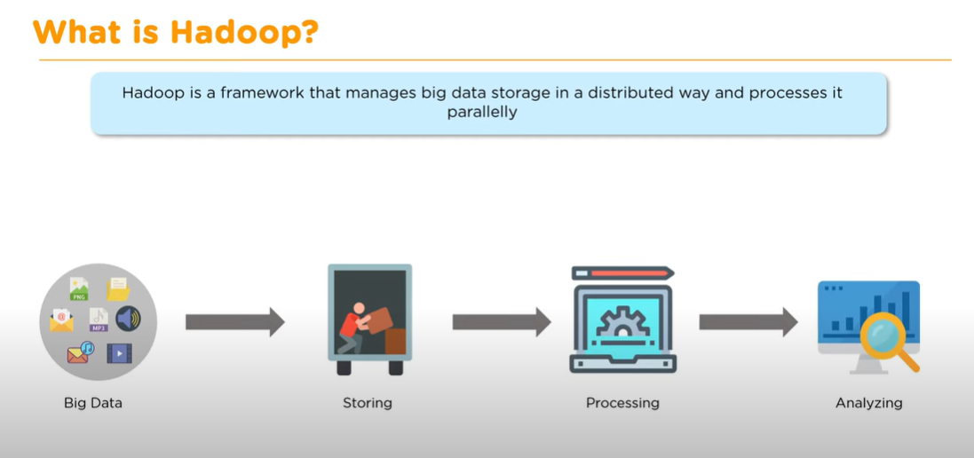
What is Hadoop?
Hadoop is an open-source framework from Apache and is used to store process and analyze data which are very huge in volume.
Hadoop is written in Java and is not OLAP (online analytical processing).
It is used for batch/offline processing. It is being used by Facebook, Yahoo, Google, Twitter, LinkedIn and many more.
It is designed to handle big data and is based on the MapReduce programming model, which allows for the parallel processing of large datasets.

Slide 8
Modules of Hadoop
HDFS: Hadoop Distributed File System. This is the storage component of Hadoop, which allows for the storage of large amounts of data across multiple machines. It states that the files will be broken into blocks and stored in nodes over the distributed architecture.
Yarn: Yet another Resource Negotiator is used for job scheduling, and is a resource management component of Hadoop, which manages the allocation of resources (such as CPU and memory) for processing the data stored in HDFS.
Map Reduce: This is a framework which helps Java programs to do the parallel computation on data using key-value pair. The Map task takes input data and converts it into a data set which can be computed in Key value pair. The output of the Map task is consumed by reduce task and then the out of reducer gives the desired result.
Hadoop also includes several additional modules that provide additional functionality, such as Hive (a SQL-like query language), Pig (a high-level platform for creating MapReduce programs), and HBase (a non-relational, distributed database).

Slide 9
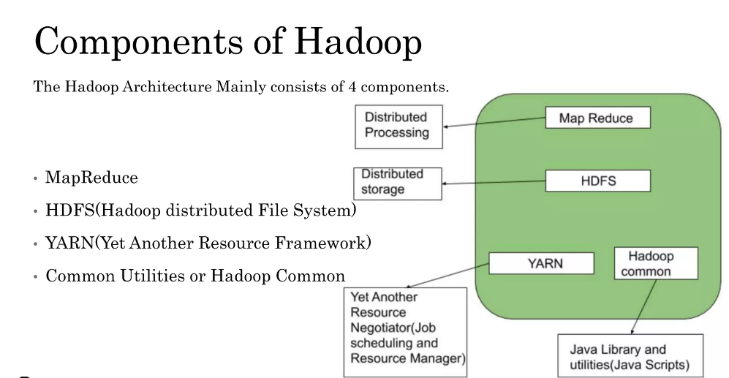
Components of Hadoop

Slide 10

Companies using Hadoop

Slide 11
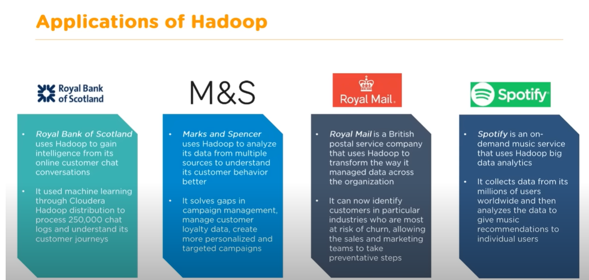
Applications of Hadoop

Slide 12
Features
Distributed Storage: Hadoop stores large data sets across multiple machines, allowing for the storage and processing of extremely large amounts of data.
Scalability: Hadoop can scale from a single server to thousands of machines, making it easy to add more capacity as needed.
Fault-Tolerance: Hadoop is designed to be highly fault-tolerant, meaning it can continue to operate even in the presence of hardware failures.
Data locality: Hadoop provides data locality feature, where the data is stored on the same node where it will be processed, this feature helps to reduce the network traffic and improve the performance
High Availability: Hadoop provides High Availability feature, which helps to make sure that the data is always available and is not lost.
Flexible Data Processing: Hadoop’s MapReduce programming model allows for the processing of data in a distributed fashion, making it easy to implement a wide variety of data processing tasks.
Data Integrity: Hadoop provides built-in checksum feature, which helps to ensure that the data stored is consistent and correct.
Data Replication: Hadoop provides a data replication feature, which helps to replicate the data across the cluster for fault tolerance.
Data Compression: Hadoop provides a built-in data compression feature, which helps to reduce the storage space and improve the performance.

Slide 13
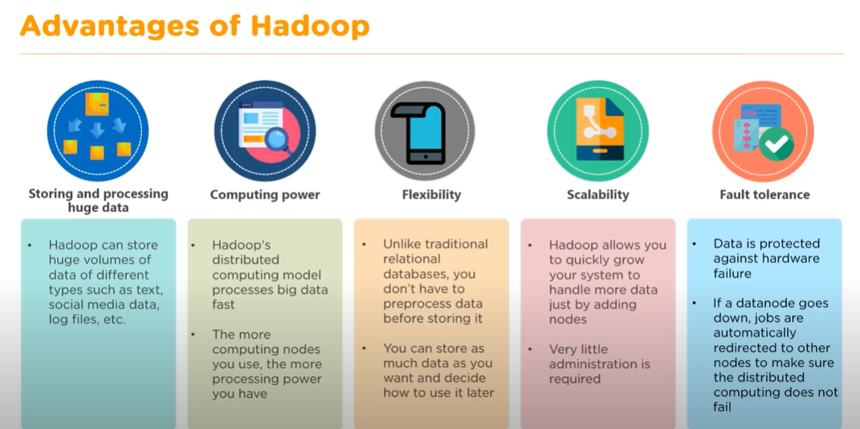
Advantages
Ability to store a large amount of data.
High flexibility.
Cost effective.
High computational power.
Tasks are independent.
Linear scaling.

Slide 14
Disadvantages
Not very effective for small data, Hard cluster management, Security concerns.
Complexity: Hadoop can be complex to set up and maintain, especially for organizations without a dedicated team of experts.
Latency: Hadoop is not well-suited for low-latency workloads and may not be the best choice for real-time data processing.
Limited Support for Real-time Processing: Hadoop’s batch-oriented nature makes it less suited for real-time streaming or interactive data processing use cases.
Limited Support for Structured Data: Hadoop is designed to work with unstructured and semi-structured data, it is not well-suited for structured data processing
Data Security: Hadoop does not provide built-in security features such as data encryption or user authentication, which can make it difficult to secure sensitive data.
Limited Support for Graph and Machine Learning: Hadoop’s core components HDFS and MapReduce are not well-suited for graph and machine learning workloads, specialized components like Apache Graph and Mahout are available but have some limitations.
Cost: Hadoop can be expensive to set up and maintain, especially for organizations with large amounts of data.
Data Loss: In the event of a hardware failure, the data stored in a single node may be lost permanently.

Slide 15
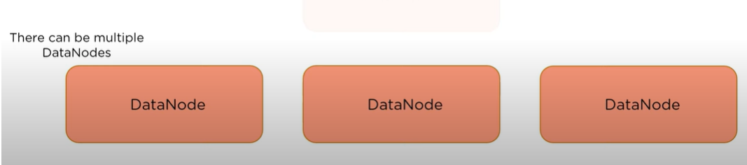
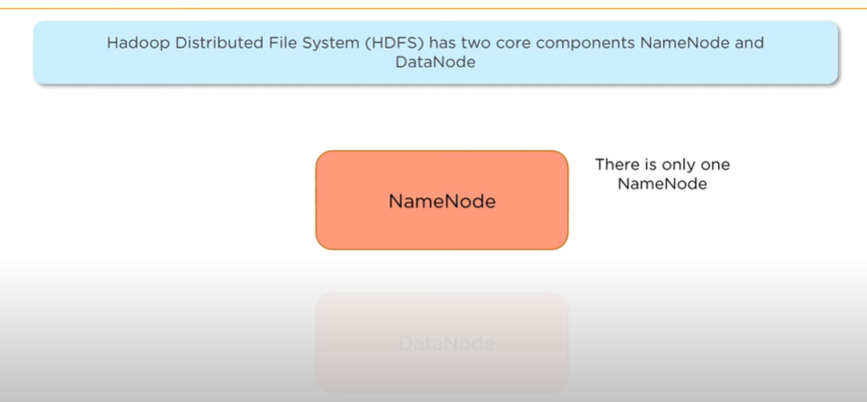
HDFS (Hadoop Distributed File System)
The Hadoop Distributed File System (HDFS) contains a master/slave architecture.
This architecture consists of a single NameNode that performs the role of master, and multiple DataNodes perform the role of a slave.
HDFS (Hadoop Distributed File System) is a unique design that provides storage for extremely large files with streaming data access pattern and it runs on commodity hardware.
Let’s elaborate the terms:
1. Extremely large files: Here we are talking about the data in range of petabytes(1000 TB).
2. Streaming Data Access Pattern: HDFS is designed on principle of write-once and read-many-times. Once data is written large portions of dataset can be processed any number times.
3. Commodity hardware: Hardware that is inexpensive and easily available in the market. This is one of feature which specially distinguishes HDFS from other file system.

Slide 16
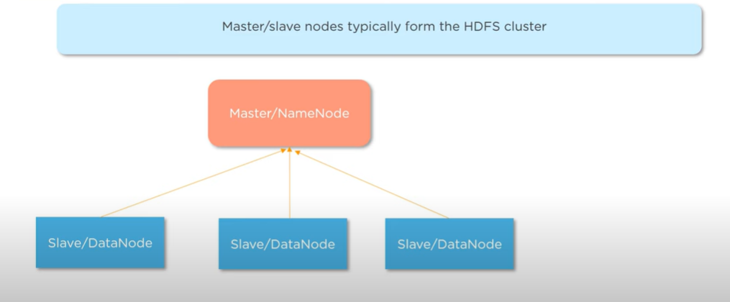
A Hadoop cluster consists of a single master and multiple slave nodes.
The master node includes Job Tracker, Task Tracker, NameNode, and DataNode whereas the slave node includes DataNode and TaskTracker.

Slide 17
Namenode (MasterNode)
It is a single master server exists in the HDFS cluster.
As it is a single node, it may become the reason for single-point failure.
Manages all the slave nodes and assign work to them.
It manages the file system namespace by executing an operation like the opening, renaming, and closing the files.
It should be deployed on reliable hardware which has the high config. not on commodity hardware.
It simplifies the architecture of the system.

Slide 18
Datanode (SlaveNode)
The HDFS cluster contains multiple DataNodes.
Each DataNode contains multiple data blocks.
These data blocks are used to store data.
Actual worker nodes, who do the actual work like reading, writing, processing etc.
They can be deployed on commodity hardware.
It is the responsibility of DataNode to read and write requests from the file system's clients.
It performs block creation, deletion, and replication upon instruction from the NameNode.

Slide 19
Job Tracker and Task Tracker
Job Tracker : The role of Job Tracker is to accept the MapReduce jobs from client and process the data by using NameNode.
In response, NameNode provides metadata to Job Tracker.
Task Tracker : It works as a slave node for Job Tracker.
It receives task and code from Job Tracker and applies that code on the file. This process can also be called as a Mapper

Slide 20
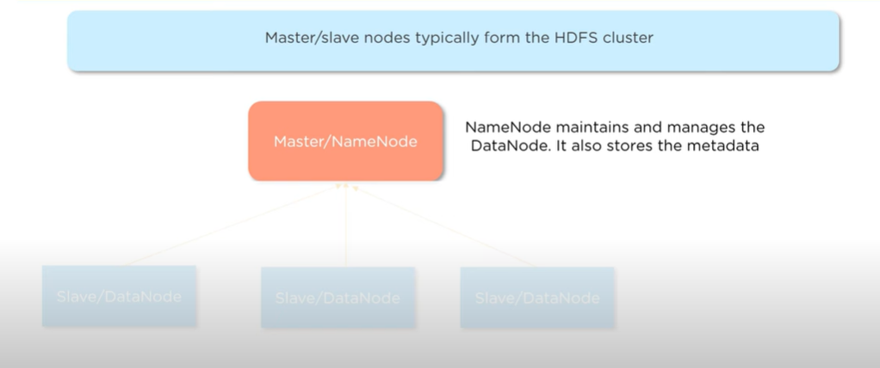
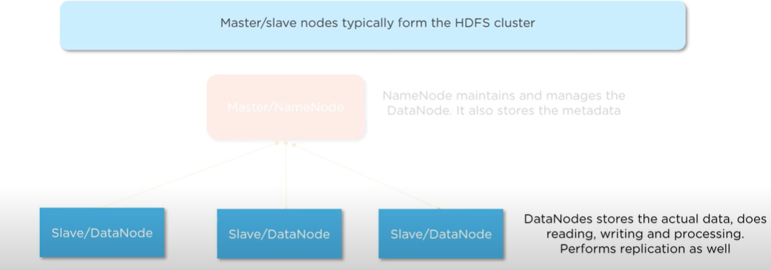

Slide 21
Data Stored in HDFS
Lets assume that 100TB file is inserted, then masternode (namenode) will first divide the file into blocks of 10TB (default size is 128 MB in Hadoop 2.x and above).
Then these blocks are stored across different datanodes (slavenode). Datanodes (slavenode) replicate the blocks among themselves and the information of what blocks they contain is sent to the master.
Default replication factor is 3 means for each block 3 replicas are created (including itself). In hdfs.site.xml we can increase or decrease the replication factor i.e we can edit its configuration here.
Note: MasterNode has the record of everything, it knows the location and info of each and every single data nodes and the blocks they contain, i.e. nothing is done without the permission of masternode.

Slide 22

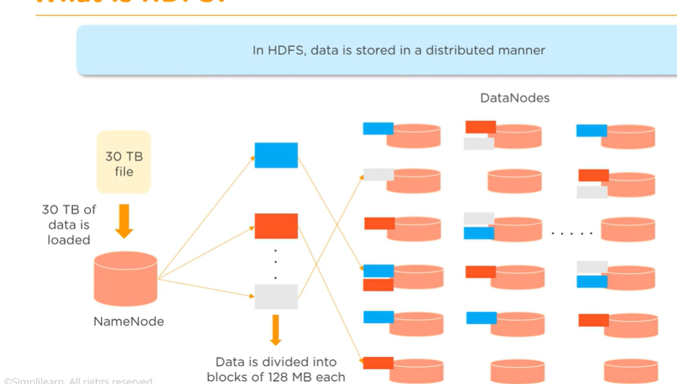

Slide 23
Why divide the files into blocks?
Let’s assume that we don’t divide, now it’s very difficult to store a 100 TB file on a single machine.
Even if we store, then each read and write operation on that whole file is going to take very high seek time.
But if we have multiple blocks of size 128MB then its become easy to perform various read and write operations on it compared to doing it on a whole file at once.
So we divide the file to have faster data access i.e. reduce seek time.

Slide 24
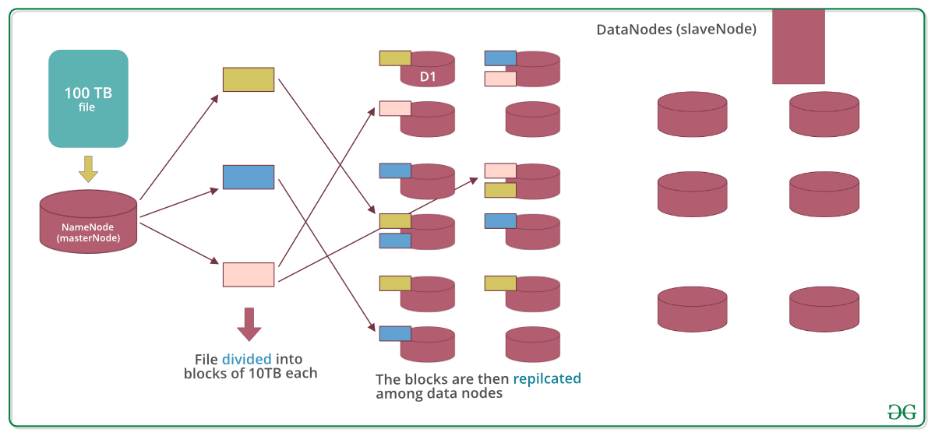
Why replicate the blocks in data nodes while storing?
Let’s assume we don’t replicate and only one yellow block is present on datanode D1.
Now if the data node D1 crashes we will lose the block and which will make the overall data inconsistent and faulty.
So we replicate the blocks to achieve fault-tolerance.

Slide 25
What is YARN?
YARN[YET ANOTHER RESOURCE NEGOTIATOR] provides the resource management.
It is the operating system of Hadoop.
It responsible for managing and monitoring workloads, also implementing security controls.
Apache YARN is also a central platform to deliver data governance tools across the clusters.
YARN allows multiple data processing engines such as real-time streaming, batch processing etc.
Why YARN?
In Hadoop version 1.0 which is also referred to as MRV1(MapReduce Version 1), MapReduce performed both processing and resource management functions. It consisted of a Job Tracker which was the single master.
The Job Tracker allocated the resources, performed scheduling and monitored the processing jobs.
It assigned map and reduce tasks on a number of subordinate processes called the Task Trackers.
The Task Trackers periodically reported their progress to the Job Tracker.

Slide 26
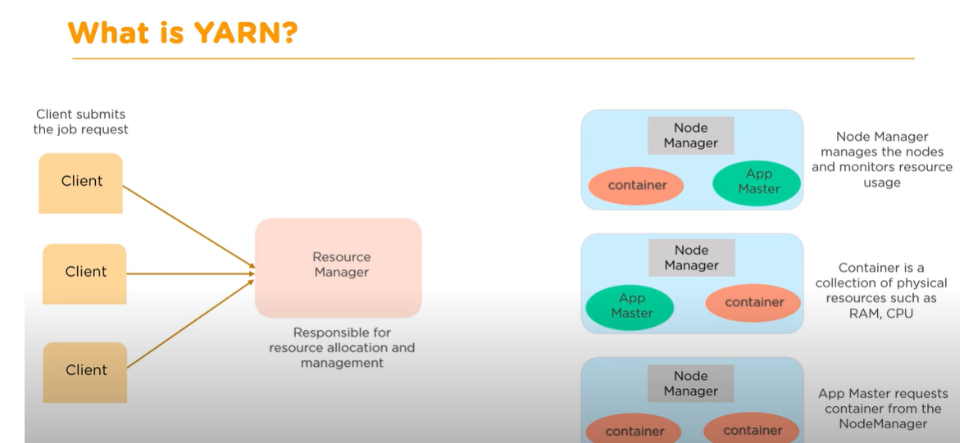
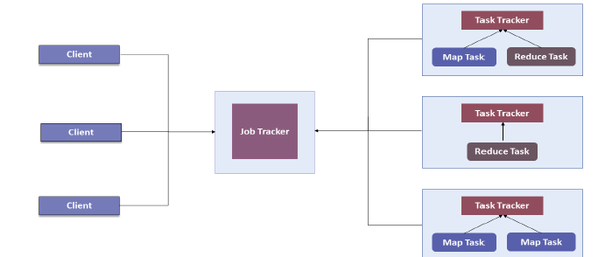
What is YARN?

Slide 27
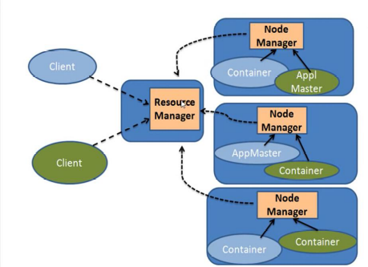
YARN Architecture
Apart from Resource Management, YARN also performs Job Scheduling. YARN performs all your processing activities by allocating resources and scheduling tasks. Apache Hadoop YARN Architecture consists of the following main components as shown in figure below:
1. Resource Manager: Runs on a master daemon and manages the resource allocation in the cluster.
2. Node Manager: They run on the slave daemons and are responsible for the execution of a task on every single Data Node.
3. Application Master: Manages the user job lifecycle and resource needs of individual applications. It works along with the Node Manager and monitors the execution of tasks.
4. Container: Package of resources including RAM, CPU, Network, HDD etc on a single node.

Slide 28
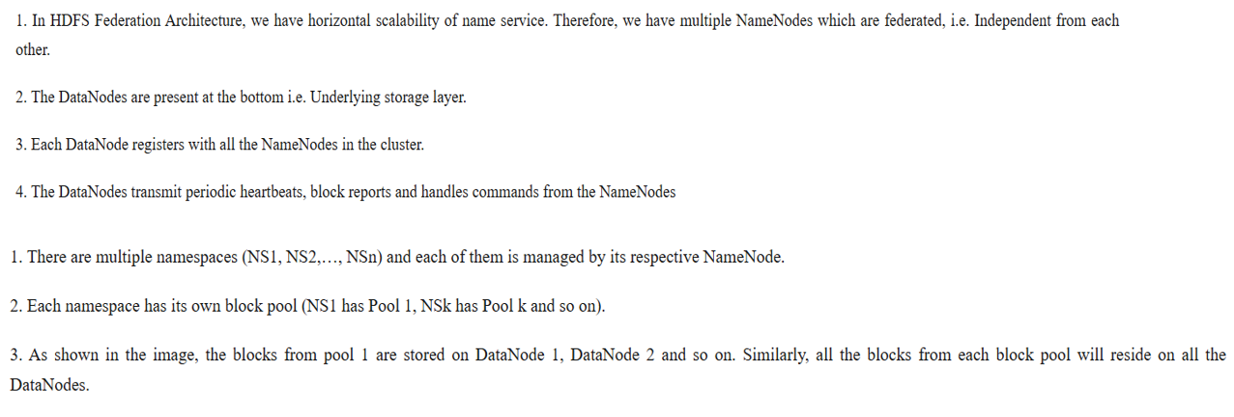
HDFS Federation

Slide 29
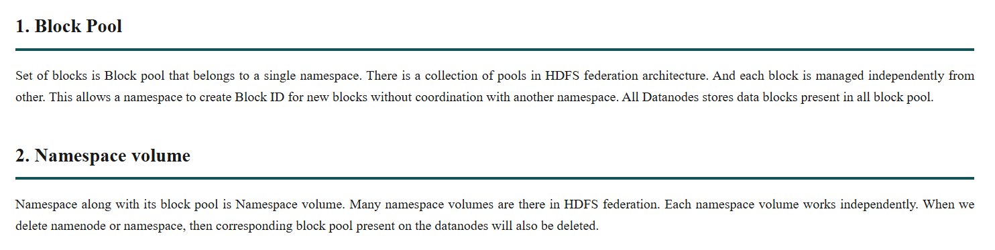
HDFS Federation

Slide 30
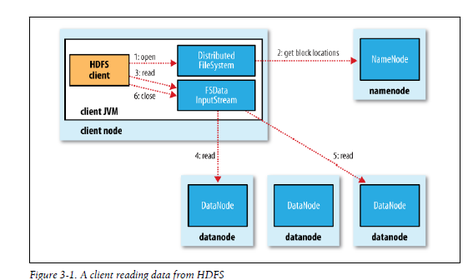
Data Flow : Anatomy of a File Read
Step 1: The client opens the file it wishes to read by calling open() on the FileSystem object, which for HDFS is an instance of Distributed File System.
Step 2: DistributedFileSystem calls the namenode, using RPC(Remote Procedure Calls), to determine the locations of the blocks for the first few blocks in the file .
Step 3: For each block, the namenode returns the addresses of the datanodes that have a copy of that block. The Distributed FileSystem returns an FSDataInputStream (an input stream that supports file seeks) to the client for it to read data from. FSDataInputStream in turn wraps a DFSInputStream, which manages the datanode and namenode I/O. The client then calls read() on the stream .
Step 4: DFSInputStream, which has stored the datanode addresses for the first few blocks in the file, then connects to the first (closest) datanode for the first block in the file. Data is streamed from the datanode back to the client, which calls read() repeatedly on the stream .
Step 5: When the end of the block is reached, DFSInputStream will close the connection to the datanode, then find the best datanode for the next block .
Step 6: This happens transparently to the client, which from its point of view is just reading a continuous stream. Blocks are read in order with the DFSInputStream opening new connections to datanodes as the client reads through the stream. It will also call the namenode to retrieve the datanode locations for the next batch of blocks as needed. When the client has finished reading, it calls close() on the FSDataInputStream .

Slide 31
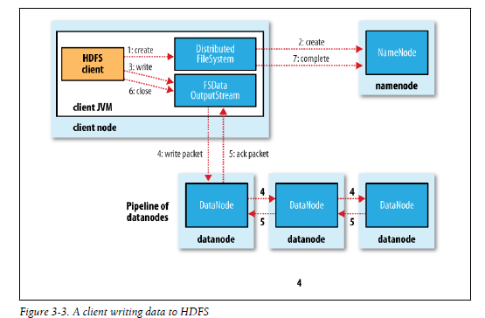
Data Flow : Anatomy of a File Write
Step 1: The client creates the file by calling create() on DistributedFileSystem .
Step 2: DistributedFileSystem makes an RPC call to the namenode to create a new file in the filesystem’s namespace, with no blocks associated with it.
Step 3: The namenode performs various checks to make sure the file doesn’t already exist, and that the client has the right permissions to create the file. If these checks pass, the namenode makes a record of the new file; otherwise, file creation fails and the client is thrown an IOException. The DistributedFileSystem returns an FSDataOutputStream for the client to start writing data to. Just as in the read case, FSDataOutputStream wraps a DFSOutput Stream, which handles communication with the datanodes and namenode.
Step 4: As the client writes data (step 3), DFSOutputStream splits it into packets, which it writes to an internal queue, called the data queue. The data queue is consumed by the Data Streamer, whose responsibility it is to ask the namenode to allocate new blocks by picking a list of suitable datanodes to store the replicas. The list of datanodes forms a pipeline—we’ll assume the replication level is three, so there are three nodes in the pipeline. The DataStreamer streams the packets to the first datanode in the pipeline, which stores the packet and forwards it to the second datanode in the pipeline. Similarly, the second datanode stores the packet and forwards it to the third (and last) datanode in the pipeline.
Step 5: DFSOutputStream also maintains an internal queue of packets that are waiting to be acknowledged by datanodes, called the ack queue. A packet is removed from the ack queue only when it has been acknowledged by all the datanodes in the pipeline.
Step 6: If a datanode fails while data is being written to it, then the following actions are taken, which are transparent to the client writing the data. First the pipeline is closed, and any packets in the ack queue are added to the front of the data queue so that datanodes that are downstream from the failed node will not miss any packets. When the client has finished writing data, it calls close() on the stream .

Slide 32
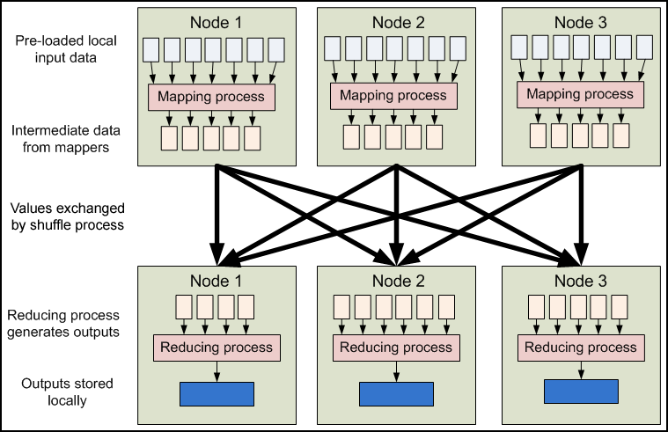
Map Reduce
A MapReduce is a data processing tool which is used to process the data parallelly in a distributed form.
The MapReduce is a paradigm which has two phases, the mapper phase, and the reducer phase.
In the Mapper, the input is given in the form of a key-value pair.
The output of the Mapper is fed to the reducer as input.
The reducer runs only after the Mapper is over.
The reducer too takes input in key-value format, and the output of reducer is the final output.

Slide 33
Why Map Reduce is Used?
Handles huge volumes of data
Supports parallel processing
Provides fault tolerance
Simplifies distributed programming
Ideal for batch processing

Slide 34
Steps in Map Reduce
The map takes data in the form of pairs and returns a list of <key, value> pairs. The keys will not be unique in this case.
Using the output of Map, sort and shuffle are applied by the Hadoop architecture. This sort and shuffle acts on these list of <key, value> pairs and sends out unique keys and a list of values associated with this unique key <key, list(values)>.
An output of sort and shuffle sent to the reducer phase. The reducer performs a defined function on a list of values for unique keys, and Final output <key, value> will be stored/displayed.

Slide 35
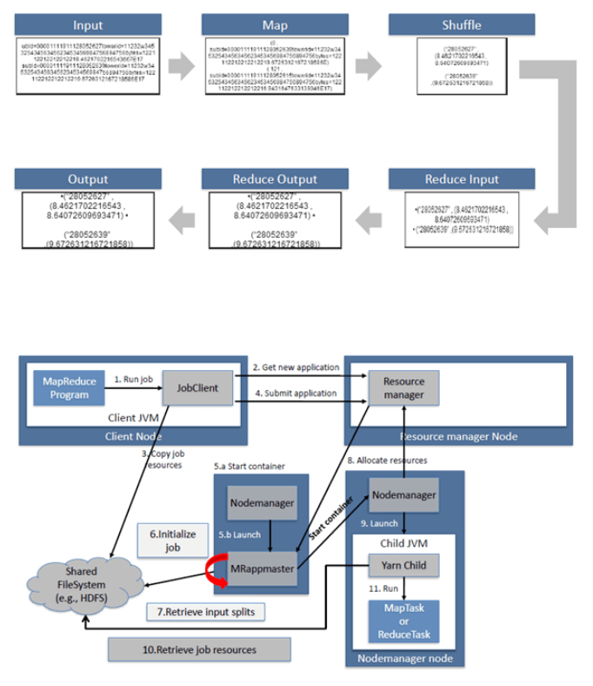

Slide 36
Sort and Shuffle
The sort and shuffle occur on the output of Mapper and before the reducer.
When the Mapper task is complete, the results are sorted by key, partitioned if there are multiple reducers, and then written to disk.
Using the input from each Mapper <k2,v2>, we collect all the values for each unique key k2.
This output from the shuffle phase in the form of <k2, list(v2)> is sent as input to reducer phase.

Slide 37
Use of MapReduce
It can be used in various application like document clustering, distributed sorting, and web link-graph reversal.
It can be used for distributed pattern-based searching.
We can also use MapReduce in machine learning.
It was used by Google to regenerate Google's index of the World Wide Web.
It can be used in multiple computing environments such as multi-cluster, multi-core, and mobile environment.

Slide 38
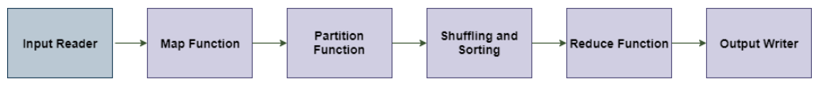
Data Flow in MapReduce
MapReduce is used to compute the huge amount of data . To handle the upcoming data in a parallel and distributed form, the data has to flow from various phases.

Slide 39
Phases of MapReduce data flow
Input reader : The input reader reads the upcoming data and splits it into the data blocks of the appropriate size (64 MB to 128 MB). Each data block is associated with a Map function.
Once input reads the data, it generates the corresponding key-value pairs. The input files reside in HDFS.
Map function : The map function process the upcoming key-value pairs and generated the corresponding output key-value pairs. The map input and output type may be different from each other.
Partition function : The partition function assigns the output of each Map function to the appropriate reducer. The available key and value provide this function. It returns the index of reducers.
Shuffling and Sorting : The data are shuffled between/within nodes so that it moves out from the map and get ready to process for reduce function. Sometimes, the shuffling of data can take much computation time.
The sorting operation is performed on input data for Reduce function. Here, the data is compared using comparison function and arranged in a sorted form.

Slide 40
Phases of MapReduce data flow
Reduce function : The Reduce function is assigned to each unique key. These keys are already arranged in sorted order. The values associated with the keys can iterate the Reduce and generates the corresponding output.
Output writer : Once the data flow from all the above phases, Output writer executes. The role of Output writer is to write the Reduce output to the stable storage.

Slide 41
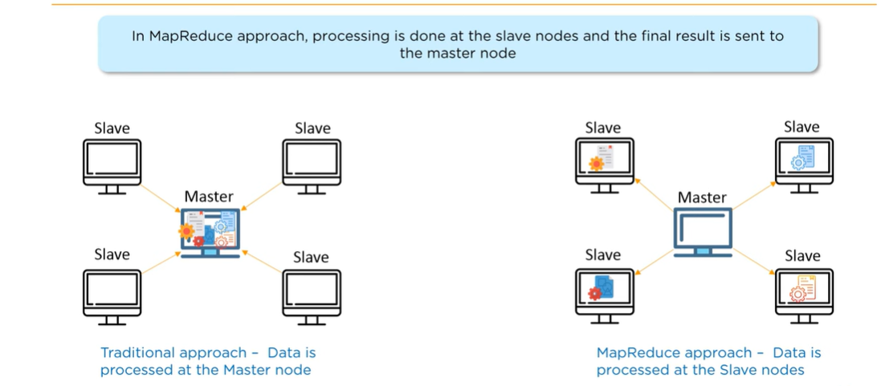

Slide 42
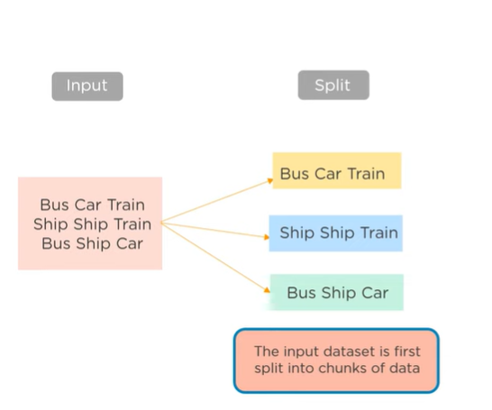
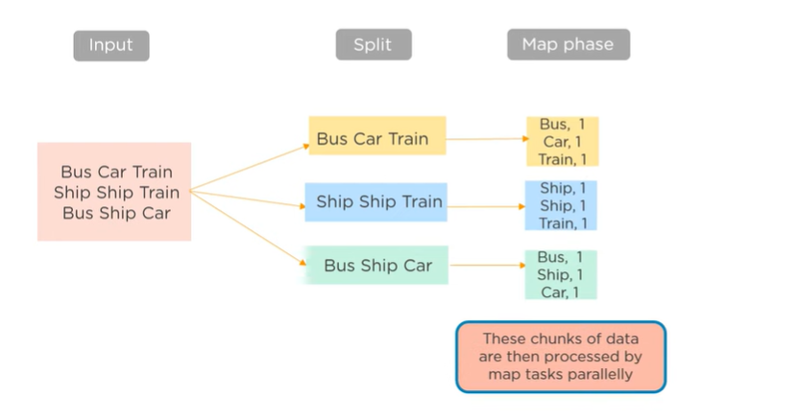
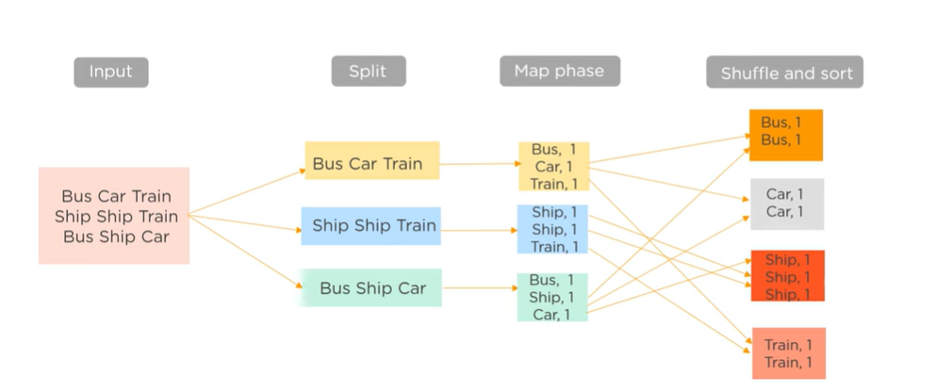

Slide 43
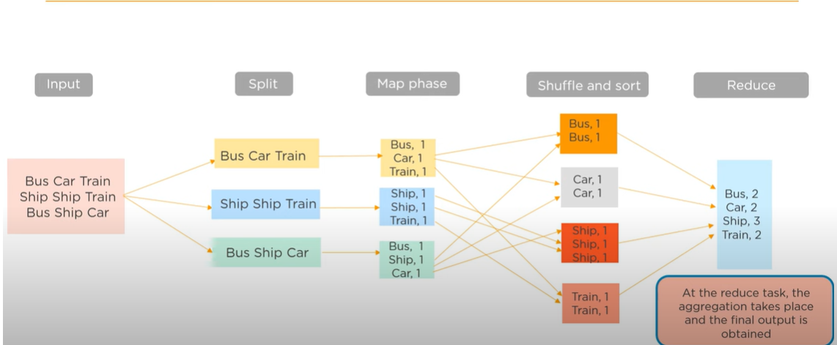

Slide 44
MapReduce APIs
MapReduce Mapper Class
In MapReduce, the role of the Mapper class is to map the input key-value pairs to a set of intermediate key-value pairs. It transforms the input records into intermediate records.
These intermediate records associated with a given output key and passed to Reducer for the final output.

Slide 45
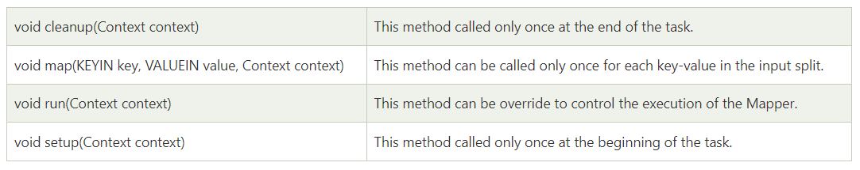
Methods of Mapper class

Slide 46
MapReduce Reducer class
In MapReduce, the role of the Reducer class is to reduce the set of intermediate values.
Its implementations can access the Configuration for the job via the JobContext.getConfiguration() method.

Slide 47
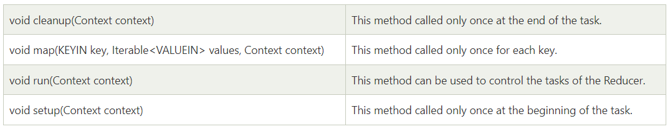
Methods of Reducer class

Slide 48
Moving the data in Hadoop
The first step in working with data in Hadoop is to make it available to Hadoop.
There are two primary methods that can be used to move data into Hadoop: writing external data at the HDFS level (a data push), or reading external data at the MapReduce level (more like a pull).
Reading data in MapReduce has advantages in the ease with which the operation can be parallelized and made fault tolerant.
Not all data is accessible from MapReduce, however, such as in the case of log files, which is where other systems need to be relied on for transportation, including HDFS for the final data hop.

Slide 49
Data Serialization and Deserialization
Data Serialization and Deserialization:
Data serialization is the process of converting data objects present in complex data structures into a byte stream for storage, transfer and distribution purposes on physical devices.
Computer systems may vary in their hardware architecture, OS, addressing mechanisms. Internal binary representations of data also vary accordingly in every environment. Storing and exchanging data between such varying environments requires a platform-and-language-neutral data format that all systems understand.
Once the serialized data is transmitted from the source machine to the destination machine, the reverse process of creating objects from the byte sequence called deserialization is carried out. Reconstructed objects are clones of the original object.
Choice of data serialization format for an application depends on factors such as data complexity, need for human readability, speed and storage space constraints. XML, JSON, BSON, YAML, MessagePack, and protobuf are some commonly used data serialization formats.

Slide 50
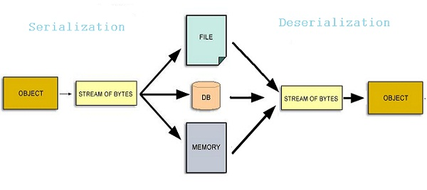
Data Serialization and Deserialization

Slide 51
How does Data Serialization and De Serialization work?
Computer data is generally organized in data structures such as arrays, tables, trees, classes. When data structures need to be stored or transmitted to another location, such as across a network, they are serialized.
For simple, linear data (number or string) there's nothing to do. Serialization becomes complex for nested data structures and object references. When objects are nested into multiple levels, such as in trees, it's collapsed into a series of bytes, and enough information (such as traversal order) is included to aid reconstruction of the original tree structure on the destination side.
When objects with pointer references to other member variables are serialized, the referenced objects are tracked and serialized, ensuring that the same object is not serialized more than once. However, all nested objects must be serializable too.
Finally, the serialized data stream is persisted in a byte sequence using a standard format. ISO-8859-1 is a popular format for 1-byte representation of English characters and numerals. UTF-8 is the world standard for encoding multilingual, mathematical and scientific data; each character may take 1-4 bytes of data in Unicode.

Slide 52
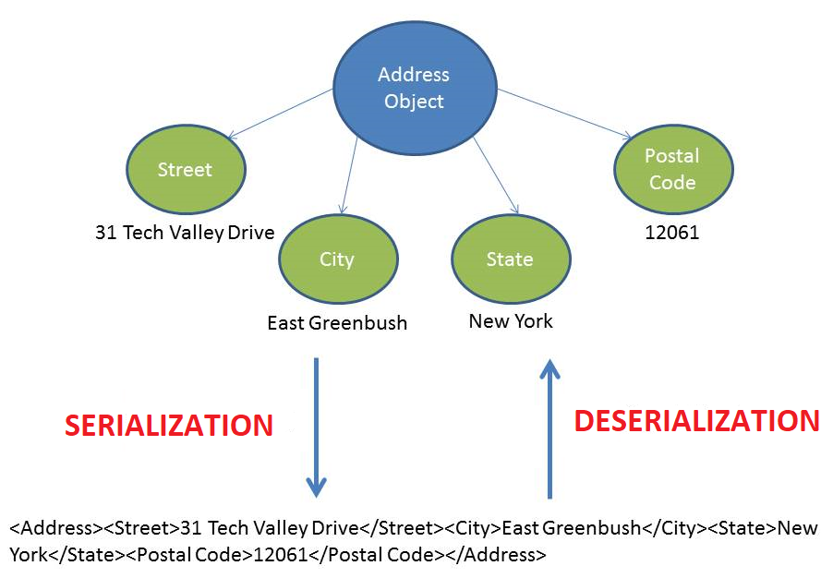
How does Data Serialization and Deserialization work?

