Slide 1

B.M.S. COLLEGE OF ENGINEERING, BENGALURU DEPARTMENT OF COMPUTER APPLICATIONS Autonomous Institute, affiliated to VTU ODD 2024-2025
Security
Cloud Cloud COMPUTING
UNIT-5
Security on Cloud
Prof T. Sunitha

Slide 2
Computer security in the new millennium
In an interconnected world, various embodiments of malware (software designed to harm a computer) can migrate easily from
one system to another, cross national borders and infect systems
all over the globe.
The security of computing and communication systems takes a new urgency as the society becomes increasingly more dependent on the information infrastructure. Even the critical infrastructure of a nation can be attacked by exploiting flaws in computer security.
Recently, the term cyberwarfare has entered the dictionary meaning “actions by a nation-state to penetrate another nation's computers or networks for the purposes of causing damage or disruption”

Slide 3
Cloud security
A computer cloud is a target-rich environment for malicious individuals and criminal organizations.
Major concern for existing users and for potential new users of cloud computing services. Outsourcing computing to a cloud generates new security and privacy concerns.
Standards, regulations, and laws governing the activities of organizations supporting cloud computing have yet to be adopted. Many issues related to privacy, security, and trust in cloud computing are far from being settled.
There is the need for international regulations adopted by the countries where data centers of cloud computing providers are located.
Service Level Agreements (SLAs) do not provide adequate legal protection for cloud computer users, often left to deal with events beyond their control.

Slide 4
Cloud security risks
Traditional threats → impact amplified due to the vast amount of cloud resources and the large user population that can be affected. The
fuzzy bounds of responsibility between the providers of cloud services and users and the difficulties to accurately identify the cause. Ex: Data Breaches (Attackers trying to gain unauthorized access to sensitive
data), Insider Threats and malware
New threats → cloud servers host multiple VMs; multiple applications may run under each VM. Multi-tenancy (If isolation is not properly enforced) and VMM vulnerabilities open new attack channels for malicious users. Identifying the path followed by an attacker is more difficult in a cloud environment. Misconfiguration of Cloud Resources
Authentication and authorization → the procedures in place for one individual does not extend to an enterprise. enterprise-level security is far more intricate than individual-level security, as it involves managing a wide range of permissions across a network of users, devices, and systems

Slide 5
Cloud security risks
Third-party control → generates a spectrum of concerns caused by the lack of transparency and limited user control.
Availability of cloud services → system failures, power outages, and other catastrophic(destructive) events could shut down services for extended periods of time.

Slide 6
Attacks in a cloud computing environment
Three actors involved- users, service providers, and attackers
Six types of attacks possible-
data breaches- A hacker exploiting weak authentication mechanisms to access customer data stored on a cloud server
DoS/DDoS - A DDoS attack targeting a cloud-based website, causing it to become slow or completely offline.
insider threats - A disgruntled employee accessing sensitive company data and leaking it to a competitor or selling it.
MitM attacks - An attacker intercepting communication between a user and a cloud application, stealing authentication credentials or tampering with data being sent.
insecure APIs- An attacker exploiting an insecure API to gain access to an organization’s cloud database
privilege escalation- attacks occur when an attacker gains higher privileges than they should have, such as administrative rights or access to restricted cloud resources.

Slide 7
Attacks in a cloud computing environment
The user can be attacked by:
Service
SSL(secure sockets layer) certificate spoofing :it is a digital file that verifies a website’s identity of the server. malicious actor creates a fake SSL/TLS certificate that appears to be valid, tricking users into thinking they're communicating with a legitimate website when they're communicating with an attacker. The goal is often to intercept or steal sensitive information, like login credentials, credit card details, or other personal data.
attacks on browser caches or phishing attacks: refer to malicious attempts to exploit the browser's cache storage location on the user's device where frequently accessed data (like images, scripts, and HTML pages) is temporarily stored for faster access. Since cached data can contain sensitive information such as login credentials, session tokens, or private data, attackers can target this storage in various ways to steal or manipulate the data.

Slide 8
Attacks in a cloud computing environment
The cloud infrastructure → attacks that either originates at the cloud or spoofs to originate from the cloud infrastructure.
The service can be attacked by:
A user→ buffer overflow, SQL injection, and privilege escalation are the common types of attacks.
The cloud infrastructure → the most serious line of attack. Limiting access to resources, privilege-related attacks, data distortion, injecting additional operations.
The cloud infrastructure can be attacked by:
A user → targets the cloud control system.
A service → requesting an excessive amount of resources and causing the exhaustion of the resources.
Surfaces of attacks in a cloud computing environment.

Slide 9
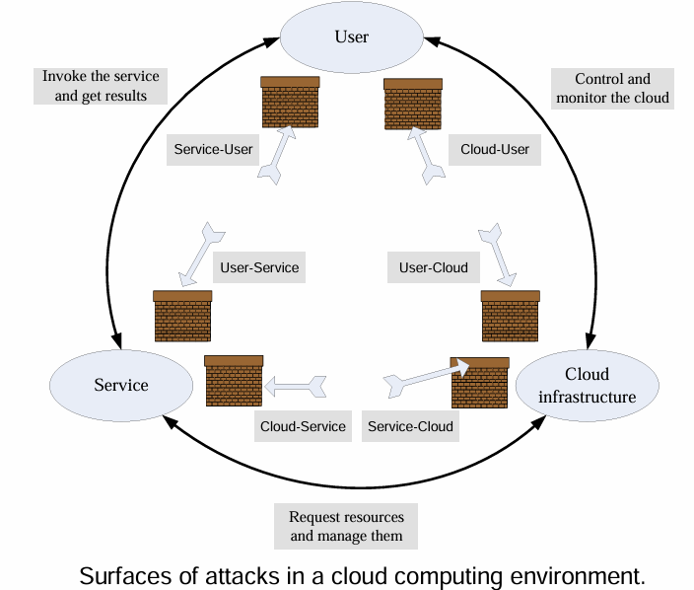
Attacks in a cloud computing environment

Slide 10
Top threats to cloud computing
Identified by a 2010 Cloud Security Alliance (CSA) report:
The abusive use of the cloud - the ability to conduct nefarious activities from the cloud.
Malicious insiders - cloud service providers do not disclose their hiring standards and policies, so this can be a serious threat.
Shared technology.
Account hijacking- take over a user's account on an application to access their information, publish content in their name or commit fraud.
Data loss or leakage - if the only copy of the data is stored on the cloud, then sensitive data is permanently lost when cloud data replication fail.
Unknown risk profile - exposure to the ignorance or underestimation of the risks of cloud computing.
APIs that are not fully secure can be a major attack vector in cloud environments.

Slide 11
Top threats to cloud computing
Here’s a real-world example of an API-related cloud attack:
Facebook (Meta) Data Leak (2019) – API Misuse & Poor Access Controls Attack Type: API Misconfiguration & Data Exposure
What Happened:
Third-party developers improperly stored Facebook user data on public cloud servers (AWS S3 buckets).
The exposed APIs allowed unauthorized access to millions of user records
without proper authentication.
Two major leaks were found:
Mexican media company Cultura Colectiva stored 540 million records (user IDs, comments, likes, reactions) in an open S3 bucket.
Another third-party app stored 22,000 passwords in plaintext, also publicly accessible.
Impact:
Massive data exposure (user interactions and credentials).
Increased risk of phishing, identity theft, and credential stuffing attacks. Facebook faced significant reputational damag
Key Takeaways: APIs must be secured with authentication & authorization Never store sensitive data in publicly accessible cloud storage

Slide 12
Auditability of cloud activities
he lack of transparency makes auditability a very difficult proposition for cloud computing.
Auditing guidelines elaborated by the National Institute of Standards (NIST) are mandatory for US Government agencies:
the Federal Information Processing Standard (FIPS).
the Federal Information Security Management Act (FISMA).

Slide 13
Security - the top concern for cloud users
The unauthorized access to confidential information and the data theft
top the list of user concerns.
Data is more vulnerable in storage, as it is kept in storage for extended periods of time.
Threats during processing cannot be ignored; such threats can originate from flaws in the VMM, rogue VMs-This allows attackers to hide their activities and maintain control over compromised systems.
There is the risk of unauthorized access and data theft posed by rogue employees of a Cloud Service Provider (CSP).
Lack of standardization is also a major concern.
Users are concerned about the legal framework for enforcing cloud computing security.
Multi-tenancy is the root cause of many user concerns. Nevertheless, multi-tenancy enables a higher server utilization, thus lower costs.
The threats caused by multi-tenancy differ from one cloud delivery model to another.

Slide 14
Legal protection of cloud users
The contract between the user and the Cloud Service Provider (CSP) should spell out explicitly:
CSP obligations to handle securely sensitive information and its obligation to comply to privacy laws.
CSP liabilities (financial obligations) for mishandling sensitive information.
CSP liabilities for data loss.
The rules governing ownership of the data.
The geographical regions where information and backups can be stored.

Slide 15
Privacy
Privacy ➔ the right of an individual. Privacy in cloud computing refers to the protection of sensitive personal, corporate, or institutional data stored and processed in the cloud environment. It involves ensuring
that this data remains confidential, accessible only by authorized
parties, and is not exposed to unauthorized access or misuse.
Privacy is protected by law;
The main aspects of privacy are: the lack of user control, potential unauthorized secondary use, data proliferation (rapid multiplication), and dynamic provisioning.
Digital age has confronted legislators with significant challenges related to privacy as new threats have emerged.
For example:personal information voluntarily shared, but stolen from sites granted access to it or misused can lead to identity theft.
Privacy concerns are different for the three cloud delivery models and also depend on the actual context.

Slide 16
Federal Trading Commission Rules
creates rules to prevent unfair business practices and to protect consumers. Web sites that collect personal identifying information about consumers online required to comply with four fair information practices:
Notice /Awareness - Companies must clearly disclose their data collection practices to consumers before collecting any personal information.
Choice/consent - Consumers should be given the ability to opt-in or opt-out of how their data is used. Such choice would encompass both internal secondary uses (such as marketing back to consumers) and external secondary uses (such as disclosing data to other entities).
Access /Participation - Individuals should have the right to access their personal information and request corrections if necessary.
Security/integrity - Organizations must take reasonable steps to protect consumer data from unauthorized access, use, or disclosure.

Slide 17
Privacy Impact Assessment (PIA)
A Privacy Impact Assessment (PIA) is a process which assists organizations in identifying and managing the privacy risks arising from new projects, initiatives, systems, processes, strategies, policies,
business relationships etc
There are no international standards for such a process, though different countries and organization require PIA reports.
The centerpiece of A proposed PIA process is based on a SaaS service.
The users of the SaaS service providing access to the PIA tool must fill in a questionnaire.
The system used a knowledge base (KB) created and maintained by domain experts.
The system uses templates to generate additional questions necessary and to fill in the PIA report.
An expert system infers which rules are satisfied by the facts in the database and provided by the users and executes the rule with the highest priority.

Slide 18
Trust
Trust → assured reliance or confidence that users and organizations place in cloud service providers
Complex phenomena to enable cooperative behavior, promote adaptive organizational forms, reduce harmful conflict, decrease transaction costs, promote effective responses to crisis.
Two conditions must exist for trust to develop.
Risk → the perceived probability of loss; trust not necessary if there is no risk involved, if there is a certainty that an action can succeed.
Interdependence → the interests of one entity cannot be archived without reliance on other entities.
A trust relationship goes through three phases:
Building phase, when trust is formed.
Stability phase, when trust exists.
Dissolution phase, when trust declines.
An entity must work very hard to build trust, but may lose the trust very easily.

Slide 19
Internet trust
confidence that individuals, organizations, and users place in online systems, services, and interactions. Lacks entirely the dimensions of character and personality, nature of relationship, and institutional character of the traditional trust.
Offers individuals the ability to conceal their identity. The anonymity reduces the cues normally used in judgments of trust.
Identity is critical for developing trust relations, it allows us to base our trust on the past history of interactions with an entity. Anonymity causes mistrust because identity is associated with accountability and in absence of identity accountability cannot be enforced.
The opacity (no transparency) extends identity to personal characteristics. It is impossible to infer if the individual we transact with
is who it pretends to be, as the transactions occur between entities
separated in time and distance.
There are no guarantees that the entities we transact with fully understand the role they have assumed.

Slide 20
How to determine trust
Policies and reputation are two ways of determining trust.
Policies reveal the conditions to obtain trust, and the actions when some of the conditions are met. Policies require the verification of credentials; credentials are issued by a trusted authority and describe the qualities of the entity using the credential.
Reputation is a quality attributed to an entity.
Recommendations are based on trust decisions made by others and filtered through the perspective of the entity assessing the trust.
In a computer science context: trust of a party A to a party B for a service X is the measurable belief of A in that B behaves dependably for a specified period within a specified context (in relation to service X).

Slide 21
Operating system security
A critical function of an OS is to protect applications against a wide range of malicious attacks, e.g., unauthorized access to privileged information, tempering with executable code, and spoofing (forging identity ).
The elements of the mandatory OS security:
Access control → mechanisms to control the access to system objects.
Authentication usage → mechanisms to authenticate a principal.
Cryptographic usage policies → mechanisms used to protect the data
Commercial OS do not support a multi-layered security;
Trusted paths mechanisms → support user interactions with trusted software. Critical for system security; if such mechanisms do not exist, then malicious software can impersonate trusted software. Some systems provide trust paths for a few functions, such as login authentication and password changing, and allow servers to authenticate their clients.

Slide 22
Operating system security
Closed-box versus open-box platforms
"closed-box" and "open-box" refer to different types of platform models that offer varying degrees of control, transparency, and flexibility. Closed-box platforms- The source code and architecture are closed to the public, and users cannot modify or inspect the underlying infrastructure, software, or systems. ,e.g., cellular phones, game consoles and ATM could have embedded cryptographic keys to reveal
their true identity to remote systems and authenticate the software running on them.
Such facilities are not available to open-box platforms, the traditional hardware for commodity operating systems. Open-box platforms allow access to the underlying source code, enabling customization, modification, and integration with other systems
Commodity operating (general purpose systems) system offer low assurance. An OS is a complex software system consisting of millions of lines of code and it is vulnerable to a wide range of malicious attacks.

Slide 23
Operating system security
An OS provides weak mechanisms for applications to authenticate to one another and create a trusted path between users and applications.
An OS poorly isolates one application from another; once an application is compromised, the entire physical platform and all applications running on it can be affected. The platform security level is reduced to the security level of the most vulnerable application running on the platform.

Slide 24
Operating system security
Feature | Closed-Box Platforms | Open-Box Platforms
Transparency | Limited; source code and infrastructure are hidden | Full access to source code and architecture
Customization | Limited; predefined services and tools | Highly customizable; can be modified as needed
Control | Provider has full control over the system | Users have control over deployment, configuration, and scaling
Support | Vendor support (paid) | Community-driven support, or paid enterprise support
Examples | AWS, Azure, Google Cloud | OpenStack, Kubernetes, Apache CloudStack

Slide 25
Virtual machine security
Hybrid and hosted VMs, expose the entire system to the vulnerability of the host OS.
In a traditional VM the Virtual Machine Monitor (VMM) controls the access to the hardware and provides a stricter isolation of VMs from one another than the isolation of processes in a traditional OS.
A VMM controls the execution of privileged operations and can enforce memory isolation as well as disk and network access.
The VMMs are considerably less complex and better structured than traditional operating systems thus, in a better position to respond to security attacks.
A major challenge → a VMM sees only raw data regarding the state of a guest operating system while security services typically operate at a higher logical level, e.g., at the level of a file rather than a disk block.
A secure TCB (Trusted Computing Base) is a necessary condition for security in a virtual machine environment; if the TCB is compromised then the security of the entire system is affected.

Slide 26
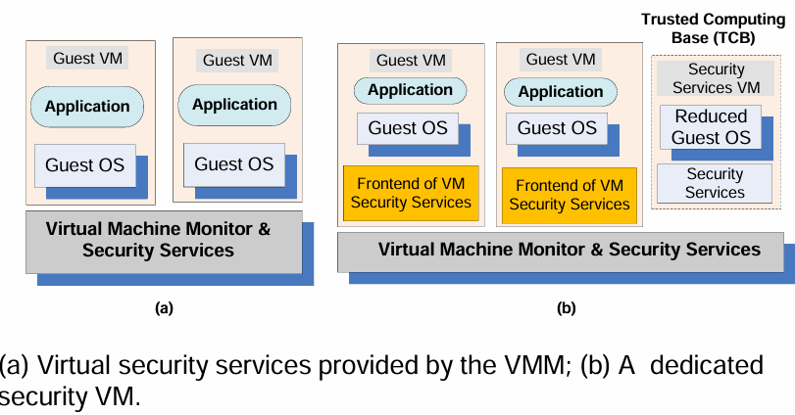
Virtual machine security

Slide 27
VMM-based threats
It refers to security risks that exploit vulnerabilities in the hypervisor
(VMM), which manages and controls virtual machines. Starvation of resources and denial of service for some VMs.Probable causes:
badly configured resource limits for some VMs.
a rogue VM (compromised by malware) with the capability to bypass resource limits set in VMM.
VM side-channel attacks: security exploit (a piece of code or program that takes advantage of a security flaw in a system to gain unauthorized access) that attempts to extract secrets from a system. malicious attack on one or more VMs by a rogue VM under the same VMM. Probable causes:
lack of proper isolation of inter-VM traffic due to misconfiguration of the virtual network residing in the VMM.
limitation of packet inspection devices (hardware or software that monitor network traffic) to handle high speed traffic, e.g., video traffic.
presence of VM instances built from insecure VM images, e.g., a VM image having a guest OS without the latest patches.

Slide 28
VMM-based threats
Buffer overflow attacks: occurs when an attacker sends more data than a program’s allocated memory buffer can handle, leading to data corruption, system crashes, or execution of malicious code.
Here are some key VMM-based threats: Hypervisor Hijacking (allows attackers to manipulate VM), Denial of Service (DoS) Attacks on Hypervisor(Attackers create excessive network & disrupt cloud services)

Slide 29
VM-based threats
VM-based threats target the virtualization layer, guest VMs, in cloud environments. Since VMs share the same physical infrastructure,
any security weakness can lead to data breaches, unauthorized
access.
Unauthorized users may create insecure VM or may perform unauthorized administrative actions on existing VMs.
Probable cause:
improper configuration of access controls on VM administrative tasks such as instance creation, launching, suspension, re-activation and so on.
Presence of insecure and tampered VM images(template of a virtual machine). Probable causes:
(a) lack of access control to the VM image repository.
(b) lack of mechanisms to verify the integrity of the images, e.g., digitally signed image. EX: VM DoS (Denial of Service) Attacks, Hypervisor Attacks (to gain control over all hosted VMs.)

Slide 30
Security of virtualization
The complete state of an operating system running under a virtual machine is captured by the VM; this state can be saved in a file and then the file can be copied and shared. Implications:
Ability to support the IaaS delivery model.
Increased reliability. An operating system with all the applications running under it can be replicated and switched to a hot standby (a backup and recovery strategy that allows a system to continue working when a hardware component fails).
Improved intrusion prevention and detection. A clone can look for known patterns in system activity and detect intrusion. The operator can switch to a hot standby when suspicious events are detected.
More efficient and flexible software testing. Instead of a very large number of dedicated systems running under different OS, different version of each OS, and different patches for each version, virtualization allows the multitude of OS instances to share a small number of physical systems.

Slide 31
More advantages of virtualization
Straightforward mechanisms to implement resource management policies:
To balance the load of a system, a VMM can move an OS and the applications running under it to another server when the load on the current server exceeds a high water mark.
To reduce power consumption, the load of lightly loaded servers can be moved to other servers and then, turn off or set on standby mode the lightly loaded servers.
When secure logging and intrusion protection are implemented at the VMM layer, the services cannot be disabled or modified. Intrusion detection can be disabled and logging can be modified by an intruder when implemented at the OS level. A VMM may be able to log only events of interest for a post-attack analysis.

Slide 32

Undesirable effects of virtualization
Diminished ability to manage the systems and track their status.
The number of physical systems in the inventory of an organization is limited by cost, space, energy consumption, and human support. Creating a virtual machine (VM) reduces ultimately to copying a file, therefore the explosion of the number of VMs. The only limitation for the number of VMs is the amount of storage space available.
Qualitative aspect of the explosion of the number of VMs → traditionally, organizations install and maintain the same version of system software. In a virtual environment the number of different operating systems, their versions, and the patch status of each version will be very diverse.
Heterogeneity will tax the support team.
The software lifecycle has serious implication on security. The traditional assumption the software lifecycle is a straight line; hence the patch management is based on a monotonic forward progress. The virtual execution model maps to a tree structure rather than a line; indeed, at any point in time multiple instances of the VM can be created and then, each one of them can be updated, different patches installed, and so on.

Slide 33
Implications of virtualization on security
Infection may last indefinitely → some of the infected VMs may be dormant at the time when the measures to clean up the systems are
taken and then, at a later time, wake up and infect other systems; the scenario can repeat itself.
In a traditional computing environment, a steady state can be reached. In this steady state all systems are brought up to a desirable state. This desirable state is reached by installing the latest version of the system software and then applying to all systems the latest patches. Due to the lack of control, a virtual environment may never reach such a steady state.
A side effect of the ability to record in a file the complete state of a VM is the possibility to roll back a VM. This allows a new type of vulnerability caused by events recorded in the memory of an attacker.
Virtualization undermines the basic principle that time sensitive data stored on any system should be reduced to a minimum.

Slide 34
Security risks posed by shared images
An Amazon Machine Image (AMI) is a pre-configured virtual machine template used to launch EC2 instances in Amazon Web Services (AWS). AMIs contain the necessary information to set up an instance, including:
Operating System (OS) – Linux (Amazon Linux, Ubuntu, Red Hat) or Windows Server.
Application Software – Pre-installed applications, databases. Security & Configuration Settings – Firewalls, user permissions, and system hardening
Image sharing is critical for the IaaS cloud delivery model.
Many of the images analyzed by a recent report allowed a user to undelete files, recover credentials, private keys, or other types of sensitive information with little effort and using standard tools.
A software vulnerability audit revealed that 98% of the Windows AMIs and 58% of Linux AMIs audited had critical vulnerabilities.

Slide 35
Security risks posed by shared images
Security risks:
Backdoors and leftover credentials: Attackers may install backdoor scripts that provide unauthorized remote access.
Default passwords and admin credentials might remain in the image.
Misconfigured services could expose internal access points.
Unsolicited connections: Compromised VMs can communicate with external servers.
Misconfigured network rules may expose sensitive data to the internet.
Malware: images may contain pre-installed malware, spyware, or ransomware.

Slide 36
Security risks posed by shared images
Key Security Considerations for AMIs
Use trusted AMIs from AWS or verified providers.
Scan for vulnerabilities before deploying custom AMIs.
Restrict AMI sharing to prevent unauthorized access.
Keep AMIs updated to mitigate security risks
Enable Logging & Monitoring – Track all image access.
By implementing these measures, you can significantly reduce the risk of malicious scripts being embedded in your custom AMIs and ensure a secure and compliant image creation and distribution process.

Slide 37
Security risks posed by a management OS
A Management OS Manages and orchestrates virtualized
environment (VMs, hypervisors, resources) in the cloud it is a used to control, configure, and maintain virtual infrastructure. that runs alongside or on top of a hypervisor to manage virtualized environments. This can include hypervisors and administrative
VMs used for monitoring and policy enforcement.
A virtual machine monitor, or hypervisor, is considerably smaller than an operating system, e.g., the Xen (open source hypervisor based on paravirtualization) VMM has ~ 60,000 lines of code.
The Trusted Computer Base (TCB) of a cloud computing environment includes not only the hypervisor but also the management OS.
The management OS supports:

Slide 38
Security risks posed by a management OS
Administrative Tools – Provides access to control cloud resources, manage VMs, and configure networking.
Live Migration – Moves running VMs between physical hosts without downtime.
Device Drivers – Enables communication between VMs and underlying hardware.
Device Emulators – Simulates hardware components for virtual machines
In Xen the management operating system runs in Dom0 which has privileged access to control and manage virtual machines (DomUs, or user domains) in a Xen hypervisor environment;
It has direct access to the physical hardware and is responsible for managing guest VMs (DomU)
it manages the building of all user domains.
The trusted computing base of a Xen-based environment includes the hardware,Xen, and the management operating system running in Dom0. The management OS supports administrative tools, live migration, device drivers, and device emulators. A guest operating system and applications running under it reside in a DomU.

Slide 39
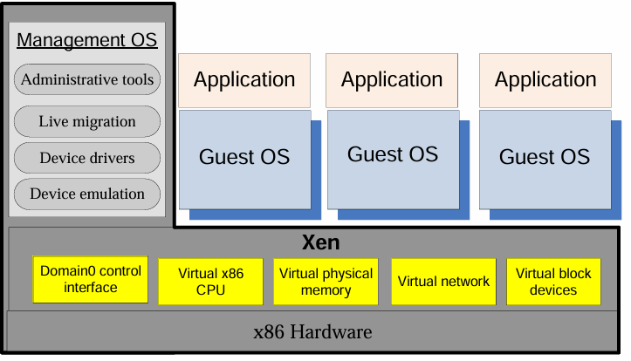
Security risks posed by a management OS

Slide 40
Possible actions of a malicious Dom0
At the time it creates a DomU (guest vm) :
Refuse to carry out the steps necessary to start the new VM.
Modify the kernel of the guest OS to allow a third party to monitor and control the execution of applications running under the new VM.
Undermine the integrity of the new VM by setting the wrong page tables (data structure used by the operating system) and/or setup wrong virtual CPU registers(temporary storage location).
Refuse to release the foreign mapping (one VM mapping memory pages that belong to another VM) and access the memory while the new VM is running.
At run time:
Dom0 exposes a set of abstract devices to the guest operating systems using split drivers with the frontend of in a DomU and the backend in Dom0. We have to ensure that run time communication through Dom0 is encrypted. Transport Layer Security (TLS) does not guarantee that Dom0 cannot extract cryptographic keys from the memory of the OS and applications running in DomU

Slide 41
A major weakness of Xen
The entire state of the system is maintained by XenStore (information storage space).
A malicious VM can deny to other VMs access to XenStore;

Slide 42
How to deal with run-time vulnerability of Dom0
To implement a secure run-time system, we have to intercept and
control the hypercalls(privileged function call made by a guest VM (DomU) to the Xen hypervisor) used for communication between a Dom0 that
cannot be trusted and a DomU we want to protect.
New hypercalls are necessary to protect:
The privacy and integrity of the virtual CPU of a VM. When Dom0 wants to save the state of the VM the hypercall should be intercepted and the contents of the virtual CPU registers should be encrypted. When DomU is restored, the virtual CPU context should be decrypted and then an integrity check should be carried out.
The privacy and integrity of the VM virtual memory. The page table update hypercall should be intercepted and the page should be encrypted so that Dom0 handles only encrypted pages of the VM. To guarantee the integrity, the hypervisor should calculate a hash (cryptographic process) of all the memory pages before they are saved by Dom0. An address translation is necessary as a restored DomU may be allocated a different memory region.
By implementing least privilege access, hypercall restrictions, live patching, real-time monitoring, and hardware security, you can greatly reduce attack vectors and ensure a secure cloud infrastructure.

