Slide 1

B.M.S. COLLEGE OF ENGINEERING, BENGALURU DEPARTMENT OF COMPUTER APPLICATIONS Autonomous Institute, affiliated to VTU ODD 2024-2025
CLOUD COMPUTING
UNIT-4
Cloud Services & Platforms
Prof T. Sunitha

Slide 2
Compute Services
Compute services provide dynamically scalable compute capacity in the cloud.
Compute resources can be provisioned on-demand in the form of virtual machines. Virtual machines can be created from standard images provided by the cloud service provider or custom images created by the users.
Compute services can be accessed from the web consoles of these services that provide graphical user interfaces for provisioning, managing and monitoring these services.
Cloud service providers also provide APIs for various programming languages that allow developers to access and manage these services programmatically.
Features: Scalable, Flexible, Secure and Cost Effective.

Slide 3
Compute Services – Amazon EC2
Amazon Elastic Compute Cloud (EC2) is a compute service provided by Amazon.
Launching EC2 Instances
To launch a new instance click on the launch instance button. This will open a wizard where you can select the Amazon machine image (AMI) with which you want to launch the instance. You can also create their own AMIs with custom applications, libraries and data. Instances can be launched with a variety of operating systems.
Instance Sizes
When you launch an instance you specify the instance type (micro, small, medium, large, extra-large, etc.), the number of instances to launch based on the selected AMI and availability zones for the instances.
Key-pairs
When launching a new instance, the user selects a key-pair from existing keypairs or creates a new keypair for the instance. Keypairs are used to securely connect to an instance after it launches.

Slide 4
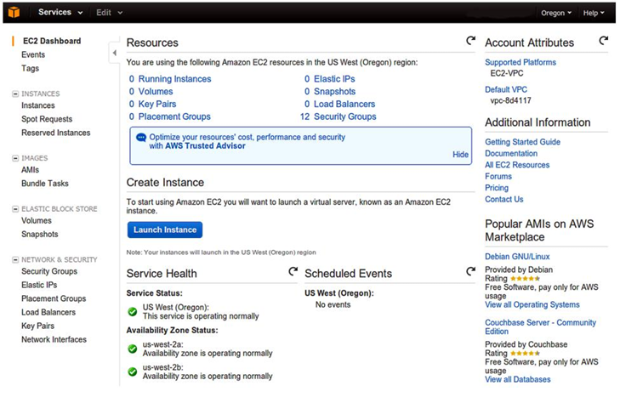
Compute Services – Amazon EC2
Security Groups
The security groups to be associated with the instance can be selected from the instance launch wizard. Security groups are used to open or block a specific network port for the launched instances.

Slide 5
Compute Services – Google Compute Engine
Google Compute Engine is a compute service provided by Google.
Launching Instances
To create a new instance, the user selects an instance machine type, a zone in which the instance will be launched, a machine image for the instance and provides an instance name, instance tags and meta-data.
Disk Resources
Every instance is launched with a disk resource. Depending on the instance type, the disk resource can be a scratch disk space or persistent disk space. The scratch disk space is deleted when the instance terminates. Whereas, persistent disks live beyond the life of an instance.
Network Options
Network option allows you to control the traffic to and from the instances. By default, traffic between instances in the same network, over any port and any protocol and incoming SSH connections from anywhere are enabled.

Slide 6
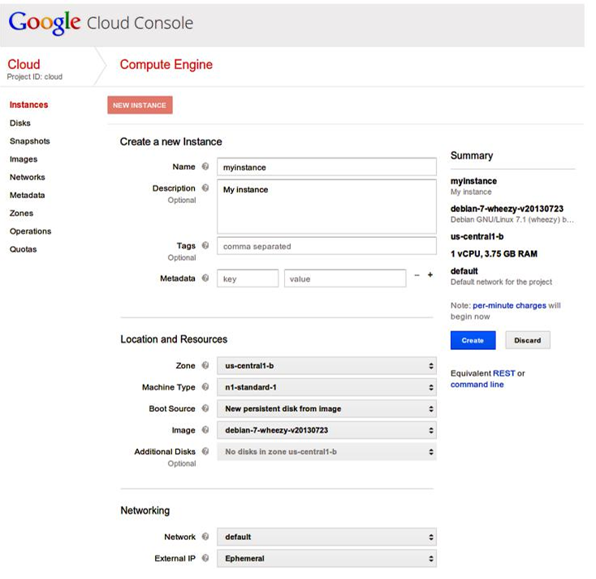
Compute Services – Google Compute Engine

Slide 7
Compute Services – Windows Azure VMs
Windows Azure Virtual Machines is the compute service from Microsoft.
Launching Instances
To create a new instance, you select the instance type and the machine image.
You can either provide a user name and password or upload a certificate file for securely connecting to the instance.
Any changes made to the VM are persistently stored and new VMs can be created from the previously stored machine images

Slide 8
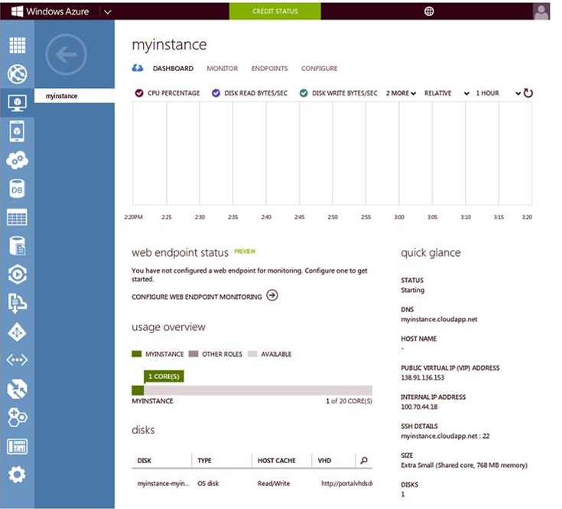
Compute Services – Windows Azure VMs

Slide 9
Storage Services
Cloud storage services allow storage and retrieval of any amount of data, at any time from anywhere on the web.
Most cloud storage services organize data into buckets or containers.
Salability
Cloud storage services provide high capacity and scalability. Objects upto several tera-bytes in size can be uploaded and multiple buckets/containers can be created on cloud storages.
Replication
When an object is uploaded it is replicated at multiple facilities and/or on multiple devices within each facility.
Access Policies
Cloud storage services provide several security features such as Access Control Lists (ACLs), bucket/container level policies, etc. ACLs can be used to selectively grant access permissions on individual objects. Bucket/container level policies can also be defined to allow or deny permissions across some or all of the objects within a single bucket/container.

Slide 10
Storage Services
Encryption
Cloud storage services provide Server Side Encryption (SSE) options to encrypt all data stored in the cloud storage.
Consistency
Strong data consistency is provided for all upload and delete operations. Therefore, any object that is uploaded can be immediately downloaded after the upload is complete

Slide 11
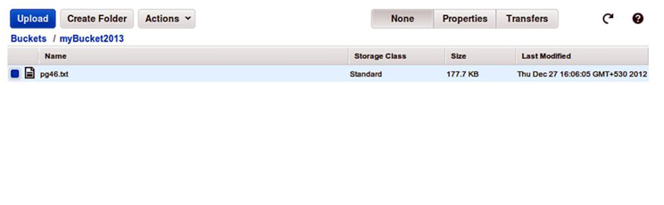
Storage Services
Amazon Simple Storage Service(S3) is an online cloud-based data storage infrastructure for storing and retrieving any amount of data.
S3 provides highly reliable, scalable, fast, fully redundant and affordable storage infrastructure.
Buckets
Data stored on S3 is organized in the form of buckets. You must create a bucket before you can store data on S3.
Uploading Files to Buckets
S3 console provides simple wizards for creating a new bucket and uploading files.
You can upload any kind of file to S3.
While uploading a file, you can specify the redundancy and encryption options and access permissions.

Slide 12
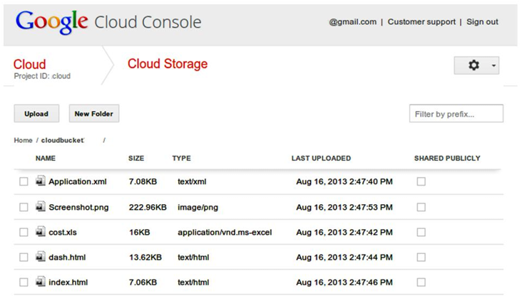
Storage Services – Google Cloud Storage
GCS is the Cloud storage service from Google
Buckets
Objects in GCS are organized into buckets.
Access Control Lists
ACLs are used to control access to objects and buckets. ACLs can be configured to share objects and buckets with the entire world, a Google group, a Google-hosted domain, or specific Google account holders.

Slide 13
Storage Services – Windows Azure Storage
Windows Azure Storage is the cloud storage service from Microsoft.
Windows Azure Storage provides various storage services such as blob storage service, table service and queue service.
Blob storage service
The blob storage service allows storing unstructured binary data or binary large objects (blobs).
Blobs are organized into containers.
Block blobs - can be subdivided into some number of blocks. If a failure occurs while transferring a block blob, retransmission can resume with the most recent block rather than sending the entire blob again.
Page blobs - are divided into number of pages and are designed for
random access. Applications can read and write individual pages at
random in a page blob.

Slide 14
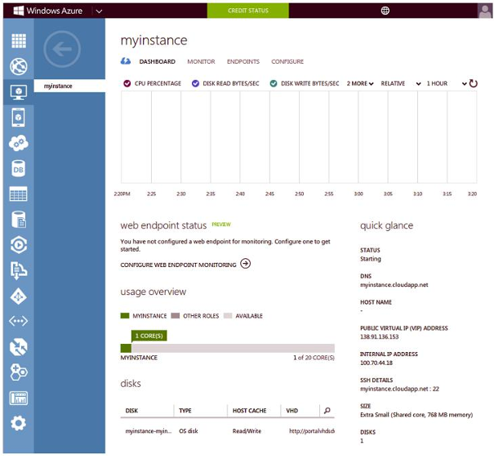
Storage Services – Windows Azure Storage

Slide 15
Database Services
Cloud database services allow you to set-up and operate relational or non-relational databases in the cloud.
Relational Databases
Popular relational databases provided by various cloud service providers include MySQL, Oracle, SQL Server, etc.
Non-relational Databases
The non-relational (No-SQL) databases provided by cloud service providers are mostly proprietary solutions.
Scalability
Cloud database services allow provisioning as much compute and storage resources as required to meet the application workload levels. Provisioned capacity can be scaled-up or down. For read-heavy workloads, read-replicas can be created.
Reliability
Cloud database services are reliable and provide automated backup and snapshot options.
Performance
Cloud database services provide guaranteed performance with options such as guaranteed input/output operations per second (IOPS) which can be provisioned upfront.
Security
restrict the access to the database instances and stored data, such as network firewalls and authentication mechanisms.

Slide 16
Database Services – Amazon RDS
Amazon Relational Database Service (RDS) is a web service that makes it easy to setup, operate and scale a relational database in the cloud.
Launching DB Instances
The console provides an instance launch wizard that allows you to select the type of database to create (MySQL, Oracle or SQL Server) database instance size, allocated storage, DB instance identifier, DB username and password. The status of the launched DB instances can be viewed from the console.
Connecting to a DB Instance
Once the instance is available, you can note the instance end point from the instance properties tab. This end point can then be used for securely connecting to the instance

Slide 17
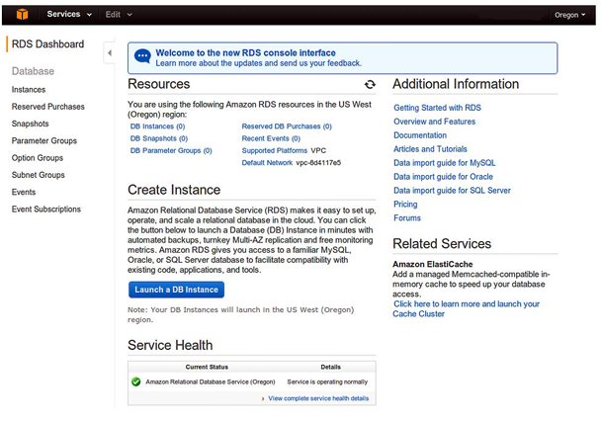
Database Services – Amazon RDS

Slide 18
Database Services – Amazon DynamoDB
Amazon DynamoDB is the non-relational (No-SQL) database service from Amazon.
Data Model
The DynamoDB data model includes include tables, items and attributes.
A table is a collection of items and each item is a collection of attributes.
To store data in DynamoDB you have to create a one or more tables and specify how much throughput capacity you want to provision and reserve for reads and writes.
Fully Managed Service
DynamoDB is a fully managed service that automatically spreads the data and traffic for the stored tables over a number of servers to meet the throughput requirements specified by the users.
Replication
All stored data is automatically replicated across multiple availability zones to provide data durability.

Slide 19
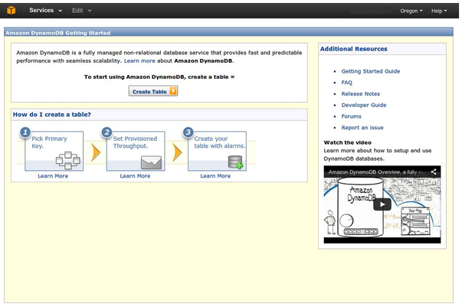
Database Services – Amazon DynamoDB

Slide 20
Storage Services – Google Cloud SQL
Google SQL is the relational database service from Google.
Google Cloud SQL service allows you to host MySQL databases in the Google’s cloud.
Launching DB Instances
You can create new database instances from the console and manage existing instances. To create a new instance you select a region, database tier, billing plan and replication mode.
Backups
You can schedule daily backups for your Google Cloud SQL instances, and also restore backed-up databases.
Replication
Cloud SQL provides both synchronous or asynchronous geographic replication and the ability to import/ export databases

Slide 21
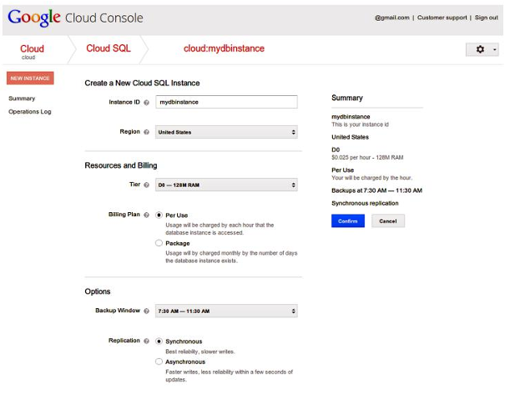
Storage Services – Google Cloud SQL

Slide 22
Storage Services – Google Cloud Datastore
Google Cloud Datastore is a fully managed non-relational database from Google.
Cloud Datastore offers ACID transactions and high availability of reads and writes.
Data Model
The Cloud Datastore data model consists of entities. Each entity has one or more properties (key-value pairs) which can be of one of several supported data types, such as strings and integers. Each entity has a kind and a key. The entity kind is used for categorizing the entity for the purpose of queries and the entity key uniquely identifies the entity.

Slide 23
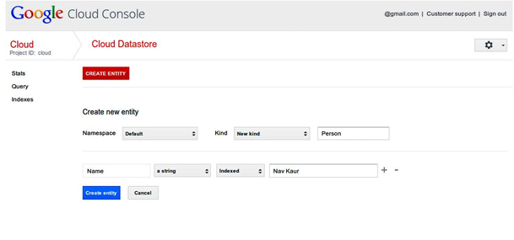
Storage Services – Google Cloud Datastore

Slide 24
Storage Services – Windows Azure SQL DB
Windows Azure SQL Database is the relational database service from Microsoft.
Azure SQL Database is based on the SQL server, but it does not give each customer a separate instance of SQL server.
Multi-tenant Service
SQL Database is a multi-tenant service, with a logical SQL Database server for each customer.

Slide 25
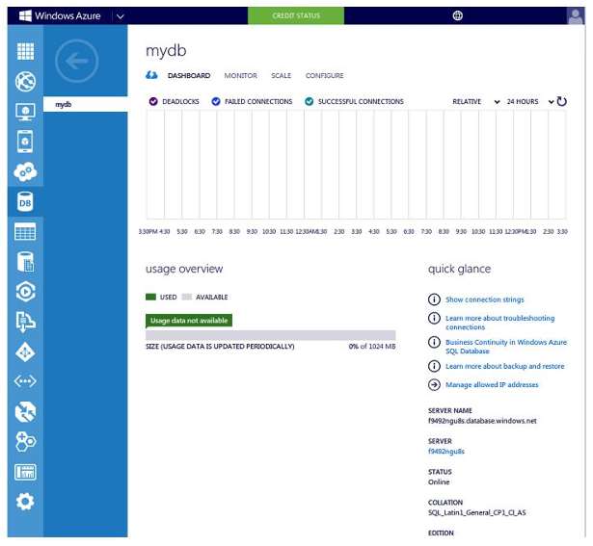
Storage Services – Windows Azure SQL DB

Slide 26
Storage Services – Windows Azure Table Service
Windows Azure Table Service is a non-relational (No-SQL) database service from Microsoft.
Data Model
The Azure Table Service data model consists of tables having multiple entities.
Tables are divided into some number of partitions, each of which can be stored on a separate machine.
Each partition in a table holds a specified number of entities, each containing as many as 255 properties.
Each property can be one of the several supported data types such as integers and strings.
No Fixed Schema
Tables do not have a fixed schema and different entities in a table can have different properties.

Slide 27
Further Reading
Amazon Elastic Compute Cloud, http://aws.amazom.com/ec2
Google Compute Engine, https://developers.google.com/compute/
Windows Azure, http://www.windowsazure.com/
Google App Engine, http://appengine.google.com
Google App Engine, https://developers.google.com/appengine
Google Cloud Storage, https://developers.google.com/storage/
Google BigQuery, https://developers.google.com/bigquery/
Google Cloud Datastore, http://developers.google.com/datastore/
Google Cloud SQL, https://developers.google.com/cloud-sql/

