Slide 1

B.M.S. COLLEGE OF ENGINEERING, BENGALURU DEPARTMENT OF COMPUTER APPLICATIONS Autonomous Institute, affiliated to VTU ODD 2024-2025
CLOUD COMPUTING
UNIT-3
Infrastructure And Advanced Techniques In Cloud Computing
Prof T. Sunitha

Slide 2
Infrastructure
Existing cloud infrastructure
The cloud computing infrastructure at Amazon, Google, and Microsoft (as of mid 2012).
Amazon is a pioneer in Infrastructure-as-a-Service (IaaS).
Google's efforts are focused on Software-as-a-Service (SaaS) and Platform-as-a-Service (PaaS).
Microsoft is involved in PaaS.
Private clouds are an alternative to public clouds. Open-source cloud computing platforms such as:
Eucalyptus,
OpenNebula,
Nimbus,
OpenStack
can be used as a control infrastructure for a private cloud.

Slide 3
Infrastructure
Eucalyptus (Elastic Utility Computing Architecture for Linking Your Programs to Useful Systems) is an open-source software platform that enables organizations to build private and hybrid cloud environments
OpenNebula is an open-source cloud computing platform that focuses on simplifying the management of heterogeneous data center infrastructures (Ex, file & database servers).
Nimbus is an open-source toolkit tailored for creating and managing cloud infrastructure. It is specifically designed for scientific and research communities.
OpenStack is a widely used open-source cloud computing platform that provides a services for building and managing public, private, and hybrid clouds can be used as a control infrastructure for a private cloud

Slide 4
Cloud Computing at Amazon
Amazon Web Services (AWS)
IaaS cloud computing services launched in 2006 by AWS.
Businesses in 200+ countries used AWS
The infrastructure consists of compute and storage servers interconnected by high-speed networks and supports a set of services.
An application developer: Installs applications on a platform of his/her choice Manages resources allocated by Amazon.
Amazon was the first provider of cloud computing, which release of its Elastic Computing platform called EC2
Elastic Compute Cloud (EC2) is a Web service with a simple interface for launching instances of an application under several operating systems, such as Microsoft Windows Server.
EC2 Is based on the Xen virtualization strategy
Simple Storage System (S3) is a storage service designed to store large objects. It supports a minimal set of functions: write, read, and delete.

Slide 5
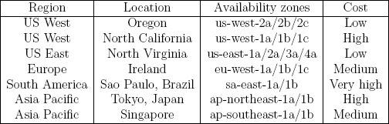
AWS regions and availability zones
Amazon offers cloud services through a network of data centers on several continents.
In each region there are several availability zones interconnected by high-speed networks.
An availability zone is a data center consisting of a large number of servers.
Regions do not share resources and communicate through the Internet.

Slide 6
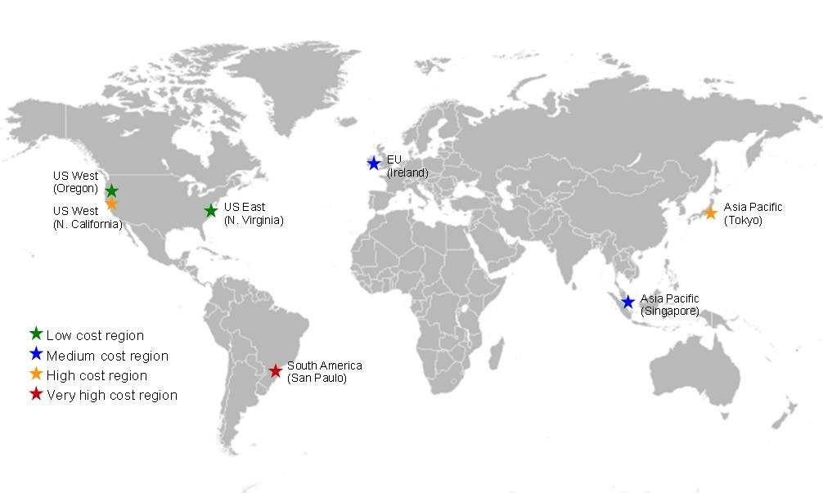
AWS regions and availability zones

Slide 7
AWS instances
An instance is a virtual server with a well specified set of resources including: CPU cycles, main memory, secondary storage, communication and I/O bandwidth.
The user chooses:
The region and the availability zone where this virtual server should be placed.
An instance type from a limited menu of instance types.
When launched, an instance is provided with a DNS name; this
name maps to a
private IP address → for internal communication within the internal EC2 communication network.
public IP address → for communication outside the internal Amazon network, e.g., for communication with the user that launched the instance.
Network Address Translation (NAT) maps external IP addresses to internal ones.

Slide 8
The public IP address is assigned for the lifetime of an instance.
An instance can request an elastic IP address, rather than a public IP address. The elastic IP address is a static public IP address allocated to an instance from the available pool of the availability zone.
An elastic IP address is not released when the instance is stopped or
terminated and must be released when no longer needed.

Slide 9
Examples of Amazon Web Services
AWS Management Console - allows users to access the services offered by AWS .
Elastic Cloud Computing (EC2) - allows a user to launch a variety
of operating systems.
Simple Queuing Service (SQS) - allows multiple EC2 instances to communicate with one another.
Simple Storage Service (S3), Simple DB, and Elastic Bloc Storage
(EBS) - storage services.
Cloud Watch - supports performance monitoring.
Auto Scaling - supports elastic resource management.
Virtual Private Cloud - allows direct migration of parallel
applications.

Slide 10
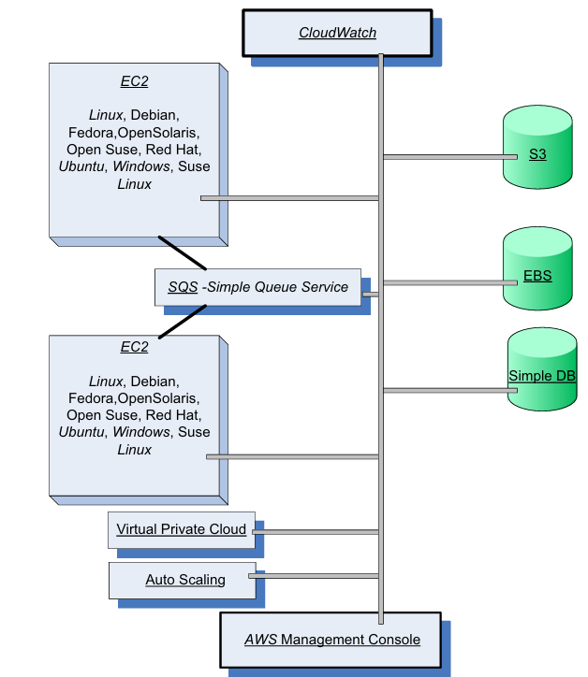

Slide 11
EC2 - web service for launching instances of an application under several operating systems, such as:
Several Linux distributions.
Microsoft Windows Server 2003 and 2008.
OpenSolaris.
FreeBSD.
NetBSD.
A user can
Load an EC2 instance with a custom application environment.
Manage network’s access permissions.
Run the image using as many or as few systems as desired
Import virtual machine (VM) images from the user environment to an instance through VM import.
EC2 instances boot from an AMI (Amazon Machine Image) digitally
signed and stored in S3.

Slide 12
Users can access:
Images provided by Amazon.
Customize an image and store it in S3.
An EC2 instance is characterized by the resources it provides:
VC (Virtual Computers) – virtual systems running the instance.
CU (Compute Units) – measure computing power of each system.
Memory.
I/O capabilities.
It also automatically distributes the incoming application traffic among multiple instances using the elastic load-balancing facility
A user can interact with EC2 using a set of SOAP (Simple Object Access Protocol) messages (It is a messaging protocol that allows programs running on different operating systems and platforms (e.g., Windows, Linux) to communicate over a network)

Slide 13
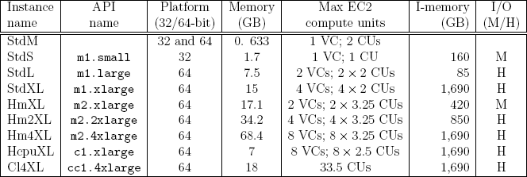
Instance types
Standard instances: micro (StdM), small (StdS), large (StdL), extra
large (StdXL); small is the default.
High memory instances: high-memory extra large (HmXL), high- memory double extra large (Hm2XL), and high-memory quadruple extra large (Hm4XL).
High CPU instances: high-CPU extra large (HcpuXL).
Cluster computing: cluster computing quadruple extra large (Cl4XL).

Slide 14
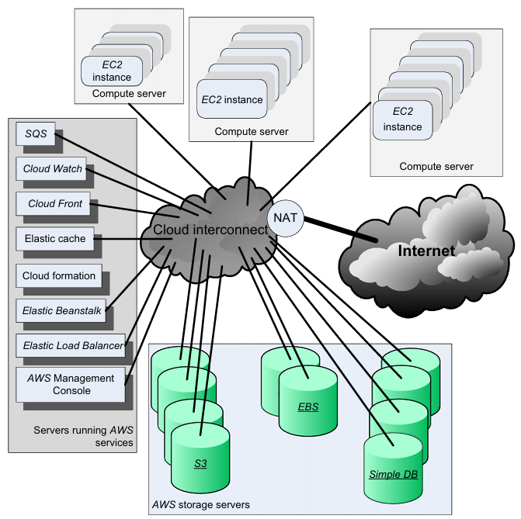

Slide 15
Simple Storage System
Service designed to store large objects; an application can handle an unlimited number of objects ranging in size from 1 byte to 5 TB.
An object is stored in a bucket and retrieved via a unique, developer-assigned key; a bucket can be stored in a Region selected by the user.
Supports a minimal set of functions: write, read, and delete; it does not support primitives to copy, to rename, or to move an object from one bucket to another.
The object names are global.
S3 maintains for each object: the name, modification time, an access control list, and up to 4 KB of user-defined metadata.
Authentication mechanisms ensure that data is kept secure.
Object Storage: S3 stores data as objects

Slide 16
Simple Storage System
Objects can be made public, and rights can be granted to other users.
S3 computes the MD5 of every object written and returns it in a
field called ETag.
A user is expected to compute the MD5 of an object stored or written and compare this with the ETag; if the two values do not match, then the object was corrupted during transmission or storage.

Slide 17
Elastic Block Store (EBS)
Provides persistent block level storage volumes for use with EC2 instances; suitable for database applications, file systems, and applications using raw data devices.
A volume appears to an application as a raw, unformatted and reliable
physical disk; the range 1 GB -1 TB.
An EC2 instance may mount multiple volumes, but a volume cannot be shared among multiple instances.
EBS supports the creation of snapshots of the volumes attached to an
instance and then uses them to restart the instance.
The volumes are grouped together in Availability Zones and are automatically replicated in each zone.

Slide 18
SimpleDB
Non-relational data store. Supports store and query functions
traditionally provided only by relational databases.
Supports high performance Web applications; users can store and
query data items via Web services requests.
Creates multiple geographically distributed copies of each data item.
It manages automatically:
The infrastructure provisioning.
Hardware and software maintenance.
Replication and indexing of data items.
Performance tuning

Slide 19
SQS-Simple Queue Service
Hosted message queues are accessed through standard SOAP and Query interfaces.
Supports automated workflows - EC2 instances can coordinate by sending and receiving SQS messages.
Applications using SQS can run independently and asynchronously, and do not need to be developed with the same technologies.
A received message is “locked'' during processing; if processing
fails, the lock expires and the message is available again.
Queue sharing can be restricted by IP address and time-of-day.

Slide 20
CloudWatch
Monitoring infrastructure used by application developers, users, and system administrators to collect and track metrics important for optimizing the performance of applications and for increasing the efficiency of resource utilization.
Without installing any software a user can monitor either seven or eight pre-selected metrics and then view graphs and statistics for these metrics.
When launching an Amazon Machine Image (AMI) the user can start the CloudWatch and specify the type of monitoring:
Basic Monitoring - free of charge; collects data at five-minute intervals for up to seven metrics.
Detailed Monitoring - subject to charge; collects data at one
minute interval.

Slide 21
AWS services introduced in 2012
Route 53 - low-latency DNS service used to manage user's DNS
public records.
Elastic MapReduce (EMR) - supports processing of large amounts of data using a hosted Hadoop running on EC2.
Simple Workflow Service (SWF) - supports workflow management; allows scheduling, management of dependencies, and coordination of multiple EC2 instances.
ElastiCache - enables web applications to retrieve data from a managed in-memory caching system rather than a much slower disk- based database.
DynamoDB - scalable and low-latency fully managed NoSQL database service.
CloudFront - web service for content delivery.
Elastic Load Balancer - automatically distributes the incoming requests across multiple instances of the application.

Slide 22
Elastic Beanstalk - handles automatically deployment, capacity provisioning, load balancing, auto-scaling, and application monitoring functions.
CloudFormation - allows the creation of a stack describing the infrastructure for an application.
Elastic Beanstalk
Handles automatically the deployment, capacity provisioning, load balancing, auto-scaling, and monitoring functions.
Interacts with other services including EC2, S3, SNS, Elastic Load
Balance and AutoScaling.
The management functions provided by the service are:
Deploy a new application version (or rollback to a previous version).
Access to the results reported by CloudWatch monitoring service.
Email notifications when application status changes or application servers are added or removed.
Access to server log files without needing to login to the application
servers.
The service is available using: a Java platform, the PHP server-side description language, or the .NET framework

Slide 23
SaaS services offered by Google
Gmail - hosts Emails on Google servers and provides a web
interface to access the Email.
Google docs - a web-based software for building text documents, spreadsheets and presentations.
Google Calendar - a browser-based scheduler; supports multiple user calendars, calendar sharing, event search, display of daily/weekly/monthly views, and so on.
Google Groups - allows users to host discussion forums to create messages online or via Email.
Picasa - a tool to upload, share, and edit images.
Google Maps - web mapping service; offers street maps, a route planner, and an urban business locator for numerous countries around the world

Slide 24
PaaS services offered by Google
AppEngine - a developer platform hosted on the cloud.
Initially supported Python, Java was added later.
The database for code development can be accessed with GQL
(Google Query Language) with a SQL-like syntax.
Google Co-op - allows users to create customized search engines based on a set of facets/categories.
Google Drive - an online service for data storage.
Google Base - allows users to load structured data from different sources to a central repository, a very large, self-describing, semi- structured, heterogeneous database.

Slide 25
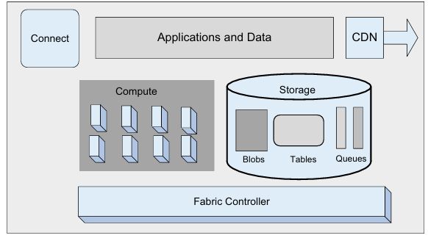
PaaS and SaaS services from Microsoft
Windows Azure - an operating system; has 3 components:
Compute - provides a computation environment.
Storage - for scalable storage.
Fabric Controller - deploys, manages, and monitors applications.
SQL Azure - a cloud-based version of the SQL Server.
Azure AppFabric, formerly .NET Services - a collection of services
for cloud applications.

Slide 26
Open-source platforms for private clouds
Eucalyptus - can be regarded as an open-source counterpart of Amazon's EC2.
Open-Nebula - a private cloud with users actually logging into the head node to access cloud functions. The system is centralized and its default configuration uses the NFS file system.
Nimbus - a cloud solution for scientific applications based on Globus software; inherits from Globus:
The image storage.
The credentials for user authentication.
The requirement that a running Nimbus process can ssh into all compute nodes.

Slide 27
Eucalyptus
Virtual Machines - run under several VMMs including Xen, KVM, and VMware.
Node Controller - runs on server nodes hosting a VM and controls
the activities of the node.
Cluster Controller - controls a number of servers.
Cloud Controller - provides the cloud access to end-users, developers, and administrators.
Storage Controller - provides persistent virtual hard drives to
applications. It is the correspondent of EBS.
Storage Service (Walrus) - provides persistent storage; similar to S3, it allows users to store objects in buckets.

Slide 28
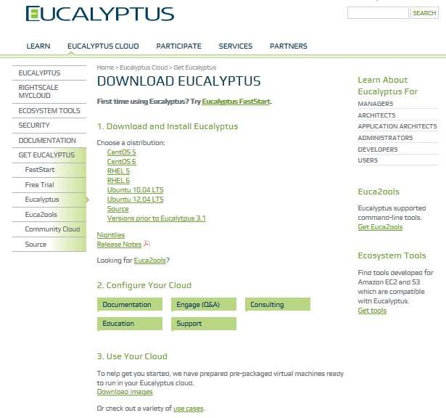
Eucalyptus

Slide 29
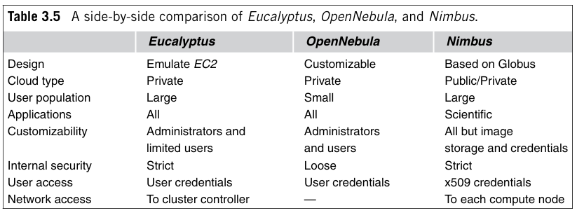
Comparision

Slide 30
Cloud storage diversity and vendor lock-in
Risks when a large organization relies on a single cloud service provider:
Cloud services may be unavailable for a short or an extended period of time.
Permanent data loss in case of a catastrophic system failure.
The provider may increase the prices for service.
Switching to another provider could be very costly due to the large volume of data to be transferred from the old to the new provider.
A solution is to replicate the data to multiple cloud service providers, similar to data replication in RAID.

Slide 31
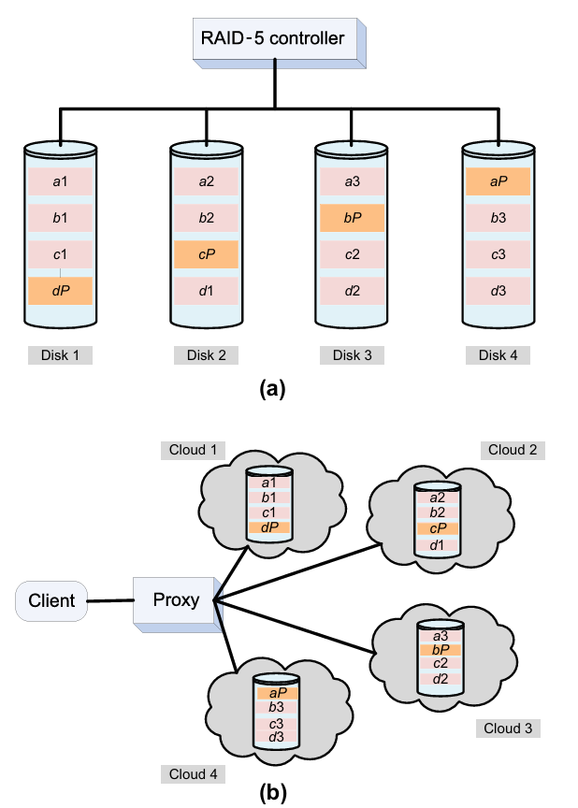

Slide 32
Cloud interoperability: the Intercloud
The concern that users could become hopelessly dependent on a single cloud service provider, the so-called vendor lock-in
An Intercloud ➔ a federation of clouds that cooperate to provide a
better user experience.
organizations increasingly rely on multiple cloud providers, interoperability challenges arise. The concept of the "Intercloud" seeks to address these challenges by enabling seamless interaction between different cloud environments.
Not likely at this time:
There are no standards for either storage or processing.
The clouds are based on different delivery models.
The set of services supported by these delivery models is large and open; new services are offered every few months.
CSPs (Cloud Service Providers) believe that they have a competitive advantage due to the uniqueness of the added value of their services.
Security is a major concern for cloud users and an Intercloud could only create new threats.

Slide 33
Energy use and ecological impact
The energy consumption of large-scale data centers and their costs for energy and for cooling are significant.
In 2006, the 6,000 data centers in the U.S consumed 61x10⁹ KWh of
energy, 1.5% of all electricity consumption, at a cost of $4.5 billion.
The energy consumed by the data centers was expected to double from 2006 to 2011 and peak instantaneous demand to increase from 7 GWto 12 GW.
The greenhouse gas emission due to the data centers is estimated to increase from 116 x10⁹ tones of CO₂ in 2007 to 257 tones in 2020 due to increased consumer demand.
The effort to reduce energy use is focused on computing, networking,
and storage activities of a data center.
Operating efficiency of a system is captured by the performance per
Watt of power.

Slide 34
Energy use and ecological impact
energy-proportional systems strategy for resource management in a computing cloud is to concentrate the load on a subset of servers and switching the rest of the servers to a standby mode whenever possible. This reduce power consumption and, the cost of providing computing and storage services
In an ideal world, the energy consumed by an idle system should be near zero and should grow linearly with the system load.
Energy-proportional systems could lead to large savings in energy costs for computing clouds. An energy-proportional system consumes no power when idle, very little power under a light load, and gradually more power as the load increases. example of an energy-proportional network is InfiniBand
The power consumption required by different types of human activities is partially responsible for the world’s greenhouse gas emissions. According to a recent study the greenhouse gas emissions due to data centers are estimated to increase from 150 tons of CO2 in 2007 to 257 tons in 2020, due primarily to increased consumer demand

Slide 35
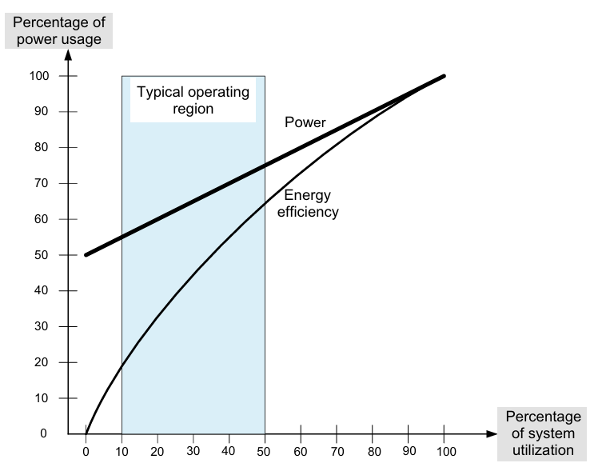
Energy use and ecological impact

Slide 36
Service Level Agreement (SLA)
SLA - a negotiated contract between the customer and CSP; can be legally binding or informal. Objectives:
Identify and define the customer’s needs and constraints including
the level of resources, security, timing, and QoS.
Provide a framework for understanding; a critical aspect of this framework is a clear definition of classes of service and the costs.
Simplify complex issues; clarify the boundaries between the
responsibilities of clients and CSP in case of failures.
Reduce areas of conflict.
Encourage dialog in the event of disputes.
Eliminate unrealistic expectations.
Specifies the services that the customer receives, rather than how
the cloud service provider delivers the services.
An SLA records a common understanding in several areas:
services, (ii) priorities, (iii) respon sibilities, (iv) guarantees, and
(v) warranties.

Slide 37
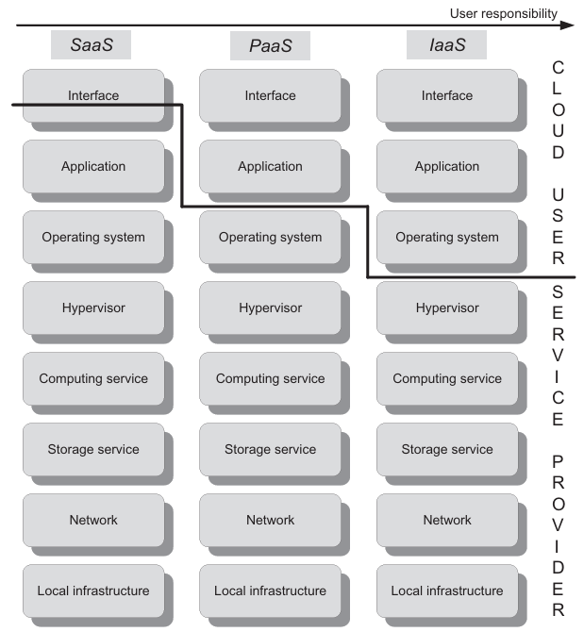
Responsibility sharing between user and CSP

Slide 38
Responsibility sharing between user and CSP
Saas service provider supplies both the hardware and the application software, and the user has direct access to these services through a Web interface and has no control over cloud resources Typical examples of SAAS are Google with Gmail, Google Docs, Google Calendar, Google Groups, and Picasa and Microsoft with the Online Services.
IaaS, the service provider supplies the hardware (servers, storage, networks) and system software (operating systems, databases); in addition, the provider ensures system attributes such as security, fault tolerance, and load balancing. The representative of IaaS is Amazon AWS.
PaaS provides only a platform, including the hardware and system software, such as operating systems and databases; the service provider is responsible for system updates, patches, and software maintenance. PaaS does not allow any user control of the operating system, security features, or the ability to install applications. examples are Google App Engine, Microsoft Azure, and Force.com, provided by Salesforce.com.

Slide 39
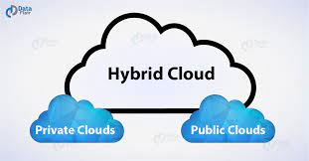
Advanced Techniques in Cloud Computing
Future Trends in Cloud Computing - Future trends in cloud computing include increased adoption of multi-cloud and hybrid cloud strategies.
Multi-Cloud and Hybrid Cloud Dominance
Hybrid IT Solutions = Cloud + on-premises compute
Multi cloud - Presence of more than one cloud service
The service is sourced from multiple cloud vendors
Distributes workload across multiple cloud environments
Ex: A company might use AWS for data storage, Azure for machine learning, and a private cloud for sensitive data.
Hybrid Cloud Computing
Hybrid cloud = private cloud + public cloud
You can shift your workload between
private cloud and public cloud

Slide 40
Future Trends in Cloud Computing
AI and Machine Learning Integration
Cloud platforms will embed AI tools and offer scalable infrastructure for ML workloads.
Enables businesses to analyze large datasets, automate tasks, and drive smarter decisions.
Example: Cloud-native AI services like AWS SageMaker, Google Vertex AI.
5G + Cloud Synergy(cloud services integrated with other technologies like Edge computing)
5G networks enable faster data transmission, enhancing mobile cloud experiences.
Powers real-time applications like AR/VR, gaming, and smart cities.
Edge Computing Expansion
Data processing is moving closer to the source—especially for real-time applications (IoT, autonomous vehicles).
Example: AWS Wavelength, Azure Stack Edge, and Google Distributed Cloud.

Slide 41
Mobile Cloud Computing
a model that combines mobile computing and cloud computing to deliver rich computing services and applications to mobile users over the internet.
It allows mobile devices (phones, tablets) to run applications and store data in the cloud instead of on the device itself.
Data storage and data processing happen outside of the mobile device
I.e into the cloud (powerful and centralized computing platforms)
With low cost and elastically in on-demand fashion
Mobile device face many resource challenges - like- battery life, storage, bandwidth etc.
Examples Google Photos – Cloud storage and AI-based photo management. Dropbox/OneDrive – File access and sync across mobile and cloud. Spotify – Streaming music from the cloud. Microsoft Office 365 Mobile – Cloud-based document editing.

Slide 42
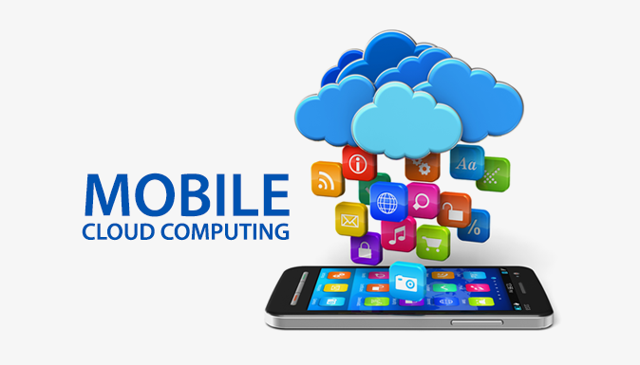
Advantages and Disadvantages of MCC
Advantages →
Saves battery power
Makes execution faster
Improves data storage capacity and processing power
Improves reliability and availability
Dynamic provisioning
Disadvantages →
Must send the program states (data) to the cloud server
Network latency can lead to execution delay

Slide 43
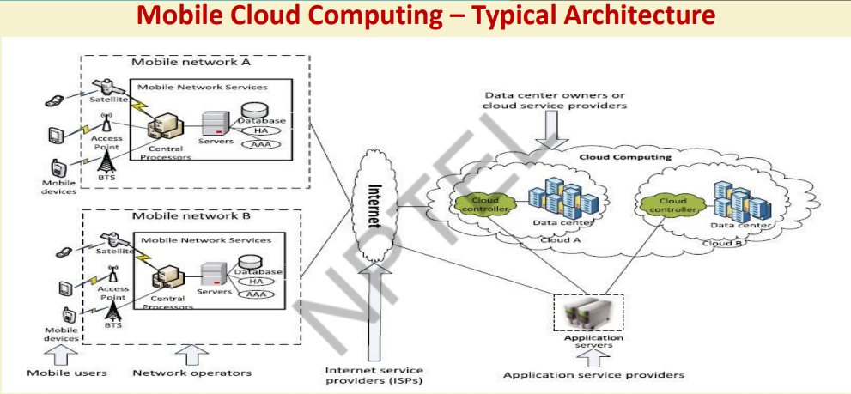

Slide 44
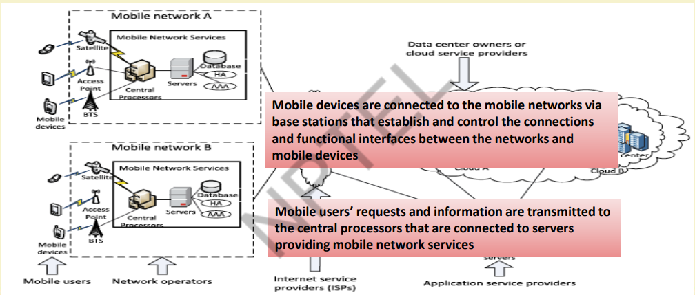

Slide 45
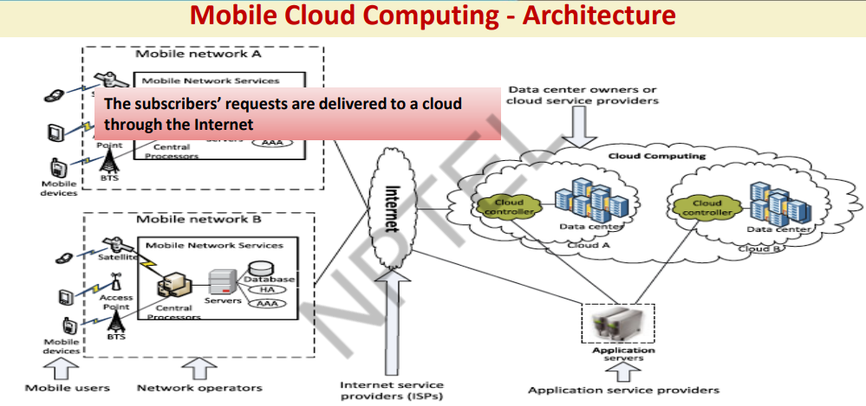

Slide 46
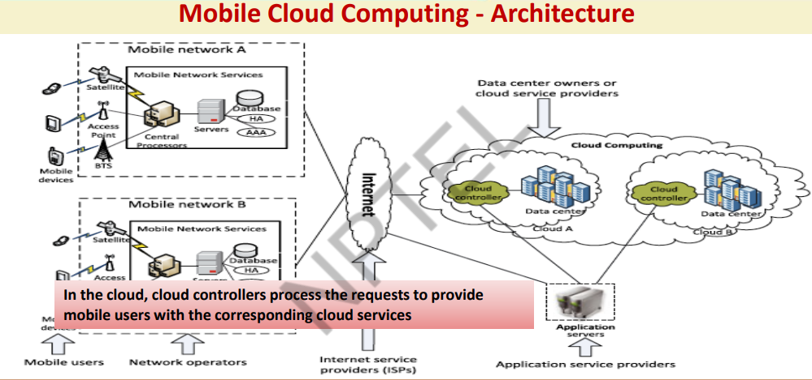

Slide 47
Mobile Cloud Application
Mobile Healthcare
Mobile healthcare (mHealth) refers to the use of mobile devices (smartphones, tablets, wearables) and wireless technologies to support medical and public health practices. It involves delivering health services, data, and information via mobile technologies.
(eg. medical records)
M-healthcare offers hospitals and healthcare organizations - a variety of on-demand services on clouds. involves using cloud resources to power mobile applications that provide healthcare services
For Ex: Health-Monitoring services, Intelligent emergency management system, Health-aware mobile devices (detect pulse rate, blood pressure, alcohol-level etc.)
Mobile Apps – health tracking, consultation, and medication apps. Wearables – smartwatches, fitness bands, ECG monitors. Cloud Computing – secure storage and access to patient data. IoT – Internet-connected medical devices.AI & Big Data – insights from real-time and historical data.

Slide 48
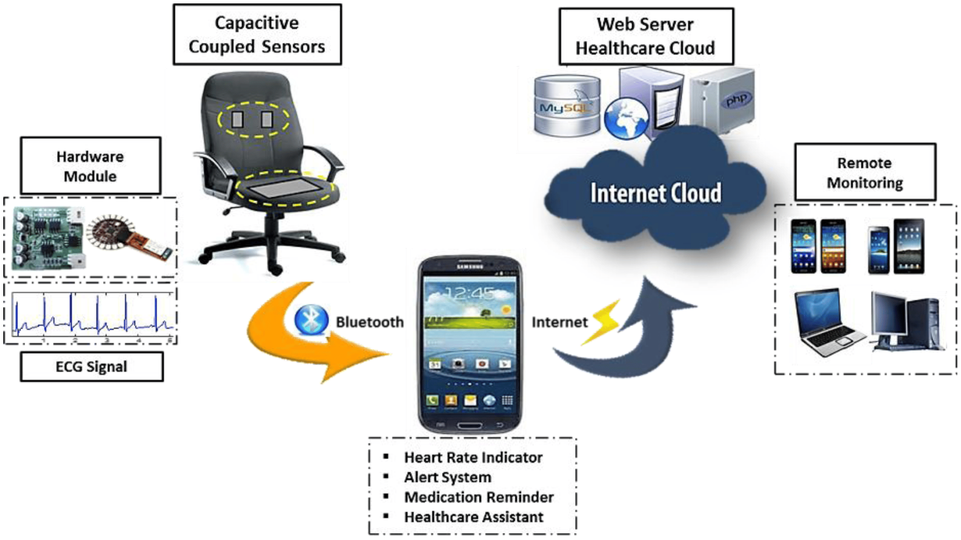
Mobile Cloud Application

Slide 49
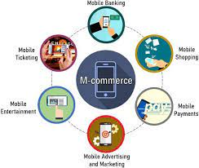
Mobile Cloud
Mobile Learning
Mobile learning (m-learning) refers to learning activities conducted using mobile devices like smartphones and tablets. It enables learning on the go, providing access to educational resources anytime, anywhere.
Enhanced communication quality between - students and teachers
Help learners to access remote resources
Mobile Commerce
M-commerce allows business models for commerce using mobile devices
Ex. mobile financial, mobile advertising, mobile shopping

Slide 50
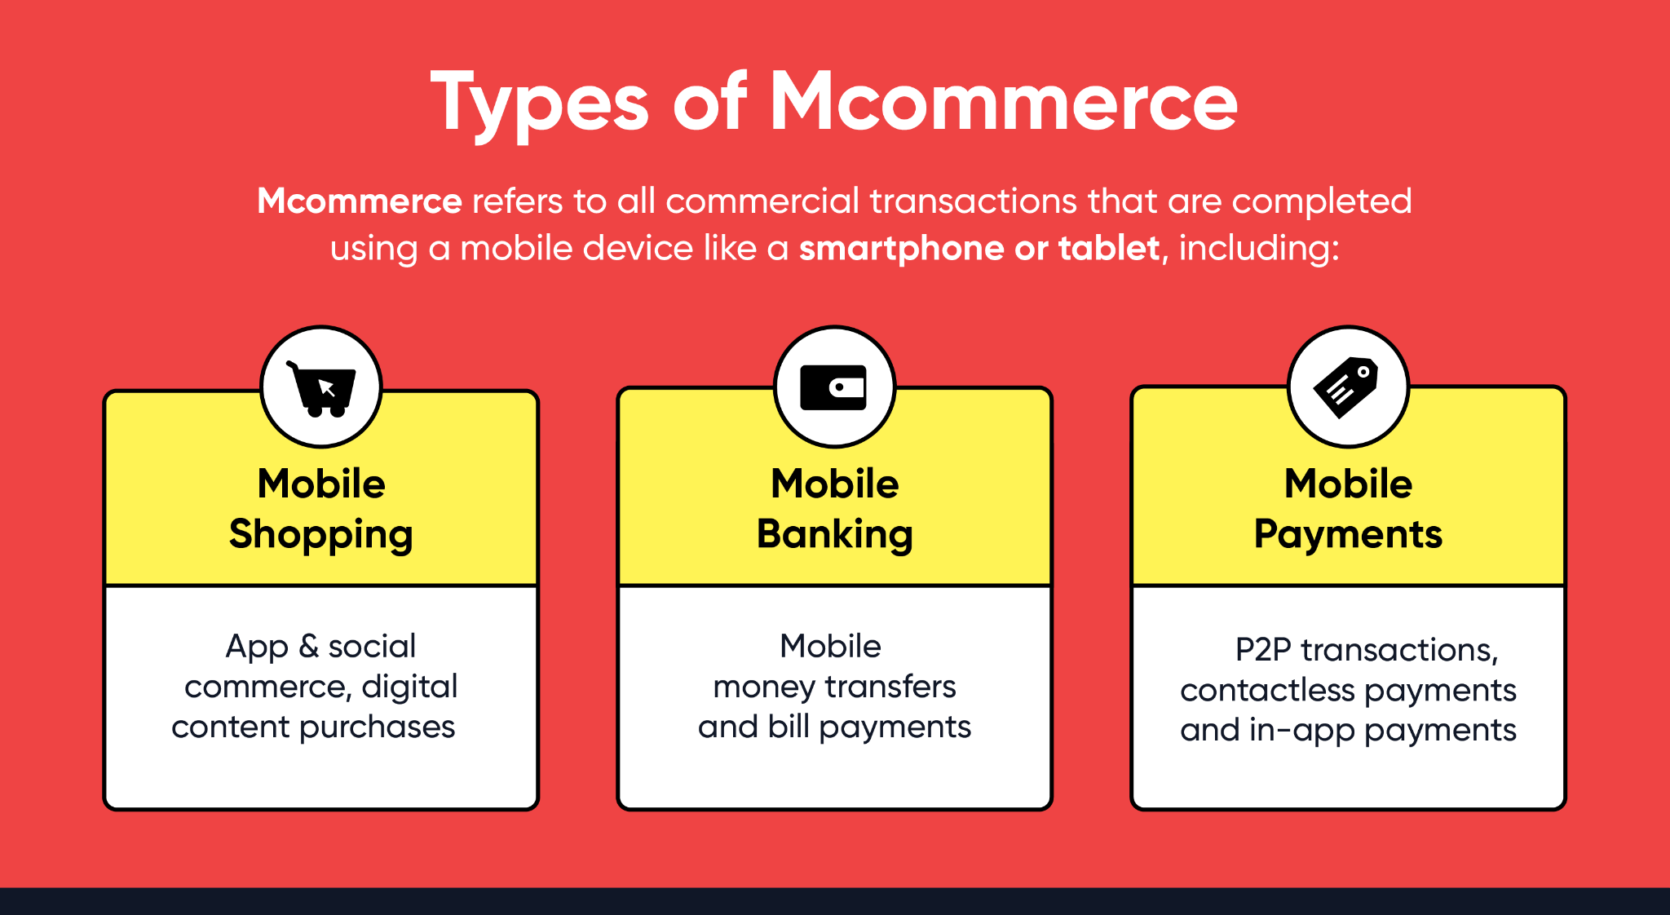
Types of MCommerce

Slide 51
Autonomic Cloud Computing
Autonomic Cloud Computing refers to cloud systems designed to manage themselves with minimal human intervention by using self-managing features inspired by the human autonomic nervous system.
These systems automatically handle tasks such as:
Characteristic | Description
Self-Configuration | Automatically sets up and configures cloud resources and services.
Self-Optimization | Continuously monitors and improves system performance and resource usage.
Self-Healing | Detects faults and recovers from failures automatically.
Self-Protection | Monitors security threats and takes protective actions without manual input.

Slide 52
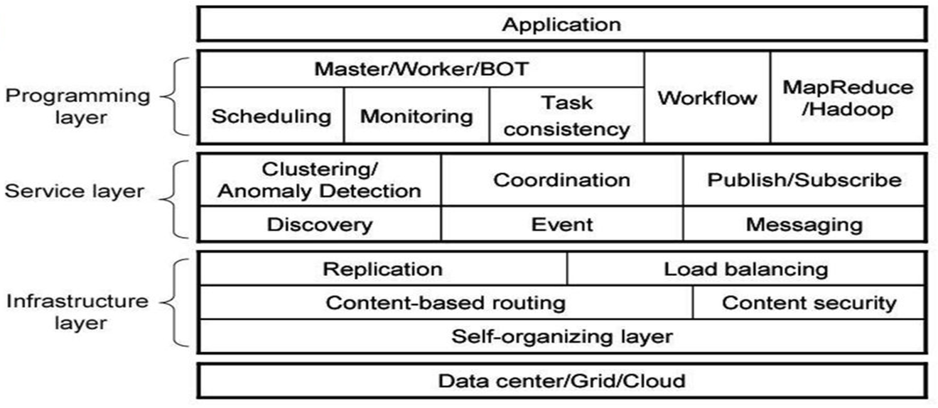
Comet Cloud - an autonomic cloud engine
CometCloud allows organizations to build flexible, on-demand cloud systems that can span across multiple cloud providers, grids, data centers, and edge environments — automatically managing resources and workloads. Ex: High-throughput computing, Real-time data analytics, Federated research infrastructures
Supports
highly heterogeneous and dynamic cloud infrastructures,
integration of public/private clouds, and cloudbursts

Slide 53
Comet cloud layered abstraction
Comet is composed of three layers –
Programming Layer
Service Layer
Infrastructure Layer
Programming Layer provides -basic framework for application, development and management
It supports range of paradigms like - master / worker
Masters generate tasks and workers consume them
The service layer -provides a range of services -
Handles scheduling, resource management, and autonomic behavior
The infrastructure layer Provides - Load Balancing, Data Replication, Content based routing, Self organizing layer. Federates resources from private clouds, public clouds (AWS, Azure), grids, and data centers.

Slide 54
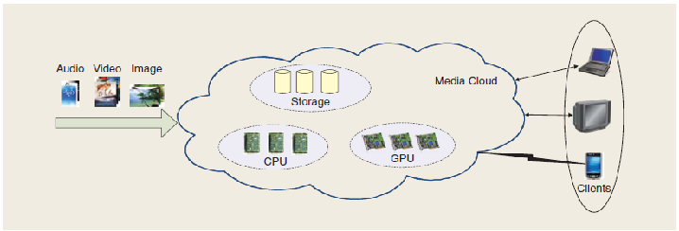
Multimedia Cloud
Multimedia Cloud refers to cloud computing services specially designed to store, process, and deliver multimedia content—such as videos, images, audio, and interactive media—over the internet.

Slide 55
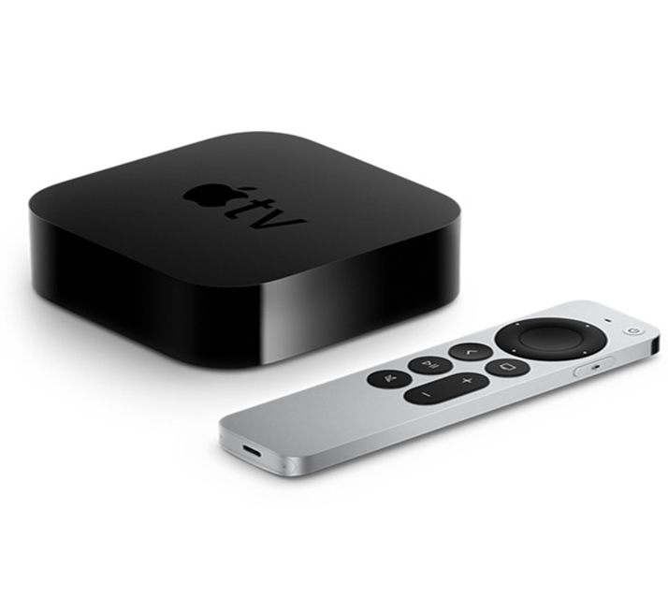
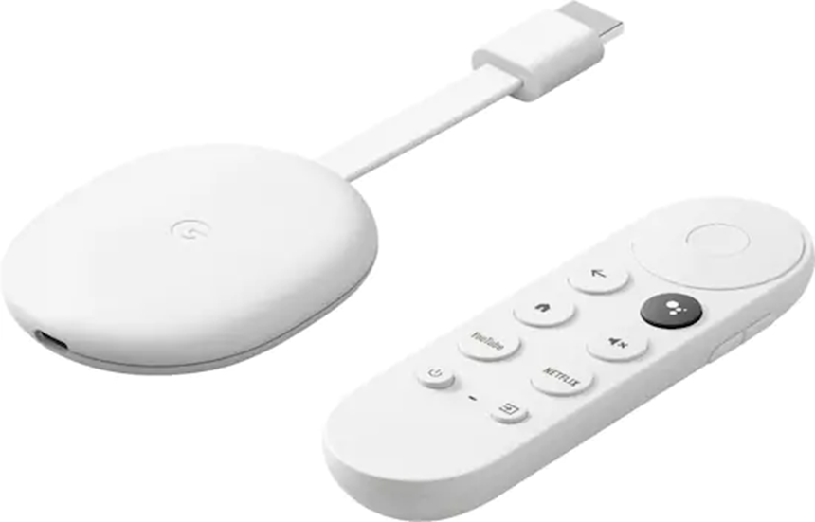
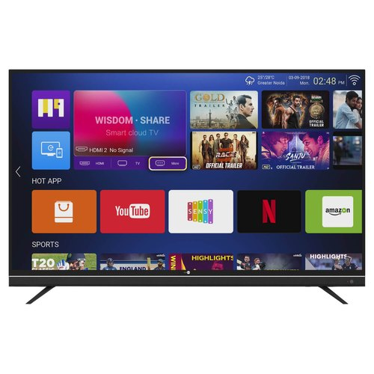
Multimedia Cloud
Service | Function
YouTube | Video hosting and streaming
Netflix | Cloud-based video streaming
Adobe Creative Cloud | Cloud media editing and storage
Twitch | Live video game streaming
Spotify | Cloud music streaming
IPTV (Internet Protocol Television) is a technology that delivers television content over Internet Protocol (IP) networks instead of traditional terrestrial, satellite, or cable formats. You can watch your favorite TV shows from computers, laptops, and mobile devices.
Ex: Smart TV, Apple TV, Google chromecast,

Slide 56
Multimedia Cloud
over-the-top (OTT) media service is a media service offered directly to viewers via the Internet. OTT bypasses cable, broadcast, and satellite television platforms.
Ex: NETFLIX Are offering - Direct-to-Consumer services With Low Prices, Advanced User Interfaces and Easy-to-Access Multi Stream Video. Popular IPTV services include: Disney+, Hulu, HBO Max, and Peacock TV, Discovery+, Paramount+, and Amazon Prime Video
OTT messaging is defined as instant messaging services or onlinechat provided by third parties as an alternative to text messaging services provided by a mobile network operator.
For Ex. - WhatsApp, Viber, WeChat, iMessage, Skype, Telegram.
OTT voice calling refers to voice communication services delivered via the internet. as provided by FaceTime, Skype, Viber, WhatsApp, WeChat, and Zoom

Slide 57
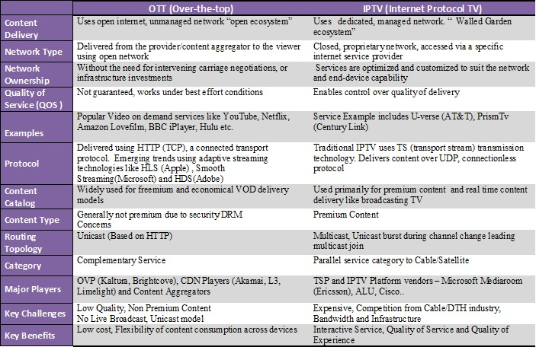
Multimedia Cloud

Slide 58
Energy Aware Cloud Computing
Green Computing (or Green IT) is the practice of environmentally sustainable computing that focuses on reducing the energy consumption, e-waste, and overall environmental impact of IT systems. It applies to hardware, software, data centers, and user practices.
Key Issues
High Power Consumption
Cooling Requirements
Underutilization of Resources
Carbon Footprint
Lack of Energy-Aware
Security vs. Energy Trade-offs
Data Transfer Energy
Infrequent Hardware Refresh
Best Practices:
Use green-certified data centers (e.g., LEED-certified)
Adopt renewable energy sources (solar, wind)
Implement auto-scaling policies
Use serverless computing to optimize resource usage
Encourage geographical load balancing (use data centers in cooler climates or near renewable sources)
Energy-Efficient Data Centers

Slide 59
Green Computing
Green use
Minimizing the electricity consumption of computers and their peripherals
By Using them in eco-friendly manner
Green disposal
Reusing old devices or recycling or disposing them in proper way
Green design
Designing energy efficient computers, servers, printers, projectors
and other digital devices
Green manufacturing
Minimizing waste during manufacturing of computers and other subsystems

Slide 60
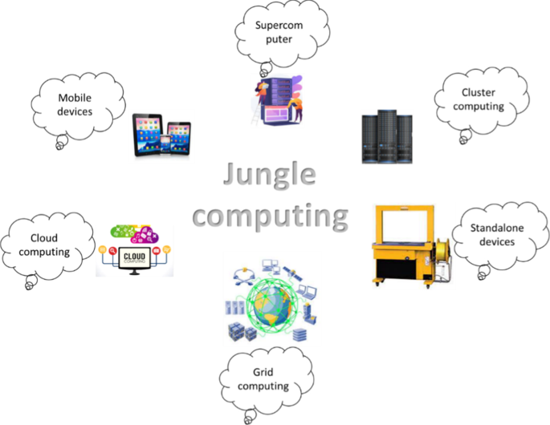
Jungle Computing
Jungle Computing refers to a complex, heterogeneous, and highly distributed computing environment that combines various types of computing resources such as:Clouds (public/private), clusters, grids, desktop grids, supercomputers, stand alone machines and mobile devices.
To efficiently run complex, large-scale, or parallel scientific and technical applications using whatever computing resources are available—regardless of location, type, or ownership.

Slide 61
Jungle Computing
Examples:
A scientific research project might use a cloud platform for data storage, a local cluster for intensive calculations, and a grid system for simulations, all as part of a jungle computing environment.

