Slide 1
Value Engineering Overview
Presented by
Prof. Mayur Appaiah
IEM Dept. - BMSCE

Slide 2
Unit 1: Introduction to Value Analysis - Key Definitions
Value: Relationship between product function & cost
Understanding Value = Relationship between a product’s function and its cost
High value means: Performs intended function effectively
Achieved at the lowest possible cost
Value Analysis (VA)Definition: A systematic approach to improve product value
Objective: Reduce cost without affecting quality or performance
Key Steps:
Identify functions
Evaluate cost vs. function
Find cost-saving alternatives
Implement without compromising quality

Slide 3
Unit 1: Introduction to Value Analysis - Key Definitions
Value Engineering (VE): Applied during design stage to improve value
Definition: Method applied during the design stage
Goal: Improve product value before production begins
Approach: Analyze functions early
Select cost-effective alternatives
Ensure performance and quality remain intact
Value Management: Integrates VA & VE for lifecycle optimization
Definition: Broader approach integrating Value Analysis (VA) and Value Engineering (VE)
Objective: Optimize value across the entire product lifecycle
Benefits:
Cost reduction at multiple stages
Improved efficiency and resource use
Sustained quality and performance over time

Slide 4
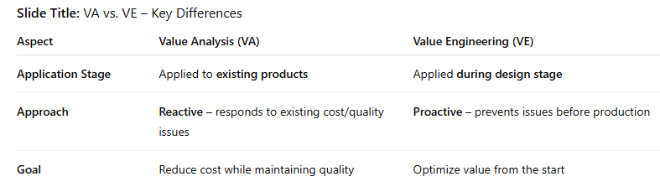
Unit 1: VA vs VE
VA: Applied to existing products; reactive approach
VE: Applied during design stage; proactive approach

Slide 5
Unit 1: Applications of VA
Product design improvements
Cost reduction initiatives
Efficiency improvements
Streamlining operations

Slide 6
Unit 1: Types of Values & Peeling Cost Onion
Use Value: Practical utility
Esteem Value: Perceived worth
Cost Value: Economic cost
Peeling Cost Onion: Breaking down total costs to find inefficiencies

Slide 7
Unit 2: Value Engineering Job Plan - Definition & Importance
Structured approach for VE application
Ensures systematic cost reduction & product optimization

Slide 8
Unit 2: Phases of VE Job Plan
Information Phase
Analysis Phase
Creative Phase
Judgment Phase
Development Planning Phase

Slide 9
Unit 2: VE Job Plan in Action
Case studies: Real-world examples
Cost reduction programs using VE techniques

Slide 10
Unit 3: Functions & Costs
Function: Primary purpose of a product/service
Functional Cost: Cost of performing a function
Types: Primary & Secondary functions

Slide 11
Unit 3: Rules for Functional Definition
Use verb + noun format
Keep it simple & precise

Slide 12
Unit 3: Function Evaluation Methods
Evaluation by comparison
Evaluation of interacting functions
Evaluation from available data
Matrix technique

Slide 13
Unit 4: Project & Team Selection
Select projects with high cost reduction potential
Multidisciplinary teams for creativity & expertise

Slide 14
Unit 4: VE for Cost Reduction
Materials management
Design optimization
Process improvements

Slide 15
Unit 4: Examples of VE Applications
Redesign for cost efficiency
Streamlined supply chain operations

Slide 16
Unit 5: FAST Diagram & LCC
FAST: Visualizes functions & relationships
LCC: Total cost of ownership across lifecycle

Slide 17
Unit 5: VE & New Variants
BPR, Product Reengineering, QFD, Benchmarking
VAMP for management practice improvement

Slide 18
Unit 5: Case Studies
Transformer tapping device
Front rings, conveyor rollers
Motorcycle speedometer, oil pump

