Slide 1
Value Engineering
Unit 1 - FUNCTIONAL COST AND ITS EVALUATION
Prepared by Prof. Mayur Appaiah
IEM - BMSCE

Slide 2
Function
The basic purpose of each expenditure, whether it be for hardware, the work of a group of men, a procedure, or whatever, is to accomplish a function.
It is necessary to establish the language of function and stay
within this language
The three main functions
In the search for basic objective thinking, functions are divided into two types.
Either or both may cause the buyer or the user to buy the product.
One type is the use function and the other is the aesthetic function

Slide 3
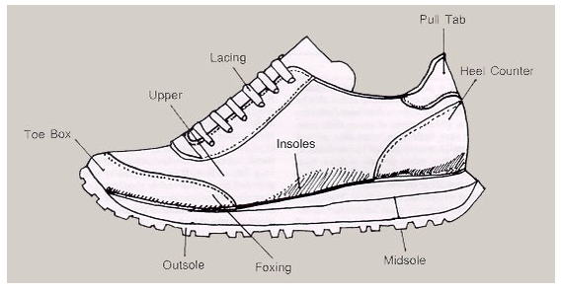
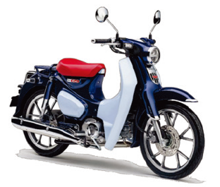
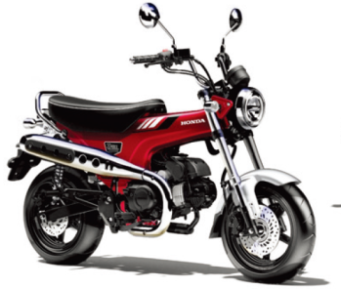
Use Function
The cost that is expended to cause the product to perform a use that the buyer wants and is willing to pay for is called the use function cost.
Aesthetic Function
The cost that is expended for the purpose of pleasing the buyer through colour or shape or feature, causing him to buy, is typed as the aesthetic function cost.
Honda – Regular Model and DaX 125 “Monkey Bike”

Slide 4
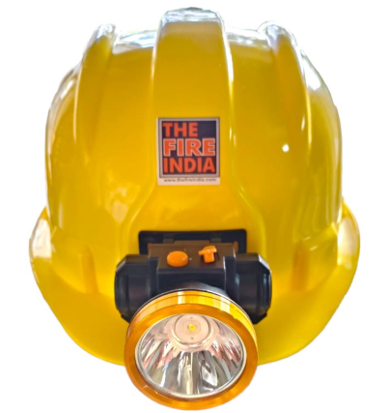
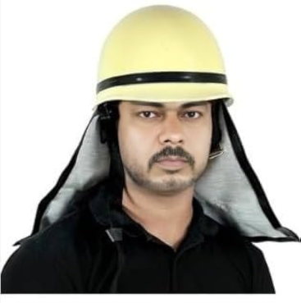

Basic Function
The basic function is that function for which the user or buyer buys the product.
Secondary Functions
Secondary functions are those functions that become necessary in order to allow the designer's choice for means of accomplishing the basic function to do so effectively.
The Fireman’s Helmet – the Basic Function and Secondary Function (Light)

Slide 5
THE END

