Slide 1

Single Point Cutting Tool Nomenclature
Prepared By
Prof.Mayur Appaiah
IEM Dept – BMSCE

Slide 2
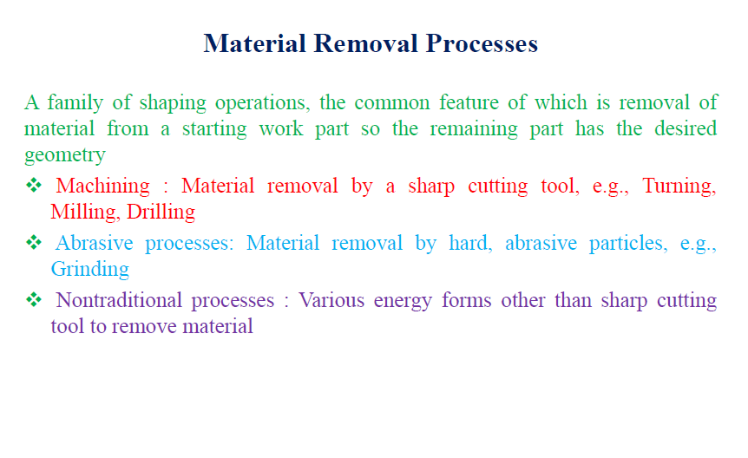
INTRODUCTION

Slide 3
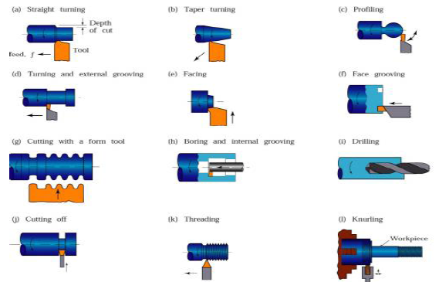
COMMON LATHE OPERATIONS

Slide 4
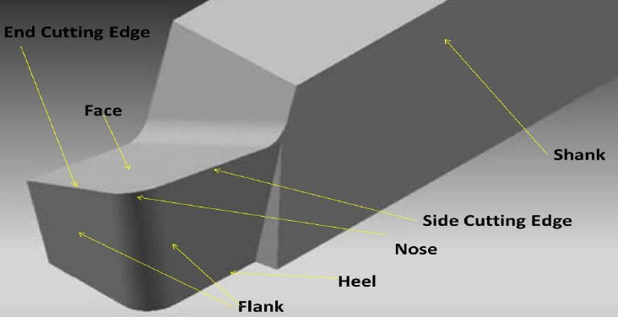
GEOMETRY OF SINGLE POINT CUTTING TOOL

Slide 5
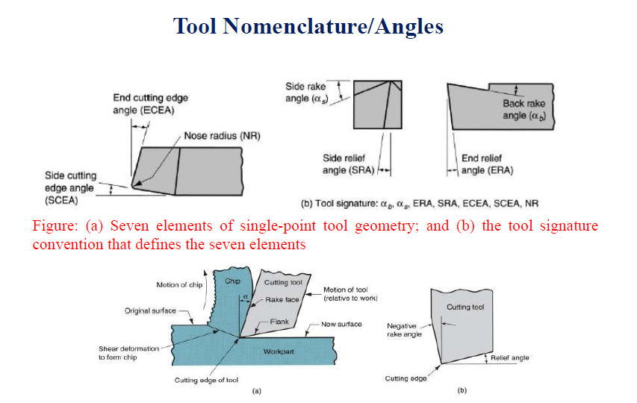
TOOL NOMENCLATURE / ANGLES
As Seen from FRONT / SIDE
As Seen From TOP

Slide 6
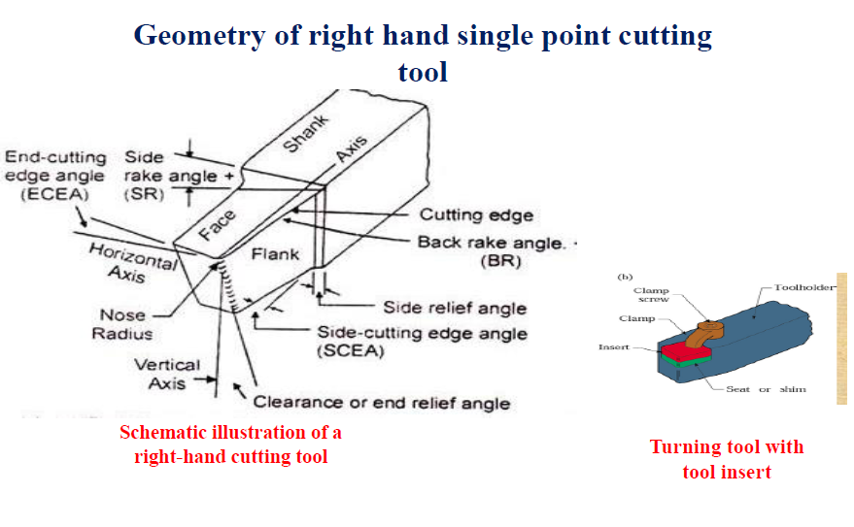
GEOMETRY OF RIGHT HAND SINGLE POINT CUTTING TOOL

Slide 7
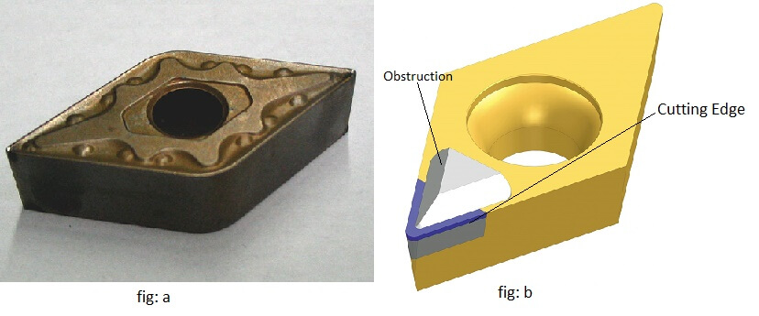
TURNING TOOL WITH TOOL INSERT

Slide 8
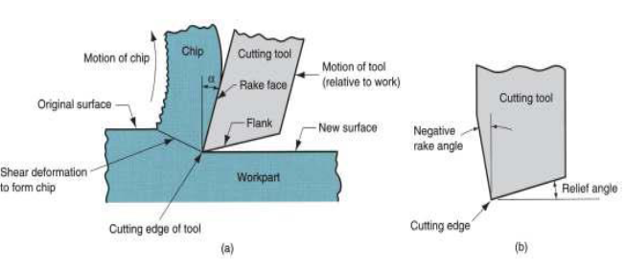
DIFFERENCE BETWEEN POSITIVE AND NEGATIVE RAKE
The Rake Angle will impact the Tool Feed (or Input Force), the Shear Force causing Chip formation and also Chip Thickness.

Slide 9
THANK YOU

