Slide 1

CAMD - Unit 2
Sections of Solids
B.M.S. College of Engineering
Department of Industrial Engineering and Management
Dr. B. Ramesh Nayak
Prof. Mayur Appaiah
Dr. Kavita Rani N.
Prof. Disha M. Nayak

Slide 4
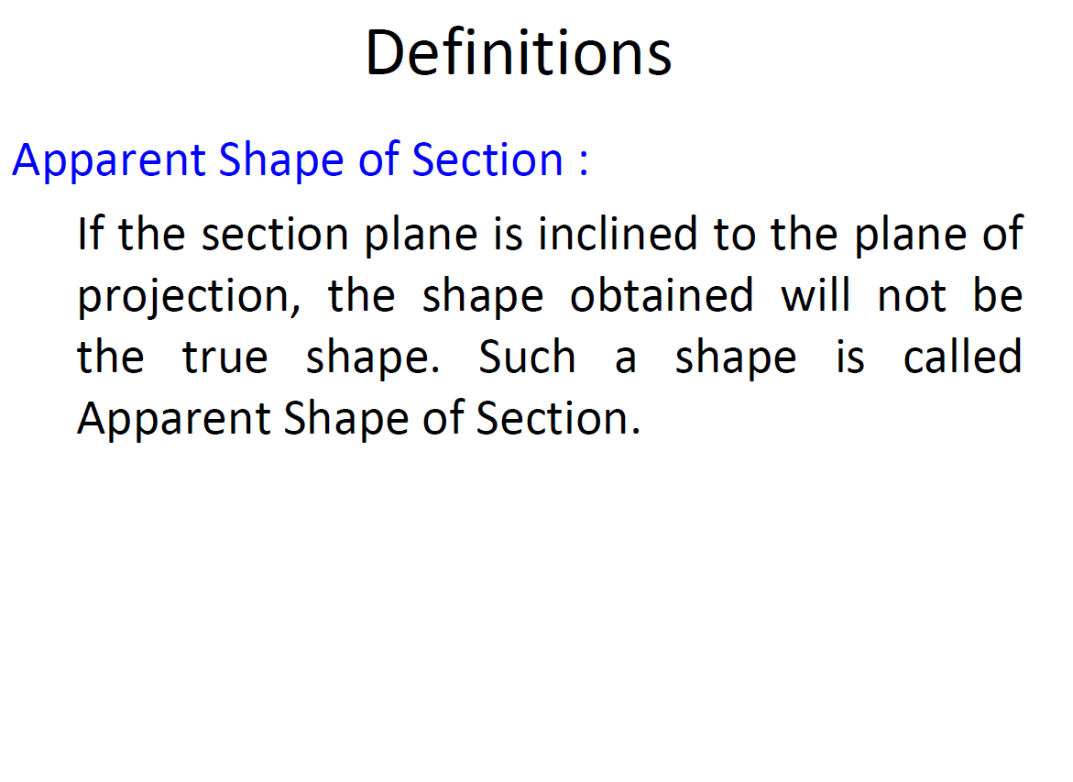

Slide 13
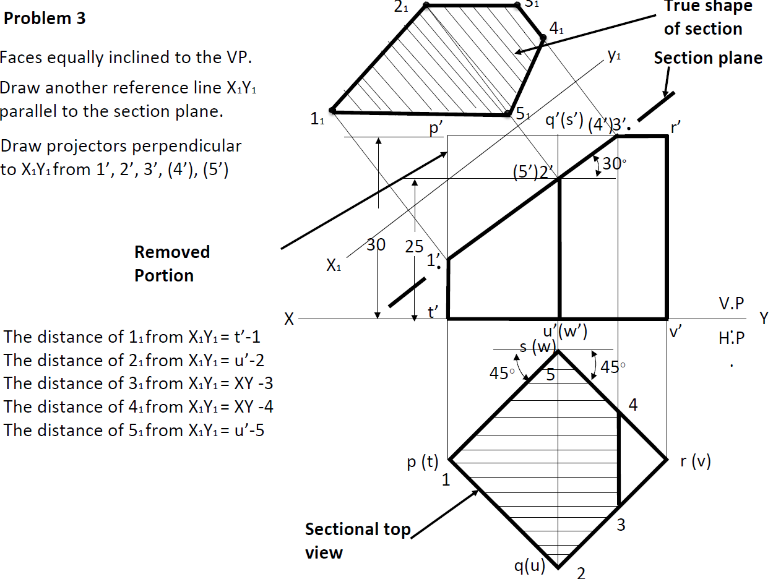

Slide 14
Problem 4

Slide 15
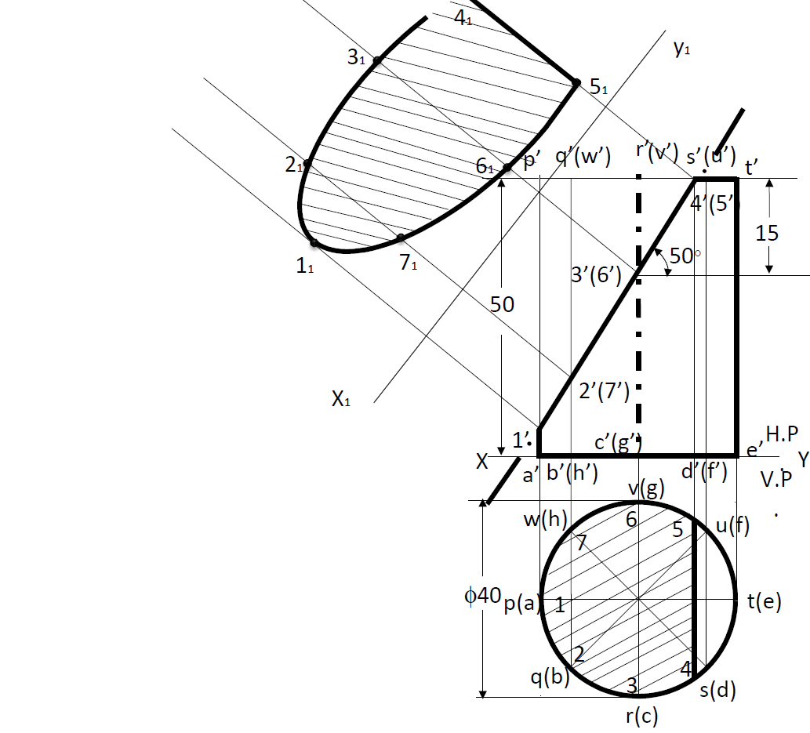
Problem 4

Slide 16
THE END

