Slide 1



Data Exploration & Visualization
Unit - 5
Dr. SELVA KUMAR S
ASSISTANT PROFESSOR
DEPT. OF CSE

Slide 2
Agenda
◆ Visualizing Data: Mapping Data onto Aesthetics
◆ Coordinate Systems and Axes, Directory of Visualizations, Visualizing Amounts.
◆ Visualizing Distributions: Histograms and Density Plots.
◆ Visualizing Multiple Distributions at the Same Time.
◆ Visualizing Distributions: Empirical Cumulative Distribution Functions and Q-Q Plots.
◆ Visualizing Many Distributions at Once
◆ Visualizing Uncertainty, Visualizing proportions.
◆ Handling overlapping points: Partial Transparency and Jittering,2D Histograms, Redundant Coding

Slide 3
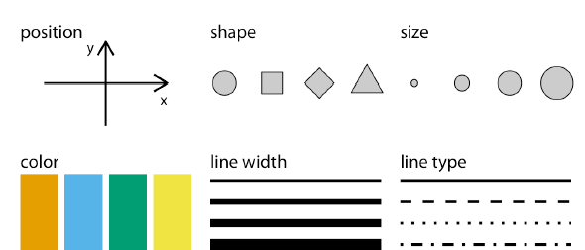
Visualizing Data :Aesthetics and Types of data
Aesthetics describe every aspect of a given graphical element.
Two groups of Aesthetic : Continuous data and Discrete data.
Continuous data : position, size, color, and line width.
Discrete data : shape and line type.
Notes:
Aesthetics describe every aspect of a given graphical element.

Slide 4
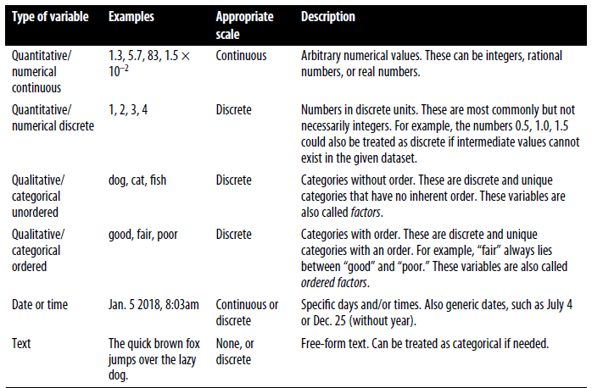
Types of variables – visualization scenarios
Notes:
Next we’ll consider the types of data we may want to represent in our visualization.
You may think of data as numbers, but numerical values are only two out of several
types of data we may encounter. In addition to continuous and discrete numerical
values, data can come in the form of discrete categories, in the form of dates or times,
and as text (Table 2-1). When data is numerical we also call it quantitative and when
it is categorical we call it qualitative. Variables holding qualitative data are factors, and
the different categories are called levels. The levels of a factor are most commonly
without order (as in the example of dog, cat, fish in Table 2-1), but factors can also be
ordered, when there is an intrinsic order among the levels of the factor (as in the
example of good, fair, poor in Table 2-1).

Slide 5
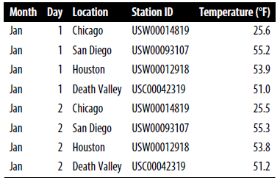
Example : Daily Temperature
Notes:
This table contains
five variables: month, day, location, station ID, and temperature (in degrees
Fahrenheit). Month is an ordered factor, day is a discrete numerical value, location is
an unordered factor, station ID is similarly an unordered factor, and temperature is a
continuous numerical value.

Slide 6
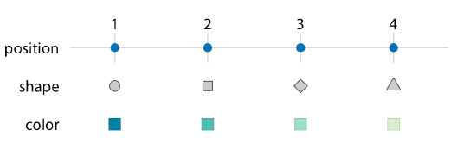
Scales Map Data Values onto Aesthetics
A Scale defines a unique mapping between data and aesthetic.
A scale must be one-to-one.
If a scale isn’t one-to-one, then the data visualization becomes ambiguous.
Notes:
Scales: These are the mappings between the data values and the aesthetics of a plot. Scales can be linear, logarithmic, categorical, etc., depending on the nature of your data. The scales ensure that the data values are appropriately represented in the visual space.
Aesthetics: These are the visual properties of the plot, such as position, color, shape, size, etc. For example, in a scatter plot, you might map the x-axis and y-axis positions to two variables, and perhaps map the color or size of the points to another variable.
Linear Scale:
Representation: In a linear scale, equal differences in values are represented by equal distances on the axis. It is a straightforward, proportional representation.
Visual Impact: Larger values have a more pronounced visual impact, and the spacing between ticks is uniform.
Common Usage: Linear scales are commonly used when the proportional relationships between values are crucial for accurate interpretation. They are suitable for a wide range of applications.
Examples: The standard x-axis and y-axis on most charts and plots are typically linear scales.
Non-linear Scale:
Representation: In a non-linear scale, the distances between values on the axis are not uniform. It involves transforming the data using a function before plotting.
Visual Impact: Non-linear scales can compress or expand certain ranges of values, depending on the transformation applied. They are used to highlight specific parts of the data.
Common Usage: Non-linear scales are used when the nature of the data or the message being conveyed benefits from a non-uniform representation. Common types include logarithmic, square root, and other transformations.
Examples: Logarithmic scales are often used for data with a wide range of values, while square root scales can be used to emphasize smaller values.
Use Cases:
Linear Scale: Appropriate when equal differences in values have equal significance. Commonly used for everyday data visualization.
Non-linear Scale: Useful when dealing with data that spans multiple orders of magnitude or when certain ranges of values need emphasis. Commonly applied in scientific, financial, and specialized visualizations.
Examples:
Linear Scale Example: A simple line chart representing population growth over time.
Non-linear Scale Example: A logarithmic scale used to represent earthquake magnitudes, where small differences in magnitude correspond to large differences in energy release.

Slide 7
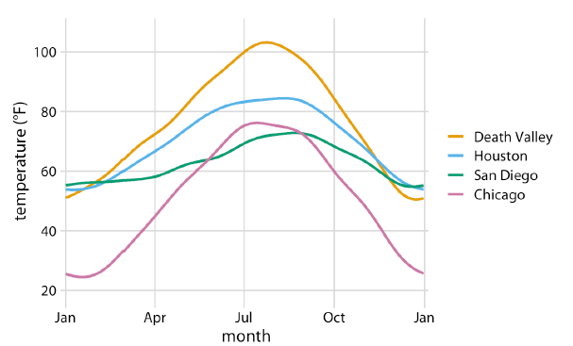
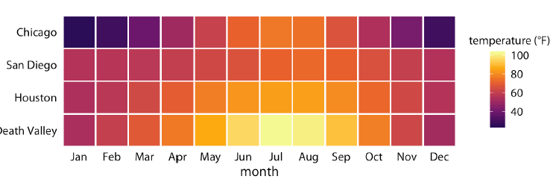
Example: 3 scale
Notes:
Daily temperature normals for four selected locations in the US. Temperature
is mapped to the y axis, day of the year to the x axis, and location to line color. Data
source: NOAA
is a fairly standard visualization for a temperature curve and likely the visualization
most data scientists would intuitively choose first. However, it is up to us
which variables we map onto which scales
I would like to emphasize that Figure 2-4 uses two position scales (month along the x
axis and location along the y axis), but neither is a continuous scale. Month is an
ordered factor with 12 levels and location is an unordered factor with 4 levels. Therefore,
the two position scales are both discrete. For discrete position scales, we generally
place the different levels of the factor at an equal spacing along the axis. If the
factor is ordered (as is here the case for month), then the levels need to be placed in
the appropriate order. If the factor is unordered (as is here the case for location), then
the order is arbitrary, and we can choose any order we want. I have ordered the locations
from overall coldest (Chicago) to overall hottest (Death Valley) to generate a
pleasant staggering of colors. However, I could have chosen any other order and the
figure would have been equally valid.
Both Figures 2-3 and 2-4 used three scales in total, two position scales and one color
scale.

Slide 8
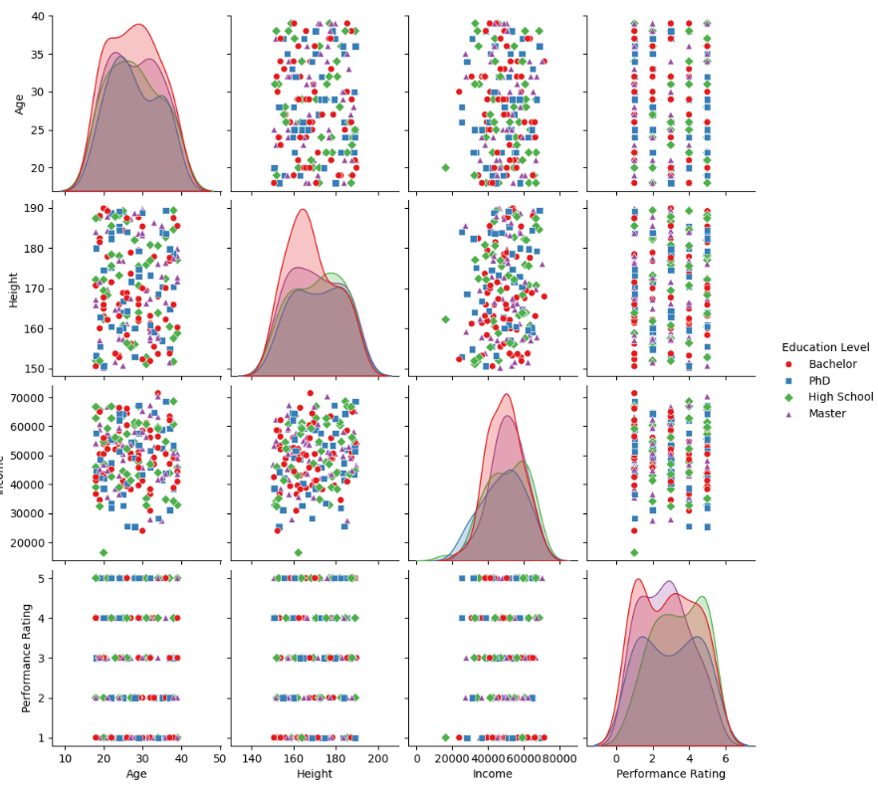
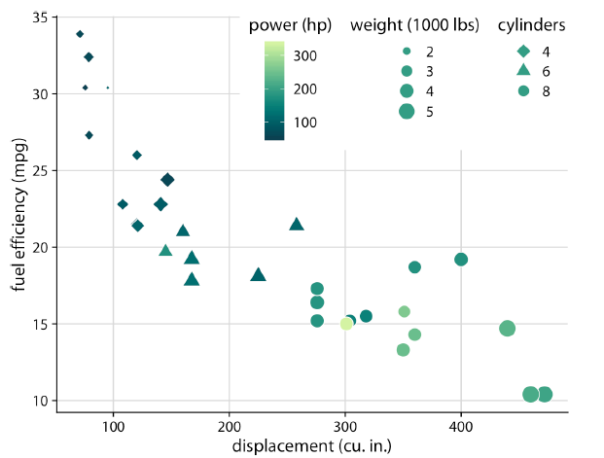
Example: 5 scale
Five scales—two position scales, one color scale, one size scale, and one shape scale.
Notes:
import seaborn as sns
import matplotlib.pyplot as plt
import pandas as pd
import numpy as np
# Creating a sample dataset
np.random.seed(42)
num_samples = 200
data = {
'Age': np.random.randint(18, 40, num_samples),
'Height': np.random.uniform(150, 190, num_samples),
'Income': np.random.normal(50000, 10000, num_samples),
'Education Level': np.random.choice(['High School', 'Bachelor', 'Master', 'PhD'], num_samples),
'Performance Rating': np.random.randint(1, 6, num_samples)
}
df = pd.DataFrame(data)
# Creating a pairplot with five scales
sns.pairplot(df, hue='Education Level', palette='Set1', markers=["o", "s", "D", "^"])
plt.suptitle('Pairplot with Five Scales', y=1.02)
plt.show()

Slide 9
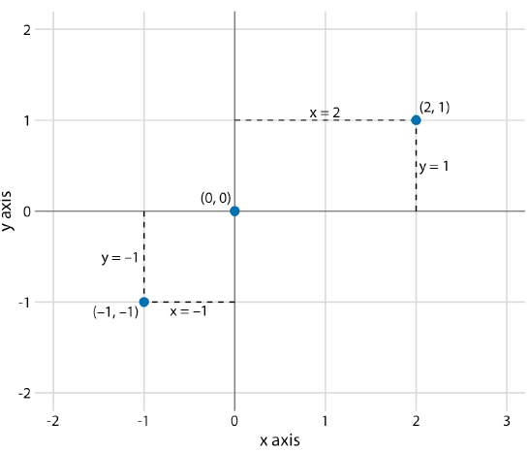
Coordinate Systems and Axes
The combination of a set of position scales and their relative geometric arrangement is called a coordinate system.
A Cartesian coordinate system can have two axes representing two different units.
Notes:
Coordinate systems and axes are fundamental concepts in the field of mathematics and graphics, especially when it comes to data visualization and plotting. They provide a framework for specifying the positions of points in space and are essential for creating meaningful visualizations.
Coordinate System:
A coordinate system is a system that uses one or more numbers, or coordinates, to uniquely determine the position of a point or other geometric element.
The most common coordinate systems are Cartesian coordinates and polar coordinates.
In a Cartesian coordinate system, points are located using two or more perpendicular axes (usually x and y) intersecting at a point called the origin. The coordinates (x, y) specify the position of a point in relation to the origin.
In a polar coordinate system, points are located using a distance and an angle from a reference point (usually the origin).
Axes:
Axes are the lines or vectors along which coordinates are measured.
In a Cartesian coordinate system, there are typically two axes: the x-axis and the y-axis. These axes are perpendicular to each other at the origin.
The x-axis is the horizontal line, and the y-axis is the vertical line. Together, they form a plane.
Additional axes can be introduced for three-dimensional coordinate systems, where you might have x, y, and z axes.
In the context of data visualization:
2D Plotting: In a 2D plot, you typically have x and y axes. These can represent different variables, such as time, distance, or categories, depending on the nature of your data.
3D Plotting: In a 3D plot, you might have x, y, and z axes. This allows you to visualize relationships between three variables.
Multivariate Plotting: For more than three variables, you might use techniques like color, size, or shape to represent additional dimensions.

Slide 10
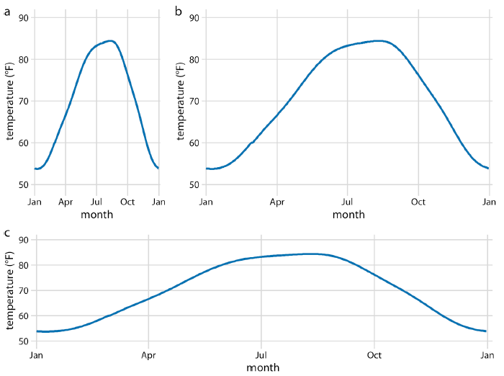
Example: Aspect Ratio
Notes:
A tall and narrow figure emphasizes change along the y axis and a short and
wide figure does the opposite. Ideally, we want to choose an aspect ratio that ensures
that any important differences in position are noticeable.
In the context of plotting, adjusting the aspect ratio can significantly impact how the data is perceived visually. An aspect ratio that is not equal might stretch or compress the plot, altering the appearance of shapes and patterns.
Adjusting the aspect ratio can be crucial in situations where maintaining the proportional relationship between the axes is important for accurate interpretation, especially when dealing with geographical maps, images, or any other data where the spatial relationship matters.
Keep in mind that aspect ratio is just one aspect (pun intended) of fine-tuning a plot. The appropriate aspect ratio depends on the nature of your data and the message you want to convey.

Slide 11
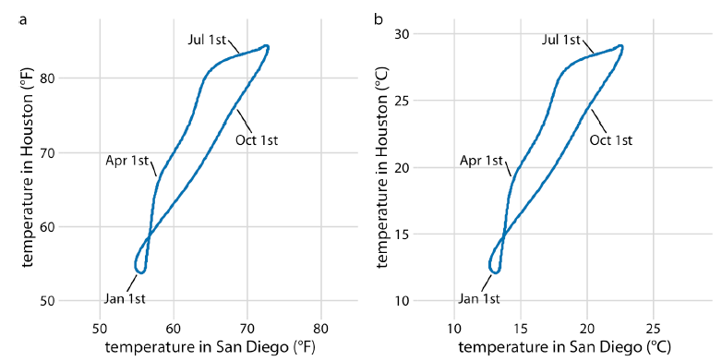
Example: Change in Units
Notes:
You may wonder what happens if you change the units of your data. After all, units
are arbitrary, and your preferences might be different from somebody else’s. A change
in units is a linear transformation, where we add or subtract a number to or from all
data values and/or multiply all data values with another number. Fortunately, Cartesian
coordinate systems are invariant under such linear transformations. Therefore,
you can change the units of your data and the resulting figure will not change as long
as you change the axes accordingly. As an example, compare Figures 3-3a and 3-3b.
Both show the same data, but in part (a) the temperature units are degrees Fahrenheit
and in part (b) they are degrees Celsius. Even though the grid lines are in different
locations and the numbers along the axes are different, the two data visualizations
look exactly the same.

Slide 12
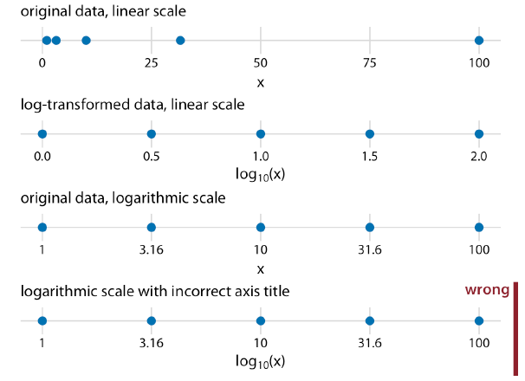
Nonlinear Axes
In a nonlinear scale, even spacing in data units corresponds to uneven spacing in the Visualization
Conversely even spacing in the visualization corresponds to uneven spacing in data units.
Notes:
Log of 3.16 is 0.5 and Log of 31.6 is 1.5.. 1, 10 and 100 is 0.0, 1.0, 2.0
This process is demonstrated in Figure 3-4, which shows the numbers
1, 3.16, 10, 31.6, and 100 placed on linear and log scales. The numbers 3.16 and 31.6
may seem like strange choices, but they were selected because they are exactly halfway
between 1 and 10 and between 10 and 100 on a log scale. We can see this by
observing that 100.5 = 10 ≈ 3.16, and equivalently 3.16 × 3.16 ≈ 10. Similarly, 101.5 =
10 × 100.5 ≈ 31.6.
In a linear scale, equal distances represent equal differences in values. In a nonlinear scale, such as logarithmic, equal distances represent equal ratios, making it easier to visualize data that spans multiple orders of magnitude.
This is especially useful when dealing with data that spans several orders of magnitude, such as financial data, earthquake magnitudes, or signal-to-noise ratios. Logarithmic scales can compress the large range of values into a more manageable visual space.
You can apply similar transformations to the x-axis using plt.xscale('log') or other nonlinear transformations like square root, power, etc., depending on the nature of your data. Keep in mind that using nonlinear scales requires careful interpretation, as the spacing between ticks is no longer uniform in the transformed space.
Logarithmic Scale:
Transformation Function: �=log⁡�(�)y=logb​(x), where �b is the base of the logarithm.
Representation: In a logarithmic scale, equal intervals on the scale represent multiplicative factors, not additive differences. The scale compresses larger values and expands smaller values.
Visual Impact: Logarithmic scales are effective for visualizing data that spans several orders of magnitude. They emphasize percentage changes rather than absolute differences.
Use Cases:
Visualizing data with a wide range of values.
Representing exponential growth or decay.
Highlighting patterns in datasets with large variations.
Exponential Scale:
Transformation Function: �=���y=ekx, where �e is the base of the natural logarithm and �k is a constant.
Representation: In an exponential scale, equal intervals on the scale represent additive differences. The scale emphasizes the rate of change in the data.
Visual Impact: Exponential scales are useful for visualizing data with rapid changes, especially when the emphasis is on the rate of growth or decay.
Use Cases:
Modeling exponential growth or decay.
Visualizing data with rapidly changing values.
Highlighting the impact of compounding or exponential processes.
Common Use Cases:
Logarithmic: Used when the data spans multiple orders of magnitude, such as in financial markets or seismic measurements.
Exponential: Used to model processes with constant growth or decay rates, such as population growth or radioactive decay.
2. Square Root Scale:
Transformation Function: �=�y=x​.
Use Cases:
Emphasizing smaller values in a dataset.
Reducing the impact of extreme values in positively skewed distributions.
Maintaining a linear relationship for positive values.
Square root scales are commonly used in various applications to visualize data with a wide range of values, especially when emphasizing smaller values. Here are some applications where square root scales are frequently employed:
1. Financial Data:
Example: Visualizing the distribution of stock price changes.
Reason: Smaller stock price changes are often of greater interest, and using a square root scale can provide a clearer representation of smaller fluctuations.
2. Population Growth:
Example: Representing population sizes of cities or countries.
Reason: Smaller population sizes are visually emphasized, making it easier to compare and analyze cities or regions with fewer inhabitants.
3. Biology and Medicine:
Example: Visualizing the sizes of organisms or biological structures.
Reason: Smaller organisms or structures are highlighted, aiding in the comparison of sizes within a diverse dataset.

Slide 13
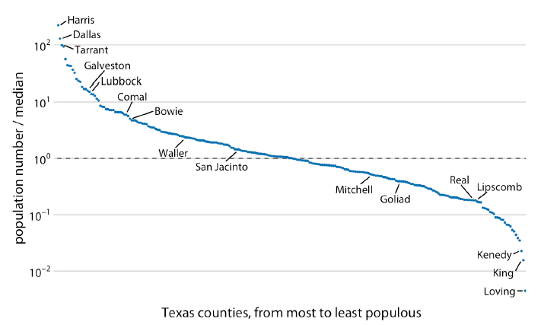
Example-1
Population numbers of Texas counties relative to their median value
Notes:
Figure 3-5. Population numbers of Texas counties relative to their median value. Select
counties are highlighted by name. The dashed line indicates a ratio of 1, corresponding to
a county with median population number. The most populous counties have approximately
100 times more inhabitants than the median county, and the least populous
counties have approximately 100 times fewer inhabitants than the median county. Data
source: 2010 US Decennial Census.

Slide 14
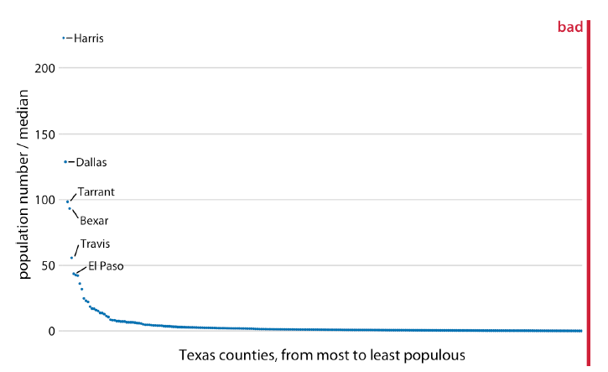
Example-2
Notes:
By contrast, for the same data, a linear scale obscures the differences between a
county with median population number and a county with a much smaller population
number than median (Figure 3-6).

Slide 15
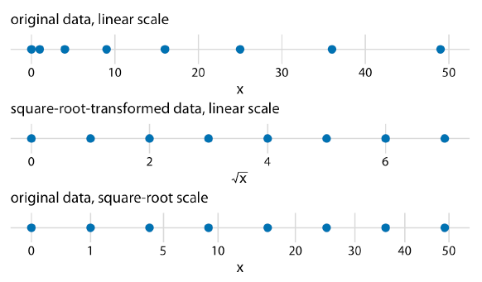
Example-3
Notes:
I see two problems with square-root scales. First, while on a linear scale one unit step
corresponds to addition or subtraction of a constant value, and on a log scale it corresponds
to multiplication with or division by a constant value, no such rule exists for a
square-root scale. The meaning of a unit step on a square-root scale depends on the
scale value at which we’re starting. Second, it is unclear how to best place axis ticks on
a square-root scale. To obtain evenly spaced ticks, we would have to place them at
squares, but axis ticks at, for example, positions 0, 4, 25, 49, and 81 (every second
square) would be unintuitive. Alternatively, we could place them at linear intervals
(10, 20, 30, etc.), but this would result in either too few axis ticks near the low end of
the scale or too many near the high end. In Figure 3-7, I have placed the axis ticks at
positions 0, 1, 5, 10, 20, 30, 40, and 50 on the square-root scale. These values are arbitrary
but provide a reasonable covering of the data range.
choose a linear scale when your data exhibits a natural linear progression and proportional differences are crucial. Use a square-root scale when dealing with quadratic relationships, highlighting smaller values, or when you want to mitigate the visual impact of extreme values in a positively skewed distribution. Always consider the characteristics of your data and the interpretability for your audience when making this decision.

Slide 16
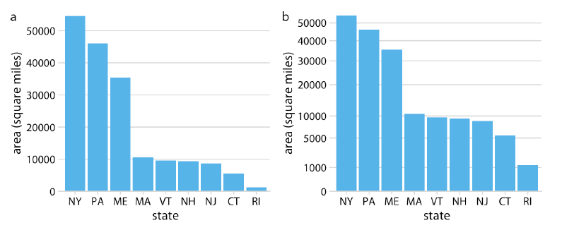
Example-4
Areas of northeastern US states. (a) Areas shown on a linear scale. (b) Areas shown on a square-root scale. Data source: Google.
Notes:
Linear Scale:
Differences in bar heights directly represent differences in actual area sizes.
The larger area (C) dominates visually, and the differences between areas are more pronounced.
Square-Root Scale:
Smaller areas (A and B) are visually emphasized, and the differences between them are more apparent.
The larger area (C) appears less dominant compared to the linear scale.
Choosing between linear and square-root scales depends on your goals. If you want to emphasize the differences in smaller values or reduce the visual impact of extreme values, a square-root scale may be appropriate. If proportional differences in the actual sizes are more critical, a linear scale might be more suitable. Always consider the story you want to convey and how the choice of scale affects the viewer's perception.

Slide 17
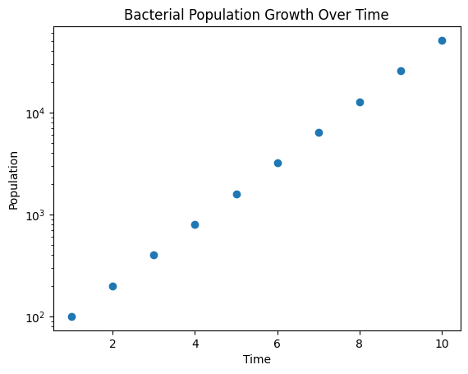
Exercise-1
Consider the dataset below representing the growth of a bacterial population over time. Create a scatter plot of the data with a logarithmic y-axis to better visualize the exponential growth.
# Sample data
time = np.array([1, 2, 3, 4, 5, 6, 7, 8, 9, 10])
population = np.array([100, 200, 400, 800, 1600, 3200, 6400, 12800, 25600, 51200])
Notes:
import matplotlib.pyplot as plt
import numpy as np
# Sample data
time = np.array([1, 2, 3, 4, 5, 6, 7, 8, 9, 10])
population = np.array([100, 200, 400, 800, 1600, 3200, 6400, 12800, 25600, 51200])
# Create a scatter plot with a logarithmic y-axis
plt.scatter(time, population)
plt.yscale('log') # Set the y-axis to be logarithmic
# Adding labels and title
plt.xlabel('Time')
plt.ylabel('Population')
plt.title('Bacterial Population Growth Over Time')
plt.show()

Slide 18
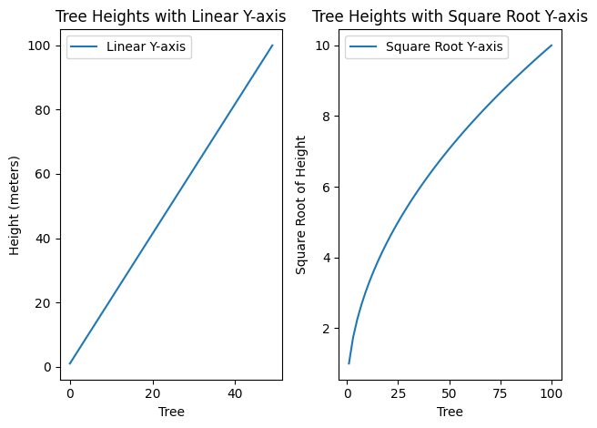
Exercise-2
Consider a dataset representing the heights of trees in a forest. The heights range from 1 meter to 100 meters. Create two separate line plots – one with a linear y-axis and another with a square root y-axis – to visualize t
# Sample data
tree_heights = np.linspace =(1, 100, 50))
Notes:
import matplotlib.pyplot as plt
import numpy as np
# Sample data
tree_heights = np.linspace(1, 100, 50)
# Create a line plot with a linear y-axis
plt.subplot(1, 2, 1)
plt.plot(tree_heights, label='Linear Y-axis')
plt.xlabel('Tree')
plt.ylabel('Height (meters)')
plt.title('Tree Heights with Linear Y-axis')
plt.legend()
# Create a line plot with a square root y-axis
plt.subplot(1, 2, 2)
plt.plot(tree_heights, np.sqrt(tree_heights), label='Square Root Y-axis')
plt.xlabel('Tree')
plt.ylabel('Square Root of Height')
plt.title('Tree Heights with Square Root Y-axis')
plt.legend()
plt.tight_layout()
plt.show()
In this solution:
The left subplot shows the heights with a linear y-axis, representing the actual heights of the trees.
The right subplot shows the heights with a square root y-axis, emphasizing the differences in the smaller values. This can be useful when you want to focus on the details of shorter trees.
This exercise helps you understand how the choice of scale can affect the visual representation of data, especially when dealing with a wide range of values.

Slide 19
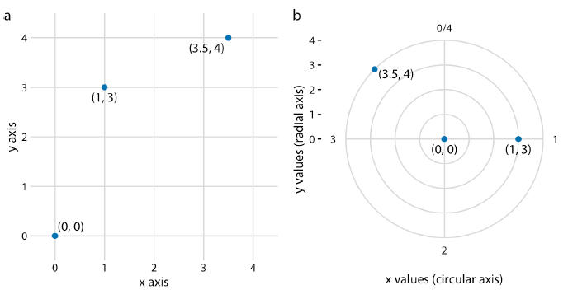
Coordinate Systems with Curved Axes
The axes themselves establish a nonlinear mapping from data values to positions.
the polar coordinate system, we specify positions via an angle and a radial distance from the origin, and therefore the angle axis is circular.
Notes:
Figure 3-9. Relationship between Cartesian and polar coordinates. (a) Three data points
shown in a Cartesian coordinate system. (b) The same three data points shown in a
polar coordinate system. We have taken the x coordinates from part (a) and used them
as angular coordinates and the y coordinates from part (a) and used them as radial
coordinates. The circular axis runs from 0 to 4 in this example, and therefore x = 0 and
x = 4 are the same locations in this coordinate system.
In polar coordinates, points are defined by a distance from the origin (radial distance) and an angle from a reference axis. This system is often used for circular or periodic data. Polar coordinates are frequently employed in applications such as:
Meteorology: Representing wind direction and speed.
Physics: Analyzing circular or rotational motion.
Engineering: Designing circular objects or systems.

Slide 20
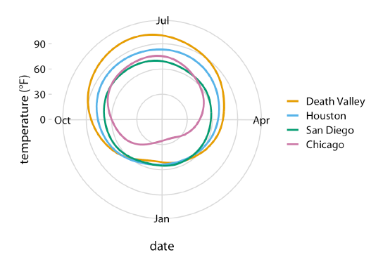
Example-5
Notes:
Figure 3-10. Daily temperature normals for four selected locations in the US, shown in
polar coordinates. The radial distance from the center point indicates the daily temperature
in Fahrenheit, and the days of the year are arranged counterclockwise starting with
Jan. 1st at the 6:00 position. Data source: NOAA.

Slide 21
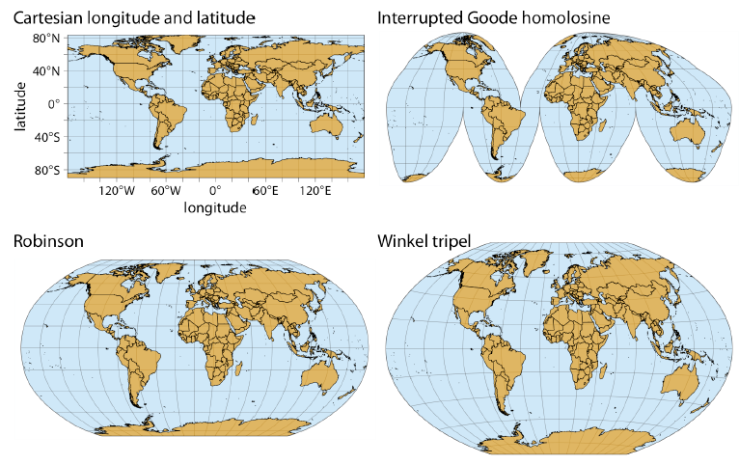
Example-6
Notes:
Figure 3-11. Map of the world, shown in four different projections. The Cartesian longitude
and latitude system maps the longitude and latitude of each location onto a regular
Cartesian coordinate system. This mapping causes substantial distortions in both areas
and angles relative to their true values on the 3D globe. The interrupted Goode homolosine
projection perfectly represents true surface areas, at the cost of dividing some land
masses into separate pieces, most notably Greenland and Antarctica. The Robinson projection
and the Winkel tripel projection both strike a balance between angular and area
distortions, and they are commonly used for maps of the entire globe.

Slide 22
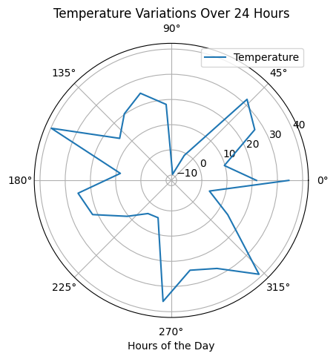
Exercise-3
You are working with a dataset that represents temperature variations throughout a day. The temperature readings range from -10°C to 40°C. Create a line plot using a polar coordinate system to visualize the temperature changes over the course of 24 hours.
# Sample data
hours = np.arange(0, 24, 1)
temperatures = np.random.uniform(-10, 40, size=24)
# Create a line plot using a polar coordinate system
# Your code here
Notes:
import matplotlib.pyplot as plt
import numpy as np
# Sample data
hours = np.arange(0, 24, 1)
temperatures = np.random.uniform(-10, 40, size=24)
# Create a line plot using a polar coordinate system
theta = np.radians(np.linspace(0, 360, 24))
r = temperatures
fig, ax = plt.subplots(subplot_kw={'projection': 'polar'})
ax.plot(theta, r, label='Temperature')
# Adding labels and title
ax.set_xlabel('Hours of the Day')
ax.set_title('Temperature Variations Over 24 Hours')
plt.legend()
plt.show()

Slide 23
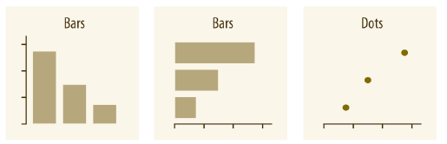
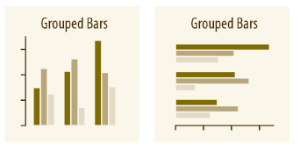
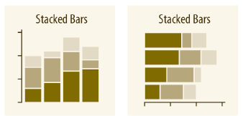
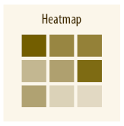
Directory of Visualizations
Amounts
Two or more sets of amount category
Notes:
The most common approach to visualizing amounts (i.e., numerical values shown for
some set of categories) is using bars, either vertically or horizontally arranged (Chapter
6). However, instead of using bars, we can also place dots at the location where the
corresponding bar would end (Chapter 6).

Slide 24
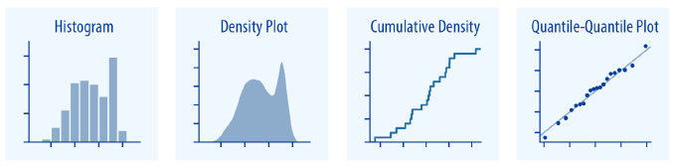
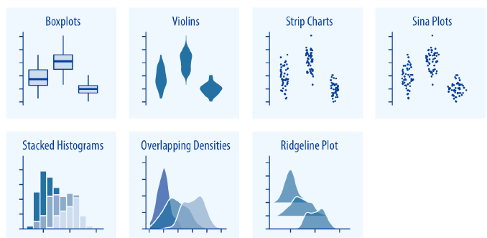
Directory of Visualizations
Distributions
Notes:
Histograms and density plots (Chapter 7) provide the most intuitive visualizations of
a distribution, but both require arbitrary parameter choices and can be misleading.
Cumulative densities and quantile-quantile (q-q) plots (Chapter 8) always represent
the data faithfully but can be more difficult to interpret.
A Quantile-Quantile (Q-Q) plot is a graphical tool used to assess whether a dataset follows a specific theoretical distribution, such as the normal distribution. It compares the quantiles of the observed data with the quantiles of the expected theoretical distribution. If the points on the Q-Q plot fall approximately along a straight line, it suggests that the data follows the assumed distribution.

Slide 25
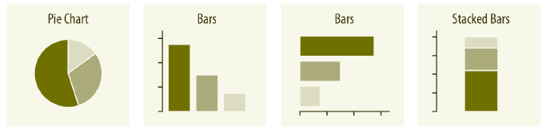
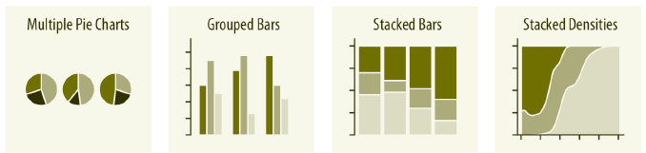
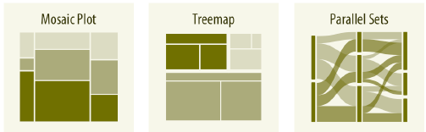
Directory of Visualizations
Proportions

Slide 26
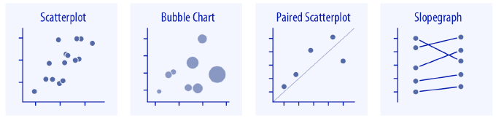
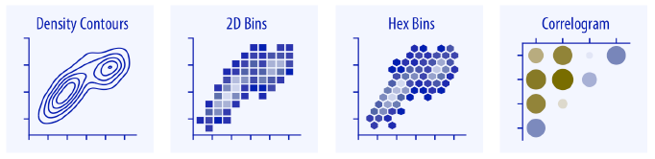
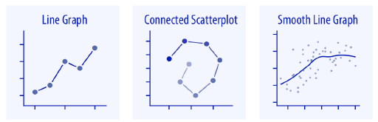
Directory of Visualizations
x-y relationships

Slide 27
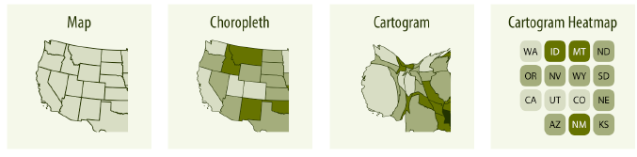
Directory of Visualizations
Geospatial Data

Slide 28
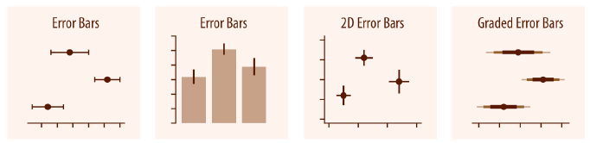
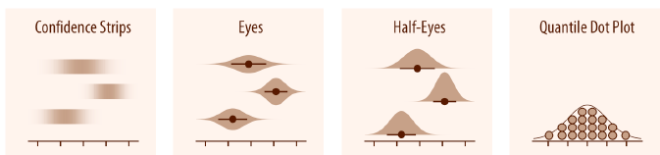
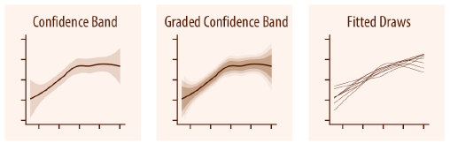
Directory of Visualizations
Uncertainty

Slide 29
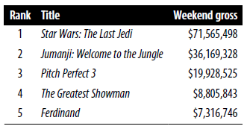
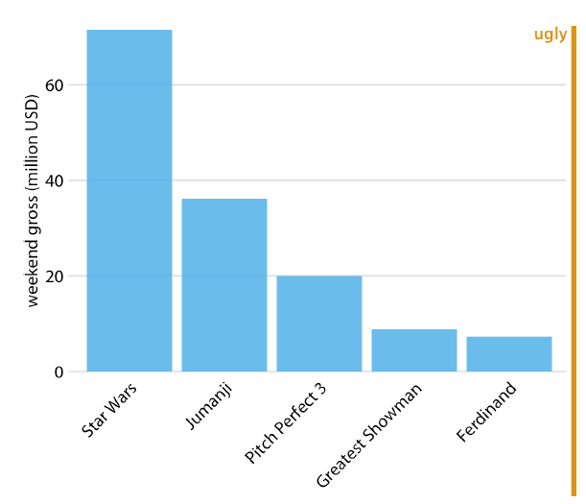
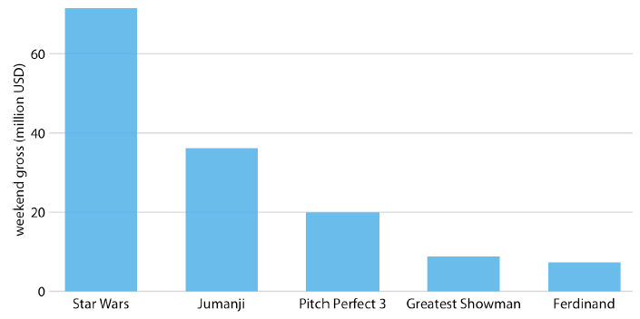
Visualizing Amounts
Bar Plots
Notes:
One problem we commonly encounter with vertical bars is that the labels identifying
each bar take up a lot of horizontal space. In fact, I had to make Figure 6-1 fairly wide
and space out the bars so that I could place the movie titles underneath. To save horizontal
space, we could place the bars closer together and rotate the labels
(Figure 6-2). However, I am not a big proponent of rotated labels. I find the resulting
plots awkward and difficult to read. And, in my experience, whenever the labels are
too long to place horizontally, they also don’t look good rotated.

Slide 30
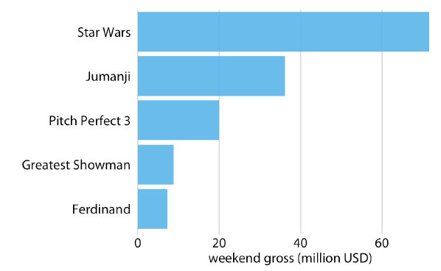
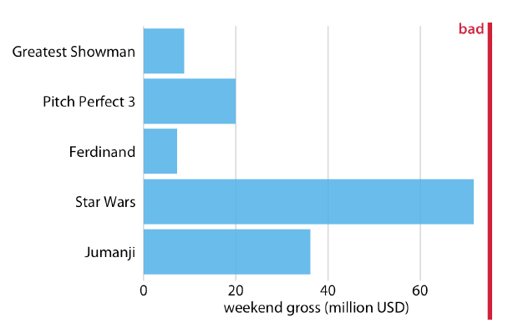
Visualizing Amounts
Notes:
Regardless of whether we place bars vertically or horizontally, we need to pay attention
to the order in which the bars are arranged. I often see bar plots where the bars
are arranged arbitrarily or by some criterion that is not meaningful in the context of
the figure. Some plotting programs arrange bars by default in alphabetical order of
the labels, and other similarly arbitrary arrangements are possible (Figure 6-4). In
general, the resulting figures are more confusing and less intuitive than figures where
bars are arranged in order of their size.
We should only rearrange bars, however, when there is no natural ordering to the categories
the bars represent. Whenever there is a natural ordering (i.e., when our categorical
variable is an ordered factor), we should retain that ordering in the
visualization

Slide 31
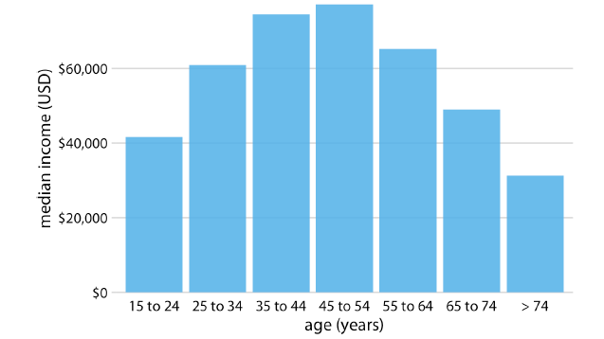
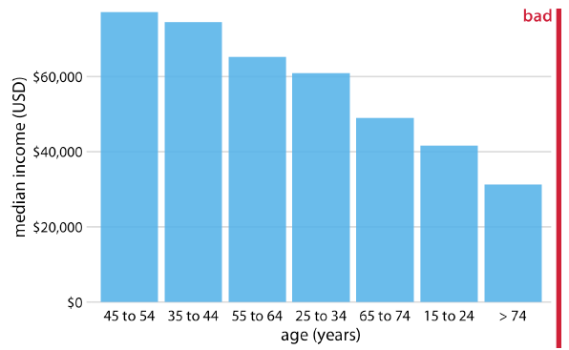
Bar Plot :Income vs Age
Notes:
Figure 6-6. 2016 median US annual household income versus age group, sorted by
income. While this order of bars looks visually appealing, the order of the age groups is
now confusing. Data source: US Census Bureau.

Slide 32
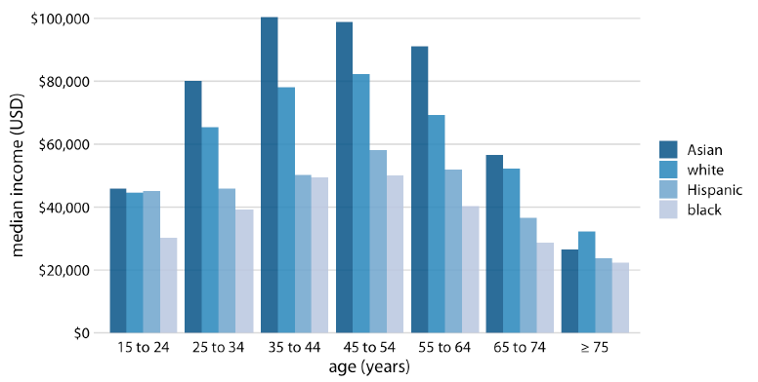
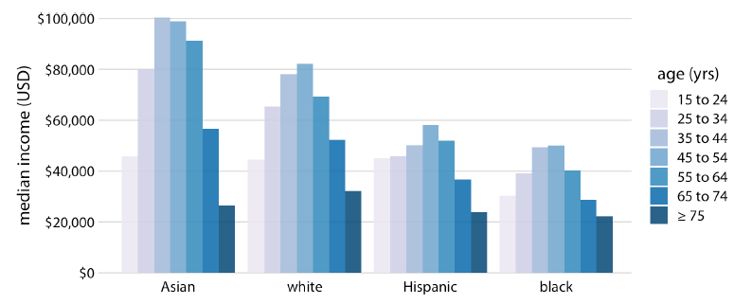
Grouped and Stacked Bars
household income versus age group and race
Notes:
Two categorical variables at the same time. For example, the US Census Bureau provides
median income levels broken down by both age and race.

Slide 33
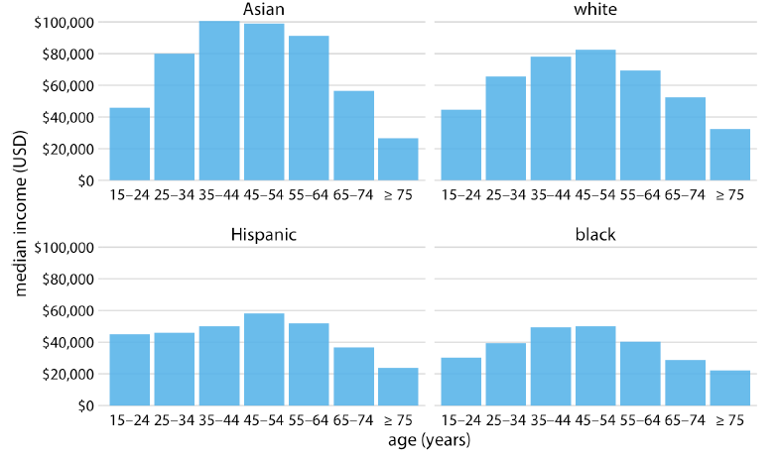
Grouped and Stacked Bars
Notes:
Both Figures 6-7 and 6-8 encode one categorical variable by position along the x axis
and the other by bar color. And in both cases, the encoding by position is easy to read
while the encoding by bar color requires more mental effort, as we have to mentally
match the colors of the bars against the colors in the legend. We can avoid this added
mental effort by showing four separate regular bar plots rather than one grouped bar
plot (Figure 6-9). Which of these various options we choose is ultimately a matter of
taste. I would likely choose Figure 6-9, because it circumvents the need for different
bar colors.

Slide 34
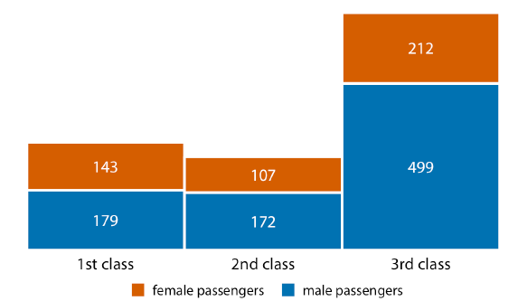
Grouped and Stacked Bars
Numbers of female and male passengers on the Titanic traveling in 1st, 2nd, and 3rd class

Slide 35
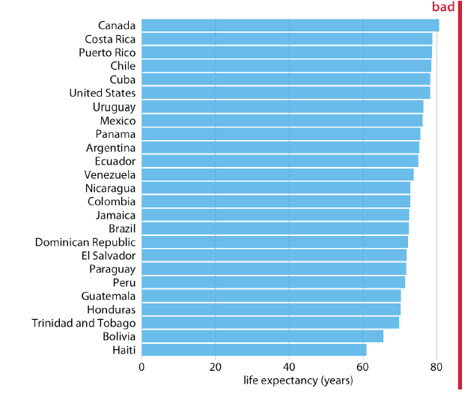

Dot Plots and Heatmaps
Life expectancies of countries in the Americas, for the year 2007
Notes:
Bars are not the only option for visualizing amounts. One important limitation of
bars is that they need to start at zero, so that the bar length is proportional to the
amount shown. For some datasets, this can be impractical or may obscure key features.
In this case, we can indicate amounts by placing dots at the appropriate locations
along the x or y axis.

Slide 36

Dot Plots and Heatmaps
Notes:
All the examples so far have represented amounts by location along a position scale,
either through the endpoint of a bar or the placement of a dot. For very large datasets,
neither of these options may be appropriate, because the resulting figure would
become too busy. We already saw in Figure 6-7 that just seven groups of four data
values can result in a figure that is complex and not that easy to read. If we had 20
groups of 20 data values, a similar figure would likely be quite confusing.

Slide 37

Heatmap
Notes:
Figure 6-14. Internet adoption over time, for select countries. Color represents the percent
of internet users for the respective country and year. Countries were ordered by percent
internet users in 2016. Data source: World Bank.

Slide 38


Visualizing a Single Distribution

Slide 39

Visualizing a Single Distribution
Titanic passengers is shown with four different bin widths: (a) 1 year; (b) 3 years; (c) 5 years; (d) 15 years.

Slide 40

Kernel Density Estimation
(a) Gaussian kernel, bandwidth = 0.5; (b) Gaussian kernel, bandwidth= 2; (c) Gaussian kernel, bandwidth = 5; (d) rectangular kernel, bandwidth = 2.
Notes:
Histograms have been a popular visualization option since at least the 18th century,
in part because they are easily generated by hand. More recently, as extensive computing
power has become available in everyday devices such as laptops and cell
phones, we see them increasingly being replaced by density plots. In a density plot, we
attempt to visualize the underlying probability distribution of the data by drawing an
appropriate continuous curve (Figure 7-3). This curve needs to be estimated from the
data, and the most commonly used method for this estimation procedure is called
kernel density estimation. In kernel density estimation, we draw a continuous curve
(the kernel) with a small width (controlled by a parameter called bandwidth) at the
location of each data point, and then we add up all these curves to obtain the final
density estimate. The most widely used kernel is a Gaussian kernel (i.e., a Gaussian
bell curve), but there are many other choices.
Just as is the case with histograms, the exact visual appearance of a density plot
depends on the kernel and bandwidth choices (Figure 7-4). The bandwidth parameter
behaves similarly to the bin width in histograms. If the bandwidth is too small,
then the density estimate can become overly peaky and visually busy and the main
trends in the data may be obscured. On the other hand, if the bandwidth is too large,
then smaller features in the distribution of the data may disappear. In addition, the
choice of the kernel affects the shape of the density curve. For example, a Gaussian
kernel will have a tendency to produce density estimates that look Gaussian-like, with
smooth features and tails. By contrast, a rectangular kernel can generate the appearance
of steps in the density curve (Figure 7-4d). In general, the more data points
there are in the dataset, the less the choice of the kernel matters. Therefore, density
plots tend to be quite reliable and informative for large datasets but can be misleading
for datasets of only a few points.
Density curves are usually scaled such that the area under the curve equals 1. This
convention can make the y axis scale confusing, because it depends on the units of the
x axis. For example, in the case of the age distribution, the data range on the x axis
goes from 0 to approximately 75. Therefore, we expect the mean height of the density
curve to be 1/75 = 0.013. Indeed, when looking at the age density curves (e.g.,
Figure 7-4), we see that the y values range from 0 to approximately 0.04, with an average
of somewhere close to 0.01.

Slide 41

Kernel Density Estimation
Notes:
Figure 7-5. Kernel density estimates can extend the tails of the distribution into areas
where no data exists and no data is even possible. Here, the density estimate for ages of
Titanic passengers has been allowed to extend into the negative age range. This is nonsensical
and should be avoided. Data source: Encyclopedia Titanica.
So should you choose a histogram or a density plot to visualize a distribution? Heated
discussions can be had on this topic. Some people are vehemently against density
plots and believe that they are arbitrary and misleading. Others realize that histograms
can be just as arbitrary and misleading. I think the choice is largely a matter of
taste, but sometimes one or the other option may more accurately reflect the specific
features of interest in the data at hand. There is also the possibility of using neither
and instead choosing empirical cumulative density functions or q-q plots (Chapter 8).
However, I believe that density estimates have an inherent advantage over histograms
as soon as we want to visualize more than one distribution at a time.

Slide 42


Visualizing Multiple Distributions at the same time
Stacked Histogram
Notes:
this type of visualization should be avoided. There are two key problems
here. First, from just looking at the figure, it is never entirely clear where exactly
the bars begin. Do they start where the color changes or are they meant to start at
zero? In other words, are there about 25 females of age 18–20, or are there almost 80?
(The former is the case.) Second, the bar heights for the female counts cannot be
directly compared to each other, because the bars all start at a different height.

Slide 43

Visualizing Multiple Distributions at the same time

Slide 44

Visualizing Multiple Distributions at the same time
Age Pyramid
Notes:
Finally, when we want to visualize exactly two distributions, we can also make two
separate histograms, rotate them by 90 degrees, and have the bars in one histogram
point in the opposite direction of the other. This trick is commonly employed when
visualizing age distributions, and the resulting plot is usually called an age pyramid

Slide 45

Visualizing Multiple Distributions at the same time
Density estimates of the butterfat percentage in the milk of four cattle breeds.
Notes:
Importantly, this trick does not work when there are more than two distributions we
want to visualize at the same time. For multiple distributions, histograms tend to
become confusing, whereas density plots work well as long as the distributions are
somewhat distinct and contiguous. For example, to visualize the distribution of butterfat
percentage in the milk of cows from four different cattle breeds, density plots
are fine (Figure 7-11).

Slide 46

Empirical Cumulative Distribution Functions and Q-Q Plots
Assume our hypothetical class has 50 students, and the students just completed an exam on which they could score between 0 and 100 points. How can we best visualize the class’s performance.
Notes:
the limitation that the resulting figure
depends to a substantial degree on parameters the user has to choose, such as the bin
width for histograms and the bandwidth for density plots. As a result, both have to be
considered as an interpretation of the data rather than a direct visualization of the
data itself.
We can plot the total number of students that have received at most a certain number
of points versus all possible point scores. This plot will be an ascending function,
starting at 0 for 0 points and ending at 50 for 100 points. A different way of thinking
about this visualization is the following: we can rank all students by the number of
points they obtained, in ascending order (so the student with the fewest points
receives the lowest rank and the student with the most points the highest), and then
plot the rank versus the actual points obtained. The result is an empirical cumulative
distribution function, or simply cumulative distribution

Slide 47

Empirical Cumulative Distribution Functions and Q-Q Plots
ECDF of student grades. The student ranks have been normalized to the total number of students, such that the y values plotted correspond to the fraction of students in the class with at most that many points.
Notes:
We can directly read off key properties of the student grade distribution from this
plot. For example, approximately a quarter of the students (25%) received less than 75
points. The median point value (corresponding to a cumulative frequency of 0.5) is
81. Approximately 20% of the students received 90 points or more.
I find ECDFs handy for assigning grade boundaries because they help me locate the
exact cutoffs that minimize student unhappiness

Slide 48


Highly skewed Distributions
Many empirical datasets display highly skewed distributions, in particular with heavy tails to the right, and these distributions can be challenging to visualize.
Distribution of the number of inhabitants in US counties. (a) Density plot. (b) Empirical cumulative distribution function
Notes:
Many empirical datasets display highly skewed distributions, in particular with heavy
tails to the right, and these distributions can be challenging to visualize. Examples of
such distributions include the number of people living in different cities or counties,
the number of contacts in a social network, the frequency with which individual
words appear in a book, the number of academic papers written by different authors,
the net worth of individuals, and the number of interaction partners of individual
proteins in protein–protein interaction networks.
The density plot (Figure 8-4a) shows a sharp peak right at 0, and virtually no details
of the distribution are visible. Similarly, the ECDF (Figure 8-4b) shows a rapid rise
near 0, and again no details of the distribution are visible. For this particular dataset,
we can log-transform the data and visualize the distribution of the log-transformed
values. This transformation works here because the distribution of population numbers
in counties is not actually a power law, but instead is a nearly perfect log-normal
distribution (see “Quantile-Quantile Plots” on page 78). Indeed, the density plot of
the log-transformed values shows a nice bell curve and the corresponding ECDF
shows a nice sigmoidal shape (Figure 8-5).

Slide 49


Highly skewed Distributions
Distribution of the logarithm of the number of inhabitants in US counties. (a) Density plot. (b) Empirical cumulative distribution function

Slide 50

Quantile-Quantile Plots
Quantile-quantile (q-q) plots are useful visualizations when we want to determine to what extent the observed data points do or do not follow a given distribution.
Notes:
Just like
ECDFs, q-q plots are also based on ranking the data and visualizing the relationship
between ranks and actual values. However, in q-q plots we don’t plot the ranks
directly; rather, we use them to predict where a given data point would fall if the data
were distributed according to a specified reference distribution. Most commonly, q-q
plots are constructed using a normal distribution as the reference. To give a concrete
example, assume the actual data values have a mean of 10 and a standard deviation of
3. Then, assuming a normal distribution, we would expect a data point ranked at the
50th percentile to lie at position 10 (the mean), a data point at the 84th percentile to
lie at position 13 (one standard deviation above the mean), and a data point at the
2.3rd percentile to lie at position 4 (two standard deviations below the mean). We can
carry out this calculation for all points in the dataset and then plot the observed values
(i.e., values in the dataset) against the theoretical values (i.e., values expected
given each data point’s rank and the assumed reference distribution).

Slide 51


Visualizing may distributions at Once
We may want to visualize how temperature varies across different months while also showing the distribution of observed temperatures within each month.
Notes:
Only the y values of the points are visualized in the boxplot in Figure 9-2. The line in
the middle of the boxplot represents the median, and the box encloses the middle
50% of the data. The vertical lines extending upwards and downwards from the box
are called whiskers. The top and bottom whiskers extend either to the maximum and
minimum values of the data or to the maximum or minimum values that fall within
1.5 times the height of the box, whichever yields the shorter whisker. The distances of
1.5 times the height of the box in either direction are called the upper and lower fences.
Individual data points that fall beyond the fences are referred to as outliers and
are usually shown as individual dots.

Slide 52


Violin Plot
Notes:
Because violin plots are derived from density estimates, they have similar shortcomings.
In particular, they can generate the appearance that there is data where none
exists, or that the dataset is very dense when actually it is quite sparse. We can try to
circumvent these issues by simply plotting all the individual data points directly, as
dots (Figure 9-6). Such a figure is called a strip chart. Strip charts are fine in principle,
as long as we make sure that we don’t plot too many points on top of each other. A
simple solution to overplotting is to spread out the points somewhat along the x axis,
by adding some random noise in the x dimension (Figure 9-7). This technique is
called jittering.

Slide 53


Strip Charts
Notes:
Mean daily temperatures in Lincoln, NE, visualized as strip charts. Each
point represents the mean temperature for one day. This figure is labeled as “bad”
because so many points are plotted on top of each other that it is not possible to ascertain
which temperatures were the most common in each month
Strip charts are fine in principle,
as long as we make sure that we don’t plot too many points on top of each other. A
simple solution to overplotting is to spread out the points somewhat along the x axis,
by adding some random noise in the x dimension (Figure 9-7). This technique is
called jittering.

Slide 54

Sina Plot
Notes:
Finally, we can combine the best of both worlds by spreading out the dots in proportion
to the point density at a given y coordinate. This method, called a sina plot [Sidiropoulos
et al. 2018],1 can be thought of as a hybrid between a violin plot and jittered
points, and it shows each individual point while also visualizing the distributions. In
Figure 9-8, I have drawn the sina plots on top of the violins to highlight the relationship
between these two approaches.
Mean daily temperatures in Lincoln, NE, visualized as sina plots (a combination
of individual points and violins). The points have been jittered along the x axis in
proportion to the point density at the respective temperature. Here, the sina plots are
shown superimposed on violin plots.

Slide 55

Visualizing Distributions along the Horizontal Axis
Ridgeline plots tend to work particularly well if you want to show trends in distributions over time.
Notes:
Because the x axis shows the response variable and the y axis shows the grouping
variable, there is no separate axis for the density estimates in a ridgeline plot. Density
estimates are shown alongside the grouping variable. This is no different from the
violin plot, where densities are also shown alongside the grouping variable, without a
separate, explicit scale. In both cases, the purpose of the plot is not to show specific
density values but instead to allow for easy comparison of density shapes and relative
heights across groups.

Slide 56


Visualizing Proportions
A pie chart breaks a circle into slices such that the area of each slice is proportional to the fraction of the total it represents.
Visualized as stacked bars. (a) Bars stacked vertically. (b) Bars stacked horizontally.

Slide 57



Visualizing Proportions
A Case of Side-by-Side Bars.

Slide 58


Visualizing Proportions
A Case of Stacked Bars and Stacked Densities
Notes:
To visualize how the proportion of women
in the Rwandan parliament has changed over time, we can draw a sequence of
stacked bar graphs (Figure 10-7). This figure provides an immediate visual representation
of the changing proportions over time. To help the reader see exactly when the
majority turned female, I have added a dashed horizontal line at 50%. Without this
line, it would be near impossible to determine whether from 2003 to 2007 the majority
was male or female. I have not added similar lines at 25% and 75%, to avoid making
the figure too cluttered.
consider the health
status of people as a function of age. Age can be considered a continuous variable,
and visualizing the data in this way works reasonably well (Figure 10-8). Even though
we have four health categories here, and I’m generally not a fan of stacking multiple
conditions, as discussed previously, I think in this case the figure is acceptable. We
can see that overall health declines as people age, and we can also see that despite this
trend, over half of the population remains in good or excellent health until very old
age.

Slide 59



Visualizing Proportions
Marital status by age, shown as proportion of the total number of people in the survey.
Notes:
However, one downside of Figure 10-11 is that this representation doesn’t make it
easy to determine relative proportions at any given point in time. For example, if we
wanted to know at what age more than 50% of all people surveyed are married, we
could not easily tell from Figure 10-11. To answer this question, we can use the same
type of display but show relative proportions instead of absolute counts along the y
axis (Figure 10-12). Now we see that married people are in the majority starting in
the late 20s, and widowed people are in the majority starting in the mid 70s.

Slide 60
Visualizing Uncertainty
One of the most challenging aspects of data visualization is the visualization of uncertainty.
Two commonly used approaches to indicate uncertainty are error bars and confidence bands.
Effective visualization of uncertainty is crucial for decision-making, risk assessment, and conveying the reliability of data and models.
By employing a variety of techniques and adhering to fundamental principles, visualizations can enhance understanding and facilitate more informed interpretations.

Slide 61

Framing Probabilities as Frequencies
Visualizing probability as frequency. There are 100 squares in each grid, and each square represents either success of failure in some random trial.
If two discrete outcomes, success or failure, then a below visualization is sufficient to represent.

Slide 62


Framing Probabilities as Frequencies
we are dealing with more complex scenarios where the outcome of a random trial is a numeric variable.
One common scenario is that of election predictions, where we are interested not only in who will win but also by how much.
The range of possible out‐ comes with their associated likelihoods is called a probability distribution, and we can draw it as a smooth curve that rises and then falls over the range of possible outcomes.
Notes:
Figure 16-3. Quantile dot plot representations of the election outcome distribution of Figure 16-2. (a) The smooth distribution is approximated with 50 dots representing a 2% chance each. The 6 yellow dots thus correspond to a 12% chance, reasonably close to the true value of 12.9%. (b) The smooth distribution is approximated with 10 dots represent‐ ing a 10% chance each. The 1 yellow dot thus corresponds to a 10% chance, still close to the true value. Quantile dot plots with a smaller number of dots tend to be easier to read, so in this example, the 10-dot version might be preferable to the 50-dot version.

