Slide 1
Unit-2
Introduction to Cassandra
Dr. Selva kumar S
Assistant Professor
Dept. of CSE, BMSCE

Slide 2
Learning Objectives and Learning Outcomes
Learning Objectives | Learning Outcomes
Introduction to Cassandra To study the features of Cassandra. To learn how to perform CRUD operations. To learn about collections in Cassandra. To import from and export to CSV format. | To comprehend the reasons behind the popularity of NoSQL database. To be able to perform CRUD operations. To distinguish between collections types such as SET, LIST and MAP. To be able to successfully import from CSV. To be able to successfully export to CSV.

Slide 3
Agenda
◆ Apache Cassandra – An Introduction
◆ Features of Cassandra
Peer-to-Peer Network
Writes in Cassandra
Hinted Handoffs
Tunable Consistency: Read Consistency and Write Consistency
◆ CQL Data Types
◆ CQLSH
◆ CRUD : Insert, Update, Delete and Select
◆ Collections : Set, List and Map
◆ Time To Live (TTL)
◆ Import and Export

Slide 4
Apache Cassandra – An Introduction

Slide 5
Apache Cassandra – An Introduction
◆ Apache Cassandra was born at Facebook. After Facebook open sourced the code in 2008, Cassandra became an Apache Incubator project in 2009 and subsequently became a top-level Apache project in 2010.
◆ It is a column-oriented database designed to support peer-to-peer symmetric
nodes instead of the master−slave architecture.
◆ It is built on Amazon’s dynamo and Google’s BigTable.

Slide 6
Features of Cassandra

Slide 7
Features of Cassandra
Open Source
Distributed
Decentralized (Server Symmetry)
No single point of failure
Column-oriented
Peer to Peer
Elastic Scalability

Slide 8
Peer to Peer Network

Slide 9
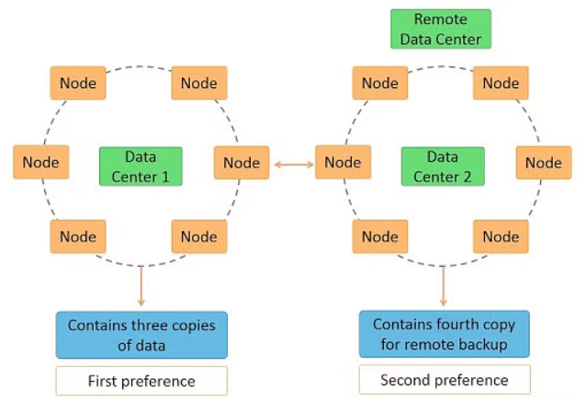
Sample Cassandra Cluster
Notes:
https://www.simplilearn.com/tutorials/big-data-tutorial/cassandra-architecture
Architecture Requirements of Cassandra
Cassandra was designed to address many architecture requirements. The most important requirement is to ensure there is no single point of failure. This means that if there are 100 nodes in a cluster and a node fails, the cluster should continue to operate.
This is in contrast to Hadoop where the namenode failure can cripple the entire system. Another requirement is to have massive scalability so that a cluster can hold hundreds or thousands of nodes. It should be possible to add a new node to the cluster without stopping the cluster.
Further, the architecture should be highly distributed so that both processing and data can be distributed. Also, high performance of read and write of data is expected so that the system can be used in real-time.
Cassandra is based on distributed system architecture. In its simplest form, Cassandra can be installed on a single machine or in a docker container, and it works well for basic testing. A single Cassandra instance is called a node. Cassandra supports horizontal scalability achieved by adding more than one node as a part of a Cassandra cluster. The scalability works with linear performance improvement if the resources are configured optimally.
https://www.instaclustr.com/blog/cassandra-architecture/

Slide 10
Writes in Cassandra

Slide 11
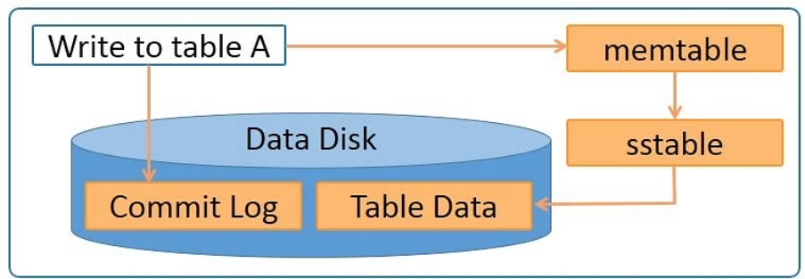
Writes in Cassandra

Slide 12
Writes in Cassandra
A client that initiates a write request.
It is first written to the commit log. A write is taken as successful only
if it is written to the commit log.
The next step is to push the write to a memory resident data structure called Memtable. A threshold value is defined in the Memtable.
When the number of objects stored in the Memtable reaches a threshold, the contents of Memtable are flushed to the disk in a file called SSTable (Stored string Table). Flushing is a non-blocking operation.
It is possible to have multiple Memtables for a single column family.
One out of them is current and the rest are waiting to be flushed.

Slide 13
Hinted Handoffs

Slide 14




Hinted Handoffs
Coordinator
Node C is down.
Write a hint in your table
A
Writes Row K
Client
System hints table
Replicates Row K
B
C
Notes:
If the responsible node is down, data will be written to another node identified as tempnode. The tempnode will hold the data temporarily till the responsible node comes alive
Hinted Handoff: If a node in Cassandra is not available for a short period, the data which is supposed to be replicated on the node is stored on a peer node. This data is called hints. Once the original node becomes available, the hints are transferred to the node, and the node is caught up with missed data. There are time and storage restrictions for hints. If a node is not available for a longer duration than configured, no hints are saved for it. Hints cannot be considered as a primary anti-entropy mechanism.

Slide 15
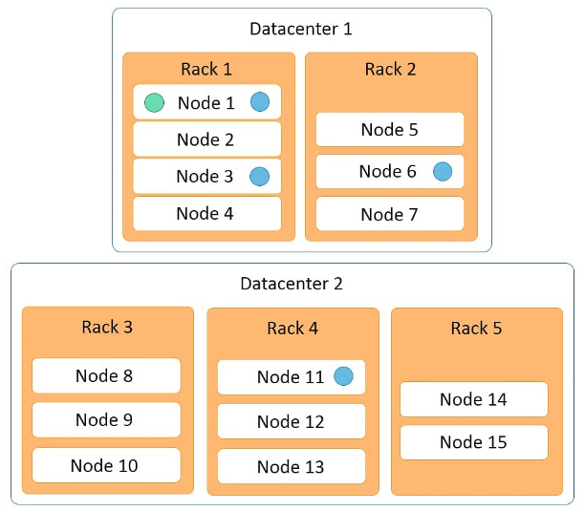
Cassandra read process
Notes:
The Cassandra read process ensures fast reads. Read happens across all nodes in parallel. If a node is down, data is read from the replica of the data. Priority for the replica is assigned on the basis of distance. Features of the Cassandra read process are:
Data on the same node is given first preference and is considered data local.
Data on the same rack is given second preference and is considered rack local.
Data on the same data center is given third preference and is considered data center local.
Data in a different data center is given the least preference.
Data in the memtable and sstable is checked first so that the data can be retrieved faster if it is already in memory.

Slide 16
Cassandra read process
Data on the same node is given first preference and is considered data local.
Data on the same rack is given second preference and is considered rack local.
Data on the same data center is given third preference and is considered data center local.
Data in a different data center is given the least preference.
Data in the memtable and sstable is checked first so that the data can be retrieved faster if it is already in memory.

Slide 17
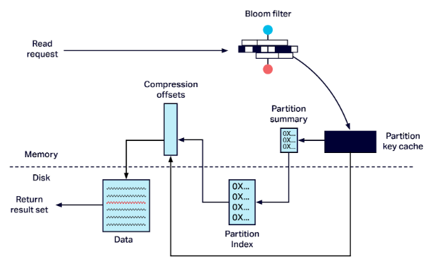
Read Operations on a Node

Slide 18
Cassandra read process
Cassandra checks the row cache for data presence. If present, the data is returned, and the request ends.
The flow of request includes checking bloom filters. If the bloom filter indicates data presented in an SSTable, Cassandra continues to look for the required partition in the SSTable.
The key cache is checked for the partition key presence. The cache hit provides an offset for the partition in SSTable. This offset is then used to retrieve the partition, and the request completes.
Cassandra continues to seek the partition in the partition summary and partition index. These structures also provide the partition offset in an SSTable which is then used to retrieve the partition and return. The caches are updated if present with the latest data read.

Slide 19
Recap..
Which Topology is commonly used in Cassandra Installation?
Why should you start with 3 nodes?
What does horizontal scaling mean?
How is data written in Cassandra DB?
How is data read?
CAP Theorem?
Notes:
It’s recommended to have at least 3 nodes or more. One reason is, in case you need strong consistency, you need to get confirmed data from at least 2 nodes. Or if 1 node goes down, your cluster would still be available because the 2 remaining nodes are up and running.
Horizontal scaling means you can increase throughput by adding more nodes. If your data is distributed to more servers, then more CPU, memory, and network capacity is available.
Cassandra processes data at several stages on the write path, starting with the immediate logging of a write and ending in with a write of data to disk:Logging data in the commit log
Writing data to the memtable
Flushing data from the memtable
Storing data on disk in SSTables
The Cassandra write process stores data in files called SSTables. SSTables are immutable. Instead of overwriting existing rows with inserts or updates, Cassandra writes new timestamped versions of the inserted or updated data in new SSTables. Cassandra does not perform deletes by removing the deleted data: instead, Cassandra marks it with tombstones.
To keep the database healthy, Cassandra periodically merges SSTables and discards old data. This process is called compaction.
Cassandra processes data at several stages on the read path to discover where the data is stored, starting with the data in the memtable and finishing with SSTables:Check the memtable
Check row cache, if enabled
Checks Bloom filter
Checks partition key cache, if enabled
Goes directly to the compression offset map if a partition key is found in the partition key cache, or checks the partition summary if notIf the partition summary is checked, then the partition index is accessed
Locates the data on disk using the compression offset map
Fetches the data from the SSTable on disk

Slide 20
Data partitions
Cassandra performs transparent distribution of data by horizontally
partitioning the data in the following manner:
A hash value is calculated based on the primary key of the data.
The hash value of the key is mapped to a node in the cluster
The first copy of the data is stored on that node.
The distribution is transparent as you can both calculate the hash value
and determine where a particular row will be stored.

Slide 21
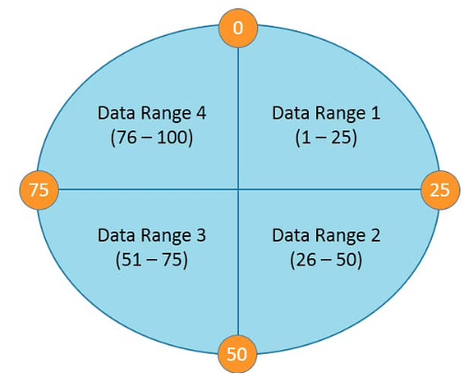
Data partitions
The following diagram depicts a four node cluster with token values of 0, 25, 50 and 75.
Notes:
For a given key, a hash value is generated in the range of 1 to 100. Keys with hash values in the range 1 to 25 are stored on the first node, 26 to 50 are stored on the second node, 51 to 75 are stored on the third node, and 76 to 100 are stored on the fourth node. Please note that actual tokens and hash values in Cassandra are 127-bit positive integers.

Slide 22
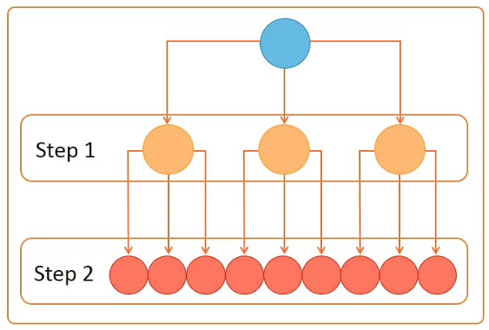
Gossip protocol
Cassandra uses a gossip protocol to communicate with nodes in a cluster.
It is an inter-node communication mechanism similar to the heartbeat protocol in Hadoop.
The gossip process runs periodically on each node and exchanges state information with three other nodes in the cluster.
Eventually, information is propagated to all cluster nodes.
Notes:
In step 1, one node connects to three other nodes. In step 2, each of the three nodes connects to three other nodes, thus connecting to nine nodes in total in step 2. So a total of 13 nodes are connected in 2 steps.

Slide 23
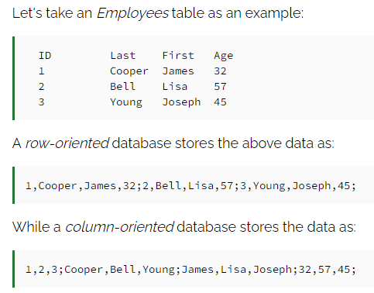
Row-oriented and column-oriented data store
Cassandra does not store its data like either a row-oriented or a column-oriented database.

Slide 24
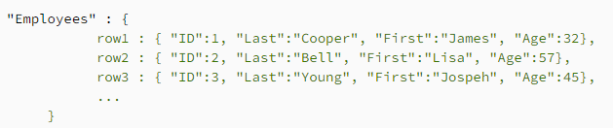
Partitioned row store
Cassandra uses a partitioned row store, which means rows contain columns. A column-family
database stores data with keys mapped to values and the values grouped into multiple column
families.
A partitioned row store has rows that contain columns, yet the number of columns in each row does not have
to be the same

Slide 25
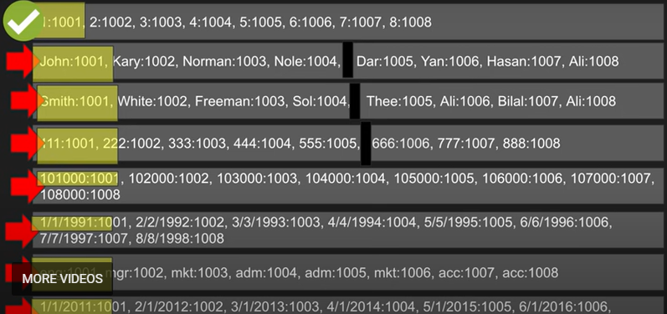
Example
Select * from emp where id=1

Slide 26
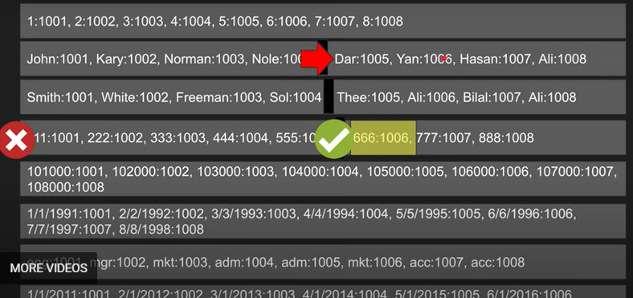
example
Select first_name from emp where ssn=666

Slide 27
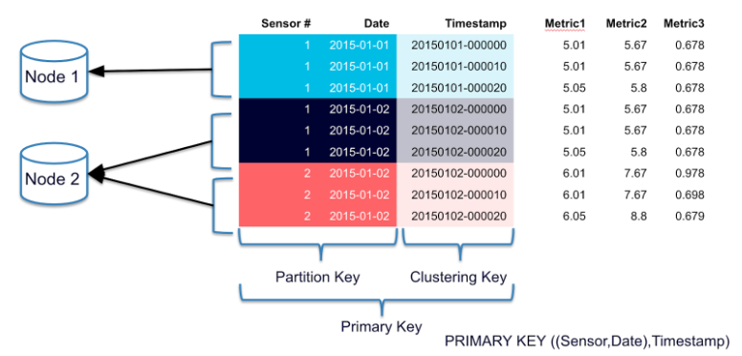
Data Partitioning
Partitioning is a method of splitting and storing a single logical dataset in multiple databases.
By distributing the data among multiple machines, a cluster of database systems can store larger datasets and handle additional requests.

Slide 28
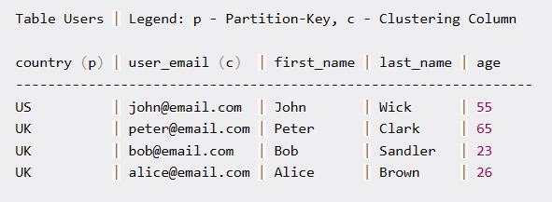
Data Partitioning
In Cassandra, the primary key consists of 2 parts:
a mandatory partition key and
an optional set of clustering columns.

Slide 29
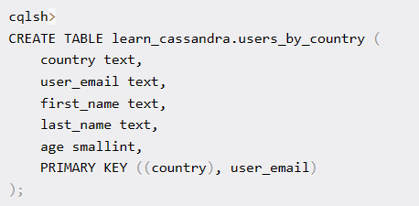
Data Partitioning
The first group of the primary key defines the partition key. All other elements of the primary key are clustering columns:

Slide 30
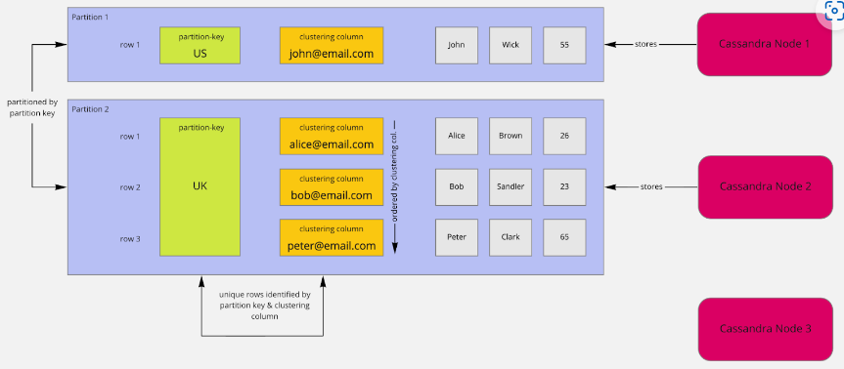
Data Partitioning
In the context of partitioning, the words partition and shard can be used interchangeably.
Notes:
Partitioning is the foundation for scalability, and it is based on the partition key. In this example, partitions are created based on country. All rows with the country US are placed in a partition. All other rows with the country UK will be stored in another partition.

Slide 31
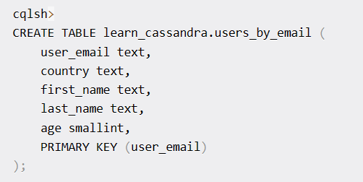
Data Partitioning

Slide 32
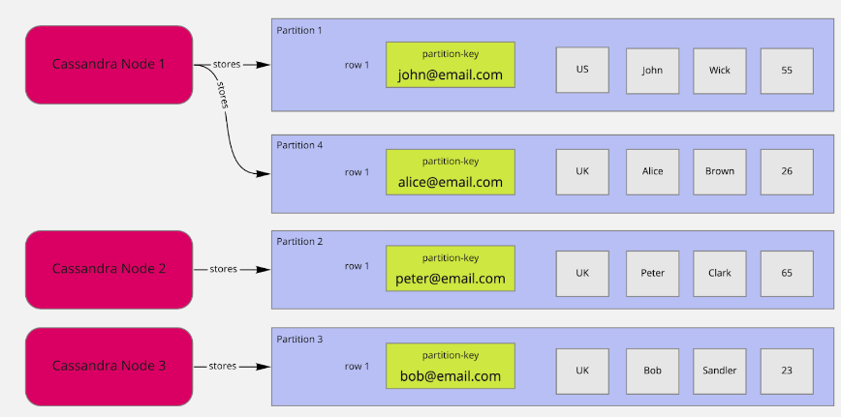
Data Partitioning
cqlsh> SELECT * FROM learn_cassandra.users_by_email WHERE user_email='alice@email.com’;
cqlsh> SELECT * FROM learn_cassandra.users_by_email WHERE age=26 ALLOW FILTERING;
Notes:
cqlsh> SELECT * FROM learn_cassandra.users_by_email WHERE user_email='alice@email.com’;
cqlsh> SELECT * FROM learn_cassandra.users_by_email WHERE age=26 ALLOW FILTERING;

Slide 33
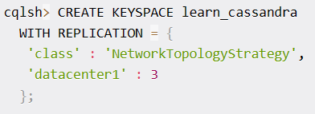
Replication
Scalability using partitioning alone is limited.
Consider a lot of write requests arriving for a single partition. All requests would be sent to a single node with technical limitations such as CPU, memory, and bandwidth. Additionally, you want to handle read and write requests if this node is not available.
By duplicating data to different nodes, so called replicas, you can serve more data simultaneously from other nodes to improve latency and throughput.
It also enables your cluster to perform reads and writes in case a replica is not available.
In Cassandra, you need to define a replication factor for every keyspace.

Slide 34
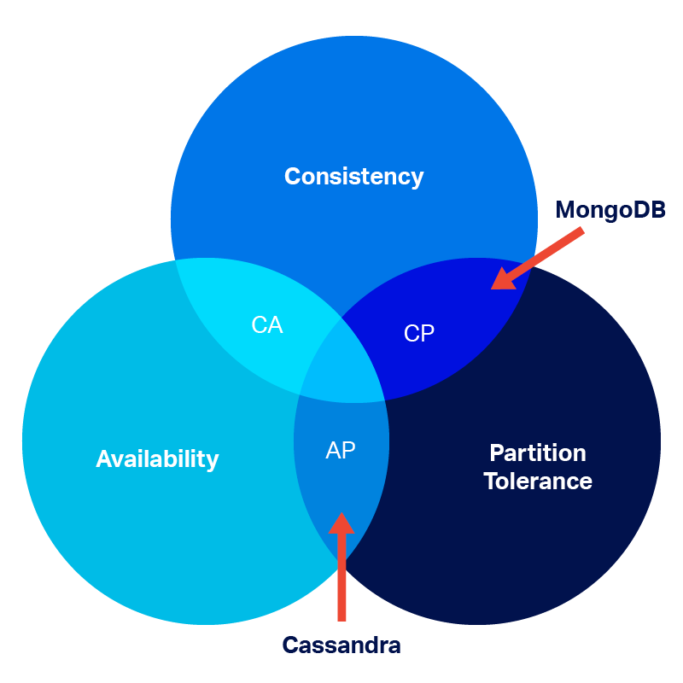
CAP Theorem
Notes:
The CAP theorem states that a distributed system can provide only two of three desired properties: consistency, availability, and partition tolerance.
Consistency (C): Every client sees the same data. Every read receives the data from the most recent write.
Availability (A): Every request gets a non-error response, but the response may not contain the most recent data.
Partition Tolerance (P): The system continues to operate despite one or more breaks in inter-node communication caused by a network or node failure.
Because a distributed system must be partition tolerant, the only choices are deciding between availability and consistency. If part of a cluster becomes unavailable, a system will either:
Safeguard data consistency by canceling the request even if it decreases the availability of the system. Such systems are called CP systems.
Provide availability even though inconsistent data may be returned. These systems are AP distributed systems.

Slide 35
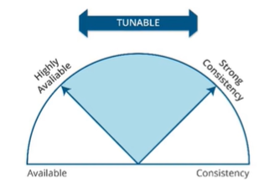
Tunable Consistency

Slide 36
Tunable Consistency
To ensure that Cassandra can provide the proper levels of consistency for its reads and writes, Cassandra extends the concept of eventual consistency by offering tunable consistency.
One can tune Cassandra's consistency level per-operation, or set it globally for a cluster or datacenter.
There is a tradeoff between operation latency and consistency:
Higher consistency incurs higher latency.
Lower consistency permits lower latency.
One can control latency by tuning consistency.
Notes:
To ensure that Cassandra can provide the proper levels of consistency for its reads and writes, Cassandra extends the concept of eventual consistency by offering tunable consistency. You can tune Cassandra's consistency level per-operation, or set it globally for a cluster or datacenter. You can vary the consistency for individual read or write operations so that the data returned is more or less consistent, as required by the client application. This allows you to make Cassandra act more like a CP (consistent and partition tolerant) or AP (highly available and partition tolerant) system according to the CAP theorem, depending on the application requirements.
There is a tradeoff between operation latency and consistency: higher consistency incurs higher latency, lower consistency permits lower latency. You can control latency by tuning consistency.
The consistency level determines the number of replicas that need to acknowledge the read or write operation success to the client application. For read operations, the read consistency level specifies how many replicas must respond to a read request before returning data to the client application. If a read operation reveals inconsistency among replicas, Cassandra initiates a read repair to update the inconsistent data.

Slide 37
What does Strong Consistency?
In contrast to eventual consistency, strong consistency means only one state of your data can be observed at any time in any location.
For example, when consistency is critical, like in a banking domain, you want to be sure that everything is correct. You would rather accept a decrease in availability and increase of latency to ensure correctness.

Slide 38
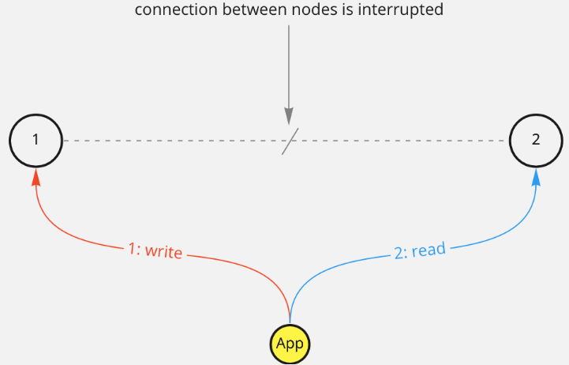
Example
You want to write a single value to a table. The data is replicated in 2 nodes, and the connection between the nodes is interrupted. First, a write-request is sent to node 1. Then, data is read from node 2.
How do you manage this situation?
Notes:
Should you disallow writes to all nodes to ensure consistency? This means availability would be sacrificed to ensure consistency and correctness.
Accept the write to node 1 and keep serving reads from both nodes. This would keep the system available but depending on what node you read from, the answer will be different, which means sacrificing consistency over availability.

Slide 39
Calculating Consistency
There is a very important formula that if true guarantees strong consistency:

Slide 40
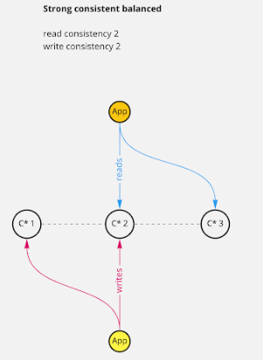
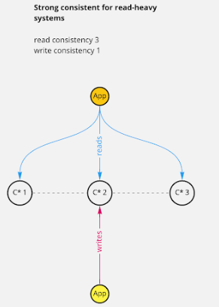
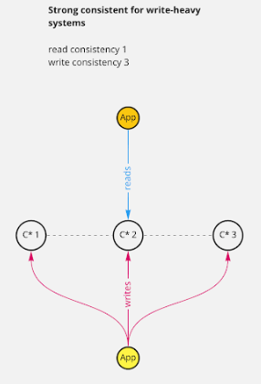
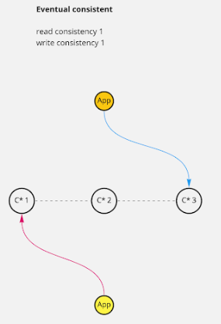
Consistency Level
You can shift read and write consistency levels to your favor if you want to keep strong consistency. Or you even give up strong consistency for better performance, which is also called eventual consistency:

Slide 41
Read Consistency
ONE | Returns a response from the closest node (replica) holding the data.
QUORUM | Returns a result from a quorum of servers with the most recent timestamp for the data.
LOCAL_QUORUM | Returns a result from a quorum of servers with the most recent timestamp for the data in the same data center as the coordinator node.
EACH_QUORUM | Returns a result from a quorum of servers with the most recent timestamp in all data centers.
ALL | This provides the highest level of consistency of all levels and the lowest level of availability of all levels. It responds to a read request from a client after all the replica nodes have responded.

Slide 42
Write Consistency
ALL | This is the highest level of consistency of all levels as it necessitates that a write must be written to the commit log and Memtable on all replica nodes in the cluster.
EACH_QUORUM | A write must be written to the commit log and Memtable on a quorum of replica nodes in all data centers.
QUORUM | A write must be written to the commit log and Memtable on a quorum of replica nodes.
LOCAL_QUORUM | A write must be written to the commit log and Memtable on a quorum of replica nodes in the same data center as the coordinator node. This is to avoid latency of inter-data center communication.
ONE | A write must be written to the commit log and Memtable of at least one replica node.
TWO | A write must be written to the commit log and Memtable of at least two replica nodes.
THREE | A write must be written to the commit log and Memtable of at least three replica nodes.
LOCAL_ONE | A write must be sent to, and successfully acknowledged by, at least one replica node in the local data center.

Slide 43
CQL Data types

Slide 44
CQL Data types
Int | 32 bit signed integer
Bigint | 64 bit signed long
Double | 64-bit IEEE-754 floating point
Float | 32-bit IEEE-754 floating point
Boolean | True or false
Blob | Arbitrary bytes, expressed in hexadecimal
Counter | Distributed counter value
Decimal | Variable – precision integer
List | A collection of one or more ordered elements
Map | A JSON style array of elements
Set | A collection of one or more elements
Timestamp | Date plus time
Varchar | UTF 8 encoded string
Varint | Arbitrary-precision integers
Text | UTF 8 encoded string

Slide 45
CQLSH

Slide 46
CRUD - Keyspace
To create a keyspace by the name “Students”
CREATE KEYSPACE Students WITH REPLICATION = {
'class':'SimpleStrategy', 'replication_factor':1
};
USE keyspace_name;
ALTER KEYSPACE excelsior WITH replication = {'class': 'SimpleStrategy', 'replication_factor' : 4};
DROP KEYSPACE excelsior;
Notes:
SimpleStrategy: Applies the same replication setting across the cluster. Use this setting only on single node test or development environments.
NetworkTopography: Applies the replication setting per datacenter. Use in production environments.
EverywhereStrategy: The default replication strategy for the dse_system and solr_admin keyspaces. Do not use or alter any instances of EverywhereStrategy.
Dropping a keyspace results in the immediate, irreversible removal of that keyspace, including all the tables, user-defined types, user-defined functions, and all the data contained in those tables.

Slide 47
CRUD – Create Table
To create a column family or table by the name “student_info”.
CREATE TABLE Student_Info ( RollNo int PRIMARY KEY, StudName text, DateofJoining timestamp, LastExamPercent double
);

Slide 48
Create Table
CREATE TABLE t (
a int,
b int,
c int,
d int,
PRIMARY KEY ((a, b), c, d)
);
INSERT INTO t (a, b, c, d) VALUES (0,0,0,0);
INSERT INTO t (a, b, c, d) VALUES (0,0,1,1);
INSERT INTO t (a, b, c, d) VALUES (0,1,2,2);
INSERT INTO t (a, b, c, d) VALUES (0,1,3,3);
INSERT INTO t (a, b, c, d) VALUES (1,1,4,4);
SELECT * FROM t;
a | b | c | d
---+---+---+---
0 | 0 | 0 | 0 1
0 | 0 | 1 | 1
0 | 1 | 2 | 2 2
0 | 1 | 3 | 3
1 | 1 | 4 | 4 3
(5 rows)
Notes:
Rows 1 and 2 are in the same partition, because both columns a and b are zero.Rows 3 and 4 are in the same partition, but a different one, because column a is zero and column b is 1 in both rows.Row 5 is in a third partition by itself, because both columns a and b are 1.
Note that a table always has a partition key, and that if the table has no clustering columns, then every partition of that table has a single row. because the partition key, compound or otherwise, identifies a single location.

Slide 49
Create table
CREATE TABLE t2 (
a int,
b int,
c int,
d int,
PRIMARY KEY (a, b, c)
);
INSERT INTO t2 (a, b, c, d) VALUES (0,0,0,0);
INSERT INTO t2 (a, b, c, d) VALUES (0,0,1,1);
INSERT INTO t2 (a, b, c, d) VALUES (0,1,2,2);
INSERT INTO t2 (a, b, c, d) VALUES (0,1,3,3);
INSERT INTO t2 (a, b, c, d) VALUES (1,1,4,4);
SELECT * FROM t2;

Slide 50
output
a | b | c | d
---+---+---+---
1 | 1 | 4 | 4
0 | 0 | 0 | 0
0 | 0 | 1 | 1
0 | 1 | 2 | 2
0 | 1 | 3 | 3
(5 rows)
SELECT * FROM t2 WHERE a = 0 AND b > 0 and b <= 3;
a | b | c | d
---+---+---+---
0 | 1 | 2 | 2
0 | 1 | 3 | 3
(2 rows)
Notes:
Row 1 is in one partition, and Rows 2-5 are in a different one. The display order is also different.
Looking more closely at the four rows in the same partition, the b clustering column defines the order in which those rows are displayed. Whereas the partition key of the table groups rows on the same node, the clustering columns control how those rows are stored on the node.
That sorting allows the very efficient retrieval of a range of rows within a partition:

Slide 51
Create Table Syntax
Syntax:
CREATE TABLE [ IF NOT EXISTS ] tablename '('
columndefinition ( ',' columndefinition )*
[ ',' PRIMARY KEY '(' primary_key ')' ]
')' [ WITH table_options ]
columndefinition::= columnname cql_type [ STATIC ] [ PRIMARY KEY]
primary_key::= partition_key [ ',' clusteringcolumns ]
partition_key::= columnname | '(' columnname ( ',' columnname )* ')'
clusteringcolumns::= columnname ( ',' columnname )*
TABLE_OPTIONS:TABLE_OPTIONS:=: compact storage [ AND table_options ]
| clustering ORDER BY '(' clustering_order ')'
[ AND table_options ] | options
clustering_order::= columnname (ASC | DESC) ( ',' columnname (ASC | DESC) )*

Slide 52
Example
CREATE TABLE monkey_species (
species text PRIMARY KEY,
common_name text,
population varint,
average_size int
) WITH comment='Important biological records';
CREATE TABLE timeline (
userid uuid,
posted_month int,
posted_time uuid,
body text,
posted_by text,
PRIMARY KEY (userid, posted_month, posted_time)
) WITH compaction = { 'class' : 'LeveledCompactionStrategy' };
CREATE TABLE loads (
machine inet,
cpu int,
mtime timeuuid,
load float,
PRIMARY KEY ((machine, cpu), mtime)
) WITH CLUSTERING ORDER BY (mtime DESC);

Slide 53
CRUD - Insert
To insert data into the column family “student_info”.
BEGIN BATCH
INSERT INTO student_info (RollNo,StudName,DateofJoining,LastExamPercent) VALUES (1,'Michael Storm','2012-03-29', 69.6)
INSERT INTO student_info (RollNo,StudName,DateofJoining,LastExamPercent) VALUES (2,'Stephen Fox','2013-02-27', 72.5)
APPLY BATCH;

Slide 54
Insert - Example
INSERT INTO NerdMovies (movie, director, main_actor, year)
VALUES ('Serenity', 'Joss Whedon', 'Nathan Fillion', 2005)
USING TTL 86400;
INSERT INTO NerdMovies JSON '{"movie": "Serenity", "director": "Joss Whedon", "year": 2005}';
Notes:
The INSERT statement writes one or more columns for a given row in a table. Since a row is identified by its PRIMARY KEY, at least one columns must be specified. The list of columns to insert must be supplied with the VALUES syntax. When using the JSON syntax, VALUES are optional. See the section on JSON support for more detail. All updates for an INSERT are applied atomically and in isolation.
Unlike in SQL, INSERT does not check the prior existence of the row by default. The row is created if none existed before, and updated otherwise. Furthermore, there is no means of knowing which action occurred.
The IF NOT EXISTS condition can restrict the insertion if the row does not exist. However, note that using IF NOT EXISTS will incur a non-negligible performance cost, because Paxos is used, so this should be used sparingly.

Slide 55
CRUD - Select
To view the data from the table “student_info”.
SELECT *
FROM student_info;

Slide 56
Select example
CREATE TABLE users (
username text PRIMARY KEY,
firstname text,
lastname text,
birth_year int,
country text
);
CREATE INDEX ON users(birth_year);
// All users are returned
SELECT * FROM users;
// All users with a particular birth year are returned
SELECT * FROM users WHERE birth_year = 1981;
SELECT * FROM users WHERE birth_year = 1981 AND country = 'FR';
SELECT * FROM users WHERE birth_year = 1981 AND country = 'FR' ALLOW FILTERING;
Notes:
In both cases, the query performance is proportional to the amount of data returned. The first query returns all rows, because all users are selected. The second query returns only the rows defined by the secondary index, a per-node implementation; the results will depend on the number of nodes in the cluster, and is indirectly proportional to the amount of data stored. The number of nodes will always be multiple number of magnitude lower than the number of user profiles stored. Both queries may return very large result sets, but the addition of a LIMIT clause can reduced the latency.

Slide 57
CRUD – Create Index
To create an index on the “studname” column of the “student_info”
column family use the following statement
CREATE INDEX ON student_info(studname);

Slide 58
CRUD – Update
To update the value held in the “StudName” column of the “student_info” column family to “David Sheen” for the record where the RollNo column has value = 2.
Note: An update updates one or more column values for a given row to the Cassandra table. It does not return anything.
UPDATE student_info SET StudName = 'David Sheen' WHERE RollNo = 2;

Slide 59
CRUD – Delete
To delete the column “LastExamPercent” from the “student_info” table for the record where the RollNo = 2.
Note: Delete statement removes one or more columns from one or more
rows of a Cassandra table or removes entire rows if no columns are specified.
DELETE LastExamPercent FROM student_info WHERE RollNo=2;

Slide 60
Collections

Slide 61
Collections
When to use collection?
Use collection when it is required to store or denormalize a small amount of data.
What is the limit on the values of items in a collection?
The values of items in a collection are limited to 64K.
Where to use collections?
Collections can be used when you need to store the following:
Phone numbers of users.
Email ids of users.

Slide 62
Collections - Set
To alter the schema for the table “student_info” to add a column “hobbies”.
ALTER TABLE student_info ADD hobbies set<text>;

Slide 63
Collections - Set
To update the table “student_info” to provide the values for “hobbies” for the student with Rollno =1.
UPDATE student_info
SET hobbies = hobbies + {'Chess, Table Tennis'} WHERE RollNo=1;

Slide 64
Collections - List
To alter the schema of the table “student_info” to add a list column “language”.
ALTER TABLE student_info ADD language list<text>;

Slide 65
Collections - List
To update values in the list column, “language” of the table “student_info”.
UPDATE student_info
SET language = language + ['Hindi, English'] WHERE RollNo=1;

Slide 66
Collections - Map
To alter the “users” table to add a map column “todo”.
ALTER TABLE users
ADD todo map<timestamp, text>;

Slide 67
Collections - Map
To update the record for user (user_id = ‘AB’) in the “users” table.
UPDATE users
SET todo =
{ ‘2014-9-24’: ‘Cassandra Session’, ‘2014-10-2 12:00’ : ‘MongoDB Session’ }
WHERE user_id = ‘AB’;

Slide 68
Time To Live

Slide 69
Time To Live
Data in a column, other than a counter column, can have an optional expiration period called TTL (time to live). The client request may specify a TTL value for the data. The TTL is specified in seconds.
CREATE TABLE userlogin(
userid int primary key, password text
);
INSERT INTO userlogin (userid, password) VALUES (1,'infy') USING TTL 30; SELECT TTL (password)
FROM userlogin
WHERE userid=1;

Slide 70
Export to CSV

Slide 71
Export data to a CSV file
Export the contents of the table/column family “elearninglists” present in the “students” database to a CSV file (d:\elearninglists.csv).
COPY elearninglists (id, course_order, course_id, courseowner, title) TO
'd:\elearninglists.csv';

Slide 72
Import from CSV

Slide 73
Import data from a CSV file
To import data from “D:\elearninglists.csv” into the table “elearninglists” present in the “students” database.
COPY elearninglists (id, course_order, course_id, courseowner, title)
FROM 'd:\elearninglists.csv';

Slide 74
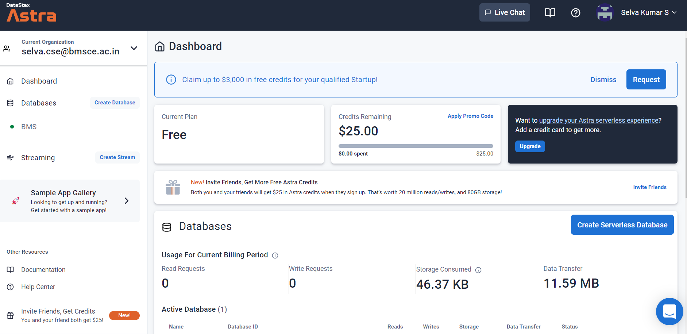

Getting Initial Hands-on Experience
Create account : Datastax.com

Slide 75
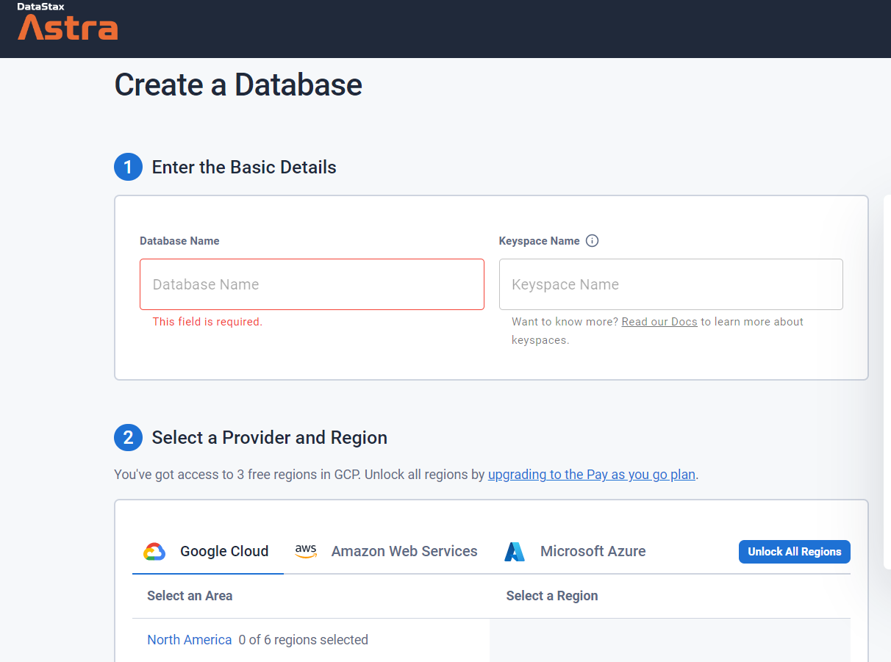
Create a database

Slide 76
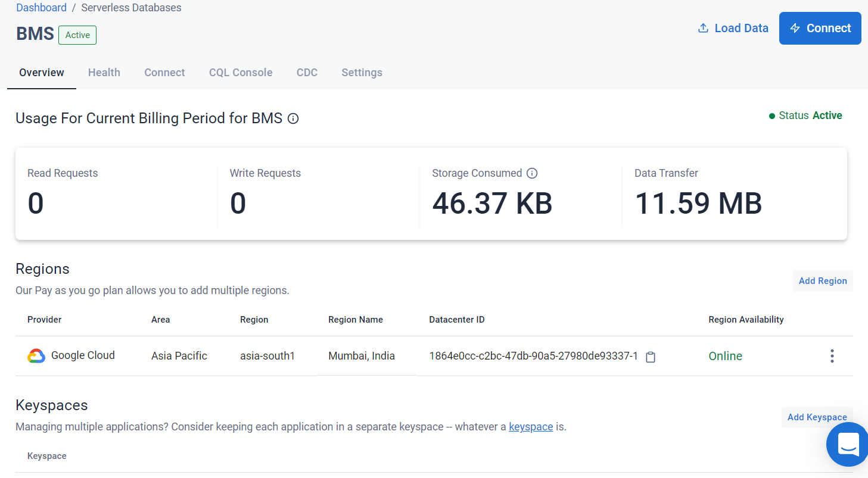
dashboard

Slide 77
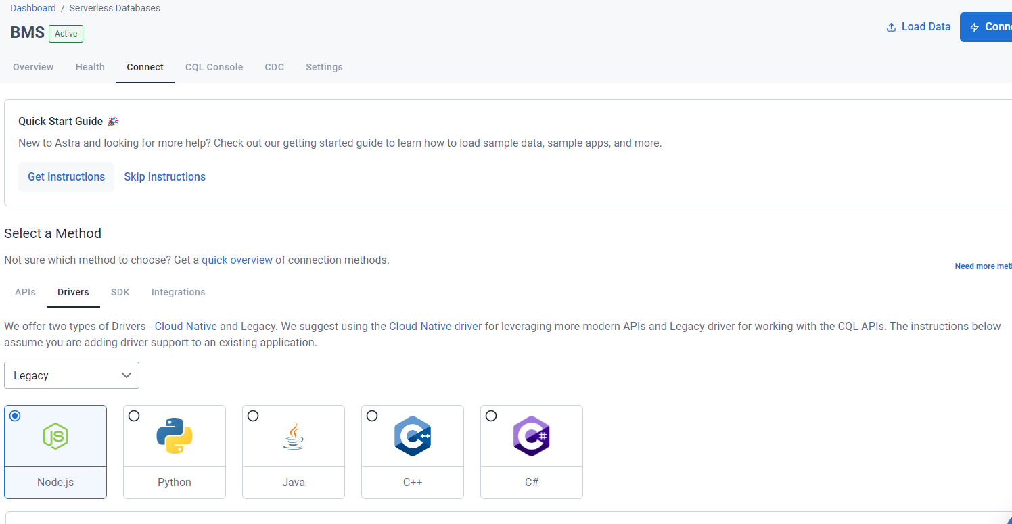
Connect tab

Slide 78
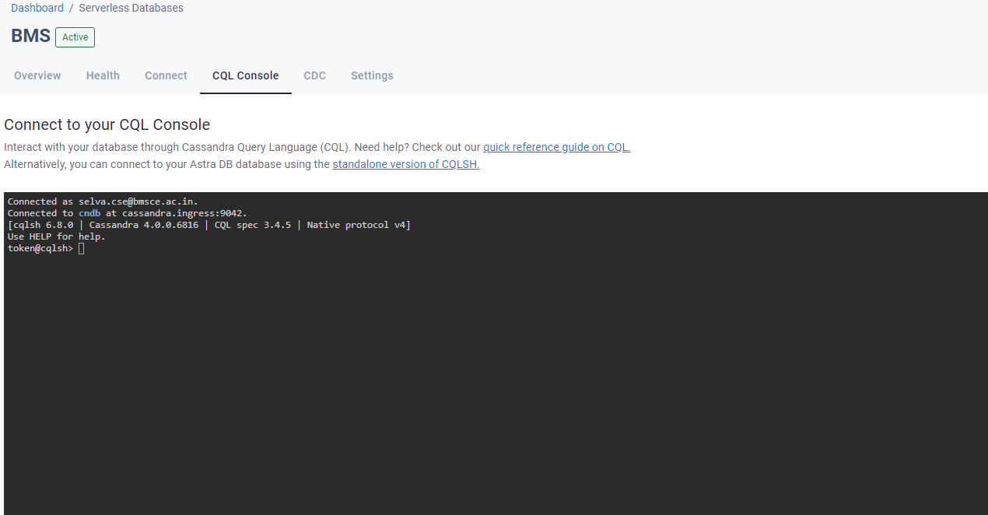
CQL console

Slide 79
Cql data definition commands
CREATE KEYSPACE − Creates a KeySpace in Cassandra.
USE − Connects to a created KeySpace.
ALTER KEYSPACE − Changes the properties of a KeySpace.
DROP KEYSPACE − Removes a KeySpace
CREATE TABLE − Creates a table in a KeySpace.
ALTER TABLE − Modifies the column properties of a table.
DROP TABLE − Removes a table.
TRUNCATE − Removes all the data from a table.
CREATE INDEX − Defines a new index on a single column of a table.
DROP INDEX − Deletes a named index.

Slide 80
CQL Data Manipulation Commands
INSERT − Adds columns for a row in a table.
UPDATE − Updates a column of a row.
DELETE − Deletes data from a table.
BATCH − Executes multiple DML statements at once.
CQL Clauses
SELECT -− This clause reads data from a table

Slide 81
demo
describe keyspaces;
or desc keyspaces;
use demo;
describe tables;
describe table emp;
describe type emp;

Slide 82
Demo contd..
create table student ( name text, usn text, mob int, id int, primary key(id));
desc student;
select * from student;
insert into student(id, usn,name,mob) values (1, '1bm20cs001','abc',2334233423);
update student set name='xyz' where id=1;
update student set name='xyz' where id=2; // no error instead create new row
Notes:
upsert // insert will update and update will insert the values
// select only works with primary key what if other columns make a another table with name as PK

Slide 83
Demo contd..
CREATE TABLE emp( emp_id int PRIMARY KEY, emp_name text, emp_city text, emp_sal varint, emp_phone varint );
Select * from emp;
INSERT INTO emp (emp_id, emp_name, emp_city,
emp_phone, emp_sal) VALUES(1,'ram', 'Hyderabad', 9848022338, 50000);
UPDATE emp SET emp_city='Delhi',emp_sal=50000 WHERE emp_id=2;
DELETE emp_sal FROM emp WHERE emp_id=3;

Slide 84
Demo contd..
uuid() function which is very important to insert value and to uniquely generates “guaranteed unique” UID value Universally.
Create table function4(Id uuid primary key, name text);
Insert into function4 (Id, name) values (1, ‘Ashish’); // fails
Insert into function4(Id, name) values (now(), ‘Ashish’); //correct

Slide 85
Demo contd..
Alter table emp add (emails set<text>, frameworks list<text>, previous_jobs map<text, int>);
INSERT INTO emp (emp_id, emp_name, emp_city, emp_phone, emp_sal, emails, frameworks,previous_jobs) VALUES(6,'ram', 'Hyderabad', 9848022338, 50000, {‘ram@gmail.com’,’ram@hotmail.com’}, [‘C#’,’java’,’node.js’],{‘Amazon’:4,’TCS’:3});

Slide 86
Interfacing and Interacting with NoSQL
In programming language to connect application with database there is a programming Pattern.
Three Easy steps are following :
Create a connection (which is called a Session)
Use the session to execute the query.
Close the connection/session.

Slide 87
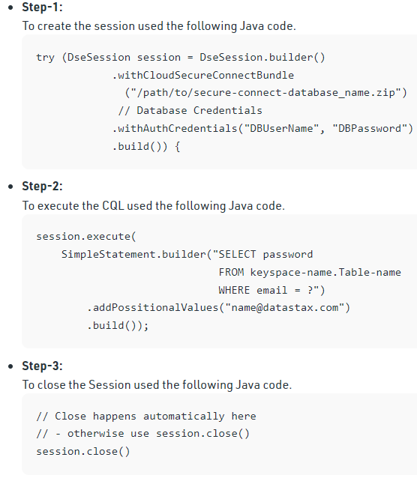
java code to connect db

Slide 88
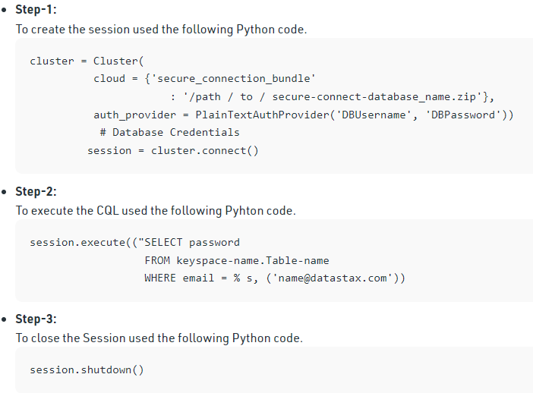
python code to connect db

Slide 89
Answer a few quick questions …

Slide 90
Answer Me
◆ What is Cassandra?
◆ Comment on Cassandra writes.
◆ What is your understanding of tunable consistency?
◆ What are collections in CQLSH? Where are they used?

Slide 91
References …

Slide 92
Further Readings
◆ http://www.datastax.com/documentation/cassandra/2.0/cassandra/gettingS tartedCassandraIntro.html
◆ http://www.datastax.com/documentation/cql/3.1/pdf/cql31.pdf
◆ http://www.datastax.com/documentation/cassandra/2.0/cassandra/dml/dm
l_config_consistency_c.html

Slide 93
Thank you

