Slide 1



Data Exploration & Visualization
Unit-3
Dr. SELVA KUMAR S
ASSISTANT PROFESSOR
DEPT. OF CSE

Slide 2
Agenda
◆ Understanding statistics
◆ Measures of central tendency
◆ Measures of dispersion
◆ Grouping Datasets
◆ Data aggregation
◆ Pivot tables and cross-tabulations
◆ Correlation

Slide 3
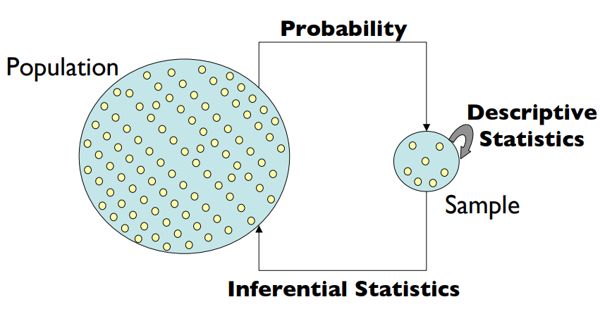
Descriptive statistics
Descriptive statistics deals with the formulation of simple summaries of data.
The summaries of data may be either numerical representations or visualizations with simple graphs.
Descriptive statistics provide valuable insights into the basic properties of a dataset, helping researchers and analysts understand the central tendencies, variability, and distribution of the data.

Slide 4
Descriptive statistics
There are two types of descriptive statistics:
  Measures of central tendency
    Mean
    Median and
    Mode
  Measures of variability (spread)
    Standard Deviation (variance),
    kurtosis,
    skewness,
    minimum and maximum values of a variables.
Notes:
Central tendency is a statistical measure that represents the center or middle of a distribution of data values. It provides a summary of the "typical" or "central" value around which the data points tend to cluster
Mean (Average): The mean is calculated by summing up all the values in a dataset and then dividing by the number of observations. It is highly sensitive to extreme values (outliers) in the dataset.
Median: The median is the middle value in a dataset when it is ordered from smallest to largest. If there is an even number of observations, the median is the average of the two middle values. The median is less sensitive to extreme values than the mean and is particularly useful when the data has outliers.
Mode: The mode is the value or values that occur most frequently in a dataset. A dataset may have no mode, one mode (unimodal), or more than one mode (multimodal).

Slide 5
Measures of central tendency
The measure of central tendency tends to describe the average or mean value of datasets.
To provide an optimal summarization of the entire set of measurements.
The value is a number that is in some way central to the set.
The most common measures for analyzing the distribution frequency of data are:
mean
median
mode.

Slide 6

Mean
The mean, or average, is a number around which the observed continuous variables are distributed.
This number estimates the value of the entire dataset
Let x be a set of integers: x = (12,2,3,5,8,9,6,4,2)
Hence, the mean value of x can be calculated as follows

Slide 7

Median
Given a dataset that is sorted either in ascending or descending order, the median divides the data into two parts.
The general formula for calculating the median is as follows:
The steps involved in calculating the median are as follows:
Sort the numbers in either ascending or descending order.
If n is odd, find the (n+1)/2th term. The value corresponding to this term is the median.
If n is even, find the (n+1)/2th term. The median value is the average of numbers on either side of the median position.
x in ascending order = (2,2,3,4,5,6,8,9,12).
Here, the median is 5

Slide 8
Mode
The mode is the integer that appears the maximum number of times in the dataset.
It happens to be the value with the highest frequency in the dataset.
In the x dataset in the median example,
x in ascending order = (2,2,3,4,5,6,8,9,12).
the mode is 2 because it occurs twice in the set

Slide 9
Three measures of Central Tendency
Mean: The mean is the average of a set of numbers. To find the mean, you sum all the values in the data set and then divide by the number of values. It's sensitive to outliers because it takes into account every value in the dataset.
Formula: Mean = (Sum of all values) / (Number of values)
2.Median: The median is the middle value in a data set when the values are arranged in ascending or descending order. If there's an even number of values, the median is the average of the two middle values. It's less affected by extreme values (outliers) compared to the mean.
3.Mode: The mode is the value that appears most frequently in a data set. A data set can have one mode (unimodal), two modes (bimodal), or more modes (multimodal). Unlike the mean and median, the mode can be used for both numerical and categorical data.

Slide 10
Example
Mean: It's commonly used in many fields like science, finance, and research to understand averages.
Median: Often used in scenarios where extreme values (outliers) might skew the data, like income distributions or house prices, as it's less affected by outliers.
Mode: Useful in categorical data or scenarios where you want to identify the most frequent category or value, such as the most common blood type in a population or the most popular choice in a survey.

Slide 11
import pandas as pd
import numpy as np
df = pd.read_csv("Automobile_data.csv")
df.head()
dataset of automobiles that enlists different features and attributes of cars, such as symboling, normalized losses, aspiration, and many others, an analysis of which will provide some valuable insight and findings in relation to automobiles in this dataset.
Notes:
To practice descriptive statistics, we would require a dataset that has multiple numerical
records in it. Here is a dataset of automobiles that enlists different features and attributes of
cars, such as symboling, normalized losses, aspiration, and many others, an analysis of
which will provide some valuable insight and findings in relation to automobiles in this
dataset.

Slide 12
Measures of Central Tendencies
To obtain the mean, median, and mode for the column that represents the height.
import pandas as pd
import numpy as np
df = pd.read_csv("Automobile_data.csv")
df.head()
height =df["height"]
mean = height.mean()
median =height.median()
mode = height.mode()
print(mean , median, mode)
The output of the preceding code is as follows:
53.766666666666715 54.1 0 50.8
dtype: float64
Now, the important thing here is to interpret the results. Just with these simple statistics, we can understand that the average height of the cars is around 53.766 and that there are a lot of cars whose mode value is 50.8.

Slide 13
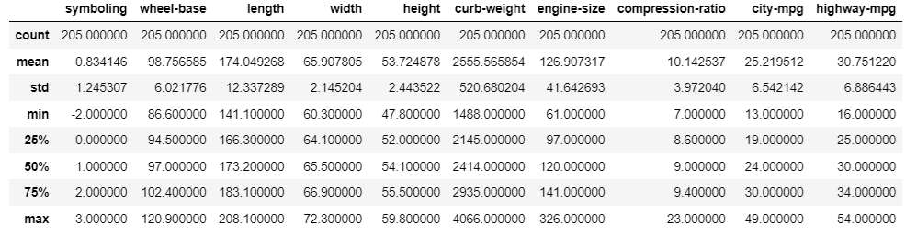
describe() function
To find descriptive statistics for the entire dataset
df.describe()

Slide 14
describe() function
Count: The number of non-null values in each column.
Mean: The average of the values in each column.
Standard Deviation: The measure of the amount of variation or dispersion in the values.
Minimum and Maximum: The smallest and largest values in each column.
25th, 50th (median), and 75th Percentiles: Values that divide the data into four equal parts.
For example:
  25th percentile (Q1) is the value below which 25% of the data fall.
  50th percentile (Q2 or median) is the value below which 50% of the data fall.
  75th percentile (Q3) is the value below which 75% of the data fall.
Interquartile Range (IQR): The difference between the 75th and 25th percentiles, which indicates the spread of the middle 50% of the data.

Slide 15
What is the total number of rows we have in our dataset?
What is the average length, width, height, price, and compression ratio of the cars?
What is the minimum height of the car? What is the maximum height of the car?
What is the maximum standard deviation of the curb weight of the cars?.

Slide 16
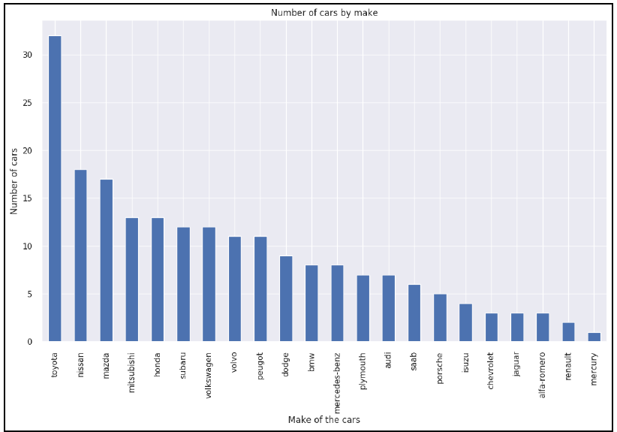
Value_counts()
df.make.value_counts().nlargest(30).plot(kind='bar', figsize=(14,8))
plt.title("Number of cars by make")
plt.ylabel('Number of cars')
plt.xlabel('Make of the cars')
Notes:
We are using the value_counts()
function from the pandas library. Once we have the list, we are getting the first 30 largest
values by using the nlargest() function.

Slide 17
Exercise-1
Scenario:
Imagine you're an HR analyst at a mid-sized company, and you've been tasked with analyzing the salaries of the employees to understand the company's payroll distribution.
You have a dataset containing the salaries of 100 employees:
$40,000,$45,000,$50,000,$55,000,$60,000,$65,000,$70,000,$75,000,$80,000,$85,000$40,000,$45,000,$50,000,$55,000,$60,000,$65,000,$70,000,$75,000,$80,000,$85,000
Task:
Calculate Measures of Central Tendency: Calculate the mean, median, and mode for the employee salaries. Determine which measure best represents the typical salary for these employees.
Interpretation and Recommendation: Based on the calculated measures of central tendency, provide an interpretation of the salary distribution. Which measure would you recommend using to describe the typical salary, and why?
Notes:
Interpretation and Recommendation:
Mean: $60,000 represents the average salary. However, if the salaries are not evenly distributed, extreme values can heavily influence the mean. In this dataset, the mean is affected by both lower and higher salaries.
Median: $62,500 is the middle value when the salaries are arranged in ascending order. It's less affected by extreme values and can provide a more accurate representation of the typical salary. In this case, the median might be a better measure of central tendency.
Given these calculations:
Recommendation: For describing the typical salary, I'd recommend using the median ($62,500) because it's less affected by outliers and provides a clearer representation of the center of the salary distribution.
Decision-making implications:
HR could consider using the median salary as a reference point for setting salary benchmarks or evaluating new compensation packages.
Further analysis could explore the reasons behind higher or lower salaries compared to the median, helping HR identify potential areas for salary adjustments or reviews.
Understanding the central tendency of salaries can aid the company in making fairer and more informed decisions regarding compensation, ensuring a balanced approach to employee remuneration.

Slide 18
Exercise-2
Scenario:
You're a real estate analyst tasked with examining the sale prices of houses in a specific neighborhood over the last year. The dataset contains the sale prices of 50 houses:
$250,000,$275,000,$300,000,$315,000,$325,000,$350,000,$375,000,$400,000,$425,000,$450,000,$250,000,$275,000,$300,000,$315,000,$325,000,$350,000,$375,000,$400,000,$425,000,$450,000, $475,000,$500,000,$525,000,$550,000,$575,000,$600,000,$625,000,$650,000,$675,000,$700,000,$475,000,$500,000,$525,000,$550,000,$575,000,$600,000,$625,000,$650,000,$675,000,$700,000, $725,000,$750,000,$775,000,$800,000,$850,000,$900,000,$950,000,$1,000,000,$1,100,000,$1,200,000,$725,000,$750,000,$775,000,$800,000,$850,000,$900,000,$950,000,$1,000,000,$1,100,000,$1,200,000, $1,300,000,$1,400,000,$1,500,000,$1,600,000,$1,700,000,$1,800,000,$1,900,000,$2,000,000,$2,250,000,$1,300,000,$1,400,000,$1,500,000,$1,600,000,$1,700,000,$1,800,000,$1,900,000,$2,000,000,$2,250,000, $2,500,000,$2,750,000,$3,000,000,$3,250,000,$3,500,000,$3,750,000,$4,000,000,$4,500,000,$5,000,000$2,500,000,$2,750,000,$3,000,000,$3,250,000,$3,500,000,$3,750,000,$4,000,000,$4,500,000,$5,000,000
Task:
Calculate Measures of Central Tendency: Compute the mean, median, and mode for the sale prices of houses in this neighborhood.
Interpretation and Recommendation: Analyze the implications of the measures of central tendency. Which measure would be the most appropriate to represent the typical house price in this neighborhood, and why?
Notes:
Interpretation and Recommendation:
Mean: At $1,525,000, the mean is heavily influenced by the few high-value houses in the dataset (e.g., $4,500,000 and $5,000,000). As a result, the mean might not represent the typical house price accurately, especially considering the presence of these high-value outliers.
Median: At $1,150,000, the median represents the middle value in the dataset when arranged in ascending order. It is less influenced by extreme values and might be a better representation of the typical house price in this neighborhood.
Given these calculations:
Recommendation: For describing the typical house price, I'd recommend using the median ($1,150,000) due to its resistance to outliers and its ability to provide a more representative value of the center of the price distribution.
Decision-making implications:
Real estate agents could consider using the median price as a reference point for listing or evaluating properties in this neighborhood.
Understanding the median price helps potential buyers or sellers get a more accurate perception of the typical property value in this area, aiding informed decisions.

Slide 19
Measures of Variability (Dispersion):
Range: The difference between the maximum and minimum values in a dataset.
Variance: The average of the squared differences from the mean. It provides a measure of the spread of the data.
Standard Deviation: The square root of the variance. It indicates the average distance of each data point from the mean.
Interquartile Range (IQR): The range between the 75th and 25th percentiles (Q3 and Q1). It describes the spread of the middle 50% of the data.
Notes:
Understanding variability:
Assessing Risk: In financial analysis, measures of dispersion like standard deviation or variance are used to understand the volatility of stocks, helping investors assess risk.
Quality Control: In manufacturing, dispersion measures help analyze variations in product quality, ensuring consistency and reliability.
Educational Assessment: In academic grading, a larger dispersion might indicate a wider range of student performances, prompting a closer look at teaching methodologies or learning gaps.

Slide 20
Standard Deviation
The standard deviation is the average/mean of the difference between each value in the dataset with its average/mean.
Using the pandas library, standard deviation in our df data frame using the df.std() function:
  std_dev =df.std()
  print(std_dev)
  # standard variance of the specific column
  sv_height=df.loc[:,"height"].std()
  print(sv_height)
Notes:
Difference:
Calculation: Variance involves squaring the differences between data points and the mean, while standard deviation takes the square root of the variance.
Units: Variance is in squared units, while standard deviation is in the original units of the data.
Interpretation: Standard deviation is often preferred for interpretation as it's in the same units as the data, making it more easily understandable compared to variance.
In summary, variance and standard deviation are closely related measures of spread, with standard deviation being the square root of variance. Standard deviation is more commonly used for interpretation due to its more relatable units and ease of understanding.

Slide 21
Example
Scenario:
You're analyzing the historical returns of two stocks, Company A and Company B, over the past year. You want to determine which stock has higher volatility based on their daily returns.
Data:
Company A Daily Returns: 1.2%,−0.5%,2.1%,−1.8%,1.5%,0.9%,−2.5%,1.8%,−0.3%,2.7%1.2%,−0.5%,2.1%,−1.8%,1.5%,0.9%,−2.5%,1.8%,−0.3%,2.7%
Company B Daily Returns: 0.8%,−1.2%,1.5%,−1.5%,1.3%,0.6%,−1.8%,1.2%,−0.6%,1.9%0.8%,−1.2%,1.5%,−1.5%,1.3%,0.6%,−1.8%,1.2%,−0.6%,1.9%

Slide 22
Example
Calculation of Standard Deviation: Compute the standard deviation for both Company A and Company B based on their daily returns. Standard deviation measures the dispersion of these daily returns around their mean.
For Company A:
  Mean Daily Return = 1.2%−0.5%+…+2.7% / 10​
  Standard Deviation for Company A
For Company B:
  Mean Daily Return = 0.8%−1.2%+…+1.9% / 10
  Standard Deviation for Company B
Interpretation: Once calculated, compare the standard deviations of Company A and Company B. A higher standard deviation implies greater volatility in daily returns, indicating higher risk.

Slide 23
Example
Outcome:
Let's say the standard deviation for Company A's daily returns is 1.6% and for Company B it's 1.1%.
Interpretation: Company A has a higher standard deviation, indicating greater volatility in its daily returns compared to Company B.
Application: Investors seeking less risk might prefer Company B due to its lower volatility (lower standard deviation) in daily returns.

Slide 24
Variance
Variance is the square of the average/mean of the difference between each value in the dataset with its average/mean.
The pandas library, the variance in our df data frame using the df.var() function:
    # variance of dataset using var() function
    variance=df.var()
    print(variance)
    # variance of the specific column
    var_height=df.loc[:,"height"].var()
    print(var_height)

Slide 25
Example
Scenario:
You're an educator analyzing the variability in exam scores for two different classes (Class A and Class B) in the recent mathematics exam. You want to understand which class has higher variability in their scores based on their performance.
Data:
Class A Scores: 80, 85, 70, 90, 95
Class B Scores: 60, 70, 75, 95, 100
Application:
Calculation of Variance: Compute the variance for both Class A and Class B. Variance measures how much the individual scores deviate from the mean score in each class.
Interpretation: Compare the variances obtained for both classes. A higher variance indicates greater variability in scores, suggesting a wider spread of individual performances.
Let's say the variance for Class A scores is 110 and for Class B scores is 190.
Application: Educators might further investigate Class B's performance to understand the wider range of scores and potentially identify areas needing additional attention or support.

Slide 26
Example Problem: Examining Test Scores
Scenario: A teacher is interested in understanding the performance of two classes (Class A and Class B) on a recent math test. The test scores for each class are as follows:
Class A: 85, 88, 92, 75, 90
Class B: 78, 80, 85, 88, 95
Descriptive Statistics:

Slide 27
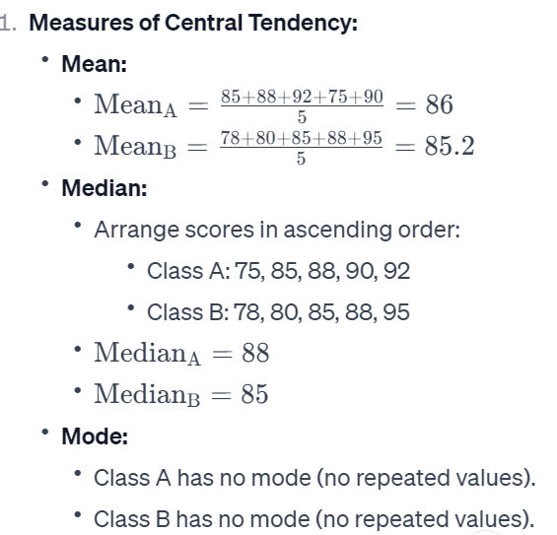
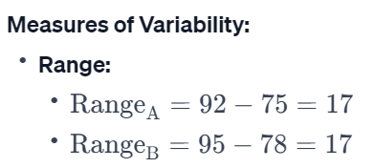

Slide 28
Inference:
Central Tendency:
  Both classes have similar mean scores, with Class A slightly higher.
  The median is higher in Class A, indicating that the middle score is higher than in Class B.
Variability:
  Both classes have the same range, suggesting a similar spread of scores.
  Further analysis of variance and standard deviation would provide a more detailed understanding of the data spread.
Distribution Shape:
  The absence of a mode suggests a relatively uniform distribution in both classes.
Inference:
  While both classes have similar mean scores, Class A appears to have a slightly higher median. This suggests that, on average, students in Class A performed slightly better, with the middle score being higher. However, the uniform distribution and similar ranges indicate comparable variability in scores.

Slide 29
Exercise-3
Scenario: Exam Performance Analysis
You're an educational analyst examining the performance of two classes (Class A and Class B) in their recent mathematics exams. You want to understand the variability of scores between the two classes to determine which class displays a more consistent performance.
Data:
Class A Scores: 85, 90, 92, 88, 86
Class B Scores: 70, 75, 80, 85, 90
Task:
Calculate Variance and Standard Deviation: Compute the variance and standard deviation for both Class A and Class B to assess the spread or variability of scores in each class.
Interpretation: Analyze and compare the variance and standard deviation values obtained for both classes. Determine which class exhibits higher variability in exam scores.
Notes:
import numpy as np
# Scores for Class A and Class B
class_a_scores = np.array([85, 90, 92, 88, 86])
class_b_scores = np.array([70, 75, 80, 85, 90])
# Calculate Variance and Standard Deviation for Class A
variance_class_a = np.var(class_a_scores)
std_dev_class_a = np.std(class_a_scores)
# Calculate Variance and Standard Deviation for Class B
variance_class_b = np.var(class_b_scores)
std_dev_class_b = np.std(class_b_scores)
print("Class A - Variance:", variance_class_a)
print("Class A - Standard Deviation:", std_dev_class_a)
print("\nClass B - Variance:", variance_class_b)
print("Class B - Standard Deviation:", std_dev_class_b)
Analysis and Interpretation:
Class A: Displays lower variance (8.8) and standard deviation (2.97), indicating less variability or spread in exam scores.
Class B: Exhibits significantly higher variance (62) and standard deviation (7.87), signifying greater variability or spread in exam scores compared to Class A.
Conclusion:
In this scenario, Class B demonstrates higher variability in exam scores, with a larger spread indicated by the higher variance and standard deviation values. Class A, on the other hand, shows more consistency in performance based on the lower variance and standard deviation values.

Slide 30
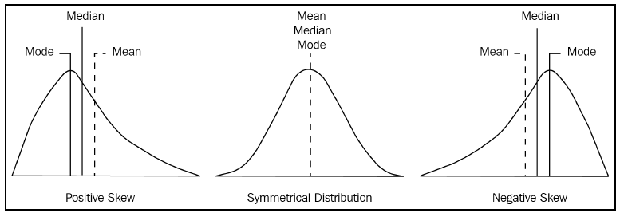
Skewness
In probability theory and statistics, skewness is a measure of the asymmetry of the variable in the dataset about its mean.
The skewness value can be positive or negative, or undefined.
The pandas library, calculate the skewness in our df data frame using the df.skew() function.
For example, the skew of the column height can be computed using the df.loc[:,"height"].skew(). function.
Notes:
The graph on the right-hand side has a tail that is longer than the tail on the
right-hand side. This indicates that the distribution of the data is skewed to the
left. If you select any point in the left-hand longer tail, the mean is less than the
mode. This condition is referred to as negative skewness.
The graph on the left-hand side has a tail that is longer on the right-hand side. If
you select any point on the right-hand tail, the mean value is greater than the
mode. This condition is referred to as positive skewness.
The graph in the middle has a right-hand tail that is the same as the left-hand tail.
This condition is referred to as a symmetrical condition.
if the skewness value is negative, it implies left-skewed, and if it's positive, it implies right-skewed.
Interpreting the skewness value:
If the skewness is around 0, it indicates a nearly symmetric distribution.
If the skewness is less than -1 or greater than 1, it suggests a highly skewed distribution.
A value between -1 and -0.5 (or between 0.5 and 1) indicates moderate skewness.
A value between -0.5 and 0.5 shows relatively low skewness.

Slide 31
Example
Scenario:
You're an economist studying the income distribution in a specific region. You want to understand the skewness of income levels to gain insights into the distribution's shape and symmetry.
Data:
Consider the following annual income data (in thousands of dollars) for households in the region:
40,45,50,55,60,65,70,75,80,85,150
Let's say after calculations, the skewness value for the income distribution data is 2.45.
Interpretation: A positive skewness of 2.45 suggests that the income distribution is right-skewed.
Application: Economists might investigate this further to understand why there's a longer tail towards higher incomes, such as the presence of high-income outliers or potential socioeconomic factors impacting income disparity.
Notes:
After running this code, it will print out the skewness value for the income distribution. Positive values indicate right-skewed distributions, negative values indicate left-skewed distributions, and values closer to zero suggest closer to symmetrical distributions.
You can execute

Slide 32
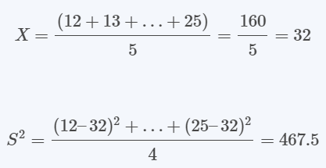

Example: Calculation
Suppose we have the following observations:
{12 13 54 56 25} Determine the skewness of the data.
Solution:
First, we must determine the sample mean and the sample standard deviation:

Slide 33

Example: Calculation
Now we can work out the skewness:
Skewness is positive. Hence, the data has a positively skewed distribution.

Slide 34
Kurtosis
Kurtosis is a statistical measure that describes the shape of a distribution.
Specifically focusing on the tails or extremities of the distribution relative to the center.
It measures whether the data has heavy tails or sharp peaks compared to a normal distribution.
Types of kurtosis:
  Mesokurtic
  Leptokurtic
  Platykurtic
Panda’s Library function : kurtosis =df.kurt()
sk_height=df.loc[:,"height"].kurt()
print(sk_height)
Notes:
Kuh+toh+sis
Skewness:
Definition: Skewness measures the asymmetry of the distribution, indicating whether the data is skewed to the left or right relative to the mean.
Interpretation:
Positive Skewness: Indicates a longer or heavier tail on the right side of the distribution (right-skewed). The mean is typically greater than the median.
Zero Skewness: Indicates a symmetrical distribution where the mean and median are approximately equal.
Negative Skewness: Indicates a longer or heavier tail on the left side of the distribution (left-skewed). The mean is typically less than the median.
Calculation: Skewness is calculated based on the third central moment and standard deviation of the data distribution.
Kurtosis:
Definition: Kurtosis measures the "tailedness" of the distribution, describing the presence of extreme values or outliers compared to a normal distribution.
Interpretation:
Positive Kurtosis (Leptokurtic): Indicates heavier tails and a sharper peak compared to a normal distribution, suggesting more extreme values.
Zero Kurtosis (Mesokurtic): Indicates a distribution with characteristics similar to a normal distribution.
Negative Kurtosis (Platykurtic): Indicates lighter tails and a flatter peak compared to a normal distribution, suggesting fewer extreme values.
Calculation: Kurtosis is calculated based on the fourth central moment and the square of the standard deviation of the data distribution.
Difference:
Focus: Skewness measures the symmetry or lack of symmetry in the distribution (left or right skew), while kurtosis measures the tails' shape and the presence of extreme values.
Aspects of Distribution: Skewness focuses on the direction and extent of asymmetry, whereas kurtosis focuses on the shape of tails and the distribution's peakedness or flatness.
Normal Distribution: Skewness can identify left or right skew in a distribution, while kurtosis compares the tails and peak to a normal distribution.
In summary, skewness and kurtosis provide complementary information about different aspects of a distribution's shape and can be used together to gain a more comprehensive understanding of the data's characteristics. Skewness focuses on asymmetry, while kurtosis focuses on the presence and extent of extreme values in the distribution.
Kurtosis = 3: The distribution has tails that are similar to the normal distribution.
The tails aren't excessively heavy or light compared to a normal distribution.
This distribution does not have exceptionally high or low outliers.
Kurtosis > 3: The distribution has fatter tails and a sharper peak compared to the normal distribution.
It signifies that there are more outliers (both high and low values) than would be expected in a normal distribution.
There's a higher probability of extreme values occurring in a leptokurtic distribution.
Kurtosis < 3: The distribution has thinner tails and a flatter peak compared to the normal distribution.
It implies that there are fewer outliers and extreme values compared to a normal distribution.
The data in a platykurtic distribution tends to be more concentrated around the mean, resulting in fewer extreme values.
A kurtosis of exactly 3 indicates a normal distribution.
Values higher than 3 indicate heavier tails (leptokurtic).
Values lower than 3 indicate lighter tails (platykurtic).

Slide 35
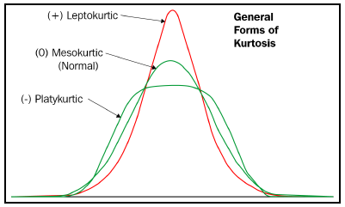
Types of Kurtosis
Leptokurtic Distribution:
  A leptokurtic distribution has a higher peak and heavier tails compared to a normal distribution.
  Kurtosis Value: Kurtosis > 3 (Positive Kurtosis)
Mesokurtic Distribution:
  A mesokurtic distribution has a similar shape to a normal distribution.
  Kurtosis Value: Kurtosis = 3 (Normal Distribution)
Platykurtic Distribution:
  A platykurtic distribution has a flatter peak and lighter tails compared to a normal distribution.
  Kurtosis Value: Kurtosis < 3 (Negative Kurtosis)

Slide 36
Example: Exam Scores Distribution
Scenario:
You're an educator analyzing the distribution of exam scores for two different classes (Class A and Class B) to understand their shapes and characteristics.
Data:
Class A Scores: 78, 82, 85, 88, 90, 92, 94, 96, 98, 100
Class B Scores: 70, 75, 80, 85, 90, 95, 100, 100, 100, 100
Application:
Calculation of Kurtosis: Compute the kurtosis for both Class A and Class B to understand the shape of their score distributions.
Interpretation: Analyze the obtained kurtosis values. Positive kurtosis suggests heavier tails or a sharper peak compared to a normal distribution, while negative kurtosis suggests lighter tails or a flatter peak.

Slide 37
Example
Let's assume the calculated kurtosis values are:
Class A Kurtosis: 1.8
Class B Kurtosis: 2.9
Interpretation:
  Class A (Kurtosis = 1.8): Indicates a distribution with somewhat heavier tails and a sharper peak compared to a normal distribution, suggesting some presence of extreme values.
  Class B (Kurtosis = 2.9): Indicates a distribution with even heavier tails and a much sharper peak than Class A, potentially suggesting a higher concentration of extreme values (e.g., higher number of perfect scores).

Slide 38




Example: Calculation
Using the data (12 13 54 56 25), determine the type of kurtosis present.
Solution
Next, we subtract 3 from the sample kurtosis and get the excess kurtosis.
Thus, excess kurtosis=0.7861–3=−2.2139
Since the excess kurtosis is negative, we have a platykurtic distribution.

Slide 39
Example
import pandas as pd
# Sample grades data
grades = [75, 80, 82, 85, 88, 90, 92, 94, 96, 98, 100, 100, 100, 100]
# Create a Pandas Series from the grades data
grades_series = pd.Series(grades)
# Calculate kurtosis using Pandas' kurtosis() function
kurtosis_value = grades_series.kurtosis()
print("Kurtosis of the grades distribution:", kurtosis_value)
Notes:
Running this code will compute the kurtosis value for the provided grades data. A higher kurtosis value indicates heavier tails or a sharper peak compared to a normal distribution. In the context of student grades, it would suggest a concentration of scores towards the extreme ends (e.g., more high scores or more low scores) or an overall deviation from a normal distribution of grades.

Slide 40
Exercise-4
Context:
You're a business analyst evaluating the monthly sales performance of two product lines (Product A and Product B) in a retail store. You want to understand the skewness and kurtosis of their monthly sales data to assess the distribution's shape and any deviations from a normal distribution.
Data:
Monthly Sales Data for Product A:
  $2000,$2500,$2200,$2400,$3000$2000,$2500,$2200,$2400,$3000
Monthly Sales Data for Product B:
  $1500,$1800,$1600,$1700,$1400$1500,$1800,$1600,$1700,$1400
Task:
Calculate Skewness and Kurtosis: Compute the skewness and kurtosis for the sales data of both Product A and Product B to analyze the shape and tail behavior of their distributions.
Interpretation: Interpret the skewness and kurtosis values obtained for both products to determine if there's any deviation from a normal distribution and any differences between the products' sales distributions.
Notes:
import pandas as pd
import numpy as np
# Monthly sales data for Product A and Product B
sales_product_a = np.array([2000, 2500, 2200, 2400, 3000])
sales_product_b = np.array([1500, 1800, 1600, 1700, 1400])
# Calculate skewness and kurtosis for Product A
skewness_a = pd.Series(sales_product_a).skew()
kurtosis_a = pd.Series(sales_product_a).kurtosis()
# Calculate skewness and kurtosis for Product B
skewness_b = pd.Series(sales_product_b).skew()
kurtosis_b = pd.Series(sales_product_b).kurtosis()
print("Product A - Skewness:", skewness_a)
print("Product A - Kurtosis:", kurtosis_a)
print("\nProduct B - Skewness:", skewness_b)
print("Product B - Kurtosis:", kurtosis_b)
Analysis and Interpretation:
Product A:
Skewness is slightly negative (−0.084−0.084), indicating a minor left skew.
Negative kurtosis (−1.6−1.6) suggests a distribution with lighter tails and a flatter peak compared to a normal distribution.
Product B:
Positive skewness (0.8450.845) indicates a right skew, suggesting a longer tail on the right side.
Negative kurtosis (−0.4−0.4) signifies a distribution with lighter tails compared to a normal distribution.
Conclusion:
In this scenario, Product A demonstrates a distribution slightly skewed to the left with flatter tails and a flatter peak compared to a normal distribution. Product B, however, shows a right skew with slightly lighter tails than a normal distribution. These insights help in understanding the differences in sales distributions between the two products and can guide further analysis or business strategies.

Slide 41
Calculating Percentile
Percentiles measure the percentage of values in any dataset that lie below a certain value.
Suppose we have the given data: 1, 2, 2, 3, 4, 5, 6, 7, 7, 8, 9, 10. Then the percentile value of 4
= (4/12) * 100 = 33.33%.
This simply means that 33.33% of the data is less than 4.
height = df["height"]
percentile = np.percentile(height, 50,)
print(percentile)
Notes:
Percentile calculation is a versatile tool used across various domains to understand data distribution, identify outliers, establish benchmarks, and make informed decisions in fields ranging from statistics and finance to healthcare and education.

Slide 42

Example
import numpy as np
# Example dataset
data = np.array([10, 20, 30, 40, 50, 60, 70, 80, 90, 100])
# Calculating the 25th percentile (Q1)
q1 = np.percentile(data, 25)
# Calculating the 50th percentile (median or Q2)
q2 = np.percentile(data, 50)
# Calculating the 75th percentile (Q3)
q3 = np.percentile(data, 75)
print("Q1 (25th percentile):", q1)
print("Q2 (50th percentile - Median):", q2)
print("Q3 (75th percentile):", q3)

Slide 43
Quartiles
Given a dataset sorted in ascending order, quartiles are the values that split the given dataset into quarters.
Quartiles refer to the three data points that divide the given dataset into four equal parts.
In terms of percentiles:
the 25th percentile is referred to as the first quartile (Q1)
the 50th percentile is referred to as the second quartile (Q2),
and the 75th percentile is referred to as the third quartile (Q3).
Inter-quartile range also measures the variability in the data set
IQR = Q3 - Q1
price = df.price.sort_values()
Q1 = np.percentile(price, 25)
Q2 = np.percentile(price, 50)
Q3 = np.percentile(price, 75)
IQR = Q3 - Q1
IQR
Notes:
Skewness:
Use in identifying outliers: Skewness measures the asymmetry of the distribution. If the distribution is highly skewed, extreme values might exist in the tail(s) of the distribution, suggesting potential outliers.
Applicability: Skewness is effective for continuous data and provides insights into the shape of the distribution.
Caution: Skewness might not always indicate outliers. It primarily reflects the symmetry or asymmetry of the distribution, so other factors should also be considered when determining outliers.
Quartiles (IQR - Interquartile Range Method):
Use in identifying outliers: The Interquartile Range (IQR) method uses quartiles to detect outliers. It defines outliers as values that fall below �1−1.5×���Q1−1.5×IQR or above �3+1.5×���Q3+1.5×IQR (where �1Q1 and �3Q3 are the 25th and 75th percentiles, respectively, and ���=�3−�1IQR=Q3−Q1).
Applicability: IQR is robust against extreme values and works well for skewed distributions. It's useful for non-normally distributed data and less sensitive to extreme values than mean-based methods.
Caution: The IQR method might miss outliers within the range of �1−1.5×���Q1−1.5×IQR to �3+1.5×���Q3+1.5×IQR. It's also less sensitive to the shape of the distribution compared to skewness.

Slide 44
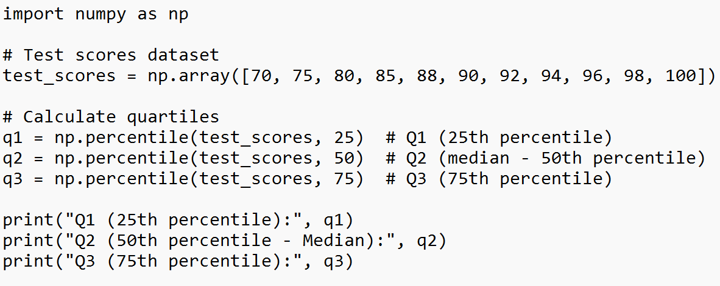
Example
Test Scores of Students (out of 100):70,75,80,85,88,90,92,94,96,98,100
Analysis and Interpretation:
Q1 (25th percentile): 80 indicates that 25% of students scored below 80.
Q2 (50th percentile - Median): 90 suggests that 50% of students scored below 90 while 50% scored above it.
Q3 (75th percentile): 96 shows that 75% of students scored below 96.
Notes:
In this scenario, the quartiles (Q1, Q2, Q3) offer insights into the distribution of test scores. For instance, Q2 (median) at 9090 signifies the central position of the dataset, while Q1 and Q3 delineate the spread and central tendencies below and above the median, respectively. These quartiles aid in understanding student performance distribution and identifying critical points within the dataset.
To calculate Q3:Arrange the dataset in ascending order.
Find the position of Q3, which is 75×(n+1)/100​, where n is the number of data points.
If the position is a whole number, take the data value at that position. If not, take the average of the values at the positions on either side.
n * (1 / 4) = 14 * (1 / 4) = 3.5
3.5 is not an integer, so Q1 is the number at position 4.
1, 1, 2, 2, 2, 3, 3, 3, 3, 4, 5, 5, 6, 6
Q1 = 2 years
n * (2 / 4) = 14 * (2 / 4) = 7
7 is an integer, so Q2 is the mean of the numbers at positions 7 and 8.
1, 1, 2, 2, 2, 3, 3, 3, 3, 4, 5, 5, 6, 6
Q2 = (3 + 3) / 2
Q2 = 3 years

Slide 45
Exercise-5
You're an HR analyst assessing the performance ratings of employees across different departments in a company. Your task is to calculate quartiles for performance ratings to understand the distribution and identify how departments compare in terms of employee performance.
Data:
Performance Ratings for Various Departments:
  Marketing Department: 65,70,72,75,78,80,82,85,88,90
  Finance Department: 60,65,68,70,72,75,78,80,85,90
  Operations Department: 50,55,60,65,68,70,75,78,80,85
Task:
Calculate Quartiles: Compute quartiles (Q1, Q2 - median, Q3) for the performance ratings in each department.
Comparison and Interpretation: Analyze and interpret the quartiles obtained for each department to compare their performance distributions.
Notes:
import numpy as np
# Performance ratings for each department
marketing_ratings = np.array([65, 70, 72, 75, 78, 80, 82, 85, 88, 90])
finance_ratings = np.array([60, 65, 68, 70, 72, 75, 78, 80, 85, 90])
operations_ratings = np.array([50, 55, 60, 65, 68, 70, 75, 78, 80, 85])
# Calculate quartiles for each department
q1_marketing = np.percentile(marketing_ratings, 25)
q2_marketing = np.percentile(marketing_ratings, 50)
q3_marketing = np.percentile(marketing_ratings, 75)
q1_finance = np.percentile(finance_ratings, 25)
q2_finance = np.percentile(finance_ratings, 50)
q3_finance = np.percentile(finance_ratings, 75)
q1_operations = np.percentile(operations_ratings, 25)
q2_operations = np.percentile(operations_ratings, 50)
q3_operations = np.percentile(operations_ratings, 75)
# Display quartiles for each department
print("Marketing Department Quartiles:")
print("Q1 (25th percentile):", q1_marketing)
print("Q2 (50th percentile - Median):", q2_marketing)
print("Q3 (75th percentile):", q3_marketing)
print("\nFinance Department Quartiles:")
print("Q1 (25th percentile):", q1_finance)
print("Q2 (50th percentile - Median):", q2_finance)
print("Q3 (75th percentile):", q3_finance)
print("\nOperations Department Quartiles:")
print("Q1 (25th percentile):", q1_operations)
print("Q2 (50th percentile - Median):", q2_operations)
print("Q3 (75th percentile):", q3_operations)

Slide 46
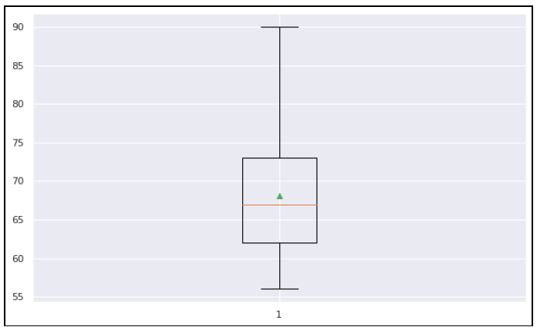
Visualizing Quartiles
scorePhysics = [34,35,35,35,35,35,36,36,37,37,37,37,37,38,38,38,39,39,40,40,40,40,40,41,42]
scoreLiterature = [49,49,50,51,51,52,52,52,52,53,54,54,55,55,55,55,56,56,56,56,56,57,57,57]
scoreComputer = [56,57,58,58,58,60,60,61,61,61,61,61,61,62,62,62,62,63,63,63,63,63,64]
plt.boxplot(scoreComputer, showmeans=True, whis = 99)
Notes:
The preceding diagram illustrates the fact that the box goes from the upper to the lower
quartile (around 62 and 73), while the whiskers (the bars extending from the box) go to a
minimum of 56 and a maximum of 90. The red line is the median (around 67), whereas the
little triangle (green color) is the mean.

Slide 47
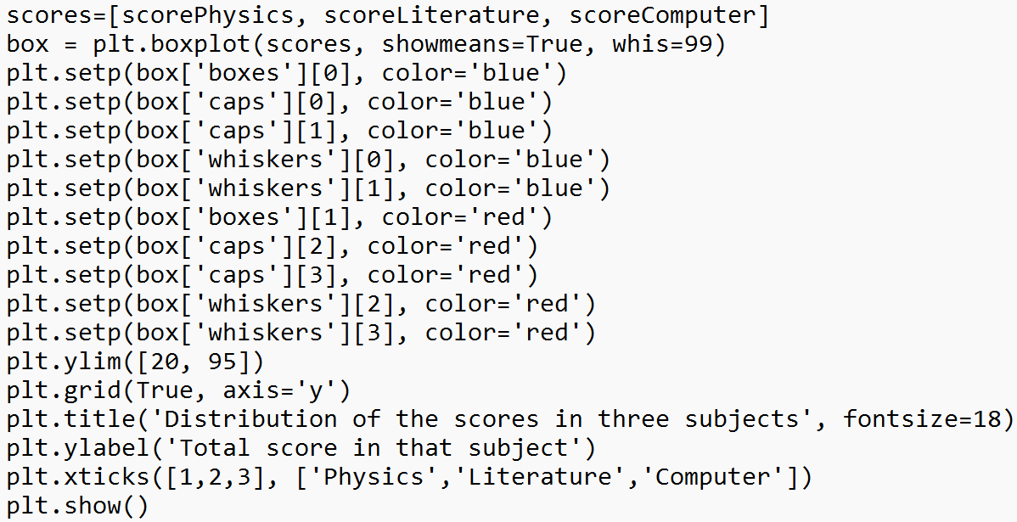
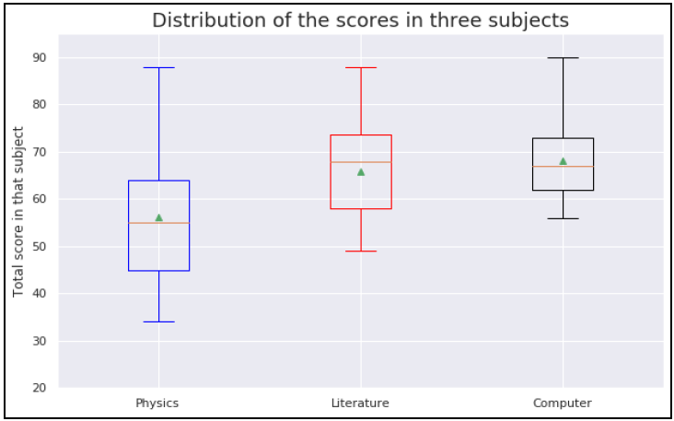
Visualizing Quartiles
Notes:
From the graph, it is clear that the minimum score obtained by the students was around 32,
while the maximum score obtained was 90, which was in the computer science subject.

Slide 48
Groupby()
During the data analysis phase, categorizing a dataset into multiple categories is often essential.
The pandas groupby function is one of the most efficient and time-saving features for doing this.
Groupby provides functionalities that allow us to split-apply-combine throughout the dataframe.
Groupby mechanics:
  Grouping by features, hierarchically
  Aggregating a dataset by groups
  Applying custom aggregation functions to groups
  Transforming a dataset groupwise
Notes:
Split the dataset into groups based on one or more factors.
Apply a function or computation to each group independently.
Combine the results back into a single dataset.
import pandas as pd
# Sample sales data
data = {
'Product_Category': ['A', 'B', 'A', 'C', 'B', 'C', 'A', 'B', 'C'],
'Sales': [100, 150, 200, 120, 180, 90, 210, 160, 80]
}
df = pd.DataFrame(data)
# Define a custom function for range calculation
def sales_range(x):
return x.max() - x.min()
# Apply the custom function using agg()
result = df.groupby('Product_Category')['Sales'].agg(sales_range)
print(result)
import pandas as pd
# Sample sales data
data = {
'Product_Category': ['A', 'B', 'A', 'C', 'B', 'C', 'A', 'B', 'C'],
'Sales': [100, 150, 200, 120, 180, 90, 210, 160, 80]
}
df = pd.DataFrame(data)
# Define a function for z-score normalization
def zscore_normalize(x):
return (x - x.mean()) / x.std()
# Transform 'Sales' column group-wise
df['Sales_Normalized'] = df.groupby('Product_Category')['Sales'].transform(zscore_normalize)
print(df)

Slide 49
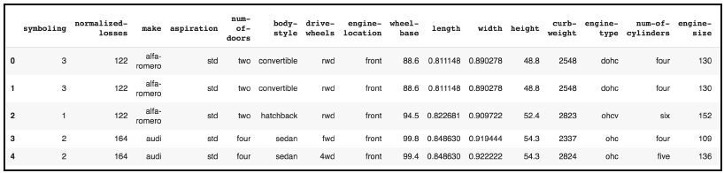
Example
import pandas as pd
df = pd.read_csv("/content/automobileEDA.csv")
df.head()
Notes:
As you can see, there are multiple columns with categorical variables.

Slide 50
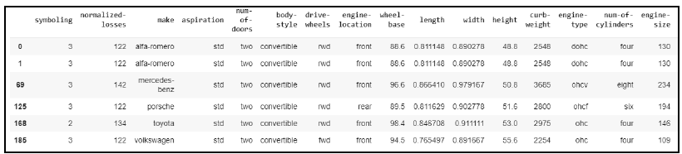
Example
# Group the dataset by the column body-style
style = df.groupby('body-style')
# Get values items from group with value convertible
style.get_group("convertible")

Slide 51
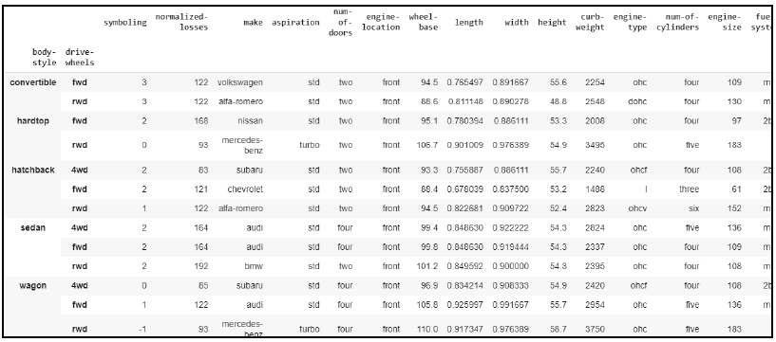
Selecting a subset of columns
double_grouping = df.groupby(["body-style","drive-wheels"])
double_grouping.first() # returns first row of each subgroup
Notes:
In Pandas, the first() function retrieves the first row of each group in a DataFrame. When used with double grouping, it returns the first row of each subgroup created by the two grouping columns.

Slide 52
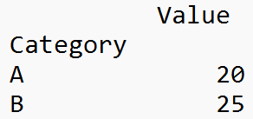
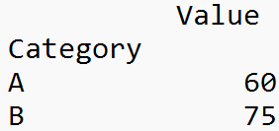
Example
import pandas as pd
data = {
'Category': ['A', 'B', 'A', 'B', 'A', 'B'],
'Value': [10, 15, 20, 25, 30, 35]
}
df = pd.DataFrame(data)
grouped = df.groupby('Category')
# Calculate the mean of each group
means = grouped.mean()
print(means)
# Calculate the sum of each group
sums = grouped.sum()
print(sums)
Notes:
The groupby() function is powerful and widely used in data analysis to perform operations on subsets of data based on certain criteria.
Once you've created a GroupBy object, you can perform various operations:
Aggregation:
Calculate summary statistics for each group using functions like mean(), sum(), max(), min(), median(), etc.
Example: grouped['column'].mean()
Transformation:
Apply functions to groups and return transformed data back to the original DataFrame while maintaining the shape.
Example: grouped['column'].transform(lambda x: x - x.mean())
Filtering:
Filter groups based on specific conditions.
Example: grouped.filter(lambda x: x['column'].sum() > threshold)
Iteration:
Iterate through groups using a for loop to perform custom operations on each group.

Slide 53
Exercise-6
Scenario:
Suppose you are managing an e-commerce platform that sells various products across different categories. You have a dataset containing information about purchases made on your platform, including product categories, purchase amounts, and customer IDs.
Dataset Example:
'Customer_ID': [1, 2, 3, 1, 2, 3, 1, 2, 3], 'Product_Category': ['A', 'B', 'A', 'B', 'A', 'B', 'A', 'B', 'A'], 'Purchase_Amount': [100, 150, 200, 120, 180, 90, 210, 160, 80]
Tasks:
Calculate the average purchase amount per product category.
Identify the top-spending customer in each product category based on their total purchase amount.
Notes:
import pandas as pd
# Sample sales data (replace this with your actual dataset)
data = {
'Customer_ID': [1, 2, 3, 1, 2, 3, 1, 2, 3],
'Product_Category': ['A', 'B', 'A', 'B', 'A', 'B', 'A', 'B', 'A'],
'Purchase_Amount': [100, 150, 200, 120, 180, 90, 210, 160, 80]
}
sales_data = pd.DataFrame(data)
# 1. Calculate the average purchase amount per product category
avg_purchase_per_category = sales_data.groupby('Product_Category')['Purchase_Amount'].mean()
print("Average Purchase Amount per Category:")
print(avg_purchase_per_category)
# 2. Identify the top-spending customer in each category
top_customers_per_category = sales_data.groupby(['Product_Category', 'Customer_ID'])['Purchase_Amount'].sum()
top_customers_per_category = top_customers_per_category.reset_index().sort_values('Purchase_Amount', ascending=False).groupby('Product_Category').head(1)
print("\nTop-Spending Customer in Each Category:")
print(top_customers_per_category)
Average Purchase Amount per Category: Product_Category A 154.0 B 130.0 Name: Purchase_Amount, dtype: float64 Top-Spending Customer in Each Category: Product_Category Customer_ID Purchase_Amount 0 A 1 310 4 B 2 310

Slide 54
Data Aggregation
Aggregation is the process of implementing any mathematical operation on a dataset or a subset of it.
The Dataframe.aggregate() function is used to apply aggregation across one or more columns.
Some of the most frequently used aggregations are as follows:
sum: Returns the sum of the values for the requested axis
min: Returns the minimum of the values for the requested axis
max: Returns the maximum of the values for the requested axis
Notes:
groupby() is used to split a DataFrame into groups based on some criteria (column name, function, etc.). It doesn't perform any computation on its own but creates a GroupBy object.
aggregate() is used to perform aggregation functions on grouped data.
It applies one or more aggregation functions to each group and combines the results into a single DataFrame or Series.
It's useful for calculating summary statistics like sum, mean, max, min, etc., within each group.
import pandas as pd
# Sample sales data
data = {
'Product_Category': ['A', 'B', 'A', 'B', 'A', 'B'],
'Sales': [100, 150, 200, 120, 180, 90],
'Profit': [20, 30, 40, 25, 35, 15]
}
df = pd.DataFrame(data)
# Grouping by 'Product_Category'
grouped = df.groupby('Product_Category')
# Aggregating using aggregate()
result_agg = grouped.aggregate({'Sales': 'sum', 'Profit': 'mean'})
print("Aggregated Data:")
print(result_agg)

Slide 55
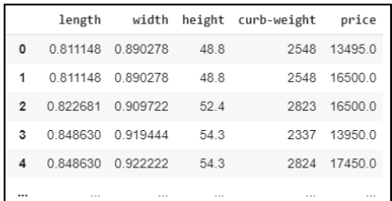
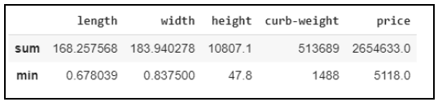
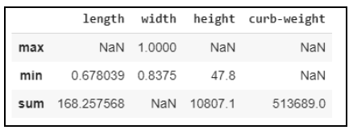
Example
# new dataframe that consist length,width,height,curb-weight and price
new_dataset = df.filter(["length","width","height","curbweight","price"],axis=1)
new_dataset
# applying aggregation sum and minimum across all the columns
new_dataset.agg(['sum', 'min’])
# find aggregation for these columns
new_dataset.aggregate({"length":['sum', 'min'],
"width":['max', 'min’], "height":['min', 'sum'],
"curb-weight":['sum']})
# if any specific aggregation is not applied on a column
# then it has NaN value corresponding to it

Slide 56
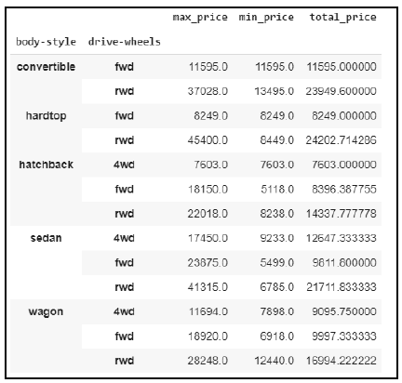
Renaming grouped aggregation
df.groupby(
["body-style","drive-wheels"]).agg(
# Get max of the price column for each group
max_price=('price', max),
# Get min of the price column for each group
min_price=('price', min),
# Get sum of the price column for each group
total_price=('price', 'mean')
)

Slide 57
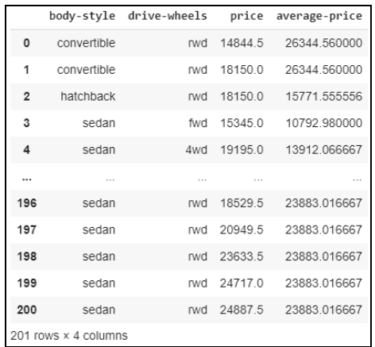
Group-wise transformations
Performing a transformation on a group or a column returns an object that is indexed by the same axis length as itself.
df["price"]=df["price"].transform(lambda x:x + x/10)
df.loc[:,'price’]
df["average-price"]=df.groupby(["body-style","drivewheels"])
["price"].transform('mean')
# selecting columns body-style,drive-wheels,price and average-price
df.loc[:,["body-style","drive-wheels","price","average-price"]]

Slide 58
Exercise-7
Scenario: You are a data analyst working for a retail company that tracks sales data across different regions and products. You have a dataset containing information about sales figures and profit margins for various products in different regions.
Data set: 'Region': ['North', 'North', 'South', 'South', 'North', 'South'], 'Product': ['A', 'B', 'A', 'B', 'A', 'B'], 'Sales': [100, 150, 200, 120, 180, 90], 'Profit_Margin': [0.2, 0.3, 0.25, 0.15, 0.18, 0.12]
Question:
Calculate the total sales and maximum profit margin for each product across all regions.
Notes:
import pandas as pd
# Sample sales data (replace this with your actual dataset)
data = {
'Region': ['North', 'North', 'South', 'South', 'North', 'South'],
'Product': ['A', 'B', 'A', 'B', 'A', 'B'],
'Sales': [100, 150, 200, 120, 180, 90],
'Profit_Margin': [0.2, 0.3, 0.25, 0.15, 0.18, 0.12]
}
sales_data = pd.DataFrame(data)
# Define aggregation functions for total sales and maximum profit margin
aggregations = {
'Sales': 'sum',
'Profit_Margin': 'max'
}
# Calculate total sales and maximum profit margin for each product
result = sales_data.groupby('Product').aggregate(aggregations)
print("Total Sales and Maximum Profit Margin per Product:")
print(result)
Total Sales and Maximum Profit Margin per Product: Sales Profit_Margin Product A 480 0.25 B 360 0.30

Slide 59
Exercise-8
Scenario: You work for a ride-sharing company that operates in multiple cities, and you have a dataset containing information about rides taken by customers. The dataset includes details such as ride duration, customer ratings, and cities where rides were taken.
Data set: 'City': ['A', 'B', 'A', 'B', 'A', 'B'], 'Ride_Duration': [15, 20, 25, 18, 22, 17], 'Driver_Rating': [4.8, 4.9, 4.7, 4.8, 4.9, 4.6]
Question:
Calculate the average ride duration for each city.
Identify the highest-rated driver in each city based on their average driver rating.
Notes:
import pandas as pd
# Sample ride data (replace this with your actual dataset)
data = {
'City': ['A', 'B', 'A', 'B', 'A', 'B'],
'Ride_Duration': [15, 20, 25, 18, 22, 17],
'Driver_Rating': [4.8, 4.9, 4.7, 4.8, 4.9, 4.6]
}
ride_data = pd.DataFrame(data)
# 1. Calculate the average ride duration per city
avg_ride_duration_per_city = ride_data.groupby('City')['Ride_Duration'].mean()
print("Average Ride Duration per City:")
print(avg_ride_duration_per_city)
# 2. Identify the highest-rated driver in each city
top_driver_per_city = ride_data.groupby('City')['Driver_Rating'].agg(['mean', 'idxmax'])
top_driver_per_city = ride_data.loc[top_driver_per_city['idxmax']]
print("\nHighest-Rated Driver in Each City:")
print(top_driver_per_city)
Average Ride Duration per City: City A 20.666667 B 18.333333 Name: Ride_Duration, dtype: float64 Highest-Rated Driver in Each City: City Ride_Duration Driver_Rating 4 A 22 4.9 1 B 20 4.9

Slide 60
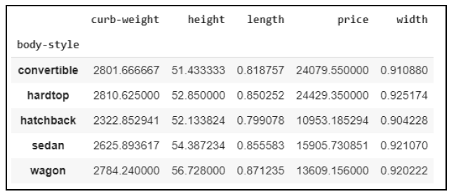
Pivot tables
The pandas.pivot_table() function creates a spreadsheet-style pivot table as a dataframe.
new_dataset1 = df.filter(["body-style","drive-wheels", "length","width","height","curbweight","
price"],axis=1)
#simplest pivot table with dataframe df and index body-style
table = pd.pivot_table(new_dataset1, index =["body-style"])
table
Notes:
In Pandas, pivot tables are a powerful tool used for reshaping and summarizing data in DataFrame format. They allow you to transform and restructure data, aggregating and summarizing information according to specific criteria. Pivot tables provide a way to create multi-dimensional summaries of data, similar to pivot tables in spreadsheet software like Excel.
They help in reorganizing the structure of a DataFrame by switching rows and columns, allowing for a clearer representation of information.
Pivot tables make it easy to explore relationships between multiple variables or factors by displaying data in a cross-tabulated format.
They enable quick grouping and summarization of data based on multiple criteria, helping in data analysis and reporting.
import pandas as pd
# Sample sales data
data = {
'Date': ['2023-01-01', '2023-01-01', '2023-01-02', '2023-01-02'],
'Product_Category': ['A', 'B', 'A', 'B'],
'Sales': [100, 150, 200, 120],
'Profit': [20, 30, 40, 25]
}
df = pd.DataFrame(data)
# Creating a pivot table
pivot = df.pivot_table(values=['Sales', 'Profit'], index='Date', columns='Product_Category', aggfunc='sum')
print("Pivot Table:")
print(pivot)

Slide 61
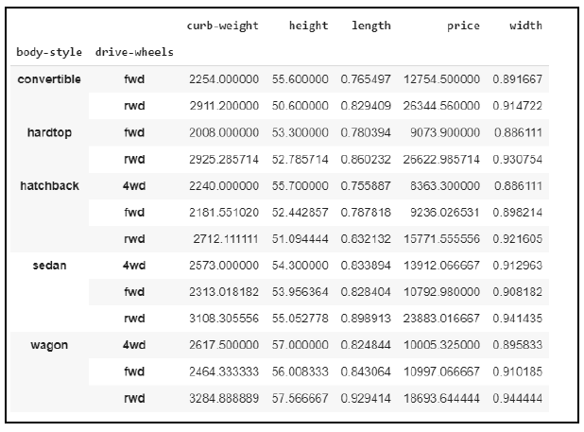
Pivot tables
#pivot table with dataframe df and index body-style and drivewheels
table = pd.pivot_table(new_dataset1, index =["body-style","drivewheels"])
table

Slide 62
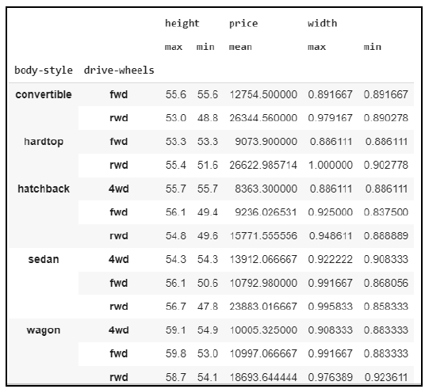
Aggregate function to different column
table = pd.pivot_table(new_dataset1,
values=['price','height','width’],
index =["body-style","drive-wheels"],
aggfunc={'price': np.mean,'height': [min,
max],'width': [min, max]}, fill_value=0)
table

Slide 63
Exercise-9
Scenario:
You are a data analyst working for a multinational corporation that manufactures electronic devices. You have a dataset containing information about the sales of different electronic products across various regions over the past year.
Dataset:
'Region': ['North', 'North', 'South', 'South', 'North', 'South'], 'Product_Category': ['Laptops', 'Smartphones', 'Laptops', 'Smartphones', 'Laptops', 'Smartphones'], 'Sales': [5000, 7000, 8000, 6000, 9000, 5500], 'Units_Sold': [50, 70, 80, 60, 90, 55]
Question:
Create a pivot table to calculate the total sales for each product category in different regions.
Create another pivot table to find the average selling price for each product category in different regions (average price per unit sold).
Notes:
import pandas as pd
# Sample sales data (replace this with your actual dataset)
data = {
'Region': ['North', 'North', 'South', 'South', 'North', 'South'],
'Product_Category': ['Laptops', 'Smartphones', 'Laptops', 'Smartphones', 'Laptops', 'Smartphones'],
'Sales': [5000, 7000, 8000, 6000, 9000, 5500],
'Units_Sold': [50, 70, 80, 60, 90, 55]
}
sales_data = pd.DataFrame(data)
# 1. Create a pivot table to calculate total sales for each product category in different regions
pivot_total_sales = sales_data.pivot_table(values='Sales', index='Region', columns='Product_Category', aggfunc='sum')
print("Pivot Table - Total Sales per Product Category in Different Regions:")
print(pivot_total_sales)
# 2. Create a pivot table to find the average selling price for each product category in different regions
sales_data['Avg_Selling_Price'] = sales_data['Sales'] / sales_data['Units_Sold']
pivot_avg_price = sales_data.pivot_table(values='Avg_Selling_Price', index='Region', columns='Product_Category', aggfunc='mean')
print("\nPivot Table - Average Selling Price per Product Category in Different Regions:")
print(pivot_avg_price)
Pivot Table - Total Sales per Product Category in Different Regions: Product_Category Laptops Smartphones Region North 14000 7000 South 8000 11500 Pivot Table - Average Selling Price per Product Category in Different Regions: Product_Category Laptops Smartphones Region North 100.0 100.0 South 100.0 100.0

Slide 64
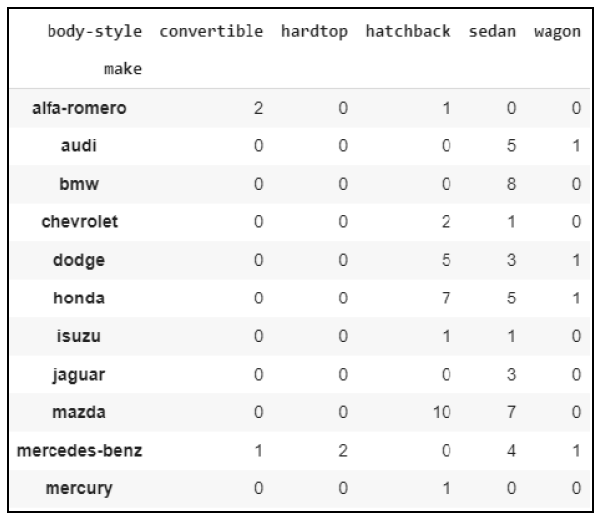
Cross-tabulations
The cross-tabulation table shows the frequency with which certain groups of data appear.
Let's use pd.crosstab() to look at how many different body styles cars are made by different makers:
pd.crosstab(df["make"], df["body-style"])
Notes:
Cross-tabulations, often referred to as crosstabs, are a type of table summarizing the distribution of one variable in rows and another variable in columns, showing the frequency, count, or proportion of occurrences of various combinations of these variables. Crosstabs display the relationship between categorical variables in a tabular format.
Crosstab: Crosstabs are specifically designed for summarizing the relationship between categorical variables by counting the occurrences or frequencies of different combinations.
Crosstab: Primarily focuses on frequency counts of the combinations of categorical variables.
Pivot Table: Offers more flexibility, allowing users to perform various calculations, including aggregations, means, sums, etc., on the data.
import pandas as pd
# Sample sales data
data = {
'Date': ['2023-01-01', '2023-01-01', '2023-01-02', '2023-01-02'],
'Product_Category': ['A', 'B', 'A', 'B'],
'Sales': [100, 150, 200, 120],
'Profit': [20, 30, 40, 25]
}
df = pd.DataFrame(data)
# Creating a crosstab
crosstab = pd.crosstab(df['Date'], df['Product_Category'])
print("Crosstab:")
print(crosstab)
# Creating a pivot table
pivot = df.pivot_table(values=['Sales', 'Profit'], index='Date', columns='Product_Category', aggfunc='sum')
print("\nPivot Table:")
print(pivot)

Slide 65
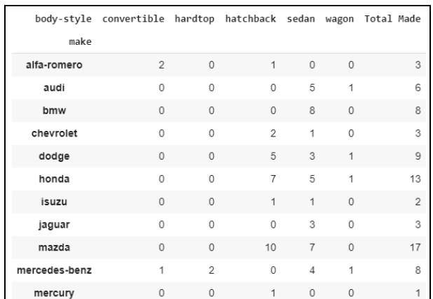
Cross-tabulations
# apply margins and margins_name attribute to displays the row wise
# and column wise sum of the cross table
pd.crosstab(df["make"], df["bodystyle"], margins=True,margins_name="Total Made")

Slide 66
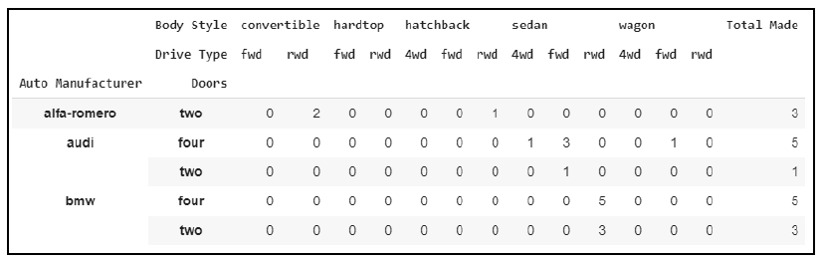
Cross-tabulations
# rename the columns and row index for better understanding of crosstab
pd.crosstab([df["make"],df["num-of-doors"]], [df["bodystyle"],
df["drive-wheels"]], rownames=['Auto Manufacturer', "Doors"],
colnames=['Body Style', "Drive Type"],
margins=True,margins_name="Total Made").head()

Slide 67
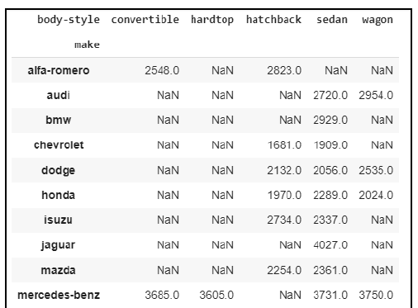
Aggregation function to the Crosstable
# values are the column in which aggregation function is to be applied
# aggfunc is the aggregation function to be applied
# round() to round the output
pd.crosstab(df["make"], df["body-style"],values=df["curb-weight"], aggfunc='mean').round(0)

Slide 68
Exercise-10
Scenario:
You are a data analyst working for a retail chain that operates stores in multiple cities. You have a dataset containing information about customer purchases across different product categories in these cities.
Dataset:
'City': ['A', 'B', 'A', 'B', 'A', 'B', 'A', 'B', 'A'], 'Product_Category': ['Electronics', 'Clothing', 'Electronics', 'Groceries', 'Electronics', 'Clothing', 'Groceries', 'Electronics', 'Clothing'], 'Customer_ID': [1, 2, 3, 1, 2, 3, 1, 2, 3]
Question:
Create a crosstab to display the frequency of purchases for each product category in each city.
Notes:
import pandas as pd
# Sample purchase data (replace this with your actual dataset)
data = {
'City': ['A', 'B', 'A', 'B', 'A', 'B', 'A', 'B', 'A'],
'Product_Category': ['Electronics', 'Clothing', 'Electronics', 'Groceries', 'Electronics', 'Clothing', 'Groceries', 'Electronics', 'Clothing'],
'Customer_ID': [1, 2, 3, 1, 2, 3, 1, 2, 3]
}
purchase_data = pd.DataFrame(data)
# Create a crosstab to display the frequency of purchases for each product category in each city
crosstab_purchases = pd.crosstab(purchase_data['City'], purchase_data['Product_Category'])
print("Crosstab - Frequency of Purchases for Each Product Category in Each City:")
print(crosstab_purchases)
Crosstab - Frequency of Purchases for Each Product Category in Each City:
Product_Category Clothing Electronics Groceries
City A 1 3 1
B 2 1 1

Slide 69
Exercise-11
Scenario:
You are analyzing survey data conducted by a company to understand customer satisfaction levels regarding different product features. You have a dataset containing responses from customers, including ratings for various product features.
Dataset:
'Customer_ID': [1, 2, 3, 4, 5, 6, 7, 8, 9, 10], 'Product_Feature': ['Durability', 'Durability', 'Design', 'Durability', 'Design', 'Design', 'Performance', 'Performance', 'Performance', 'Durability'], 'Satisfaction_Rating': [4, 3, 5, 4, 2, 3, 5, 4, 3, 4]
Question:
Create a crosstab to display the distribution of satisfaction ratings for each product feature.
Notes:
import pandas as pd
# Sample survey data (replace this with your actual dataset)
data = {
'Customer_ID': [1, 2, 3, 4, 5, 6, 7, 8, 9, 10],
'Product_Feature': ['Durability', 'Durability', 'Design', 'Durability', 'Design', 'Design', 'Performance', 'Performance', 'Performance', 'Durability'],
'Satisfaction_Rating': [4, 3, 5, 4, 2, 3, 5, 4, 3, 4]
}
survey_data = pd.DataFrame(data)
# Create a crosstab to display the distribution of satisfaction ratings for each product feature
crosstab_satisfaction = pd.crosstab(survey_data['Product_Feature'], survey_data['Satisfaction_Rating'])
print("Crosstab - Distribution of Satisfaction Ratings for Each Product Feature:")
print(crosstab_satisfaction)
Crosstab - Distribution of Satisfaction Ratings for Each Product Feature:
Satisfaction_Rating 2 3 4 5
Product_Feature
Design 1 1 0 1
Durability 0 1 3 0
Performance 0 1 1 1

Slide 70
Correlation
The strength of relationship between two variables of a dataset is called correlation.
It is represented by a numerical value between -1 and 1.
It measures both the strength and direction of the linear relationship between two variables.
Correlation answers questions such as how one variable changes with respect to another.
For example: height and weight are both related; that is, taller people tend to be heavier than shorter people.
Notes:
Correlation answers questions such as how one variable changes with respect to another.
If it does change, then to what degree or strength?
Additionally, if the relation between those variables is strong enough, then we can make predictions for future behavior.
Correlation tells us how variables change together, both in the same or opposite directions and in the magnitude (that is, strength) of the relationship. To find the correlation, we calculate the Pearson correlation coefficient, symbolized by ρ (the Greek letter rho). This is obtained by dividing the covariance by the product of the standard deviations of the variables:
Consider two variables, such as the number of hours spent studying and exam scores. A positive correlation close to +1 would suggest that as the number of study hours increases, exam scores also tend to increase.

Slide 71
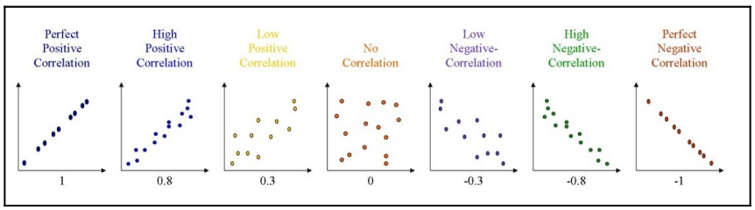
Correlation
Types of Correlation:
Positive Correlation:
  When two variables change in the same direction. As one variable increases, the other also tends to increase. It's indicated by a correlation coefficient close to +1.
Negative Correlation:
  When two variables change in opposite directions. As one variable increases, the other tends to decrease. It's indicated by a correlation coefficient close to -1.
No Correlation (Zero Correlation):
  When there is no discernible relationship between the variables. Changes in one variable do not predict changes in the other. It's indicated by a correlation coefficient close to 0.
Notes:
In terms of the strength of the relationship, the value of the correlation between two variables, A and B, varies between +1 and -1. If the correlation is +1, then it is said to be a perfect positive/linear correlation (that is, variable A is directly proportional to variable B), while a correlation of -1 is a perfect negative correlation (that is, variable A is inversely proportional to variable B). Note that values closer to 0 are not supposed to be correlated at all. If correlation coefficients are near to 1 in absolute value, then the variables are said to be strongly correlated; in comparison, those that are closer to 0.5 are said to be weakly correlated

Slide 72
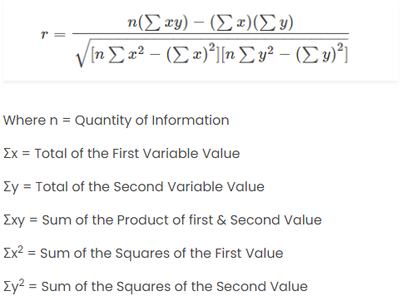
Correlation formula
Pearson Correlation Coefficient Formula
The most common formula is the Pearson Correlation coefficient used for linear dependency between the data sets.

Slide 73
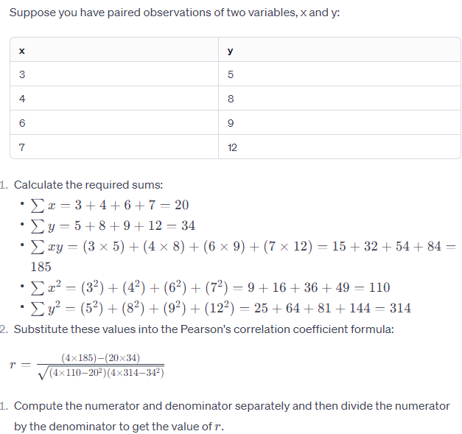
Example-1

Slide 74
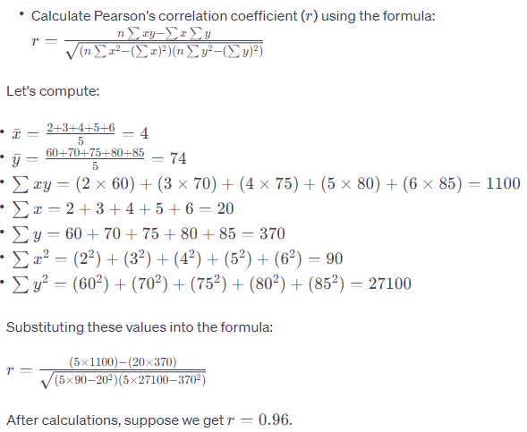
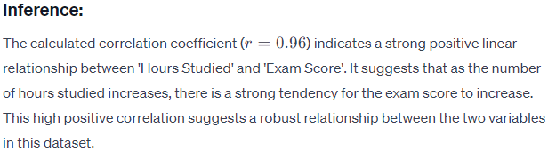
Example-2
Let's consider an example where we have two variables: 'Hours Studied' and 'Exam Score'. We'll calculate the correlation between these two variables and infer the relationship based on the correlation coefficient.
Hours Studied | Exam Score
2 | 60
3 | 70
4 | 75
5 | 80
6 | 85

Slide 75
Example-3
import pandas as pd
# Sample data
data = {
'X': [1, 2, 3, 4, 5],
'Y': [2, 4, 6, 8, 10]
}
df = pd.DataFrame(data)
# Calculate the correlation between columns 'X' and 'Y'
correlation = df['X'].corr(df['Y'])
print("Correlation between X and Y:", correlation)

Slide 76
Exercise-11
Scenario: You are analyzing data from a fitness app that tracks users' exercise habits and their reported feelings of overall wellness. The dataset includes information about the number of days users exercised per week and their self-reported wellness scores.
Dataset:
'Exercise_Days': [2, 3, 4, 5, 6, 7, 2, 4, 5, 7],
'Wellness_Score': [3, 4, 5, 6, 7, 8, 3, 5, 6, 9]
Question:
Calculate the correlation coefficient between the number of exercise days per week and the wellness scores.
Interpret the strength and direction of the correlation coefficient obtained.
Notes:
import pandas as pd
# Sample fitness data (replace this with your actual dataset)
data = {
'Exercise_Days': [2, 3, 4, 5, 6, 7, 2, 4, 5, 7],
'Wellness_Score': [3, 4, 5, 6, 7, 8, 3, 5, 6, 9]
}
fitness_data = pd.DataFrame(data)
# Calculate the correlation coefficient between exercise days and wellness scores
correlation = fitness_data['Exercise_Days'].corr(fitness_data['Wellness_Score'])
print("Correlation Coefficient between Exercise Days and Wellness Scores:", correlation)
Correlation Coefficient between Exercise Days and Wellness Scores: 0.99
For instance, if the obtained correlation coefficient is +0.85, it would indicate a strong positive correlation, suggesting that as users exercise more frequently, their reported feelings of wellness also tend to increase.

