Slide 1
Unit-2
Introduction to MongoDB
Dr. Selva kumar S
Assistant Professor
Dept. of CSE, BMSCE

Slide 2
Learning Objectives and Learning Outcomes
Learning Objectives | Learning Outcomes
Introduction to MongoDB To study the features of MongoDB. To learn how to perform CRUD operations. To study aggregation. To study the MapReduce Framework. To import from and export to CSV format. | To comprehend the reasons behind the popularity of NoSQL database. To be able to perform CRUD operations. To comprehend MapReduce framework. To understand the aggregation. To be able to successfully import from and export to CSV.

Slide 3
Agenda
NoSQL: Types of NoSQL databases
CAP Theorem
Terms used in RDBMS and MongoDB
MongoDB Query Language: CRUD
Finding documents based on search criteria
Dealing with Null values
Count, Limit, Sort Skip, Aggregate Functions

Slide 4
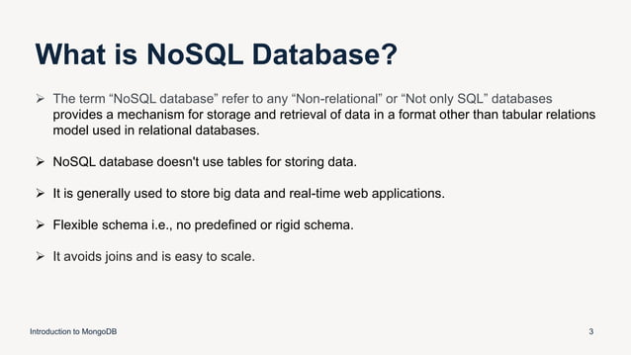

Slide 5
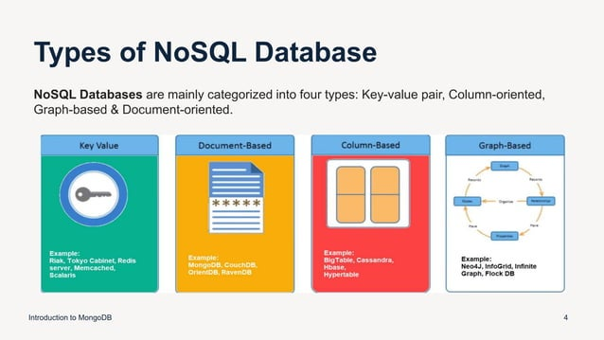

Slide 6
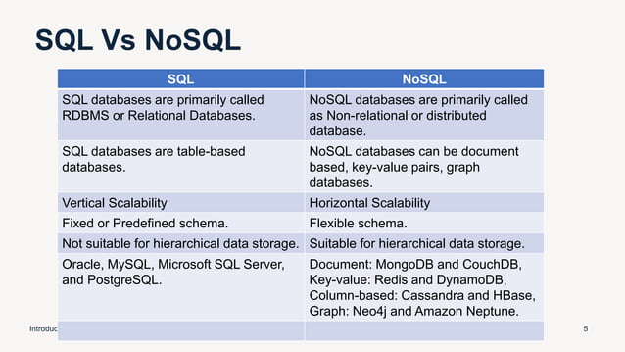

Slide 7
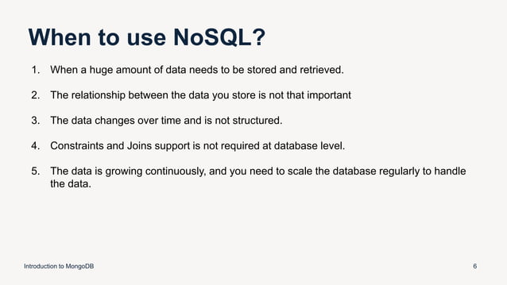

Slide 8
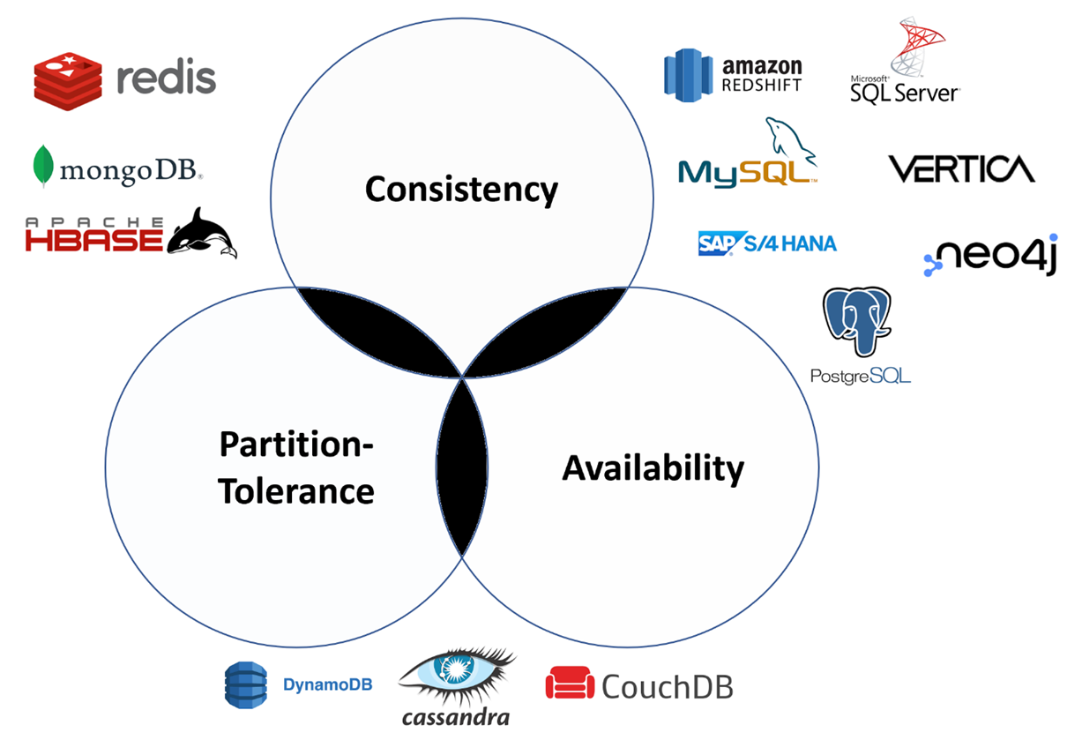
CAP Theorem
The CAP theorem says that a distributed system can deliver only two of three desired characteristics:
consistency, availability and partition tolerance
Notes:
A distributed system is a network that stores data on more than one node (physical or virtual machines) at the same time. Because all cloud applications are distributed systems, it’s essential to understand the CAP theorem when designing a cloud app so that you can choose a data management system that delivers the characteristics your application needs most.
Consistency
Consistency means that all clients see the same data at the same time, no matter which node they connect to. For this to happen, whenever data is written to one node, it must be instantly forwarded or replicated to all the other nodes in the system before the write is deemed ‘successful.’
Availability
Availability means that any client making a request for data gets a response, even if one or more nodes are down. Another way to state this—all working nodes in the distributed system return a valid response for any request, without exception.
Partition tolerance
A partition is a communications break within a distributed system—a lost or temporarily delayed connection between two nodes. Partition tolerance means that the cluster must continue to work despite any number of communication breakdowns between nodes in the system.

Slide 9
What is MongoDB?
◆ MongoDB is:
◆ Cross-Platform.
◆ Open Source.
◆ Non-relational.
◆ Distributed.
◆ NoSQL.
◆ Document-oriented data store.

Slide 10
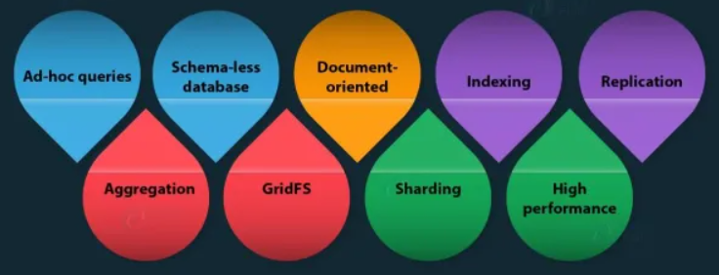
Why MongoDB?

Slide 11
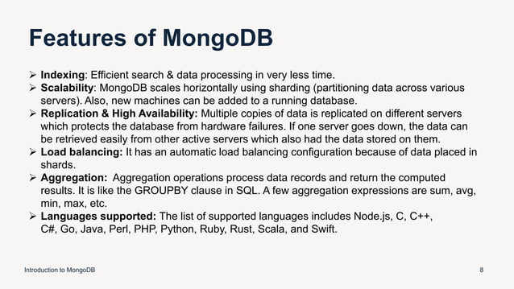

Slide 12
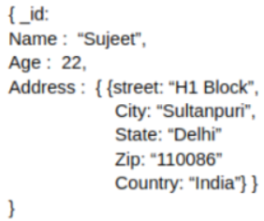
Using JSON
JSON, or JavaScript Object Notation, is a human-readable data interchange format.
JSON objects are associative containers, wherein a string key is mapped to a value (which can be a number, string, boolean, array, an empty value — null, or even another object).
BSON, or Binary JSON, is the data format that MongoDB uses to organize and store data.

Slide 13

Creating or Generating a Unique Key
Each JSON document should have a unique identifier.
It is similar to the primary key of relational databases.
This facilitates search for documents based on the unique identifier.
ObjectIds use 12 bytes of storage, which gives them a string representation that is 24 hexadecimal digits: 2 digits for each byte.
Notes:
A 4-byte timestamp, representing the ObjectId's creation, measured in seconds since the Unix epoch.
A 5-byte random value generated once per process. This random value is unique to the machine and process.
A 3-byte incrementing counter, initialized to a random value.
The _id field is immutable—that is, once a document exists in your MongoDB system, it has, by definition, been assigned an _id, and you cannot change or update its primary key. That said, _id can be overridden when you insert new documents, but by default it will be populated with an ObjectID. Overriding the _id field for a document can be useful, but when you do so, you need to ensure the values for each document are unique.

Slide 14
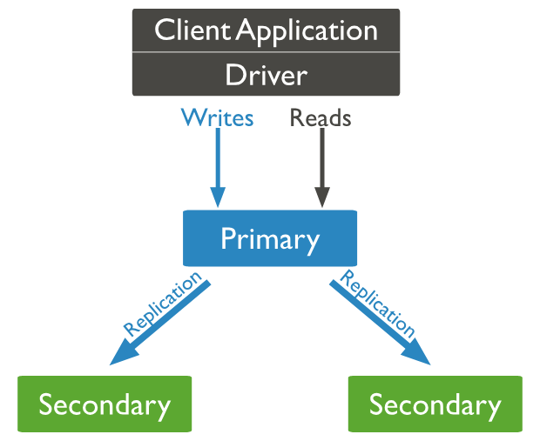
Replication
MongoDB provides data redundancy and high availability.
It helps to recover from hardware failure and service interruption.

Slide 15
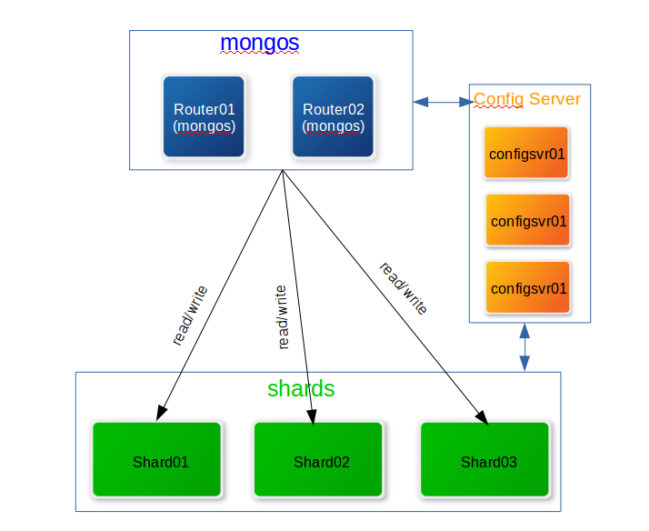
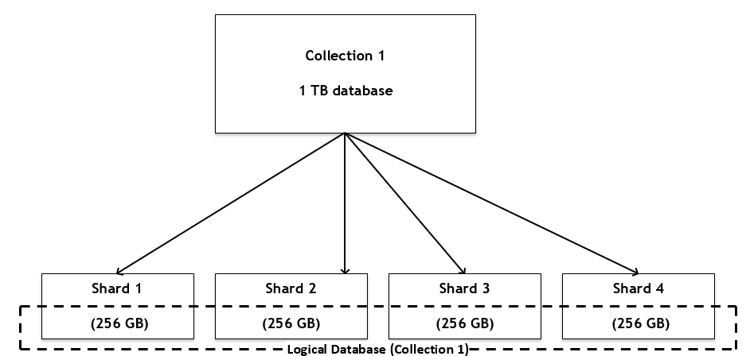
Sharding
Sharding is a method for distributing or partitioning data across multiple machines.
Horizontal scaling, also known as scale-out, refers to adding machines to share the data set and load.
Notes:
In MongoDB, a sharded cluster consists of:
Shards
Mongos
Config servers
A shard is a replica set that contains a subset of the cluster’s data.
The mongos acts as a query router for client applications, handling both read and write operations. It dispatches client requests to the relevant shards and aggregates the result from shards into a consistent client response. Clients connect to a mongos, not to individual shards.
Config servers are the authoritative source of sharding metadata. The sharding metadata reflects the state and organization of the sharded data. The metadata contains the list of sharded collections, routing information, etc.

Slide 16
Advantages of Sharding
Increased read/write throughput.
Increased storage capacity.
Data Locality.
Notes:
Increased read/write throughput: You can take advantage of parallelism by distributing the data set across multiple shards. Let’s say one shard can process one thousand operations per second. For each additional shard, you would gain an additional one thousand operations per second in throughput.
Increased storage capacity: Similarly, by increasing the number of shards, you can also increase overall total storage capacity. Let’s say one shard can hold 4TB of data. Each additional would increase your total storage by 4TB. This allows near-infinite storage capacity.
Data Locality: Zone Sharding allows you to easily create distributed databases to support geographically distributed apps, with policies enforcing data residency within specific regions. Each zone can have one or more shards.
MongoDB supports two sharding strategies for distributing data across sharded clusters:
Ranged Sharding
Hashed Sharding
Ranged sharding divides data into ranges based on the shard key values. Each chunk is then assigned a range based on the shard key values.

Slide 17
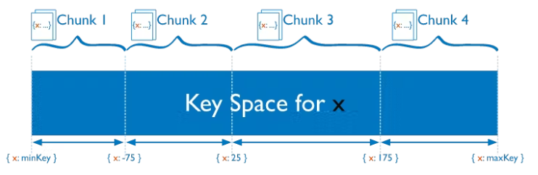
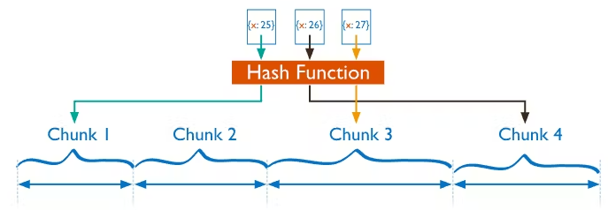
Sharding Strategy
MongoDB supports two sharding strategies for distributing data across sharded clusters:
Ranged Sharding
Hashed Sharding
Notes:
Increased read/write throughput: You can take advantage of parallelism by distributing the data set across multiple shards. Let’s say one shard can process one thousand operations per second. For each additional shard, you would gain an additional one thousand operations per second in throughput.
Increased storage capacity: Similarly, by increasing the number of shards, you can also increase overall total storage capacity. Let’s say one shard can hold 4TB of data. Each additional would increase your total storage by 4TB. This allows near-infinite storage capacity.
Data Locality: Zone Sharding allows you to easily create distributed databases to support geographically distributed apps, with policies enforcing data residency within specific regions. Each zone can have one or more shards.
MongoDB supports two sharding strategies for distributing data across sharded clusters:
Ranged Sharding
Hashed Sharding
Ranged sharding divides data into ranges based on the shard key values. Each chunk is then assigned a range based on the shard key values.

Slide 18
Data Types in MongoDB
String | Must be UTF-8 valid. Most commonly used data type.
Integer | Can be 32-bit or 64-bit (depends on the server).
Boolean | To store a true/false value.
Double | To store floating point (real values).
Min/Max keys | To compare a value against the lowest or highest BSON elements.
Arrays | To store arrays or list or multiple values into one key.
Timestamp | To record when a document has been modified or added.
Null | To store a NULL value. A NULL is a missing or unknown value.
Date | To store the current date or time in Unix time format. One can create object of date and pass day, month and year to it.
Object ID | To store the document’s id.
Binary data | To store binary data (images, binaries, etc.).
Code | To store javascript code into the document.
Regular expression | To store regular expression.

Slide 19
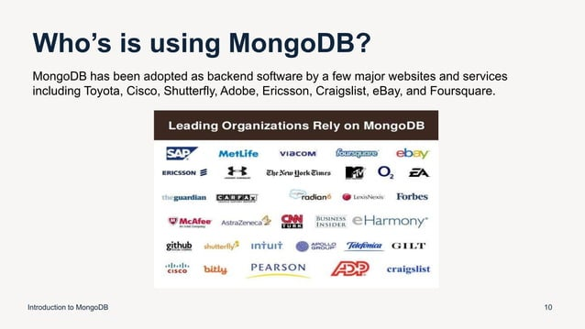

Slide 20
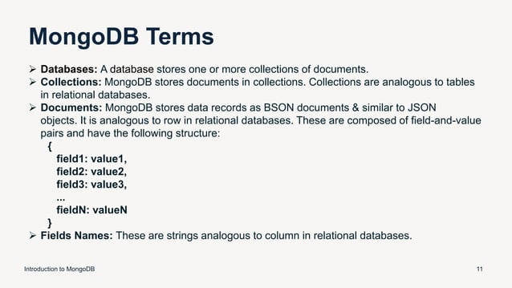
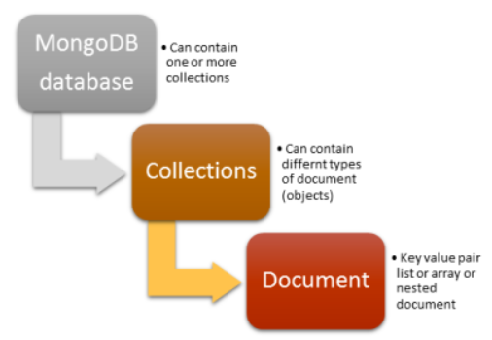

Slide 21
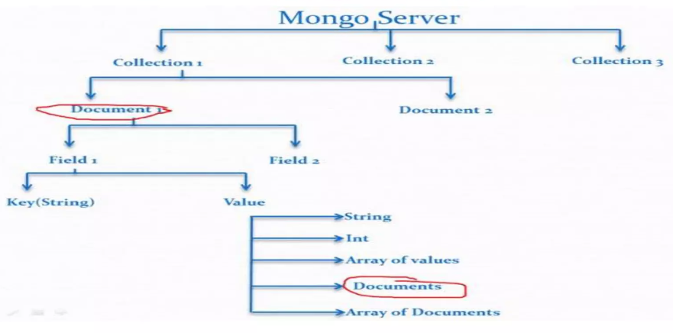
Data Storage Mechanism

Slide 22
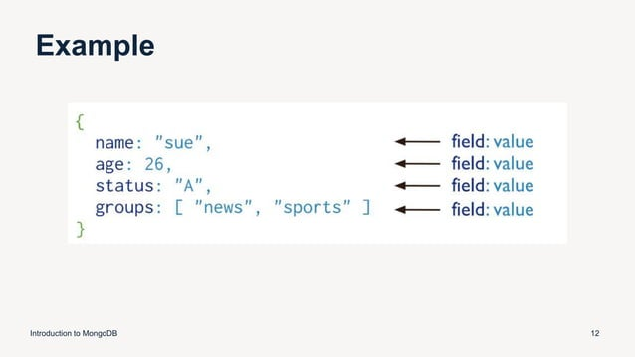

Slide 23
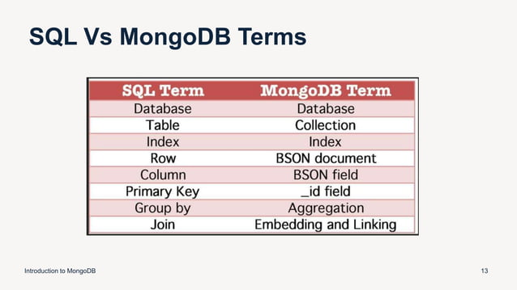

Slide 24


Slide 25
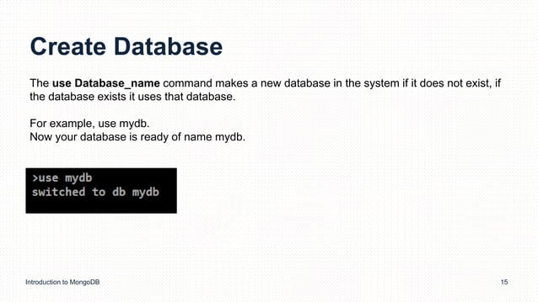

Slide 26
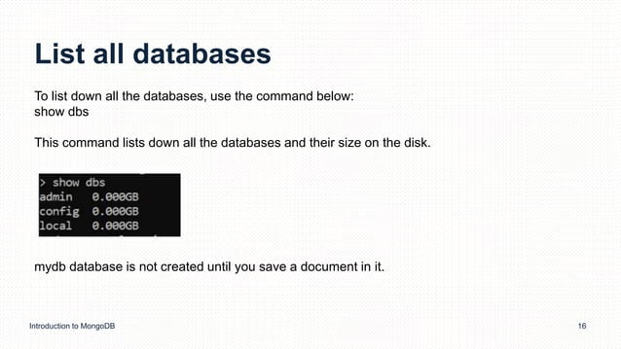

Slide 27
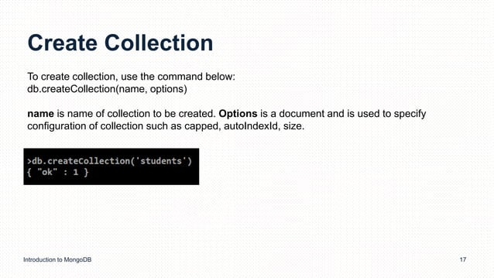
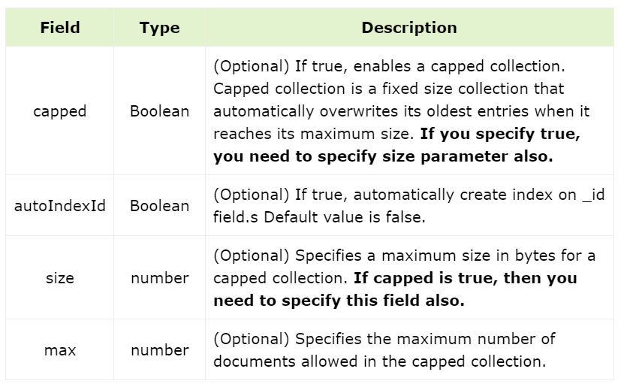

Slide 28
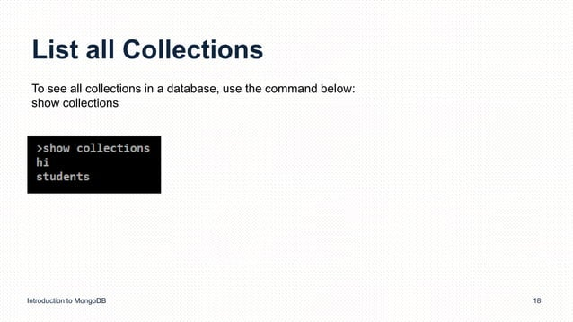

Slide 29
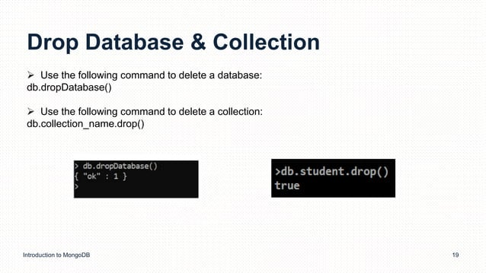

Slide 30
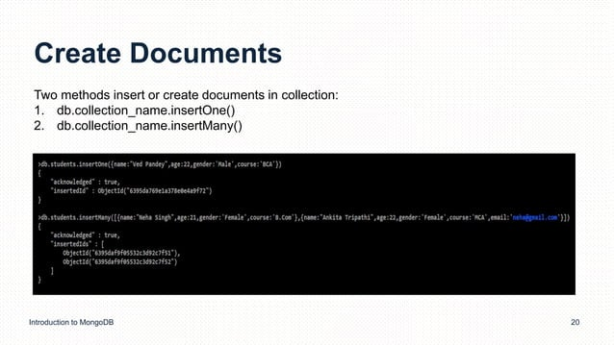

Slide 31
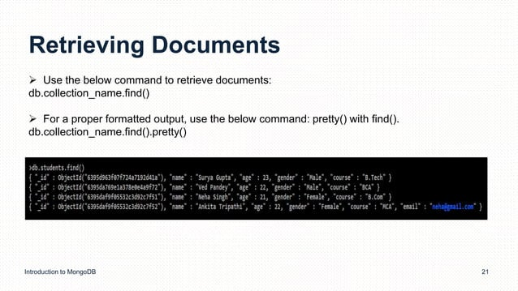

Slide 32
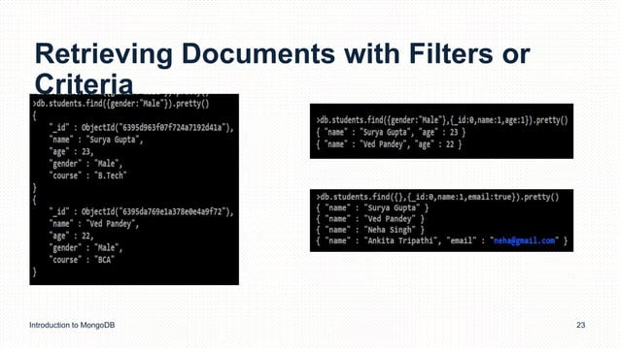

Slide 33
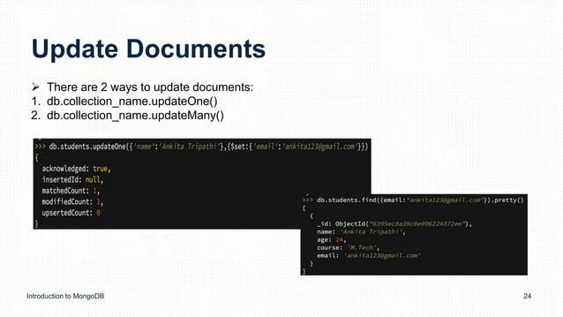

Slide 34
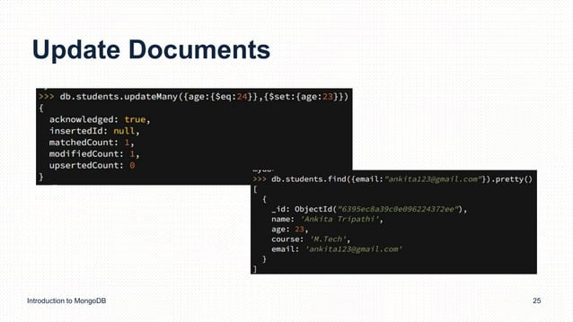

Slide 35
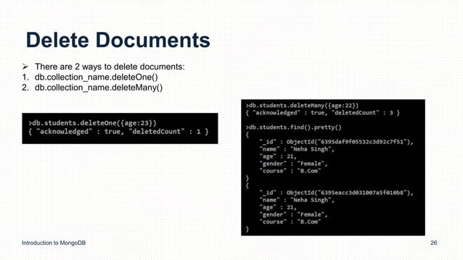

Slide 36
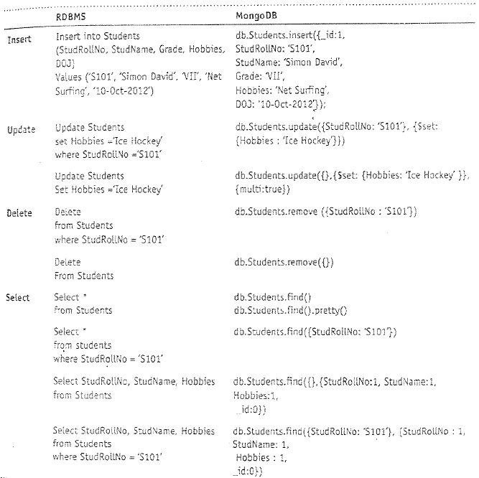

Slide 37
Collections
To create a collection by the name “Person”. Let us take a look at the
collection list prior to the creation of the new collection “Person”.
db.createCollection(“Person”);

Slide 38
Collections
To drop a collection by the name “food”.
db.food.drop();

Slide 39
Insert Method
Create a collection by the name “Students” and store the following data in it.
db.Students.insert({_id:1, StudName:"Michelle Jacintha", Grade: "VII", Hobbies:
"Internet Surfing"});

Slide 40
Update Method
Insert the document for “Aryan David” into the Students collection only if it does not already exist in the collection. However, if it is already present in the collection, then update the document with new values. (Update his Hobbies from “Skating” to “Chess”.) Use “Update else insert” (if there is an existing document, it will attempt to update it, if there is no existing document then it will insert it).
db.Students.update({_id:3, StudName:"Aryan David", Grade: "VII"},{$set:{Hobbies: "Skating"}},{upsert:true});

Slide 41
Adding new field – update method
To add a new field to an existing document in MongoDB, you can use the updateOne() or updateMany() method along with the $set operator.
db.collection.updateOne(
// Filter to select the document(s) you want to update
{ <filter> },
// Update operation
{
// $set operator to add a new field
$set: {
newField: "value" // Specify the new field and its value
}
}
);
db.users.updateOne(
{ name: "John" }, // Filter documents where name is "John"
{ $set: { age: 30 } } // Add the new field "age" with value 30
);

Slide 42
Removing an existing field
To remove an existing field from an existing document in MongoDB, you can use the updateOne() or updateMany() method along with the $unset operator.
db.collection.updateOne(
// Filter to select the document(s) you want to update
{ <filter> },
// Update operation
{
// $unset operator to remove a field
$unset: {
fieldName: "" // Specify the name of the field you want to remove
}
}
);
db.users.updateOne(
{ name: "John" }, // Filter documents where name is "John"
{ $unset: { age: "" } } // Remove the "age" field
);
Notes:
remove() removes entire documents from the collection based on the specified query, while $unset removes specific fields from documents without deleting the entire documents.
remove() is a destructive operation that permanently deletes documents, while $unset is a non-destructive operation that only removes specified fields from documents.

Slide 43
Save Method
Save() method is used to update an existing document in a collection or insert a new document if it does not already exist.
// Update an existing document with _id "123abc"
db.collection.save({
_id: "123abc",
name: "Updated Name",
age: 30,
status: "active"
});
// Insert a new document if _id "456def" doesn't already exist
db.collection.save({
_id: "456def",
name: "New Document",
age: 25,
status: "inactive"
});

Slide 44
Remove Method
Remove() method is used to delete documents from a collection that match a specified query. It can remove either a single document or multiple documents depending on the criteria provided.
db.collection.remove(
<query>,
{
justOne: <boolean>,
writeConcern: <document>
}
)
db.users.remove({ name: "John" });
db.users.remove({ name: "John" }, { justOne: true });

Slide 45
Find Method
To search for documents from the “Students” collection based on certain search criteria.
db.Students.find({StudName:"Aryan David"});

Slide 46
Find Method
To display only the StudName and Grade from all the documents of the Students collection. The identifier _id should be suppressed and NOT displayed.
db.Students.find({},{StudName:1,Grade:1,_id:0});

Slide 47
Find Method
To find those documents where the Grade is set to ‘VII’
db.Students.find({Grade:{$eq:'VII'}}).pretty();

Slide 48
Find Method
To find those documents from the Students collection where the Hobbies is set to either ‘Chess’ or is set to ‘Skating’.
db.Students.find ({Hobbies :{ $in: ['Chess','Skating']}}).pretty ();

Slide 49
Find Method
To find documents from the Students collection where the StudName begins
with “M”.
db.Students.find({StudName:/^M/}).pretty();

Slide 50
Find Method
To find documents from the Students collection where the StudName has an “e”
in any position.
db.Students.find({StudName:/e/}).pretty();

Slide 51
Find Method
To find the number of documents in the Students collection.
db.Students.count();

Slide 52
Find Method
To sort the documents from the Students collection in the descending order of StudName.
db.Students.find().sort({StudName:-1}).pretty();

Slide 53
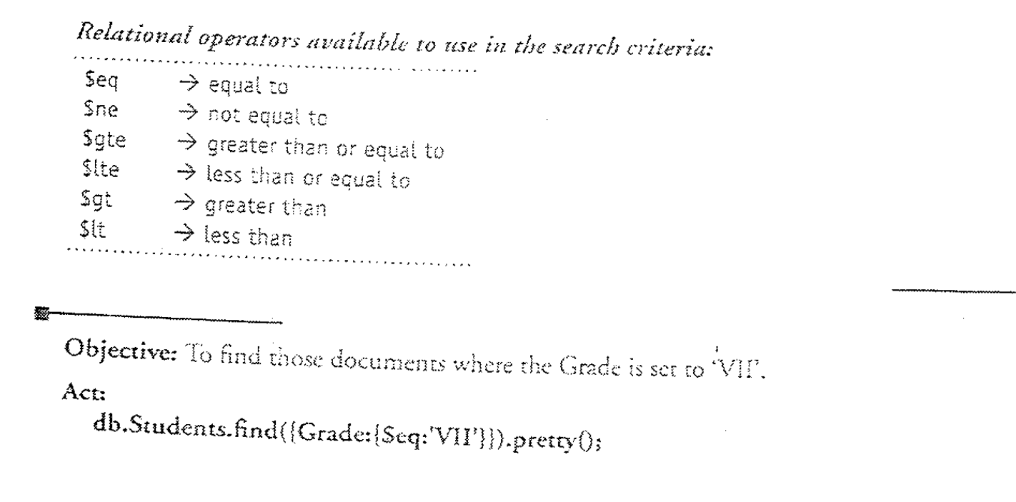
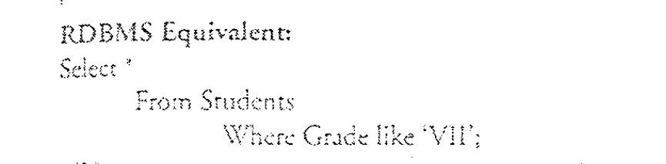

Slide 54
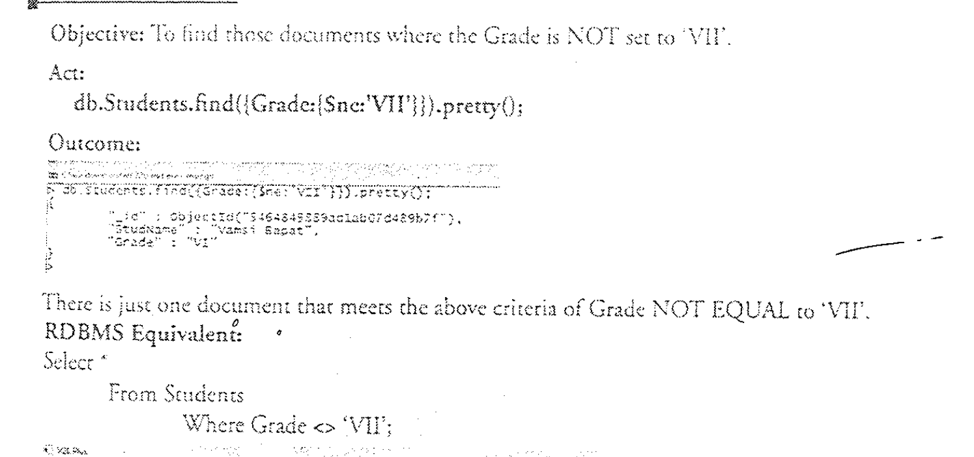

Slide 55
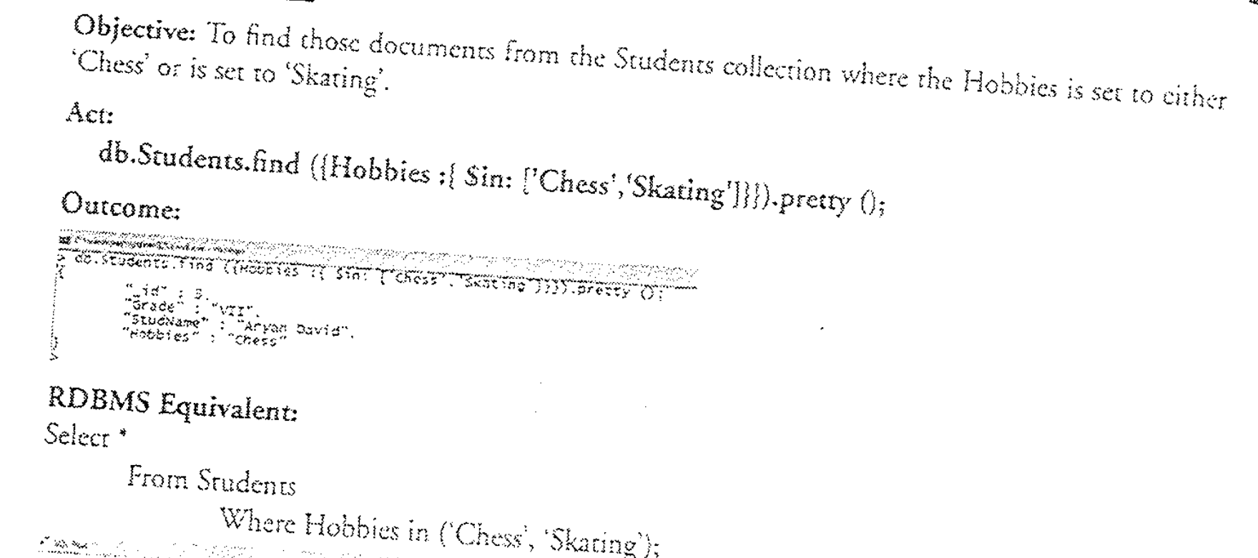

Slide 56
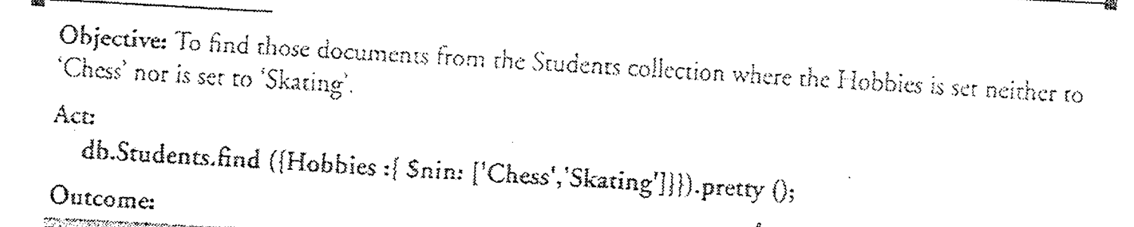
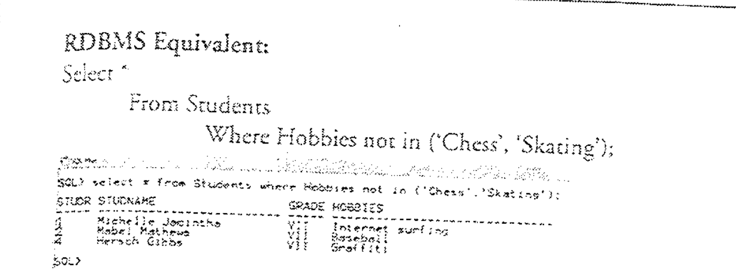

Slide 57
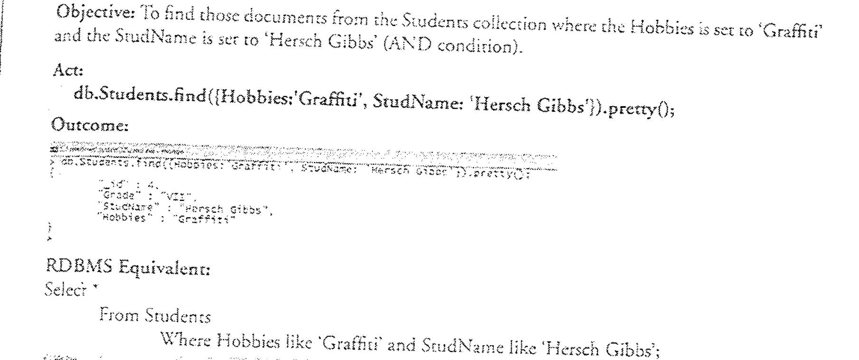

Slide 58
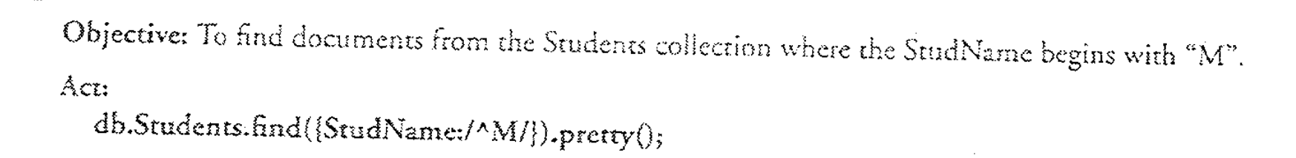
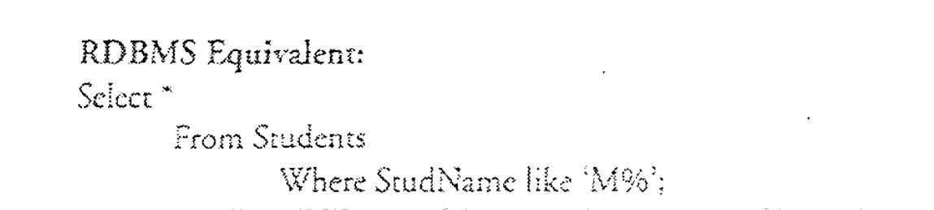

Slide 59
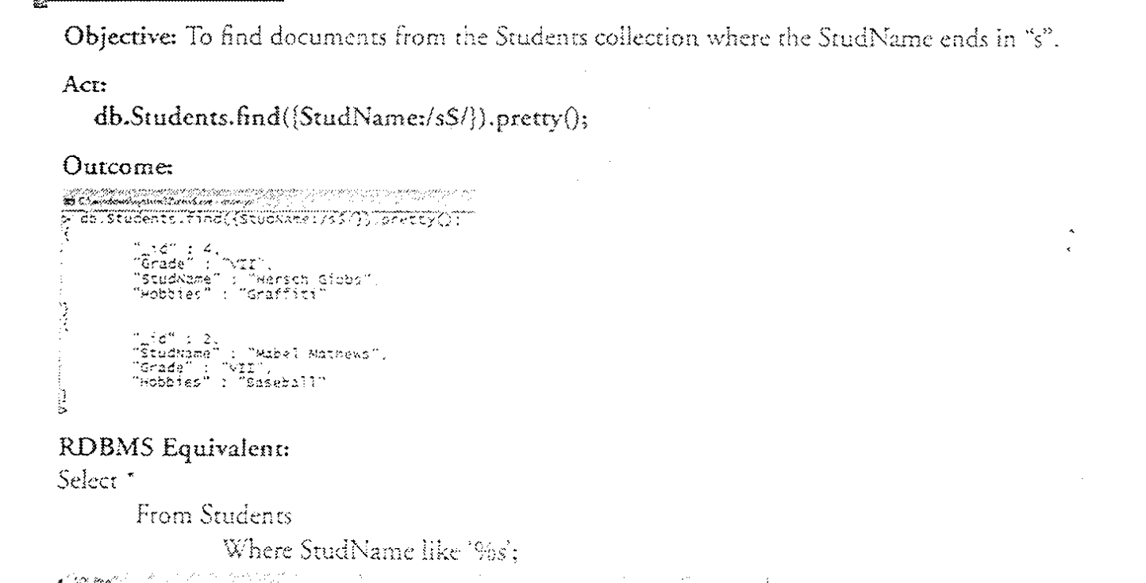

Slide 60
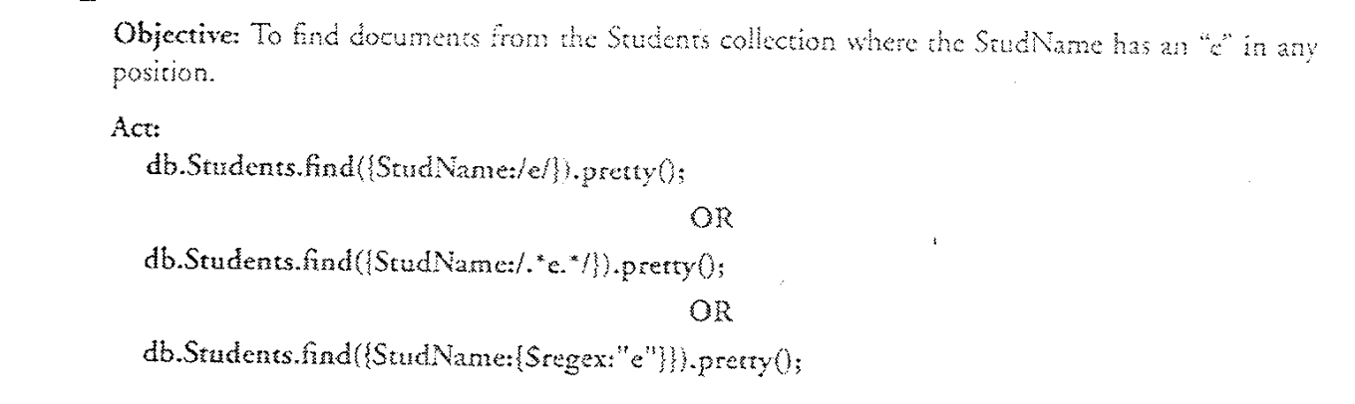
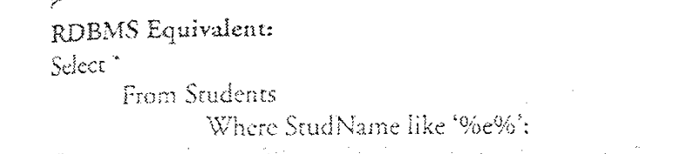

Slide 61
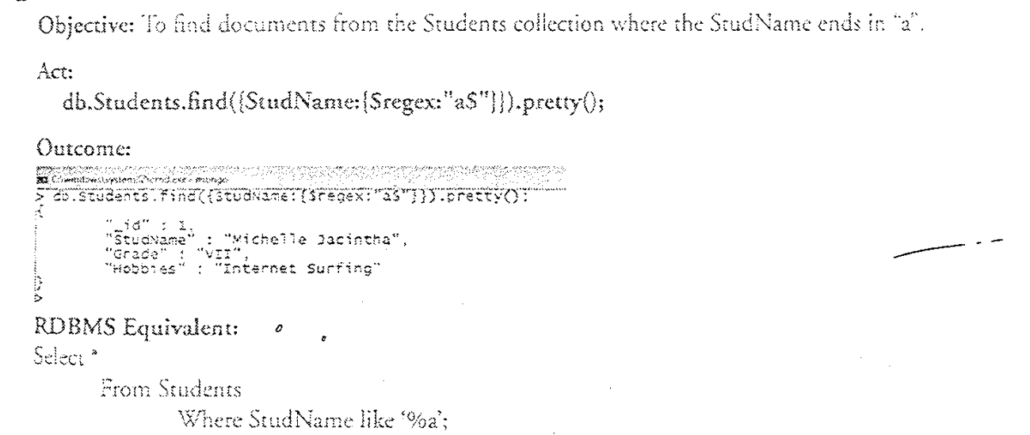

Slide 62
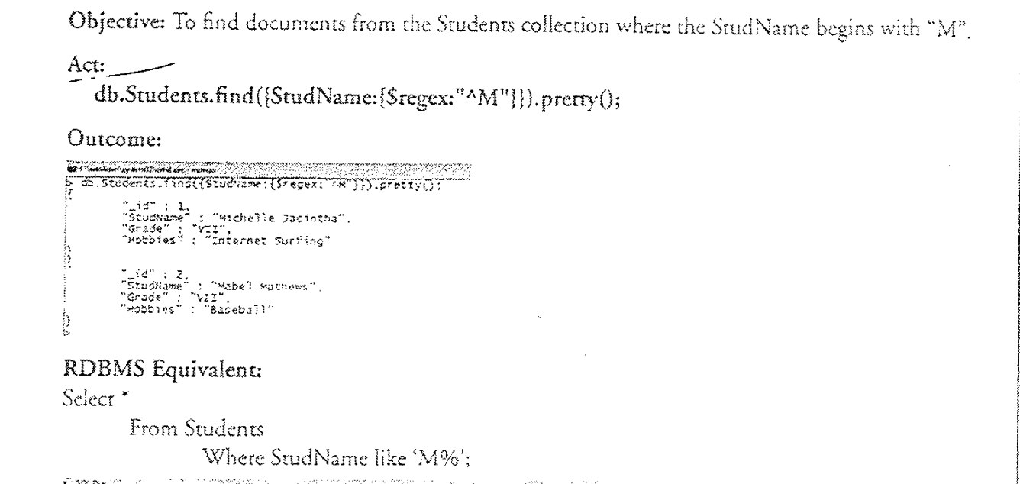

Slide 72
Aggregate Function

Slide 73
Aggregate Function
{ } | CustID: “C123”, AccBal: 500, AccType: “S”
{ } | CustID: “C123”, AccBal: 900, AccType: “S”
{
 | CustID: “C111”,
 |  | $match
 | AccBal: 1200,
 | AccType: “S”
}
{ } | CustID: “C123”, AccBal: 1500, AccType: “C”
{ } | CustID: “C123”, AccBal: 500, AccType: “S”
{
 | CustID: “C123”,
 | AccBal: 900,
 | AccType: “S”
 |  | $group
}
{ } | CustID: “C111”, AccBal: 1200, AccType: “S”
{
_id: “C123”,
TotAccBal: 1400
}
{
_id: “C111”,
TotAccBal: 1200
}
Customers

Slide 74
Aggregate Function
First filter on “AccType:S” and then group it on “CustID” and then compute the sum of “AccBal” and then filter those documents wherein the “TotAccBal” is greater than 1200, use the below syntax:
db.Customers.aggregate( { $match : {AccType : "S" } },
{ $group : { _id : "$CustID",TotAccBal : { $sum : "$AccBal" } } },
{ $match : {TotAccBal : { $gt : 1200 } }});

Slide 75
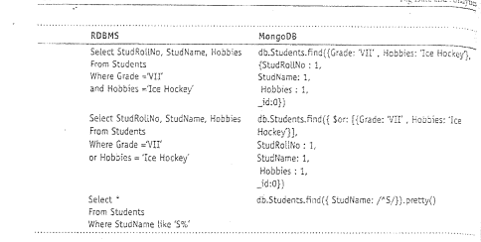

Slide 76
Exercise
SELECT name, age FROM employees;
db.employees.find({}, { name: 1, age: 1, _id: 0 });

Slide 77
Exercise
SELECT * FROM employees WHERE age > 30;
db.employees.find({ age: { $gt: 30 } });

Slide 78
Exercise
SELECT * FROM employees ORDER BY age DESC;
db.employees.find().sort({ age: -1 });

Slide 79
Exercise
SELECT * FROM employees LIMIT 10;
db.employees.find().limit(10);

Slide 80
Exercise
SELECT department, COUNT(*) AS total_employees FROM employees GROUP BY department;
db.employees.aggregate([ { $group: { _id: "$department", total_employees: { $sum: 1 } } } ]);

Slide 81
Import data from a CSV file
Given a CSV file “sample.txt” in the D: drive, import the file into the MongoDB
collection, “SampleJSON”. The collection is in the database “test”.
Mongoimport --db test --collection SampleJSON --type csv --headerline --file d:\sample.txt

Slide 82
Export data to a CSV file
This command used at the command prompt exports MongoDB JSON documents from “Customers” collection in the “test” database into a CSV file “Output.txt” in the D: drive.
Mongoexport
d:\output.txt
--db test --collection Customers --csv --fieldFile
d:\fields.txt --out

Slide 83
Assignment-1
You are tasked with developing a blogging platform where users can create posts, comment on posts, and like posts. Each post can have multiple comments and likes. Design a MongoDB schema to handle this scenario efficiently.
Notes:
{
_id: ObjectId("123abc..."),
title: "Introduction to MongoDB",
content: "MongoDB is a NoSQL database...",
author: "user123",
likes: ["user456", "user789"],
comments: [
{
_id: ObjectId("abc123..."),
author: "user789",
text: "Great article!",
createdAt: ISODate("2024-04-01T12:00:00Z")
},
{
_id: ObjectId("def456..."),
author: "user456",
text: "Very informative.",
createdAt: ISODate("2024-04-01T12:30:00Z")
}
]
}

Slide 84
Assignment-2
You are developing a social media analytics platform that tracks user engagement metrics for posts on various social media platforms. Each post contains information such as the platform it was posted on, the number of likes, shares, and comments it received, as well as the timestamp of the post. Design a MongoDB schema to efficiently store and query this data.
How would you retrieve posts made on Facebook with more than 200 likes and sort them in descending order based on the number of shares they received?
Notes:
{
_id: ObjectId("123abc..."),
platform: "Twitter",
likes: 100,
shares: 50,
comments: 20,
timestamp: ISODate("2024-04-01T08:00:00Z")
}
db.posts.find({
platform: "Facebook",
likes: { $gt: 200 }
}).sort({ shares: -1 });

Slide 85
Assignment-3
You are developing an e-commerce platform where users can browse and purchase products. Each product has a unique identifier, a name, a category, a price, and available quantity. Additionally, users can add products to their cart and place orders. Design a MongoDB schema to efficiently handle product information, user carts, and orders.
Query to
Retrieve All Products.
Retrieve Products in a Specific Category (e.g., Electronics).
Retrieve Products with Quantity Greater Than 0.
Retrieve Products Sorted by Price in Ascending Order.
Retrieve Products with Price Less Than or Equal to $100.
Retrieve Products Added to a User's Cart (User with ID "789ghi...")
Retrieve Orders Placed by a User (User with ID "123abc...")
Retrieve Total Price of Orders Placed by a User (User with ID "123abc...")
Notes:
{
_id: ObjectId("123abc..."),
name: "Smartphone",
category: "Electronics",
price: 599.99,
quantity: 100
}
{
_id: ObjectId("456def..."),
userId: ObjectId("789ghi..."),
items: [
{ productId: ObjectId("123abc..."), quantity: 2 },
{ productId: ObjectId("456def..."), quantity: 1 }
]
}
{
_id: ObjectId("789ghi..."),
userId: ObjectId("123abc..."),
items: [
{ productId: ObjectId("456def..."), quantity: 2, price: 599.99 },
{ productId: ObjectId("789ghi..."), quantity: 1, price: 299.99 }
],
totalPrice: 1499.97
}
db.products.find({});
db.products.find({ category: "Electronics" });
db.products.find({ quantity: { $gt: 0 } });
db.products.find().sort({ price: 1 });
db.products.find({ price: { $lte: 100 } });
db.carts.find({ userId: ObjectId("789ghi...") });
db.orders.find({ userId: ObjectId("123abc...") });
db.orders.aggregate([
{ $match: { userId: ObjectId("123abc...") } },
{ $group: { _id: null, total: { $sum: "$totalPrice" } } }
]);

Slide 86
Assignment-4
Additional Aggregation queries based on Assignment-3 design:
1 .Calculate Total Number of Products in Each Category.
2. Calculate Total Price of Products in Each Category.
3. Find Average Price of Products.
4. Find Products with Quantity Less Than 10.
5. Sort Products by Price in Descending Order.
6. Calculate Total Price of Orders Placed by Each User.
7. Find Users with the Highest Total Price of Orders.
8. Find Average Total Price of Orders.
Notes:
db.products.aggregate([
{ $group: { _id: "$category", totalProducts: { $sum: 1 } } }
]);
db.products.aggregate([
{ $group: { _id: "$category", totalPrice: { $sum: "$price" } } }
]);
db.products.aggregate([
{ $group: { _id: null, averagePrice: { $avg: "$price" } } }
]);
db.products.aggregate([
{ $match: { quantity: { $lt: 10 } } }
]);
db.products.aggregate([
{ $sort: { price: -1 } }
]);
db.orders.aggregate([
{ $unwind: "$items" },
{ $group: { _id: "$userId", total: { $sum: "$items.price" } } }
]);
db.orders.aggregate([
{ $unwind: "$items" },
{ $group: { _id: "$userId", total: { $sum: "$items.price" } } },
{ $sort: { total: -1 } },
{ $limit: 1 }
]);
db.orders.aggregate([
{ $unwind: "$items" },
{ $group: { _id: null, averageTotal: { $avg: "$totalPrice" } } }
]);

Slide 87
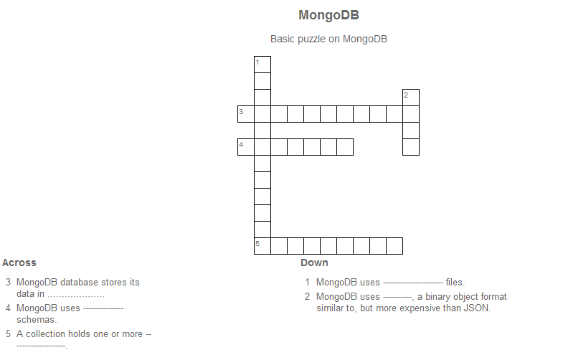
Crossword

Slide 88
Further Readings
http://www.mongodb.org/ https://university.mongodb.com/ http://www.tutorialspoint.com/mongodb/

Slide 89
Thank you

