Slide 1



Data Exploration & Visualization
Unit-2
Dr. SELVA KUMAR S
ASSISTANT PROFESSOR
DEPT. OF CSE

Slide 2
Agenda
◆ Transformation Techniques
◆ Performing data deduplication
◆ Replacing values
◆ Discretization and binning
◆ Introduction to Missing data
◆ Handling missing data
◆ Traditional methods
◆ Maximum Likelihood Estimation

Slide 3
Prerequisites
Pandas
NumPy
Seaborn
Matplotlib
https://www.youtube.com/watch?v=kjXgYBiOzc4

Slide 4
Data Transformation
Data transformation is a set of techniques used to convert data from one format or structure to another format or structure.
Notes:
Data transformation is a crucial step in data preprocessing and analysis. By applying appropriate data transformation techniques, you can prepare the data to be suitable for downstream analysis or modeling. The different types of data transformation techniques such as manipulation, normalization, attribute construction, generalization, discretization, aggregation, and smoothing can help solve various problems that arise in data analysis projects.
It's essential to understand the data, identify the project objectives, and consider the downstream analysis or modeling techniques to choose the best data transformation techniques for the project. Experimentation and iteration are also crucial to refine the data transformation process and improve the quality of the data.
By incorporating data transformation techniques into your data analysis or machine learning projects, you can improve the accuracy and reliability of your results and gain valuable insights from your data. Therefore, it's crucial to pay close attention to data transformation techniques and choose the best ones that meet your project's needs.

Slide 5
Transformation Activities
Data deduplication
Key restructuring
Data cleansing
Data validation
Format revisioning
Data derivation
Data aggregation
Data integration
Data filtering
Data joining
Notes:
Data deduplication involves the identification of duplicates and their removal.
Key restructuring involves transforming any keys with built-in meanings to the
generic keys.
Data cleansing involves extracting words and deleting out-of-date, inaccurate, and
incomplete information from the source language without extracting the
meaning or information to enhance the accuracy of the source data.
Data validation is a process of formulating rules or algorithms that help in
validating different types of data against some known issues.
Format revisioning involves converting from one format to another.
Data derivation consists of creating a set of rules to generate more information
from the data source.
Data aggregation involves searching, extracting, summarizing, and preserving
important information in different types of reporting systems.
Data integration involves converting different data types and merging them into a
common structure or schema.
Data filtering involves identifying information relevant to any particular user.
Data joining involves establishing a relationship between two or more tables.
The main reason for transforming the data is to get a better representation such that the
transformed data is compatible with other data.

Slide 6
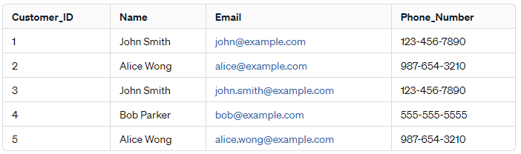
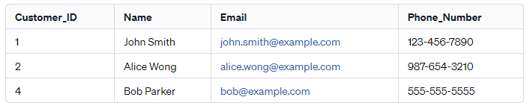
Data deduplication
Original Data:
Deduplication Process:
Identification of Duplicates: Identify duplicates based on specific criteria, such as matching email addresses or phone numbers.
Removal of Duplicates: After identification, choose which records to keep and which ones to remove.
Deduplicated Data:
Notes:
https://www.youtube.com/watch?v=wzN1UyfRSWI
https://towardsai.net/p/data-science/combine-datasets-using-pandas-merge-join-concat-and-append
https://blog.devgenius.io/combining-data-in-pandas-31c984afceb7
https://docs.kanaries.net/articles/pandas-dataframe-merge-join-concat
In Pandas for a horizontal combination we have merge() and join(), whereas for vertical combination we can use concat() and append(). Merge and join perform similar tasks but internally they have some differences, similar to concat and append. And in this blog, I had tried to list out the differences in the nature of these methods.

Slide 7
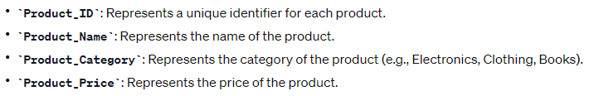
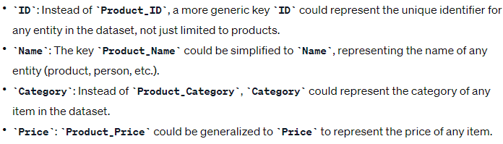
Key restructuring
Key restructuring involves transforming any keys with built-in meanings to the generic keys.
Th restructuring makes the keys more generic and applicable to a wider range of data or entities, rather than being specifically tied to products.
It allows for easier reuse and scalability if the dataset expands beyond just products to include other types of entities.
Example:

Slide 8
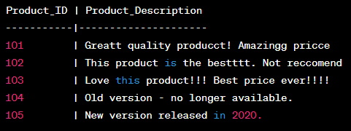
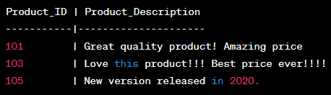
Data cleansing
Data cleansing involves extracting words and deleting out-of-date, inaccurate, and
incomplete information from the source language without extracting the Meaning.
Original Data:
Data Cleansing Process:
Extracting Words: First, extract words from the product descriptions to remove spelling errors and make the text more uniform.
Deleting Outdated, Inaccurate, and Incomplete Information: Remove outdated, inaccurate, or incomplete information without altering the intended meaning.
Cleansed Data:

Slide 9
Data validation
Data validation is a process of formulating rules or algorithms that help in validating different types of data against some known issues.
Data Validation Rules:
Name Field:
Rule: The name should contain only alphabetic characters and spaces.
Example: John Doe, Alice Smith
Email Field:
Rule: Email should follow a standard email format.
Example: john@example.com, alice.smith@emailprovider.com
Phone Number Field:
Rule: Phone number should be in a specific format (e.g., ###-###-####).
Example: 123-456-7890, 987-654-3210

Slide 10
Format revisioning
Format revisioning involves converting from one format to another.
Format Revisioning Process:
Identifying Old Format Files: Locate the existing text documents in the older "DOC" format that need to be revised or updated to the newer format.
Converting to New Format:
Use software or tools capable of batch conversion to convert all "DOC" files to the "DOCX" format.
Microsoft Word, for instance, allows for batch conversion where multiple "DOC" files can be opened and saved as "DOCX" files.

Slide 11
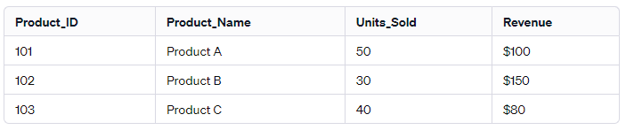
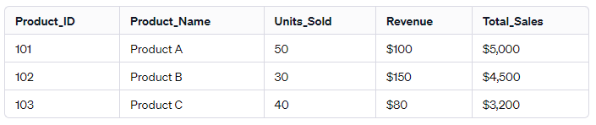
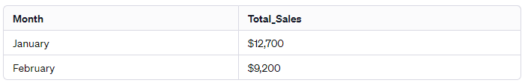
Data derivation
Data derivation consists of creating a set of rules to generate more information
from the data source.
Example:
Creating a New Column - Total Sales: Units_Sold * Revenue
Deriving Monthly Sales Data: Sum the Total_sales

Slide 12
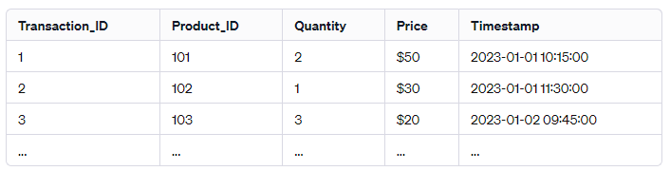
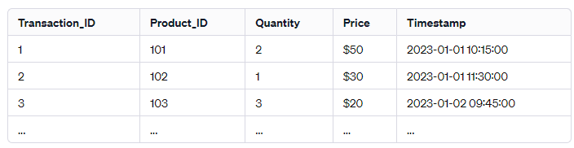
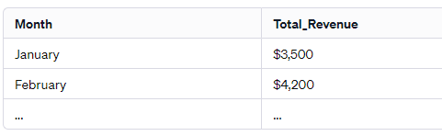
Data aggregation
Data aggregation involves searching, extracting, summarizing, and preserving important information in different types of reporting systems.
Example:
Summarizing Daily Sales:
Calculating Monthly Revenue:

Slide 13
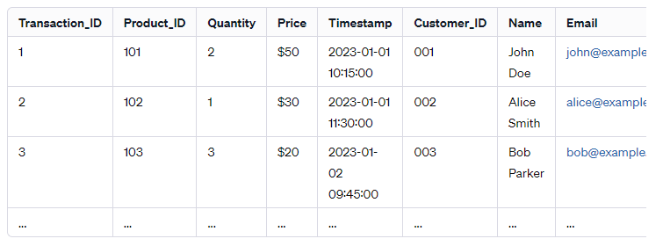
Data integration
Data integration involves converting different data types and merging them into a
common structure or schema.
Example:
Suppose a retail company has data stored in various formats and locations:
Sales Data: Stored in a SQL database with columns like Transaction_ID, Product_ID, Quantity, Price, and Timestamp.
Customer Data: Stored in a CSV file containing customer information such as Customer_ID, Name, Email, and Phone_Number.
Inventory Data: Stored in an Excel sheet with details like Product_ID, Product_Name, Stock_Quantity, and Supplier.

Slide 14
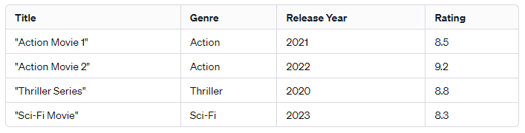
Data filtering
Data filtering involves identifying information relevant to any particular user.
Example:
Imagine a scenario where a user wants to find movies or TV shows based on specific criteria, such as genre, release year, and rating.

Slide 15
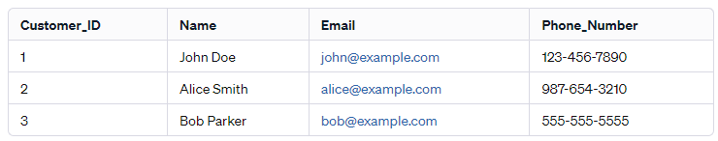
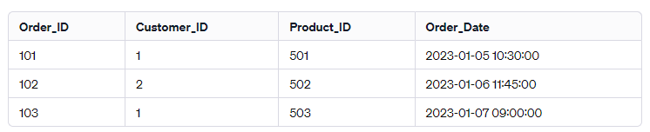
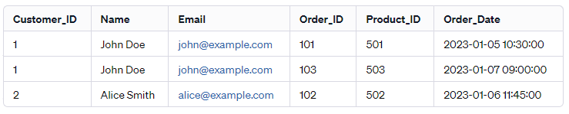
Data joining
Data joining involves establishing a relationship between two or more tables.
Example:
Result of Data Joining:

Slide 16
Pandas dataframes
Pandas offer different functionalities for combining DataFrames:
Append
Concat
Merge
Join

Slide 17
When to use each Function?
append: Use when adding rows from one DataFrame to another.
concat: Use for combining DataFrames along rows or columns based on axes.
merge: Use for performing SQL-like joins based on common columns.
join: Use for combining DataFrames based on index or specific columns.
Notes:
append and concat focus on combining data vertically or horizontally without considering specific column relationships. merge and join perform merges based on specified columns or indexes.
join() method is used to perform join on row indices and doesn’t support joining on columns unless setting column as an index.
join() by default performs left join.
merge() method is used to perform join on indices, columns, and a combination of these two.
merge() by default performs inner join.
Both these methods support inner, left, right, and outer join types. merge additionally supports the cross-join.

Slide 18
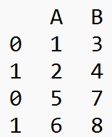
Append function
Usage: Appending rows from one DataFrame to another.
Example:
import pandas as pd
# Creating DataFrames
df1 = pd.DataFrame({'A': [1, 2], 'B': [3, 4]})
df2 = pd.DataFrame({'A': [5, 6], 'B': [7, 8]})
# Appending df2 to df1
df_appended = df1.append(df2)
print(df_appended)

Slide 19
Concat Function
Usage: Concatenating DataFrames along rows or columns based on axes.
Example:
import pandas as pd
# Creating DataFrames
df1 = pd.DataFrame({'A': [1, 2], 'B': [3, 4]})
df2 = pd.DataFrame({'A': [5, 6], 'B': [7, 8]})
# Concatenating along rows (axis=0)
df_concatenated = pd.concat([df1, df2], axis=0)
print("Concatenated DataFrame:")
print(df_concatenated)

Slide 20
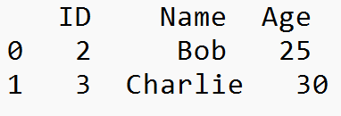
Merge Function
Usage: Performing database-style joins by merging DataFrames based on key columns.
Example:
import pandas as pd
# Creating DataFrames
df1 = pd.DataFrame({'ID': [1, 2, 3], 'Name': ['Alice', 'Bob', 'Charlie']})
df2 = pd.DataFrame({'ID': [2, 3, 4], 'Age': [25, 30, 28]})
# Merging based on 'ID' column
merged_df = pd.merge(df1, df2, on='ID', how='inner')
print("Merged DataFrame:")
print(merged_df)

Slide 21
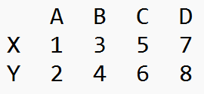
Join Function
Usage: Joining DataFrames based on their index or a specific column.
Example:
import pandas as pd
# Creating DataFrames
df1 = pd.DataFrame({'A': [1, 2], 'B': [3, 4]}, index=['X', 'Y'])
df2 = pd.DataFrame({'C': [5, 6], 'D': [7, 8]}, index=['X', 'Y'])
# Joining based on index
joined_df = df1.join(df2)
print("Joined DataFrame:")
print(joined_df)

Slide 22
Guess the output??
import pandas as pd
df1 = pd.DataFrame({'A': [1, 2], 'B': [3, 4]})
df2 = pd.DataFrame({'A': [5, 6], 'C': [7, 8]})
df_appended = df1.append(df2, sort=False) # sort=False to handle different columns
print("Appended DataFrame:")
print(df_appended)

Slide 23
Answer
A B C
0 1 3.0 NaN
1 2 4.0 NaN
0 5 NaN 7.0
1 6 NaN 8.0

Slide 24
Guess the output?
import pandas as pd
# Creating DataFrames with unequal columns
df1 = pd.DataFrame({'A': [1, 2], 'B': [3, 4]})
df2 = pd.DataFrame({'A': [5, 6], 'C': [7, 8]})
# Concatenating along columns (axis=1) with unequal columns
df_concatenated = pd.concat([df1, df2], axis=1, sort=False)
print("Concatenated DataFrame:")
print(df_concatenated)

Slide 25
Answer
A B A C
0 1 3 5 7
1 2 4 6 8

Slide 26
Guess the output?
import pandas as pd
df1 = pd.DataFrame({'ID': [1, 2], 'Name': ['Alice', 'Bob']})
df2 = pd.DataFrame({'ID': [1, 2], 'Age': [25, 30], 'Location': ['NY', 'CA']})
# Merging based on 'ID' column
merged_df = pd.merge(df1, df2, on='ID', how='inner')
print("Merged DataFrame:")
print(merged_df)

Slide 27
Answer
ID Name Age Location
0 1 Alice 25 NY
1 2 Bob 30 CA

Slide 28
Guess the output?
import pandas as pd
# Creating DataFrames
df1 = pd.DataFrame({'A': [1, 2], 'B': [3, 4]}, index=['X', 'Y'])
df2 = pd.DataFrame({'C': [5, 6], 'D': [7, 8]}, index=['X', 'Y'])
# Joining based on index
joined_df = df1.join(df2, how='outer')
print("Joined DataFrame:")
print(joined_df)

Slide 29
Answer
A B C D
X 1 3 5 7
Y 2 4 6 8

Slide 30
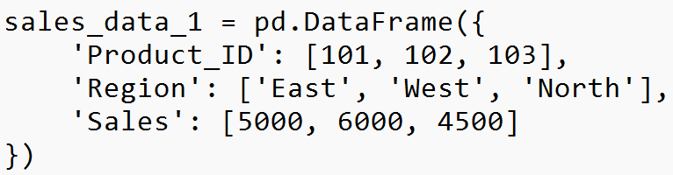
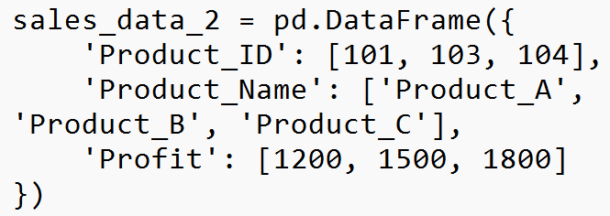
Exercise-1
Use Case: Sales Data Analysis
Scenario:
Suppose you have two datasets related to sales:
sales_data_1 containing sales figures for various products in different regions.
sales_data_2 containing additional sales information for specific products.
Tasks:
Append Data: Combine both datasets vertically to create a comprehensive sales dataset.
Concatenate Data: Concatenate the sales data along columns for a more detailed analysis.
Merge Data: Merge the datasets based on a common key (product ID) to enrich the sales information.
Join Data: Join the datasets based on the product names to analyze sales by product names.

Slide 31
Transformation Techniques

Slide 32
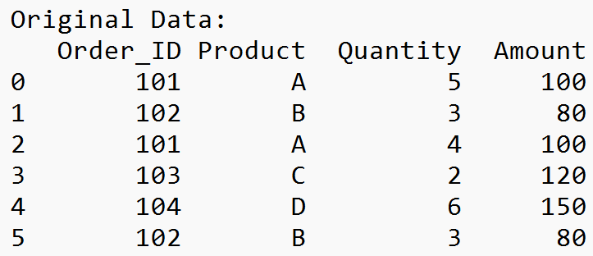
Performing data deduplication
Data deduplication involves removing duplicate rows from a dataset to maintain data integrity and accuracy.
Example:
import pandas as pd
# Sample data with duplicates
data = {
'Order_ID': [101, 102, 101, 103, 104, 102],
'Product': ['A', 'B', 'A', 'C', 'D', 'B'],
'Quantity': [5, 3, 4, 2, 6, 3],
'Amount': [100, 80, 100, 120, 150, 80]
}
sales_data = pd.DataFrame(data)
print("Original Data:")
print(sales_data)

Slide 33
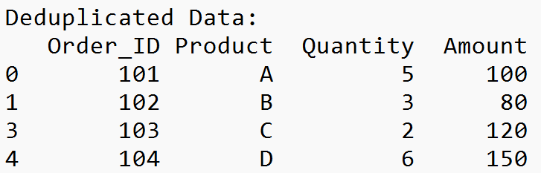
Deduplication
Deduplication using the drop_duplicates() method in Pandas:
# Removing duplicates based on all columns
deduplicated_data = sales_data.drop_duplicates()
print("\nDeduplicated Data:")
print(deduplicated_data)

Slide 34
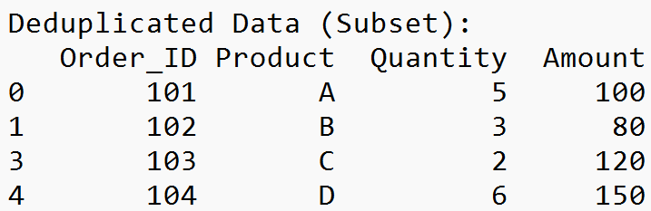
Deduplication
# Removing duplicates based on specific columns
deduplicated_data_subset = sales_data.drop_duplicates(subset=['Order_ID', 'Product'])
print("\nDeduplicated Data (Subset):")
print(deduplicated_data_subset)

Slide 35
Guess the output?
frame3 = pd.DataFrame({'column 1': ['Looping'] * 3 + ['Functions']
* 4, 'column 2': [10, 10, 22, 23, 23, 24, 24]})
frame3
frame3.duplicated()
frame4 = frame3.drop_duplicates()
frame4

Slide 36
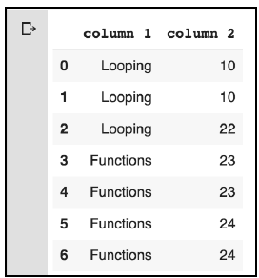
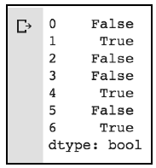
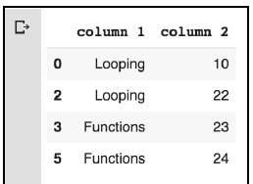
Answer

Slide 37
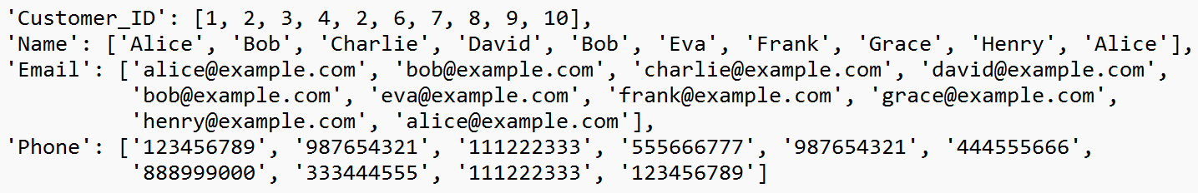
Exercise-2
Scenario: You are working as a data analyst for an e-commerce company that has a massive dataset containing customer information. The dataset has accumulated duplicate entries due to various reasons like multiple registrations, system errors, or data entry mistakes. Your task is to use the Pandas library in Python to identify and remove these duplicate entries efficiently.

Slide 38
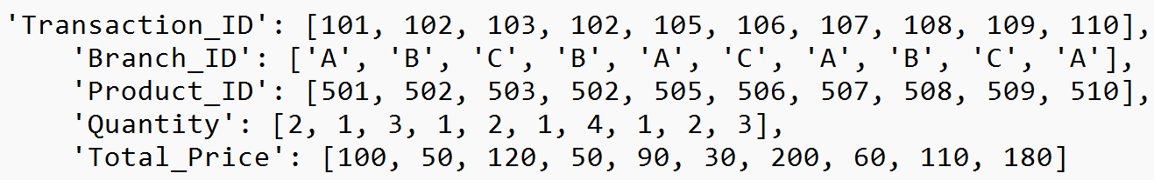
Exercise-3
Scenario: You're analyzing a sales dataset from a retail store chain that contains transactions from multiple branches. Due to system errors and data integration issues, the dataset has accumulated duplicate records of sales transactions. Your task is to use Pandas to identify these duplicates based on specific columns and retain only the unique transactions.

Slide 39
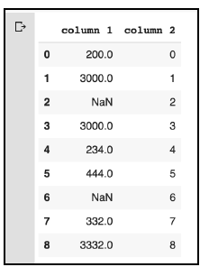
Replacing Values
use the replace method:
import numpy as np
replaceFrame = pd.DataFrame({'column 1': [200., 3000., -786.,
3000., 234., 444., -786., 332., 3332. ], 'column 2': range(9)})
replaceFrame.replace(to_replace =-786, value= np.nan)
Replace multiple values:
replaceFrame.replace(to_replace =[-786, 0], value= [np.nan, 2])

Slide 40
Exercise-4
Scenario:
You're working with a dataset that contains information about product sales. However, you've noticed that certain entries have inconsistent or incorrect values in the 'Category' column. You need to standardize these categories by replacing specific values with a unified category name using Pandas' replace() method.
data = {
'Product_ID': [1, 2, 3, 4, 5],
'Product_Name': ['Apple', 'Banana', 'Orange', 'Pear', 'Grapes'],
'Category': ['Fruit', 'Fruit', 'Fruit', 'Veggie', 'Fruit']
}

Slide 41
Handling Missing Data
NaN value is used to indicate that there is no value.
There could be several reasons why a value could be NaN:
It can happen when data is retrieved from an external source and there are some incomplete values in the dataset.
It can also happen when we join two different datasets and some values are not matched.
Missing values due to data collection errors.
When the shape of data changes, there are new additional rows or columns that are not determined.
Reindexing of data can result in incomplete data.

Slide 42
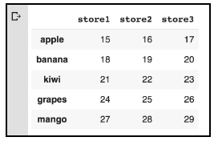
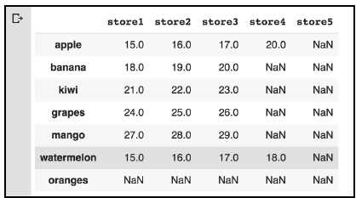
Example
data = np.arange(15, 30).reshape(5, 3)
dfx = pd.DataFrame(data, index=['apple', 'banana', 'kiwi’, 'grapes', 'mango'], columns=['store1', 'store2', 'store3’])
dfx
dfx['store4'] = np.nan
dfx.loc['watermelon'] = np.arange(15, 19)
dfx.loc['oranges'] = np.nan
dfx['store5'] = np.nan
dfx['store4']['apple'] = 20.
dfx

Slide 43
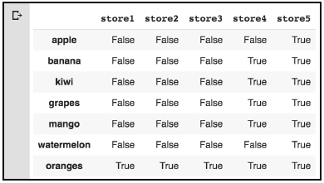
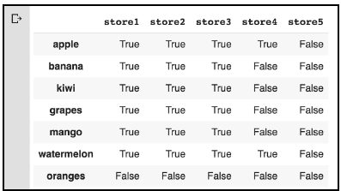
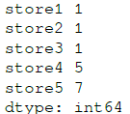
NaN values in Pandas Objects
dfx.isnull()
dfx.notnull()
dfx.isnull().sum()
dfx.isnull().sum().sum()
dfx.count()
Notes:
We can use the sum() method to count the number of NaN values in each store.
We can go one level deeper to find the total number of missing values:
instead of counting the number of missing values, we can count the number
of reported values:

Slide 44
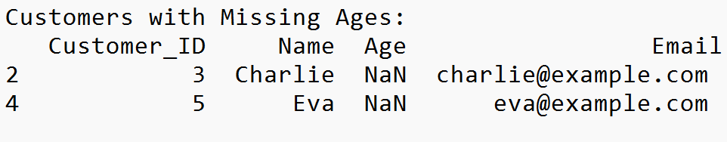
Example
import pandas as pd
# Load your dataset into a DataFrame
df = pd.read_csv('your_dataset.csv')
# Check for missing values in the entire DataFrame
print(df.isnull().sum())
# Check for missing values in a specific column
print(df['Column_Name'].isnull().sum())

Slide 45
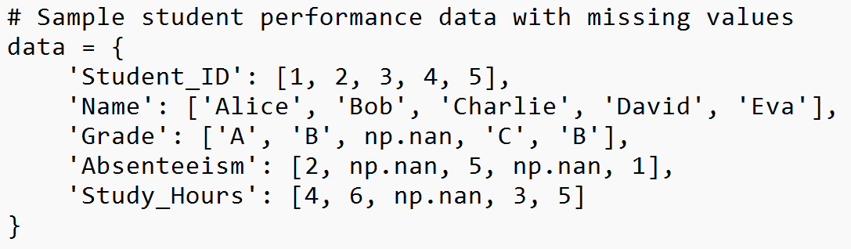
Exercise-5
Scenario: You've received a dataset containing information about students' performance, but the dataset has missing values across multiple columns due to various reasons. Your task is to analyze and handle these missing values using Pandas' methods.
Questions:
How many missing values are there in the 'Grade' column of the dataset?
What is the total count of missing values in the entire dataset?
Can you identify and display rows where 'Absenteeism' values are missing?
How many rows have complete data (non-missing) in the 'Study Hours' column?
What is the sum of missing values across each column in the dataset?
How many missing values are there in each column of the dataset?

Slide 46
Dropping missing values
One of the ways to handle missing values is to simply remove them from dataset.
dropna() method just returns a copy of the dataframe by dropping the rows with NaN. The original dataframe is not changed.
Drop rows with any missing values
df.dropna(inplace=True) # Use inplace=True to modify the original DataFrame
Drop rows where specific columns have missing values
df.dropna(subset=['Column_Name'], inplace=True)
Drop rows where entire row values are NaN
df.dropna(how=‘all’)
Drop rows where entire column values are NaN
df.dropna(how=‘all’,axis=1)
Drop column with minimum number of NaN exist
df.dropna(thresh=5,axis=1)

Slide 47
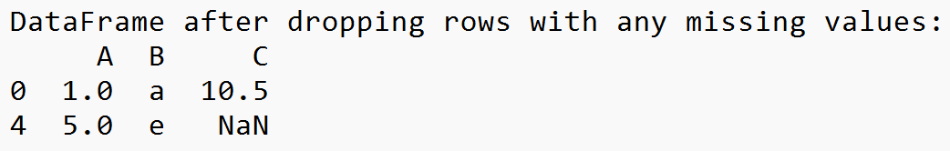
Example-1
import pandas as pd
# Sample data with missing values
data = {
'A': [1, 2, None, 4, 5],
'B': ['a', 'b', 'c', None, 'e'],
'C': [10.5, None, 30.2, 40.1, None]
}
# Creating a DataFrame
df = pd.DataFrame(data)
# Dropping rows with any missing values
df_dropped = df.dropna()
print("DataFrame after dropping rows with any missing values:")
print(df_dropped)

Slide 48
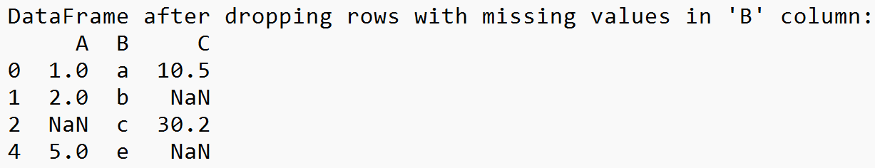
Example-2
import pandas as pd
# Sample data with missing values
data = {
'A': [1, 2, None, 4, 5],
'B': ['a', 'b', 'c', None, 'e'],
'C': [10.5, None, 30.2, 40.1, None]
}
# Dropping rows where 'B' column has missing values
df_dropped_b = df.dropna(subset=['B'])
print("DataFrame after dropping rows with missing values in 'B' column:")
print(df_dropped_b)

Slide 49
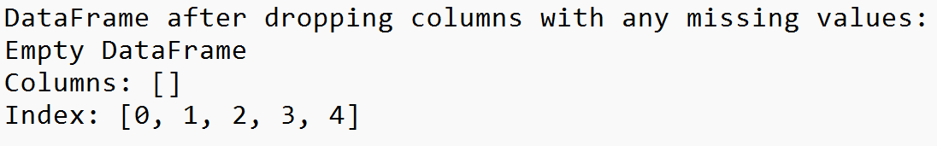
Example-3
import pandas as pd
# Sample data with missing values
data = {
'A': [1, 2, None, 4, 5],
'B': ['a', 'b', 'c', None, 'e'],
'C': [10.5, None, 30.2, 40.1, None]
}
# Dropping columns with any missing values
df_dropped_columns = df.dropna(axis=1)
print("DataFrame after dropping columns with any missing values:")
print(df_dropped_columns)

Slide 50
Mathematical operations with NaN
Consider the following example:
ar1 = np.array([100, 200, np.nan, 300])
ser1 = pd.Series(ar1)
ar1.mean(), ser1.mean()
The output of the preceding code is the following:
(nan, 200.0)
When a NumPy function encounters NaN values, it returns NaN.
Pandas, on the other hand, ignores the NaN values and moves ahead with processing. When performing the sum operation, NaN is treated as 0. If all the values are NaN, the result is also NaN.

Slide 51
Exercise-6
Scenario:
You are analyzing a dataset containing information about employees in a company. However, the dataset is not entirely clean and has missing values in various columns due to data entry errors and incomplete records. Your task is to preprocess the data by handling missing values using Pandas' dropna() method.
Questions:
How would you drop all rows with any missing values from the entire dataset using Pandas?
If the 'Salary' column is critical for analysis, how can you drop only the rows where 'Salary' values are missing while preserving the rest of the dataset?
In some columns, missing values are acceptable up to a certain limit. How would you drop rows with more than two missing values across any column?
For the 'Department' column, there are missing values that can't be imputed. How can you drop rows where 'Department' is missing while keeping rows with other missing values intact?
Considering the 'Address' and 'Phone' columns have a significant number of missing values, how can you drop these columns entirely from the dataset?
If you want to drop rows where 'Years of Experience' are missing and 'Salary' is also missing or zero, how would you achieve this?

Slide 52
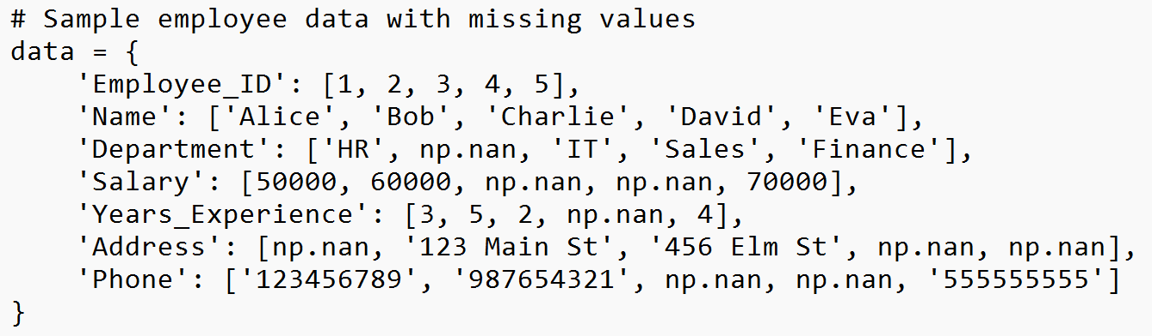
Dataset

Slide 53
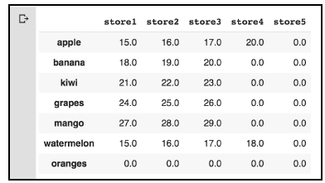
Filling Missing values
We can use the fillna() method to replace NaN values with any particular values.
Example:
filledDf = dfx.fillna(0)
filledDf
# Fill missing values with a specific constant
df['Column_Name'].fillna(value=0, inplace=True)
# Fill missing values with the mean of the column
df['Column_Name'].fillna(df['Column_Name'].mean(), inplace=True)
# Fill missing values with the most frequent value in the column
df['Column_Name'].fillna(df['Column_Name'].mode()[0], inplace=True)

Slide 54
Example
import pandas as pd
import numpy as np
data = {
'A': [1, 2, np.nan, 4, 5], 'B': ['a', np.nan, 'c', 'd', 'e’], 'C': [10, 20, np.nan, np.nan, 50],
'D': [np.nan, 'Yes', 'No', 'Yes', np.nan]
}
df = pd.DataFrame(data)
# 1. Fill missing numerical values with the mean of the column
df_filled_mean = df.copy()
df_filled_mean['A'].fillna(df_filled_mean['A'].mean(), inplace=True)
df_filled_mean['C'].fillna(df_filled_mean['C'].mean(), inplace=True)
# 2. Fill missing categorical values with the most frequent value (mode)
df_filled_mode = df.copy()
df_filled_mode['B'].fillna(df_filled_mode['B'].mode()[0], inplace=True)
df_filled_mode['D'].fillna(df_filled_mode['D'].mode()[0], inplace=True)
print("DataFrame with missing values:") print(df)
print("\nDataFrame after filling missing numerical values with mean:") print(df_filled_mean)
print("\nDataFrame after filling missing categorical values with mode:") print(df_filled_mode)
Notes:
Mode()[0] 0 means first index of the mode result

Slide 55
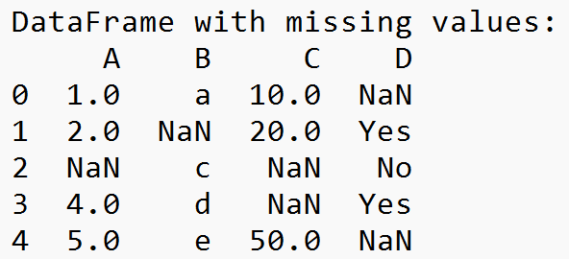
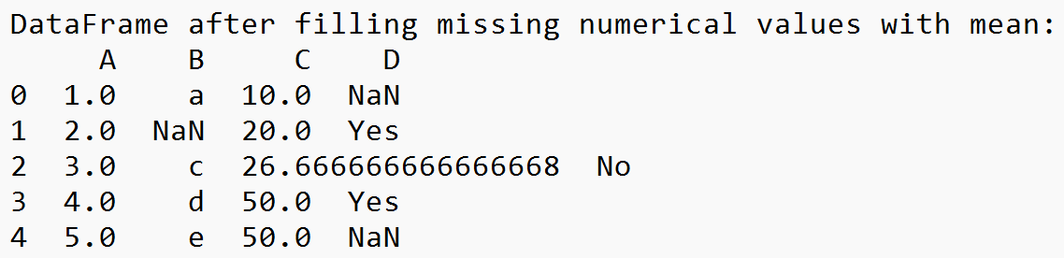
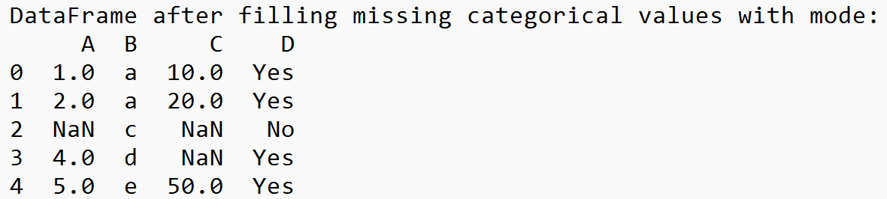
Output

Slide 56
Backward and Forward Filling
NaN values can be filled based on the last known values.
# Forward fill missing values with the previous valid value
df.fillna(method='ffill', inplace=True)
# Backward fill missing values with the next valid value
df.fillna(method='bfill', inplace=True)

Slide 57
Example
# Sample data with missing values
data = {
'A': [1, 2, np.nan, 4, 5], 'B': ['a', np.nan, 'c', 'd', 'e’], 'C': [10, 20, np.nan, np.nan, 50],
'D': [np.nan, 'Yes', 'No', 'Yes', np.nan]
}
df = pd.DataFrame(data)
# 1. Forward fill missing values in categorical columns
df_ffill = df.copy()
df_ffill['B'].fillna(method='ffill', inplace=True)
df_ffill['D'].fillna(method='ffill', inplace=True)
# 2. Backward fill missing values in numerical columns
df_bfill = df.copy()
df_bfill['A'].fillna(method='bfill', inplace=True)
df_bfill['C'].fillna(method='bfill', inplace=True)
print("DataFrame with missing values:") print(df)
print("\nDataFrame after forward filling missing categorical values:") print(df_ffill)
print("\nDataFrame after backward filling missing numerical values:") print(df_bfill)

Slide 58
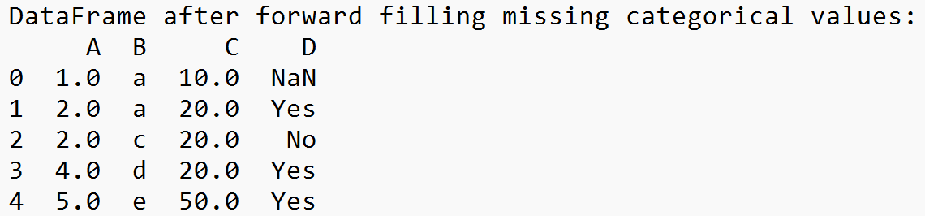
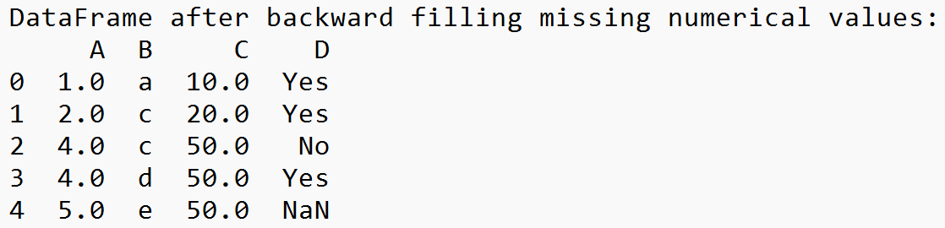
Output

Slide 59
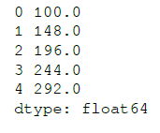
Interpolating missing value
The pandas library provides the interpolate() function both for the series and the
dataframe.
By default, it performs a linear interpolation of our missing values.
ser3 = pd.Series([100, np.nan, np.nan, np.nan, 292])
ser3.interpolate()
# Use linear interpolation to fill missing values
df['Column_Name'] = df['Column_Name'].interpolate(method='linear')
Notes:
(292-100)/(5-1) = 48. So, the next value after 100 is 100 + 48 = 148.

Slide 60
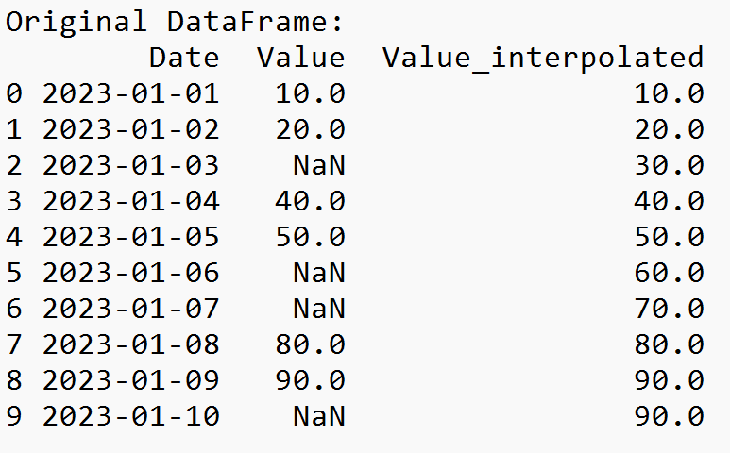
Example
import pandas as pd
import numpy as np
# Sample data with missing values
data = {
'Date': pd.date_range(start='2023-01-01', periods=10),
'Value': [10, 20, np.nan, 40, 50, np.nan, np.nan, 80, 90, np.nan]
}
# Creating a DataFrame
df = pd.DataFrame(data)
# Interpolating missing values in the 'Value' column using linear interpolation
df['Value_interpolated'] = df['Value'].interpolate(method='linear')
# Displaying the original and interpolated DataFrames
print("Original DataFrame:")
print(df)

Slide 61
Using Mask for missing values
Creating a Mask : Once you've identified the missing values, create a boolean mask that indicates the positions of these missing values in your dataset.
For example, in Pandas, you can use functions like isnull() or notnull() to create a boolean mask.
import pandas as pd
import numpy as np
data = pd.DataFrame({'A': [1, 2, np.nan, 4],
'B': [5, np.nan, 7, 8]})
# Creating a mask for missing values
mask = data.isnull()

Slide 62
Using Mask
Use the mask to perform specific operations:
Filling missing values with a certain value
Dropping rows or columns with missing values
Performing computations only on non-missing values.
# Filling missing values with a specific number
filled_data = data.fillna(0)
# Dropping rows with any missing values
cleaned_data = data.dropna()
# Performing operations only on non-missing values
mean_without_missing = data.mean(skipna=True)
# Create a mask to identify missing values in a column
mask = df['Column_Name'].isnull()
# Use the mask to perform operations or replacements on missing values
df.loc[mask, 'Column_Name'] = 'Missing' # For instance, replace missing values with a string 'Missing'

Slide 63
Applying the Mask
Apply the mask to filter out missing values or perform operations selectively on non-missing values.
# Applying the mask to get non-missing values
non_missing_values = data[mask == False]
# Applying mask to perform operations selectively
sum_without_missing = data[mask == False].sum()

Slide 64
Scenario-1
Handling missing values can vary based on the nature of the data and the context of the analysis.
Scenario 1: Numerical Data
Approach 1: Imputation
Mean/Median/Mode Imputation: Replace missing values in numerical columns with the mean, median, or mode of the non-missing values in that column.
# Impute missing values with mean
data['column'].fillna(data['column'].mean(), inplace=True)
Notes:
Approach-1 central tendency (mean/median/mode)

Slide 65
Scenario-2
Scenario 2: Categorical Data
Approach 1: Mode Imputation
Replace missing categorical values with the mode (most frequent) value in that column.
# Impute missing categorical values with mode
data['column'].fillna(data['column'].mode()[0], inplace=True)
Approach 2: Create a New Category
If the missing values represent a category on their own, you might encode missing values as a separate category.
# Replace missing categorical values with 'Unknown'
data['column'].fillna('Unknown', inplace=True)

Slide 66
Scenario-3
Scenario 3: Time Series Data
Approach 1: Forward or Backward Fill
Use the previous (backward fill) or next (forward fill) known value to fill missing values in a time series.
# Forward fill missing values
data['column'].fillna(method='ffill', inplace=True)
Approach 2: Interpolation
Interpolate missing values based on existing data points. For time series, you might use linear interpolation.
# Linear interpolation
data['column'] = data['column'].interpolate(method='linear')

Slide 67
Renaming axis indexes
Renaming axis indexes is a common operation in pandas when you want to change the labels or names of rows or columns.
Renaming Row Indexes (Axis=0)
import pandas as pd
data = pd.DataFrame({'A': [1, 2, 3], 'B': [4, 5, 6]}, index=['X', 'Y', 'Z'])
data.rename(index={'X': 'New_X'}, inplace=True)
data.rename(index={'X': 'New_X', 'Y': 'New_Y'}, inplace=True)
Renaming Column Indexes (Axis=1)
data.rename(columns={'A': 'Column_A', 'B': 'Column_B'}, inplace=True)

Slide 68
Scenario
Let's consider a scenario where you have a dataset representing sales data for different products in a store. The dataset contains sales figures indexed by the product names, and you want to rename some products and update the column names to better reflect the data.
import pandas as pd
# Creating sample sales data
sales_data = pd.DataFrame({
'Old_Product_A': [100, 120, 90],
'Old_Product_B': [80, 60, 70],
'Old_Product_C': [50, 40, 60]
}, index=['Jan', 'Feb', 'Mar'])
# Renaming indexes (products) and columns
sales_data.rename(index={'Jan': 'January', 'Feb': 'February', 'Mar': 'March'}, inplace=True)
sales_data.rename(columns={'Old_Product_A': 'Product_X', 'Old_Product_B': 'Product_Y', 'Old_Product_C': 'Product_Z'}, inplace=True)
print(sales_data)

Slide 69
Discretization and Binning
Discretization:
Discretization involves dividing a continuous variable into intervals or bins. There are mainly two types:
Equal Width Discretization:
Divides the range of values into equally spaced intervals.
Example:
import pandas as pd
data = pd.DataFrame({'A': [10, 15, 18, 20, 31, 34, 41, 46, 51, 53, 54]})
bins = pd.cut(data['A'], bins=3) # Divides data into 3 equal-width bins
Equal Frequency Discretization (Quantile-Based):
Divides the data into intervals with approximately the same number of observations in each bin.
Example:
bins = pd.qcut(data['A'], q=3) # Divides data into 3 quantile-based bins

Slide 70
Equal Width Discretization
Dataset points: 10, 15, 18, 20, 31, 34, 41, 46, 51, 53, 54
Step 1: Sort the dataset in ascending order: 10, 15, 18, 20, 31, 34, 41, 46, 51, 53, 54.
Step 2: Determine the width of each bin using the formula: w = (max-min) / N ( N is number of bin)
w is calculated as (54 - 10) / 4 = 11.
BIN 1 : [lower bound , upper bound] = [(min) , (min + w -1)] = [10, 20]
BIN 2 : [lower bound , upper bound] = [(min + w) , (min + 2w -1)] = [21, 31]
BIN 3 : [lower bound , upper bound] = [(min + 2w) , (min + 3w -1)] = [32, 42]
BIN 4 : [lower bound , upper bound] = [(min + 3w) , (max)] = [43, 54]
BIN 1 : [10, 15, 18, 20]
BIN 2 : [31]
BIN 3 : [34, 41]
BIN 4 : [46, 51, 53, 54]

Slide 71
Equal Frequency Discretization
Dataset: 10,15, 18, 20, 31, 34, 41, 46, 51, 53, 54, 60
Step 1: sort the data.
Step 2: find the frequency. To calculate the frequency
total number of data points/number of bins.
The total number of data points is 12, and the number of bins required is 3.
Therefore, the frequency comes out to be 4
BIN 1: 10, 15, 18, 20
BIN 2: 31, 34, 41, 46
BIN 3: 51, 53, 54, 60

Slide 72

Binning
Binning involves assigning continuous values to specific bins or categories based on certain criteria. This can be applied to group data or simplify its representation.
Example:
Suppose you have a list of ages and want to categorize them into different age groups:
import pandas as pd
ages = [22, 35, 47, 50, 28, 19, 65, 37, 42, 51]
# Define bins and labels for age groups
bins = [18, 30, 40, 50, 60, 100]
labels = ['18-29', '30-39', '40-49', '50-59', '60+']
# Create age groups based on defined bins and labels
age_groups = pd.cut(ages, bins=bins, labels=labels)
# Add age groups to the original data
data = pd.DataFrame({'Age': ages, 'AgeGroup': age_groups})
print(data)

Slide 73
Exercise-7
Scenario: You're working on a dataset containing information about housing prices in a city. One of the features in your dataset is the square footage of the houses. You've been tasked with binning the square footage data into categories to better understand how the size of a house relates to its price.

Slide 74
Outlier detection and filtering
Outlier detection and filtering are important steps in data preprocessing.
Identify and handle anomalous or extreme values that can skew statistical analyses or machine learning models.
Several methods can be employed to detect outliers.
Filtering can involve handling them by removing, capping, or transforming them.

Slide 75
Outlier Detection Methods
Statistical Methods:
Z-Score: Identifying values far from the mean in terms of standard deviations.
IQR (Interquartile Range): Using quartiles to identify values outside a specific range.
Visualization Techniques:
Boxplots: Visual representation of the data's distribution to spot outliers.
Scatterplots: Visualizing relationships and identifying points distant from others.
Machine Learning Methods:
Clustering Algorithms: Detecting data points that don’t cluster well with others.
Isolation Forest, Local Outlier Factor (LOF): Algorithms specifically designed for outlier detection.

Slide 76
Filtering Outliers
Removal:
Deleting the identified outlier data points from the dataset.
Capping or Flooring:
Setting a threshold and capping or flooring outlier values to a specific limit.
Transformations:
Applying mathematical transformations (log, square root) to reduce the impact of outliers.

Slide 77
Example
import pandas as pd
import numpy as np
# Load housing price data
housing_data = pd.read_csv('housing_data.csv')
# Calculate Z-Score for 'Price' column
mean_price = np.mean(housing_data['Price'])
std_price = np.std(housing_data['Price'])
z_scores = (housing_data['Price'] - mean_price) / std_price
# Detect and filter outliers (considering a Z-Score threshold of 3)
outlier_threshold = 3
filtered_data = housing_data[abs(z_scores) < outlier_threshold]
# Explore filtered data
print(filtered_data.head())

Slide 78
Permutation and random sampling
Permutation refers to rearranging or shuffling the order of a set of elements.
In statistics, permutation tests involve creating new arrangements of the data to assess the likelihood of obtaining the observed results by chance.
Example:
import numpy as np
# Original data
data = np.array([10, 20, 30, 40, 50])
# Permute the data (shuffle the order)
permuted_data = np.random.permutation(data)
print(permuted_data)
[30 40 10 50 20]

Slide 79
Permutation and random sampling
Random sampling involves selecting a subset of data points from a larger dataset.
Each data point has an equal probability of being chosen.
It's used to create representative samples for analysis without bias.
Example:
import pandas as pd
# Original dataset
dataset = pd.read_csv('data.csv')
# Random sampling of 30% of the data
sampled_data = dataset.sample(frac=0.3, random_state=42)
print(sampled_data)
Notes:
Frac=0.3 is 30% data is selected as sample
The choice of the value 42 is arbitrary; you can use any integer value for random_state. Using the same random_state value ensures that the sequence of random numbers generated by the algorithm remains consistent across runs, allowing for reproducibility in data operations that involve randomness.

Slide 80

Random sampling without replacement
It involves selecting a subset of items from a larger set without allowing for duplicates in the selected subset.
Example:
import pandas as pd
# Original dataset (a DataFrame)
data = pd.DataFrame({'Values': [10, 20, 30, 40, 50, 60, 70, 80, 90, 100]})
# Random sampling without replacement using Pandas
sampled_data = data['Values'].sample(n=5, replace=False)
print(sampled_data)

Slide 81


Example
Consider a dataset of student grades:
import pandas as pd
import numpy as np
# Create a DataFrame with student grades
data = pd.DataFrame({
'Student_ID': np.arange(1, 21), # IDs for 20 students
'Grade': np.random.randint(60, 100, size=20) # Random grades between 60 and 100
})
print("Original Data:")
print(data)
# Random sampling without replacement
sampled_data = data['Grade'].sample(n=5, replace=False)
print("\nSampled Data:")
print(sampled_data)

Slide 82

Random sampling with replacement
It involves selecting items from a dataset where each selection is made independently and with the possibility of selecting the same item multiple times.
Example:
import pandas as pd
import numpy as np
# Create a DataFrame with student grades
data = pd.DataFrame({
'Student_ID': np.arange(1, 21), # IDs for 20 students
'Grade': np.random.randint(60, 100, size=20) # Random grades between 60 and 100
})
print("Original Data:")
print(data)
# Random sampling with replacement
sampled_data = data['Grade'].sample(n=5, replace=True, random_state=42)
print("\nSampled Data:")
print(sampled_data)

Slide 83
Exercise-8
You are given a dataset containing the daily sales figures of a retail store for the past month. The dataset comprises 30 entries, each representing the sales amount for a particular day.
Use pandas library to perform the following:
Create dataset
Perform random sampling with replacement to select a subset of 8 days' sales figures. Display the sampled data.
Perform random sampling without replacement to select a subset of 8 days' sales figures. Display the sampled data.

Slide 84
Benefits of data transformation
Handling Skewed Distributions
Improving Model Performance
Managing Missing Values
Better Visualization
Noise Reduction
Outlier Handling

