Slide 1
BIG DATA & ANALYTICS
Unit-I
Dr. SELVA KUMAR S
ASSISTANT PROFESSOR
DEPT. OF CSE

Slide 2
Learning Objectives and Learning Outcomes
Learning Objectives | Learning Outcomes
Introduction to digital data and its types Structured data: Sources of structured data, ease with structured data, etc. Semi-Structured data: Sources of semi-structured data, characteristics of semi- structured data. Unstructured data: Sources of unstructured data, issues with terminology, dealing with unstructured data. | To differentiate between structured, semi-structured and unstructured data. To understand the need to integrate structured, semi- structured and unstructured data.

Slide 3
Agenda
Types of Digital Data
◆ Structured
Sources of structured data
Ease with structured data
◆ Semi-Structured
Sources of semi-structured data
◆ Unstructured
Sources of unstructured data
Issues with terminology
Dealing with unstructured data

Slide 4
Classification of Digital Data
Digital data is classified into the following categories:
◆ Structured data- This is the data which is in an organized form(e.g, rows and columns) and can be easily used by a computer program. Relationships exist between entities of data, such as classes and their objects. Data stored in databases is an example of structured data.
◆ Semi-structured data- This is the data which does not conform to a data model but has some structure. However, it is not in a form which can be used easily by a computer program, for example, emails, XML, markup languages like HTML etc.,
◆ Unstructured data- -This is the data which does not conform to a data model or is not in a form which can be used easily by a computer program. About 80%-90% data of an organization is in this format for example, memos, chat rooms, powerpoint presentations, images, videos, letters etc,.

Slide 5
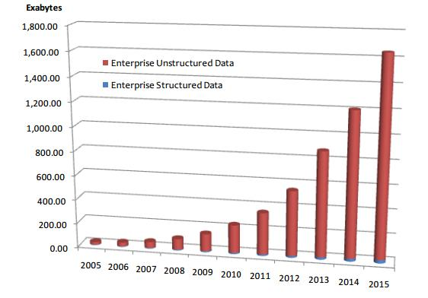
Approximate Distribution of Digital Data
Approximate percentage distribution of digital data

Slide 6
Structured Data

Slide 7
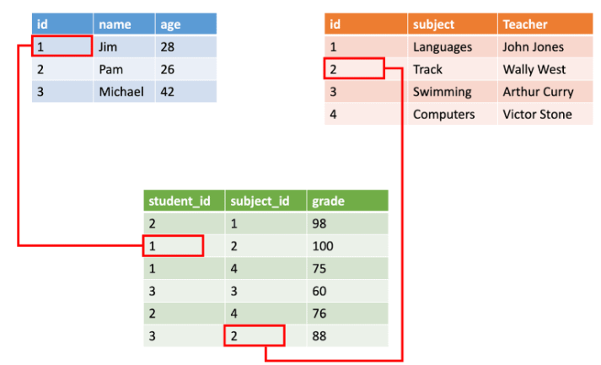
Structured Data
◆ This is the data which is in an organized form (e.g., in rows and columns) and can be easily used by a computer program.
◆ In structured data, all row in a table has the same set of columns.
◆ Data stored in databases is an example of structured data.

Slide 8
Sources of Structured Data
Databases such as Oracle, DB2, Teradata, MySql, PostgreSQL, etc
Structured data
Spreadsheets
OLTP Systems

Slide 9
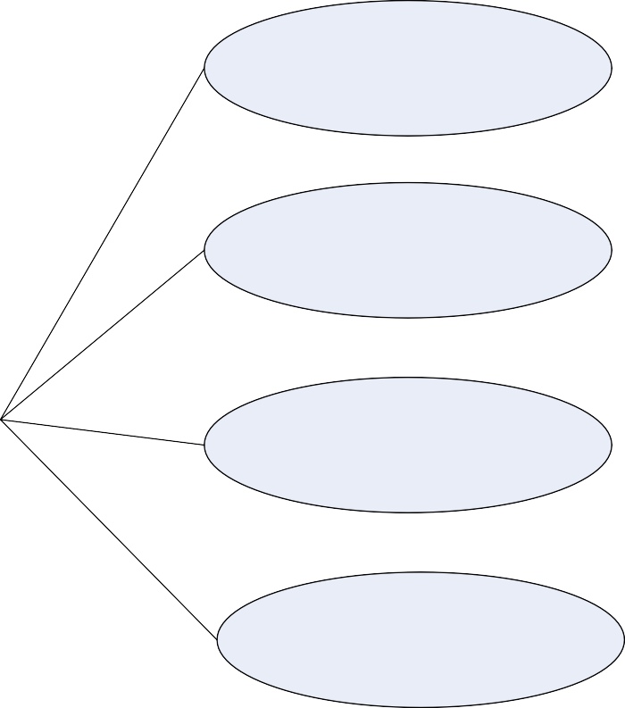
Ease with Structured Data
Input / Update / Delete
Security
Ease with Structured data
Indexing / Searching
Scalability
Transaction Processing(ACID properties

Slide 10
Semi-structured Data

Slide 11
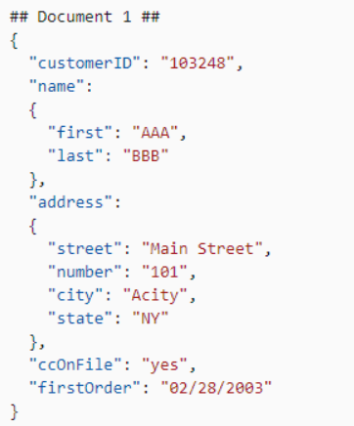
Semi-structured Data
◆ This is the data which does not conform to a data model but has some structure. However, it is not in a form which can be used easily by a computer program.
◆ Example, emails, XML, markup languages like HTML, etc. Metadata for this data is available but is not sufficient.

Slide 12
Sources of Semi-structured Data
XML Extensible MarkUp Language
Other MarkUp Language
JSON(JavaScript Object Notation)
Semi-Structured Data

Slide 13
Characteristics of Semi-structured Data
Inconsistent Structure
Self-describing (lable/value pairs)
Semi-structured data
Often Schema information is blended with data values
Data objects may have different attributes not known beforehand

Slide 14
Unstructured Data

Slide 15
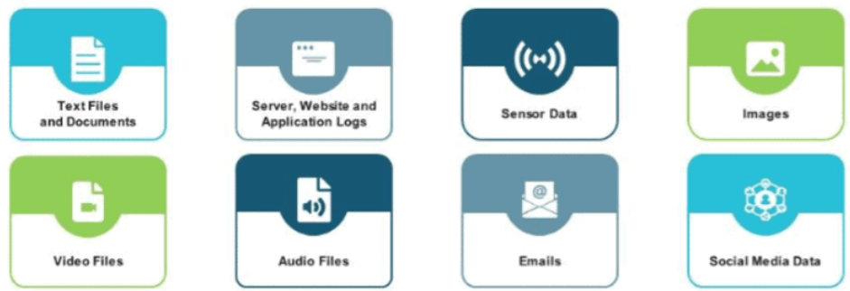
Unstructured Data
◆ This is the data which does not conform to a data model or is not in a form which can be used easily by a computer program.
◆ About 80–90% data of an organization is in this format.
◆ Example: memos, chat rooms, PowerPoint presentations, images, videos, letters, researches, white papers, body of an email, etc.

Slide 16
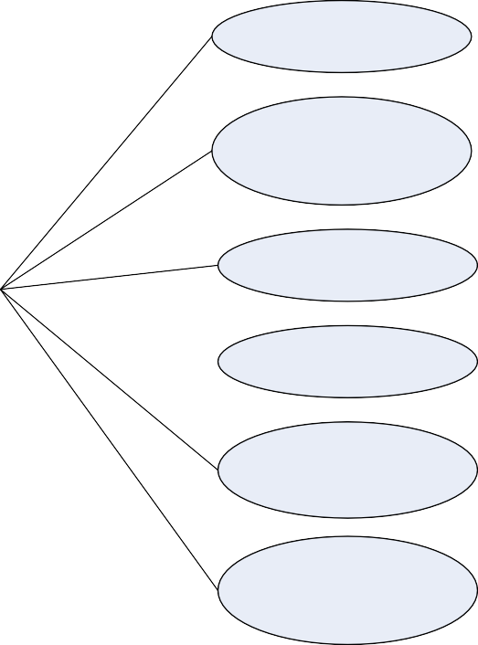
Sources of Unstructured Data
Web Pages
Images
Free-Form Text
Unstructured data
Audios
Videos
Body of Email
Text Messages
Chats Social
Media data
Word
Document

Slide 17
Issues with terminology – Unstructured Data
Structure can be implied despite not being formerly defined.
Issues with terminology
Data with some structure may still be labeled
unstructured if the structure doesn’t help with processing task at hand
Data may have some structure or may even be
highly structured in ways that are unanticipated or unannounced.

Slide 18
Dealing with Unstructured Data
Data Mining
Natural Language Processing (NLP)
Dealing with Unstructured Data
Text Analytics
Noisy Text Analytics

Slide 19
Dealing with Unstructured Data
Data Mining
  Association Rule Mining
  Regression Analysis
  Collaborative Filtering
Text analysis and Text Mining
Natural Language Processing(NLP)
Noisy text Analysis
Manual tagging with metadata
Part-of-speech tagging
Unstructured Information Management Architecture(UIMA)

Slide 20
Answer a few quick questions …

Slide 21
Answer Me
◆ Which category (structured, semi-structured, or unstructured) will you place a Web Page in?
◆ Which category (structured, semi-structured, or unstructured) will you place
Word Document in?
◆ State a few examples of human generated and machine-generated data.

Slide 26
Summary please…
few participants of the learning program to summarize the lecture.

Slide 27
Properties | Structured data | Semi-structured data | Unstructured data
Technology | It is based on Relational database table | It is based on XML/RDF(Resource Description Framework). | It is based on character and binary data
Transaction management | Matured transaction and various concurrency techniques | Transaction is adapted from DBMS not matured | No transaction management and no concurrency
Version management | Versioning over tuples,row,tables | Versioning over tuples or graph is possible | Versioned as a whole
Flexibility | It is schema dependent and less flexible | It is more flexible than structured data but less flexible than unstructured data | It is more flexible and there is absence of schema
Scalability | It is very difficult to scale DB schema | It’s scaling is simpler than structured data | It is more scalable.
Robustness | Very robust | New technology, not very spread | —
Query performance | Structured query allow complex joining | Queries over anonymous nodes are possible | Only textual queries are possible

Slide 28
References …

Slide 29
Further Readings
◆ http://data-magnum.com/the-big-deal-about-big-data-whats-inside- structured-unstructured-and-semi-structured-data/
◆ http://www.webopedia.com/TERM/S/structured_data.html
◆ http://en.wikipedia.org/wiki/UIMA

Slide 30
Thank you

Slide 31
Chapter 2
Introduction to Big Data

Slide 32
Learning Objectives and Learning Outcomes
Learning Objectives | Learning Outcomes
Introduction to big data Definition of big data. Challenges of big data. Why big data? Traditional Business Intelligence versus big data. | To understand the significance of big data. To understand the other characteristics of data that are not definitional characteristics of big data. To understand the challenges of big data and how to deal with the same. To understand what is new today.

Slide 33
Agenda
◆ Definition of Big Data
Volume
Velocity
Variety
◆ Challenges of Big Data
◆ Other Characteristics of Data Which are Not Definitional Traits of Big
Data
◆ Why Big Data?
◆ Traditional Business Intelligence (BI) versus Big Data
A Typical Data Warehouse Environment
A Typical Hadoop Environment
Coexistence of Big Data and Data Warehouse

Slide 34
Characteristics of Data
Data has three characteristics:
Composition: deals with structure of data, that is, the sources of data , the granularity, the types, and the nature of the data as to whether it is static or real-time streaming.
2. Condition: The condition of data deals with the state of the data that is “can one use this data as is for analysis?” or “Does it require cleansing for further enhancement and enrichment?”
3. Context: deals with “Where has this data been generated?”, “Why was this data generated?” and so on.

Slide 35
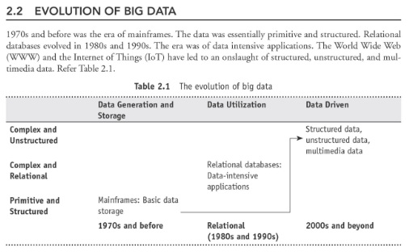

Slide 36
Definition of Big Data

Slide 37

Definition of Big Data
High-volume High-velocity High-variety
Big Data is high-volume, high- velocity, and high-variety information assets that demand cost effective, innovative forms of information processing for enhanced insight and decision making.
Source: Gartner IT Glossary
Cost-effective, innovative forms of information processing
Enhanced insight & decision making
Notes:
Doug Laney

Slide 38
Volume
- A Mountain of Data
1 Kilobyte (KB) = 1000 bytes
1 Megabyte (MB) = 1,000,000 bytes
1 Gigabyte (GB) = 1,000,000,000 bytes
1 Terabyte (TB) = 1,000,000,000,000 bytes
1 Petabyte (PB) = 1,000,000,000,000,000 bytes
1 Exabyte (EB) = 1,000,000,000,000,000,000 bytes
1 Zettabyte (ZB) = 1,000,000,000,000,000,000,000 bytes
1 Yottabyte (YB) = 1,000,000,000,000,000,000,000,000 bytes

Slide 39
Volume
Where does this data get generated?
Typical internal sources:
  Data Storage- File systems, SQL, NoSQL (MongoDB, Cassandra).
  Archives – Archives of scanned documents, paper archives, customer records,
  patient health records etc,.
2. External data sources:
  public web - Wikipedia, weather, regulatory, census etc.
3. Both (internal+external)
  Sensor data – Car sensors, smart electric meters, office buildings etc,.
  Machine log data – Event logs, application logs, Business process logs, audit logs etc.
  Social media – Twitter, blogs, Facebook, LinkedIn, Youtube, Instagram etc,.
  Business apps – ERP,CRM, HR, Google Docs, and so on.
  Media – Audio, Video, Image, Podcast, etc.
  Docs – CSV, Word Documents, PDF,XLS, PPT and so on.

Slide 40
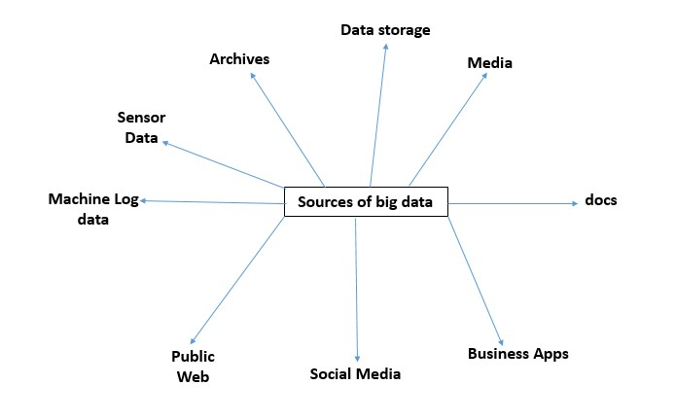
Sources of Big Data

Slide 41
Velocity
Batch → Periodic → Near real time → Real-time processing

Slide 42
Variety
◆ Structured data: example: traditional transaction processing systems and
RDBMS, etc.
◆ Semi-structured data: example: Hyper Text Markup Language (HTML), eXtensible Markup Language (XML).
◆ Unstructured data: example: unstructured text documents, audio, video,
email, photos, PDFs, social media, etc.

Slide 43
Other Characteristics of Data –
Which are not Definitional Traits of Big Data
Veracity and Validity-Veracity refers to biases, noises and abnormality in data.
Validity refers to the accuracy and correctness of the data.
Volatility-Deals with, how long is the data valid? And how long should it be stored?
Variability- Data flows can be highly inconsistent with periodic peaks.

Slide 44
Challenges with Big Data

Slide 45
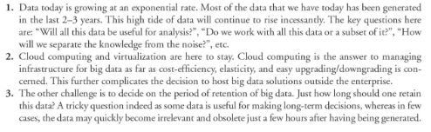
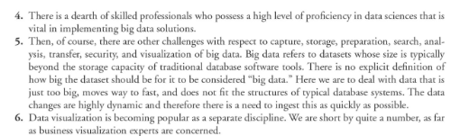

Slide 46
Challenges with Big Data
Capture
Storage
Curation
Challenges with Big Data
Search
Analysis
Transfer
Visualization
Privacy
Violations

Slide 47
Why Big Data?

Slide 48
Why Big Data?
More Data
More Accurate Analysis
More Confidence in decision making
Greater operational efficiencies, Cost reduction,
Time reduction, New product development, Optimized offerings, etc.

Slide 49
Traditional Business Intelligence (BI) versus Big Data
In traditional BI environment, all the enterprise’s data is housed in a central server whereas in a big data environment data resides in a distributed file system. The distributed file system scales by scaling in or out horizontally as compared to typical database server that scales vertically.
In traditional BI, data is generally analyzed in an offline mode whereas in big data, it is analyzed in both real time as well as in offline mode.
Traditional BI is about structured data and it is here that data is taken to processing functions whereas big data is about variety and here the processing functions are taken to the data.

Slide 50
A Typical Data Warehouse Environment
ERP
Reporting / Dashboarding
CRM
OLAP
Legacy
Data Warehouse
Ad hoc querying
3rd party Apps
Modeling

Slide 51
Co-existence of Big Data and Data Warehouse
Web Logs
HDFS
Hadoop
Operational Systems
Images and Videos
Data Warehouse
Social Media
(Twitter, Facebook, etc.)
Data Warehouse
MapReduce
Data Marts
Docs & PDFs
ODS
Notes:
ODS- Operational Data Store- is a central database that provides a snapshot of the latest data from multiple transactional systems for operational reporting. It enables organizations to combine data in its original format from various sources into a single destination to make it available for business reporting.
A data mart is a simple form of data warehouse focused on a single subject or line of business. With a data mart, teams can access data and gain insights faster, because they don't have to spend time searching within a more complex data warehouse or manually aggregating data from different sources.
An operational database is a database that stores data inside of an enterprise. They can contain things like payroll. records, customer information and employee data. They are critical to data.
A data warehouse is a type of data management system that is designed to enable and support business intelligence (BI) activities, especially analytics.

Slide 52
What is changing in the realms of Big data
Competitive Advantage
Decision Making
Value of Data

Slide 53
Its time for Activity…

Slide 56
Teams Games Tournaments

Slide 58
Answer Me
◆ Share your understanding of Big Data.
◆ How is traditional BI environment different from the Big Data environment?
◆ Share your experience as a customer on an e-commerce site. Comment on the
big data that gets created on a typical e-commerce site.

Slide 59
Summary please…
Ask a few participants of the learning program to summarize the lecture.

Slide 60
References …

Slide 61
Further Readings
◆ Big data for dummies - Judith Hurwitz, Alan Nugent, Fern Halper, Marcia Kaufman
◆ http://en.wikipedia.org/wiki/Big_data
◆ http://www.sas.com/en_us/insights/big-data/what-is-big-data.html
◆ https://www.oracle.com/bigdata/
◆ http://bigdatauniversity.com/

Slide 62
THANK YOU

