Slide 1
For thousands of years it is tried to be understood how humans think - how a mere handful of matter can perceive, understand, predict, and manipulate a world far larger and more complicated than itself.
The field of Artificial Intelligence goes further and attempts not just to understand but also to build intelligent systems
It is one of the newest science – started after World War 2 and the name given in 1956- Johnmccarthy- Father of AI
It is one of the most preferred science – together with molecular biology
Still has openings for several full time Einsteins

Slide 2
Huge variety of subfields – ranging from general purpose areas such as learning and perception to such specific tasks as playing chess, proving mathematical theorems, writing poetry, and diagnosing diseases
• AI systematizes and automates intellectual tasks and therefore it is relevant to any sphere of intellectual activity

Slide 3
10 Best Examples of Artificial Intelligence (AI) | Power of Artificial Intelligence in Real Life - YouTube
Rational- based on or in accordance with reason or logic:
"I'm sure there's a perfectly rational explanation"
able to think sensibly or logically

Slide 4
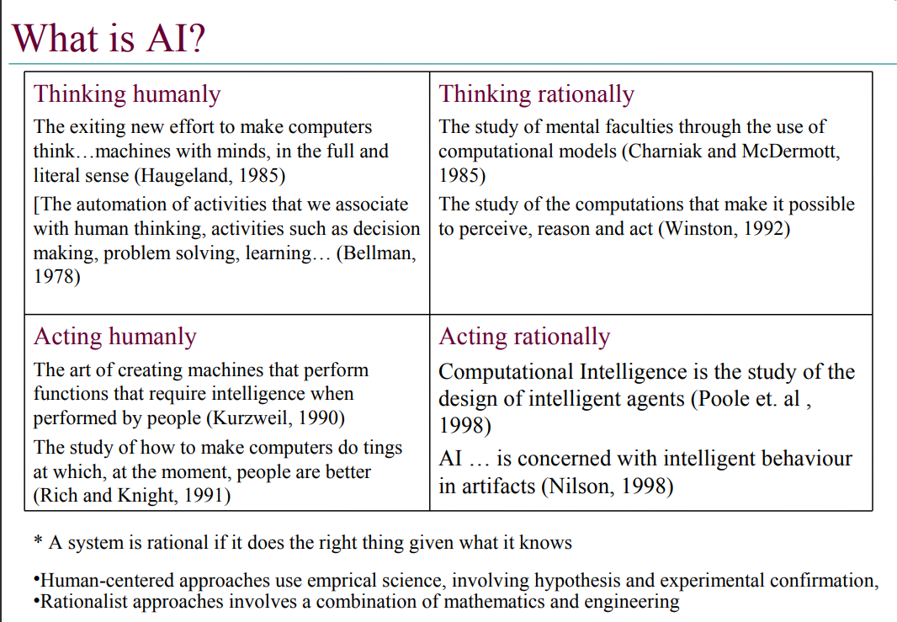

Slide 5
Note-Empirical science- is either one which, as the term implies, is supported by the evidence of the senses, or one which is built up out of the elements of experience
information acquired by observation or experimentation

Slide 6
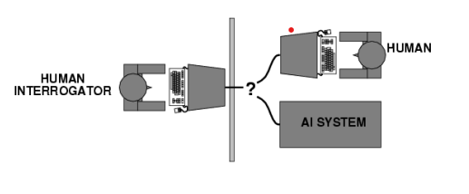
Acting humanly: Turing Test
Proposed by Alan Turing (1950)
• Operational definition for intelligent behaviour: the Imitation Game
The computer passes the test if a human interrogator, after posing some written questions, cannot tell whether the written responses come from a person or not
• Suggested major components of AI: natural language processing, knowledge representation, automated reasoning, machine learning

Slide 7
Natural language processing -to enable it to communicate successfully in English;
• Knowledge representation-to store what it knows or hears;
• Automated reasoning - to use the stored information to answer questions and to draw new conclusions;
• Machine learning to adapt to new circumstances and to detect and extrapolate patterns
To pass the total Turing Test, the computer will need
• Computer vision to perceive objects, and
• Robotics to manipulate objects and move about.

Slide 8
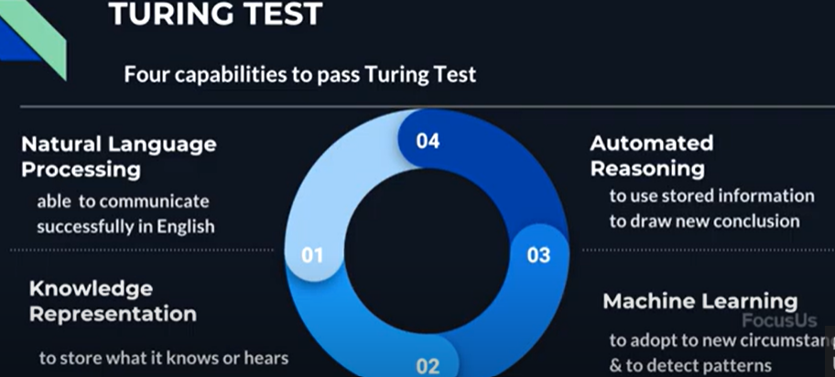

Slide 9
Cognitive- of, relating to, being, or involving conscious intellectual activity (such as thinking, reasoning, or remembering)

Slide 10
Thinking humanly: cognitive modeling
In order to say that a given program thinks like a human, we must have some way of determining how humans thinks
We need to get inside the actual workings of human minds.
There are three ways to do this:
through introspection—trying to catch our own thoughts as they go by;
through psychological experiments—observing a person in action; and
through brain imaging—observing the brain in action.
Once we have a sufficiently precise theory of the mind, it becomes possible to express the theory as a computer program.
If the program’s input–output behavior matches corresponding human behavior, that is evidence that some of the program’s mechanisms could also be operating in humans

Slide 11
The interdisciplinary field of cognitive science --brings together
computer models from AI and
experimental techniques from psychology
--to construct precise and testable theories of the human mind

Slide 12
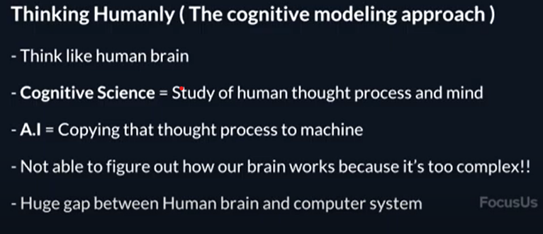

Slide 14
Thinking rationally: "laws of thought"
The Greek philosopher Aristotle was one of the first to attempt to codify “right thinking,” that is, reasoning processes
He provided patterns for argument structures that always yielded correct conclusions when given correct premises(syllogisms)—for example,
“Socrates is a man; all men are mortal; therefore, Socrates is mortal.”
“all dogs are animals; all animals have four legs; therefore all dogs have four legs”
These laws of thought were LOGIC supposed to govern the operation of the mind; their study initiated the field called logic
Developed various forms of logic: notation and rules of derivation for thoughts
Develop programs that could, in principle, solve any solvable problem described in logical notation.

Slide 15
There are two main obstacles to this approach.
First, it is not easy to take informal knowledge and state it in the formal terms required by logical notation
Second, there is a big difference between solving a problem “in principle” and solving it in practice.
Even problems with just a few hundred facts can exhaust the computational resources of any computer unless it has some guidance as to which reasoning steps to try first

Slide 16
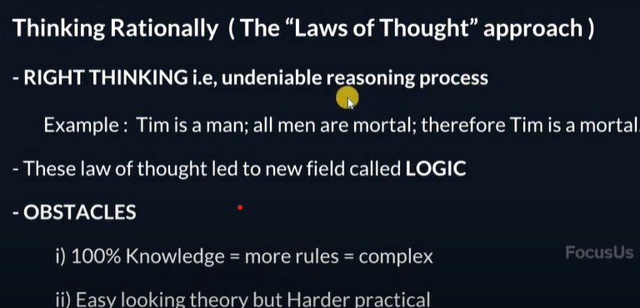

Slide 17
Acting rationally: The rational agent approach
Rational behavior: doing the right thing
The right thing: that which is expected to maximize goal achievement, given the available information
An agent is just something that acts- that operate autonomously, perceive their environment, persist over a prolonged time period, adapt to change, and create and pursue goals.
A rational agent is one that acts so as to achieve the best outcome or, when there is uncertainty, the best expected outcome.

Slide 18
In the “laws of thought” approach to AI, the emphasis was on correct inferences
(inference-a conclusion reached on the basis of evidence and reasoning):
There are also ways of acting rationally that cannot be said to involve inference.
For example, recoiling from a hot stove is a reflex action
The rational-agent approach has two advantages over the other approaches.
First, it is more general than the “laws of thought” approach because correct inference is just one of several possible mechanisms for achieving rationality.
Second, it is more amenable to scientific development than are approaches based on human behavior or human thought.
The standard of rationality is mathematically well defined and completely general, and can be “unpacked” to generate agent designs that provably achieve it

Slide 19
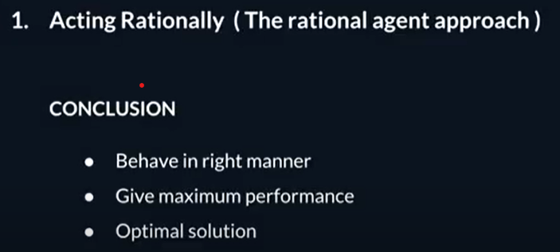

Slide 20
THE FOUNDATIONS OF ARTIFICIAL INTELLIGENCE
A brief history of the disciplines that contributed ideas, viewpoints,
and techniques to AI.
Philosophy
• Can formal rules be used to draw valid conclusions?
• How does the mind arise from a physical brain?
• Where does knowledge come from?
• How does knowledge lead to action?
RATIONALISM - reasoning
DUALISM – soul in human
MATERIALISM – hold brain to work with law of physics
EMPIRICISM – no understanding, if not first in the senses
INDUCTION – repeated associations
Observation sentence – sensory inputs
Theory confirmation – acquired from experience

Slide 21
Mathematics
What are the formal rules to draw valid conclusions?
What can be computed?
How do we reason with uncertain information?
Algorithm
Incompleteness theorem
Computible
Tractability
NP-Completeness
Probability
AI
21

Slide 22
Economics
How should we make decisions so as to maximize payoff?
How should we do this when others may not go along?
How should we do this when the payoff may be far in the future?
Utility
Decision Theory
Game Theory
Operations Research
Satisficing – good decision
AI
22

Slide 23
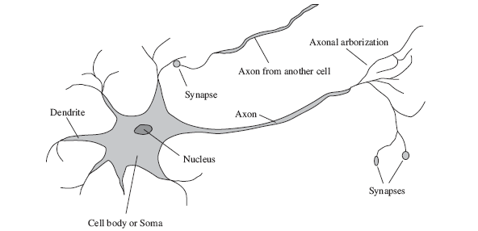
Neuroscience
How do brains process information?
Neuroscience
Neuron
Singularity – computer at superhuman level
AI
23

Slide 24
Psychology
How do humans and animals think and act?
Behaviourism
Cognitive psychology
Cognitive science
AI
24

Slide 25
Computer Engineering
How can we build an efficient computer?
The first operational computer was the electromechanical Heath Robinson, built in 1940 by Alan Turing’s team for a single purpose: deciphering German messages.
The first electronic computer, the ABC, was assembled by John Atanasoff and his student Clifford Berry
Charles Babbage (1792–1871) designed two machines
AI
25

Slide 26
Control theory and cybernetics
How can artifacts operate under their own control?
Control theory
Cybernetics
Objective function
AI
26

Slide 27
Linguistics
How does language relate to thought?
Computational Linguistic
AI
27

Slide 28
History
Aristotle (384–322 B.C.) developed an informal system of syllogisms for proper reasoning, which in principle allowed one to generate conclusions mechanically, given initial premises. -an instance of a form of reasoning in which a conclusion is drawn from two given or assumed propositions (premises)
Ramon Lull (d. 1315) had the idea that useful reasoning could actually be carried out by a mechanical artifact.
Thomas Hobbes (1588–1679) proposed that reasoning was like numerical computation, that “we add and subtract in our silent thoughts.”

Slide 29
Leonardo da Vinci (1452–1519) designed calculator
First Mechanical calculator by German scientist Wilhelm Schickard (1592–1635), although the Pascaline, built in 1642 by Blaise Pascal (1623–1662).
In his 1651 book Leviathan, Thomas Hobbes suggested the idea of an “artificial animal,” arguing “For what is the heart but a spring; and the nerves, but so many strings; and the joints, but so many wheels.”

Slide 30
Artificial intelligence (AI) is a field of computer science that focuses on creating machines that can perform tasks that typically require human intelligence, such as learning, reasoning, and decision-making 1. | traditional computer programs are designed to follow a set of predefined rules and instructions to solve specific problems
AI systems can learn from data and improve their performance over time without being explicitly programmed to do so. | traditional computer programs require explicit programming to perform specific tasks
AI systems can handle complex tasks that are difficult or impossible for traditional computer programs to solve. For example, AI systems can recognize speech, images, and patterns in data with high accuracy

Slide 31
1
Chapter 2 Intelligent Agents

Slide 32
Outline
2
Agents and environments
Rationality
PEAS (Performance measure, Environment, Actuators, Sensors)
Environment types
Agent types

Slide 33
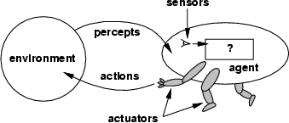
Agents
3
An agent is anything that can be viewed as
perceiving its environment through sensors and
acting upon that environment through actuators
Assumption: Every agent can perceive its own actions (but not always the effects)

Slide 34
Agents
4
Human agent:
eyes, ears, and other organs for sensors;
hands,legs, mouth, and other body parts for actuators
Robotic agent:
cameras and infrared range finders for sensors;
various motors for actuators
A software agent:
Keystrokes, file contents, received network packages as sensors
Displays on the screen, files, sent network packets as actuators

Slide 35
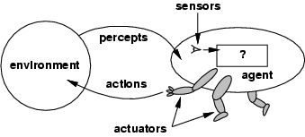
Agents and environments
5
Percept: agent’s perceptual input at any given instant
Percept sequence: complete history of everything the agent has ever perceived
An agent’s choice of action at any given instant can depend on the entire percept sequence observed to date
•
•
An agent’s behavior is described by the agent function which maps from percept histories to actions:
[f: P* → A]
We can imagine tabulating the agent function that describes any given agent (External characterization)
Internally, the agent function will be implemented by an agent program which runs on the physical architecture to produce f
agent = architecture + program
•
•
•

Slide 36
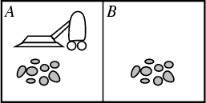
Vacuum-cleaner world
6
•
•
•
Two locations: A and B
Percepts: location and contents, e.g., [A,Dirty] Actions: Left, Right, Suck, NoOp
Percept sequence | Actions
[A,Clean] | Right
[A, Dirty] | Suck
[B,Clean] | Left
[B,Dirty] | Suck
[A,Clean],[A,Clean] | Right
[A,Clean],[A,Dirty] | Suck
… | …
[A,Clean],[A.Clean],[A,Clean] | Right
[A,Clean],[A,Clean],[A,Clean] | Suck
One simple function is :
if the current square is dirty then suck, otherwise move to the other square

Slide 37
The concept of rationality
7
A rational agent is one that does the right thing- An agent should strive to "do the right thing", based on what it can perceive and the actions it can perform.
What does it mean to do the right thing? - By considering the consequences of the agent’s behavior.
When an agent is plunked down in an environment, it generates a sequence of actions according to the percepts it receives.
This sequence of actions causes the environment to go through a sequence of states. If the sequence is desirable, then the agent has performed well.
This notion of desirability is captured by a performance measure that evaluates any given sequence of environment states.
•

Slide 38
We said environment states, not agent states?. If we define success in terms of agent’s opinion of its own performance, an agent could achieve perfect rationality simply by deluding itself that its performance was perfect
Performance measure for vaccum cleaner?
Measure performance by the amount of dirt cleaned up in a single eight-hour shift.?
OR
Reward the agent for having a clean floor. For example, one point could be awarded for each clean square at each time step?
It is better to design performance measures according to what one actually wants in the environment, rather than according to how one thinks the agent should behave.

Slide 40
Rationality
8
What is rational at any given time depends on four things
The performance measure that defines the criterion of success
The agent’s prior knowledge of the environment
The actions that the agent can perform
The agent’s percept sequence to date
Rational Agent: For each possible percept sequence, a rational agent should select an action that is expected to maximize its performance measure, given the evidence provided by the percept sequence and whatever built-in knowledge the agent has.
Is Vacuum cleaner agent rational?

Slide 41
Vacuum cleaner agent
9
Let’s assume the following
The performance measure awards one point for each clean square at each time step, over a lifetime of 1000 time steps
The geography of the environment is known a priori but the dirt distribution and the initial location of the agent are not.
Clean squares stay clean and the sucking cleans the current square.
The Left and Right actions move the agent left and right except when this would take the agent outside the environment, in which case the agent remains where it is
The only available actions are Left, Right, Suck and NoOp
The agent correctly perceives its location and whether that location contains dirt
Under these circumstances the agent is rational:its expected performance is at least as high as any other agent’s
•

Slide 42
Vacuum cleaner agent
10
Same agent would be irrational under different circumstances
once all dirt is cleaned up it will oscillate needlessly back and forth.
If the performance measure includes a penalty of one point for each movement left or right, the agent will fare poorly.
A better agent for this case would do nothing once it is sure that all the squares are clean.
If the clean squares can become dirty again,
the agent should occasionally check and clean them if needed.
If the geography of the environment is unknown the agent will need to explore it rather than stick to squares A and B

Slide 43
OMNISCIENT AND RATIONALITY
11
Rational agent knows the actual outcome of its actions and can act accordingly; but omniscience is impossible in reality
Rationality is distinct from omniscience (all-knowing with infinite knowledge)
Rationality maximizes expected performance while perfection maximizes actual performance
Our definition of rationality does not require omniscience, then, because the rational choice depends only on the percept sequence to date
A chess AI would be a good example of this. It’s simply not possible with current technology to foresee every possible outcome or know the exact result of any given move

Slide 44
Important aspects
Doing actions in order to modify future percepts—sometimes called information gathering— is an important part of rationality
A second example of information gathering is provided by the exploration that must be undertaken by a vacuum-cleaning agent in an initially unknown environment

Slide 45
Importance of Learning:
Our definition requires a rational agent not only to gather information but also to learn as much as possible from what it perceives.
The agent’s initial configuration could reflect some prior knowledge of the environment, but as the agent gains experience this may be modified and augmented.
There are extreme cases in which the environment is completely known a priori.
In such cases, the agent need not perceive or learn; it simply acts correctly. Of course, such agents are fragile

Slide 46
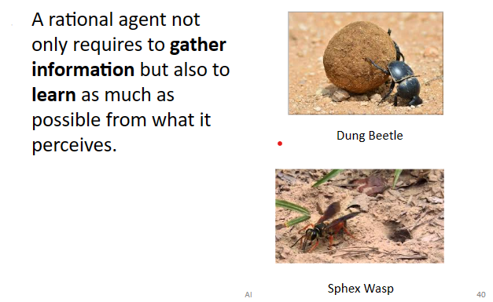

Slide 47
The female sphex will dig a burrow, go out and sting a caterpillar and drag it to the burrow, enter the burrow again to check all is well, drag the caterpillar inside, and lay its eggs. The caterpillar serves as a food source when the eggs hatch. So far so good, but if an entomologist moves the caterpillar a few inches away while the sphex is doing the check, it will revert to the “drag” step of its plan and will continue the plan without modification, even after dozens of caterpillar-moving interventions

Slide 48
Importance of autonomy
If an agent relies on the prior knowledge of its designer rather than on its own percepts, we say that the agent lacks autonomy.
A rational agent should be autonomous—it should learn what it can to compensate for partial or incorrect prior knowledge.
a vacuum-cleaning agent that learns to foresee where and when additional dirt will appear will do better than one that does not.
As a practical matter, one seldom requires complete autonomy from the start: when the agent has had little or no experience, it would have to act randomly unless the designer gave some assistance.

Slide 49
The nature of environments
We have a definition of rationality, we are almost ready to think about building rational agents.
First, however, we must think about task environments, which are essentially the “problems” to which rational agents are the “solutions.”
We begin by showing how to specify a task environment
In designing an agent, the first step must always be to specify the task environment as fully as possible.
PEAS (Performance, Environment, Actuators, Sensors)

Slide 50
Specifying the task environment (PEAS)
12
PEAS:
Performance measure,
Environment,
Actuators,
Sensors
In designing an agent, the first step must always be to specify the task environment (PEAS) as fully as possible

Slide 51
PEAS for an automated taxi driver
13
Performance measure: minimizing fuel consumption and wear and tear; minimizing the trip time or cost; minimizing violations of traffic laws and disturbances to other drivers; maximizing safety and passenger comfort; maximizing profits
Environment: Roads, other traffic, pedestrians, customers
Actuators: Steering wheel, accelerator, brake, signal, horn
Sensors: Cameras, sonar, speedometer, GPS, odometer, engine sensors, keyboard

Slide 52
PEAS for a medical diagnosis system
14
Performance measure: Healthy patient, minimize costs, lawsuits
Environment: Patient, hospital, staff
Actuators: Screen display (questions, tests, diagnoses, treatments, referrals)
Sensors: Keyboard (entry of symptoms, findings, patient's answers)

Slide 53
PEAS for a satellite image analysis system
15
Performance measure: correct image categorization
Environment: downlink from orbiting satellite
Actuators: display categorization of scene
Sensors: color pixel arrays

Slide 54
PEAS for a part-picking robot
16
Performance measure: Percentage of parts in correct bins
Environment: Conveyor belt with parts, bins
Actuators: Jointed arm and hand
Sensors: Camera, joint angle sensors

Slide 55
PEAS for a refinery controller
17
Performance measure: maximize purity, yield, safety
Environment: refinery, operators
Actuators: valves, pumps, heaters, displays
Sensors: temperature, pressure, chemical sensors

Slide 56
PEAS for Interactive English tutor
18
Performance measure: Maximize student's score on test
Environment: Set of students
Actuators: Screen display (exercises, suggestions, corrections)
Sensors: Keyboard

Slide 57
List of agent types includes some programs that operate in the entirely artificial environment defined by keyboard input and character output on a screen
what matters is not the distinction between “real” and “artificial” environments, but the complexity of the relationship among the behavior of the agent, the percept sequence generated by the environment, and the performance measure
Some “real” environments are actually quite simple. For example, a robot designed to inspect parts

Slide 58
In contrast, some software agents (or software robots or softbots) -Complex
Imagine a softbot Web site operator designed to scan Internet news sources and show the interesting items to its users,
while selling advertising space to generate revenue.
To do well, that operator will need some natural language processing abilities, it will need to learn what each user and advertiser is interested in, and it will need to change its plans dynamically

Slide 59
Environment types
19
•
•
•
•
•
•
Fully observable vs. partially observable Deterministic vs. stochastic
Episodic vs. sequential Static vs. dynamic Discrete vs. continuous Single agent vs. multiagent

Slide 60
Environment types
20
Fully observable vs. partially observable:
An environment is fully observable if an agent's sensors give it access to the complete state of the environment at each point in time.
Fully observable environments are convenient, because the agent need not maintain any internal state to keep track of the world
An environment might be partially observable because of noisy and inaccurate sensors or because parts of the state are simply missing from the sensor data
Examples: vacuum agent with only a local dirt sensor cannot tell whether there is dirt in other squares, and an automated taxi cannot see what other drivers are thinking
•
•
•

Slide 61
Environment types
25
Single agent vs. multiagent:
An agent operating by itself in an environment is single agent Examples: Crossword is a single agent while chess is two-agents
Question: Does an agent A have to treat an object B as an agent or can it be treated merely as an object behaving according to the laws of physics
Whether B's behaviour is best described by as maximizing a performance measure whose value depends on agent's A behaviour
In chess, the opponent entity B is trying to maximize its performance measure, which, by the rules of chess, minimizes agent A’s performance measure. Thus, chess is a competitive multiagent environment.

Slide 62
In the taxi-driving environment, on the other hand, avoiding collisions maximizes the performance measure of all agents, so it is a partially cooperative multiagent environment
Examples: chess is a competitive multiagent environment while taxi driving is a partially cooperative multiagent environment

Slide 63
Environment types
21
Deterministic vs. stochastic:
The environment is deterministic if the next state of the environment is completely determined by the current state and the action executed by the agent.
In principle, an agent need not worry about uncertainty in a fully observable, deterministic environment
If the environment is partially observable then it could appear to be stochastic
Most real situations are so complex that it is impossible to keep track of all the unobserved aspects; for practical purposes, they must be treated as stochastic.

Slide 64
Taxi driving is clearly stochastic in this sense, because one can never predict the behavior of traffic exactly; moreover, one’s tires blow out and one’s engine seizes up without warning
The vacuum world as we described it is deterministic

Slide 65
Environment types
22
Episodic vs. sequential:
In episodic environments, the agent's experience is divided into atomic "episodes" (each episode consists of the agent perceiving and then performing a single action), and the choice of action in each episode depends only on the episode itself.
Crucially, the next episode does not depend on the actions taken in previous episodes
Examples: an agent that has to spot defective parts on an assembly line bases each decision on the current part, regardless of previous decisions nor future-classification tasks
In sequential environments, the current decision could affect all future decisions
Examples: chess and taxi driver

Slide 66
Environment types
23
Static vs. dynamic:
The environment is unchanged while an agent is deliberating.
Static environments are easy to deal with because the agent need not keep looking at the world while it is deciding on the action or need it worry about the passage of time
Dynamic environments continuously ask the agent what it wants to do
The environment is semi-dynamic if the environment itself does not change with the passage of time but the agent's performance score does
Examples: taxi driving is dynamic, chess when played with a clock is semi-dynamic, crossword puzzles are static

Slide 67
Environment types
24
Discrete vs. continuous:
A limited number of distinct, clearly defined states, percepts and actions.
Examples: Chess has finite number of discrete states, and has discrete set of percepts and actions. Taxi driving has continuous states, and actions

Slide 68
Known vs. unknown:
This distinction refers not to the environment itself but to the agent’s state of knowledge about the “laws of physics” of the environment.
In a known environment, the outcomes for all actions are given.
Obviously, if the environment is unknown, the agent will have to learn how it works in order to make good decisions.
Note that the distinction between known and unknown environments is not the same as the one between fully and partially observable environments.
It is quite possible for a known environment to be partially observable—for example, in solitaire card games,
I know the rules but am still unable to see the cards that have not yet been turned over . Conversely, an unknown environment can be fully observable—in a new video game, the screen may show the entire game state but I still don’t know what the buttons do until I try them.

Slide 69
As one might expect, the hardest case is partially observable, multiagent, stochastic, sequential, dynamic, continuous, and unknown

Slide 70
Environment types
26
Task Environment | Observable | Deterministic | Episodic | Static | Discrete | Agents
Crossword puzzle Chess with a clock | Fully Fully | Deterministic Strategic | Sequential Sequential | Static Semi | Discrete Discrete | Single Multi
Poker Backgammon | Partially Fully | Stochastic Stochastic | Sequential Sequential | Static Static | Discrete Discrete | Multi Multi
Taxi driving Medical Diagnosis | Partially Partially | Stochastic Stochastic | Sequential Sequential | Dynamic Dynamic | Continuous Continuous | Multi Single
Image Analysis Part-picking robot | Fully Partially | Deterministic Stochastic | Episodic Episodic | Semi Dynamic | Continuous Continuous | Single Single
Refinery controller | Partially | Stochastic | Sequential | Dynamic | Continuous | Single
Interactive English Tutor | Partially | Stochastic | Sequential | Dynamic | Discrete | Multi
•
•
The environment type largely determines the agent design
The real world is (of course) partially observable, stochastic, sequential, dynamic, continuous, multi-agent

Slide 71
Agent functions and programs
27
An agent is completely specified by the agent function mapping percept sequences to actions
Aim: find a way to implement the rational agent function concisely -> design an agent program
Agent = agent program + architecture
Architecture: some sort of computing device with physical sensors and actuators (PC, robotic car)
– should be appropriate: walk action requires legs

Slide 72
Agent functions and programs
28
Agent program:
Takes the current percept as input from the sensors
Return an action to the actuators
While agent function takes the whole percept history, agent program takes just the current percept as input which the only available input from the environment
The agent need to remember the whole percept sequence, if it needs it

Slide 73
Table-lookup agent
29
A trivial agent program: keeps track of the percept sequence and then uses it to index into a table of actions to decide what to do
The designers must construct the table that contains the appropriate action for every possible percept sequence
function TABLE-DRIVEN-AGENT(percept) returns an action
static: percepts, a sequence, initially empty
table, a table of actions, indexed by percept sequences, initially fully specified append percept to the end of percepts
action <--LOOKUP(percepts, table)
return action
Drawbacks:
Huge table (P^T , P: set of possible percepts, T: lifetime)
Space to store the table
Take a long time to build the table
No autonomy
Even with learning, need a long time to learn the table entries

Slide 74
The table-driven approach to agent construction is doomed to failure.
Let P be the set of possible percepts and let T be the lifetime of the agent (the total number of percepts it will receive).
The lookup table will contain entries
Even the lookup table for chess—a tiny, well-behaved fragment of the real world—would have at least 10power150 entries
The daunting size of these tables that
(a) no physical agent in this universe will have the space to store the table,
(b) the designer would not have time to create the table,
(c) no agent could ever learn all the right table entries from its experience, and
(d) even if the environment is simple enough to yield a feasible table size, the designer still has no guidance about how to fill in the table entries.

Slide 76
Agent types
30
Rather than a table how we can produce rational behavior from a small amount of code

Slide 77
Our basic kinds of agent programs that embody the principles underlying almost all intelligent systems:
• Simple reflex agents;
• Model-based reflex agents;
• Goal-based agents;
• Utility-based agents.
Learning agents
Each kind of agent program combines particular components in particular ways to generate actions.

Slide 78
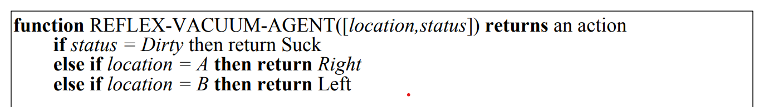
Simple Reflex agents
The simplest kind of agent is the simple reflex agent.
These agents select actions on the basis of the current percept, ignoring the rest of the percept history.
The vacuum agent is a simple reflex agent, because its decision is based only on the current location and on whether that location contains dirt.
An agent program for this agent is shown

Slide 79
Vacuum agent program is very small indeed compared to the corresponding table.
The most obvious reduction comes from ignoring the percept history, which cuts down the number of possibilities from 4T to just 4.
A further, small reduction comes from the fact that when the current square is dirty, the action does not depend on the location

Slide 80
Simple reflex behaviors occur even in more complex environments.
Imagine yourself as the driver of the automated taxi.
If the car in front brakes and its brake lights come on, then you should notice this and initiate braking.
In other words, some processing is done on the visual input to establish the condition we call
“The car in front is braking.”
Then, this triggers some established connection in the agent program to the action “initiate braking.” We call such a connection a condition–action rule,
if car-in-front-is-braking then initiate-braking.
.

Slide 81
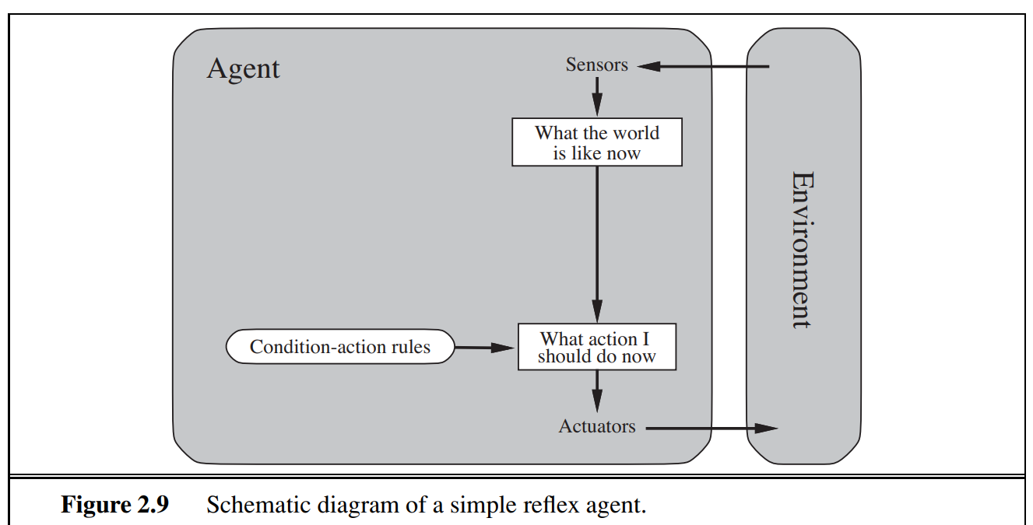
The program in Figure 2.8 is specific to one particular vacuum environment.
A more general and flexible approach is first to build a general-purpose interpreter for condition– action rules and then to create rule sets for specific task environments

Slide 82
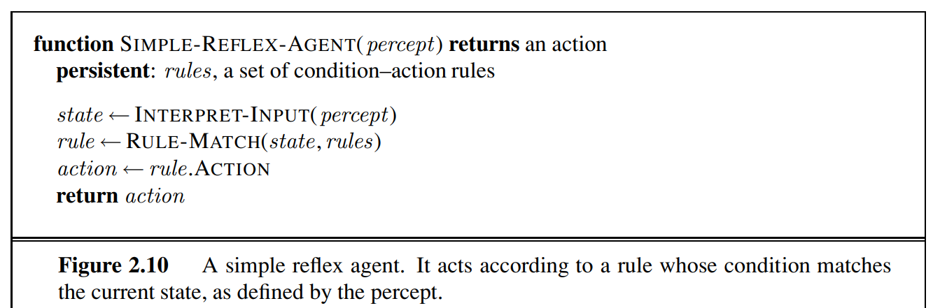
The INTERPRET-INPUT function generates an abstracted description of the current state from the percept, and
the RULE-MATCH function returns the first rule in the set of rules that matches the given state description

Slide 83
Simple reflex agents have the admirable property of being simple, but they turn out to be of limited intelligence.
The agent in Figure will work only if the correct decision can be made on the basis of only the current percept—that is, only if the environment is fully observable.
Even a little bit of unobservability can cause serious trouble.
For example, the braking rule given earlier assumes that the condition car-in-front-is-braking can be determined from the current percept—a single frame of video.
This works if the car in front has a centrally mounted brake light.

Slide 84
A simple reflex vacuum agent is deprived of its location sensor and has only a dirt sensor.
Such an agent has just two possible percepts: [Dirty] and [Clean].
It can Suck in response to [Dirty]; what should it do in response to [Clean]? Moving Left fails (forever) if it happens to start in square A, and moving Right fails (forever) if it happens to start in square B
Infinite loops are often unavoidable for simple reflex agents operating in partially observable environments.
Escape from infinite loops is possible if the agent can randomize its actions. For example, if the vacuum agent perceives [Clean], it might flip a coin to choose between Left and Right

Slide 85
Model-based reflex agents
The most effective way to handle partial observability is for the agent to keep track of the part of the world it can’t see now.
That is, the agent should maintain some sort of internal state that depends on the percept history and thereby reflects at least some of the unobserved aspects of the current state
Eg: braking problem, the internal state is not too extensive— just the previous frame from the camera, allowing the agent to detect when two red lights at the edge of the vehicle go on or off simultaneously.
For other driving tasks such as changing lanes, the agent needs to keep track of where the other cars are if it can’t see them all at once

Slide 86
Updating this internal state information as time goes by requires two kinds of knowledge to be encoded in the agent program.
First, we need some information about how the world evolves independently of the agent—for example,
overtaking car generally will be closer behind than it was a moment ago.
Second, we need some information about how the agent’s own actions affect the world—for example,
that when the agent turns the steering wheel clockwise, the car turns to the right.
This knowledge about “how the world works”—is called a model of the world. An agent that uses such a model is called a model-based agent.

Slide 87
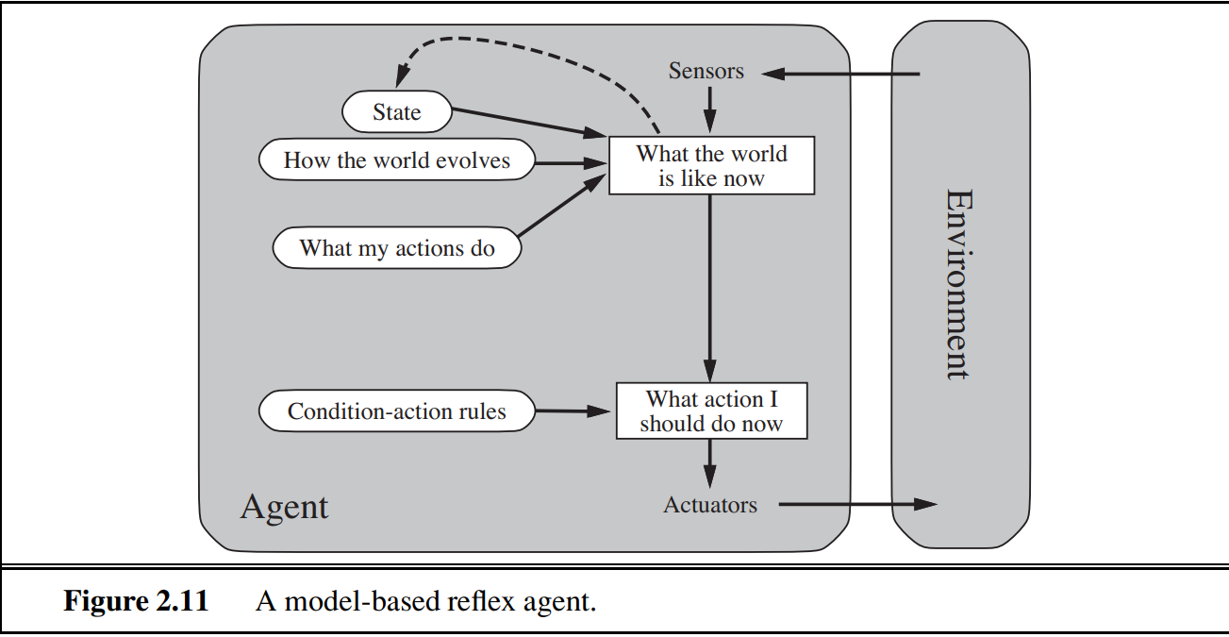
The current percept is combined with the old internal state to generate the updated description of the current state, based on the agent’s model of how the world works

Slide 88
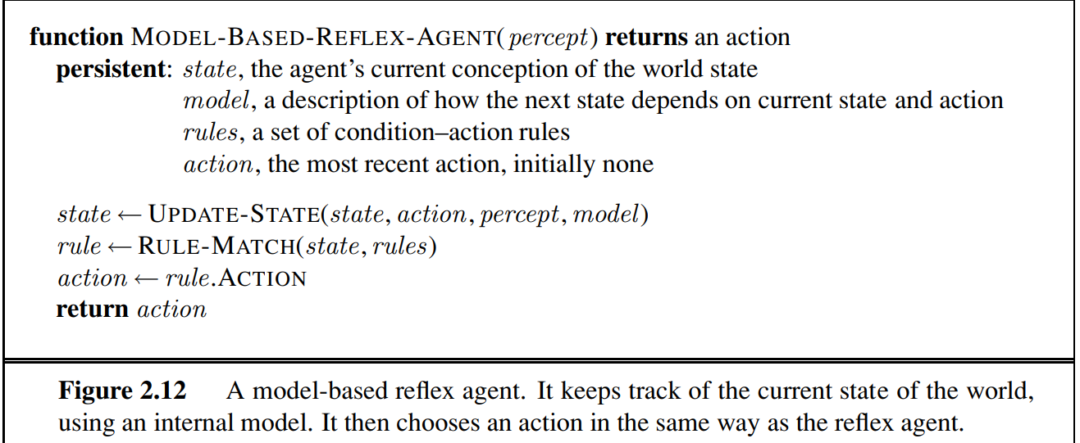
Update state is responsible for creating the new internal state description.

Slide 89
Goal-based agents
Knowing something about the current state of the environment is not always enough to decide what to do.
For example, at a road junction, the taxi can turn left, turn right, or go straight on.
The correct decision depends on where the taxi is trying to get to.
In other words, as well as a current state description, the agent needs some sort of goal information that describes situations that are desirable—for example, being at the passenger’s destination.

Slide 90
The agent program can combine this with the model (the same information as was used in the modelbased reflex agent) to choose actions that achieve the goal
Sometimes goal-based action selection is straightforward—for example, when goal satisfaction results immediately from a single action.
Sometimes it will be more tricky—for example, when the agent has to consider long sequences of twists and turns in order to find a way to achieve the goal.
Search and planning are the subfields of AI devoted to finding action sequences that achieve the agent’s goals

Slide 91
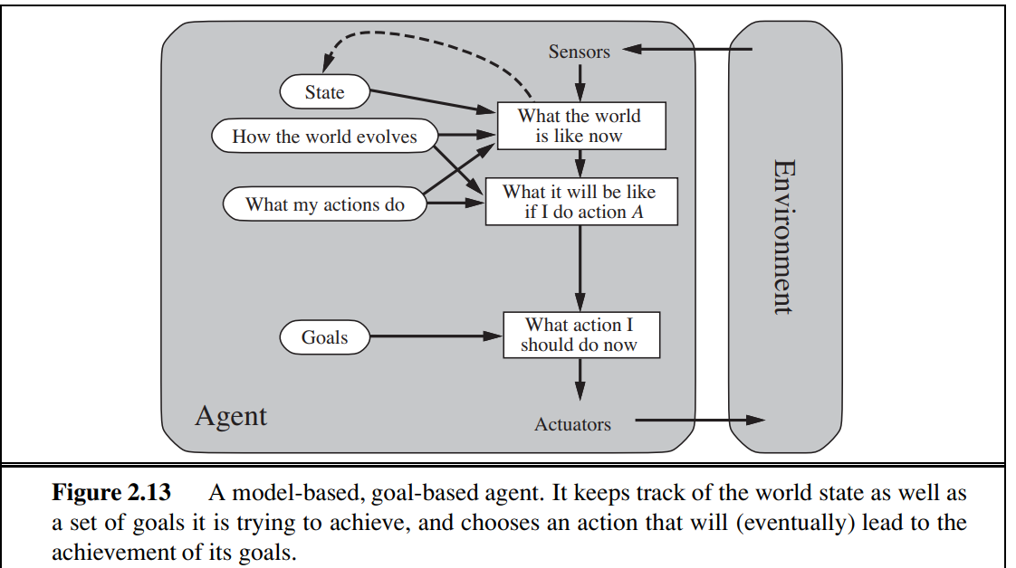

Slide 92
Goal based vs Reflex agent
Decision making of goal based kind is fundamentally different from the condition– action rules
Goal based involves consideration of the future—both “What will happen if I do such-and-such?” and “Will that make me happy?”
In the reflex agent designs, this information is not explicitly represented, because the built-in rules map directly from percepts to actions.
The reflex agent brakes when it sees brake lights.
A goal-based agent, in principle, could reason that if the car in front has its brake lights on, it will slow down

Slide 93
The goal-based agent appears less efficient, it is more flexible because the knowledge that supports its decisions is represented explicitly and can be modified.
If it starts to rain, the agent can update its knowledge of how effectively its brakes will operate; this will automatically cause all of the relevant behaviors to be altered to suit the new conditions.
For the reflex agent, on the other hand, we would have to rewrite many condition–action rules.
The goal-based agent’s behavior can easily be changed to go to a different destination, simply by specifying that destination as the goal.
The reflex agent’s rules for when to turn and when to go straight will work only for a single destination; they must all be replaced to go somewhere new.

Slide 94
Utility-based agents
Goals alone are not enough to generate high-quality behavior in most environments.
For example, many action sequences will get the taxi to its destination (thereby achieving the goal) but some are quicker, safer, more reliable, or cheaper than others.
Goals just provide a crude binary distinction between “happy” and “unhappy” states.
A more general performance measure should allow a comparison of different world states according to exactly how happy they would make the agent.

Slide 95
Happy—Utility
Measuring happiness- Utility function
Performance measure assigns a score to any given sequence of environment states
An agent’s utility function is essentially an internalization of the performance measure.
If the internal utility function and the external performance measure are in agreement, then an agent that chooses actions to maximize its utility will be rational according to the external performance measure

Slide 96
Furthermore, in two kinds of cases, goals are inadequate but a utility-based agent can still make rational decisions.
First, when there are conflicting goals, only some of which can be achieved (for example, speed and safety), the utility function specifies the appropriate tradeoff.
Second, when there are several goals that the agent can aim for, none of which can be achieved with certainty,

Slide 97
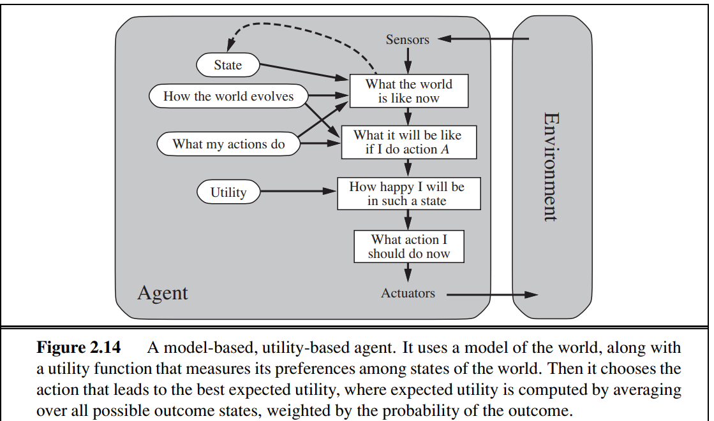

Slide 98
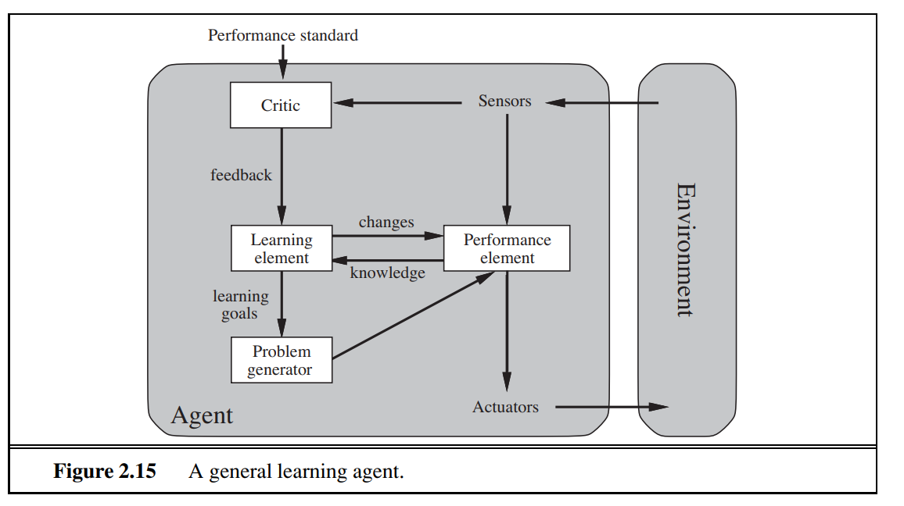
Learning agents
Described agent programs with various methods for selecting actions. We have not, so far, explained how the agent programs come into being.

Slide 99
A learning agent can be divided into four conceptual components,
1.Learning Element- responsible for making improvements
2. Performance Element- responsible for selecting external actions
The performance element is what we have previously considered to be the entire agent: it takes in percepts and decides on actions.
3. Critic- The learning element uses CRITIC feedback from the critic on how the agent is doing and determines how the performance element should be modified to do better in the future

Slide 100
The critic tells the learning element how well the agent is doing with respect to a fixed performance standard.
The critic is necessary because the percepts themselves provide no indication of the agent’s success.
For example, a chess program could receive a percept indicating that it has checkmated its opponent, but it needs a performance standard to know that this is a good thing; the percept itself does not say so.
4. Problem Generator- The last component of the learning agent is the problem generator. It is responsible for suggesting actions that will lead to new and informative experiences
The problem generator’s job is to suggest these exploratory actions

Slide 101
To make the overall design more concrete, let us return to the automated taxi example.
The performance element consists of whatever collection of knowledge and procedures the taxi has for selecting its driving actions.
The taxi goes out on the road and drives, using this performance element.
The critic observes the world and passes information along to the learning element.
For example, after the taxi makes a quick left turn across three lanes of traffic, the critic observes the shocking language used by other drivers.

Slide 102
From this experience, the learning element is able to formulate a rule saying this was a bad action, and the performance element is modified by installation of the new rule.
The problem generator might identify certain areas of behavior in need of improvement and suggest experiments, such as trying out the brakes on different road surfaces under different conditions.

Slide 103
The learning element can make changes to any of the “knowledge” components shown in the agent diagrams
The simplest cases involve learning directly from the percept sequence.
Observation of pairs of successive states of the environment can allow the agent to learn “How the world evolves,” and
observation of the results of its actions can allow the agent to learn “What my actions do.”
For example, if the taxi exerts a certain braking pressure when driving on a wet road, then it will soon find out how much deceleration is actually achieved.
Clearly, these two learning tasks are more difficult if the environment is only partially observable

Slide 104
The forms of learning in the preceding paragraph do not need to access the external performance standard—in a sense, the standard is the universal one of making predictions that agree with experiment.
The situation is slightly more complex for a utility-based agent that wishes to learn utility information.
For example, suppose the taxi-driving agent receives no tips from passengers who have been thoroughly shaken up during the trip.

Slide 105
The external performance standard must inform the agent that the loss of tips is a negative contribution to its overall performance; then the agent might be able to learn that violent maneuvers do not contribute to its own utility.
In a sense, the performance standard distinguishes part of the incoming percept as a reward (or penalty) that provides direct feedback on the quality of the agent’s behavior

Slide 106
How the components of agent programs work
We have described agent programs (in very high-level terms) as consisting of various components, whose function it is to answer questions such as:
"What is the world like now?"
"What action should ldo now?"
"What do my actions do?“
The next question for a student of AI is, "How on earth do these components work?“
Place the representations along an axis of increasing complexity and expressive
power—atomic, factored, and structured.
To illustrate these ideas, to consider a particular agent component, such as the one that deals with "What my actions do."

Slide 107
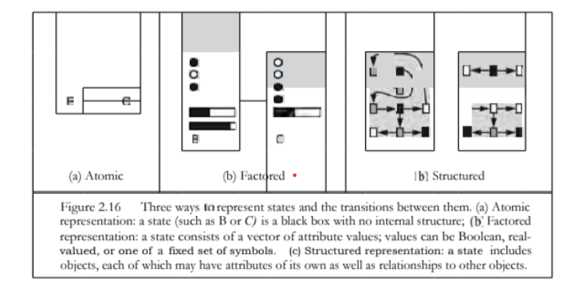
This component describes the changes that might occur in the environment as the result of taking an action, and
Figure provides schematic depictions of how those transitions might be represented

Slide 108
In an atomic representation each state of the world is indivisible—it has no internal structure.
Consider the problem of finding a driving route from one end of a country to the other via some sequence of cities.
For the purposes of solving this problem, it may suffice to reduce the state of world to just the name of the city we are in—a single atom of knowledge; a "black box" whose only property is that of being identical to or different from another black box.
Eg: Algorithms underlying search and game-playing , Hidden Markov models

Slide 109
Now consider a higher-fidelity description for the same problem, where we need to be concerned with more than just atomic location in one city or another; we might need to pay attention to
how much gas is in the tank,
our current GPS coordinates,
whether or not the oil warning light is working,
how much spare change we have for toll crossings,
what station is on the radio, and so on.
A factored representation splits up each state into a fixed set of variables or attributes, each of which can have a value.
Eg: constraint satisfaction algorithms , propositional logic , planning, Bayesian networks and the machine learning

Slide 110
For many purposes, we need to understand the world as having things in it that are related to each other, not just variables with values.
For example, we might notice that a large truck ahead of us is reversing into the driveway of a dairy farm but a cow has got loose and is blocking the truck's path.
A factored representation is unlikely to be pre-equipped with the attribute “Truckaheadbackingintocow” value true or false
Instead, we would need a structured representation, in which objects such as cows and trucks and their various and varying relationships can be described explicitly.

Slide 111
Chapter 3 Solving Problems by Searching
We see how an agent can find a sequence of actions that achieves its goals when no single action will do.
Reflex agents, which base their actions on a direct mapping from states to actions.
Such agents cannot operate well in environments for which this mapping would be too large to store and would take too long to learn.
Goal-based agents, on the other hand, consider future actions and the desirability of their outcomes

Slide 112
one kind of goal-based agent called a problem-solving agent.
Problem-solving agents use atomic representations, that is, states of the world are considered as wholes, with no internal structure visible to the problem solving algorithms
Our discussion of problem solving begins with
precise definitions of problems and their solutions
Describe several general-purpose search algorithms that can be used to solve these problems.
We will see several uninformed search algorithms—algorithms that are given no information about the problem other than its definition.
Informed search algorithms, on the other hand, can do quite well given some guidance on where to look for solutions

Slide 113
Problem Solving Agents
Intelligent agents are supposed to maximize their performance measure.
Achieving this is sometimes simplified if the agent can adopt a goal and aim at satisfying it.
Let us look at why and how an agent might do this
Agent in the city of Arad, Romania, enjoying a touring holiday
Performance measure: it wants to improve its suntan, improve its Romanian, take in the sights
The decision problem is a complex
Suppose the agent has a nonrefundable ticket to fly out of Bucharest the following day.
.

Slide 114
In that case, it makes sense for the agent to adopt the goal of getting to Bucharest
Courses of action that don’t reach Bucharest on time can be rejected without further consideration and the agent’s decision problem is greatly simplified
Goals help organize behavior by limiting the objectives that the agent is trying to achieve and hence the actions it needs to consider.
Therefore Goal formulation, based on the current situation and the agent’s performance measure, is the first step in problem solving.

Slide 115
Consider a goal to be a set of world states—exactly those states in which the goal is satisfied.
The agent’s task is to find out how to act, now and in the future, so that it reaches a goal state.

Slide 116
Problem Formulation:
Problem formulation is the process of deciding what actions and states to consider, given a goal.
Suppose the agent has a map of Romania.
The point of a map is to provide the agent with information about the states it might get itself into and the actions it can take.
The agent can use this information, to find a journey that eventually gets to Bucharest.
Once it has found a path on the map from Arad to Bucharest, it can achieve its goal by carrying out the driving actions
In general, an agent with several immediate options of unknown value can decide what to do by first examining future actions that eventually lead to states of known value.

Slide 117
In general, an agent with several immediate options of unknown value can decide what to do by first examining future actions that eventually lead to states of known value.

Slide 118
Properties of the environment
The environment is observable, so the agent always knows the current state. For the agent driving in Romania, it’s reasonable to suppose that each city on the map has a sign indicating its presence to arriving drivers.
We also assume the environment is discrete, so at any given state there are only finitely many actions to choose from. - each city is connected to a small number of other cities.
We will assume the environment is known, so the agent knows which states are reached by each action
Finally, we assume that the environment is deterministic, so each action has exactly one outcome.

Slide 119
Under these assumptions, the solution to any problem is a fixed sequence of actions
The process of looking for a sequence of actions that reaches the goal is called search.
A search algorithm takes a problem as input and returns a solution in the form of an action sequence.
Once a solution is found, the actions it recommends can be carried out.
This is called the execution phase.
Thus, we have a simple “formulate, search, execute” design for the agent

Slide 120
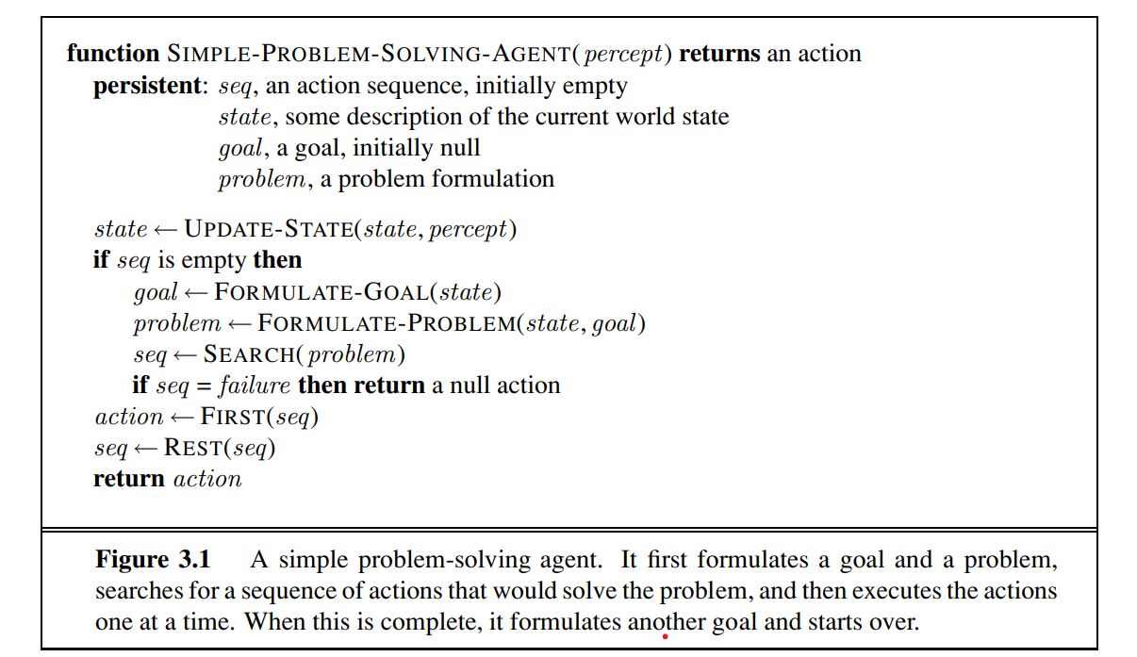

Slide 121
Well-defined problems and solutions
A problem can be defined formally by five components:
Initial State: The initial state that the agent starts in. For example, the initial state for our agent in Romania might be described as In(Arad).
2. Action- A description of the possible actions available to the agent. Given a particular state s, ACTIONS(s) returns the set of actions that can be executed in s.
We say that each of these actions is applicable in s.
For example, from the state In(Arad), the applicable actions are {Go(Sibiu), Go(Timisoara), Go(Zerind)}.

Slide 122
3. Transition Model: A description of what each action does; the formal name for this is the transition model, specified by a function RESULT(s, a) that returns the state that results from doing action a in state s.
RESULT(In(Arad),Go(Zerind)) = In(Zerind)
4. State space- Together, the initial state, actions, and transition model implicitly define the state space of the problem—the set of all states reachable from the initial state by any sequence of actions.
The state space forms a directed network or graph in which the nodes are states and the links between nodes are actions.

Slide 123
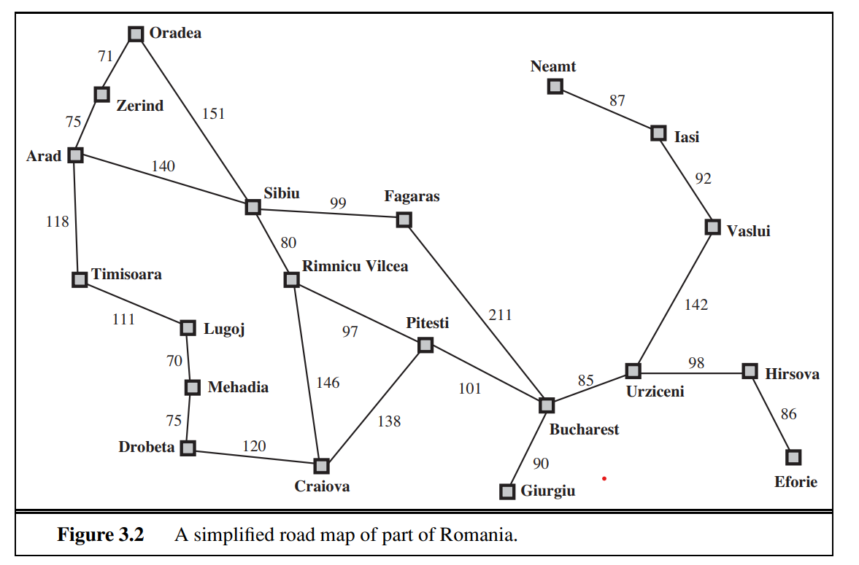
Interpreted as a state-space graph if we view each road as standing for two driving actions, one in each direction

Slide 124
5. Path: A path in the state space is a sequence of states connected by a sequence of actions.
6. The goal test: which determines whether a given state is a goal state
The agent’s goal in Romania is the singleton set {In(Bucharest)}
7. Path Cost - Path cost function that assigns a numeric cost to each path.
The problem-solving agent chooses a cost function that reflects its own performance measure
the agent trying to get to Bucharest, time is of the essence, so the cost of a path might be its length in kilometers
The step cost of taking action a in state s to reach state s is denoted by c(s, a, s ). The step costs for Romania are shown in Figure 3.2 as route distances.

Slide 125
OPTIMAL SOLUTION : The preceding elements
Define a problem and can be gathered into a single data structure that is
Given as input to a problem-solving algorithm.
A solution to a problem is an action sequence that leads from the initial state to a goal state.
Solution quality is measured by the path cost function, and an optimal solution has the lowest path cost among all solutions.

Slide 126
Formulating problem
Abstraction-
Compare the simple state description we have chosen, In(Arad), to an actual crosscountry trip, where the state of the world includes so many things:
the traveling companions,
the current radio program,
the scenery out of the window.
All these considerations are left out of our state descriptions because they are irrelevant to the problem of finding a route to Bucharest.
The process of removing detail from a representation is called abstraction.

Slide 127
In addition to abstracting the state description, we must abstract the actions themselves. A driving action has many effects.
Besides changing the location of the vehicle and its occupants,
it takes up time,
consumes fuel
Our formulation takes into account only the change in location
The choice of a good abstraction thus involves removing as much detail as possible while retaining validity and ensuring that the abstract actions are easy to carry out

Slide 128
Example Problems
Toy and real-world problems
A toy problem is intended to illustrate or exercise various problem-solving methods.
It can be given a concise, exact description and
hence is usable by different researchers to compare the performance of algorithms.
.

Slide 129
A real-world problem is one whose solutions people actually care about.
Such problems tend not to have a single agreed-upon description, but we can give the general flavor of their formulations

Slide 130
Toy problems
The first example we examine is the vacuum world
• Initial state: Any state can be designated as the initial state.
States: The state is determined by both the agent location and the dirt locations.
The agent is in one of two locations, each of which might or might not contain dirt.
Thus, there are 2 × 2power2 = 8 possible world states. A larger environment with n locations has n · 2n states.

Slide 131
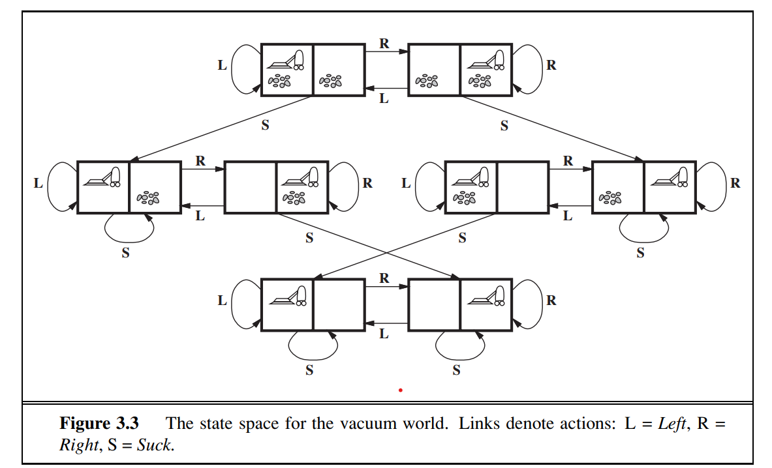

Slide 132
• Actions: In this simple environment, each state has just three actions: Left, Right, and Suck.
• Transition model: The actions have their expected effects, except that moving Left in the leftmost square, moving Right in the rightmost square, and Sucking in a clean square have no effect. The complete state space is shown in Figure 3.3.
• Goal test: This checks whether all the squares are clean.
• Path cost: Each step costs 1, so the path cost is the number of steps in the path

Slide 133
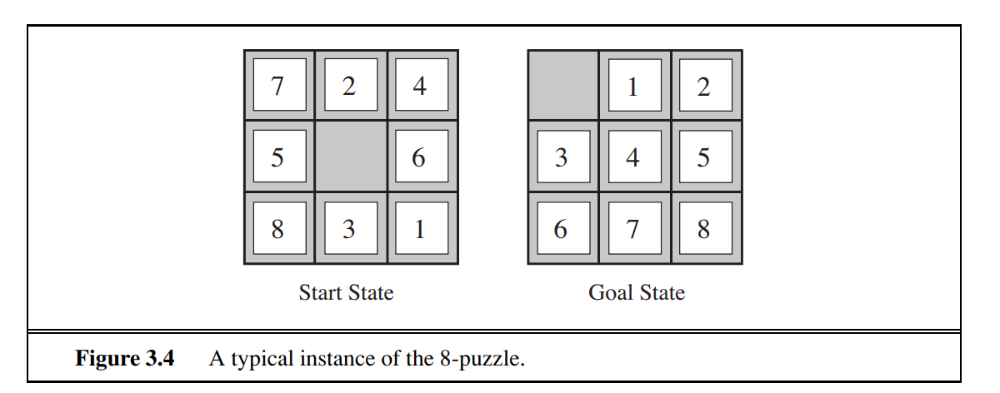
2. The 8-puzzle: an instance of which is shown in figure, consists of a 3×3 board with eight numbered tiles and a blank space.
A tile adjacent to the blank space can slide into the space.
The object is to reach a specified goal state, such as the one shown on the right of the figure.
The standard formulation is as follows:

Slide 134
States: A state description specifies the location of each of the eight tiles and the blank in one of the nine squares.
• Initial state: Any state can be designated as the initial state.
• Actions: The simplest formulation defines the actions as movements of the blank space Left, Right, Up, or Down. Different subsets of these are possible depending on where the blank is.
• Transition model: Given a state and action, this returns the resulting state; for example, if we apply Left to the start state in Figure 3.4, the resulting state has the 5 and the blank switched.

Slide 135
• Goal test: This checks whether the state matches the goal configuration shown in Figure
• Path cost: Each step costs 1, so the path cost is the number of steps in the path
The actions are abstracted to their beginning and final states, ignoring the intermediate locations where the block is sliding

Slide 136
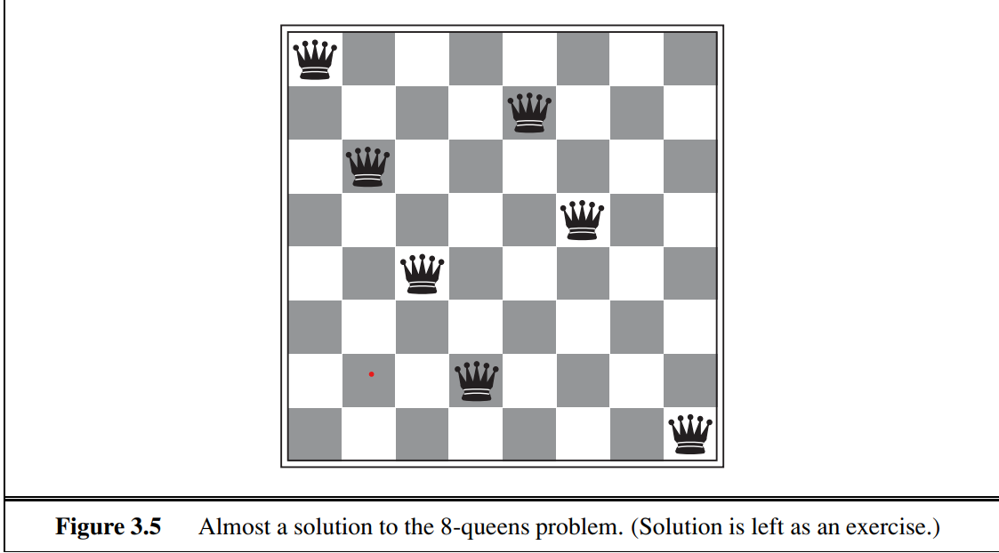
3. 8-queens problem : The goal of the 8-queens problem is to place eight queens on a chessboard such that no queen attacks any other

Slide 137
There are two main kinds of formulation.
An incremental formulation involves operators that augment the state description, starting with an empty state; for the 8-queens problem, this means that each action adds a queen to the state.
A complete-state formulation starts with all 8 queens on the board and moves them around.
In either case, the path cost is of no interest because only the final state counts.

Slide 138
The first incremental formulation one might try is the following:
• States: Any arrangement of 0 to 8 queens on the board is a state.
• Initial state: No queens on the board.
• Actions: Add a queen to any empty square.
• Transition model: Returns the board with a queen added to the specified square.
• Goal test: 8 queens are on the board, none attacked

Slide 139
In this formulation, we have 64 · 63 ··· 57 ≈ 1.8 × 10power14 possible sequences to investigate.
A better formulation would prohibit placing a queen in any square that is already attacked:
• States: All possible arrangements of n queens (0 ≤ n ≤ 8), one per column in the leftmost n columns, with no queen attacking another.
• Actions: Add a queen to any square in the leftmost empty column such that it is not attacked by any other queen.
This formulation reduces the 8-queens state space from 1.8 × 10power14 to just 2,057

Slide 140
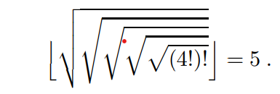
4. Our final toy problem was devised by Donald Knuth and illustrates how infinite state spaces can arise.
Knuth conjectured that, starting with the number 4, a sequence of factorial, square root, and floor operations will reach any desired positive integer.
For example, we can reach 5 from 4 as follows

Slide 141
The problem definition is very simple:
• States: Positive numbers.
• Initial state: 4.
• Actions: Apply factorial, square root, or floor operation (factorial for integers only).
• Transition model: As given by the mathematical definitions of the operations.
• Goal test: State is the desired positive integer
The number 620,448,401,733,239,439,360,000 is generated in the expression for 5—so the state space for this problem is infinite.

Slide 142
Real-world problems
Consider the airline travel problems that must be solved by a travel-planning Web site:
• States: Each state obviously includes a location (e.g., an airport) and the current time.
• Initial state: This is specified by the user’s query.
• Actions: Take any flight from the current location, in any seat class, leaving after the current time, leaving enough time for within-airport transfer if needed.

Slide 143
• Transition model: The state resulting from taking a flight will have the flight’s destination as the current location and the flight’s arrival time as the current time.
• Goal test: Are we at the final destination specified by the user?
• Path cost: This depends on monetary cost, waiting time, flight time, customs and immigration procedures, seat quality, time of day, type of airplane, frequent-flyer mileage awards, and so on

Slide 144
Touring problems are closely related to route-finding problems, but with an important difference.
Consider, for example, the problem “Visit every city in Figure at least once, starting and ending in Bucharest.”
The state space-
Each state must include not just the current location but also the set of cities the agent has visited.
Initial state would be In(Bucharest), Visited({Bucharest}),
a typical intermediate state would be In(Vaslui), Visited({Bucharest, Urziceni, Vaslui}), and the
goal test would check whether the agent is in Bucharest and all 20 cities have been visited

Slide 145
3. The traveling salesperson problem (TSP) is a touring problem in which each city must be visited exactly once. The aim is to find the shortest tour.
4. A VLSI layout problem requires positioning millions of components and connections on a chip to minimize area, minimize circuit delays, minimize stray capacitances, and maximize manufacturing yield
. The layout problem comes after the logical design phase and is usually split into two parts: cell layout and channel routing.
In cell layout, the primitive components of the circuit are grouped into cells, each of which performs some recognized function.
Channel routing finds a specific route for each wire through the gaps between the cells.

Slide 146
5. Robot navigation is a generalization of the route-finding problem
Rather than following a discrete set of routes, a robot can move in a continuous space with (in principle) an infinite set of possible actions and states.
6. Automatic assembly sequencing of complex objects by a robot.
In assembly problems, the aim is to find an order in which to assemble the parts of some object. If the wrong order is chosen, there will be no way to add some part later in the sequence without undoing some of the work already done

Slide 147
Searching for Solutions
A solution is an action sequence, so search algorithms work by considering various possible action sequences.
The possible action sequences of search tree
the initial state at the root;
the branches are actions and the
nodes correspond to states in the state space of the problem.
Figure shows the first few steps in growing the search tree for finding a route from Arad to Bucharest.

Slide 148
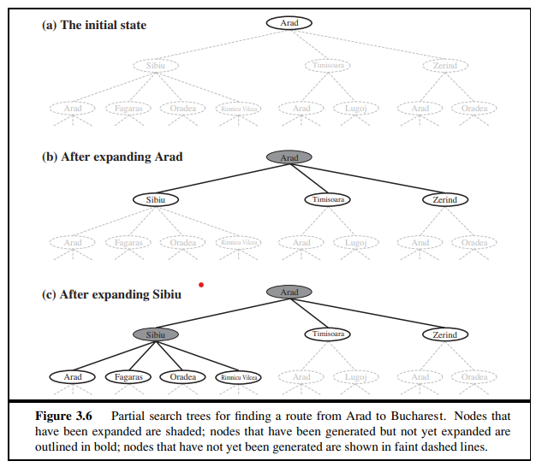

Slide 149
The root node of the tree corresponds to the initial state, In(Arad).
The first step is to test whether this is a goal state.
Consider taking various actions --by expanding the current state- generate a new set of states.
In this case, we add three branches from the parent node In(Arad) leading to three new child nodes: In(Sibiu), In(Timisoara), and In(Zerind).
Now we must choose which of these three possibilities to consider further

Slide 150
Suppose we choose Sibiu first.
We check to see whether it is a goal state (it is not) and then expand it to get In(Arad), In(Fagaras), In(Oradea), and In(RimnicuVilcea)
We can then choose any of these four or go back and choose Timisoara or Zerind
The set of all leaf nodes available for expansion at any given point is called the frontier.

Slide 151
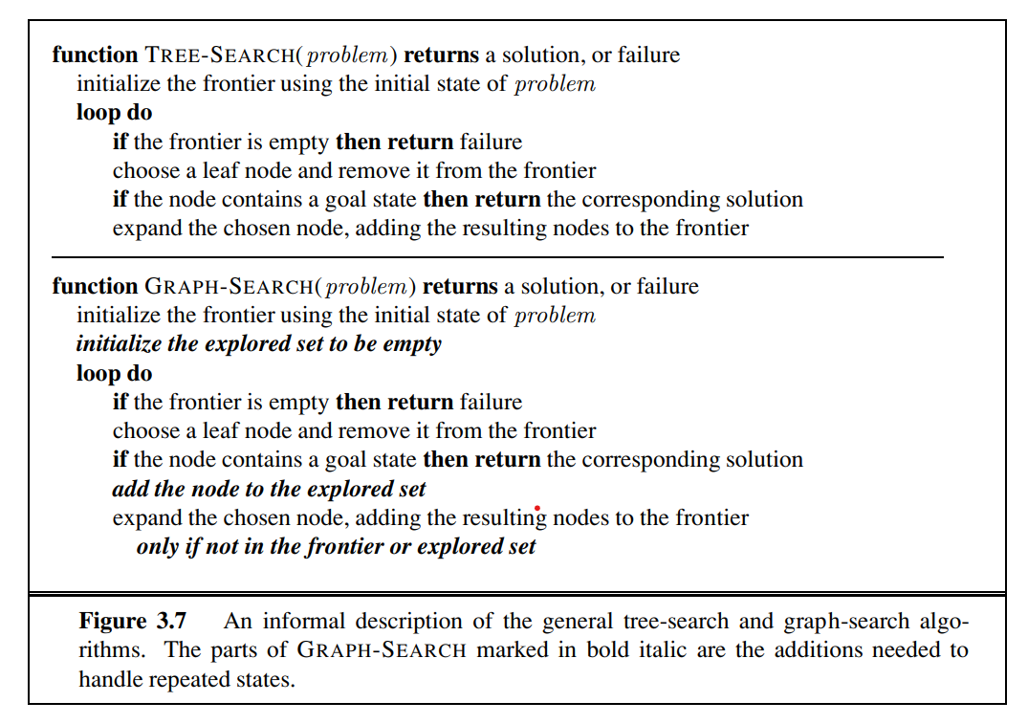
The general TREE-SEARCH algorithm is shown

Slide 152
The search tree shown in Figure includes the path from Arad to Sibiu and back to Arad again!
We say that In(Arad) is a repeated state in the search tree, generated in this case by a loopy path.
Considering such loopy paths means that the complete search tree for Romania is infinite because there is no limit to how often one can traverse a loop.
The way to avoid exploring redundant paths is to remember where one has been.
To do this, we augment the algorithm with a data structure called the explored set which remembers every expanded node.

Slide 153
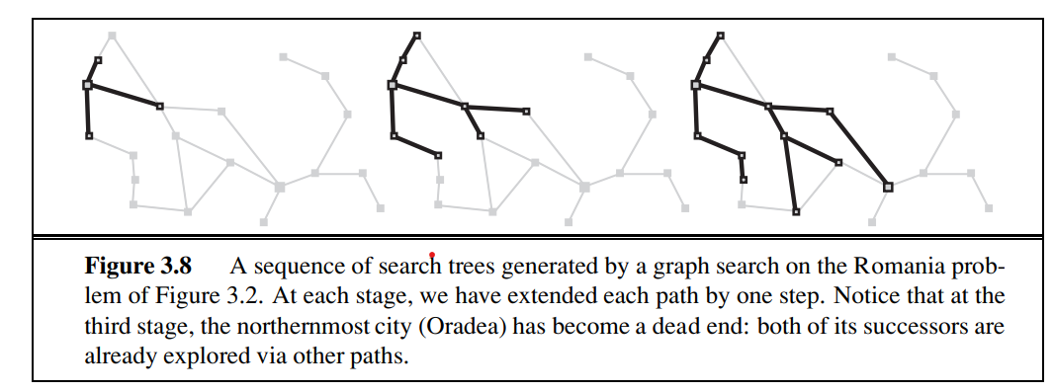
Newly generated nodes that match previously generated nodes—ones in the explored set or the frontier—can be discarded instead of being added to the frontier
The search tree constructed by the algorithm contains at most one copy of each state, so we can think of it as growing a tree directly on the state-space graph, as shown in Figure

Slide 154
Searching for Solutions
A solution is an action sequence, so search algorithms work by considering various possible action sequences.
The possible action sequences of search tree
the initial state at the root;
the branches are actions and the
nodes correspond to states in the state space of the problem.
Figure shows the first few steps in growing the search tree for finding a route from Arad to Bucharest.

Slide 156
The root node of the tree corresponds to the initial state, In(Arad).
The first step is to test whether this is a goal state.
Consider taking various actions --by expanding the current state- generate a new set of states.
In this case, we add three branches from the parent node In(Arad) leading to three new child nodes: In(Sibiu), In(Timisoara), and In(Zerind).
Now we must choose which of these three possibilities to consider further

Slide 157
Suppose we choose Sibiu first.
We check to see whether it is a goal state (it is not) and then expand it to get In(Arad), In(Fagaras), In(Oradea), and In(RimnicuVilcea)
We can then choose any of these four or go back and choose Timisoara or Zerind
The set of all leaf nodes available for expansion at any given point is called the frontier.

Slide 158
The general TREE-SEARCH algorithm is shown

Slide 159
The search tree shown in Figure includes the path from Arad to Sibiu and back to Arad again!
We say that In(Arad) is a repeated state in the search tree, generated in this case by a loopy path.
Considering such loopy paths means that the complete search tree for Romania is infinite because there is no limit to how often one can traverse a loop.
The way to avoid exploring redundant paths is to remember where one has been.
To do this, we augment the algorithm with a data structure called the explored set which remembers every expanded node.

Slide 160
Newly generated nodes that match previously generated nodes—ones in the explored set or the frontier—can be discarded instead of being added to the frontier
The search tree constructed by the algorithm contains at most one copy of each state, so we can think of it as growing a tree directly on the state-space graph, as shown in Figure

Slide 161
Infrastructure for search algorithms
• n.STATE: the state in the state space to which the node corresponds;
• n.PARENT: the node in the search tree that generated this node;
• n.ACTION: the action that was applied to the parent to generate the node;
• n.PATH-COST: the cost, traditionally denoted by g(n), of the path from the initial state to the node, as indicated by the parent pointers

Slide 162
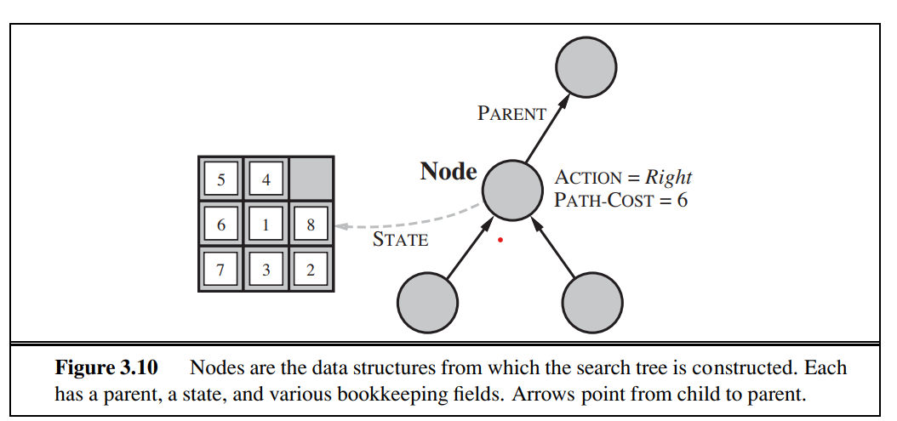

Slide 163
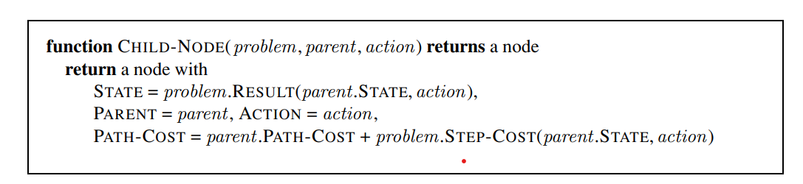
Given the components for a parent node, it is easy to see how to compute the necessary components for a child node.
The function CHILD-NODE takes a parent node and an action and returns the resulting child node:

Slide 164
Measuring problem-solving performance
Algorithm’s performance in four ways:
• Completeness: Is the algorithm guaranteed to find a solution when there is one?
• Optimality: Does the strategy find the optimal solution,
• Time complexity: How long does it take to find a solution?
• Space complexity: How much memory is needed to perform the search?

Slide 165
Algorithm complexity is expressed in terms of three quantities:
b, the branching factor or maximum number of successors of any node;
d, the depth of the shallowest goal (i.e., the number of steps along the path from the root); and
m, the maximum length of any path in the state space.
Time is often measured in terms of the number of nodes generated
during the search
and
space in terms of the maximum number of nodes stored in memory

Slide 166
To assess the effectiveness of a search algorithm, we can consider just the
search cost— which typically depends on the time complexity and a term for memory usage—or
total cost, which combines the search cost and the path cost of the solution found.
For the problem of finding a route from Arad to Bucharest, the search cost is the amount of time taken by the search and the solution cost is the total length of the path
, to compute the total cost, we have to add milliseconds and kilometers

Slide 167
Unit 2

Slide 168
Uninformed search strategy- blind search
The term means that the strategies have no additional information about states beyond that provided in the problem definition.
All they can do is generate successors and distinguish a goal state from a non-goal state.
All search strategies are distinguished by the order in which nodes are expanded.
Strategies that know whether one non-goal state is “more promising” than another are called informed search or heuristic
search strategies

Slide 169
Breadth-first search
Breadth-first search is a simple strategy in which the root node is expanded first, then all the successors of the root node are expanded next, then their successors, and so on.
In general, all the nodes are expanded at a given depth in the search tree before any nodes at the next level are expanded.
Breadth-first search is an instance of the general graph-search algorithm in which the shallowest unexpanded node is chosen for expansion
This is achieved very simply by using a FIFO queue for the frontier.

Slide 170
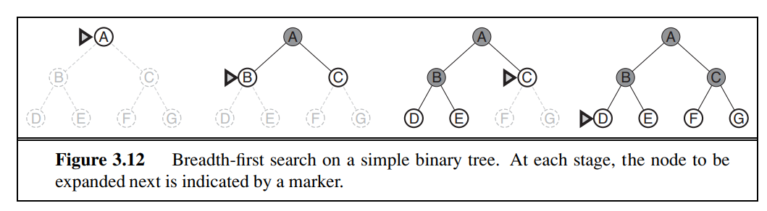

Slide 171
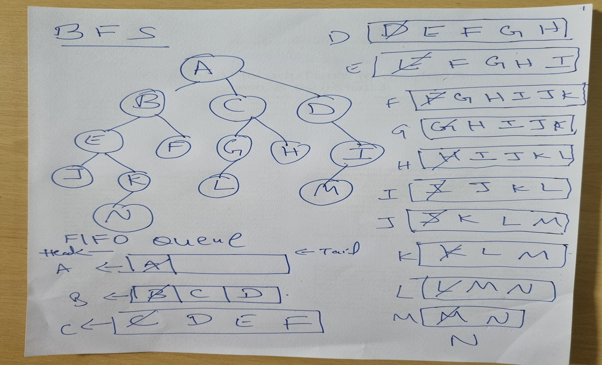

Slide 172
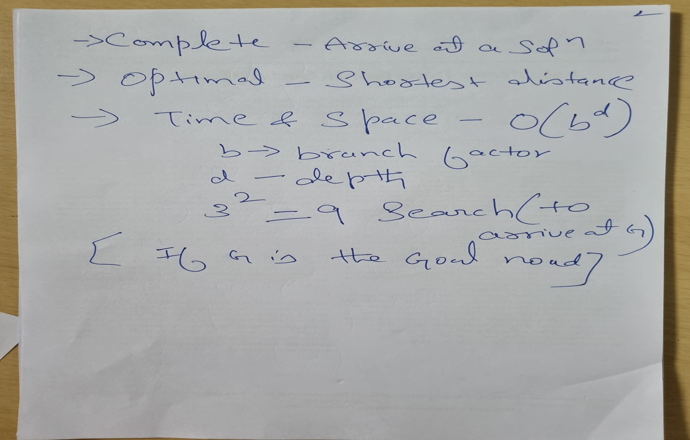

Slide 173
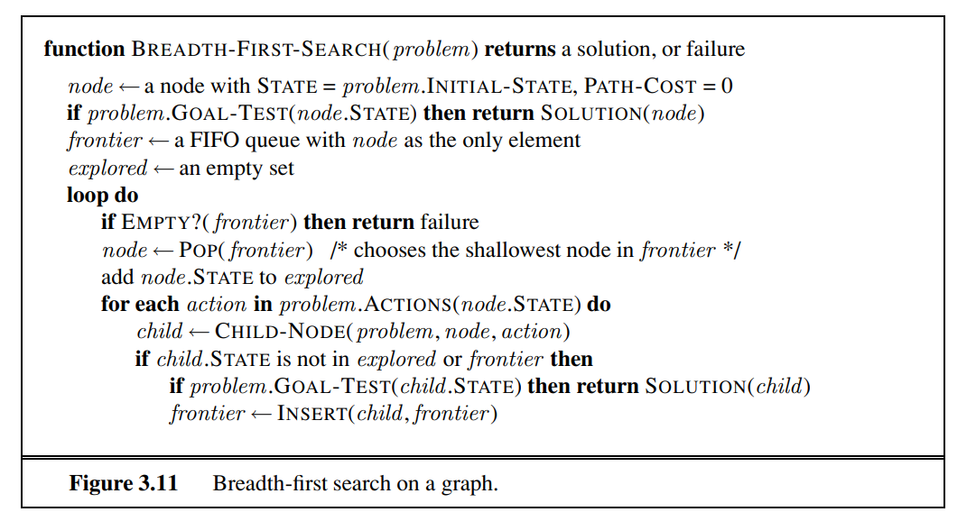

Slide 174
Breadth-first search rate according to the four criteria
Completeness: DFS is complete if the search tree is finite, meaning for a given finite search tree, DFS will come up with a solution if it exists.
Optimality: DFS is not optimal, meaning the number of steps in reaching the solution, or the cost spent in reaching it is high.
Time Complexity: . Imagine searching a uniform tree where every state has b successors.

Slide 175

The root of the search tree generates b nodes at the first level, each of which generates b more nodes, for a total of b² at the second level.
Each of these generates b more nodes, yielding b³ nodes at the third level, and so on.
Now suppose that the solution is at depth d. In the worst case, it is the last node generated at that level. Then the total number of nodes generated is
Space complexity:every node generated remains in
memory. There will be O(b^{d}−1) nodes in the explored set and O(b^{d}) nodes in the frontier,
exponential-complexity search problems cannot be solved by uninformed methods for any but the smallest instances

Slide 176
Uniform-cost search
Breadth-first search is optimal because it always expands the shallowest unexpanded node
By a simple extension, we can find an algorithm that is optimal with any step-cost function.
Instead of expanding the shallowest node, uniform-cost expands the node n with the lowest path cost g(n).
This is done by storing the frontier as a priority queue ordered by g

Slide 177
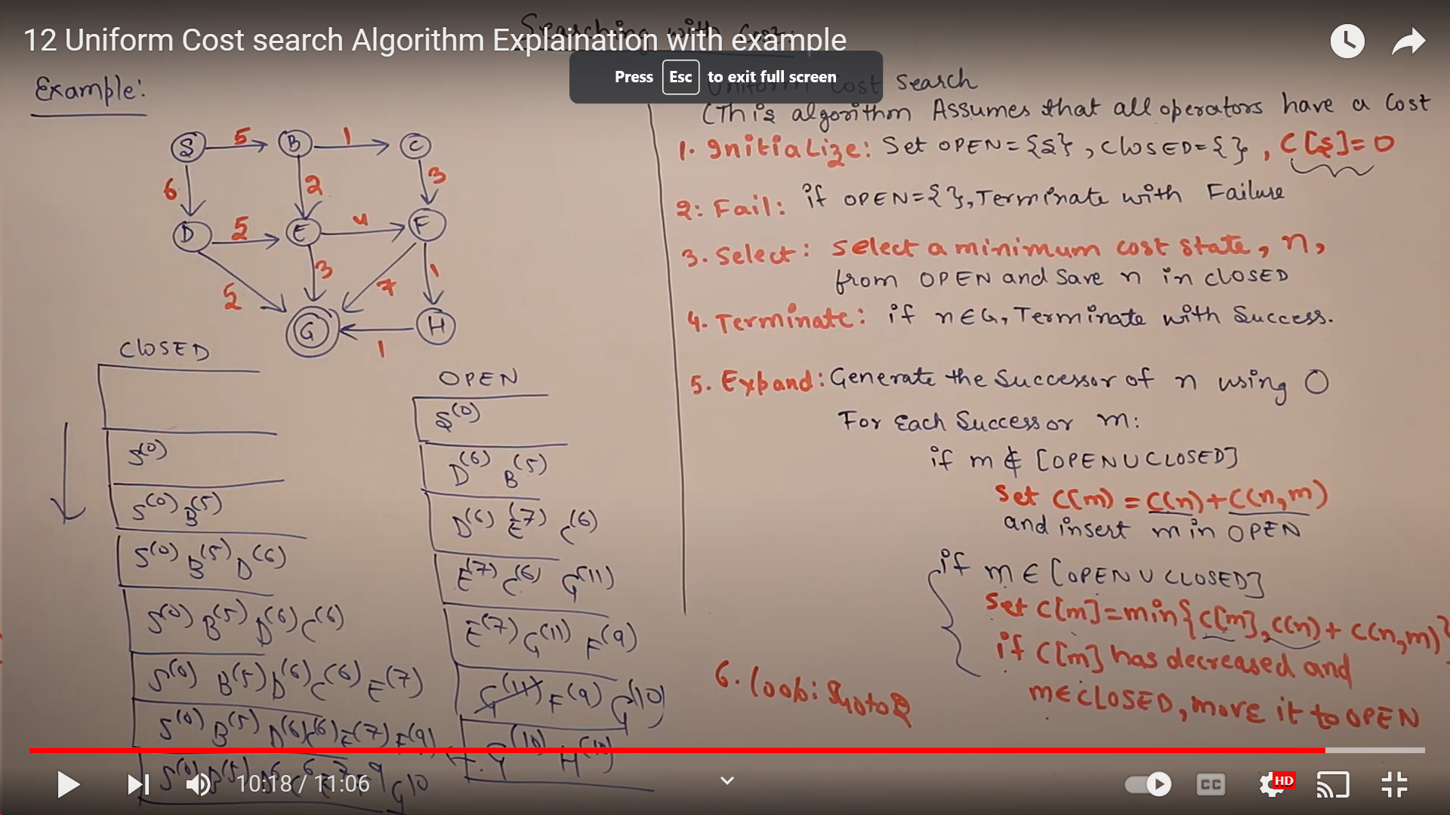

Slide 178
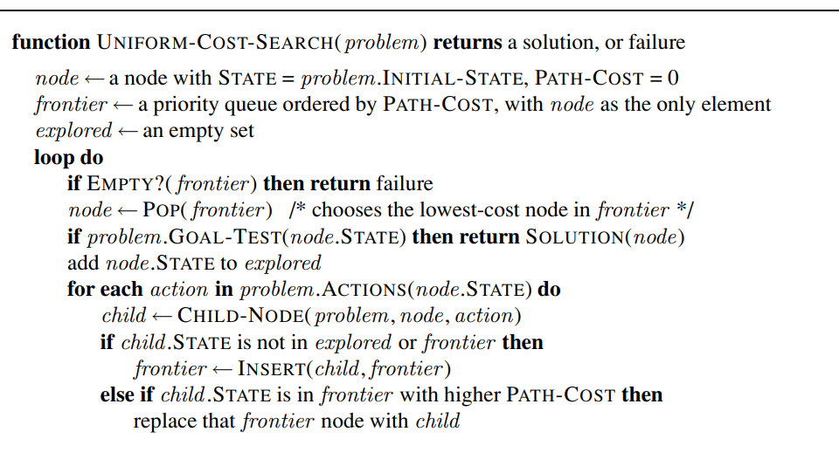

Slide 179
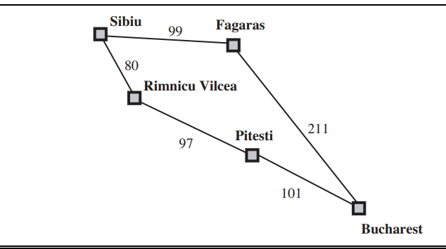

Slide 180
Uniform-cost search is guided by path costs rather than depths, so its complexity is not
easily characterized in terms of b and d.
Instead, let C∗ be the cost of the optimal solution,
and assume that every action costs at least € .
Then the algorithm’s worst-case time and space complexity is O(b¹+C∗/ €), which can be much greater than b^{d}.
This is because uniformcost search can explore large trees of small steps before exploring paths involving large and perhaps useful steps.
When all step costs are equal, b¹+C∗/ is just b^{d}+1.
When all step costs are the same, uniform-cost search is similar to breadth-first search, except that the latter stops as soon as it generates a goal, whereas uniform-cost search examines all the nodes at the goal’s depth to see if one has a lower cost; thus uniform-cost search does strictly more work by expanding nodes at depth d unnecessarily

Slide 181
Depth-first search
Expands the deepest node in the current frontier of the search tree.
The progress of the search is illustrated in Figure.
The search proceeds immediately to the deepest level of the search tree, where the nodes have no successors.
As those nodes are expanded, they are dropped from the frontier, so then the search “backs up” to the next deepest node that still has unexplored successors.

Slide 182
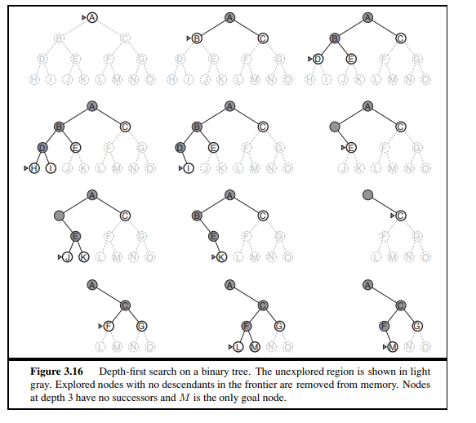

Slide 183
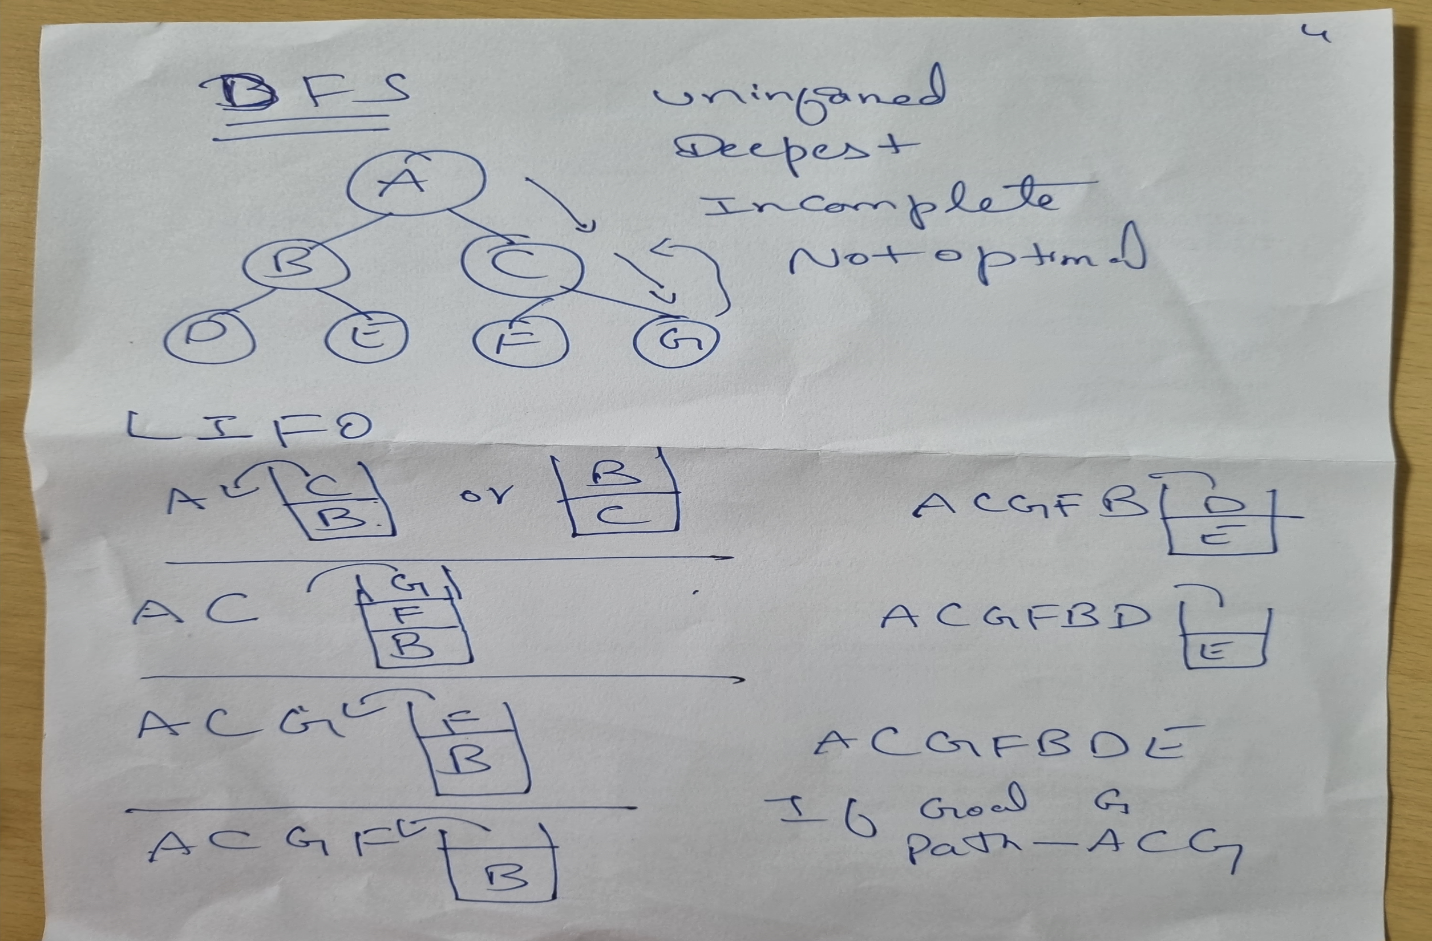

Slide 184
1. If the initial state is a goal state, quit and return success.
2. Otherwise, do the following until success or failure is signaled:
a) Generate a successor, E, of the initial state.
If there are no more successors, signal failure.
b) Call Depth-First Search with E as the initial state.
c) If success is returned, signal success. Otherwise continue in this loop

Slide 185
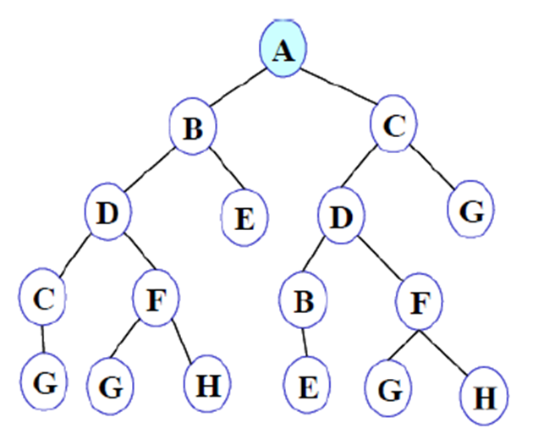
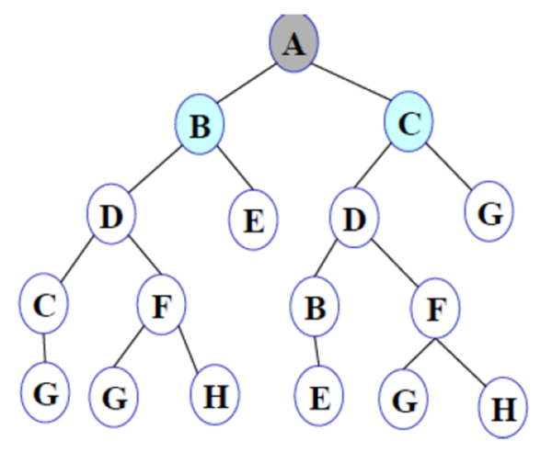
Step 1: Initially NODE-LIST contains only one node corresponding to the source state A.
NODE-LIST:A
Step 2- Node A is removed from NODE-LIST. A is expanded and its children B and C are put in front of NODE-LIST.
NODE-LIST: B C

Slide 186
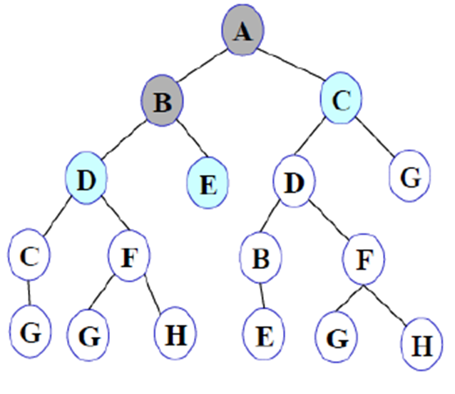
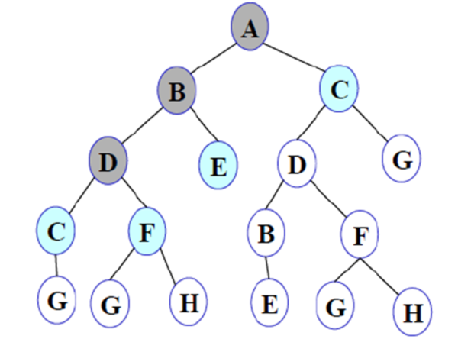
Step 3: Node B is removed from NODE-LIST, and its children D and E are pushed in front of NODE-LIST.
NODE-LIST: D E C
Step 4: Node D is removed from NODE-LIST. C and F are pushed in front of NODE-LIST.

Slide 187
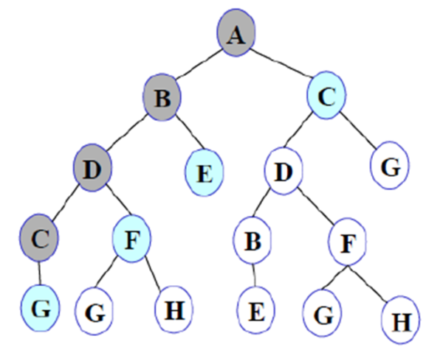
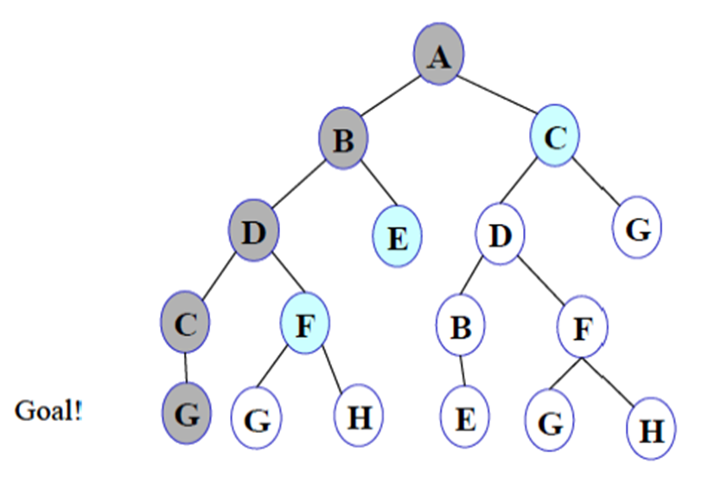
Step 5: Node C is removed from NODE-LIST. Its child G is pushed in front of NODE-LIST.
NODE-LIST: G F E C
Step 6: Node G is expanded and found to be a goal node.
NODE-LIST: G F E C
The solution path A-B-D-C-G is returned and the algorithm terminates.

Slide 188
Depth-first search depend strongly on whether the graph-search or
tree-search version is used.
The graph-search version, which avoids repeated states and redundant paths, is complete in finite state spaces because it will eventually expand every node.
The tree-search version, on the other hand, is not complete—for example, in Figure the algorithm will follow the Arad–Sibiu–Arad–Sibiu loop forever

Slide 189
Advantages
1. Depth-first search requires less memory since only the nodes on the current path are stored and thereby avoids infinite loop in finite spaces. This contrasts with breadth-first search, where all of the trees that have so far been generated must be stored.
2. The depth-first search may find a solution without examining much of the search space at all. This contrasts with breadth-first search in which all parts of the tree must be examined to level n before any nodes on level n + i can be examined

Slide 190
1 Optimality: may find a sub-optimal solution (one that is deeper or more costly than the best solution)
2. Completeness: - Incomplete: without a depth bound, one may not find a solution even if one exists.(Infinite search space)
3. Complexity- For a state space with branching factor b and maximum depth m, depth-first search requires
Storage of only O(bm) nodes.
The time complexity O(b^{m}) nodes

Slide 191
Depth-limited search
The embarrassing failure of depth-first search in infinite state spaces can be alleviated by supplying depth-first search with a predetermined depth limit l.
That is, nodes at depth l are treated as if they have no successors.
This approach is called depth-limited search
The depth limit solves the infinite-path problem.

Slide 192
Unfortunately, it also introduces
a)Incompleteness - If we choose l<d, that is, the shallowest goal is beyond the depth limit. (This is likely when d is unknown.)
b) NonOptimal- Depth-limited search will also be nonoptimal if we choose l >d.
Its time complexity is O(b^{l}) and its space complexity is O(bl).
Depth-first search can be viewed as a special case of depth-limited search with l=∞.

Slide 193
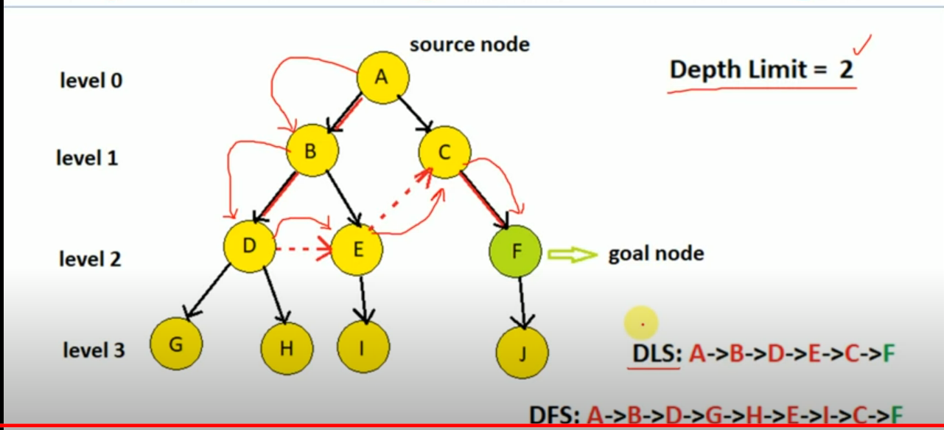

Slide 194
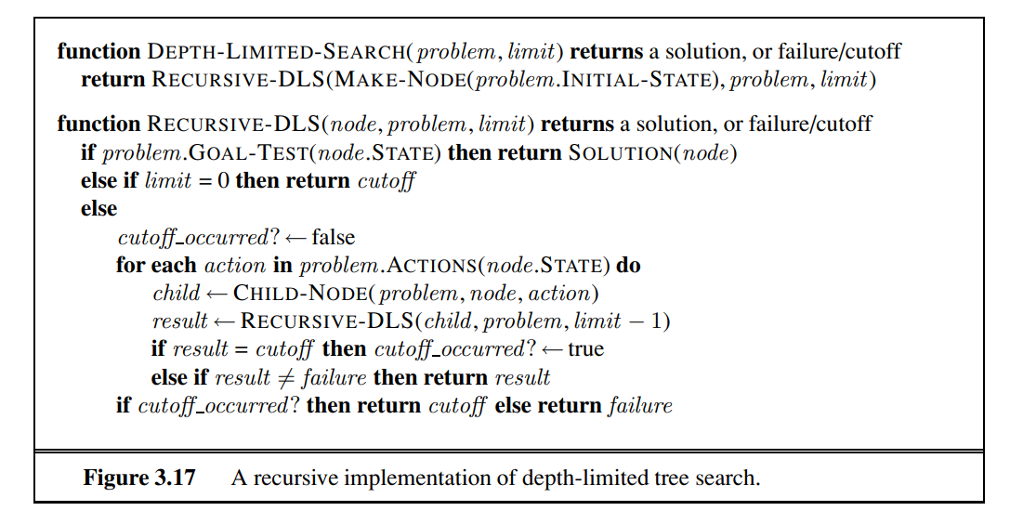
Notice that depth-limited search can terminate with two kinds of failure:
the standard failure value indicates no solution;
the cutoff value indicates no solution within the depth limit

Slide 195
Iterative deepening depth-first search
Iterative deepening search (or iterative deepening depth-first search) is a general strategy, often used in combination with depth-first tree search, that finds the best depth limit.
It does this by gradually increasing the limit—first 0, then 1, then 2, and so on—until a goal is found.
This will occur when the depth limit reaches d, the depth of the shallowest goal node.

Slide 196
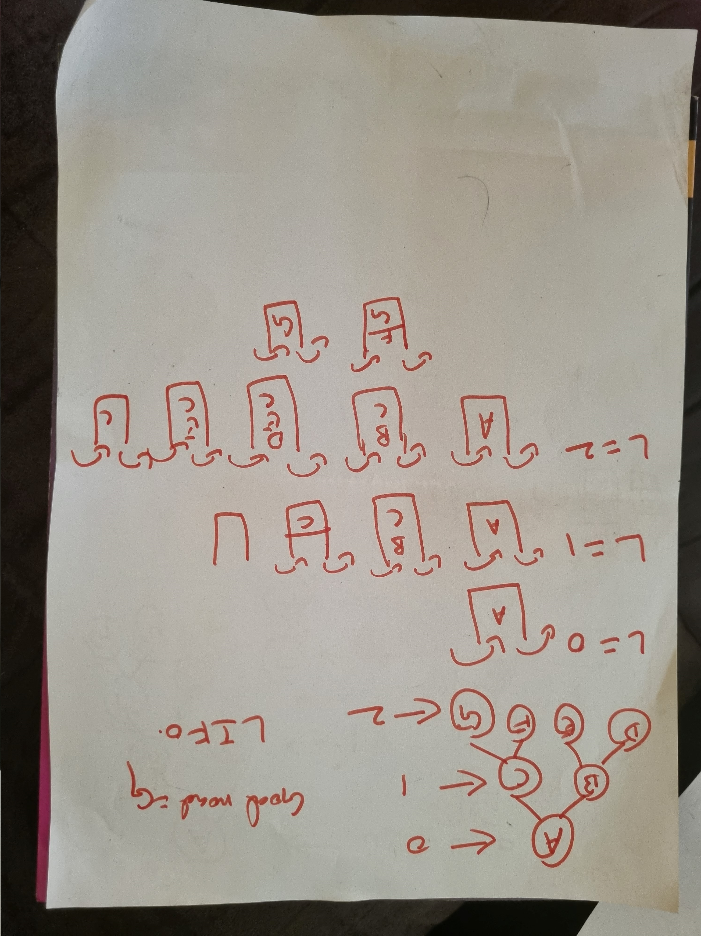

Slide 197
Advantages
Inherits advantages of both DFS and DLS
Disadvantage
Repeats process of previous states

Slide 198
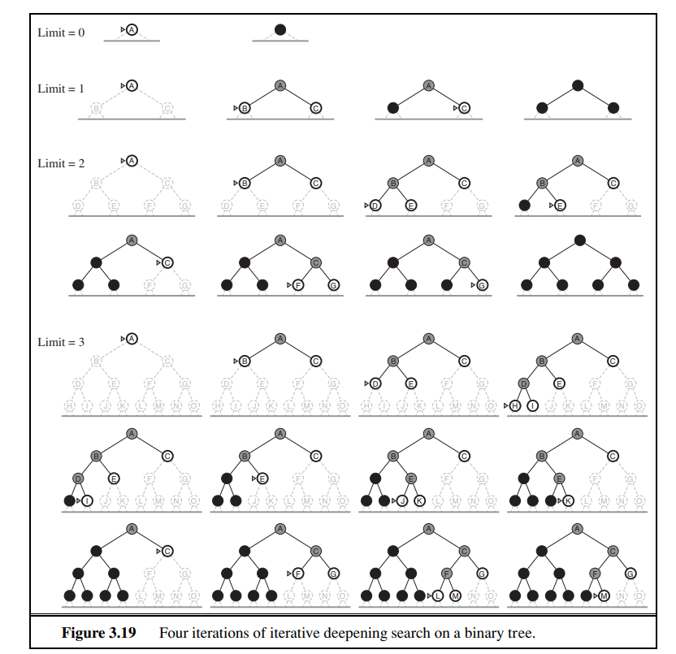

Slide 199


Slide 200
Complete when the branching factor is finite and
2, Optimal when the path cost is a nondecreasing function of the depth of the node
3. N(IDS)=(d)^{b} + (d − 1)b² + ··· + (1)b^{d} , which gives a time complexity of O(bd)—asymptotically the same as breadth-first search.
There is some extra cost for generating the upper levels multiple times, but it is not large.
For example, if b = 10 and d = 5, the numbers are
N(IDS) = 50 + 400 + 3, 000 + 20, 000 + 100, 000 = 123, 450
N(BFS) = 10 + 100 + 1, 000 + 10, 000 + 100, 000 = 111, 110 .

Slide 201


Slide 202
Greedy best-first search
Greedy best-first search tries to expand the node that is closest to the goal, on the grounds that this is likely to lead to a solution quickly.
Thus, it evaluates nodes by using just the heuristic function; that is,
f(n) = h(n).

Slide 203


Slide 204
For route-finding problems in Romania; we use the straight-line distance heuristic, which we will call hSLD .
If the goal is Bucharest, we need to know the straight-line distances to Bucharest, which are shown in Figure For example, hSLD (In(Arad)) = 366.
Notice that the values of hSLD cannot be computed from the problem description itself

Slide 205


The first node to be expanded from Arad will be Sibiu because it is closer to Bucharest than either Zerind or Timisoara.
The next node to be expanded will be Fagaras because it is closest.
Fagaras in turn generates Bucharest, which is the goal.
For this particular problem, greedy best-first search using hSLD finds a solution and its search cost is minimal.

Slide 206
Optimal- It is not optimal, however: the path via Sibiu and Fagaras to Bucharest is 32 kilometers longer than the path through Rimnicu Vilcea and Pitesti. This shows why the algorithm is called “greedy”—at each step it tries to get as close to the goal as it can.
Completeness-Greedy best-first tree search is also incomplete even in a finite state space, much like depth-first search. Consider the problem of getting from Iasi to Fagaras.
The heuristic suggests that Neamt be expanded first because it is closest to Fagaras, but it is a dead end.
The solution is to go first to Vaslui—a step that is actually farther from the goal according to the heuristic—and then to continue to Urziceni, Bucharest, and Fagaras.
The algorithm will never find this solution, however, because expanding Neamt puts Iasi back into the frontier, Iasi is closer to Fagaras than Vaslui is, and so Iasi will be expanded again, leading to an infinite loop.
The worst-case time and space complexity for the tree version is O(b^{m}), where m is the maximum depth of the search space.

Slide 207
A* search: Minimizing the total estimated solution cost
The most widely known form of best-first search is called A∗
It evaluates nodes by combining g(n), the cost to reach the node, and h(n), the cost to get from the node to the goal:
f(n) = g(n) + h(n) .
Since g(n) gives the path cost from the start node to node n, and h(n) is the estimated cost of the cheapest path from n to the goal,
we have
f(n) = estimated cost of the cheapest solution through n .
If we are trying to find the cheapest solution, a reasonable thing to try first is the node with the lowest value of g(n) + h(n)

Slide 208
A∗ search is both complete and optimal.
The algorithm is identical to UNIFORM-COST-SEARCH except that A∗ uses g + h instead of g.

Slide 209



Slide 210


Slide 211


Slide 212
Conditions for optimality: Admissibility and consistency
The first condition we require for optimality is that h(n) be an admissible heuristic.
An admissible heuristic is one that never overestimates the cost to reach the goal.
Because g(n) is the actual cost to reach n along the current path, and
f(n) = g(n) + h(n), we have as an
immediate consequence that f(n) never overestimates the true cost of a solution along the current path through n

Slide 213


Slide 214



Slide 215



Slide 216


Slide 217


Slide 218


Slide 219


Slide 220



Underestimation
Overestimation
5>4

Slide 221


Slide 222


Slide 223
Optimality of A* - Under what condition is A* optimal
A∗ has the following properties:
The tree-search version of A∗ is optimal if h(n) is admissible,
while the graph-search version is optimal if h(n) is consistent.
The first step is to establish the following: if h(n) is consistent, then the values of f(n) along any path are nondecreasing

Slide 224



Slide 225



Slide 226


Along any path if we have a node N and if we have a successor N¹
Of N then the f value at N¹ will be greater than or equal to the f value at node N.

Slide 227

So we see that f value will only increase or remain the same which means it is a non decreasing function and so along any path the f value will be non decreasing

Slide 228
The next step is to prove that whenever A∗ selects a node n for expansion, the optimal path to that node has been found

Slide 229


Slide 230


Slide 231


Slide 232


Slide 233


Slide 234


Slide 235


Slide 236


Slide 237


Slide 238

Heuristic Functions
8 Puzzle Problem - The object of the puzzle is to slide the tiles horizontally or vertically into the empty space until the configuration matches the goal configuration.
The empty space can only move in four directions viz.,
1. Up 2.Down 3. Right or 4. Left

Slide 239

Uninformed searching takes a lot of time to search as it doesn’t know where to head and where the best chances of finding the element are.

Slide 240
The 8 Puzzle Solution Search Space
The 8-puzzle is the largest possible N-puzzle that can be solved entirely.
It is simple and yet has a significant problem space.
There are larger variants to the same problem type, like the 15-puzzle. But those cannot be solved to completion
8 puzzle has 9! possible tile permutation states. Out of these, every second permutation state is solvable. Hence, there is a total of 9!/2 = 181,440 solvable problem states.
The problem lies in creating the possible search tree and then traversing the most optimal tree branch that will lead from the start state to the end state.
So, how do we find the most optimal branch of the tree? Enter the Heuristic Search!

Slide 241
A Heuristic search is a technique to solve a search problem faster than classical methods.
In many cases, it finds an approximate solution when classical methods cannot.
It is thus a generalized and approximate strategy for problem-solving.
In layman’s terms, it can be thought of as a rule of thumb, or a common-sense knowledge, where the answer isn’t guaranteed to be correct but helps to reach a decision quickly.
It is a shortcut that we take to trade-off either the optimality, the completeness, the accuracy, or the precision for speed.
Heuristic searches are often associated with heuristic values

Slide 242
If we want to find the shortest solutions by using A∗, we need a heuristic function that never overestimates the number of steps to the goal
The heuristic value of an 8 puzzle state is a combination of two values.
It is often called the cost function f.
f = h + g
Two ways to obtain heuristic

Slide 243
• h1 = the number of misplaced tiles.
h1 is an admissible heuristic because it is clear that any tile that is out of place must be moved at least once

Slide 244

f-score = h-score + g-score

Slide 245


Slide 246
h2 = the sum of the distances of the tiles from their goal positions.
This is sometimes called the city block distance or Manhattan distance.
h2 is also admissible because all any move can do is move one tile one step closer to the goal.

Slide 247


Slide 248

h1 = 8.
h2=18
neither of these overestimates the true solution cost, which is 26.

Slide 249
B∗ ≈ N^(1/d)
53 = ((B∗)^(d+1) - 1) / (B∗ - 1),
The effect of heuristic accuracy on performance
The quality of heuristics can be characterized on the basis of the effective branching factor b*.
If the total number of nodes generated by A* for a problem is N, and the solution depth is d, then:
N = b* + (b*)2 + (b*)3 + (b*)4 + ….. + (b*)d
if A∗ finds a solution at depth 5 using 52 nodes, then the effective branching factor is 1.92.

Slide 250

h2 is always better than h1
A∗ using h2 will never expand more nodes than A∗ using h1

Slide 251
Local Search Algorithms
The search algorithms that we have seen so far are designed to explore search spaces systematically.
This systematicity is achieved by keeping one or more paths in memory and by recording which alternatives have been explored at each point along the path.
When a goal is found, the path to that goal also constitutes a solution to the problem.
In many problems, however, the path to the goal is irrelevant.
For example, in the 8-queens problem what matters is the final configuration of queens, not the order in which they are added, integrated-circuit design, factory-floor layout, job-shop scheduling

Slide 252
If the path to the goal does not matter, we might consider a different class of algorithms, ones that do not worry about paths at all.
Local search algorithms operate using a single current node (rather than multiple paths) and generally move only to neighbors of that node.
Typically, the paths followed by the search are not retained.
Although local search algorithms are not systematic, they have two key advantages:
(1) they use very little memory—usually a constant amount; and
(2) they can often find reasonable solutions in large or infinite (continuous) state spaces for which systematic algorithms are unsuitable

Slide 253
In addition to finding goals, local search algorithms are useful for solving pure optimization problems, in which the aim is to find the best state according to an objective function
To understand local search, we find it useful to consider the state-space landscape
A landscape has both “location” (defined by the state) and “elevation” (defined by the value of the heuristic cost function or objective function).
If elevation corresponds to cost, then the aim is to find the lowest valley—a global minimum;
If elevation corresponds to an objective function, then the aim is to find the highest peak—a global maximum.Local search algorithms explore this landscape.

Slide 254



Slide 255
Hill-climbing search
The hill-climbing search algorithm (steepest-ascent version) is shown in Figure 4.2
It is simply a loop that continually moves in the direction of increasing value—that is, uphill.
It terminates when it reaches a “peak” where no neighbor has a higher value.
The algorithm does not maintain a search tree, so the data structure for the current node need only record the state and the value of the objective function.
Hill climbing does not look ahead beyond the immediate neighbors of the current state

Slide 256



Slide 257


To illustrate hill climbing, we will use the 8-queens problem
Each state has 8 queens on the board, one per column.
The successors of a state are all possible states generated by moving a single queen to another square in the same column (so each state has 8 × 7 = 56 successors).
.

Slide 258




1The heuristic cost function h is the number of pairs of queens that are attacking each other, either directly or indirectly
H=1
2. Hill climbing with initial state
Total Attcking Queens –Directly and Indirectly -17 h=17
When moved queen as shown h becomes=15

Slide 259



For each move h is calculated and best successors is found found
When moved to this is the next best successor anh when calculate h value at this stage it is more than 12
The global minimum of this function is zero, which occurs only at perfect solutions.

Slide 260
Hill climbing often gets stuck for the following reasons.
Local maxima: a local maximum is a peak that is higher than each of its neighboring states but lower than the global maximum. Hill-climbing algorithms that reach the vicinity of a local maximum will be drawn upward toward the peak but will then be stuck with nowhere else to go.
Ridges:. Ridges result in a sequence of local maxima that is very difficult for greedy algorithms to navigate.
• Plateaux: a plateau is a flat area of the state-space landscape. It can be a flat local maximum, from which no uphill exit exists, or a shoulder, from which progress is possible.

Slide 261


Slide 262


Slide 263


Slide 264


Slide 265


Slide 266


Slide 267


Slide 268


Slide 269


Slide 270


Slide 272
Logical Agents
We design agents
that can form representations of a complex world,
use a process of inference to derive new representations about the world, and
use these new representations to deduce what to do.

Slide 273
Humans, know things; and what they know helps them do things. These are not empty statements.
They make strong claims about how the intelligence of humans is achieved—not by purely reflex mechanisms but by processes of reasoning that operate on internal representations of knowledge.
In AI, this approach to intelligence is embodied in knowledge-based agents

Slide 274

The central component of a knowledge-based agent is its knowledge base, or KB.
A knowledge base is a set of sentences. (Here “sentence” is used as a technical term. It is related but not identical to the sentences of English and other natural languages.)
Each sentence is expressed in a language called a knowledge representation language and represents some assertion about the world.
Sometimes we dignify a sentence with the name axiom, when the sentence is taken as given without being derived from other sentences

Slide 275

Figure below shows the outline of a knowledge-based agent program.
Like all our agents, it takes a percept as input and returns an action.
The agent maintains a knowledge base, KB, which may initially contain some background knowledge.
.
.
Each time the agent program is called, it does three things

Slide 276
First, it TELLs the knowledge base what it perceives.
Second, it ASKs the knowledge base what action it should perform.
In the process of answering this query, extensive reasoning may be done about the current state of the world, about the outcomes of possible action sequences, and so on.
Third, the agent program TELLs the knowledge base which action was chosen, and the agent executes the action

Slide 277
MAKE-PERCEPT-SENTENCE constructs a sentence asserting that the agent perceived the given percept at the given time.
MAKE-ACTION-QUERY constructs a sentence that asks what action should be done at the current time.
Finally, MAKE-ACTION-SENTENCE constructs a sentence asserting that the chosen action was executed.
The details of the inference mechanisms are hidden inside TELL and ASK

Slide 278
The agent in Figure appears quite similar to the agents with internal state described in Chapter 2.
Because of the definitions of TELL and ASK, however, the knowledge-based agent is not an arbitrary program for calculating actions.
It is amenable to a description at the knowledge level, where we need specify only what the agent knows and what its goals are, in order to fix its behavior
Eg: an automated taxi might have the goal of taking a passenger from San Francisco to Marin County and might know that the Golden Gate Bridge is the only link between the two locations.
Then we can expect it to cross the Golden Gate Bridge because it knows that that will achieve its goal.

Slide 279
Notice that this analysis is independent of how the taxi works at the implementation level.
It doesn’t matter whether its geographical knowledge is implemented as linked lists or pixel maps, or whether it reasons by manipulating strings of symbols stored in registers or by propagating noisy signals in a network of neurons
A knowledge-based agent can be built simply by TELLing it what it needs to know. Starting with an empty knowledge base, the agent designer can TELL sentences one by one until the agent knows how to operate in its environment. This is called the declarative approach to system building.
In contrast, the procedural approach encodes desired behaviors directly as program code

Slide 280
The Wumpus world
The wumpus world is a cave consisting of rooms connected by passageways. Lurking somewhere in the cave is the terrible wumpus, a beast that eats anyone who enters its room.
The wumpus can be shot by an agent, but the agent has only one arrow.
Some rooms contain bottomless pits that will trap anyone who wanders into these rooms (except for the wumpus, which is too big to fall in).
The only mitigating feature of this bleak environment is the possibility of finding a heap of gold

Slide 281


Slide 282
Performance:
+1000 bonus points if the agent returns from the tunnel with the gold.
Being eaten by the wumpus or plummeting into the pit results in a -1000 point penalty.
Each move is worth -1, and using an arrow is worth -10.
The game is over if either agent dies or exits the tunnel.
2. Environment:
A four-by-four grid of chambers.
The operative begins in room square [1, 1], facing the right.
Wumpus and gold locations are selected randomly except for the first square [1,1].
Except for the first square, each square in the tunnel has a 0.2 chance of being a pit

Slide 283
3. Actuators: They are the actions that the agent can take to interact with the world. The worker in Wumpus World in AI can carry out the following tasks:
Left turn
Right turn
Move forward
Grab
Release
Shoot
4. Sensors: They are how the agent senses its surroundings. The agent's instruments in the Wumpus World provide the following information:
If the agent is in the chamber next to the wumpus, he will notice the stench. (Not diagonally).
If the agent is in the room immediately adjacent to the pit, he will notice a breeze.

Slide 284
The agent will notice the glitter in the chamber with the gold.
The agent will notice the bump if he runs into a wall.
When the Wumpus is shot, it lets out a horrifying scream that can be heard throughout the tunnel.
These perceptions can be represented as a five-element list with distinct indicators for each sensor.
For example, if an agent detects stench and breeze but not glitter, bump, or scream, it can be depicted as [Stench, Breeze, None, None,None].

Slide 285
Let us watch a knowledge-based wumpus agent exploring the environment shown in Figure above. We use an informal knowledge representation language consisting of writing down symbols in a grid
Agent's first step:The agent’s initial knowledge base contains the rules of the environment, as described previously; in particular, it knows that it is in [1,1] and that [1,1] is a safe square; we denote that with an “A” and “OK,” respectively, in square [1,1].
Then, the agent is represented by symbol A, the breeze by symbol B, the glitter or gold by symbol G, the visited chamber by symbol V, the pits by symbol P, and the wumpus by symbol W.
The agent does not detect any breeze or Stench in Room [1,1], implying that the neighboring squares are also fine.

Slide 286

Agent's second step: Now that the agent has to proceed forward, it will either go to [1, 2] or [2, 1]. Assume the agent moves to room [2, 1]. The agent detects a breeze in this chamber, indicating that the pit is nearby. The pit can be in [3, 1] or [2, 2], so we'll put the symbol P? to indicate whether or not this is a Pit room.

Slide 287
Now, the agent will pause and reflect before making any bad moves. Finally, the agent will return to the [1, 1] chamber. The agent visits rooms [1,1] and [2,1], so we will use V to symbolize the visited squares.
Agent's third step: At the third stage, the agent will proceed to room [1,2], which is fine. The agent perceives a stench in [1,2], resulting in the state of knowledge shown in Figure 7.4(a). The stench in [1,2] means that there must be a wumpus nearby. But the wumpus cannot be in [1,1], by the rules of the game, and it cannot be in [2,2] (or the agent would have detected a stench when it was in [2,1]). Therefore, the agent can infer that the wumpus is in [1,3]. The notation W! indicates this inference.

Slide 288

Moreover, the lack of a breeze in [1,2] implies that there is no pit in [2,2]. Yet the agent has already inferred that there must be a pit in either [2,2] or [3,1], so this means it must be in [3,1]. This is a fairly difficult inference, because it combines knowledge gained at different times in different places and relies on the lack of a percept to make one crucial step

Slide 289
Agent's fourth move: Because there is no stench or breeze in room [2,2], let us assume the agent chooses to relocate to [2,3]. The agent detects glitter in the room [2,3], so it should take the gold and climb out of the cave.
Note that in each case for which the agent draws a conclusion from the available information, that conclusion is guaranteed to be correct if the available information is correct. This is a fundamental property of logical reasoning

Slide 290
Logic
Summarizes the fundamental concepts of logical representation and reasoning
Knowledge bases consist of sentences.
The logical representation of these sentences are expressed according to the syntax of the representation language, which specifies all the sentences that are well formed.
Eg: in ordinary arithmetic: “x + y = 4” is a well-formed sentence, whereas “x4y+ =” is not

Slide 291
A logic must also define the semantics or meaning of sentences.
The semantics defines the truth of each sentence with respect to each possible world.
For example, the semantics for arithmetic specifies that the sentence “x + y = 4” is true in a world where x is 2 and y is 2, but false in a world where x is 1 and y is 1.

Slide 292
When we need to be precise, we use the term model in place of “possible world.”
Whereas possible worlds might be thought of as real environments that the agent might or might not be in, models are mathematical abstractions, each of which simply fixes the truth or falsehood of every relevant sentence
The possible models are just all possible assignments of real numbers to the variables x and y.
Eg: if xy=0 is model, assigning any value to x and y becomes sentences

Slide 293
Each such assignment fixes the truth of any sentence of arithmetic whose variables are x and y.
If a sentence α is true in model m, we say that m satisfies α or sometimes m is a model of α. Eg: x=0 y=12 is true in xy=0 so α is true in M
i.e. x=0 and y=12 satisfies the model xy=0
x=1 and y=12 does not satisfies the model
We use the notation M(α) to mean the set of all models of α

Slide 294
Now that we have a notion of truth, we are ready to talk about logical reasoning.
This involves the relation of logical entailment between sentences—the idea that a sentence follows logically from another sentence.
In mathematical notation, we write
α |= β α entails the sentence β.
The formal definition of entailment is this:
α |= β if and only if, in every model in which α is true, β is also true.
α |= β if and only if M(α) ⊆ M(β) .
x=0 |= xy=0 p= True |= (p v q) False |= True(if β is always true and α is true some time and false sometime)
Eg: sentence x = 0 entails the sentence xy = 0. Obviously, in any model where x is zero, it is the case that xy is zero

Slide 295


We can apply the same kind of analysis to the wumpus-world reasoning example given in the preceding section.
Consider the situation in Figure 7.3(b): the agent has detected nothing in [1,1] and a breeze in [2,1]. These percepts, combined with the agent’s knowledge of the rules of the wumpus world, constitute the KB

Slide 296




The agent is interested in whether the adjacent squares [1,2], [2,2], and [3,1] contain pits. Each of the three squares might or might not contain a pit, so there are 2power3 = 8 possible models. These eight models are shown

Slide 297


We can also see that in some models in which KB is true, α2 is false.
Hence, KB |= α2: the agent cannot conclude that there is no pit in [2,2].
(Nor can it conclude that there is a pit in [2,2].)
By inspection, we see the following:
in every model in which KB is true, α1 is also true.
Hence, KB |= α1: there is no pit in [1,2].

Slide 298
The preceding example not only illustrates entailment but also shows how the definition of entailment can be applied to derive conclusions—that is, to carry out logical inference.
α1 = “There is no pit in [1,2].”
α2 = “There is no pit in [2,2].”
The inference algorithm illustrated in Figure is called model checking, because it enumerates all possible models to check that α is true in all models in which KB is true, that is, that M(KB) ⊆ M(α)

Slide 299
An inference algorithm must be
1. Sound- that derives only entailed sentences is called sound or truth preserving.
2. Complete- an inference algorithm is complete if it can derive any sentence that is entailed - which are finite in extent
Grounding- the connection between logical reasoning processes and the real environment in which the agent exists. In particular, how do we know that KB is true in the real world?
A simple answer is that the agent’s sensors create the connection. For example, our wumpus-world agent has a smell sensor. The agent program creates a suitable sentence whenever there is a smell. Then, whenever that sentence is in the knowledge base, it is true in the real world.

Slide 300
Propositional Logic - A very simple logic
Syntax - The syntax of propositional logic defines the allowable sentences.
The atomic sentences consist of a single proposition symbol.
Each such symbol stands for a proposition that can be true or false.
We use symbols that start with an uppercase letter and may contain other letters or subscripts, for example: P, Q, R, W1,3 and North
Note- There are two proposition symbols with fixed meanings: True is the always-true proposition and False is the always-false proposition

Slide 301

Complex sentences are constructed from simpler sentences, using parentheses and logical connectives.
There are five connectives in common use:

Slide 302
¬ (not). A sentence such as ¬W1,3 is called the negation of W1,3. A literal is either an atomic sentence (a positive literal) or a negated atomic sentence (a negative literal).
∧ (and). A sentence whose main connective is ∧, such as W1,3 ∧ P3,1, is called a conjunction; its parts are the conjuncts.
∨ (or). A sentence using ∨, such as (W1,3∧P3,1)∨W2,2, is a disjunction of the disjuncts(W1,3 ∧ P3,1) and W2,2
⇒ (implies). A sentence such as (W1,3∧P3,1) ⇒ ¬W2,2 is called an implication (or conditional). Its premise or antecedent is (W1,3 ∧P3,1), and its conclusion or consequent is ¬W2,2. Implications are also known as rules or if–then statements..
⇔ (if and only if). The sentence W1,3 ⇔ ¬W2,2 is a biconditional.

Slide 303

. To eliminate the ambiguity we define a precedence for each operator.
The “not” operator (¬) has the highest precedence,
which means that in the sentence ¬A ∧ B the ¬ binds most tightly, giving us the equivalent
of (¬A)∧B rather than ¬(A∧B).

Slide 304
Semantics
The semantics defines the rules for determining the truth of a sentence with respect to a particular model.
In propositional logic, a model simply fixes the truth value—true or false—for every proposition symbol.
For example, if the sentences in the knowledge base make use of the
proposition symbols P1,2, P2,2, and P3,1, then one possible model is
m1 = {P1,2 = false, P2,2 = false, P3,1 = true} .
With three proposition symbols, there are 2power3 = 8 possible models—exactly those depicted in Figure 7.5

Slide 305
The semantics for propositional logic must specify how to compute the truth value of any sentence, given a model. This is done recursively.
Truth of Atomic sentences :
• True is true in every model and False is false in every model.
• The truth value of every other proposition symbol must be specified directly in the model.
For example, in the model m1 given earlier, P1,2 is false

Slide 306

For complex sentences, we have five rules, which hold for any subsentences P and Q in any model m (here “iff” means “if and only if”):
• ¬P is true iff P is false in m.
• P ∧ Q is true iff both P and Q are true in m.
• P ∨ Q is true iff either P or Q is true in m.
• P ⇒ Q is true unless P is true and Q is false in m.
• P ⇔ Q is true iff P and Q are both true or both false in m.

Slide 307

The rules can also be expressed with truth tables that specify the truth value of a complex sentence for each possible assignment of truth values to its components
From these tables, the truth value of any sentence s can be computed with respect to any model m by a simple recursive evaluation. For example
¬P1,2 ∧ (P2,2 ∨ P3,1), evaluated in m1, gives true ∧ (false ∨ true) = true ∧ true = true.(m1 = {P1,2 = false, P2,2 = false, P3,1 = true} )

Slide 308
A simple knowledge base - A knowledge base for the wumpus world.
we need the following symbols for each [x, y] location
Px,y is true if there is a pit in [x, y].
Wx,y is true if there is a wumpus in [x, y], dead or alive.
Bx,y is true if the agent perceives a breeze in [x, y].
Sx,y is true if the agent perceives a stench in [x, y].
Consider sentences Ri
• There is no pit in [1,1]:
R1 : ¬P1,1 .
• A square is breezy if and only if there is a pit in a neighboring square. This has to be stated for each square; for now, we include just the relevant squares:
R2 : B1,1 ⇔ (P1,2 ∨ P2,1) .
R3 : B2,1 ⇔ (P1,1 ∨ P2,2 ∨ P3,1) .
•

Slide 309
The preceding sentences are true in all wumpus worlds. Now we include the breeze percepts for the first two squares visited in the specific world the agent is in, leading up to the situation in Figure 7.3(b).
R4 : ¬B1,1 .
R5 : B2,1 .

Slide 310
A simple inference procedure
Our goal now is to decide whether KB |= α for some sentence α.
For example, is ¬P1,2entailed by our KB?
Our algorithm for inference is a model-checking approach that is a direct implementation of the definition of entailment:
enumerate the models, and
check that α is true in every model in which KB is true.
Models are assignments of true or false to every proposition symbol.
Wumpus-world example-
The relevant proposition symbols are B1,1, B2,1, P1,1, P1,2, P2,1, P2,2, and P3,1.

Slide 311

With seven symbols, there are 2power7 = 128 possible models; in three of these, KB is true .
In those three models, ¬P1,2 is true, hence there is no pit in [1,2].
On the other hand, P2,2 is true in two of the three models and false in one, so we cannot yet tell whether there is a pit in [2,2].

Slide 312

TT-ENTAILS? performs a recursive enumeration of a finite space of assignments to symbols

Slide 313


Slide 314


Slide 315


Slide 316


Slide 317


Slide 318


Slide 319



Slide 320



Slide 321

Watch: Inference in Propositional Logic (youtube.com)

Slide 322


Slide 323


Slide 324
Propositional Theorem Proving
Entailment by model checking: enumerating models and showing that the sentence must hold in all models.
In this section, we show how entailment can be done by theorem proving—applying rules of inference directly to the sentences in our knowledge base to construct a proof of the desired sentence without consulting models.
If the number of models is large but the length of the proof is short, then theorem proving can be more efficient than model checking.

Slide 325
Additional concepts related to entailment.
1. The first concept is logical equivalence:
Two sentences α and β are logically equivalent if they are true in the same set of models.
We write this as α ≡ β.
For example, we can easily show (using truth tables) that P ∧ Q and Q ∧ P are logically equivalent; other equivalences are shown in Figure 7.11

Slide 326


Slide 327
2. The second concept we will need is validity.
A sentence is valid if it is true in all models.
For example, the sentence P ∨ ¬P is valid.
Valid sentences are also known as tautologies—they are necessarily true.
Because the sentence True is true in all models, every valid sentence is logically equivalent to True.

Slide 328
3. The final concept we will need is satisfiability.
A sentence is satisfiable if it is true in, or satisfied by, some model.
For example, the knowledge base given earlier, (R1 ∧ R2 ∧ R3 ∧ R4 ∧ R5), is satisfiable because there are three models in which it is true
Satisfiability can be checked by enumerating the possible models until one is found that satisfies the sentence
Validity and satisfiability are of course connected:
α is valid iff ¬α is unsatisfiable; contrapositively, α is satisfiable iff ¬α is not valid.
We also have the following useful result:
α |= β if and only if the sentence (α ∧ ¬β) is unsatisfiable.

Slide 329

Inference and proofs
This section covers inference rules that can be applied to derive a proof—a chain of conclusions that leads to the desired goal
1. The best-known rule is called Modus Ponens (Latin for mode that affirms) and is written
Whenever any sentences of the form α ⇒ β and α are given, then the sentence β can be inferred.
For example, if (WumpusAhead ∧WumpusAlive) ⇒ Shoot and (WumpusAhead ∧ WumpusAlive) are given, then Shoot can be inferred
Another useful inference rule is And-Elimination, which says that, from a conjunction, any of the conjuncts can be inferred: α ∧ β/ α .
For example, from (WumpusAhead ∧ WumpusAlive), WumpusAlive can be inferred

Slide 330

All of the logical equivalences in Figure 7.11 can be used as inference rules.
For example, the equivalence for biconditional elimination yields the two inference rules

Slide 331
Let us see how these inference rules and equivalences can be used in the wumpus world.
We start with the knowledge base containing R1 through R5 and show how to prove ¬P1,2, that is, there is no pit in [1,2].
R1 : ¬P1,1
R2 : B1,1 ⇔ (P1,2 ∨ P2,1) .
R3 : B2,1 ⇔ (P1,1 ∨ P2,2 ∨ P3,1)
R4 : ¬B1,1 .
R5 : B2,1.
First, we apply biconditional elimination to R2 to obtain
R6 : (B1,1 ⇒ (P1,2 ∨ P2,1)) ∧ ((P1,2 ∨ P2,1) ⇒ B1,1) .
Then we apply And-Elimination to R6 to obtain
R7 : ((P1,2 ∨ P2,1) ⇒ B1,1) .
Logical equivalence for contrapositives gives
R8 : (¬B1,1 ⇒ ¬(P1,2 ∨ P2,1)) .
Now we can apply Modus Ponens with R8 and the percept R4 (i.e., ¬B1,1), to obtain
R9 : ¬(P1,2 ∨ P2,1) .
Finally, we apply De Morgan’s rule, giving the conclusion
R10 : ¬P1,2 ∧ ¬P2,1 .
That is, neither [1,2] nor [2,1] contains a pit.

Slide 332
we can also apply any of the search algorithms in to find a sequence of steps that constitutes a proof.
We just need to define a proof problem as follows
INITIAL STATE: the initial knowledge base.
• ACTIONS: the set of actions consists of all the inference rules applied to all the sentences that match the top half of the inference rule.
• RESULT: the result of an action is to add the sentence in the bottom half of the inference rule.
• GOAL: the goal is a state that contains the sentence we are trying to prove.

Slide 333
4. One final property of logical systems is monotonicity, which says that the set of entailed sentences can only increase as information is added to the knowledge base.
For any sentences α and β, if KB |= α then KB ∧ β |= α

Slide 334

Proof by resolution
Resolution, that yields a complete inference algorithm
We begin by using a simple version of the resolution rule in the wumpus world.
Let us consider the steps leading up to Figure : the agent returns from [2,1] to [1,1] and then goes to [1,2], where it perceives a stench, but no breeze.
We add the following facts to the knowledge base:
R11 : ¬B1,2 .
R12 : B1,2 ⇔ (P1,1 ∨ P2,2 ∨ P1,3) .
By the same process that led to R10 earlier, we can now derive the absence of pits in [2,2] and [1,3] (remember that [1,1] is already known to be pitless):
R13 : ¬P2,2 .
R14 : ¬P1,3

Slide 335
We can also apply biconditional elimination to R3, followed by Modus Ponens with R5, to obtain the fact that there is a pit in [1,1], [2,2], or [3,1]:(R3 : B2,1 ⇔ (P1,1 ∨ P2,2 ∨ P3,1) R5 : B2,1.)
R15 : P1,1 ∨ P2,2 ∨ P3,1 .
Now comes the first application of the resolution rule: the literal ¬P2,2 in R13 resolves with the literal P2,2 in R15 to give the resolvent
R16 : P1,1 ∨ P3,1 .
In English; if there’s a pit in one of [1,1], [2,2], and [3,1] and it’s not in [2,2], then it’s in [1,1] or [3,1].
Similarly, the literal ¬P1,1 in R1 resolves with the literal P1,1 in R16 to give
R17 : P3,1 .
In English: if there’s a pit in [1,1] or [3,1] and it’s not in [1,1], then it’s in [3,1].
These last two inference steps are examples of the unit resolution inference rule

Slide 336


where each l is a literal and li and m are complementary literals
Thus, the unit resolution rule takes a clause(P1,1 ∨ P2,2 ∨ P3,1 )—a disjunction of literals—and a literal and produces a new clause(P1,1 ∨ P3,1 ).
Note that a single literal can be viewed as a disjunction of one literal, also known as a unit clause.
The unit resolution rule can be generalized to the full resolution rule
where li and mj are complementary literals.
This says that resolution takes two clauses and produces a new clause containing all the literals of the two original clauses except the two complementary literals.

Slide 337
One more technical aspect of the resolution rule:
the resulting clause should contain only one copy of each literal
The removal of multiple copies of literals is called factoring.
For example, if we resolve (A ∨ B) with (A ∨ ¬B), we obtain (A ∨ A), which is reduced to just A

Slide 338
Conjunctive normal form
The resolution rule applies only to clauses (that is, disjunctions of literals), so it would seem to be relevant only to knowledge bases and queries consisting of clauses.
How, then, can it lead to a complete inference procedure for all of propositional logic?
The answer is that every sentence of propositional logic is logically equivalent to a conjunction of clauses.
A sentence expressed as a conjunction of clauses is said to be in conjunctive normal form or CNF

Slide 339
Procedure for converting to CNF. B1,1 ⇔ (P1,2 ∨ P2,1) into CNF.
The steps are as follows:
1. Eliminate ⇔, replacing α ⇔ β with (α ⇒ β) ∧ (β ⇒ α).
(B1,1 ⇒ (P1,2 ∨ P2,1)) ∧ ((P1,2 ∨ P2,1) ⇒ B1,1) .
2. Eliminate ⇒, replacing α ⇒ β with ¬α ∨ β:
(¬B1,1 ∨ P1,2 ∨ P2,1) ∧ (¬(P1,2 ∨ P2,1) ∨ B1,1) .
3. CNF requires ¬ to appear only in literals, so we “move ¬ inwards” by repeated application of the following equivalences from Figure 7.11:
¬(¬α) ≡ α (double-negation elimination)
¬(α ∧ β) ≡ (¬α ∨ ¬β) (De Morgan)
¬(α ∨ β) ≡ (¬α ∧ ¬β) (De Morgan)
In the example, we require just one application of the last rule:
(¬B1,1 ∨ P1,2 ∨ P2,1) ∧ ((¬P1,2 ∧ ¬P2,1) ∨ B1,1) .
4. Now we have a sentence containing nested ∧ and ∨ operators applied to literals. We
apply the distributivity law from Figure 7.11, distributing ∨ over ∧ wherever possible.
(¬B1,1 ∨ P1,2 ∨ P2,1) ∧ (¬P1,2 ∨ B1,1) ∧ (¬P2,1 ∨ B1,1) .
The original sentence is now in CNF, as a conjunction of three clauses.

Slide 340
A resolution algorithm
Inference procedures based on resolution work by using the principle of proof by contradiction which states as
(Validity and satisfiability are of course connected: α is valid iff ¬α is unsatisfiable; contrapositively, α is satisfiable iff ¬α is not valid. We also have the following useful result: α |= β if and only if the sentence (α ∧ ¬β) is unsatisfiable.).
That is, to show that KB |= α, we show that (KB ∧ ¬α) is unsatisfiable.
We do this by proving a contradiction

Slide 341
A resolution algorithm is shown in Figure
First, (KB ∧ ¬α) is converted into CNF.
Then, the resolution rule is applied to the resulting clauses.
Each pair that contains complementary literals is resolved to produce a new clause, which is added to the set if it is not already present.
The process continues until one of two things happens:
• there are no new clauses that can be added, in which case KB does not entail α; or,
• two clauses resolve to yield the empty clause, in which case KB entails α

Slide 342


Slide 343

We can apply the resolution procedure to a very simple inference in the wumpus world.
When the agent is in [1,1], there is no breeze, so there can be no pits in neighboring squares.
The relevant knowledge base is
KB = R2 ∧ R4 = (B1,1 ⇔ (P1,2 ∨ P2,1)) ∧ ¬B1,1 and we wish to prove α which is, say, ¬P1,2.
When we convert (KB ∧ ¬α) into CNF, we obtain the clauses shown at the top of Figure 7.13. The second row of the figure shows clauses obtained by resolving pairs in the first row.
Then, when P1,2 is resolved with ¬P1,2, we obtain the empty clause, shown as a small square.

Slide 344
Completeness of resolution
To conclude our discussion of resolution, we now show why PL-RESOLUTION is complete.
To do this, we introduce the resolution closure RC (S) of a set of clauses S, which is the set of all clauses derivable by repeated application of the resolution rule to clauses in S or their derivatives.
The resolution closure is what PL-RESOLUTION computes as the final value of the variable clauses.
It is easy to see that RC (S) must be finite, because there are only finitely many distinct clauses that can be constructed out of the symbols P1,...,Pk that appear in S.

Slide 345
Horn clauses and definite clauses
In many practical situations, however, the full power of resolution is not needed. Some real-world knowledge bases satisfy certain restrictions on the form of sentences they contain, which enables them to use a more restricted and efficient inference algorithm.

Slide 346
One such restricted form is the
Definite clause, which is a disjunction of literals of which exactly one is positive.
For example, the clause (¬L1,1 ∨ ¬Breeze ∨ B1,1) is a definite clause, whereas (¬B1,1 ∨ P1,2 ∨ P2,1) is not. A ^ B=>C written as (¬A ∨ ¬B ∨ C) is definite
Horn clause- Slightly more general is the Horn clause, which is a disjunction of literals of which at most one is positive. So all definite clauses are Horn clauses,
Goal clause- Horn clauses as are clauses with no positive literals; these are called goal clauses

Slide 347


Slide 348
Knowledge bases containing only definite clauses are interesting for three reasons:
Every definite clause can be written as an implication whose premise is a conjunction of positive literals and whose conclusion is a single positive literal.
For example, the definite clause (¬L1,1 ∨ ¬Breeze ∨ B1,1) can be written as the implication (L1,1 ∧ Breeze) ⇒ B1,1.
It says that if the agent is in [1,1] and there is a breeze, then [1,1] is breezy.
In Horn form, the premise is called the body and the conclusion is called the head.
A sentence consisting of a single positive literal, such as L1,1, is called a fact. True ⇒ L1,1 or just L1,1

Slide 349
2. Inference with Horn clauses can be done through the forward-chaining and backwardchaining algorithms
3. Deciding entailment with Horn clauses can be done in time that is linear in the size of the knowledge base

Slide 350
Forward chaining
The forward-chaining algorithm PL-FC-ENTAILS?(KB, q) determines if a single proposition symbol q—the query—is entailed by a knowledge base of definite clauses.
It begins from known facts (positive literals) in the knowledge base. If all the premises of an implication are known, then its conclusion is added to the set of known facts.
For example, if L1,1 and Breeze are known and (L1,1 ∧ Breeze) ⇒ B1,1 is in the knowledge base, then B1,1 can be added.
This process continues until the query q is added or until no further inferences can be made.
The detailed algorithm is shown in Figure

Slide 351


Slide 352


Slide 353





Slide 354





Slide 355


Slide 356
First Order Logic
In which we notice that the world is blessed with many objects, some of which are related to other objects, and in which we endeavor to reason about them.
We examine first-order logic, which is sufficiently expressive to represent a good deal of our commonsense knowledge.

Slide 357
Representation Revisited
Programming languages (such as C++ or Java or Lisp) are by far the largest class of formal languages in common use.
Programs themselves represent, in a direct sense, only computational processes.
Data structures within programs can represent facts;
Example- a program could use a 4 × 4 array to represent the contents of the wumpus world.
Thus, the programming language statement World[2,2]← Pit is a fairly natural way to assert that there is a pit in square [2,2].

Slide 358
Programming languages lack is any general mechanism for deriving facts from other facts;
Each update to a data structure is done by a domain-specific procedure whose details are derived by the programmer from his or her own knowledge of the domain.
This procedural approach can be contrasted with the declarative nature of propositional logic, in which knowledge and inference are separate, and inference is entirely domain independent.
A second drawback of data structures in programs (and of databases, for that matter) is the lack of any easy way to say, for example, “There is a pit in [2,2] or [3,1]” or “If the wumpus is in [1,1] then he is not in [2,2].”
.

Slide 359
Programs can store a single value for each variable, and some systems allow the value to be “unknown,” but they lack the expressiveness required to handle partial information
Propositional logic is a declarative language because its semantics is based on a truth relation between sentences and possible worlds.
It also has sufficient expressive power to deal with partial information, using disjunction and negation.
Propositional logic has a third property that is desirable in representation languages, namely, compositionality

Slide 360
In a compositional language, the meaning of a sentence is a function of the meaning of its parts. For example, the meaning of “S1,4 ∧ S1,2” is related to the meanings of “S1,4” and “S1,2
Propositional logic lacks the expressive power to concisely describe an environment with many objects.
For example, we were forced to write a separate rule about breezes and pits for each square, such as B1,1 ⇔ (P1,2 ∨ P2,1)

Slide 361
The language of thought
Natural languages (such as English or Spanish) are very expressive indeed
The modern view of natural language is that it serves a as a medium for communication rather than pure representation.
When a speaker points and says, “Look!” the listener comes to know that, say, Superman has finally appeared over the rooftops
We would not want to say that the sentence “Look!” represents that fact.
Rather, the meaning of the sentence depends both on the sentence itself and on the context in which the sentence was spoken
Natural languages also suffer from ambiguity, a problem for a representation language
Language also seems to influence thought through seemingly arbitrary grammatical features such as the gender of nouns. For example, “bridge” is masculine in Spanish and feminine in German

Slide 362
Combining the best of formal and natural languages
We can adopt the foundation of propositional logic—a declarative, compositional semantics that is context-independent and unambiguous—and build a more expressive logic on that foundation, borrowing representational ideas from natural language while avoiding its drawback
In the syntax of natural language the most obvious elements are nouns and noun phrases that refer to objects (squares, pits, wumpuses) and
verbs and verb phrases that refer to relations among objects (is breezy, is adjacent to, shoots).
Some of these relations are functions—relations in which there is only one “value” for a given “input.

Slide 363
Objects: people, houses, numbers, theories, Ronald McDonald, colors, baseball games, wars, centuries ...
Relations: these can be unary relations or properties such as red, round, bogus, prime, multistoried ..., or more general n-ary relations such as brother of, bigger than, inside, part of, has color, occurred after, owns, comes between, ...
• Functions: father of, best friend, third inning of, one more than, beginning of ...

Slide 364
Examples
“One plus two equals three.”
Objects: one, two, three, one plus two;
Relation: equals;
Function: plus. (“One plus two” is a name for the object that is obtained by applying the function “plus” to the objects “one” and “two.” “Three” is another name for this object.) •
“Squares neighboring the wumpus are smelly.”
Objects: wumpus, squares;
Property: smelly;
Relation: neighboring. •
“Evil King John ruled England in 1200.”
Objects: John, England, 1200;
Relation: ruled;
Properties: evil, king

Slide 365
The language of first-order logic, is built around objects and relations
First-order logic can also express facts about some or all of the objects in the universe “Squares neighboring the wumpus are smelly.”
The primary difference between propositional and first-order logic lies in the ontological commitment made by each language
For example, propositional logic assumes that there are facts that either hold or do not hold in the world. Each fact can be in one of two states: true or false, and each model assigns true or false to each proposition symbol
First-order logic assumes more; namely, that the world consists of objects with certain relations among them that do or do not hold.

Slide 366
Special-purpose logics make still further ontological commitments; for example, temporal logic assumes that facts hold at particular times and that those times are ordered.
Higher-order logic views the relations and functions referred to by first-order logic as objects in themselves.
This allows one to make assertions about all relations—for example, one could wish to define what it means for a relation to be transitive

Slide 367
A logic can also be characterized by its epistemological commitments—the possible states of knowledge that it allows with respect to each fact
In both propositional and firstorder logic, a sentence represents a fact and the agent either believes the sentence to be true, believes it to be false, or has no opinion.
These logics therefore have three possible states of knowledge regarding any sentence.
Systems using probability theory, on the other hand can have any degree of belief, ranging from 0 (total disbelief) to 1 (total belief).3
For example, a probabilistic wumpus-world agent might believe that the wumpus is in [1,3] with probability 0.75.
The ontological and epistemological commitments of five different logics are summarized in Figure 8.1

Slide 368


Slide 369
Syntax and Semantics of First Order Logic
Models for first-order logic
Models for first-order logic are much more interesting.
First, they have objects in them!
The domain of a model is the set of objects or domain elements it contains.
The domain is required to be nonempty—every possible world must contain at least one object
Figure 8.2 shows a model with five objects:

Slide 370

Richard the Lionheart, King of England;
his younger brother, the evil King John;
the left legs of Richard and John;
and a crown
The objects in the model may be related in various ways.
1. In the figure, Richard and John are brothers.
Formally speaking, a relation is just the set of tuples of objects that are related
The brotherhood relation in this model is the set { Richard the Lionheart, King John, King John, Richard the Lionheart }

Slide 371
2. The crown is on King John’s head, so the “on head” relation contains just one tuple, (the crown, King John).
The “brother” and “on head” relations are binary relations—that is, they relate pairs of objects.
The model also contains unary relations, or properties:
the “person” property is true of both Richard and John;
the “king” property is true only of John and the
“crown” property is true only of the crown

Slide 372
Certain kinds of relationships are best considered as functions, in that a given object must be related to exactly one object in this way.
For example,
Each person has one left leg,
So the model has a unary “left leg” function that includes the following mappings:
Richard the Lionheart → Richard’s left leg
King John → John’s left leg

Slide 373
Symbols and interpretations
The basic syntactic elements of first-order logic are the symbols that stand for objects , relations, and functions.
The symbols, therefore, come in three kinds: constant symbols, which stand for objects; predicate symbols, which stand for relations; and function symbols, which stand for functions.
These symbols will begin with uppercase letters
As in propositional logic, every model must provide the information required to determine if any given sentence is true or false.

Slide 374
Thus, in addition to its objects, relations, and functions, each model includes an interpretation that specifies exactly which objects, relations and functions are referred to by the constant, predicate, and function symbols.
One possible interpretation -intended interpretation—is as follows:
• Richard refers to Richard the Lionheart and John refers to the evil King John.
• Brother refers to the brotherhood relation, that is, the set of tuples of objects given in Equation (8.1);
OnHead refers to the “on head” relation that holds between the crown
and King John;
Person, King, and Crown refer to the sets of objects that are persons,
kings, and crowns.
• LeftLeg refers to the “left leg” function, that is, the mapping given in Equatio (8.2)

Slide 375


Slide 376
Terms
A term is a logical expression that refers to an object.
Constant symbols
Function symbols-- LeftLeg(John)-Complex term
A complex term is formed by a function symbol followed by a parenthesized list of terms as arguments to the function symbol.
f(t1,...,tn)
The function symbol f refers to some function in the model (call it F); the argument terms refer to objects in the domain (call them d1,...,dn); and the term as a whole refers to the object that is the value of the function F applied to d1,...,dn.

Slide 377
Atomic sentences
We have both terms for referring to objects and predicate symbols for referring to relations, we can put them together to make atomic sentences that state facts.
An atomic sentence is formed from a predicate symbol optionally followed by a parenthesized list of terms, such as Brother (Richard, John).
This states, under the intended interpretation given earlier, that Richard the Lionheart is the brother of King John.
Atomic sentences can have complex terms as arguments.
Thus, Married(Father (Richard), Mother (John))
An atomic sentence is true in a given model if the relation referred to by the predicate symbol holds among the objects referred to by the arguments

Slide 378
Complex sentences
We can use logical connectives to construct more complex sentences
Here are four sentences that are true in the model of Figure 8.2 under our intended interpretation:
¬Brother (LeftLeg(Richard), John)
Brother (Richard, John) ∧ Brother (John, Richard)
King(Richard) ∨ King(John)
¬King(Richard) ⇒ King(John) .

Slide 379
Quantifiers
Once we have a logic that allows objects, it is only natural to want to express properties of entire collections of objects, instead of enumerating the objects by name.
Quantifiers
First-order logic contains two standard quantifiers, called universal and existential.

Slide 380
Universal quantification (∀)
Rules such as “Squares neighboring the wumpus are smelly” and “All kings are persons”
∀ x King(x) ⇒ Person(x) . ∀ is usually pronounced “For all ...”.
Thus, the sentence says, “For all x, if x is a king, then x is a person.”
The symbol x is called a variable.
By convention, variables are lowercase letters.
A variable is a term all by itself, and as such can also serve as the argument of a function—for example, LeftLeg(x).
The sentence ∀ x P, where P is any logical expression, says that P is true for every object x

Slide 381
More precisely, ∀ x P is true in a given model if P is true in all possible extended interpretations constructed from the interpretation given in the model, where each extended interpretation specifies a domain element to which x refers.
x → Richard the Lionheart,
x → King John,
x → Richard’s left leg,
x → John’s left leg,
x → the crown.
That is, the universally quantified sentence is equivalent to asserting the following five sentences:
Richard the Lionheart is a king ⇒ Richard the Lionheart is a person.
King John is a king ⇒ King John is a person.
Richard’s left leg is a king ⇒ Richard’s left leg is a person.
John’s left leg is a king ⇒ John’s left leg is a person.
The crown is a king ⇒ the crown is a person

Slide 382
The universally quantified sentence ∀ x King(x) ⇒ Person(x) is true in the original model if the sentence King(x) ⇒ Person(x) is true under each of the five extended interpretations.
By asserting the universally quantified sentence, which is equivalent to
asserting a whole list of individual implications,
we end up asserting the conclusion of the rule just for those objects for whom the premise is true and saying nothing at all about those individuals for whom the premise is false

Slide 383
Existential quantification (∃)
Universal quantification makes statements about every object.
Similarly, we can make a statement about some object in the universe without naming it, by using an existential quantifier.
To say, for example, that King John has a crown on his head, we write
∃ x Crown(x) ∧ OnHead(x, John) .
∃x is pronounced “There exists an x such that ...” or “For some x...”.

Slide 384
Intuitively, the sentence ∃ x P says that P is true for at least one object x.
More precisely, ∃ x P is true in a given model if P is true in at least one extended interpretation that assigns x to a domain element.
That is, at least one of the following is true:
Richard the Lionheart is a crown ∧ Richard the Lionheart is on John’s head;
King John is a crown ∧ King John is on John’s head;
Richard’s left leg is a crown ∧ Richard’s left leg is on John’s head;
John’s left leg is a crown ∧ John’s left leg is on John’s head;
The crown is a crown ∧ the crown is on John’s head.
The fifth assertion is true in the model, so the original existentially quantified sentence is true in the model.

Slide 385
Nested quantifiers
Want to express more complex sentences using multiple quantifiers.
The simplest case is where the quantifiers are of the same type.
For example,
“Brothers are siblings” can be written as
∀ x ∀ y Brother (x, y) ⇒ Sibling(x, y) .
siblinghood is a symmetric relationship, we can write
∀ x, y Sibling(x, y) ⇔ Sibling(y, x) .

Slide 386
In other cases we will have mixtures.
“Everybody loves somebody” means that for every person, there is someone that person loves: ∀ x ∃ y Loves(x, y) .
On the other hand, to say “There is someone who is loved by everyone,” we write ∃ y ∀ x Loves(x, y) .
The order of quantification is therefore very important.
It becomes clearer if we insert parentheses.
∀ x (∃ y Loves(x, y)) says that everyone has a particular property, namely, the property that they love someone.
On the other hand, ∃ y (∀ x Loves(x, y)) says that someone in the world has a particular property, namely the property of being loved by everybody

Slide 387
Connections between ∀ and ∃
The two quantifiers are actually intimately connected with each other, through negation.
Asserting that everyone dislikes parsnips is the same as asserting there does not exist someone who likes them, and vice versa:
∀ x ¬Likes(x,Parsnips ) is equivalent to ¬∃ x Likes(x,Parsnips) .
We can go one step further: “Everyone likes ice cream” means that there is no one who does not like ice cream:
∀ x Likes(x,IceCream) is equivalent to ¬∃ x ¬Likes(x,IceCream) .

Slide 388


Slide 389
Equality
First-order logic includes one more way to make atomic sentences
We can use the equality symbol to signify that two terms refer to the same object.
Father (John) = Henry says that the object referred to by Father (John) and the object referred to by Henry are the same.
Equality can also be used with negation to insist that two terms are not the same object.
To say that Richard has at least two brothers, we would write
∃ x, y Brother (x, Richard) ∧ Brother (y, Richard) ∧ ¬(x = y) .

Slide 390
Suppose that we believe that Richard has two brothers, John and Geoffrey.
Can we capture this state of affairs by asserting
Brother (John, Richard) ∧ Brother (Geoffrey, Richard) ? Not quite.
First, this assertion is true in a model where Richard has only one brother— we need to add John ≠Geoffrey.
Second, the sentence doesn’t rule out models in which Richard has many more brothers besides John and Geoffrey.
Thus, the correct translation of “Richard’s brothers are John and Geoffrey” is as follows:
Brother (John, Richard) ∧ Brother (Geoffrey, Richard) ∧ John ≠ Geoffrey
∧ ∀ x Brother (x, Richard) ⇒ (x = John ∨ x = Geoffrey) .

Slide 391
Using First Order Logic
We provide more systematic representations of some simple domains.
In knowledge representation, a domain is just some part of the world about which we wish to express some knowledge.
We begin with a brief description of the TELL/ASK interface for first-order knowledge bases.

Slide 392
Assertions and queries in first-order logic
Sentences are added to a knowledge base using TELL.
Such sentences are called assertions.
For example, we can assert that John is a king, Richard is a person, and all kings are persons:
TELL(KB, King(John)) .
TELL(KB, Person(Richard)) .
TELL(KB, ∀ x King(x) ⇒ Person(x)) .
We can ask questions of the knowledge base using ASK. For example,
ASK(KB, King(John)) returns true.
Questions asked with ASK are called queries or goals.

Slide 393
Generally speaking, any query that is logically entailed by the knowledge base should be answered affirmatively.
For example, given the two preceding assertions, the query ASK(KB,Person(John)) should also return true.
We can ask quantified queries, such as ASK(KB, ∃ x Person(x))
The answer is true, but this is perhaps not as helpful as we would like
If we want to know what value of x makes the sentence true, we will need a different function, ASKVARS, which we call with
ASKVARS(KB,Person(x)) and which yields a stream of answers.
In this case there will be two answers: {x/John} and {x/Richard}.
Such an answer is called a substitution or binding list

Slide 394
The kinship domain(blood relationship)
The objects in our domain are people.
We have two unary predicates, Male and Female.
Kinship relations—parenthood, brotherhood, marriage, and so on—are represented by binary predicates: Parent, Sibling, Brother , Sister , Child, Daughter, Son, Spouse, Wife, Husband, Grandparent, Grandchild , Cousin, Aunt, and Uncle.
We use functions for Mother and Father , because every person has exactly one of each of these

Slide 395
We can go through each function and predicate, writing down what we know in terms of the other symbols.
For example, one’s mother is one’s female parent:
∀ m, c Mother (c) = m ⇔ Female(m) ∧ Parent(m, c) .
One’s husband is one’s male spouse:
∀ w, h Husband(h, w) ⇔ Male(h) ∧ Spouse(h, w) .
Male and female are disjoint categories:
∀ x Male(x) ⇔ ¬Female(x) .
Parent and child are inverse relations:
∀ p, c Parent(p, c) ⇔ Child(c, p) .
A grandparent is a parent of one’s parent:
∀ g, c Grandparent(g, c) ⇔ ∃ p Parent(g, p) ∧ Parent(p, c) .
.
A sibling is another child of one’s parents:
∀ x, y Sibling(x, y) ⇔ x = y ∧ ∃ p Parent(p, x) ∧ Parent(p, y)

Slide 396
Each of these sentences can be viewed as an axiom of the kinship domain
Our kinship axioms are also definitions; they have the form
∀ x, y P(x, y) ⇔ ...
Not all logical sentences about a domain are axioms. Some are theorems—that is, they are entailed by the axioms.
For example, consider the assertion that siblinghood is symmetric:
∀ x, y Sibling(x, y) ⇔ Sibling(y, x) .
Is this an axiom or a theorem? In fact, it is a theorem that follows logically from the axiom that defines siblinghood.

Slide 397
Numbers, sets, and lists
Numbers are perhaps the most vivid example of how a large theory can be built up from a tiny kernel of axioms.
We describe here the theory of natural numbers or non-negative integers.
We need a predicate NatNum that will be true of natural numbers;
We need one constant symbol, 0; and we need one function symbol, S (successor).
The Peano axioms define natural numbers and addition.

Slide 398
Natural numbers are defined recursively:
NatNum(0) .
∀ n NatNum(n) ⇒ NatNum(S(n)) .
That is, 0 is a natural number, and for every object n, if n is a natural number, then S(n) is a natural number.
So the natural numbers are 0, S(0), S(S(0)), and so on

Slide 399
We also need axioms to constrain the successor function:
∀ n 0 = S(n) .
∀ m, n m = n ⇒ S(m) = S(n) .
Now we can define addition in terms of the successor function:
∀ m NatNum(m) ⇒ + (0, m) = m .
∀ m, n NatNum(m) ∧ NatNum(n) ⇒ + (S(m), n) = S(+(m, n)) .
To make our sentences about numbers easier to read, we allow the use
of infix notation.
∀ m, n NatNum(m) ∧ NatNum(n) ⇒ (m + 1) + n = (m + n)+1 .
This axiom reduces addition to repeated application of the successor function. The use of infix notation is an example of syntactic sugar

Slide 400
The domain of sets is also fundamental to mathematics as well as to commonsense reasoning.
We want to be able to
represent individual sets, including the empty set.
We need a way to build up sets by adding an element to a set or taking the union or intersection of two sets.
We will want to know whether an element is a member of a set and we will want to distinguish sets from objects that are not sets

Slide 401
We will use the normal vocabulary of set theory as syntactic sugar.
The empty set is a constant written as { }.
There is one unary predicate, Set, which is true of sets.
The binary predicates are x∈ s (x is a member of set s) and s1 ⊆ s2 (set s1 is a subset.
The binary functions are s1 ∩ s2 (the intersection of two sets), s1 ∪ s2
(the union of two sets),
and {x|s} (the set resulting from adjoining element x to set s).
One possible set of axioms is as follows

Slide 402
1. The only sets are the empty set and those made by adjoining something to a set:
∀ s Set(s) ⇔ (s = { }) ∨ (∃ x, s2 Set(s2) ∧ s = {x|s2}) .
2. The empty set has no elements adjoined into it. In other words, there is no way to decompose { } into a smaller set and an element:
¬∃ x, s {x|s} = { } .
3. Adjoining an element already in the set has no effect:
∀ x,s x∈ s ⇔ s = {x|s} .
4. The only members of a set are the elements that were adjoined into it. We express this recursively, saying that x is a member of s if and only if s is equal to some set s2 adjoined with some element y, where either y is the same as x or x is a member of s2:
∀ x, s x∈ s ⇔ ∃ y,s2 (s = {y|s2} ∧ (x = y ∨ x∈ s2))

Slide 403
5. A set is a subset of another set if and only if all of the first set’s members are members of the second set:
∀ s1, s2 s1 ⊆ s2 ⇔ (∀ x x∈ s1 ⇒ x∈ s2) .
6. Two sets are equal if and only if each is a subset of the other:
∀ s1, s2 (s1 = s2) ⇔ (s1 ⊆ s2 ∧ s2 ⊆ s1) .
7. An object is in the intersection of two sets if and only if it is a member of both sets:
∀ x, s1, s2 x∈ (s1 ∩ s2) ⇔ (x∈ s1 ∧ x∈s2) .
8. An object is in the union of two sets if and only if it is a member of either set:
∀ x, s1, s2 x∈ (s1 ∪ s2) ⇔ (x∈ s1 ∨ x∈s2) .∀ s1, s2 (s1 = s2) ⇔ (s1 ⊆ s2 ∧ s2 ⊆ s1)

Slide 404
Lists - Lists are similar to sets.
The differences are that lists are ordered and the same element can appear more than once in a list.
We can use the vocabulary of Lisp for lists:
Nil is the constant list with no elements;
Cons, Append, First, and Rest are functions;
Find is the predicate that does for lists what Member does for sets.
List? is a predicate that is true only of lists.

Slide 405
As with sets, it is common to use syntactic sugar in logical sentences involving lists.
The empty list is [ ].
The term Cons(x, y), where y is a nonempty list, is written [x|y].
The term Cons(x, Nil) (i.e., the list containing the element x) is written as [x].
A list of several elements, such as
[A, B, C], corresponds to the nested term Cons(A, Cons(B, Cons(C, Nil)))

Slide 406
The wumpus world
The corresponding first-order sentence stored in the knowledge base must include both the percept and the time at which it occurred; otherwise, the agent will get confused about when it saw what.
We use integers for time steps.
A typical percept sentence would be Percept
([Stench, Breeze, Glitter , None, None], 5) .
Here, Percept is a binary predicate, and Stench and so on are constants placed in a list.
The actions in the wumpus world can be represented by logical terms:
Turn(Right), Turn(Left), Forward, Shoot, Grab, Climb .

Slide 407
To determine which is best, the agent program executes the query
ASKVARS(∃ a BestAction(a, 5)) ,
which returns a binding list such as {a/Grab}.
The agent program can then return Grab as the action to take.
The raw percept data implies certain facts about the current state.
For example:
∀ t, s, g, m, c Percept([s, Breeze, g, m, c], t) ⇒ Breeze(t) ,
∀ t, s, b, m, c Percept([s, b, Glitter , m, c], t) ⇒ Glitter(t) ,
and so on

Slide 408
Simple “reflex” behavior can also be implemented by quantified implication sentences.
For example, we have(action)
∀ t Glitter (t) ⇒ BestAction(Grab, t) .
We have represented the agent’s inputs and outputs;
Now it is time to represent the environment itself. Let us begin with objects.
Obvious candidates are squares, pits, and the wumpus.
We could name each square—Square 1,2 and so on—but then the fact that Square1,2 and Square1,3 are adjacent would have to be an “extra” fact, and we would need one such fact for each pair of squares.

Slide 409

It is better to use a complex term in which the row and column appear as integers; for example, we can simply use the list term [1, 2].
Adjacency of any two squares can be defined as
∀ x, y, a, b Adjacent([x, y], [a, b]) ⇔
(x = a ∧ (y = b − 1 ∨ y = b + 1)) ∨ (y = b ∧ (x = a − 1 ∨ x = a + 1)) .

Slide 410
The agent’s location changes over time, so we write At(Agent, s, t) to mean that the agent is at square s at time t.
We can fix the wumpus’s location with ∀t At(Wumpus, [2, 2], t).
We can then say that objects can only be at one location at a time:
∀ x, s1, s2, t At(x, s1, t) ∧ At(x, s2, t) ⇒ s1 = s2 .

Slide 411
Given its current location, the agent can infer properties of the square from properties of its current percept.
For example, if the agent is at a square and perceives a breeze, then that
square is breezy:
∀ s, t At(Agent, s, t) ∧ Breeze(t) ⇒ Breezy(s) .
It is useful to know that a square is breezy because we know that the pits cannot move about.
Notice that Breezy has no time argument.

Slide 412
Having discovered which places are breezy (or smelly) and, very important, not breezy or not smelly), the agent can deduce where the pits are
Whereas propositional logic necessitates a separate axiom for each square and would need a different set of axioms for each geographical layout of the world,
first-order logic just needs one axiom:
∀ s Breezy(s) ⇔ ∃ r Adjacent(r, s) ∧ Pit(r) . (8.4)

Slide 413
Similarly, in first-order logic we can quantify over time, so we need just one successor-state axiom for each predicate, rather than a different copy for each time step.
For example, the axiom for the arrow (Equation (7.2) on page 267) becomes
∀ t HaveArrow(t + 1) ⇔ (HaveArrow(t) ∧ ¬Action(Shoot, t))

Slide 414
Propositional vs First order inference
Inference rules for quantifiers
Let us begin with universal quantifiers.
Suppose our knowledge base contains the standard folkloric axiom stating that all greedy kings are evil: ∀ x King(x) ∧ Greedy(x) ⇒ Evil(x) .

Slide 415
Then it seems quite permissible to infer any of the following sentences:
King(John) ∧ Greedy(John) ⇒ Evil(John)
King(Richard) ∧ Greedy(Richard) ⇒ Evil(Richard)
King(Father (John)) ∧ Greedy(Father (John)) ⇒ Evil(Father (John)) .
.
.
.
The rule of Universal Instantiation (UI for short) says that we can infer any sentence obtained by substituting a ground term
To write out the inference rule formally, we use the notion of substitution

Slide 416
Let SUBST(θ,α) denote the result of applying the substitution θ to the sentence α.
Then the rule is written
∀ v α
SUBST({v/g}, α)
for any variable v and ground term g.
For example, the three sentences given earlier are obtained with the substitutions {x/John}, {x/Richard}, and {x/Father (John)}.

Slide 417
In the rule for Existential Instantiation, the variable is replaced by a single new consant symbol.
The formal statement is as follows: for any sentence α, variable v, and constant symbol k that does not appear elsewhere in the knowledge base,
∃ v α
SUBST({v/k}, α) .
For example, from the sentence
∃ x Crown(x) ∧ OnHead(x, John)
we can infer the sentence
Crown(C1) ∧ OnHead(C1, John)
as long as C1 does not appear elsewhere in the knowledge base

Slide 418
suppose we discover that there is a number that is a little bigger than 2.71828 and that satisfies the equation d(xy)/dy = xy for x.
We can give this number a name, such as e, but it would be a mistake to give it the name of SKOLEM CONSTANT an existing object, such as π.
In logic, the new name is called a Skolem constant

Slide 419
Whereas Universal Instantiation can be applied many times to produce many different consequences,
Existential Instantiation can be applied once, and then the existentially quantified sentence can be discarded.
For example, we no longer need ∃ x Kill(x, Victim) once
we have added the sentence Kill(Murderer , Victim).

Slide 420
Reduction to propositional inference
Once we have rules for inferring nonquantified sentences from quantified sentences, it becomes possible to reduce first-order inference to propositional inference

Slide 421
The first idea is that, just as an existentially quantified sentence can be replaced by one instantiation, a universally quantified sentence can be replaced by the set of all possible instantiations.
For example, suppose our knowledge base contains just the sentences
∀ x King(x) ∧ Greedy(x) ⇒ Evil(x)
King(John)
Greedy(John)
Brother (Richard, John) . (9.1)

Slide 422
Then we apply UI to the first sentence using all possible ground-term substitutions from thevocabulary of the knowledge base—in this case, {x/John} and {x/Richard}.
We obtain
King(John) ∧ Greedy(John) ⇒ Evil(John)
King(Richard) ∧ Greedy(Richard) ⇒ Evil(Richard) ,
and we discard the universally quantified sentence.
Now, the knowledge base is essentially propositional if we view the ground atomic sentences—King (John), Greedy(John), and so on—as proposition symbols.
Therefore, we can apply any of the complete propositional algorithms to obtain conclusions such as Evil(John).

Slide 423

Unification and lifting
A first-order inference rule

Slide 424
if there is some substitution θ thatmakes each of the conjuncts of the premise of the implication identical to sentences already in the knowledge base, then we can assert the conclusion of the implication, after applying θ.
In this case, the substitution θ = {x/John} achieves that aim
Suppose that instead of knowing Greedy(John), we know that everyone is greedy:
∀ y Greedy(y) . (9.2)
Then we would still like to be able to conclude that Evil(John), because we know that John is a king (given) and John is greedy (because everyone is greedy). What we need for this to work is to find a substitution both for the variables in the implication sentence and for the variables in the sentences that are in the knowledge base. In this case, applying the
substitution {x/John, y/John} to the implication premises King(x) and Greedy(x) and the knowledge-base sentences King(John) and Greedy(y) will make them identical.
Thus, we can infer the conclusion of the implication.

Slide 425

This inference process can be captured as a single inference rule that we call Generalized Modus Ponens:

Slide 427
Propositional vs First order inference
Inference rules for quantifiers
Let us begin with universal quantifiers.
Suppose our knowledge base contains the standard folkloric axiom stating that all greedy kings are evil: ∀ x King(x) ∧ Greedy(x) ⇒ Evil(x) .

Slide 428
Then it seems quite permissible to infer any of the following sentences:
King(John) ∧ Greedy(John) ⇒ Evil(John)
King(Richard) ∧ Greedy(Richard) ⇒ Evil(Richard)
King(Father (John)) ∧ Greedy(Father (John)) ⇒ Evil(Father (John)) .
.
.
.
The rule of Universal Instantiation (UI for short) says that we can infer any sentence obtained by substituting a ground term
To write out the inference rule formally, we use the notion of substitution

Slide 429

Let SUBST(θ,α) denote the result of applying the substitution θ to the sentence α.
Then the rule is written
for any variable v and ground term g.
For example, the three sentences given earlier are obtained with the substitutions {x/John}, {x/Richard}, and {x/Father (John)}.

Slide 430

In the rule for Existential Instantiation, the variable is replaced by a single new consant symbol.
The formal statement is as follows: for any sentence α, variable v, and constant symbol k that does not appear elsewhere in the knowledge base,
For example, from the sentence
∃ x Crown(x) ∧ OnHead(x, John)
we can infer the sentence
Crown(C1) ∧ OnHead(C1, John)
as long as C1 does not appear elsewhere in the knowledge base

Slide 431
suppose we discover that there is a number that is a little bigger than 2.71828 and that satisfies the equation d(xy)/dy = xy for x.
We can give this number a name, such as e, but it would be a mistake to give it the name of an existing object, such as π.
In logic, the new name is called a Skolem constant

Slide 432
Whereas Universal Instantiation can be applied many times to produce many different consequences,
Existential Instantiation can be applied once, and then the existentially quantified sentence can be discarded.
For example, we no longer need ∃ x Kill(x, Victim) once we have added the sentence Kill(Murderer , Victim).

Slide 433
Reduction to propositional inference
Once we have rules for inferring nonquantified sentences from quantified sentences, it becomes possible to reduce first-order inference to propositional inference
The first idea is that, just as an existentially quantified sentence can be replaced by one instantiation, a universally quantified sentence can be replaced by the set of all possible instantiations.
For example, suppose our knowledge base contains just the sentences
∀ x King(x) ∧ Greedy(x) ⇒ Evil(x)
King(John)
Greedy(John)
Brother (Richard, John) . (9.1)

Slide 434
Then we apply UI to the first sentence using all possible ground-term substitutions from the vocabulary of the knowledge base—in this case, {x/John} and {x/Richard}.
We obtain
King(John) ∧ Greedy(John) ⇒ Evil(John)
King(Richard) ∧ Greedy(Richard) ⇒ Evil(Richard) ,
and we discard the universally quantified sentence.
Now, the knowledge base is essentially propositional if we view the ground atomic sentences—King (John), Greedy(John), and so on—as proposition symbols.
Therefore, we can apply any of the complete propositional algorithms to obtain conclusions such as Evil(John).

Slide 435


Slide 436
There is a problem: when the knowledge base includes a function symbol, the set of possible ground-term substitutions is infinite!
For example, if the knowledge base mentions the Father symbol, then infinitely many nested terms such as Father (Father (Father (John))) can be constructed.
Our propositional algorithms will have difficulty with an infinitely large set of sentences.

Slide 437
Unification and lifting
A first-order inference rule
The inference that John is evil—that is, that {x/John} solves the query Evil(x)—works like this:
to use the rule that greedy kings are evil, find some x such that x is a king and x is greedy, and then infer that this x is evil.
If there is some substitution θ that makes each of the conjuncts of the premise of the implication identical to sentences already in the knowledge base, then we can assert the conclusion of the implication, after applying θ.
In this case, the substitution θ = {x/John} achieves that aim

Slide 438
Suppose that instead of knowing Greedy(John), we know that everyone is greedy:
∀ y Greedy(y) . (9.2)
Then we would still like to be able to conclude that Evil(John), because we know that John is a king (given) and John is greedy (because everyone is greedy).
What we need for this to work is to find a substitution both for the variables in the implication sentence and for the variables in the sentences that are in the knowledge base.
In this case, applying the substitution {x/John, y/John} to the implication premises King(x) and Greedy(x) and the knowledge-base sentences King(John) and Greedy(y) will make them identical.
Thus, we can infer the conclusion of the implication.

Slide 440
This inference process can be captured as a single inference rule that we call Generalized Modus Ponens:

Slide 441
Generalized Modus Ponens is a lifted version of Modus Ponens—it raises Modus Ponens from ground (variable-free) propositional logic to first-order logic
The key advantage of lifted inference rules over propositionalization is that they make only those substitutions that are required to allow particular inferences to proceed.

Slide 442
Unification Lifted inference rules require finding substitutions that make different logical expressions look identical.
This process is called unification and is a key component of all first-order inference algorithms.
The UNIFY algorithm takes two sentences and returns a unifier for them if one exists:
UNIFY(p, q) = θ where SUBST(θ, p) = SUBST(θ, q)

Slide 443


Slide 444


Slide 445


Slide 446


Slide 447


Slide 448
Let us look at some examples of how UNIFY should behave.
Suppose we have a query AskVars(Knows(John, x)): whom does John know?
Answers to this query can be found by finding all sentences in the knowledge base that unify with Knows(John, x).
Here are the results of unification with four different sentences that might be in the knowledge base:
UNIFY(Knows(John, x), Knows(John, Jane)) = {x/Jane}
UNIFY(Knows(John, x), Knows(y, Bill)) = {x/Bill, y/John}
UNIFY(Knows(John, x), Knows(y, Mother (y))) = {y/John, x/Mother (John)}
UNIFY(Knows(John, x), Knows(x,Elizabeth)) = fail .

Slide 449
The last unification fails because x cannot take on the values John and Elizabeth at the same time.
Now, Knows(x,Elizabeth) means “Everyone knows Elizabeth,” so we should be able to infer that John knows Elizabeth.
The problem arises only because the two sentences happen to use the same variable name, x.
The problem can be avoided by standardizing apart one of the two sentences being unified, which means renaming its variables to avoid name clashes.
For example, we can rename x in Knows(x,Elizabeth) to x17 (a new variable name) without changing its meaning.
Now the unification will work: UNIFY(Knows(John, x), Knows(x17,Elizabeth)) = {x/Elizabeth, x17/John} .

Slide 450
There is one more complication: we said that UNIFY should return a substitution that makes the two arguments look the same.
But there could be more than one such unifier.
For example, UNIFY(Knows(John, x), Knows(y, z)) could return {y/John, x/z} or {y/John, x/John, z/John}.
The first unifier gives Knows(John, z) as the result of unification, whereas the second gives Knows(John, John).
The second result could be obtained from the first by an additional substitution {z/John};
we say that the first unifier is more general than the second, because it places fewer restrictions on the values of the variables.

Slide 451
An algorithm for computing most general unifiers is shown in Figure 9.1
The process is simple: recursively explore the two expressions simultaneously “side by side,” building up a unifier along the way, but failing if two corresponding points in the structures do not match.
There is one expensive step: when matching a variable against a complex term, one must check whether the variable itself occurs inside the term; if it does, the match fails because no consistent unifier can be constructed.
For example, S(x) can’t unify with S(S(x)). This is called occur check

Slide 452


Slide 453


Slide 454
Forward Chaining
Forward Chaining is one of the two methodologies using an inference engine, the other one being backward Chaining.
It starts with a base state and uses the inference rules and available knowledge in the forward direction till it reaches the end state.
The process iterates till the final state is reached

Slide 455


Slide 456
First-order definite clause
First-order definite clauses closely resemble propositional definite clauses they are disjunctions of literals of which exactly one is positive.
A definite clause either is atomic or is an implication whose antecedent is a conjunction of positive literals and whose consequent is a single positive literal.
King(x) ∧ Greedy(x) ⇒ Evil(x) . King(John) . Greedy(y) .
Unlike propositional literals, first-order literals can include variables, in which case those variables are assumed to be universally quantifier

Slide 457
Reference Slide- From Prepositional logic
Knowledge bases containing only definite clauses are interesting for three reasons:
Every definite clause can be written as an implication whose premise is a conjunction of positive literals and whose conclusion is a single positive literal.
For example, the definite clause (¬L1,1 ∨ ¬Breeze ∨ B1,1) can be written as the implication (L1,1 ∧ Breeze) ⇒ B1,1.
It says that if the agent is in [1,1] and there is a breeze, then [1,1] is breezy.
In Horn form, the premise is called the body and the conclusion is called the head.
A sentence consisting of a single positive literal, such as L1,1, is called a fact. True ⇒ L1,1 or just L1,1

Slide 458
Consider the following problem:
The law says that it is a crime for an American to sell weapons to hostile nations. The country Nono, an enemy of America, has some missiles, and all of its missiles were sold to it by Colonel West, who is American
it is a crime for an American to sell weapons to hostile nations
Nono ... has some missiles.”
All of its missiles were sold to it by Colonel West
We will also need to know that missiles are weapons
We will also need to know that missiles are weapons
we must know that an enemy of America counts as “hostile”:
West is an American
The country Nono, an enemy of America ...

Slide 459
We will prove that West is a criminal.
First, we will represent these facts as first-order definite clauses.
“... it is a crime for an American to sell weapons to hostile nations”:
American(x) ∧ Weapon(y) ∧ Sells(x, y, z) ∧ Hostile(z) ⇒ Criminal(x) . (9.3)
“Nono ... has some missiles.”
The sentence ∃ x Owns(Nono, x)∧Missile(x) is transformed into two definite clauses by Existential Instantiation, introducing a new constant M1:
Owns(Nono, M1) (9.4)
Missile (M1) (9.5)

Slide 460
All of its missiles were sold to it by Colonel West”:
Missile(x) ∧ Owns(Nono, x) ⇒ Sells(West, x, Nono) . (9.6)
We will also need to know that missiles are weapons:
Missile(x) ⇒ Weapon(x) (9.7)
and we must know that an enemy of America counts as “hostile”:
Enemy(x, America) ⇒ Hostile(x) . (9.8)
“West, who is American ...”:
American(West) . (9.9)
“The country Nono, an enemy of America ...”:
Enemy(Nono, America) . 9.10

Slide 461
We use our crime problem to illustrate how FOL-FC-ASK works.
The implication sentences are (9.3), (9.6), (9.7), and (9.8).
Two iterations are required:
• On the first iteration, rule (9.3) has unsatisfied premises.
Rule (9.6) is satisfied with {x/M1}, and Sells(West, M1, Nono) is added.
Rule (9.7) is satisfied with {x/M1}, and Weapon(M1) is added.
Rule (9.8) is satisfied with {x/Nono}, and Hostile(Nono) is added.
• On the second iteration, rule (9.3) is satisfied with
{x/West, y/M1, z/Nono},
and
Criminal(West) is added.

Slide 462



Slide 463


Slide 464


Slide 465

Standardizing apart eliminates overlap of variables,
e.g., Knows(John,x) Knows(x,OJ) could be written as Knows(z17,OJ)

Slide 466
Backward Chaining
The second major family of logical inference algorithms uses the backward chaining approach
These algorithms work backward from the goal, chaining through rules to find known facts that support the proof.
A backward-chaining algorithm shows a backward-chaining algorithm for definite clauses.
FOL-BC-ASK(KB, goal) will be proved if the knowledge base contains a clause of the form lhs ⇒ goal, where lhs (left-hand side) is a list of conjuncts.
An atomic fact like American(West) is considered as a clause whose lhs is the empty list.
Now a query that contains variables might be proved in multiple ways.
For example, the query Person(x) could be proved with the substitution {x/John} as well as with {x/Richard}.
So we implement FOL-BC-ASK as a generator— a function that returns multiple times, each time giving one possible result.

Slide 467
Now a query that contains variables might be proved in multiple ways.
For example, the query Person(x) could be proved with the substitution {x/John} as well as with {x/Richard}.
So we implement FOL-BC-ASK as a generator— a function that returns multiple times, each time giving one possible result.

Slide 468
Backward chaining is a kind of AND/OR search—the OR part because the goal query can be proved by any rule in the knowledge base, and the AND part because all the conjuncts in the lhs of a clause must be proved.
FOL-BC-OR works by fetching all clauses that might unify with the goal, standardizing the variables in the clause to be brand-new variables, and then
if the rhs of the clause does indeed unify with the goal, proving every conjunct in the lhs, using FOL-BC-AND.
That function in turn works by proving each of the conjuncts in turn, keeping track of the accumulated substitution as we go

Slide 469


Slide 470



Slide 471



Slide 472



Slide 473


Slide 474


Slide 475
Quantifying uncertainty
Acting under uncertainty
Agents may need to handle uncertainty, whether due to partial observability, nondeterminism, or a combination of the two.
An agent may never know for certain what state it’s in or where it will end up after a sequence of actions
Problem-solving agents and logical agents designed to handle uncertainty by keeping track of a belief state—a representation of the set of all possible world states that it might be in—and generating a contingency plan that handles every possible eventuality that its sensors may report during execution.

Slide 476
Despite its many virtues, however, this approach has significant drawbacks when taken literally as a recipe for creating agent programs.
When interpreting partial sensor information, a logical agent must consider every logically possible explanation for the observations, no matter how unlikely. This leads to impossible large and complex belief-state representations.
• A correct contingent plan that handles every eventuality can grow arbitrarily large and must consider arbitrarily unlikely contingencies.
• Sometimes there is no plan that is guaranteed to achieve the goal—yet the agent must act. It must have some way to compare the merits of plans that are not guaranteed.

Slide 477
Suppose, for example, that an automated taxi has the goal of delivering a passenger to the airport on time.
The agent forms a plan, A90, that involves leaving home 90 minutes before the flight departs and driving at a reasonable speed.
Even though the airport is only about 5 miles away, a logical taxi agent will not be able to conclude with certainty that “Plan A90 will get us to the airport in time.”
Instead, it reaches the weaker conclusion “Plan A90 will get us to the airport in time, as long as the car doesn’t break down or run out of gas, and
I don’t get into an accident, and there are no accidents on the bridge, and
the plane doesn’t leave early, and no meteorite hits the car, and ... .”
None of these conditions can be deduced for sure, so the plan’s success cannot be inferred.
This is the qualification problem

Slide 478
Summarizing uncertainty
Let’s consider an example of uncertain reasoning: diagnosing a dental patient’s toothache.
Diagnosis—whether for medicine, automobile repair, or whatever—almost always involves uncertainty.
Let us try to write rules for dental diagnosis using propositional logic, so that we
can see how the logical approach breaks down.
Consider the following simple rule:
Toothache ⇒ Cavity . The problem is that this rule is wrong.
Not all patients with toothaches have cavities; some of them have gum disease, an abscess, or one of several other problems:
Toothache ⇒ Cavity ∨ GumProblem ∨ Abscess ...

Slide 479
Unfortunately, in order to make the rule true, we have to add an almost unlimited list of
possible problems. We could try turning the rule into a causal rule:
Cavity ⇒ Toothache
But this rule is not right either; not all cavities cause pain.
The only way to fix the rule is to make it logically exhaustive: to augment the left-hand side with all the qualifications required for a cavity to cause a toothache.
Trying to use logic to cope with a domain like medical diagnosis thus fails for three mai reasons:
• Laziness: It is too much work to list the complete set of antecedents or consequents needed to ensure an exceptionless rule and too hard to use such rules.
• Theoretical ignorance: Medical science has no complete theory for the domain.
• Practical ignorance: Even if we know all the rules, we might be uncertain about a particular patient because not all the necessary tests have been or can be run.

Slide 480
The connection between toothaches and cavities is just not a logical consequence in either direction.
The agent’s knowledge can at best provide only a degree of belief in the relevant sentences.
Our main tool for dealing with degrees of belief is probability theory
Probability provides a way of summarizing the uncertainty that comes from our laziness and ignorance, thereby solving the qualification problem.
We might not know for sure what afflicts a particular patient, but we believe that there is, say, an 80% chance—that is, a probability of 0.8—that the patient who has a toothache has a cavity

Slide 481
Basic Probability Notation
For our agent to represent and use probabilistic information, we need a formal language.
Like logical assertions, probabilistic assertions are about possible worlds.
Whereas logical assertions say which possible worlds are strictly ruled out (all those in which the assertion is false), probabilistic assertions talk about how probable the various worlds are.
In probability theory, the set of all possible worlds is called the sample space.
The possible worlds are mutually exclusive and exhaustive
For example, if we are about to roll two (distinguishable) dice, there are 36 possible worlds to consider: (1,1), (1,2), ..., (6,6).
The Greek letter Ω (uppercase omega) is used to refer to the sample space, and
ω (lowercase omega) refers to elements of the space, that is, particular possible worlds

Slide 482
2. A fully specified probability model associates a numerical probability P(ω) with each possible world.
The basic axioms of probability theory say that
every possible world has a probability between 0 and 1 and that the
total probability of the set of possible worlds is 1:

Slide 483
3. Probabilistic assertions and queries are not usually about particular possible worlds, but about sets of them.
For example, we might be interested in the cases where the two dice add up to 11,
the cases where doubles are rolled, and so on.
In probability theory, these sets are called events.
In AI, the sets are always described by propositions in a formal language.
For each proposition, the corresponding set contains just those possible worlds in which the proposition holds.
The probability associated with a proposition is defined to be the sum of the probabilities of the worlds in which it holds:

Slide 484
For example,
1. When rolling fair dice, we have
P(Total = 11) = P((5, 6)) + P((6, 5)) = 1/36 + 1/36 = 1/18
2. the dice conspire to produce the same number P(doubles)=1/4

Slide 485
4. Probabilities such as P(Total = 11) and P(doubles) are called unconditional or prior probabilities they refer to degrees of belief in propositions in the absence of any other information.
Most of the time, however, we have some information, usually called evidence, that has already been revealed.
For example, the first die may already be showing a 5 and we are waiting with for the other one tos top spinning.
In that case, we are interested not in the unconditional probability of rolling doubles, but the conditional or posterior probability of rolling doubles given that the first die is a 5.
This probability is written P(doubles | Die1 = 5), where the “ | ” is pronounced “given.”

Slide 486
Similarly, if I am going to the dentist for a regular checkup, the probability P(cavity)=0.2 might be of interest;
but if I go to the dentist because I have a toothache, it’s
P(cavity |toothache)=0.6 that matters.
If we had the further information that the dentist found no cavities, we definitely would not want to conclude that cavity is true with probability 0.6;
instead we need to use
P(cavity|toothache ∧ ¬cavity)=0.

Slide 487

The definition of conditional probability, Equation (13.3), can be written in a different form called the product rule:
P(a ∧ b) = P(a | b)P(b) ,
The product rule is perhaps easier to remember:
it comes from the fact that, for a and b to be true, we need b to be true, and we also need a to be true given b

Slide 488
The language of propositions in probability assertions
Propositions describing sets of possible worlds are written in a notation that combines elements of propositional logic and constraint satisfaction notation.
It is a factored representation, in which a possible world is represented by a set of variable/value pair
Variables in probability theory are called random variables and their names begin with an uppercase letter.
Thus, in the dice example, Total and Die1 are random variables.
Every random variable has a domain—the set of possible values it can take on.

Slide 489
The domain of Total for two dice is the set {2,..., 12} and the domain of Die1 is {1,..., 6}.
A Boolean random variable has the domain {true, false} (notice that values are always lowercase);
By convention, propositions of the form A = true are abbreviated simply as a, while A = false is abbreviated as ¬a.
the domain of Age to be {juvenile,teen, adult} and
the domain of Weather might be {sunny, rain, cloudy, snow}.
When no ambiguity is possible, it is common to use a value thus, sunny can
stand for Weather = sunny

Slide 490
Finally, we can combine these sorts of elementary propositions by using the connectives of propositional logic.
“The probability that the patient has a cavity, given that she is a teenager with no toothache, is 0.1” as follows:
P(cavity | ¬toothache ∧ teen)=0.1 .
Sometimes we will want to talk about the probabilities of all the possible values of a random variable. We could write:
P(Weather = sunny)=0.6
P(Weather = rain)=0.1
P(Weather = cloudy)=0.29
P(Weather = snow)=0.01 ,
but as an abbreviation we will allow P(Weather ) = 0.6, 0.1, 0.29, 0.01

Slide 491

where the bold P indicates that the result is a vector of numbers, and where we assume a predefined ordering sunny, rain, cloudy, snow on the domain of Weather .
We say that the P statement defines a probability distribution for the random variable Weather .
The P notation is also used for conditional distributions:
P(X | Y ) gives the values of P(X = xi | Y = yj ) for each possible i, j pair.
For continuous variables, it is not possible to write out the entire distribution as a vector, because there are infinitely many values.
Instead, we can define the probability that a random variable takes on some value x as a parameterized function of x.
For example, the sentence expresses the belief that the temperature at noon is distributed uniformly between 18 and 26 degrees Celsius. We call this a probability density function

Slide 492
In addition to distributions on single variables, we need notation for distributions on multiple variables.
For example, P(Weather , Cavity) denotes the probabilities of all combinations of the values of Weather and Cavity.
This is a 4 × 2 table of probabilities called the joint probability distribution of Weather and Cavity
Similarly P(sunny, Cavity) would be a two-element vector giving the probabilities of a sunny day with a cavity and a sunny day with no cavity.

Slide 493

The product rules for all possible values of Weather and Cavity can be written as a single equation:
P(Weather , Cavity) = P(Weather | Cavity)P(Cavity) (using abbreviations W and C)
P(W = sunny ∧ C = true) = P(W = sunny|C = true) P(C = true)
P(W = rain ∧ C = true) = P(W = rain|C = true) P(C = true)
P(W = cloudy ∧ C = true) = P(W = cloudy|C = true) P(C = true)
P(W = snow ∧ C = true) = P(W = snow|C = true) P(C = true)
P(W = sunny ∧ C = false) = P(W = sunny|C = false) P(C = false)
P(W = rain ∧ C = false) = P(W = rain|C = false) P(C = false)
P(W = cloudy ∧ C = false) = P(W = cloudy|C = false) P(C = false)
P(W = snow ∧ C = false) = P(W = snow|C = false) P(C = false)

Slide 494
From the preceding definition of possible worlds, it follows that a probability model is completely determined by the joint distribution for all of the random variables—the so-called full joint probability distribution.
For example, if the variables are Cavity, Toothache, and Weather , then the full joint distribution is given by
P(Cavity, Toothache,Weather ).
This joint distribution can be represented as a 2 × 2 × 4 table with 16 entries.

Slide 495
Probability axioms and their reasonableness
The basic axioms of probability (Equations (13.1) and (13.2)) imply certain relationships among the degrees of belief that can be accorded to logically related propositions
P(¬a) =1 − P(a)
Probability of a disjunction, sometimes called the inclusion–exclusion principle:
P(a ∨ b) = P(a) + P(b) − P(a ∧ b)

Slide 496

Inference using Full Joint Distributions
In this section we describe a simple method for probabilistic inference
We use the full joint distribution as the “knowledge base” from which answers to all questions may be derived.
a domain consisting of just the three Boolean variables Toothache, Cavity, and Catch (the dentist’s nasty steel probe catches in my tooth).
The full joint distribution is a 2 × 2 × 2 table as shown in Figure
The probabilities in the joint distribution sum to 1, as required by the axioms of probability

Slide 497
There are six possible worlds in which cavity ∨ toothache holds:
P(cavity ∨ toothache)=0.108 + 0.012 + 0.072 + 0.008 + 0.016 + 0.064 = 0.28
One particularly common task is to extract the distribution over some subset of variables or a single variable.
For example, adding the entries in the first row gives the unconditional or marginal probability of cavity:
P(cavity)=0.108 + 0.012 + 0.072 + 0.008 = 0.2 .
This process is called marginalization, or summing out—because we sum up the probabilities for each possible value of the other variable

Slide 498


Slide 499


Conditional probabilities can be found by first using Equation (13.3) to obtain an expression in terms of unconditional probabilities and then evaluating the expression from the full joint distribution.
For example, we can compute the probability of a cavity, given evidence of a toothache, as follows

Slide 500
The two values sum to 1.0, as they should. Notice that in these two calculations the term 1/P(toothache ) remains constant, no matter which value of Cavity we calculate.
In fact, it can be viewed as a normalization constant for the distribution P(Cavity |toothache), ensuring that it adds up to 1.
Throughout the chapters dealing with probability, we use α to denote such constants. With this notation, we can write the two preceding equations in one:
P(Cavity |toothache) = α P(Cavity,toothache)
= α [P(Cavity,toothache, catch) + P(Cavity,toothache,¬catch)]
= α [0.108, 0.016 + 0.012, 0.064] = α 0.12, 0.08 = 0.6, 0.4

Slide 501
Independence
Let us expand the full joint distribution in Figure 13.3 by adding a fourth variable, Weather .
The full joint distribution then becomes P(Toothache, Catch, Cavity, Weather ) which has 2 × 2 × 2 × 4 = 32 entries.
What relationship do these editions have to each other and to the original three-variable table?
For example, how are
P(toothache, catch, cavity, cloudy) and P(toothache, catch, cavity) related?
We can use the product rule:
P(toothache, catch, cavity, cloudy)= P(cloudy |toothache, catch, cavity)
P(toothache, catch, cavity) .

Slide 502
Weather does not influence the dental variables.
Therefore, the following assertion seems reasonable:
P(cloudy |toothache, catch, cavity) = P(cloudy) (13.10)
The property we used in Equation (13.10) is called independence
In particular, the weather is independent of one’s dental problems.
From this, we can deduce
P(toothache, catch, cavity, cloudy) = P(cloudy)P(toothache, catch, cavity) .
Thus, the 32-element table for four variables can be constructed from one 8-element table and one 4-element table.
This decomposition is illustrated schematically in Figure 13.4(a).

Slide 503


Slide 504
Independence between propositions a and b can be written as
P(a | b) = P(a) or P(b | a) = P(b) or P(a ∧ b) = P(a)P(b) . (13.11)
All these forms are equivalent (Exercise 13.12).
Independence between variables X and Y can be written as follows (again, these are all equivalent):
P(X | Y ) = P(X) or P(Y | X) = P(Y ) or P(X, Y ) = P(X)P(Y ) .

Slide 505


Slide 506



Slide 507


Slide 508


Slide 509


Slide 510


Slide 511


Slide 512


Slide 513


Slide 514


Slide 515


Slide 516


Slide 517


Slide 518


Slide 519


